Slide 1



Graph-based Semi-supervised Learning: Realizing Pointwise Smoothness Probabilistically
Yuan Fang, University of Illinois at Urbana-Champaign
Kevin Chang, University of Illinois at Urbana-Champaign
Hady Lauw, Singapore Management University
06/24/2014 @ ICML

Slide 2
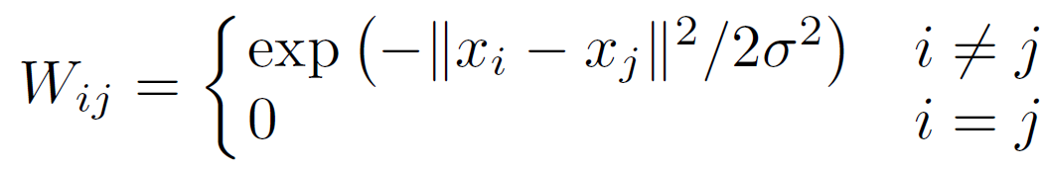
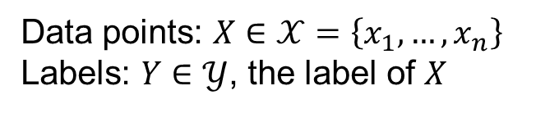
Graph-based semi-supervised learning
Data points: $X∈𝒳=\left\{x_{1},…,x_{n}\right\}$
Labels: $Y∈𝒴$, the label of $X$
Labeled data
+
Structures in unlabeled data
Affinity: pairwise geodesic distance

Slide 3
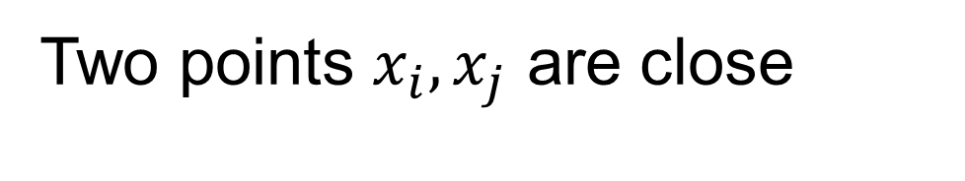


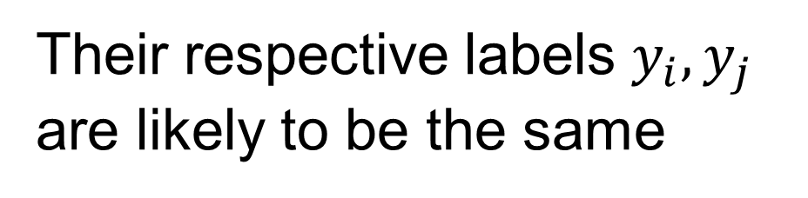
Central notion in SSL: smoothness
“
Two points $x_{i}, x_{j}$ are close
$$x_{j}$$
$$x_{i}$$
Their respective labels $y_{i},y_{j}$
are likely to be the same

Slide 4
Current graph-based smoothness does not precisely realize the nature of smoothness
Realizing
Pointwise Nature
through
Probabilistic Modeling

Slide 5






Goal 1: Pointwise nature of smoothness
Inherently a property occurring “everywhere”
on every point
$$x_{3}$$
$$x_{2}$$
$$x_{1}$$
$$x_{5}$$
$$x_{4}$$
$$x_{6}$$
Relating the behaviour of each point to that of its close points

Slide 6




Precisely expressing pointwise smoothness
If two points are close, their labels are likely to be the same.
P1. How to judge if two points are close?
(Data Closeness)
$$x_{i}$$
$$x_{j}$$
Vague!
(Rigollet, 2007; Lafferty+, 2007)
P2. Meaning of labels “likely to be the same”?
$$y_{i}$$
$$y_{j}$$
(Label Coupling)

Slide 7
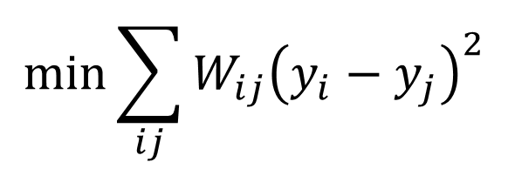
Existing graph-based methods only express aggregate, not pointwise, smoothness
$$\min{\sum_{ij}{W_{ij}{\left(y_{i}−y_{j}\right)}^{2}}}$$
aggregate pairwise differences
“Average” smooth across the graph
Not pointwise formulation (P1 & P2)
Not an explicit realization of smoothness!

Slide 8


Goal 2: Probabilistic model of smoothness
P1. How to judge if two points are close?
How close is sufficiently close? → Deterministic binary decision
Probabilistic formulation
P2. Meaning of labels “likely to be the same”?
Deterministic
Probabilistic
Probabilistic Modelling: $P\left(Y | X\right)$, or $P(X|Y)$ and $P(Y)$

Slide 9
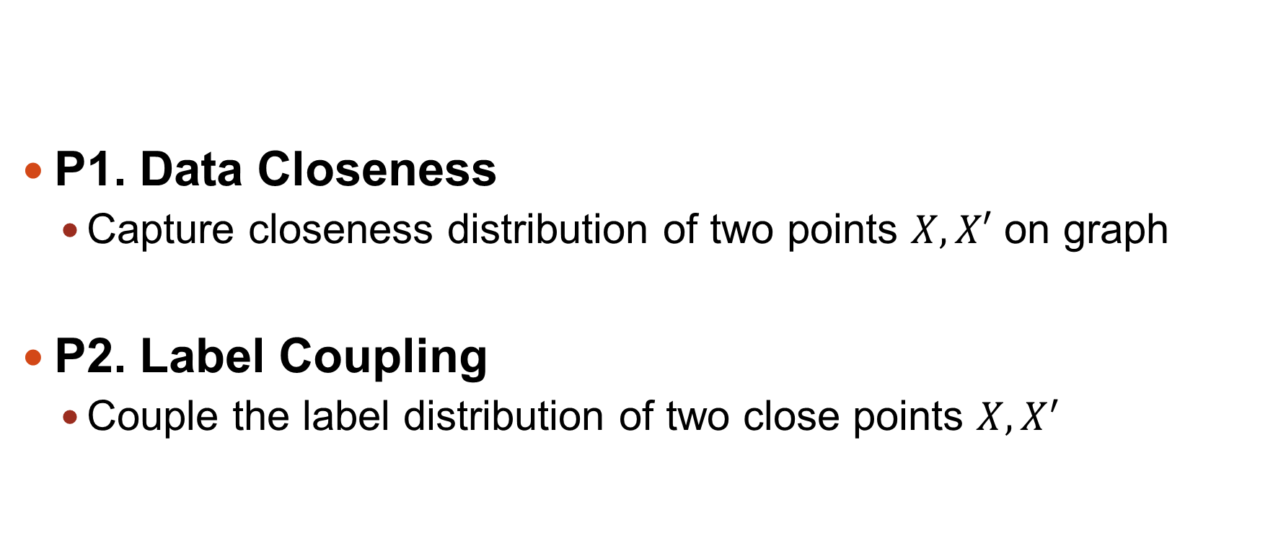
Our Proposal: Probabilistic Graph-based Pointwise Smoothness (PGP)
P1. Data Closeness
Capture closeness distribution of two points $X,X′$ on graph
P2. Label Coupling
Couple the label distribution of two close points $X,X^{′}$

Slide 10

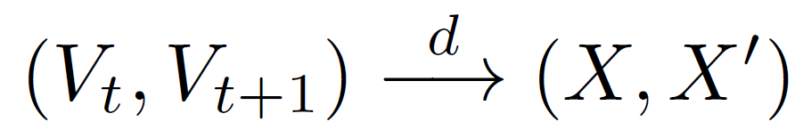
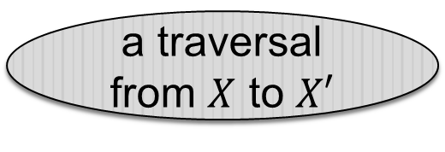

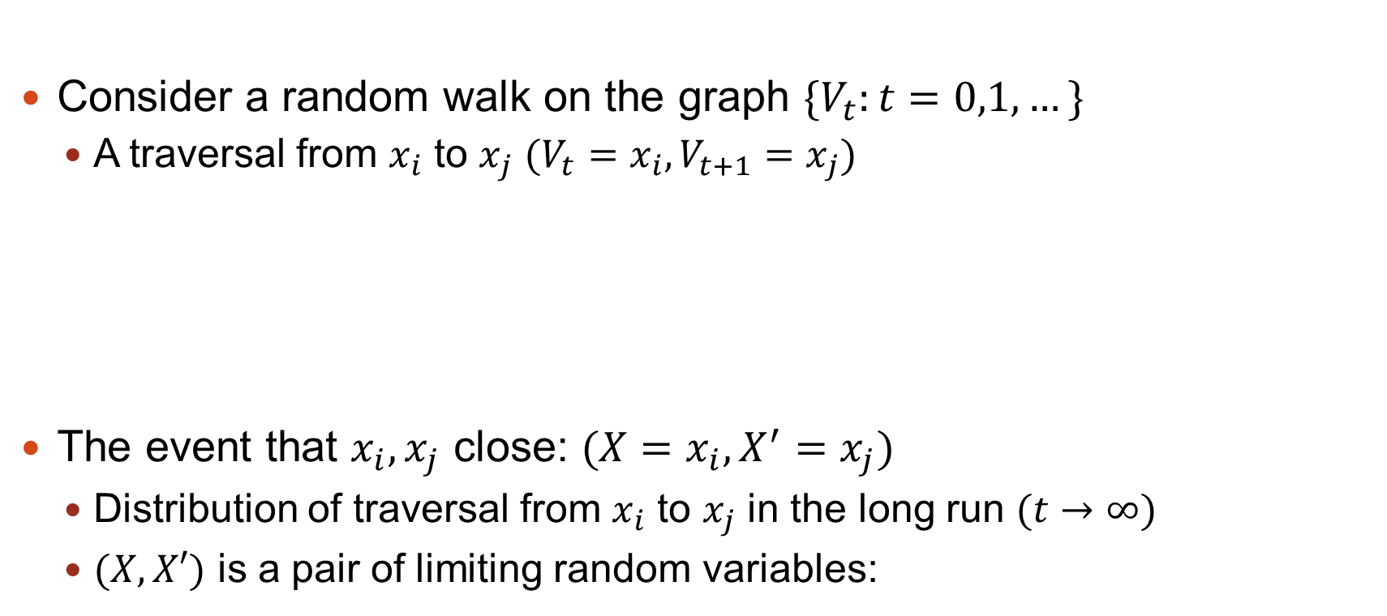

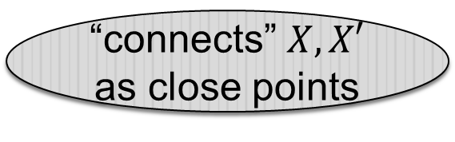
P1. Data Closeness: Random walk on graph
Consider a random walk on the graph $\{V_{t}:t=0,1,…\}$
A traversal from $x_{i}$ to $x_{j}$ $(V_{t}=x_{i},V_{t+1}=x_{j})$
The event that $x_{i},x_{j}$ close: $(X=x_{i},X^{′}=x_{j})$
Distribution of traversal from $x_{i}$ to $x_{j}$ in the long run $(t→∞)$
$(X,X′)$ is a pair of limiting random variables:
$$x_{j}$$
a traversal from $X$ to $X′$
“connects” $X,X′$ as close points
$$x_{i}$$

Slide 11

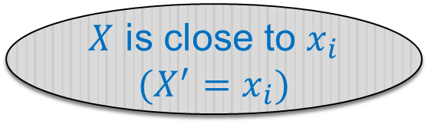


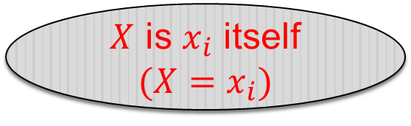


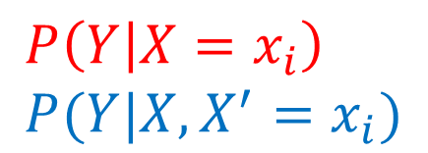

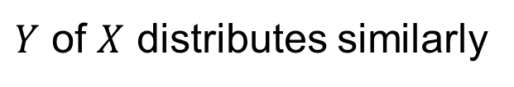

P2. Label Coupling: Statistical indistinguishability
$$X=x_{i}$$
$X$ is $x_{i}$ itself
$$(X=x_{i})$$
$$X′=x_{i}$$
$$x_{j3}$$
or
$$x_{i}$$
$Y$ of $X$ distributes similarly
$$x_{j1}$$
$X$ is close to $x_{i}$
$$(X^{′}=x_{i})$$
$$x_{j2}$$
$$X$$
$$P\left(Y | X=x_{i}\right) \\ P(Y|X,X^{′}=x_{i})$$
are alike
Statistical Indistinguishability

Slide 12
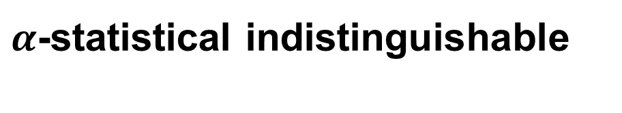
P2. Label Coupling: Statistical indistinguishability
$α$-statistical indistinguishable
Intuition: indistinguishability will slowly fade along a “chain” of close points

Slide 13
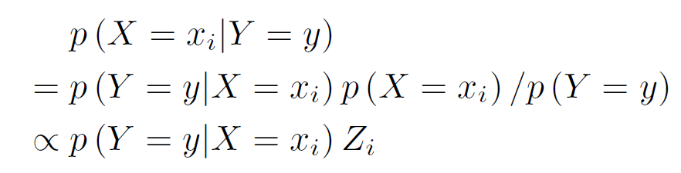
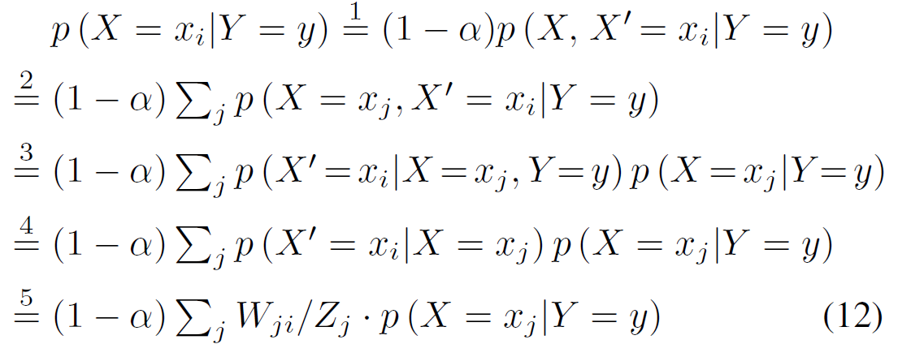
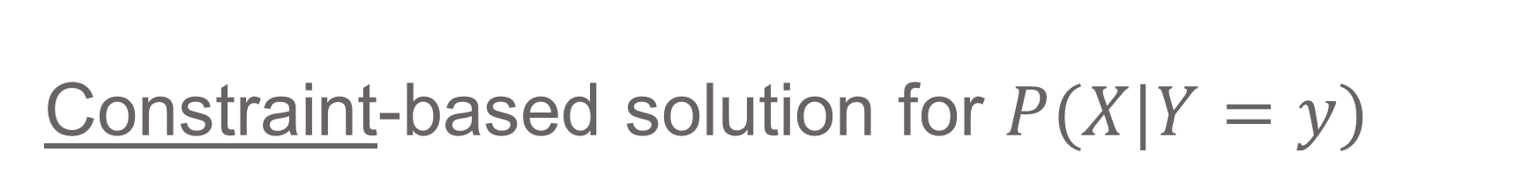
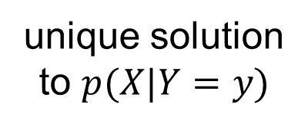
Constraint-based solution for $P(X|Y=y)$
Labelled data:
Unlabelled data (smoothness P1 & P2):
unique solution
to $p(X|Y=y)$

Slide 14
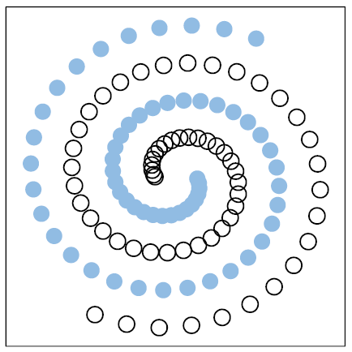
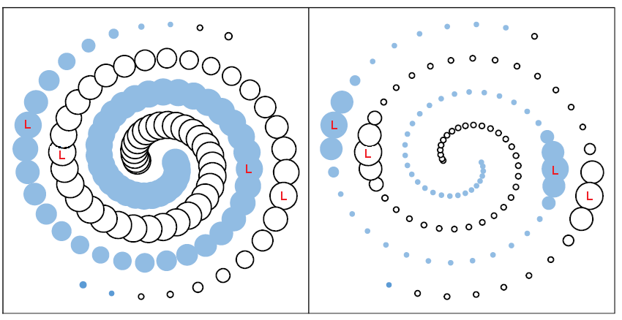
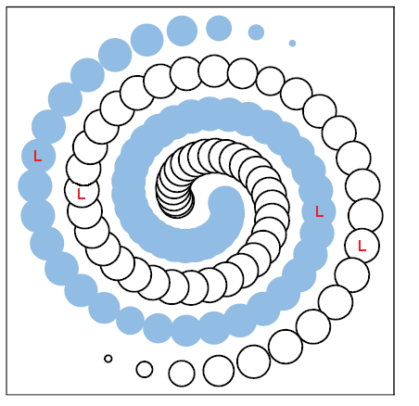
Experiment 1: PGP is smooth “everywhere"
Dataset
GRF
MP
PGP
L: labeled point
Non-smooth area
Size: magnitude of decision function
Color: predicted class
Misclassification

Slide 15
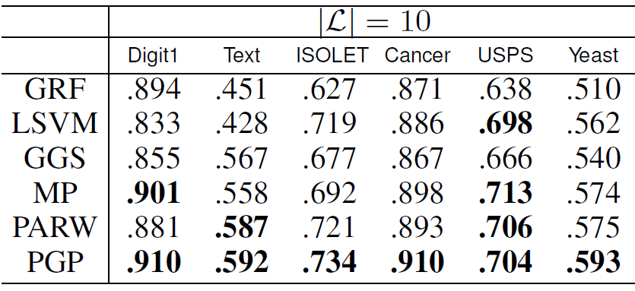
Experiment 2: PGP is consistently the best

Slide 16
Conclusion
Smoothness is pointwise in nature
Probabilistic modelling of smoothness

