Slide 1
Correlation-Sensitive Next-Basket Recommendation
Duc-Trong Le, Hady W. Lauw, Yuan Fang
IJCAI 2019
Macau, China

Slide 2
Outline
Correlation-Sensitive Recommendation
Basket-Sequence Correlation Networks (Beacon)
Item-Item Correlation Matrix
Correlation-Sensitive Components
Experiments on TaFeng, Delicious, Foursquare

Slide 3
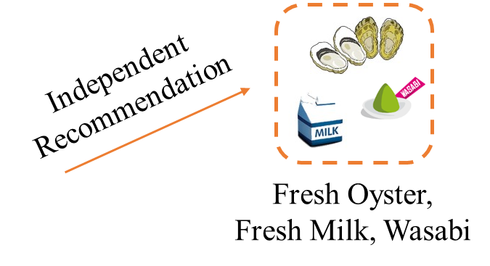
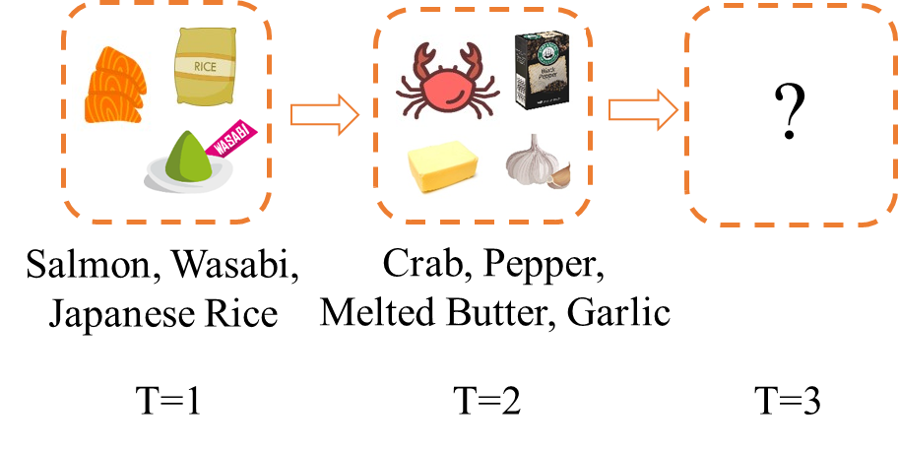
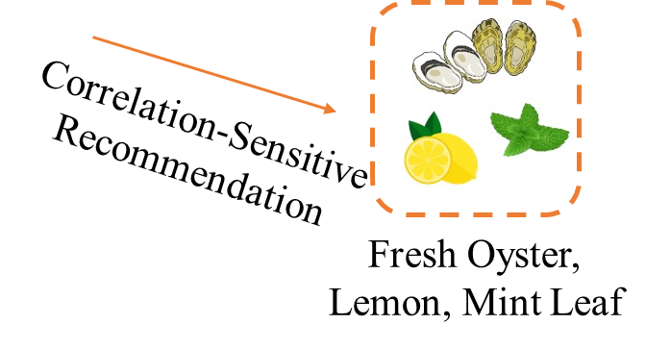
Correlation-Sensitive Recommendation
TASK:
Modeling concurrently correlative & sequential associations in basket sequences to predict the next basket of correlated items.

Slide 4
Correlation-Sensitive Next-Basket Recommendation with Basket-Sequence Correlation Networks (Beacon)
Next-basket Recommendation

Slide 5
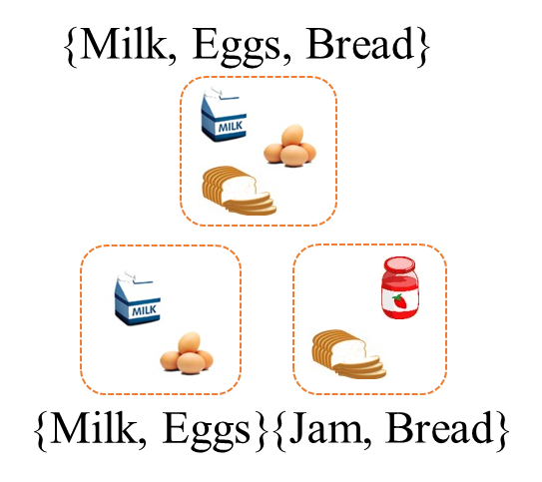
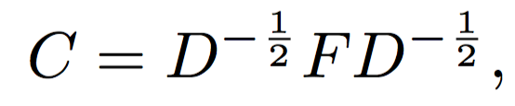


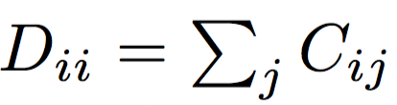



Item-Item Correlation Matrix $C$
Objective: Leverage correlations between item-item pairs
A pair with frequent co-occurrence has a higher score than less frequent pairs.
A pair with exclusive connection have a higher score than non-exclusive pairs.
$$→$$
$N$-th order matrix
Notes:
Decompose the past adoptions. We witness the notion of baskets

Slide 6










Correlation-Sensitive Basket Encoder
Input: Given a basket $B_{t}$
The immediate representation of $B_{t}$:
The L-dimensional latent representation:
Item Importance Parameters
Noise-Canceling
Parameter

Slide 7
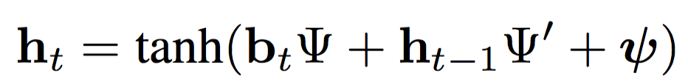




Sequence Encoder
Input: Given the L-dimensional latent representation of basket $B_{t}$ at time t
The recurrent hidden output $h_{t}$ at time t:

Slide 8
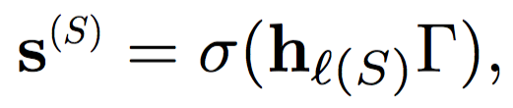


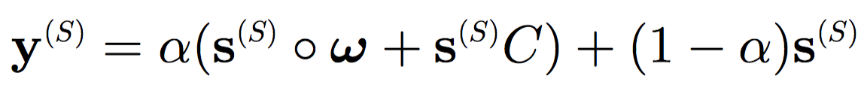



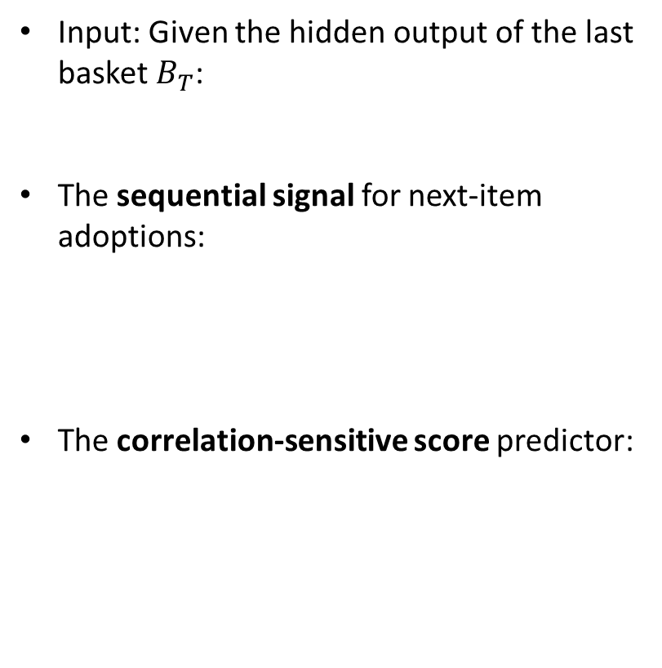
Correlation-Sensitive Score Predictor
Input: Given the hidden output of the last basket $B_{T}$:
The sequential signal for next-item adoptions:
The correlation-sensitive score predictor:
Basket-Sensitive
Sequence-Sensitive

Slide 9

Next-Basket Recommendation Strategy
The predicted ranking $r^{(S)}$ of the item set based on $y^{(S)}$
$$r^{(S)}:y^{(S)}→\left\{1, 2, …, N\right\}$$
where $r_{i}^{(S)}$ is the ranking of item $i$.
Approximately recommended basket $B_{T+1}$ of size K:
$$B_{T+1}|K=\{i|r_{i}^{(S)}≤K\}$$
Top-K
Next-basket Recommendation
Score
…
Ranked Item List
Notes:
Decompose the past adoptions. We witness the notion of baskets

Slide 10
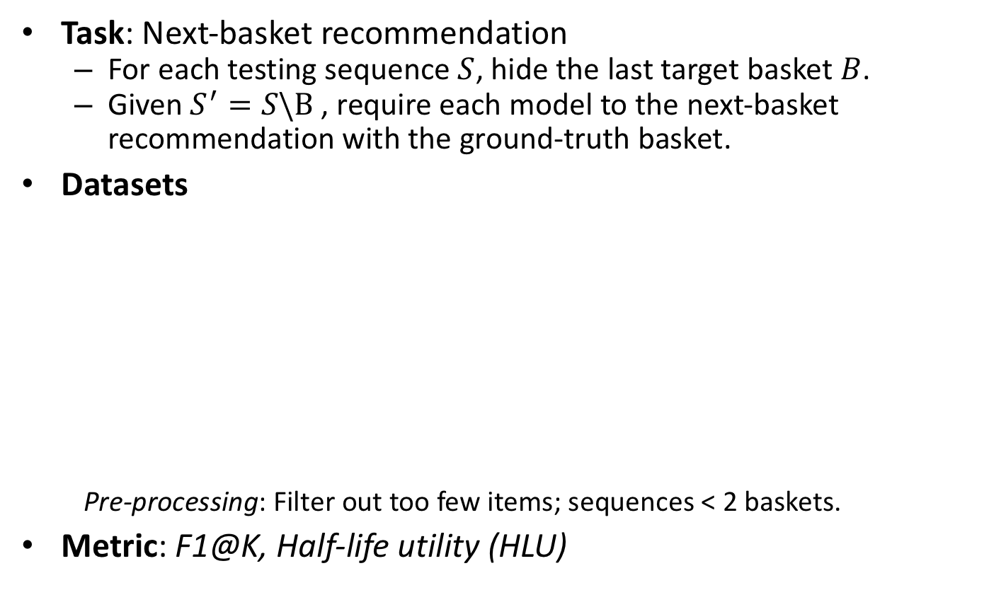
Experimental Setup
Task: Next-basket recommendation
For each testing sequence $S$, hide the last target basket $B$.
Given $S^{′}=S\backslash B$, require each model to the next-basket recommendation with the ground-truth basket.
Datasets
Pre-processing: Filter out too few items; sequences < 2 baskets.
Metric: F1@K, Half-life utility (HLU)
Dataset | #Sequence | #Item | #Average Length | #Average Basket Size
TaFeng (E-commerce) | 77209 | 9964 | 7.0 | 5.9
Delicious (Bookmark Tag) | 61908 | 6520 | 21.4 | 3.8
Foursquare (Check-ins) | 100980 | 5527 | 22.2 | 1.8

Slide 11
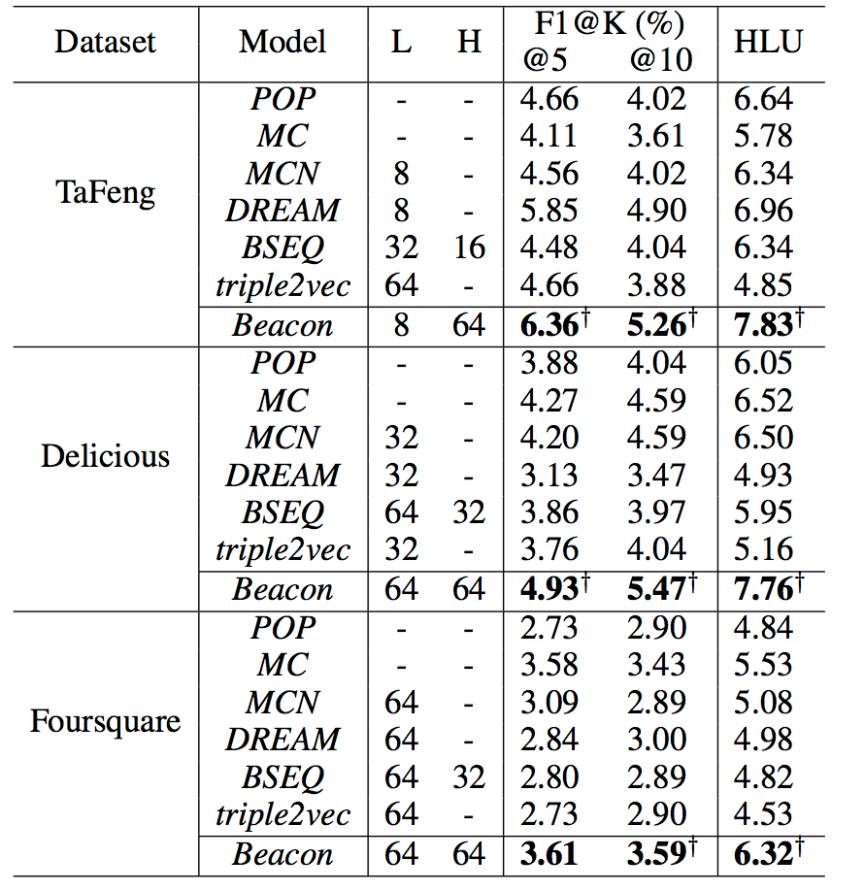

RQ1: Does Beacon outperform against baselines?
denote statistically significant improvements (p<0.05) of Beacon over MCN, DRM, BSEQ

Slide 12
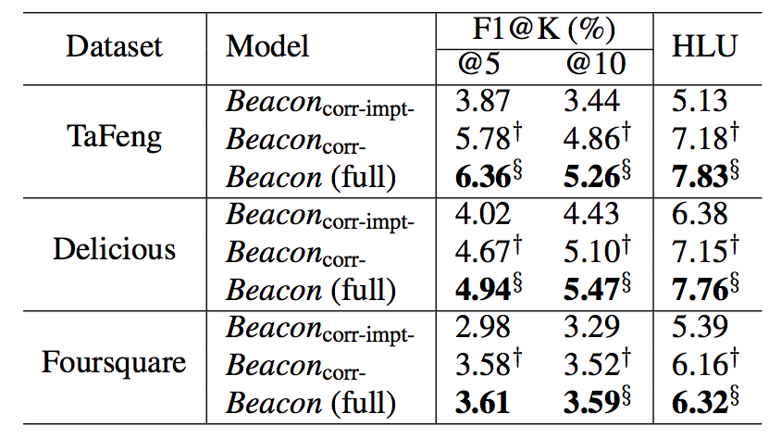

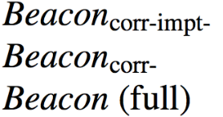
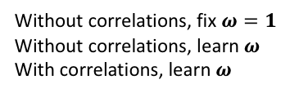
RQ2: Is the learning of item importance $ω$useful?
denotes statistically significant improvements (p<0.05)
Without correlations, fix $ω=1$
Without correlations, learn $ω$
With correlations, learn $ω$

Slide 13
RQ3: Is the modeling of correlations useful?
denotes statistically significant improvements (p<0.05)
Without correlations, fix $ω=1$
Without correlations, learn $ω$
With correlations, learn $ω$

Slide 14
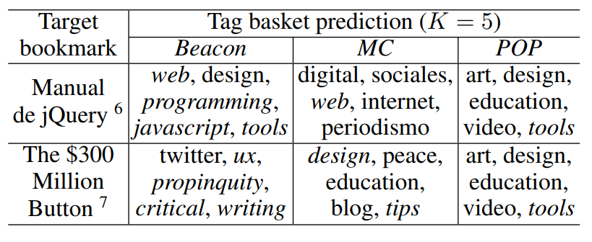
A Qualitative Example on Delicious
A description of jQuery via a set of tags {web, programming, javascript, tools}
A critical discussion on how to increase a site’s revenue by maximizing user experience (i.e., ux) with efficient design (e.g., propinquity between buttons and fields)

Slide 15
Conclusion
Modeling concurrently correlative & sequential associations in basket sequences to predict next-basket of correlated items.
Propose Beacon show statistically significant improvements over:
Traditional Basket Sequence Models (MCN, DRM, BSEQ, triple2vec)
in terms of top-K recommendations.

Slide 16
THANK YOU Q&A

Slide 17
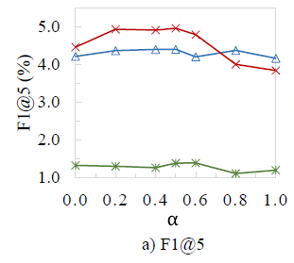
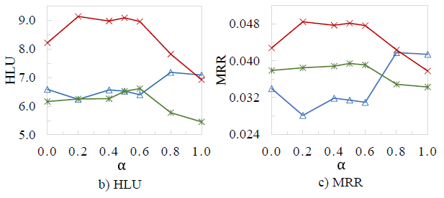
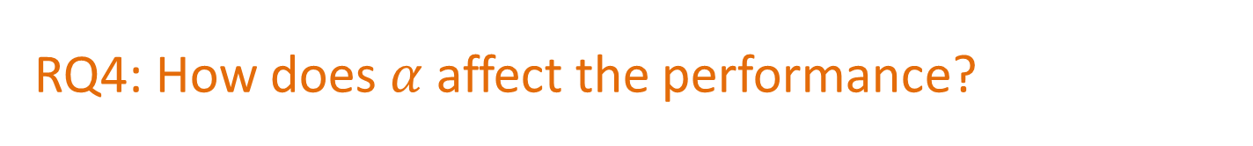
RQ4: How does $α$ affect the performance?

