Slide 1
Conﬁdence-Aware Graph Regularization with Heterogeneous Pairwise Features
Yuan Fang University of Illinois at Urbana-Champaign
Bo-June (Paul) Hsu Microsoft Research
Kevin Chen-Chuan Chang University of Illinois at Urbana-Champaign
SIGIR 2012 @ Portland, OR, USA

Slide 2
Outline
Problem and motivation
Regularization framework
Applications in IR
Experiments
Conclusion

Slide 3
Classifications in IR
Many classification tasks in IR
Given some objects and a set of classes
Some objects are labeled (with known classes)
Predict the class of each unlabeled object
Eg 1. Text categorization
Spam detection
Information filtering
Email organization
…
Eg 2. Query intent classification
Search vertical
Ads targeting
…
Notes:
Many different classification tasks, for various applications

Slide 4
Challenges
Feature sparsity
In our query classification dataset, 95% of queries contain no more than five words
Scarcity of labeled data
Especially for IR tasks with a large number of classes
Our query classification dataset contains 2000+ fine-grained classes for the shopping domain alone
Eg. Inkjet-printer, laser-printer, line printer
Notes:
Conventional machine learning can be used, but straightforward applications are unfruitful
Two challenges

Slide 5
Graph Regularization
Addresses both challenges
Feature sparsity
Traditionally features are extracted at object level
Features can be potentially extracted from each pair of objects
Can be modeled by an undirected graph
Vertices: objects
Edges: pairwise features
Scarcity of labeled data
Neighboring objects on the graph are similar
Labels propagate across similar objects
“Similar objects share similar labels”
Semi-supervised in nature

Slide 6
Key Observation 1
Heterogeneous Pairwise Features
Most existing frameworks use a single pairwise feature
Heterogeneous features exist
Complement each other
More robust
Eg. in query intent classiﬁcation
Co-clicks
If two queries share a common click landing on the same page
Lexical similarity
If two queries contain overlapping words
only about ¼ of the queries have clicks
“laptop” vs. “notebook computer”
“laptop” vs. “laptop bag”
same products
different products

Slide 7
Key Observation 2
Confidence-aware regularization
Existing frameworks regularize based on similarity only
“Similar objects share similar labels”
More similar → higher influence on label
Classification confidence also matters
Some objects are easier to classify than others
If we are more conﬁdent about the prediction on an object, we expect it to inﬂuence its neighbors more
b
a: a printer
b: more likely a printer c: less likely a printer
a
c
a
a: a printer (90% confident)
b: a camera (10% confident) c: more likely a printer than a camera
c
b

Slide 8
Outline
Problem and motivation
Regularization framework
Applications in IR
Experiments
Conclusion

Slide 9
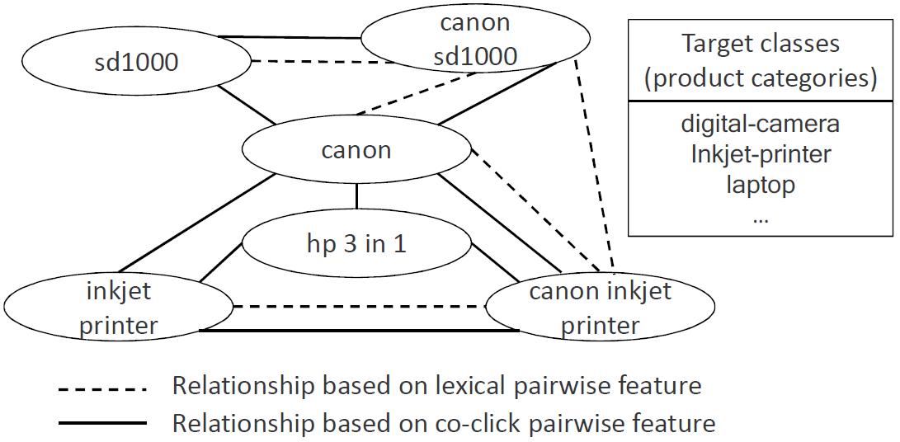

Object-Relationship Graph
Vertices: objects, $o$
Edges: relationships, $e=(o,o^{′},τ)$
Have different types $τ$ for different pairwise features
Can have multiple edges between two objects
Weights encode the affinity between objects, $W(o,o^{′},τ)$

Slide 10
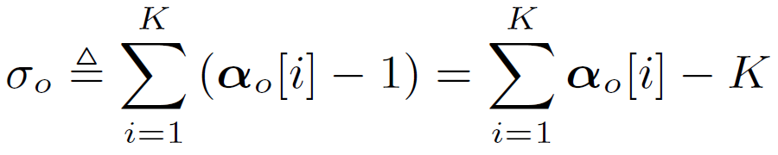
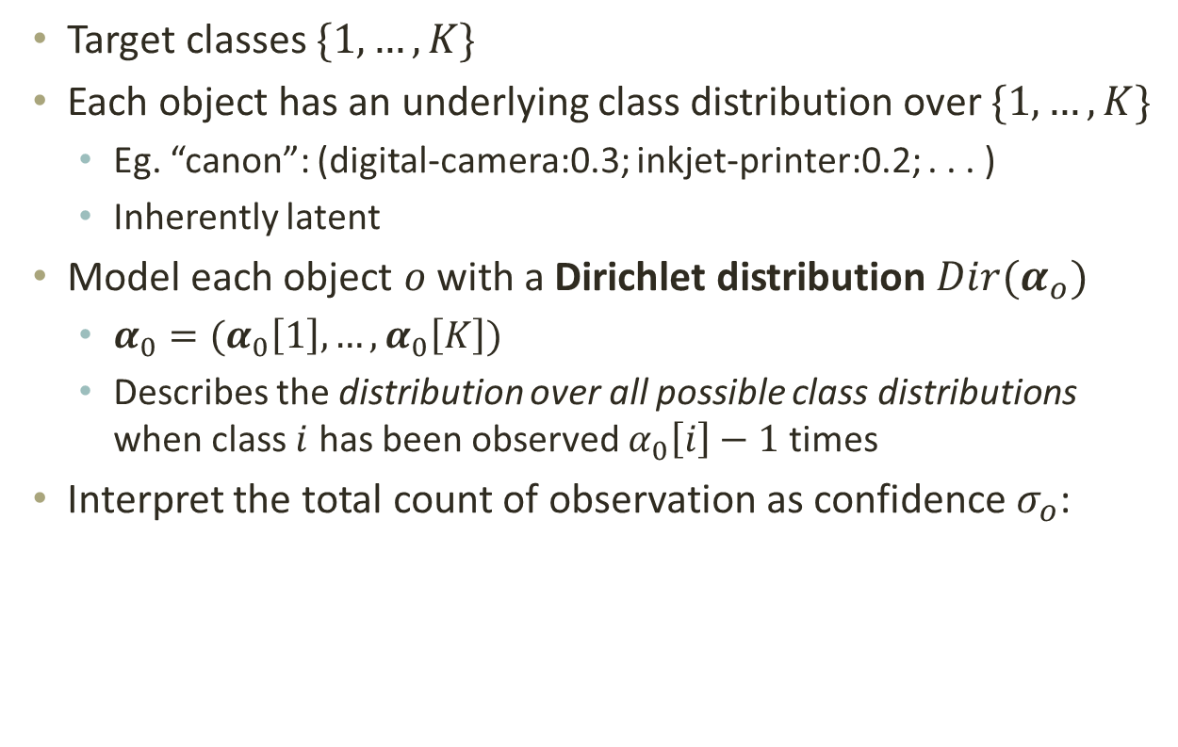
Dirichlet Distribution
Target classes $\{1,…,K\}$
Each object has an underlying class distribution over $\{1,…,K\}$
Eg. “canon”: (digital-camera:0.3; inkjet-printer:0.2; . . . )
Inherently latent
Model each object $o$ with a Dirichlet distribution $Dir(α_{o})$
$α_{0}=(α_{0}\left[1\right],…,α_{0}\left[K\right])$
Describes the distribution over all possible class distributions when class $i$ has been observed $α_{0}\left[i\right]−1$ times
Interpret the total count of observation as confidence $σ_{o}$:

Slide 11
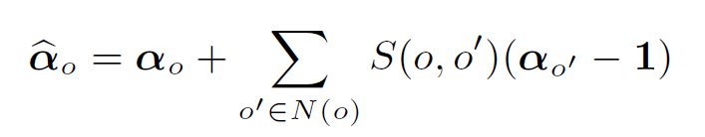
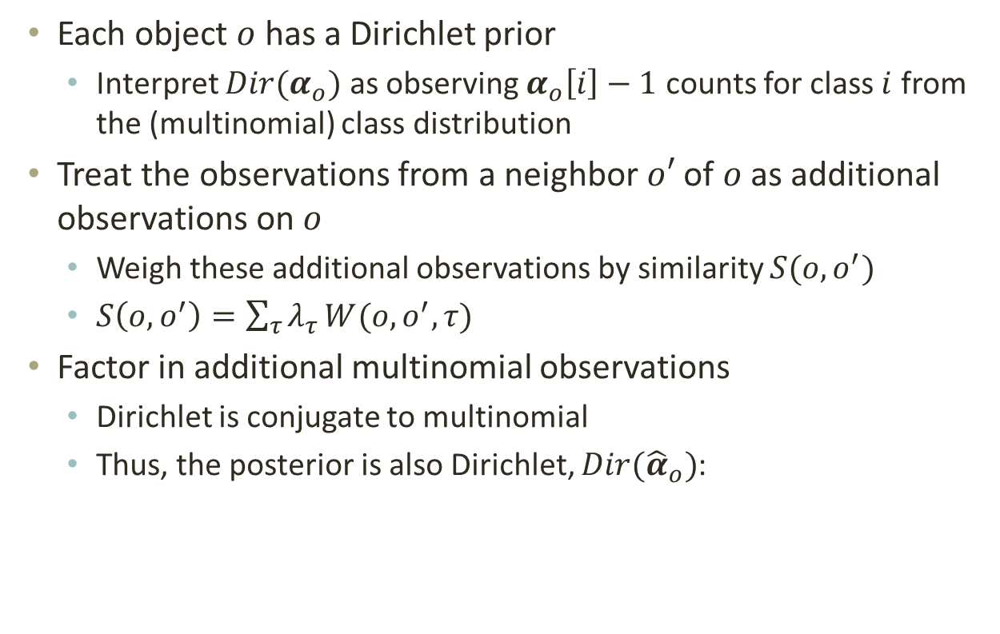
Regularization by Neighbors
Each object $o$ has a Dirichlet prior
Interpret $Dir(α_{o})$ as observing $α_{o}\left[i\right]−1$ counts for class $i$ from the (multinomial) class distribution
Treat the observations from a neighbor $o′$ of $o$ as additional observations on $o$
Weigh these additional observations by similarity $S(o,o^{′})$
$S\left(o,o^{′}\right)=\sum_{τ}{λ_{τ}}W(o,o^{′},τ)$
Factor in additional multinomial observations
Dirichlet is conjugate to multinomial
Thus, the posterior is also Dirichlet, $Dir({\hat{α}}_{o})$:

Slide 12




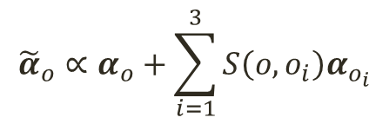

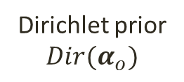



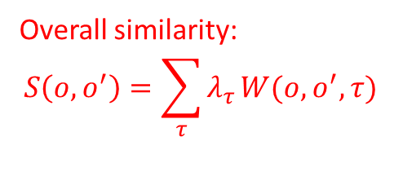



Regularization by Neighbors
Additional multinomial observations
Dirichlet prior
$Dir(α_{o})$
$$o_{1}$$
$$S(o,o_{1})$$
$$(α_{o_{1}}−1)$$
More neighbors →
More observations →
Higher confidence?
$$o$$
$$o_{2}$$
$$S(o,o_{1})$$
$$(α_{o_{2}}−1)$$
Normalize
$$o_{3}$$
$$S(o,o_{1})$$
$$(α_{o_{3}}−1)$$
Overall similarity:
$$S\left(o,o^{′}\right)=\sum_{τ}{λ_{τ}}W(o,o^{′},τ)$$
Dirichlet posterior
$Dir\left({\tilde{α}}_{o}\right)$
$${\tilde{α}}_{o}∝α_{o}+\sum_{i=1}^{3}{S\left(o,o_{i}\right)α_{o_{i}}}$$

Slide 13
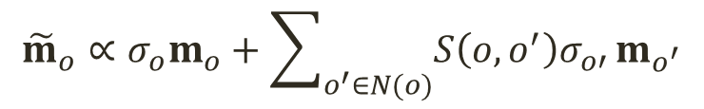
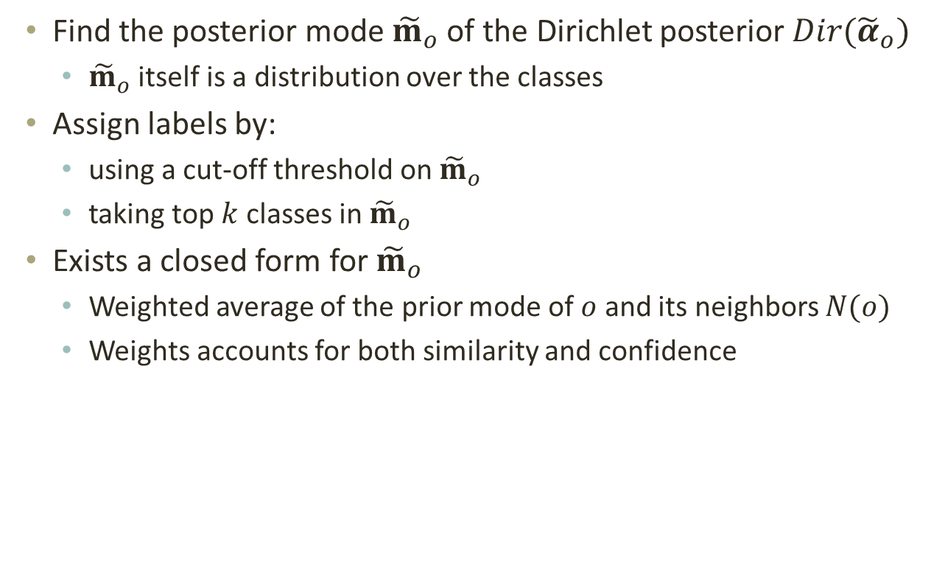
Confidence-Aware Prediction
Find the posterior mode ${\tilde{m}}_{o}$ of the Dirichlet posterior $Dir({\tilde{α}}_{o})$
${\tilde{m}}_{o}$ itself is a distribution over the classes
Assign labels by:
using a cut-off threshold on ${\tilde{m}}_{o}$
taking top $k$ classes in ${\tilde{m}}_{o}$
Exists a closed form for ${\tilde{m}}_{o}$
Weighted average of the prior mode of $o$ and its neighbors $N(o)$
Weights accounts for both similarity and confidence
similarity
confidence
$${\tilde{m}}_{o}∝σ_{o}m_{o}+\sum_{o^{′}∈N(o)}{S\left(o,o^{′}\right)σ_{o′}^{}}m_{o^{′}}$$

Slide 14
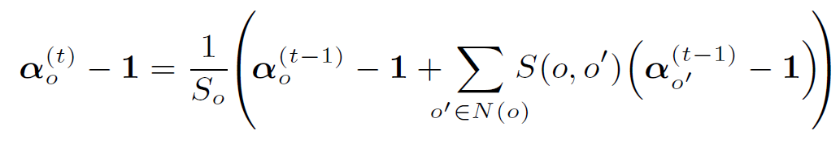
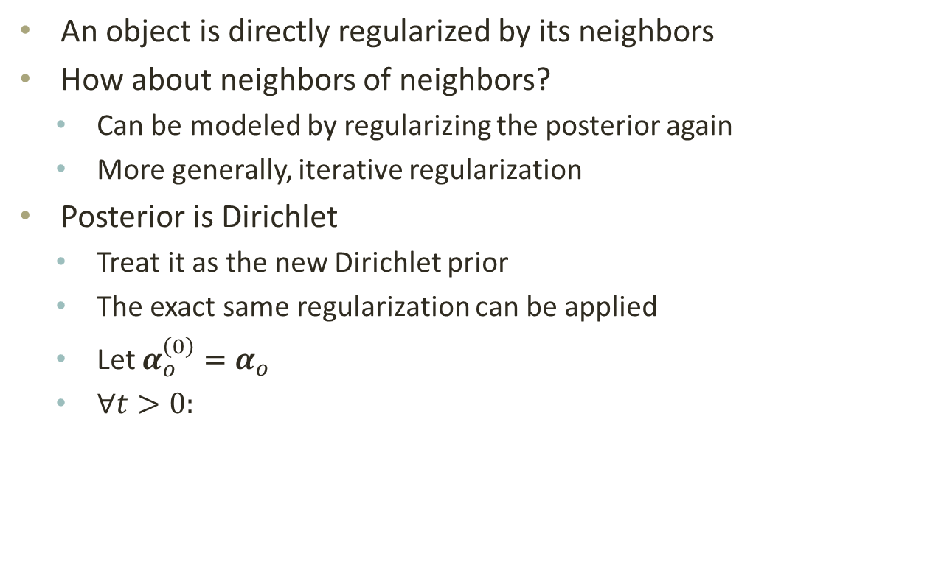
Iterative Regularization
An object is directly regularized by its neighbors
How about neighbors of neighbors?
Can be modeled by regularizing the posterior again
More generally, iterative regularization
Posterior is Dirichlet
Treat it as the new Dirichlet prior
The exact same regularization can be applied
Let $α_{o}^{\left(0\right)}=α_{o}$
$∀t>0:$

Slide 15
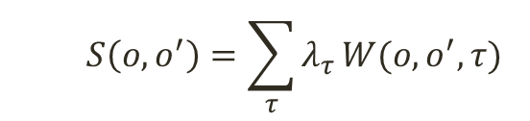
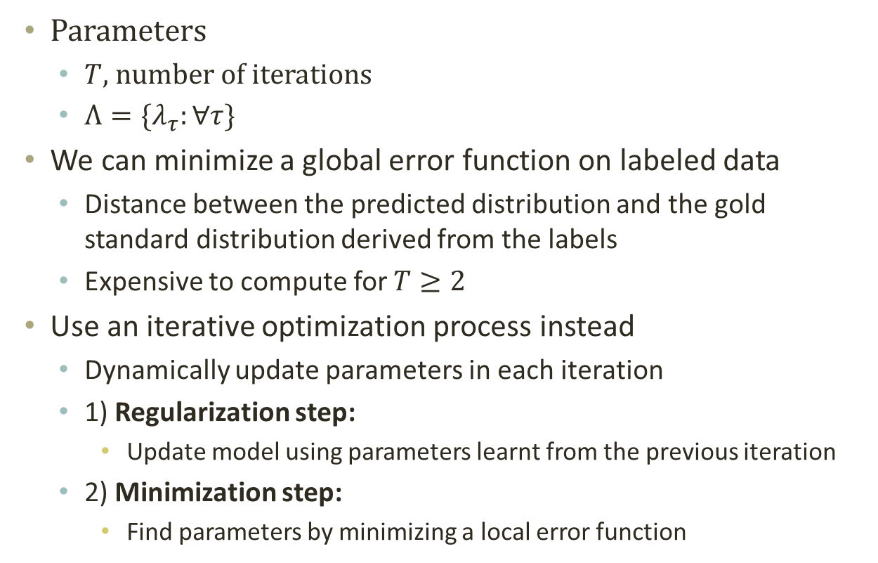
Parameters Learning
Parameters
$T$, number of iterations
$Λ=\{λ_{τ}:∀τ\}$
We can minimize a global error function on labeled data
Distance between the predicted distribution and the gold standard distribution derived from the labels
Expensive to compute for $T≥2$
Use an iterative optimization process instead
Dynamically update parameters in each iteration
1) Regularization step:
Update model using parameters learnt from the previous iteration
2) Minimization step:
Find parameters by minimizing a local error function
$$S\left(o,o^{′}\right)=\sum_{τ}{λ_{τ}}W(o,o^{′},τ)$$

Slide 16
Outline
Problem and motivation
Regularization framework
Applications in IR
Experiments
Conclusion

Slide 17
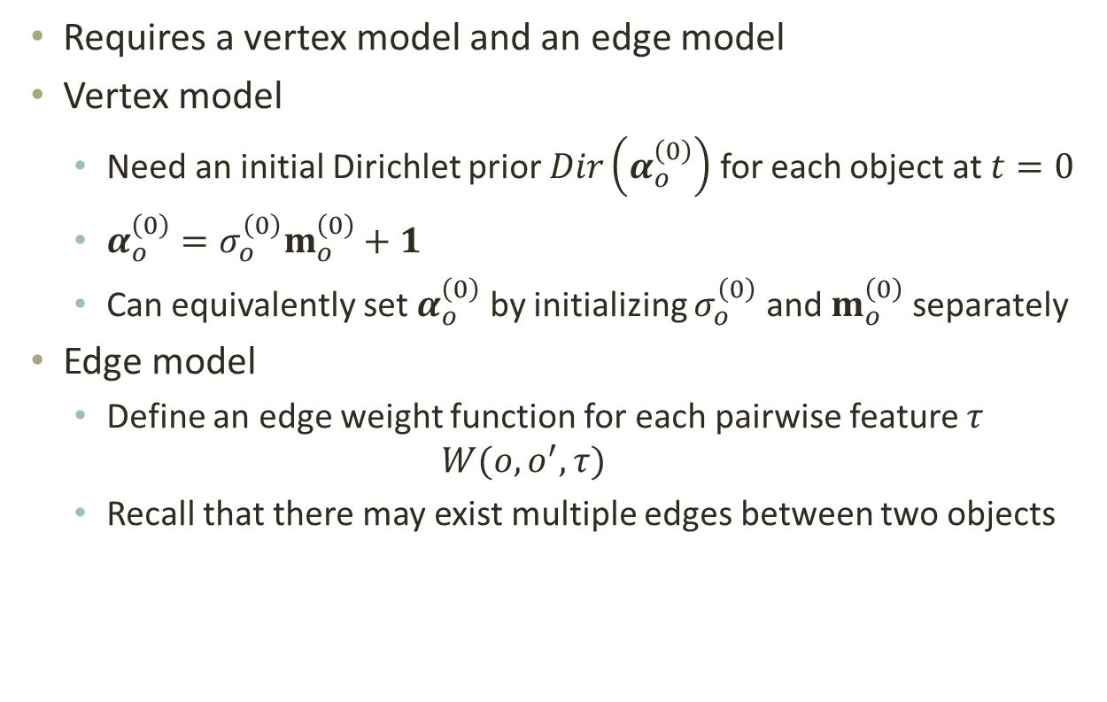
Realization of Framework
Requires a vertex model and an edge model
Vertex model
Need an initial Dirichlet prior $Dir\left(α_{o}^{\left(0\right)}\right)$ for each object at $t=0$
$α_{o}^{\left(0\right)}=σ_{o}^{\left(0\right)}m_{o}^{\left(0\right)}+1$
Can equivalently set $α_{o}^{\left(0\right)}$ by initializing $σ_{o}^{\left(0\right)}$ and $m_{o}^{\left(0\right)}$ separately
Edge model
Define an edge weight function for each pairwise feature $τ$
$$W(o,o^{′},τ)$$
Recall that there may exist multiple edges between two objects
mode
confidence

Slide 18
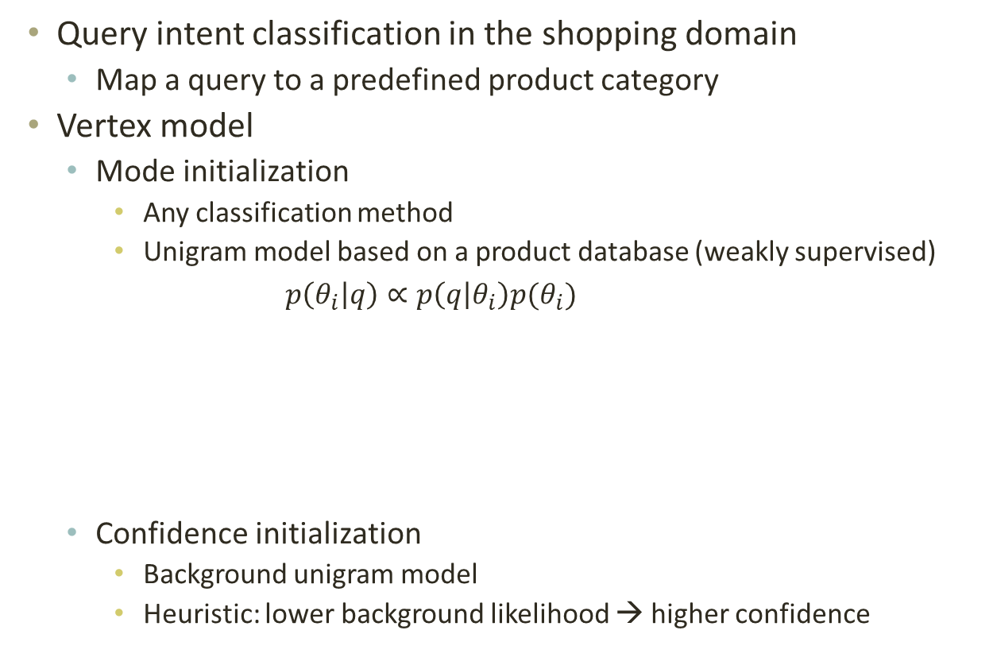
Example: query intent
Query intent classification in the shopping domain
Map a query to a predefined product category
Vertex model
Mode initialization
Any classification method
Unigram model based on a product database (weakly supervised) $p\left(θ_{i} | q\right)∝p\left(q | θ_{i}\right)p(θ_{i})$
Confidence initialization
Background unigram model
Heuristic: lower background likelihood → higher confidence
Title | Description | Brand | Category
SD1000 Camera | A digital camera… | Canon | digital camera
15 inch laptop | A laptop for… | Dell | laptop
… | … | … | …

Slide 19
Example: query intent
Two edge models for two pairwise feature
Lexical pairwise feature
A simple binary similarity
1 if one of the query contains all the words in the other query
0 otherwise
Co-click pairwise feature
More co-clicks → higher similarity (like tf)
Popular clickthroughs contribute less (like idf)
Other potential edge models
Co-session, search results, user profiles

Slide 20
Outline
Problem and motivation
Regularization framework
Applications in IR
Experiments
Conclusion

Slide 21
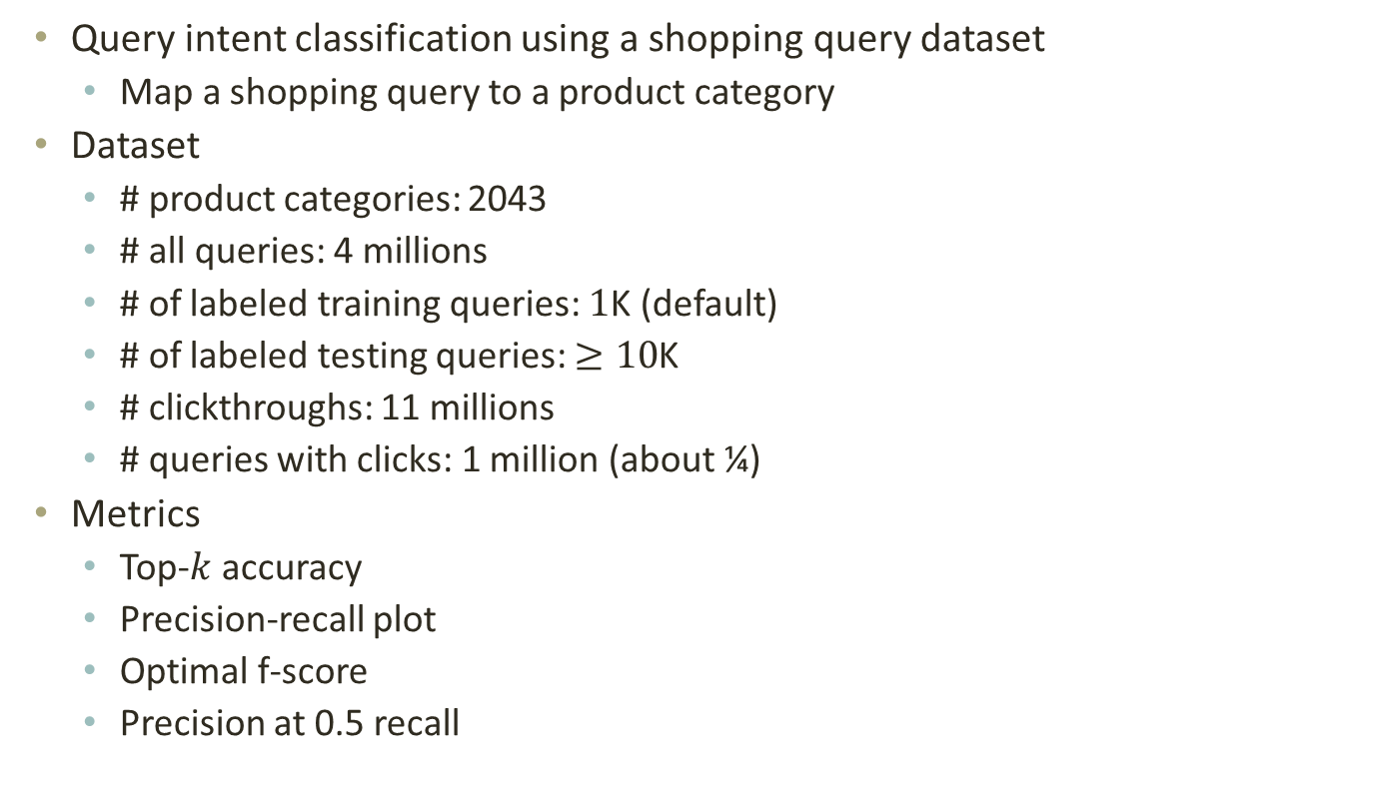
Experiment Setup
Query intent classification using a shopping query dataset
Map a shopping query to a product category
Dataset
# product categories: 2043
# all queries: 4 millions
# of labeled training queries: $1$K (default)
# of labeled testing queries: $≥10$K
# clickthroughs: 11 millions
# queries with clicks: 1 million (about ¼)
Metrics
Top-$k$ accuracy
Precision-recall plot
Optimal f-score
Precision at 0.5 recall

Slide 22
Illustrative results
Classification of two example queries using unigram model
The actual classes can be predicted using their neighbors
Look at the lexical neighbors of “canon 35”
canon 35 mm lens
canon 35 f 2
35 mm wide angle 1.4 canon lens
Look at the co-click neighbors of “Hp laptop hard drive”
hard drive 1tb
seagate harddrive
western digital 2tb external
 | Misclassified | Actual
canon 35 | camcorder | camera-lens
hp laptop hard drive | laptop | hard-drive

Slide 23
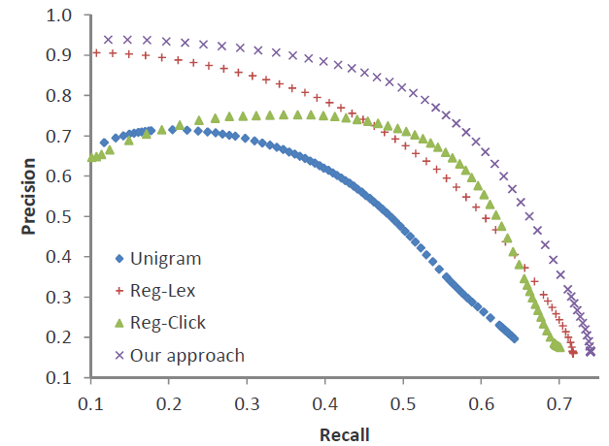
Heterogeneous Pairwise Features
unigram + lex
unigram + lex + click
unigram + click
unigram

Slide 24
Queries without clicks
“Click” alone has no effect
“Lex + Click” performs better than “Lex” alone
Even queries without clicks can benefit from co-click features
Their lexical neighbors (or neighbors of neighbors) may have clicks
Iterative regularization helps propagate the evidence from those clicks

Slide 25
Confidence
NoConf: no confidence information
Heuristic: the heuristic method using the background model
Simulated: generate confidence using available labels

Slide 26
Labeled and unlabeled data
# labeled training queries
# total queries (using the same 1000 training queries)
0.04M 0.8M 1.6M 2.4M 3.2M 4M
Number of total queries

Slide 27
Outline
Problem and motivation
Regularization framework
Applications in IR
Experiments
Conclusion

Slide 28
Conclusion
We observe the benefits of:
Regularization using heterogeneous pairwise features
Regularization with confidence
We may further improve performance by:
Exploring more pairwise features like query sessions, etc.
Better confidence estimation
Can be applied to other classification tasks in IR
E.g. Text categorization
Using pairwise features such as co-readership, social tagging overlap, document similarity, etc.

