Slide 1
Entity Linking on Microblogs with Spatial and Temporal Signals
Yuan Fang * Institute for Infocomm Research, Singapore
Ming-Wei Chang Microsoft Research, USA
10/26/2014
* Work done while a student at Univ of Illinois at Urbana-Champaign and intern at Microsoft Research.

Slide 2
Problem
Entity Linking in Microblogs: Map entity mentions in a short message (e.g. a tweet, facebook messages) into predefined entities (e.g. entries in Wikipedia).
PER
LOC
ORG
FILM PRODUCT TVSHOW HOLIDAY
US secretary of state Clinton is hospitalized due to …
Offline setting
http://en.wikipedia.org/wiki/Hillary_Rodham_Clinton
http://en.wikipedia.org/wiki/United_States

Slide 3




Why is entity linking in microblogs important?
Motivation: intelligence gathering (market/disaster/politics)
But word-based matching is ineffective due to ambiguity
Noisy & informal: in-depth NLP analysis is difficult
Short: insufficient contexts
“Washington”?
“Spurs”?

Slide 4

Why is entity linking in microblogs important?
Motivation: intelligence gathering (market/disaster/politics)
But word-based matching is ineffective due to ambiguity
Noisy & informal: in-depth NLP analysis is difficult
Short: insufficient contexts
Different peaks → Different entities?
A single peak → A mixture of entities?

Slide 5
Proposed Approach
Leveraging spatiotemporal signals to improve entity linking

Slide 6
Observation & Intuition
Intuition 1: Spatiotemporal signals
Entity prior changes over time or space
Intuition 2: Easier surface forms
Inter-tweet interactions
“spurs” → SA Spurs
91% in US vs. 8% in UK
“Clinton” vs. “Hillary Clinton”

Slide 7
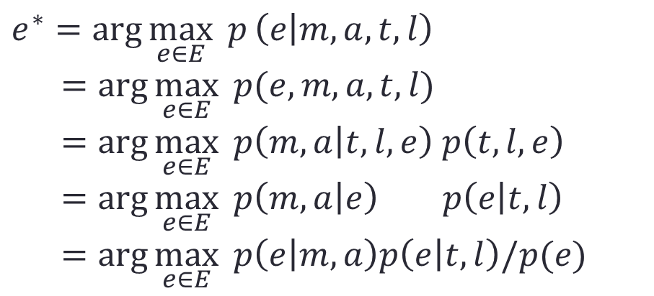
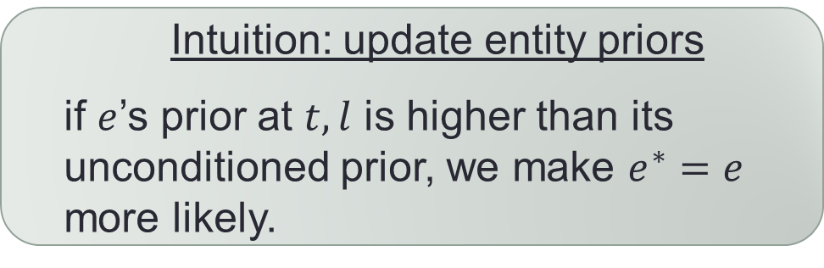
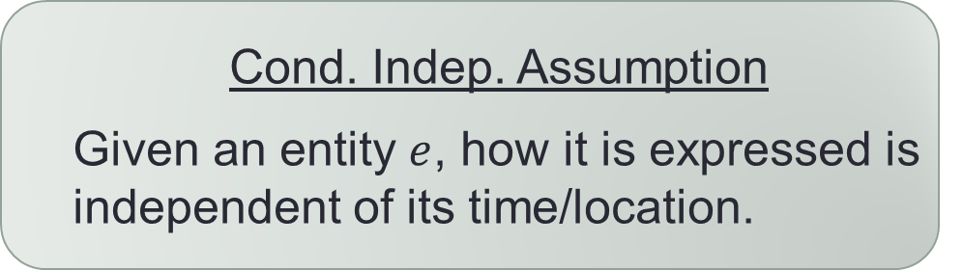
Proposal: Spatiotemporal entity linking
m: target message (e.g. a tweet)
a: anchor text (surface form)
t: time – when m was published
l: location – where m was published
$$e^{∗}=\arg{\max_{e∈E}{ p}\left(e | m,a,t,l\right)}$$
$=\arg{\max_{e∈E}{ p(e,m,a,t,l)}}$
$=\arg{\max_{e∈E}{p\left(m,a | t,l,e\right) p\left(t,l,e\right)}}$
$=\arg{\max_{e∈E}{ p\left(m,a | e\right) p\left(e | t,l\right)}}$
$=\arg{\max_{e∈E}{ p\left(e | m,a\right)p\left(e | t,l\right)/p(e)}}$
Cond. Indep. Assumption
Given an entity $e$, how it is expressed is independent of its time/location.
Intuition: update entity priors
if $e$’s prior at $t,l$ is higher than its unconditioned prior, we make $e^{∗}=e$ more likely.

Slide 8
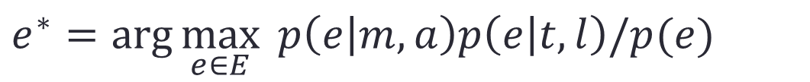
Predicting the entity
m: target message (e.g. a tweet)
a: anchor text (surface form)
t: time – when m was published
l: location – where m was published
$$e^{∗}=\arg{\max_{e∈E}{ p\left(e | m,a\right)p\left(e | t,l\right)/p(e)}}$$
some existing model without using spatiotemporal signals
?
Wikipedia pageview statistics

Slide 9
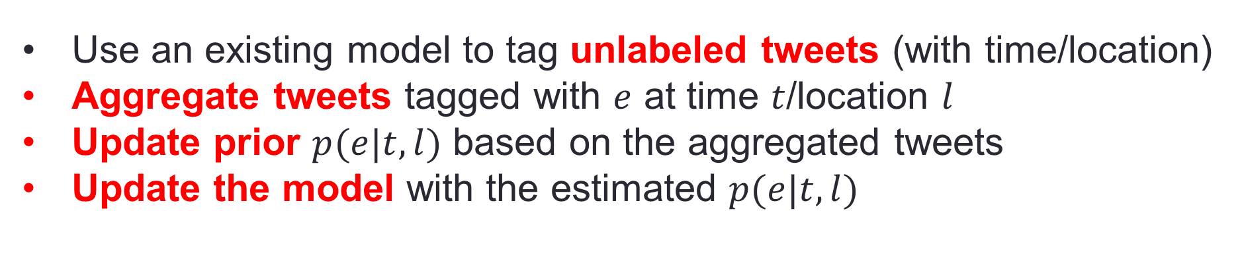
Challenges: Estimating $p(e|t,l)$
Challenge 1
Lack of large-scale entity annotations
Use an existing model to tag unlabeled tweets (with time/location)
Aggregate tweets tagged with $e$ at time $t$/location $l$
Update prior $p(e|t,l)$ based on the aggregated tweets
Update the model with the estimated $p(e|t,l)$
Block Coordinate Ascent

Slide 10
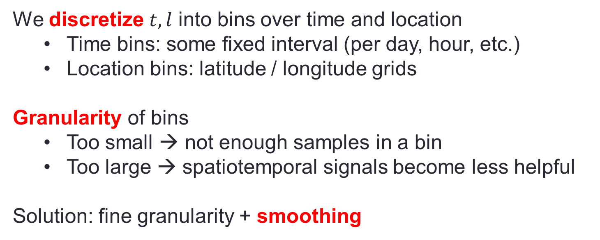

Challenges: Estimating $p(e|t,l)$
Challenge 2
How to handle continuous $t,l$?
We discretize $t,l$ into bins over time and location
Time bins: some fixed interval (per day, hour, etc.)
Location bins: latitude / longitude grids
Granularity of bins
Too small → not enough samples in a bin
Too large → spatiotemporal signals become less helpful
Solution: fine granularity + smoothing

Slide 11


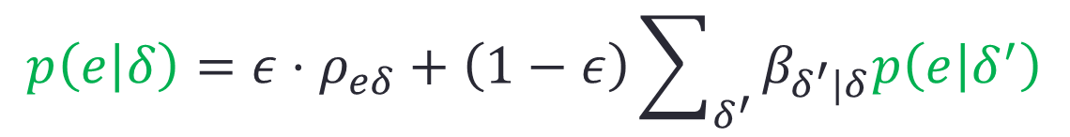


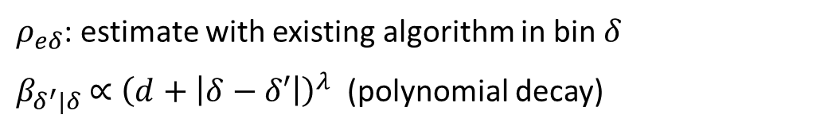

Smoothing over bins
Study how a tweet is written
There is an 𝜖 probability to spontaneously write a tweet
There is an 1−𝜖 chance of imitate a tweet in a near by time/location bin
Imitating from which time/location bin follows a polynomial decay
$$δ_{1}$$
$$δ_{2}$$
$$p\left(e | δ\right)=ε⋅ρ_{eδ}+\left(1−ε\right)\sum_{δ^{′}}{β_{δ^{′}|δ}p\left(e | δ^{′}\right)}$$
$$δ_{0}$$
$ρ_{eδ}$: estimate with existing algorithm in bin $δ$
$β_{δ^{′}|δ}$ $∝{\left(d+\left|δ−δ′\right|\right)}^{λ}$ (polynomial decay)
$$δ_{4}$$
$$δ_{3}$$

Slide 12
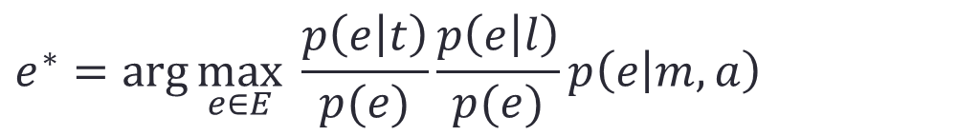

Conditional independence assumption
Data scarcity more severe if we use bins over $(t,l)$ jointly
Assume conditional independence
Binning over time / location independently
$$e^{∗}=\arg{\max_{e∈E}{ \frac{p\left(e | t\right)}{p(e)}}}\frac{p\left(e | l\right)}{p(e)}p\left(e | m,a\right)$$

Slide 13
Empirical Study
Quantitative Results and Case Study

Slide 14
Dataset
Tweets
One month: Dec 2012
Focus on tweets from verified users
Only keep tweets in English and with locations in the United States
Discard retweets
1.8 million tweets in total
Entity priors over time/locations are bootstrapped from them
Notes:
Tweets from regular users tend to be less valuable (a majority are small talks)
Retweets: makes time and location signals more noisy

Slide 15
Evaluation methodology
IE-driven evaluation
Uniformly sample 500 tweets (250 dev + 250 test)
Metric: macro F-score [NAACL13]
IR-driven evaluation
Important for many applications
e.g. sentiment analysis for a product
Select ten query entities
Sample 100 tweets for each query entity
Total 1000 tweets
Labeled each to indicate whether it mentions the query entity or not
Metric: macro F-score, but only consider the query entity
Ten entities
Newtown, Connecticut
Big Bang (South Korean band)
Les Misérables (2012 film)
Winter solstice
San Antonia Spurs
Hillary Rodham Clinton
Catherine, Duchess of Cambridge
Washington (state)
Hanukkah
Django unchained (2012 film)

Slide 16
Algorithm settings
Baseline: E2E [NAACL 2013]
State-of-the-art
Learn to jointly detect mention and disambiguate entities
SVM trained with independent data
Convert output to probability by minimizing cross entropy on dev set
Baseline: LP (link probability)
Link probability in Wikipedia articles
Choose mention detection threshold by minimizing cross entropy on dev set
Our algorithm
Tune parameters on dev set
Notes:
E2E: convert to probability using dev set
LP: background tuned over dev set

Slide 17
A) Are the baselines good enough?
 | Precision | Recall | F1
Wikiminer | 78.9 | 24.7 | 37.6
Illinois | 77.3 | 34.9 | 48.1
LP | 49.7 | 47.0 | 48.3
E2E | 85.5 | 42.8 | 57.0

Slide 18
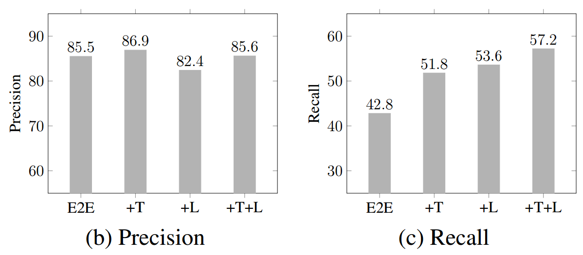
B) Are spatiotemporal signals useful?
 | IE-driven | IR-driven
E2E | 57.0 | 58.4
+ Time | 64.9 | 71.4
+ Location | 65.0 | 76.1
+ Both | 68.6 | 79.0
 | IE-driven | IR-driven
LP | 48.3 | 48.5
+ Time | 52.4 | 59.7
+ Location | 50.3 | 61.8
+ Both | 49.0 | 53.3
(a) Macro F-scores

Slide 19
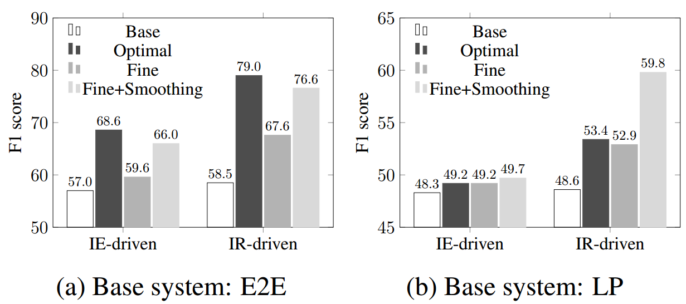
C) Graph-based smoothing

Slide 20
D) Case Study: More informative time profiling
Target entity: Washington (state)
(1) Washington (state): legalization of marijauna
(2) Washington, D.C.: fiscal cliff + winter weather alert
(3) Washingont redskins: Game for division title
Are all these peaks for washington state?

Slide 21

Conclusion & future work
We demonstrated that
Spatiotemporal signals are critical in advancing entity linking
Aggregation of many (individually) noisy tweets help
Future work
A more general framework to incorporate more non-text meta data
Online updating of spatiotemporal model
Of course, improve the base model!
We made some improvement to the base model $p(e|m,a)$

