Slide 1
Incremental and Accuracy-aware Personalized Pagerank through Scheduled Approximation
Fanwei Zhu, Yuan Fang, Kevin Chang, Jing Ying
Zhejiang University
University of Illinois at Urbana-Champaign

Slide 2
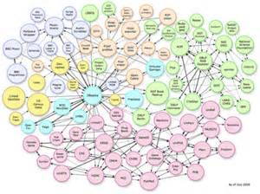
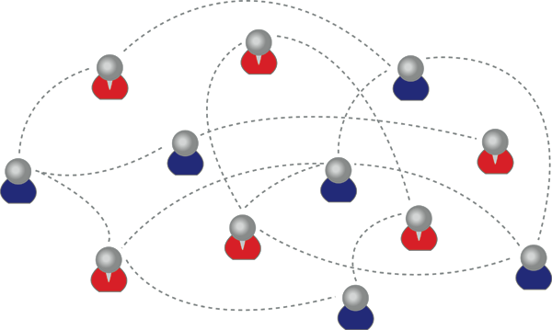
Motivation: Useful for ranking, expensive to compute
Graphs are everywhere, calling for graph-based ranking algorithm
Personalized Pagerank (PPV)
Effective for ranking
Expensive to compute
social network
DBLP citation network
Notes:
There are many applications based on graph data, e.g. find potential friend based on social network, recommend relevant paper on a DBLP citation network.
All call for a graph-based ranking algorithm which decides the importance of each node in the graph w.r.t. the query.
Personal, is an Effective alg. to calculate such query-specific relevance based on link structure of the graph.

Slide 3
Focus: Efficiency aspect of PPV computation
Approximation
Partial personalization
Arbitrary query
Accuracy
Exact computation
Efficiency
Prohibitive space/time cost
Notes:
Foucs is: efficiency
Exact impossible
partial personalization restrict query to only some node, however in apps, arbitrary node could be query. not flexible.
approximation, trade accuracy for time, however, one challenge is for user/application to control the tradeoff.
Aims at accuracy-aware approximation allows flexile tradeoff in a way user can easily control

Slide 4
Key insight: Scheduled approximation
Partitioning by importance
Prioritizing computation
b
T1: Medium
a
T0: High
d
a →b
a →b → d
a→ c
a →c →d
a →c →e
c
g
e
f
a →c →e →f
T2: Low
b
0.098
c
0.056
T¹
T⁰
d
0.063
0.042
e
0.021
T²
f
0.016
Notes:
The key insight of our proposal is scheduled approximation with two components:
Partition: disjoint tour sets e.g. graph, query node, partition into 3 sets
prioritizing: always handle the important tours earlier
e.g. most important T0, obtain an estimate ranks b,c,d
second important T1:the estimate is updated, become more accurate
finally, T2, all tours are covered, equals to exact PPV

Slide 5
Novelty: Incremental & accuracy-aware
Incremental query processing
Accuracy aware
Thru iterations
T⁰
T⁰
Tour set:
T¹
T⁰
T¹
partition
T²
T²
Estimates:
enough ?
enough ?
enough ?
sum of current estimates
Notes:
Our alg. is novel in 2 aspects:
First, enables an incremental query processing with PPV gradually enhanced
Second, we proof there is an easy way to compute the L1-error of the estimation without knowing the exact PPV.

Slide 6
Challenges: Efficient implementation
Challenge 1: How to effectively partition tours?
Challenge 2: How to efficiently compute each PPV increment?
importance of tours w.r.t query?
T⁰
T¹
T²
Notes:
2 challenges need to deal with:
#1:need a simple metric to evaluate the importance of tours at query time.
#2:need to sum up PPV increments over each tour set handled. compute the incremnts from the scratch is also expensive. Would like an efficient alg. for efficient processing.

Slide 7
Solution: Hub-based realization
Hub nodes
Discriminating: high out-degree decaying reachability
Sharing: popularity segments shared by tours
R=0.054
b
a
d
c
g
R=0.027
e
f
Notes:
Towards these 2 challenges, propose a hub-based solution.
in G, identify some special nodes at the center of diff. connections, which have two desirable properties:
1.discriminating: has many out-neighbors, the high out degree of hubs would significantly decay the reachability of tours passing thru them, E.g. resembling tours with same ending nodes, length, reachability is only ½ because of the decay power of node c
so, hubs are discriminating in terms of tour importance.

Slide 8
Solution: Hub-based realization
Hub nodes
Discriminating: high out-degree decaying reachability
Sharing: popular segments shared by tours
b
a
a
d
c
c
d
g
g
e
f
shared by
Notes:
2.sharing: the segments around hubs are shared by diff. tours. E.g. a-c is a segment shared by 4 diff. tours in this graph
2 properties are useful for tackling 2 challenges

Slide 9
Challenge 1: Discriminating provides partition metric
More hubs, less important
Partition tours by hub length (# of hubs)
b
a
d
q → c →e
q → c → d
q → a →b
→d
T0: High
Hub length =0
q→a
q→c
c
T1: Medium
hub length=1
q
e
q → a → c → e
q → a → c → d
f
T2: Low
Hub length=2
Notes:
discriminating provides simple effective metric to partition tours
more hubs, less important
can be partition by tour set, e.g. suppose q is query node, partition tour by their hub length so that T0 contains only tours with hl=0, T1, hl=1.. we can see, T0 is the most important, T1 less important and T2 least important.

Slide 10
Challenge 2: Sharing enables reusing overlaps
Reuse “prefix” among iterations
Precompute “building blocks”
d
b
d
b
q
a
c
a
d
e
c
q
c
d
q
e
e
f
prefix
precomputed
Building blocks
Notes:
2. sharing
1)reuse some prefix: in T0, two tours q-a and q-c, tours in T1, them are expanded from T0, or T0 can be treated as prefix of T1, similarly, T1 can be treated as prefix of T2.
So in computing PPV increment over different tour set, we can reuse these prefix to avoid redundant computation
2)common building blocks can be precomputed: the for each tour in T1, the remaining part beyond its prefix is a hub segment which start at some hub node and with hub length =0, e.g. hub segment of a, and c. Similarly for tours in T2.

Slide 11
Results: Fast with accuracy control
More iterations render better accuracy
Faster online/offline computation
2~7x faster than H
2~5x faster than M
4~11x faster than H
3~14x faster than M

Slide 12
Conclusion and future work
Conclusion
a scheduled approximation strategy to approximate PPVs
an efficient hub-based realization
up to 7x faster with accuracy control
Future work
automatic parameter configuration
tackling dynamic, evolving graph
generalizing to other graph algorithms

Slide 13
Thank you!

