Slide 1
Postman api TESTING TOOL

Slide 2
What is Postman?
Postman is one of the most popular open source tool used in API testing
It is powerful tool for API development and testing.
It presents you with a friendly GUI for constructing requests and reading responses
It lets you write a test thus reduces manual efforts and time
It is a powerful tool for performing integration testing with your API

Slide 3
Why Use Postman?
Accessibility - To use Postman, one would just need to log-in to their own accounts making it easy to access files anytime, anywhere as long as a Postman application is installed on the computer.
Use of Collections - Postman lets users create collections for their API calls. Each collection can create subfolders and multiple requests. This helps in organizing your test suites.
Collaboration - Collections and environments can be imported or exported making it easy to share files. A direct link can also be used to share collections.
Creating Environments - Having multiple environments aids in less repetition of tests as one can use the same collection but for a different environment.
Creation of Tests - Test checkpoints such as verifying for successful HTTP response status can be added to each API calls which help ensure test coverage.
Automation Testing - Through the use of the Collection Runner or Newman, tests can be run in multiple iterations saving time for repetitive tests.
Debugging - Postman console helps to check what data has been retrieved making it easy to debug tests.

Slide 4
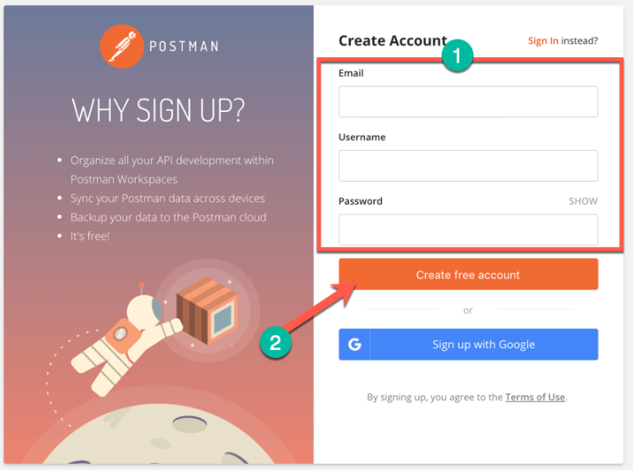
How to Download and Install POSTMAN
Go to https://www.getpostman.com/downloads/ and choose your desired platform among Mac, Windows or Linux.

Slide 5
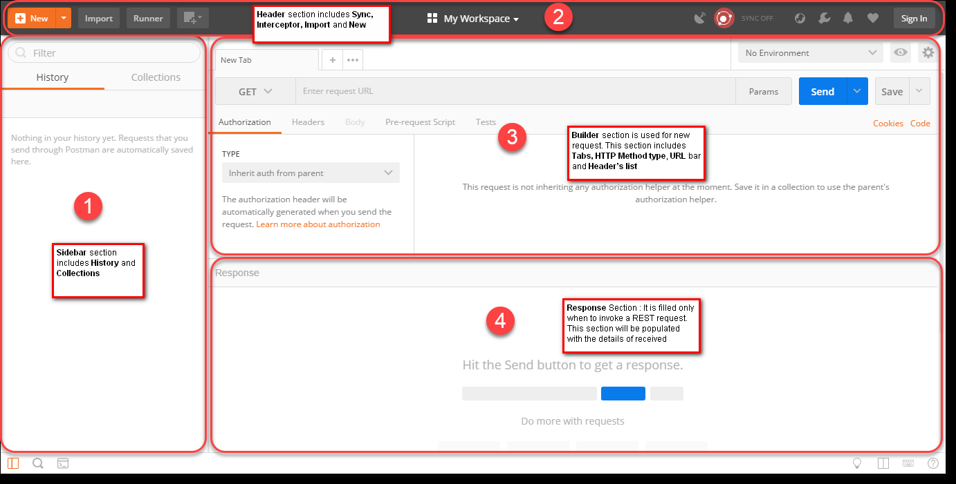
POSTMAN INTERFACE

Slide 6
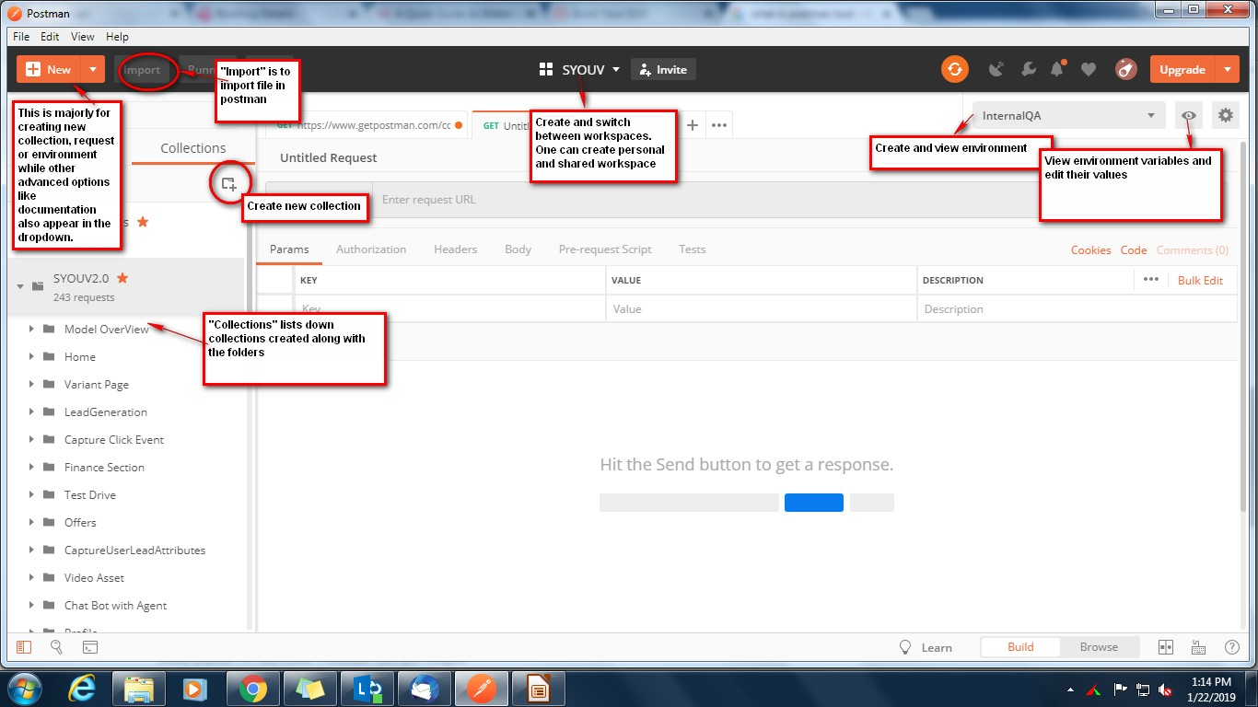
POSTMAN INTERFACE - 1

Slide 7
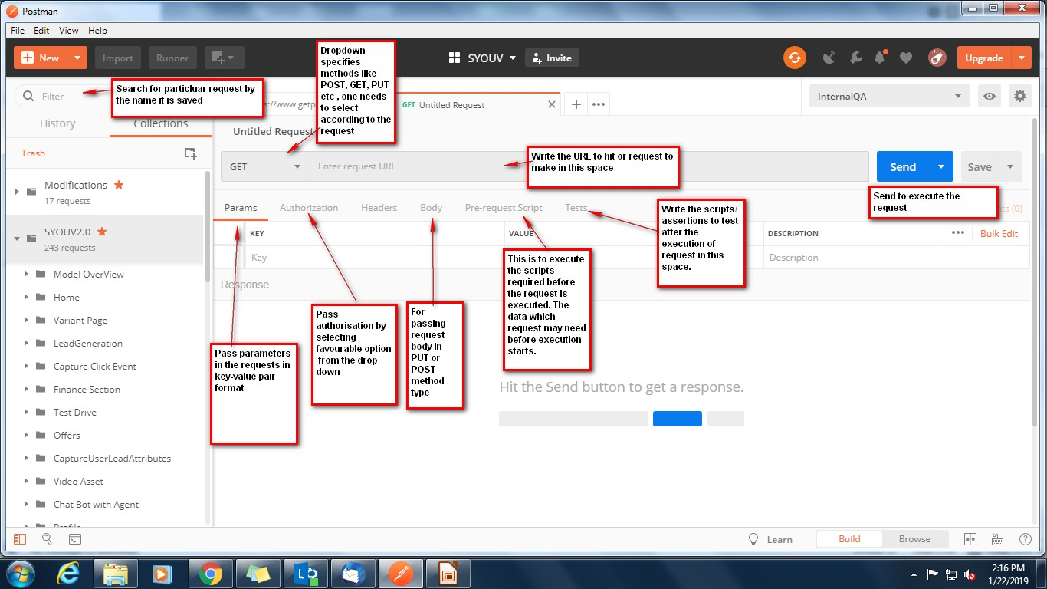
POSTMAN INTERFACE - 2

Slide 8
API TESTING WITH POSTMAN
API Name : GetFinanceTerms
API Description: This API returns ROI and Tenure for the finance present.
HTTP Method: GET
URL : {{PS_Url}}/api/VariantFinance/GetFinanceTerms
EXPECTATION: The response should include parameters – Tenure and ROI and these two are mandatory fields.
The standard response should strictly include parameters Errorcode, Errormsg, IsSuccessful and ResponseData.

Slide 9
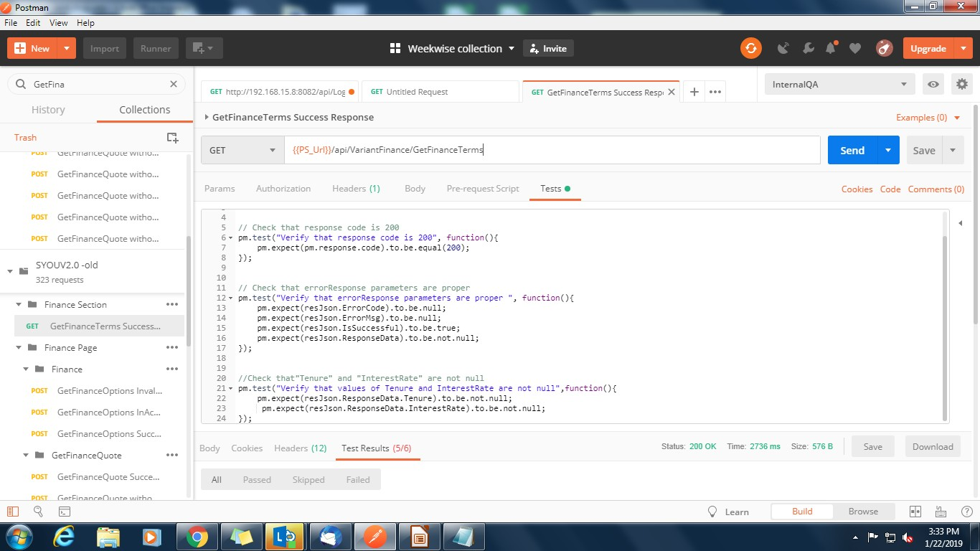
TEST SCRIPT

Slide 10
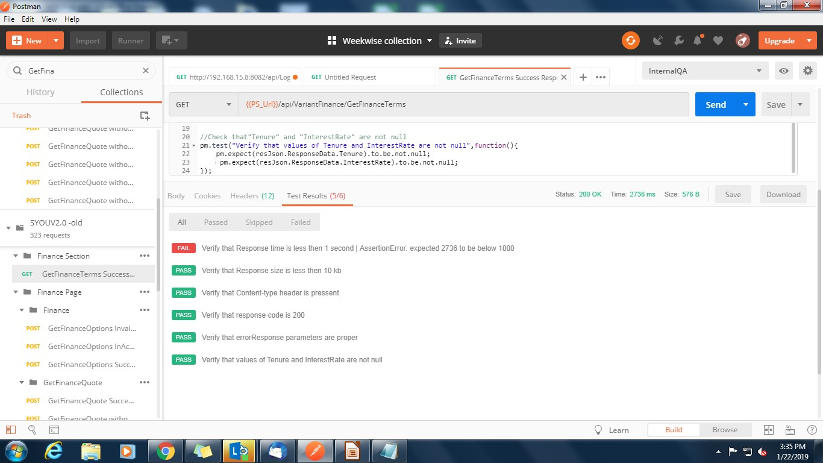
TEST RESULTS

Slide 11
PASSING REQUEST WITH POST METHOD
Select POST method
Navigate to BODY section.
Select raw
Select “application/json” from Text dropdown.
Add request body in JSON format.

Slide 12
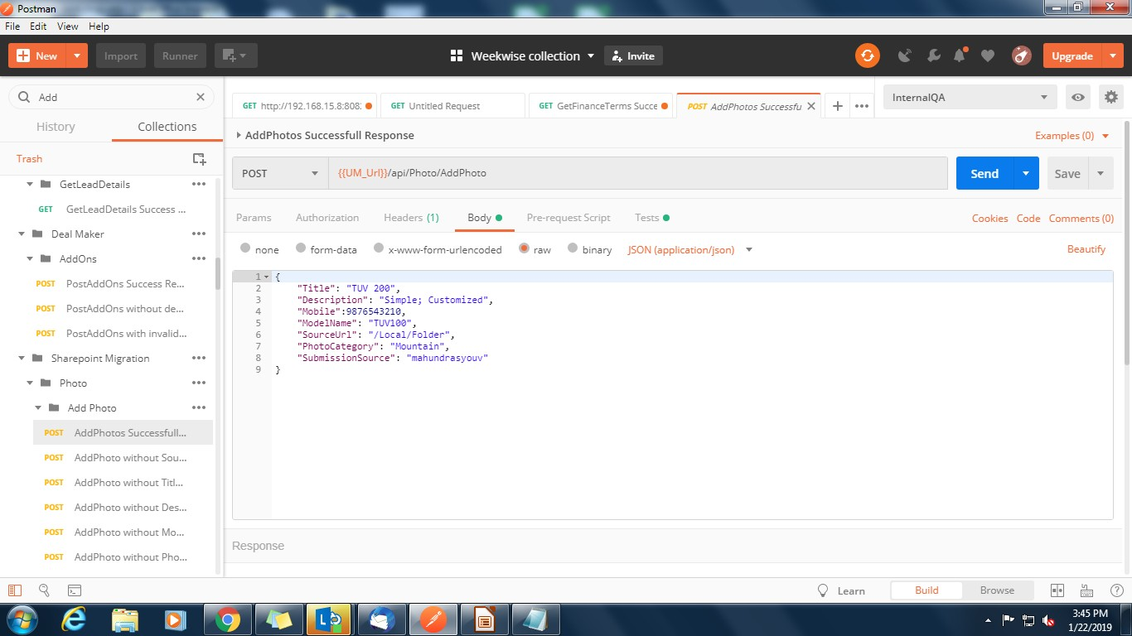
PASSING REQUEST WITH POST METHOD

Slide 13
Assignment No.1
Please come up with following tasks from your own projects.
Create collection
Create environment variables
GET request with following assertions
200 status code
Not null
To be null
Response time
Response size

Slide 14
SESSION 2
WORKING WITH VARIABLES
SET ENVIRONMENT VARIABLES
UNSET VARIABLES
USING VARIABLES IN URL
USING VARIABLES IN REQUEST BODY
WORKING WITH LOOPS
LOOPS & NESTED LOOPS

Slide 15
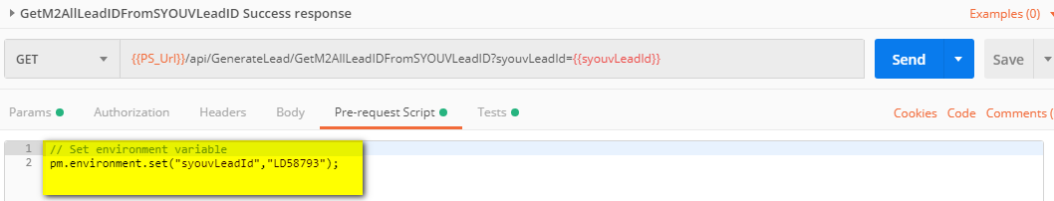
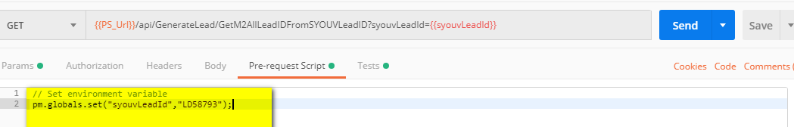
SET ENV & GLOBAL VARIABLE
pm.environment.set(“variable_name”,”variable_value”);
pm.globals.set(“variable_name”,”variable_value”);

Slide 16
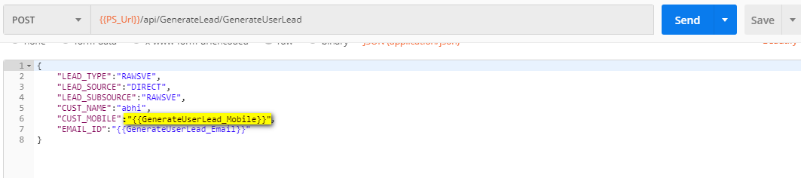
ACCESSING VAR AS PARA IN REQUEST URL AND BODY:

Slide 17
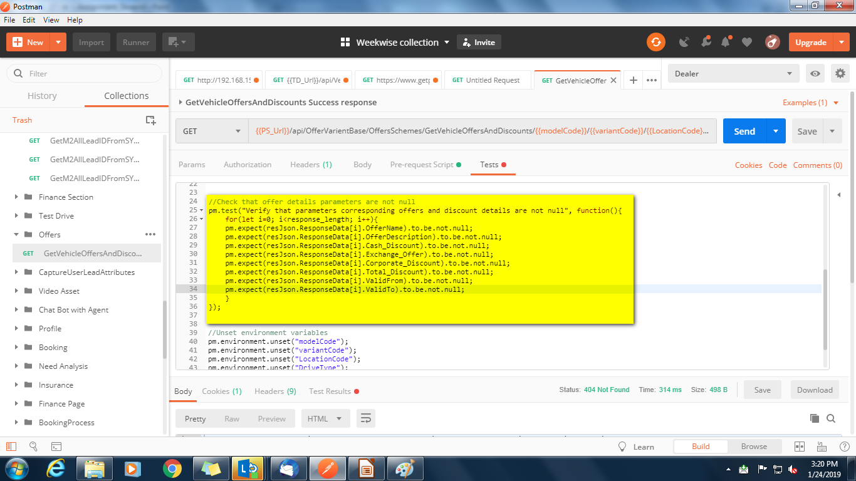
LOOPS

Slide 18
Nested Loops
We may have to use nested loops into test scripts according to the API response.
For example : We need to check the value of parameter “AccessoryTypeName” residing in “ResponseData → Accessories → AccessoryTypeName”

Slide 19
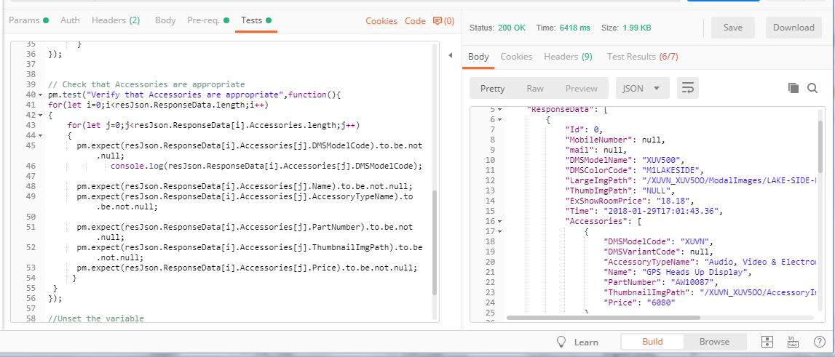
Nested Loops

Slide 20
REPORT GENERATION THROUGH NEWMAN
Install Node.js
Install NPM (node package manager)
Install Newman
Link to refer installation procedure is :
https://www.toolsqa.com/postman/install-newman-using-npm/
Install html reporter :
type : npm install -g newman-reporter-html in cmd

Slide 21
REPORT GENERATION THROUGH NEWMAN
Commands for running collection through command prompt using NEWMAN
newman run link_as_copied_from_postman_collection_sharing

Slide 22
Thank You

