Slide 1
Dyna
Distributed Version Control for Resource Catalogs SDMF Engineering

Slide 2
Dyna
Distributed Version Control for Resource Catalogs
A Pijul-inspired system for collaborative JSON resource editing with S3 storage, changeset-based versioning, and an elfo-rs actor server.
From monolithic pain to distributed gain.

Slide 3
SDMF: A Massive Catalog of 40,000+ Resources
The Semantic Data Modeling Framework became the backbone of enterprise data architecture — a living catalog of interconnected JSON resources.

Slide 4
Scale
40,000+ JSON resources
Hundreds of namespaces
Entities, connectors, threat models
Semantic mappings and schemas
Resource Types
Type | Count
Entity Definitions | ~12,000
Connector Configs | ~8,000
Threat Models | ~5,000
Semantic Mappings | ~15,000

Slide 5
Users Reported Critical Friction
The pain was real and growing
Minutes-long startup — loading 40K resources into memory at launch
Destructive overwrites — no version history, last-write-wins
No concurrent editing — single-user lock on the entire catalog
No branching — experimental changes polluted production
Excessive memory pressure — entire catalog resident in RAM
“We lost three days of work because someone overwrote the connector namespace. There was no way to recover.”

Slide 6
The Vision: Git-Like Version Control for JSON
We envisioned a system where every change is tracked, every branch is isolated, and every client stays in sync.

Slide 7
Core Principles
Immutable changesets — content-addressed, tamper-proof
Channels — isolated branches for safe experimentation
Distributed sync — push/pull like Git, but for JSON
Lazy loading — on-demand, not all-at-once
Inspired By
System | Borrowed Concept
Pijul | Patch commutativity
Git | Content-addressable storage
CouchDB | JSON-native documents
Nix | Reproducible builds

Slide 8
Data Model: Resources → Patches → Changesets → Channels
Four layers, each building on the last — from raw JSON documents to named branches.

Slide 9
Layer | Identity | Immutable?
Resource | UUID | No (evolves)
Patch | SHA-256 | Yes
Changeset | SHA-256 | Yes
Channel | Name string | No (HEAD moves)
RFC 6902 Operations
[ {"op": "replace", "path": "/role", "value": "admin"}, {"op": "add", "path": "/permissions/-", "value": "write"}, {"op": "remove", "path": "/deprecated"} ]

Slide 10
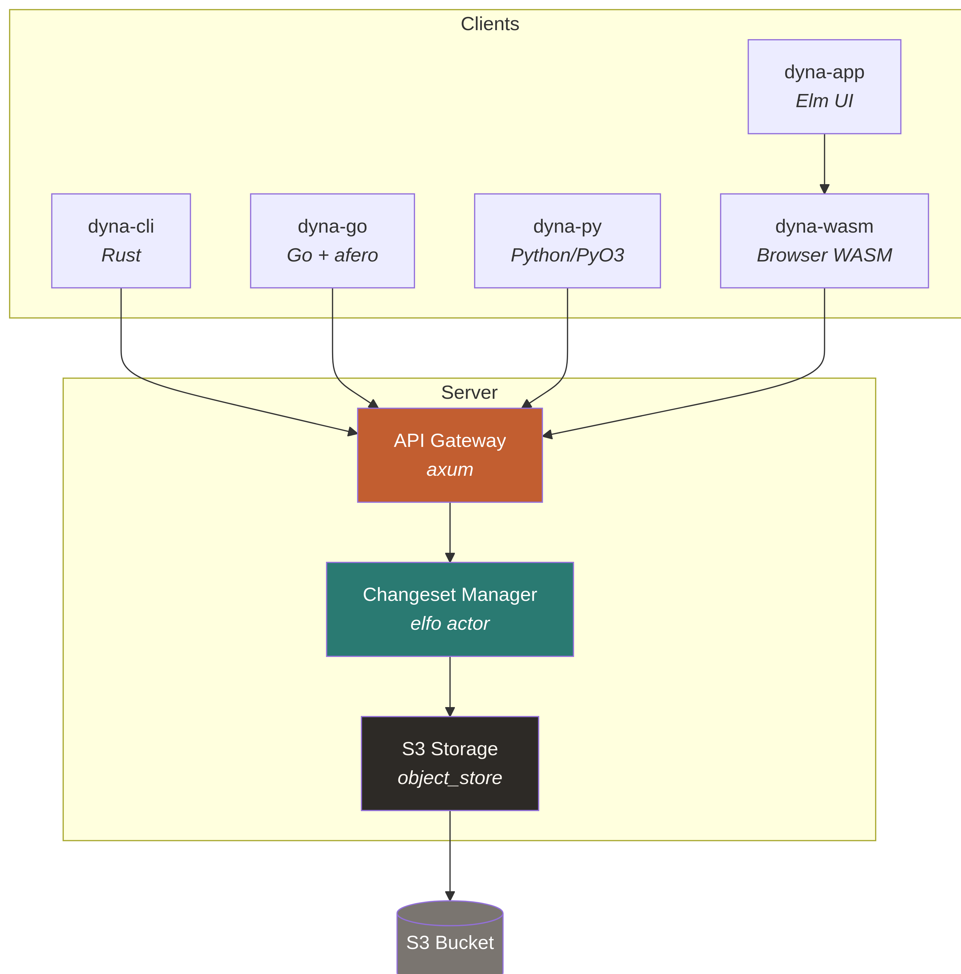
Architecture: One Protocol, Five Languages
A Rust server at the center, with clients in Rust, Go, Python, WebAssembly, and Elm — all sharing the same REST + WebSocket protocol.

Slide 11
Actor-Based Server with S3 Persistence
The server uses the elfo actor framework for fault isolation, clean message-passing, and structured concurrency.

Slide 12
Actor Hierarchy
REST Endpoints
Actor | Responsibility
API Gateway | HTTP ↔ elfo bridge (axum)
Changeset Manager | Validation, channels, merge
Storage Actor | S3 I/O via object_store
Notification Actor | WebSocket broadcast
Method | Path
POST | /resources
GET | /resources/:id
PUT | /resources/:id
DELETE | /resources/:id
POST | /changesets
POST | /push
POST | /pull
POST | /clone
GET | /channels
POST | /channels
WS | /ws
Message Flow
HTTP → API Gateway → Changeset Manager → Storage Actor → S3 ↘ Notification Actor → WebSocket

Slide 13
Lazy Loading: Minutes → Milliseconds
Instead of loading 40,000 resources at startup, lazy clients fetch only metadata, materialise on-demand, cache locally, and receive real-time updates.

Slide 14
Traditional Loading
Startup: Load ALL 40K resources ├── Fetch from S3 ~45s ├── Deserialize JSON ~30s ├── Build index ~15s └── Ready ~90s total Memory: ~2.4 GB resident
Lazy Loading
Startup: Connect + fetch metadata ├── WebSocket connect ~50ms ├── List resource IDs ~200ms └── Ready ~250ms total Memory: ~12 MB baseline
On-Demand Materialisation
User requests resource by ID
Client fetches patches from server
Replays RFC 6902 operations
Caches materialised snapshot
Subsequent reads hit local cache
Cache Invalidation
WebSocket push on changeset commit
Client re-materialises affected resources
Delivers UpdateEvent with full metadata

Slide 15
Lazy Loaders in Four Languages
Identical semantics across Rust, Go, Python, and WebAssembly — connect, list, get, subscribe.

Slide 16
Rust (lazy-cat)
let client = LazyClient::connect(url).await?; let ids = client.list_resources().await?; let resource = client.get_resource(&id).await?; client.on_update(|event| { println!("Updated: {:?}", event.affected_resources); }).await;
Go (lazy-go)
client := lazydyna.NewClient(url) client.Connect(ctx) ids, _ := client.ListResources(ctx) res, _ := client.GetResource(ctx, id) client.OnUpdate(func(e UpdateEvent) { fmt.Printf("Updated: %v\n", e.AffectedResources) })
Python (lazy-py)
async with LazyClient(url) as client: ids = await client.list_resources() resource = await client.get_resource(id) async for event in client.updates(): print(f"Updated: {event.affected_resources}")
WASM (lazy-wasm)
const client = await LazyWasmClient.new(url); const ids = client.list_resources(); const resource = client.get_resource(id); client.on_update((event) => { console.log("Updated:", event.affected_resources); });

Slide 17
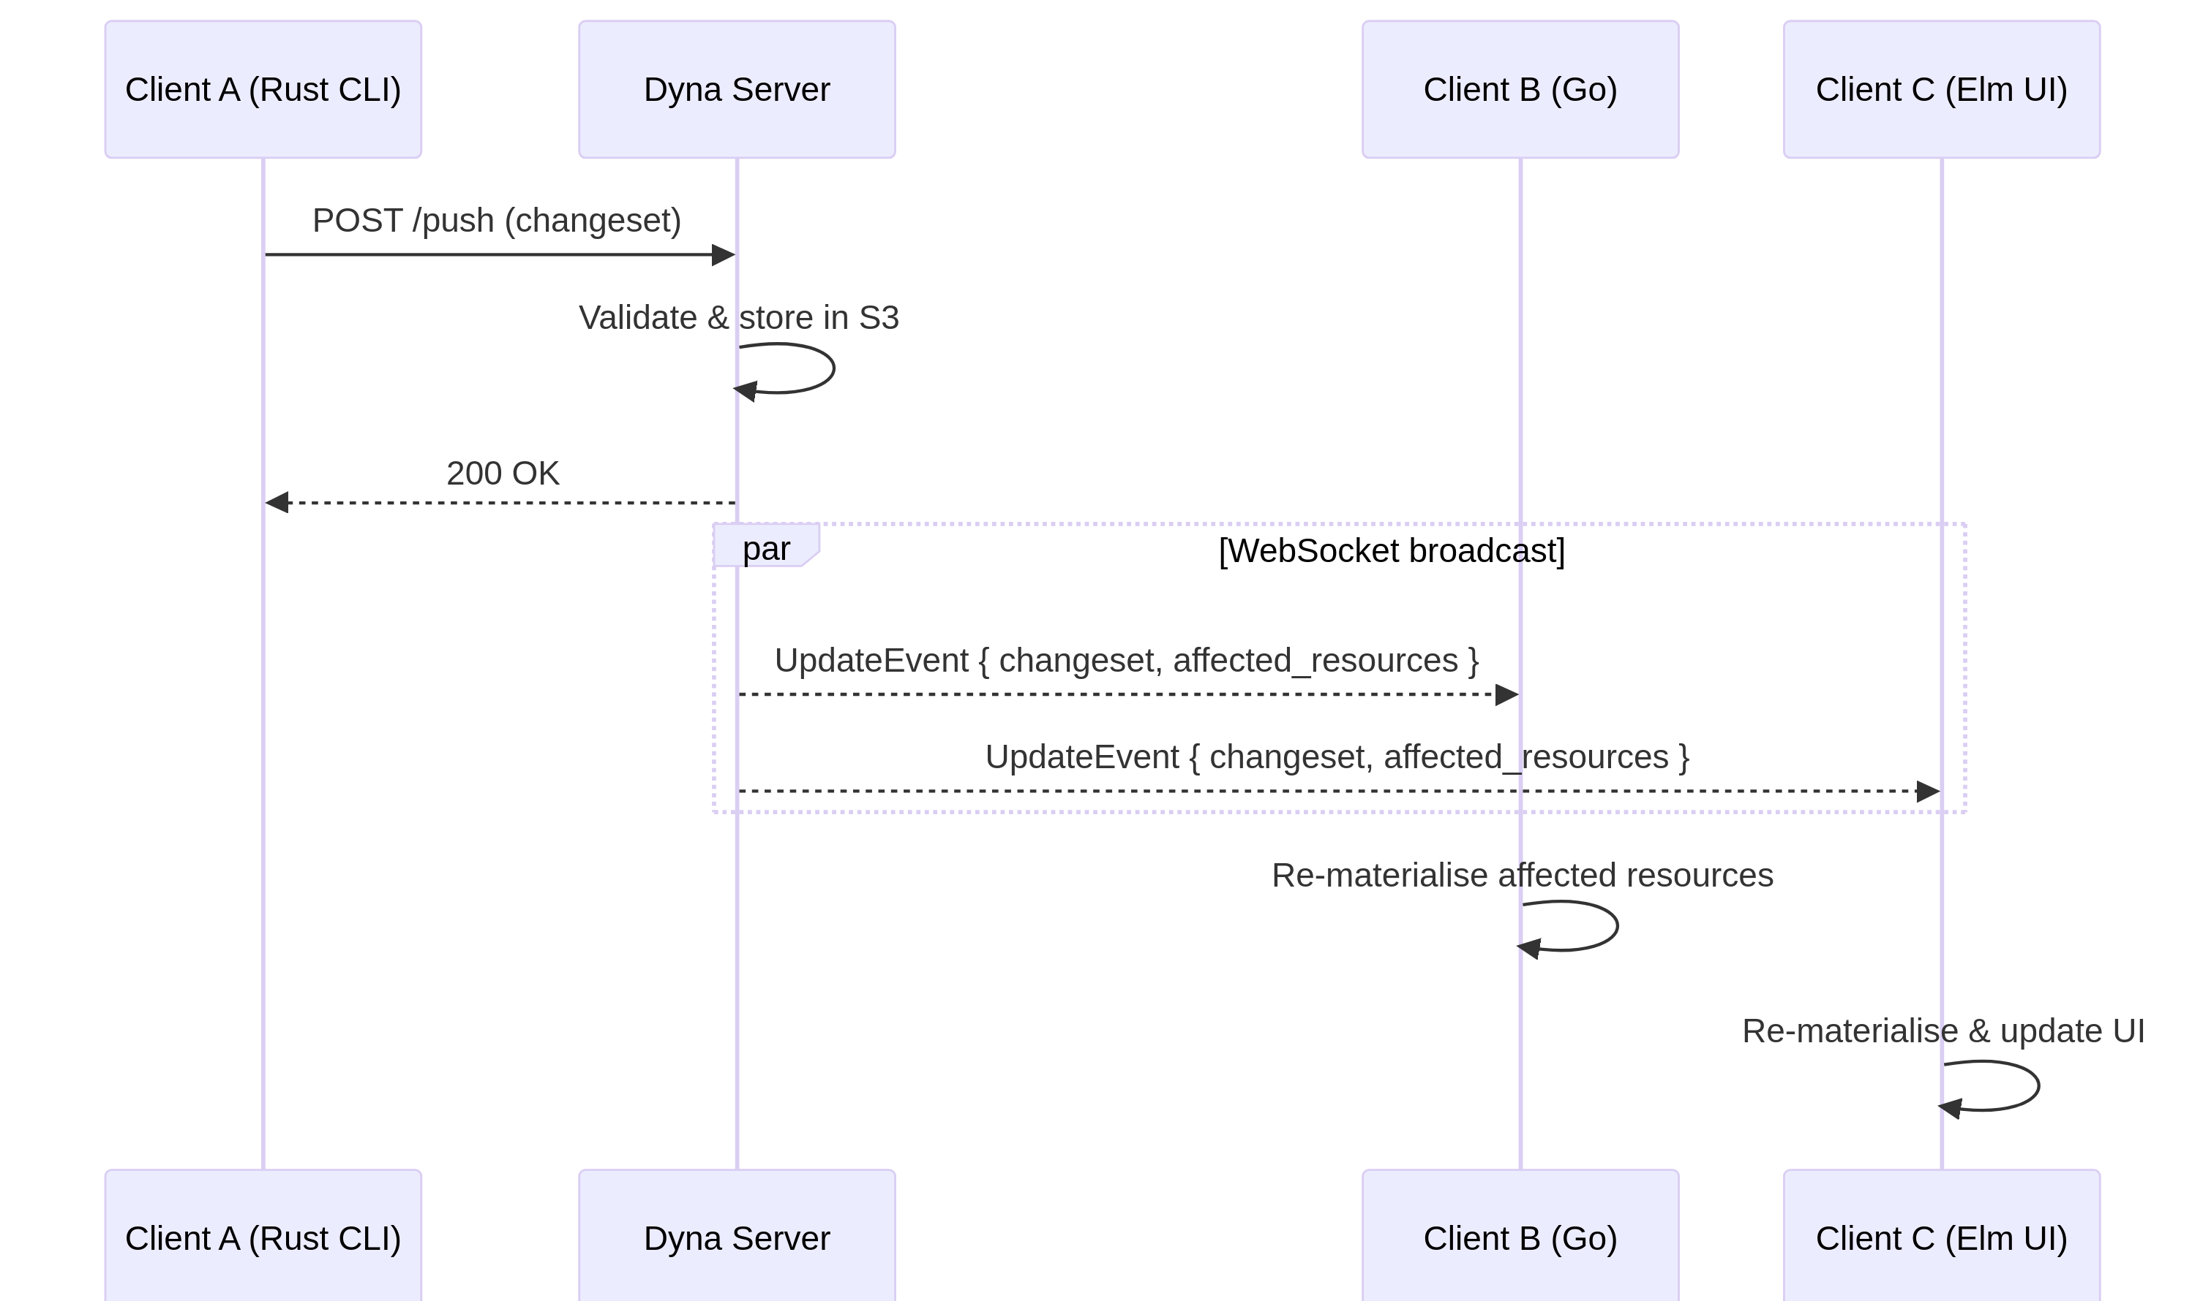
Real-Time Collaboration via WebSocket
Changes propagate to all connected clients within milliseconds. Every client receives rich UpdateEvent objects with full changeset metadata.

Slide 18
UpdateEvent Structure
{ "changeset_id": "sha256:a1b2c3...", "author": "alice", "channel": "main", "affected_resources": ["res-001", "res-042"], "operations_count": 5, "timestamp": "2026-03-05T10:30:00Z" }

Slide 19
Browser UI: Elm + WebAssembly
Two browser applications for visual resource management — dyna-app for full CRUD editing and lazy-elm-demo for lazy-loading demonstration.

Slide 20
dyna-app (Full Editor)
Elm 0.19 + WASM bridge via ports
Create, read, update, delete resources
Channel management (create, switch, promote)
Changeset history and diff viewer
Real-time sync via WebSocket
Architecture
Elm App ←→ Ports ←→ JS Bridge ←→ WASM Client ↕ Dyna Server
lazy-elm-demo (Lazy Viewer)
Two-panel layout with scrollable resource list
JSON detail view with syntax highlighting
Live update log with changeset metadata
On-demand resource materialisation
Minimal memory footprint
Key Features
Feature | Implementation
Resource list | Scrollable, click-to-select
Detail view | Pretty-printed JSON
Live updates | Streaming event log
Lazy fetch | WASM get_resource()

Slide 21
Reproducible Builds: One Nix Flake, 24+ Packages
The entire ecosystem — server, CLI, clients, demos, OCI images — is built and deployed from a single flake.nix.

Slide 22
Package Matrix
Build Commands
# Build everything nix build .#all # Build specific package nix build .#dyna-server # Run demo nix run .#lazy-cat-demo # Development shell nix develop # OCI image nix build .#dyna-server-oci docker load < result
Guarantees
Hermetic — no ambient system dependencies
Reproducible — same inputs → same outputs
Cacheable — Nix binary cache for CI
Cross-platform — Linux, macOS, WASM
Package | Language | Builder
dyna-core | Rust | crane
dyna-server | Rust | crane
dyna-cli | Rust | crane
dyna-wasm | Rust→WASM | wasm-pack
dyna-py | Rust→Python | maturin
dyna-go | Go | buildGoModule
dyna-app | Elm | elmPackages
lazy-cat | Rust | crane
lazy-go | Go | buildGoModule
lazy-py | Rust→Python | maturin
lazy-wasm | Rust→WASM | wasm-pack
lazy-elm-demo | Elm | elmPackages

Slide 23
Impact: Transforming How Teams Work
Dyna fundamentally changed the SDMF workflow — from fragile single-user editing to robust distributed collaboration.

Slide 24
360×
Faster Startup
200×
Less Memory
100%
Audit Trail
5
Client Languages

Slide 25
Roadmap: What Comes Next
Near Term
Three-way merge — automatic conflict resolution for non-overlapping edits
Partial namespace sync — subscribe to subsets of the catalog
JSON Schema validation — enforce resource structure at commit time
Incremental materialisation — apply only new patches, skip replayed history
Long Term
Federated catalogs — multi-server sync across organizational boundaries
Conflict resolution UI — visual merge tool in the Elm app
Performance benchmarks — published comparisons of full vs. lazy loading
Branch/merge operations — Git-like workflows with channel promotion

Slide 26
Design Principles Going Forward
Every feature must preserve the core invariants: immutable changesets, content-addressable storage, and lazy-by-default loading.

Slide 27
Thank You
Dyna — Distributed Version Control for Resource Catalogs
Questions?
Built with Rust · Go · Python · Elm · WebAssembly · Nix

