Slide 1
SORTING ALGORITHMS
(MERGE SORT, BUBBLE SORT AND INSERTION SORT)
Team 7
Sidratul Muntaha
Arpit Shah
Steve St Fleur
Afrida Mehanaz shaik
Nidheesha Rudraraju

Slide 2
INTRODUCTION
A sorting algorithm is a method used to rearrange a given array or list of elements according to a comparison operator on the elements. These algorithms are primarily employed to organize data into a specific order, most commonly numerical or alphabetical (or lexicographical) order. Sorting can be done in ascending order (A-Z, 0-9) or descending order (Z-A, 9-0), depending on the requirements.
Sorting algorithms are essential in various fields, including computer science, mathematics, and data analysis, where ordered data is crucial for efficient processing and analysis.
They play a vital role in tasks such as searching, data mining, and statistical analysis by providing a structured way to access and manipulate data

Slide 3
CLASSIFICATION OF A SORTING ALGORITHM
Sorting algorithms can be classified by:
Time complexity : A measure used to analyze the efficiency of an algorithm in terms of the amount of time it takes to execute as a function of the input size. It helps us understand how the algorithm's runtime grows as the input size increases.
Space Complexity : The amount of memory space required by an algorithm to solve a problem as a function of the input size. It measures the maximum amount of memory space used by the algorithm during its execution.
Stability
Some popular sorting algorithms are:
Insertion sort, Selection sort, Merge sort, Heap sort, Quick sort, Shell sort, Bubble sort, Exchange sort, Counting sort, Bucket sort, etc.
As a part of this project we are implementing: Merge Sort, Bubble sort and Insertion sort.

Slide 4
PROBLEM STATEMENT
We have tried creating JAVA programs for developing sorting tool that allows users to input a list of integers and sorts them using three different sorting algorithms: Merge Sort, Bubble Sort, and Insertion Sort. The tool should provide the following functionality:
Input: Allow users to input integers one by one until they decide to stop by typing 'exit'. The tool should handle invalid inputs gracefully, displaying appropriate error messages.
Sorting: After receiving the input, the tool should sort the list of integers using each of the three sorting algorithms separately: Merge Sort, Bubble Sort, and Insertion Sort.
Output: Display the sorted list of integers for each sorting algorithm, along with the original unsorted list.
User Interaction: The tool should provide a user-friendly interface, prompting users for input and displaying the results clearly.
Error Handling: Handle any potential errors or exceptions gracefully, ensuring the tool does not crash and provides helpful error messages to the user.

Slide 5
MERGE SORT

Slide 6
What is Merge Sort?
Merge Sort is a divide-and-conquer algorithm that divides the unsorted list into smaller sublists, sorts those sublists recursively, and then merges them back together to produce a sorted list.
It's efficient and stable, meaning it maintains the relative order of equal elements.
Merge Sort is:
Comparison-based algorithm.
Stable sort
Divide and conquer algorithm that was invented by John Von Neumann in 1945. (https://en.wikipedia.org/wiki/Merge_sort)

Slide 7
HOW IT WORKS!
Using the divide and conquer algorithm:
Divide the unsorted list into n subsets, each containing one element.
Repeatedly merge sublist to produce new sorted sublists until there is only one sublist remaining. That will be the sorted list. (https://en.wikipedia.org/wiki/Merge_sort)

Slide 8
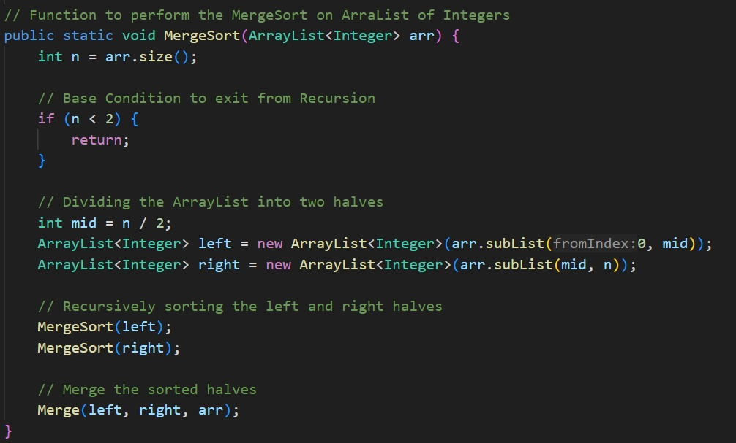
THE MERGE SORT ALGORITHM
merge(A, p, q, r)
{
n1= q-p+1
n2= r-q
Let L[1:n+1] and R[1:n2+1] be new arrays
for (i=1:n1)
L[i]= A[p+i-1]
for (j=1:n2)
R[j]= A[q+j]
L[n1 + 1]= infinity
R[n2 + 1]= infinity
i=1, j=1
for (k=p:r)
{
if (L[i] <= R[j])
A[k] = L[i]
i= i+1
else
A[k] = R[j]
j= j+1
}
}
(https://betterprogramming.pub/5-basic-sorting-algorithms-you-must-know-9ef5b1f3949c)

Slide 9
BUBBLE SORT

Slide 10
WHAT IS BUBBLE SORT?
Bubble Sort is a simple comparison-based algorithm that repeatedly steps through the list, compares adjacent elements, and swaps them if they are in the wrong order.
It continues to do so until the list is sorted.
Bubble sort is:
A simple sorting algorithm
Also known as sinking sort
Is a comparison sort, named for the way larger elements bubble up to the top of list. (https://en.wikipedia.org/wiki/Bubble_sort)

Slide 11
HOW IT WORKS!
Bubble sort repeatedly swaps the adjacent elements if they are in the wrong order. After each iteration or pass, the largest element reaches the end (in case of ascending order) or the smallest element reaches the end (in case of descending order). The pass through the list is repeated until the list is sorted.

Slide 12
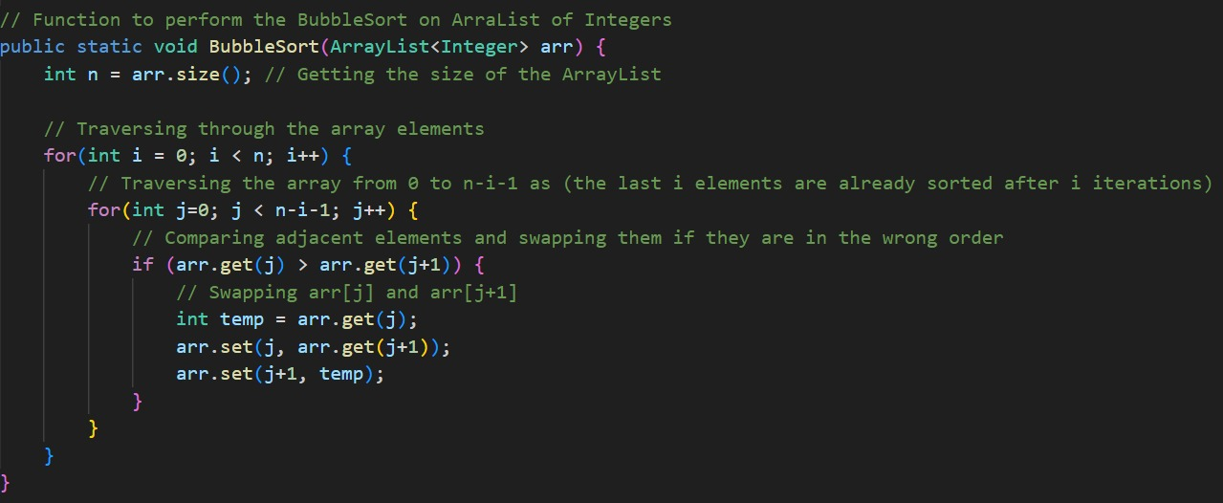
THE BUBBLE SORT ALGORITHM
BubbleSort(array)
for i <- 1 to indexOfLastUnsortedElement-1
if leftElement > rightElement
swap leftElement and rightElement
end bubbleSort

Slide 13
INSERTION SORT

Slide 14
WHAT IS INSERTION SORT?
Insertion Sort is another simple sorting algorithm that builds the final sorted list one element at a time by repeatedly taking the next element and inserting it into the correct position among the elements already sorted.
Insertion sort is:
Simple sorting algorithm.
Places an unsorted element at its suitable place in each iteration.
Performs well on small data sets
More efficient when the array is nearly sorted
Does not require more additional memory beyond the array being sorted
Stable

Slide 15
HOW IT WORKS!
To sort an array of size N in ascending order, iterate over the array and compare the current element(Key) to its predecessor, if the key element is smaller than its predecessor, compare it to the elements before. Move the greater elements one position up to make space for the swapped element. (https://www.geeksforgeeks.org/insertion-sort/)
Fig: Insertion Sort

Slide 16
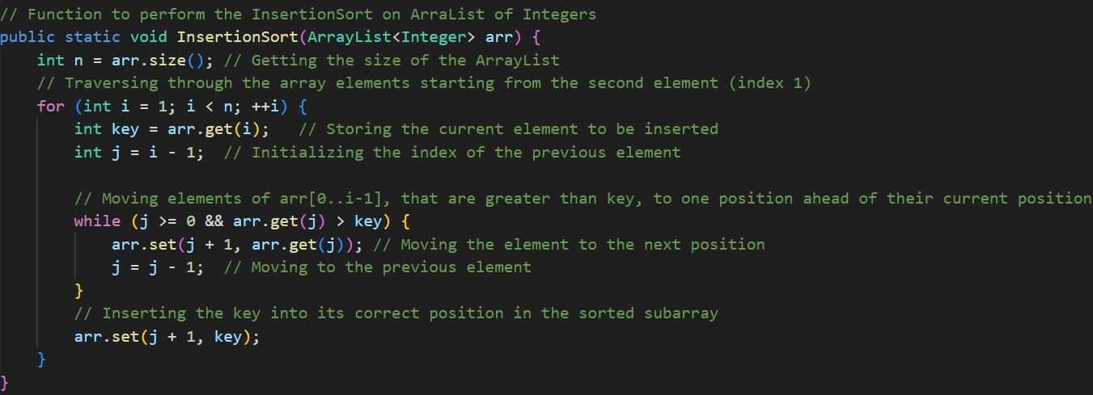
THE INSERTION SORT ALGORITHM
Insertion-sort(A)
{
for j=1 to A.length
key = A[ i ];
// insert A [ i ] into sorted sequence A[1, 2, 3, .. n]
j = i - 1 ;
while (j>0 and A[j] > key)
A[ j + 1] = A[j];
j = j -1
A[j+1] = key
}

Slide 17
WHY IS EFFICIENCY IMPORTANT?
Sorting algorithms are very important because they reduce the complexity of a problem.
Efficient sorting is important for
Optimizing the efficiency of other algorithms that require input data to be in a sorted list.
The algorithms include searching algorithms, database algorithms, divide and conquer methods, data structure algorithms and many more.
For optimum efficiency, the input data should be stored in a data structure, which allows random access rather than one that allows only sequential access.
Notes:
ADD BULLET PTS

Slide 18
Complexity: Best, Worst and Average Case
Best Case Complexity:
The best case complexity represents the minimum amount of time or space required by an algorithm to solve a problem for a given input size i.e., when the input data is already sorted or nearly sorted.
E.g.: 1,2,3,5,4
Worst Case Complexity:
The worst case complexity represents the maximum amount of time or space required by an algorithm to solve a problem for a given input size i.e., when the input data is in reverse order or contains elements that require extensive movement.
E.g.: 5,4,3,2,1
Average Case Complexity: The average case complexity represents the expected amount of time or space required by an algorithm to solve a problem for a given input size, averaged over all possible input.
E.g.: 2,1,3,5,4
Understanding the best case, worst case, and average case complexities of sorting algorithms helps in evaluating their performance across different scenarios and selecting the most suitable algorithm for a given problem based on the expected input characteristics.

Slide 19
COMPARISON BETWEEN THE SORTING ALGORITHMS
Time Complexity | Merge Sort | Bubble Sort | Insertion Sort
Worst Case | O( n log n) | O(n^2) | O(n^2)
Best Case | O( n log n) | O(n) | O(n)
Average Case | O( n log n) | O(n^2) | O(n^2)
Space Complexity | O(n) | O(1) | O(1)
Fig: Table for showing different time complexities and space complexity

Slide 20
EXPLANING COMPARISONS
Bubble and insertion sort appear to have identical complexities in terms of time and space. However, insertion sort will perform better on a list that is substantially sorted while bubble sort is beginner friendly because of having fewer line.Merge sort is much faster than bubble sort and insertion sort. It takes less time to sort large lists and lists that are more unordered. But, when we want to work with smaller lists, bubble sort will be quicker than merge sort.
Merge sort has the worst space complexity as it needs memory to store the data as it is merged. This can be a problem when there is a larger data set. A merge sort can however, be parallelised in order to make it suitable for manipulating big data.
Therefore, we can conclude that Merge sort is the best sorting algorithm compared to both bubble sort and insertion sort.

Slide 21
REAL LIFE APPLICATIONS OF SORTING ALGORITHMS
Sorting algorithms have a wide range of real-life applications across various industries and domains. Some of the most common applications include:
Database Management:
Search Engines
E-commerce
Data Analytics
Networking
Healthcare

Slide 22
CONCLUSION
In conclusion, sorting algorithms play a fundamental role in computer science, facilitating efficient organization and retrieval of data across various applications. Through this presentation, we've explored a diverse array of sorting algorithms, each with unique characteristics, advantages, and complexities. Understanding these algorithms equips us with powerful tools to optimize performance and enhance the functionality of our software systems. As we continue to innovate and evolve in the field of computer science, the importance of sorting algorithms remains undeniable, serving as a cornerstone in the development of efficient and reliable computational solutions.

Slide 23
THANK YOU!

