Slide 1
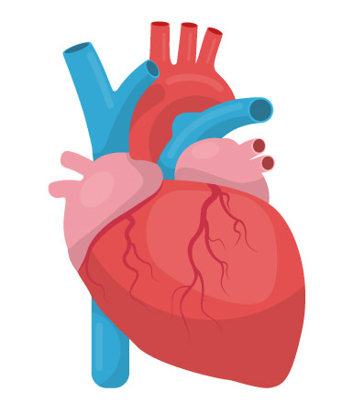

CS 513 A
Knowledge Discovery and Data Mining
HEART FAILURE PREDICTION

Slide 2



Group Members
PAVAN PINNAM 20012969
Neha Sutariya 20021648
Srihari muramshetty 10474183

Slide 3
Contents
Dataset Description
Objective
EDA - Exploratory Data Analysis
Classification algorithms used
KNN Methodology
Distance based
Gaussian Naive Bayes
Artificial Neural Network
Decision Trees (CART)
Tree Based
Non tree based (Using Logistic Regression)
Non tree based (Using K-nearest neighbors)
Conclusion

Slide 4
Dataset description
Heart Failure Prediction dataset- https://www.kaggle.com/datasets/fedesoriano/heart-failure-prediction/
dataRaw data - Numerical columns - Categorical columns
Number of columns - 12
Number of rows - 918
Categorical rows - 5
Numerical rows - 7
Target Feature - ‘RainTomorrow’
Age
RestingBP
Cholesterol
FastingBS
MaxHR
Oldpeak
HeartDisease
Sex
ChestPainTyp
RestingECG
ExerciseAngina
ST_Slope
Target Column -
HeartDisease

Slide 5
Problem Statement -
Cardiovascular diseases (CVDs) are the number 1 cause of death globally, taking an estimated 17.9 million lives each year, which accounts for 31% of all deaths worldwide. Four out of 5CVD deaths are due to heart attacks and strokes, and one-third of these deaths occur prematurely in people under 70 years of age. Heart failure is a common event caused by CVDs and this dataset contains 11 features that can be used to predict a possible heart disease.
The target variable in the heart failure prediction dataset is whether or not a patient will develop heart failure. This is a binary classification problem, as the target variable can only take on two values: 0 (no heart failure) or 1 (heart failure).
Objective-

Slide 6
Exploratory Data Analysis
Data preprocessing
Data preprocessing is crucial for effective machine learning. Null values (NaN) are common in real-world datasets and need intervention.
Identification of Null Values
Use df.info() to check data types and non-null counts.
Use df.isnull().sum() to identify the count of null values in each column.
Imputation
Avoid removing rows/columns to prevent information loss.
Utilize imputation to substitute missing values.
Example: SimpleImputer from sklearn for mean imputation.
Demonstration (if applicable)
Displayed code snippets for identification and handling of null values.
c.

Slide 7
Exploratory Data Analysis
Feature Scaling and Categorical Variables
Feature Scaling
Necessary for distance-based algorithms (e.g., KNN, SVM).
Normalization: Scales values between 0 and 1.
Standardization: Centers data around mean with unit standard deviation.
Choose based on the algorithm and data distribution.
Demonstration of Scaling
Displayed code snippets and visualizations for normalization, standardization, and robust scaling.
Handling Categorical Variables
Two types: Nominal and Ordinal.
Use Label Encoding for tree-based models.
For non-tree models, utilize One-Hot Encoding.
Demonstrated encoding using LabelEncoder and pd.get_dummies().

Slide 8
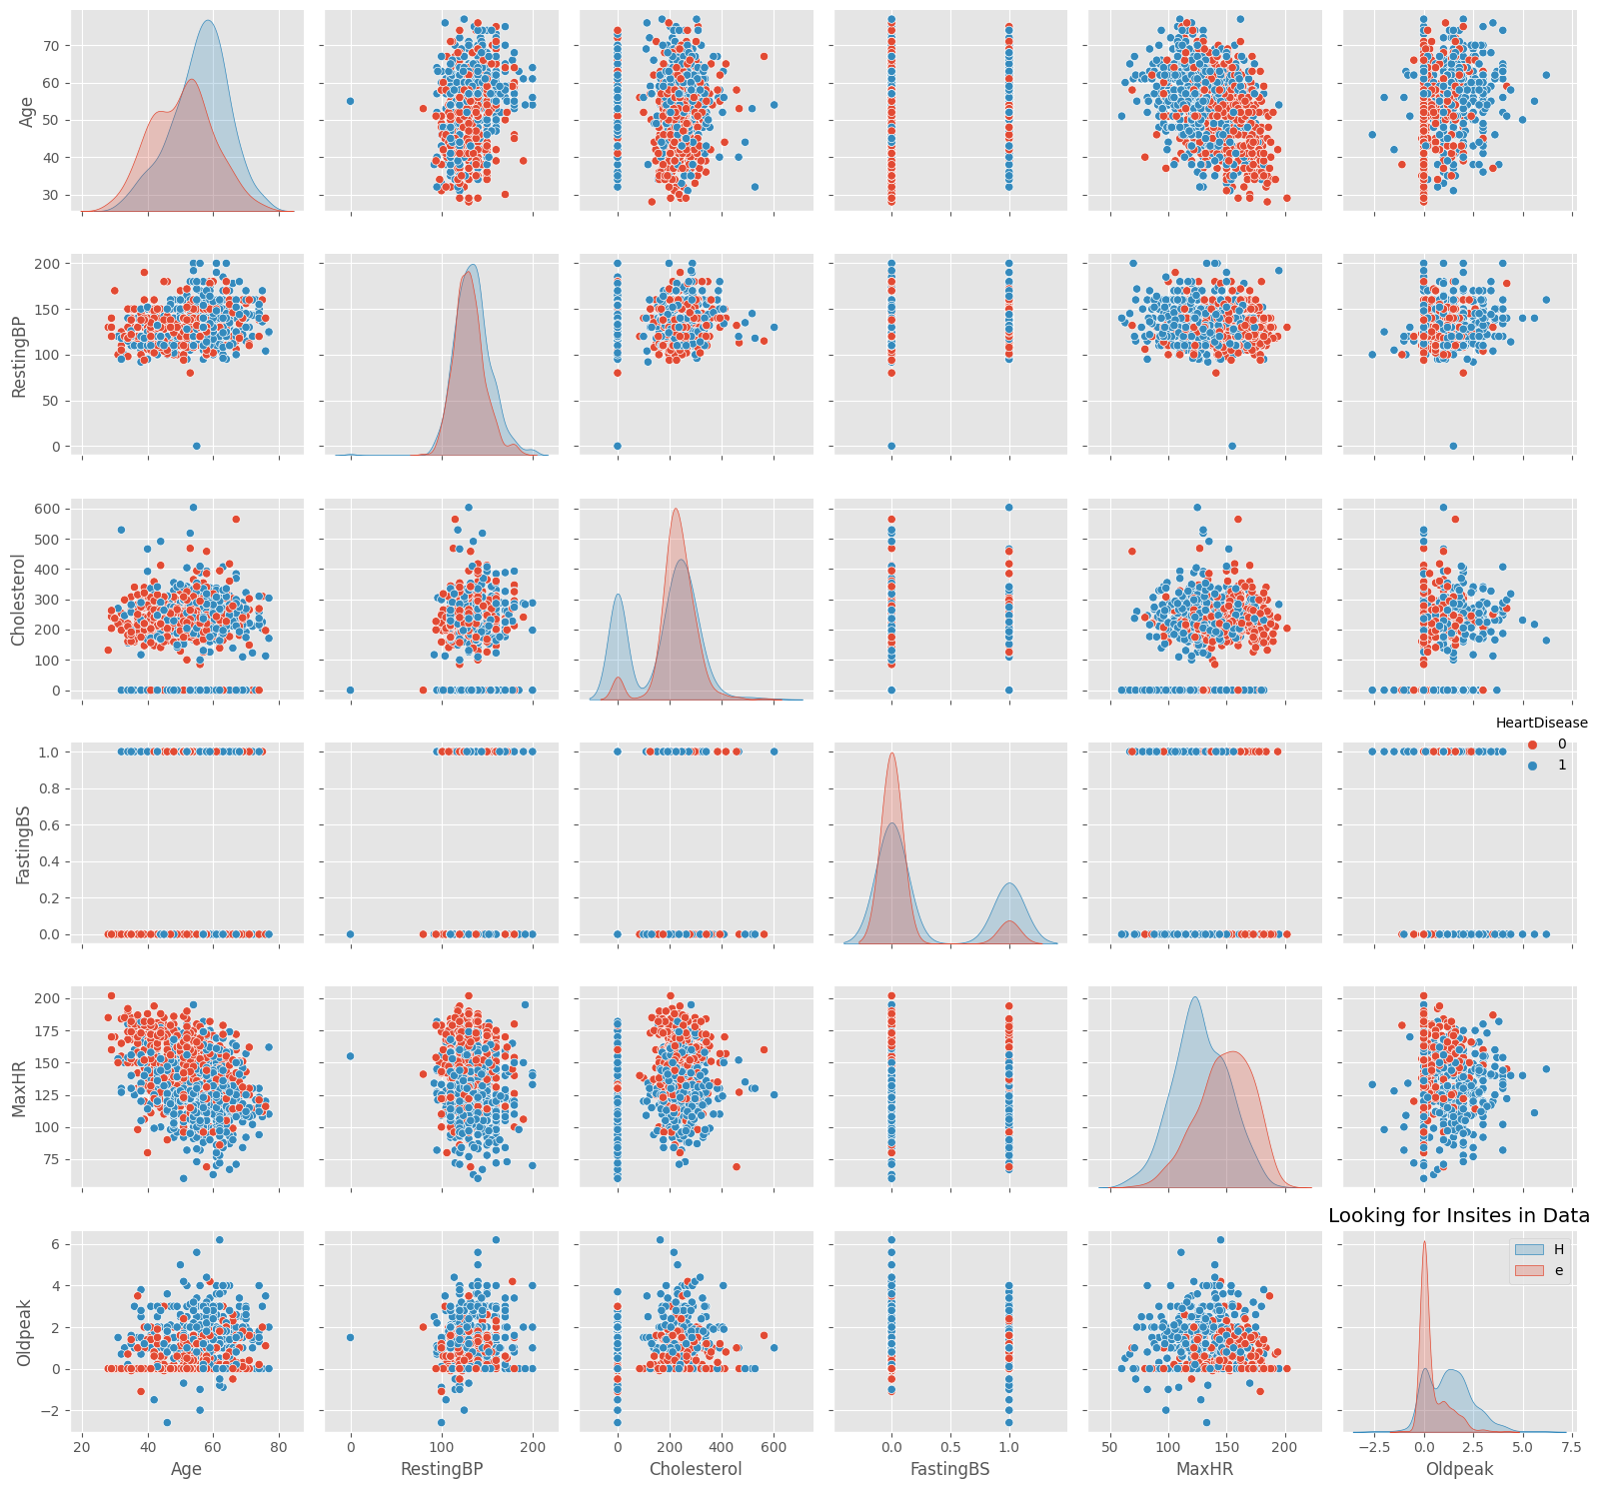
Exploratory Data Analysis
Feature Engineering - Plotting the graph for all the values

Slide 9
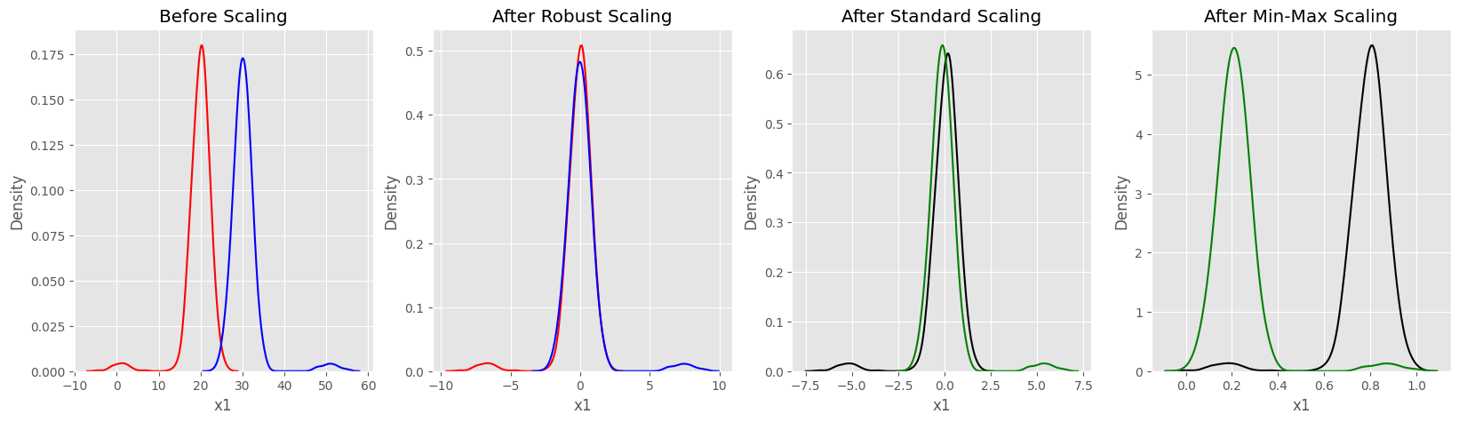
Exploratory Data Analysis
Feature Engineering - Normalisation

Slide 10
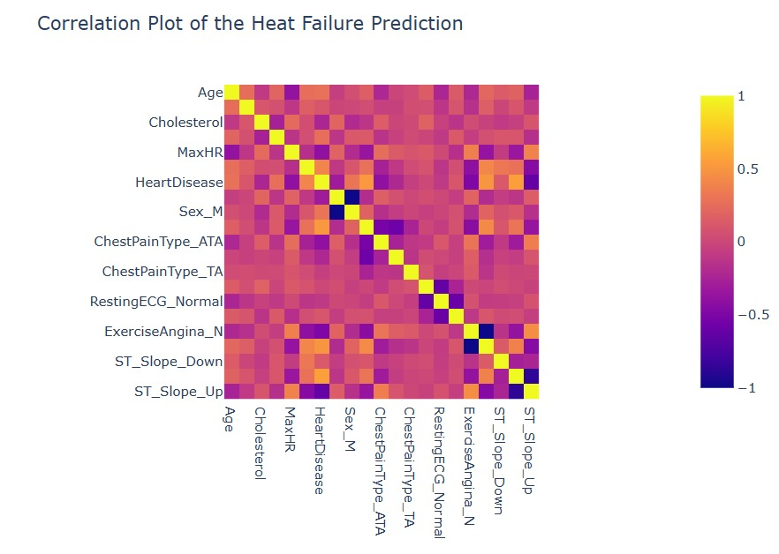
Exploratory Data Analysis
Feature Engineering - Correlation Heart failure

Slide 11
Exploratory Data Analysis
Box Plots for Heart Disease Analysis
In this analysis, we employ box plots, a powerful visualization tool, to gain insights into the distribution of key quantitative variables in relation to Heart Disease. Box plots succinctly summarize the five-number summary—minimum, first quartile, median, third quartile, and maximum—providing a comprehensive view of the dataset. The central rectangle represents the interquartile range, while whiskers extend to the minimum and maximum values.
Age vs. Heart Disease
Visualization of how age varies concerning the presence or absence of Heart Disease.
Identification of quartiles, median, and potential outliers.

Slide 12
Exploratory Data Analysis
Resting Blood Pressure vs. Heart Disease
Comparison of Resting Blood Pressure distribution based on Heart Disease status.
Utilization of color to differentiate distributions by gender.
Cholesterol vs. Heart Disease
Examination of Cholesterol distribution concerning Heart Disease.
Insights into the spread and central tendency of Cholesterol levels.
Oldpeak and MaxHR vs. Heart Disease
Visual analysis of the distribution of Oldpeak and MaxHR in relation to Heart Disease.
Identification of patterns, outliers, and central tendencies.

Slide 13
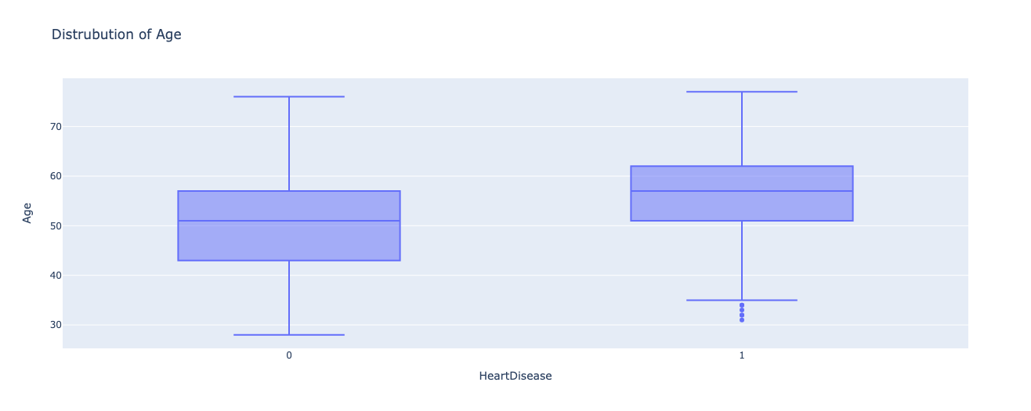
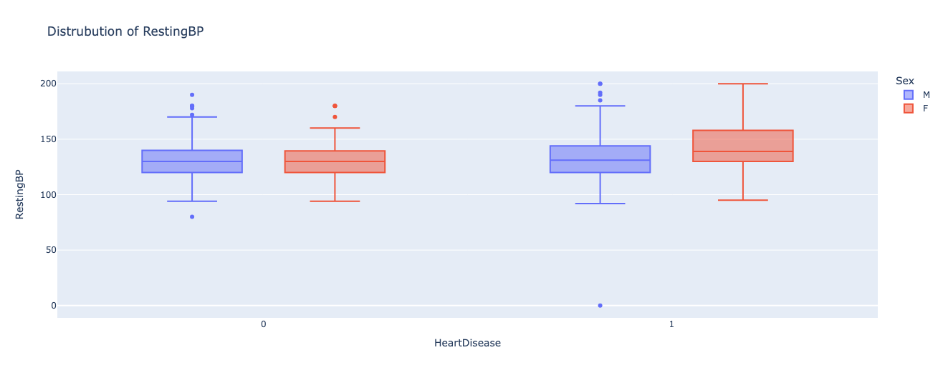
Exploratory Data Analysis
Box Plot for the required variables

Slide 14
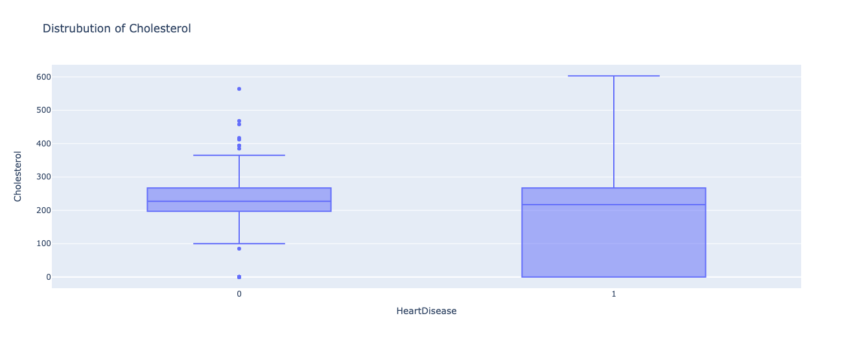
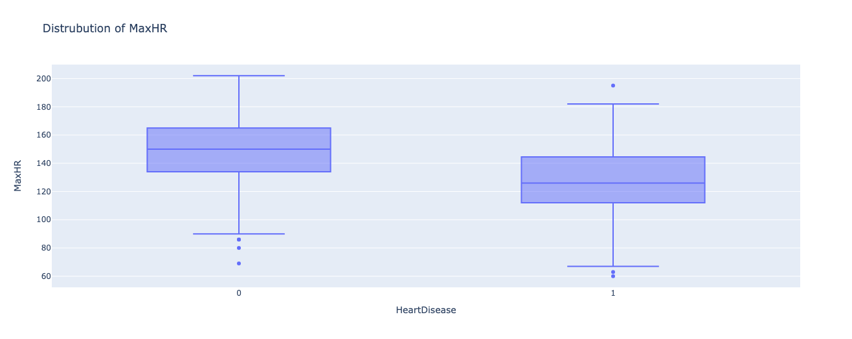
Exploratory Data Analysis

Slide 15
Exploratory Data Analysis
Pair Plot for the required variables
The diagram graphs pairs of numerical data, with one numerical data, with one variable on each axis, to look for a relationship between them.
If the variables are correlated, the points will fall along a line or curve.
The better the correlation, the tighter the points will hug the line.

Slide 16
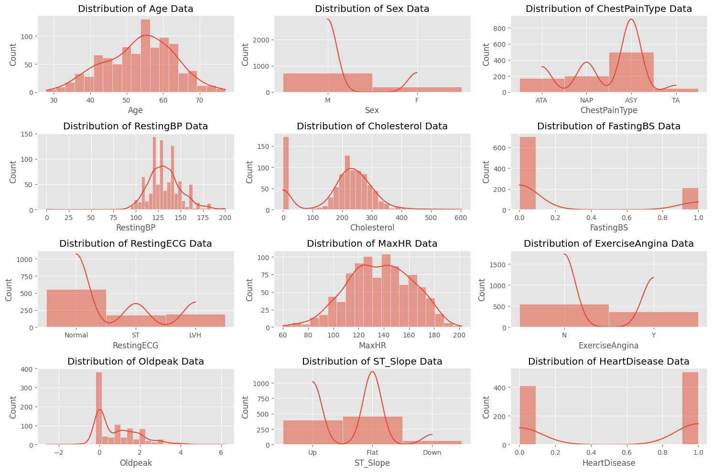
Exploratory Data Analysis
Histogram Plot for the required variables

Slide 17
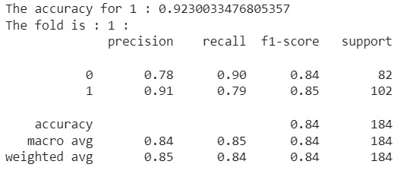
KNN Methodology
Accuracy ~ 92.30%

Slide 18
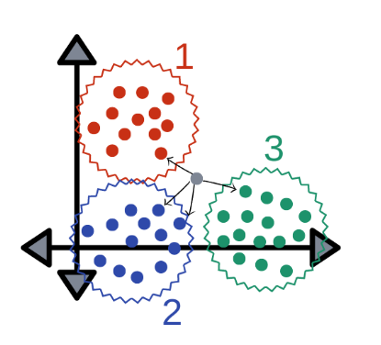
Distance based
Accuracy ~ 84.79%

Slide 19
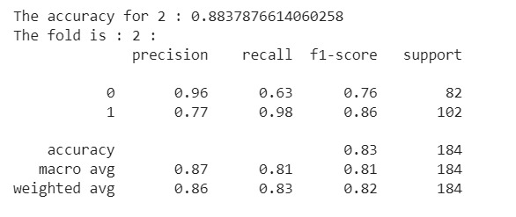
Gaussian Naive Bayes
Accuracy ~ 88.37%

Slide 20
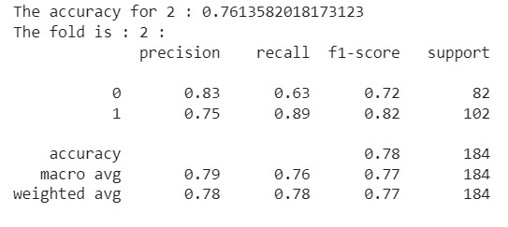
Decision Trees (CART)
Accuracy ~ 76.13%

Slide 21
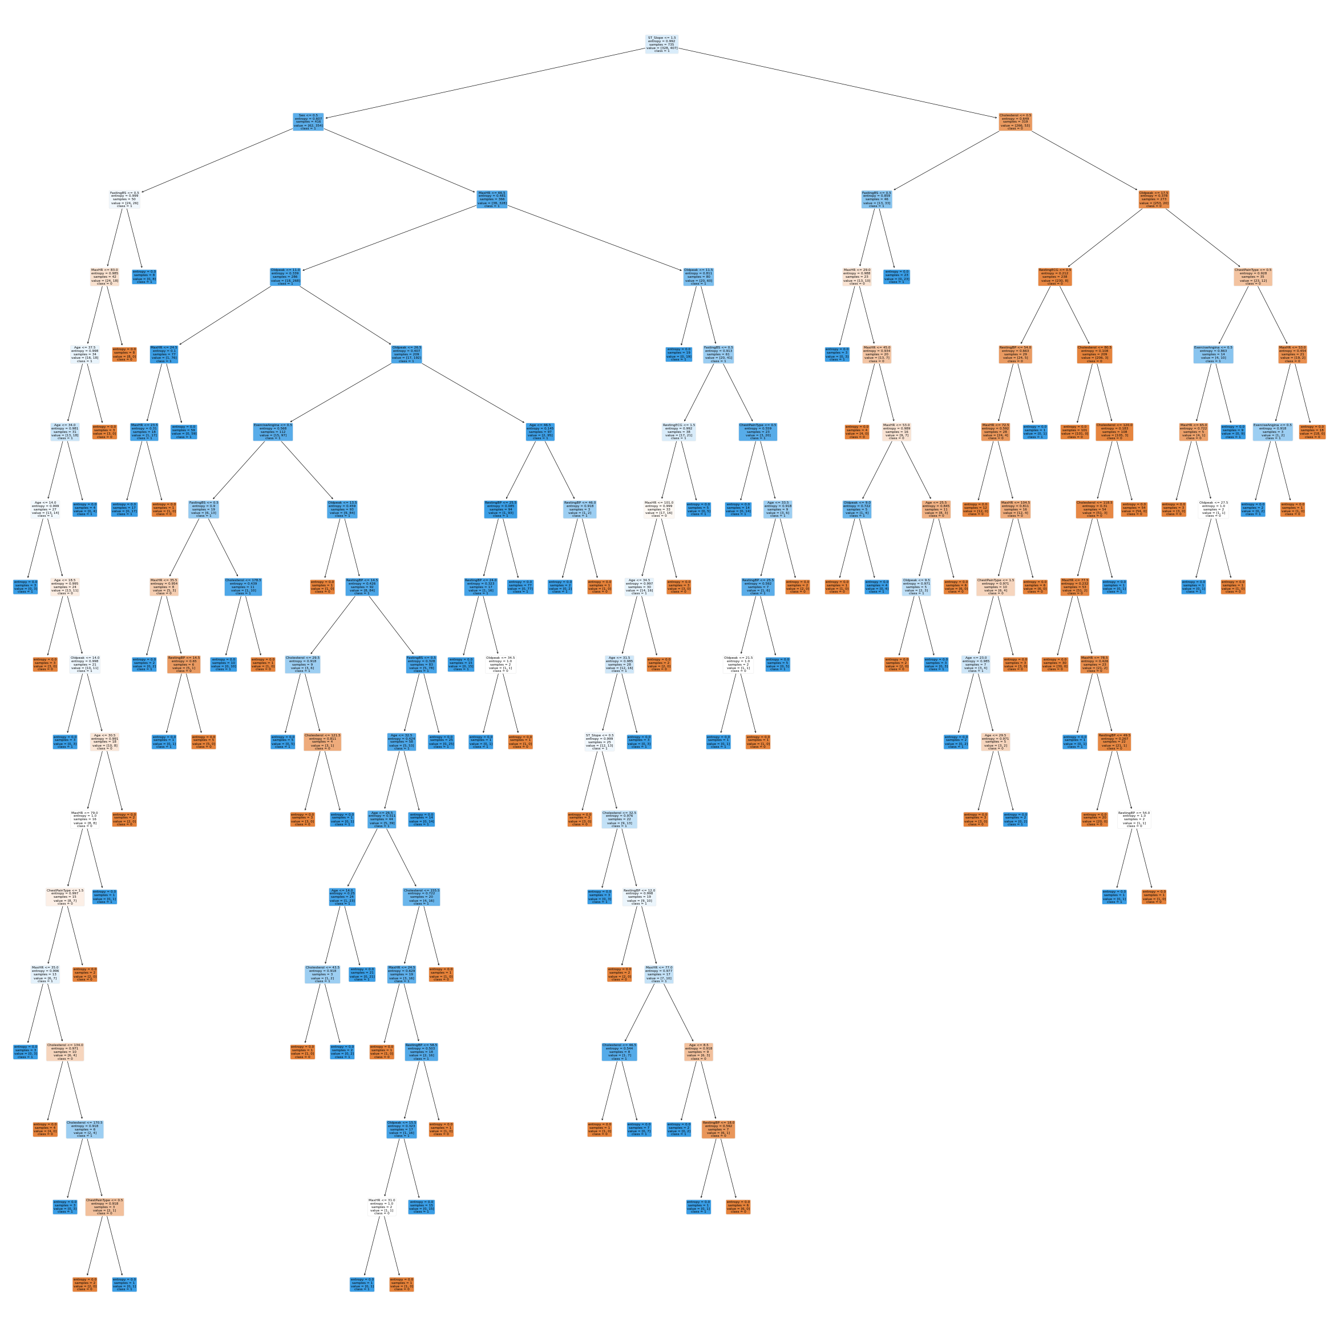
Tree Based Algorithm

Slide 22
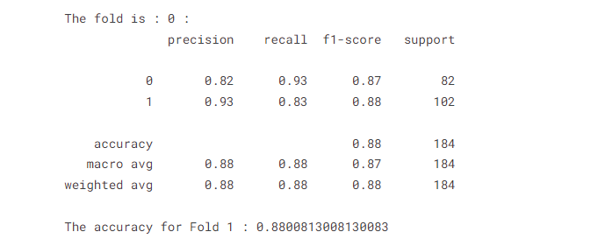
Non Tree based
Using Logistic Regression
Accuracy ~ 88.00%

Slide 23
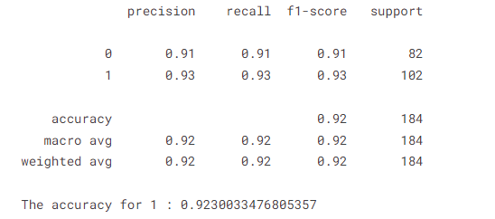
Using K-nearest Neighbors
Accuracy ~ 92.30%

Slide 24
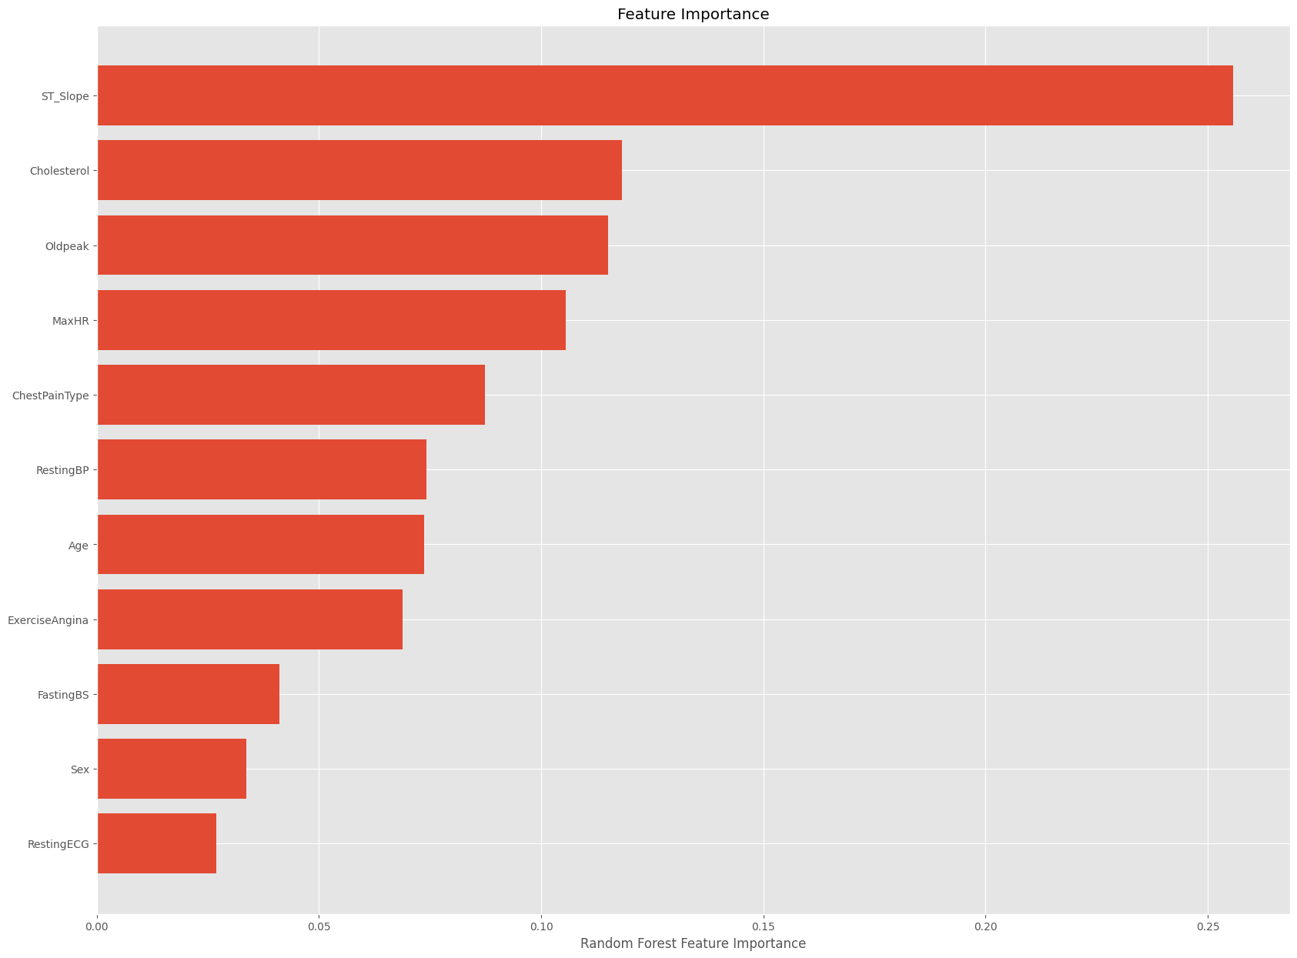
Random Forest Feature Importance

Slide 25
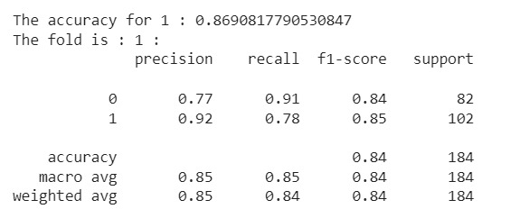
SVM Methodology
Accuracy ~ 86.90%

Slide 26
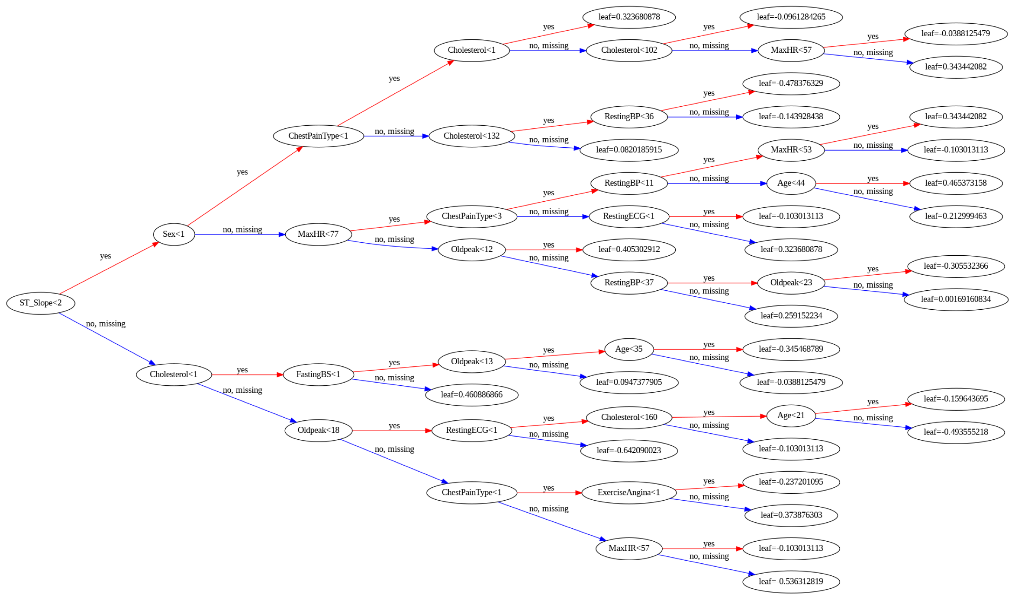
XG Boost

Slide 27
Conclusion and Insights
In summary, this presentation highlights the alarming global impact of cardiovascular diseases (CVDs), responsible for 17.9 million deaths annually. With heart attacks and strokes causing four out of five CVD deaths, early detection is crucial. The dataset, focused on predicting heart disease, features 11 key factors.
The talk emphasizes the significance of data preprocessing, showcasing methods to identify and handle missing values. Practical examples of imputation techniques, like SimpleImputer, are presented. The importance of feature scaling is discussed, with insights into normalization and standardization using code snippets. Categorical variable handling is demonstrated through Label Encoding and One-Hot Encoding methods, providing essential tools for refining datasets in the context of cardiovascular disease prediction.

Slide 28
THE END

