Slide 1
Семейство операторов Join
«Базы данных и экспертные системы»
Сергей Сергеевич Гребенкин
Сергей Константинович Муравьев

Slide 2
запрос
Select R1.*,R2.*
From R1 Join R2 On R1.x=R2.y
Where условие

Slide 3
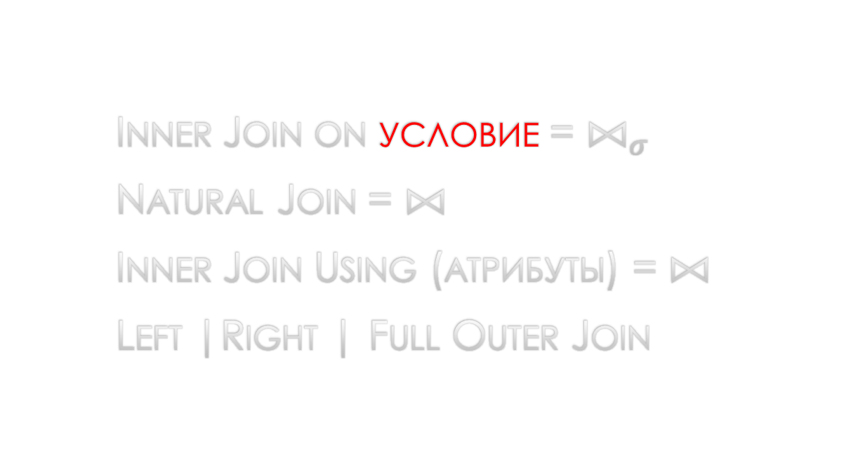
Запрос inner join on условие
Inner Join on условие = $⨝_{σ}$
Natural Join = ⨝
Inner Join Using (атрибуты) = ⨝
Left |Right | Full Outer Join

Slide 4
join
select distinct sname, major
from Student,Apply
where Student.sID = Apply.sID

Slide 5
join
select distinct sname, major
from Student inner join Apply
on Student.sID = Apply.sID

Slide 6
join
select distinct sname, major
from Student join Apply
on Student.sID = Apply.sID

Slide 7
join
select distinct sname, major
from Student join Apply
on Student.sID = Apply.sID
where sizeHS < 1000 and major=‘CS’ and uName = ‘MEPHI’

Slide 8
join
select distinct sname, major
from Student join Apply
on Student.sID = Apply.sID and sizeHS < 1000 and major=‘CS’ and uName = ‘MEPHI’

Slide 9
join
select Apply.sID, sName, GPA, Apply.uName, enrollemnt
from Student, Apply, University
on Student.sID = Apply.sID and Apply.uName=University.uName

Slide 10
join
select Apply.sID, sName, GPA, Apply.uName, enrollemnt
from
(Student join Apply on Apply.sID=Student.sID)
join University
on Apply.uName=University.uName

Slide 11
join
select distinct sname, major
from Student inner join Apply
on Student.sID = Apply.sID

Slide 12
join
select * from Student natural join Apply

Slide 13
join
select sID from Student natural join Apply

Slide 14
join
select sID from Student, Apply

Slide 15
Join using
select * from Student join Apply using(sID)
where
sizeHS < 1000 and
major=‘cs’ and
uName=‘MEPHI’

Slide 16
Left outer join
select * from Student left outer join
Apply using(sID)

