Slide 1
Machine Learning
Lecture 2: Algebra and Calculus Review
Dr. Beilun Wang
Southeast University
School of Computer Science
and Engineering

Slide 2
Notation
Inputs
X, X_{j} (jth element of vector X ) : random variables written in capital letter
p #input variables, n #observations
X : matrix written in bold capital
Vectors are assumed to be column vectors
Discrete inputs often described by characteristic vector (dummy variables)

Slide 3
Notation
Outputs
quantitative Y
qualitative C (for categorical)
Observed variables written in lower case
The i-th observed value of X_{j} is X_{j,i} (a scalar)

Slide 4
DEFINITIONS - SCALAR
a scalar is a number
(denoted with regular type: 1 or 22)

Slide 5


DEFINITIONS - VECTOR
Vector: a single row or column of numbers
denoted with bold small letters
row vector
column vector (default)

Slide 6

DEFINITIONS - VECTOR
Vector in real space R^{n} is an ordered set of n real numbers.
– e.g. v = (1,6,3,4)^{T} is in R⁴
A column vector:
v^{T} as a row vector:
(1 6 3 4)

Slide 7
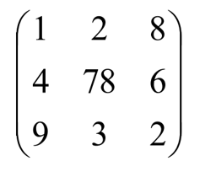
DEFINITIONS - MATRIX
m-by-n matrix in R^{mxn} with m rows and n columns, each entry filled with a (typically) real number:
e.g. 3*3 matrix
Square matrix

Slide 8

DEFINITIONS - MATRIX
We normally write the entry of a matrix as
Denoted with a Capital letter
All matrices have an order (or dimension):
that is, the number of rows * the number of columns.
So, A is 2 by 3 or (2 * 3).
A square matrix is a matrix that has the same number of rows and columns (n * n)

Slide 9
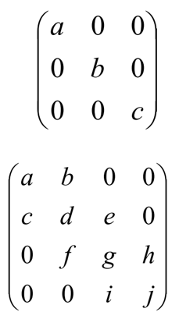
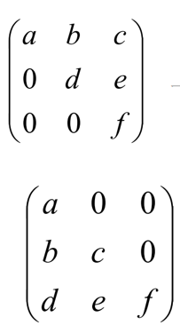
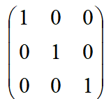
Special matrices
diagonal
upper-triangular
tri-diagonal
lower-triangular
I (identity matrix)

Slide 10

Special matrices: Symmetric Matrices
e.g.:

Slide 11
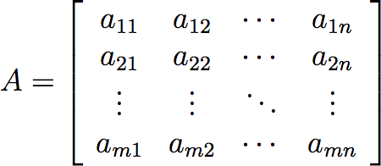

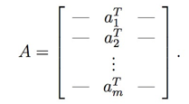
Column or Row Views to Denote
We denote the jth column of A by
a_{j} or A_{:,j}:
We denote the ith row of A by a_{i}^{T} or A_{i,:}:
Note that these definitions are ambiguous(e.g. the a₁ and a₁^{T} in the previous two definitions are not the same vector). Usually the meaning of the notation should be obvious from its use.

Slide 12
Review of MATRIX OPERATIONS
Transposition
Addition and Subtraction
Multiplication
Norm (of vector)
Matrix Inversion
Matrix Rank
Matrix calculus

Slide 13
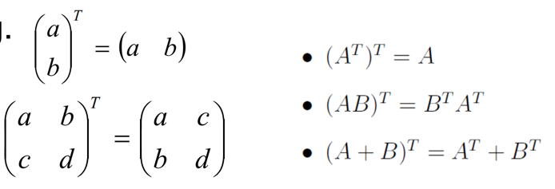
(1) Transpose
Transpose: You can think of it as
“flipping” the rows and columns
e.g.

Slide 14
(2) Matrix Addition/Subtraction
Matrix addition/subtraction
Matrices must be of same size.
Entry-wise operation across all entries

Slide 15
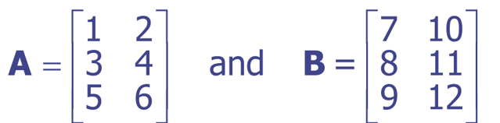
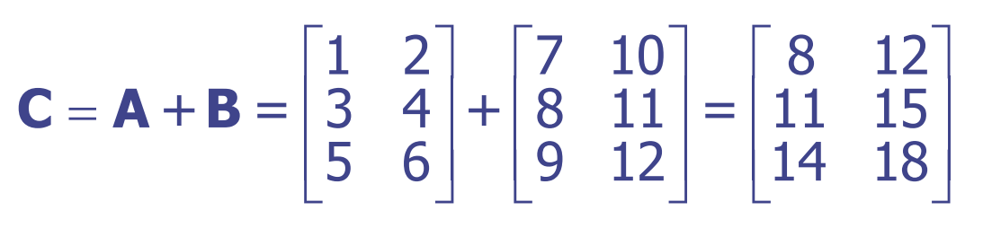
(2) Matrix Addition/Subtraction An Example
If we have
then we can calculate C = A + B by

Slide 16
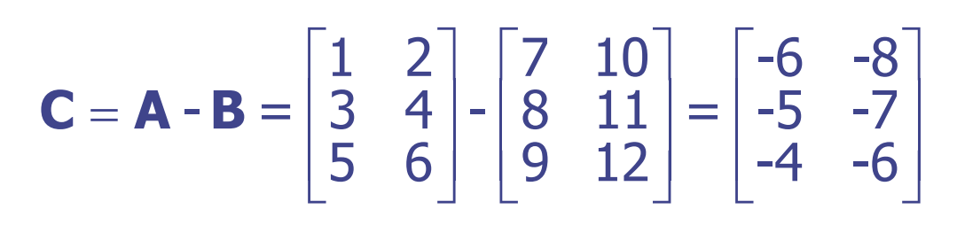
(2) Matrix Addition/Subtraction An Example
Similarly, if we have
then we can calculate C = A - B by

Slide 17
OPERATION on MATRIX
Transposition
Addition and Subtraction
Multiplication
Norm (of vector)
Matrix Inversion
Matrix Rank
Matrix calculus

Slide 18
(3) Products of Matrices
We write the multiplication of two matrices A and B as AB
This is referred to either as
pre-multiplying B by A
or
post-multiplying A by B
So for matrix multiplication AB, A is referred to as the premultiplier and B is referred to as the postmultiplier

Slide 19
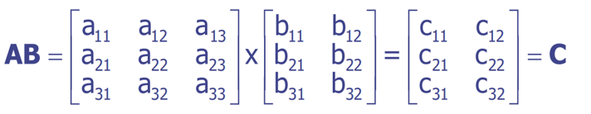
Products of Matrices
If we have A_{(3x3)} and B_{(3x2)} then
where
^{c}11 ^{= a}11^{b}11 ^{+ a}12^{b}21 ^{+ a}13^{b}31 ^{c}12 ^{= a}11^{b}12 ^{+ a}12^{b}22 ^{+ a}13^{b}32 ^{c}21 ^{= a}21^{b}11 ^{+ a}22^{b}21 ^{+ a}23^{b}31 ^{c}22 ^{= a}21^{b}12 ^{+ a}22^{b}22 ^{+ a}23^{b}32 ^{c}31 ^{= a}31^{b}11 ^{+ a}32^{b}21 ^{+ a}33^{b}31 ^{c}32 ^{= a}31^{b}12 ^{+ a}32^{b}22 ^{+ a}33^{b}32

Slide 20
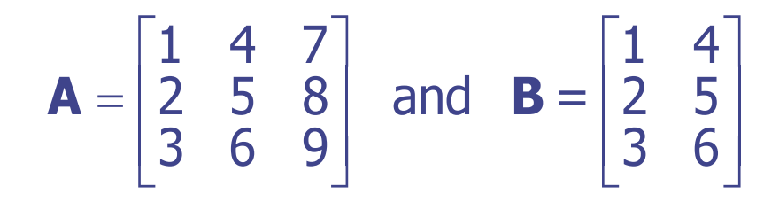
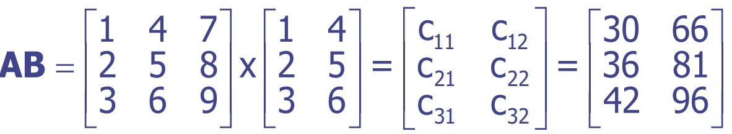
Matrix Multiplication - An Example
If we have
then
where
c₁₁ = a₁₁b₁₁ + a₁₂b₂₁ + a₁₃b₃₁ = 1 (1) + 4 (2) + 7 (3) = 30 c₁₂ = a₁₁b₁₂ + a₁₂b₂₂ + a₁₃b₃₂ = 1 (4 ) + 4 (5) + 7 (6 ) = 66 c₂₁ = a₂₁b₁₁ + a₂₂b₂₁ + a₂₃b₃₁ = 2 (1) + 5 (2) + 8 (3) = 36 c₂₂ = a₂₁b₁₂ + a₂₂b₂₂ + a₂₃b₃₂ = 2 (4 ) + 5 (5) + 8 (6 ) = 81 c₃₁ = a₃₁b₁₁ + a₃₂b₂₁ + a₃₃b₃₁ = 3 (1) + 6 (2) + 9 (3) = 42
c₃₂ = a₃₁b₁₂ + a
b + a b = 3 (4) + 6 (5) + 9 (6) =96
32 22
33 32

Slide 21
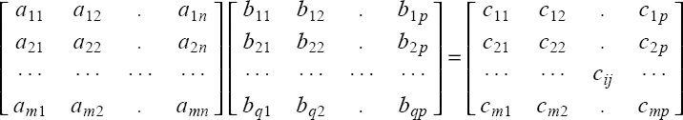

Products of Matrices
m x n
q x p
m x p
n
Condition: n = q

Slide 22
Products of Matrices: Conformable
In order to multiply matrices, they must be conformable (the number of columns in the premultiplier must equal the number of rows in postmultiplier)
Note that
an (m x n) x (n x p) = (m x p)
an (m x n) x (p x n) = cannot be done
a (1 x n) x (n x 1) = a scalar (1 x 1)

Slide 23
Some Properties of Matrix Multiplication
Note that
Even if conformable, AB does not necessarily equal BA (i.e., matrix multiplication is not commutative)
Matrix multiplication can be extended beyond two matrices
matrix multiplication is associative, i.e.,
A(BC) = (AB)C

Slide 24
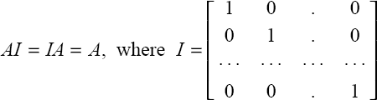
Some Properties of Matrix Multiplication
Multiplication and transposition
(AB)^{T} = B^{T}A^{T}
Multiplication with Identity Matrix

Slide 25
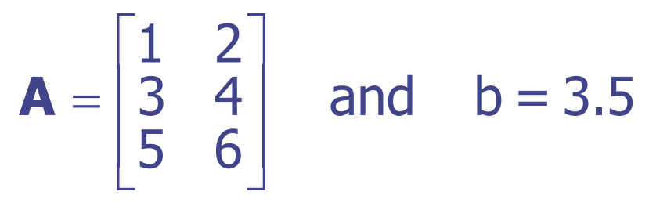
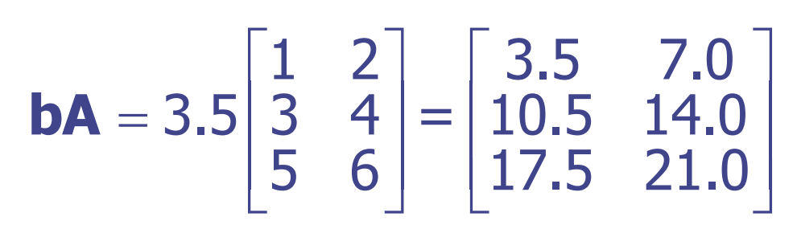
Special Uses for Matrix Multiplication
Products of Scalars & Matrices ➔ Example, If we have
then we can calculate bA by
Note that bA = Ab if b is a scalar

Slide 26
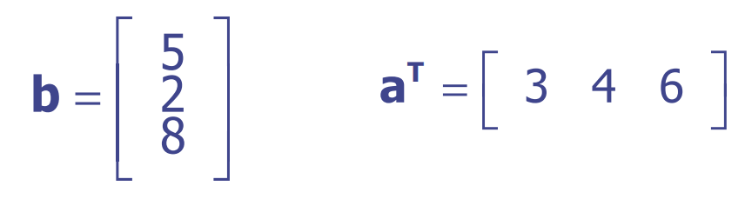
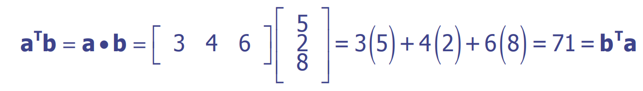
Special Uses for Matrix Multiplication
Dot (or Inner) Product of two Vectors
Premultiplication of a column vector a by conformable row vector b yields a single value called the dot product or inner product
-If
then their inner product gives us
which is the sum of products of elements in similar positions for the two vectors

Slide 27
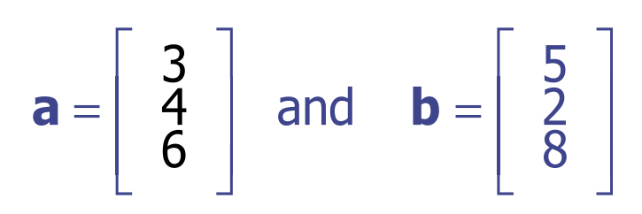
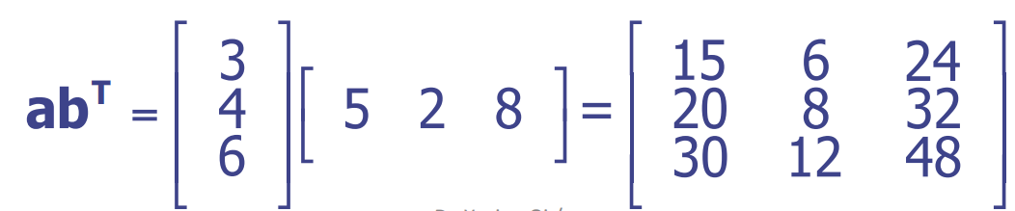
Special Uses for Matrix Multiplication
Outer Product of two Vectors
Postmultiplication of a column vector a by conformable row vector b yields a matrix containing the products of each pair of elements from the two matrices (called the outer product)
- If
then ab^{T} gives us

Slide 28
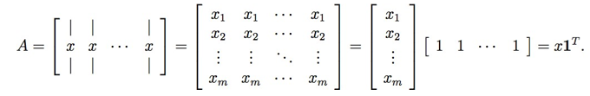
Special Uses for Matrix Multiplication
Outer Product of two Vectors, e.g. a special case :
As an example of how the outer product can be useful, let 1 ∈ R^{n} denote an n-dimensional vector whose entries are all equal to 1. Furthermore, consider the matrix A ∈ R^{mxn} whose columns are all equal to some vector x ∈ R^{m} . Using outer products, we can represent A compactly as,

Slide 29
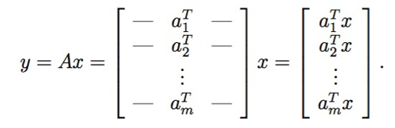
Special Uses for Matrix Multiplication
Matrix-Vector Products (I)
Given a matrix A ∈ R^{mxn} and a vector x ∈ R^{n} , their product is a vector y = Ax ∈ R^{m}
If we write A by rows, then we can express Ax as,

Slide 30
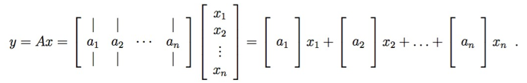
Special Uses for Matrix Multiplication
Matrix-Vector Products (II)
Alternatively, let’s write A in column form. In this case we see that,
In other words, y is a linear combination of the columns of A, where the coefficients of the linear combination are given by the entries of x.

Slide 31

Special Uses for Matrix Multiplication
Matrix-Vector Products (III)
To multiply on the left by a row vector. This is written, y^{T} = x^{T} A for A ∈ R^{mxn}, x ∈ R^{m}, and y ∈ R^{n}.
Which demonstrates that the ith entry of y^{T} is equal to the inner product of x and the ith column of A.

Slide 32
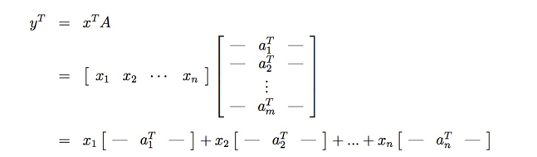
Special Uses for Matrix Multiplication
Matrix-Vector Products (IV)
So we see that y^{T} is a linear combination of the rows of A, where the coefficients for the linear combination are given by the entries of x.

Slide 33
MATRIX OPERATIONS
Transposition
Addition and Subtraction
Multiplication
Norm (of vector)
Matrix Inversion
Matrix Rank
Matrix calculus

Slide 34


(4) Vector norms
A norm of a vector ||x|| is informally a measure of the “length” of the vector.
Common norms: L₁, L₂ (Euclidean)
^{L}infinity

Slide 35

Vector Norm
(L2, when p=2)

Slide 36
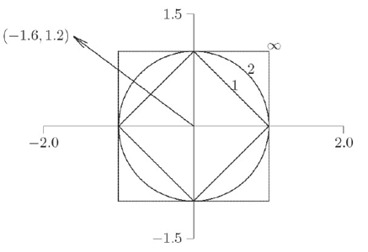


Vector Norms (e.g.,)
Draw shows unit sphere in two dimensions for each norm
Norms have following values for vector shown
In general, for any vector x in ,

Slide 37





More General : Norm
A norm is any function g() that maps vectors to real numbers that satisﬁes the following conditions:
Non-negativity：for all , ,
Strictly positive：for all , implies that x = 0
Homogeneity：for all x and a, , where |a| is the absolute value.
Triangle inequality：for all

Slide 38
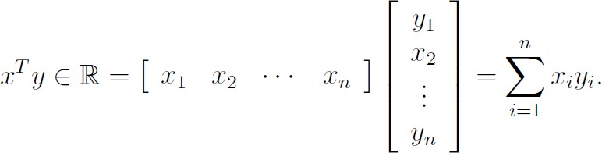
Orthogonal & Orthonormal
Inner Product defined between column vector x and y , as
If u•v=0, ||u||₂ != 0, ||v||₂ != 0
→ u and v are orthogonal
If u•v=0, ||u||₂ = 1, ||v||₂ = 1
→ u and v are orthonormal
= x•y

Slide 39
Orthogonal matrices
If square A is orthogonal, it is easy to find its inverse:
Property:

Slide 40
Matrix Norm
Definition: Given a vector norm ||x||, the matrix norm defined by the vector norm is given by:
A = max ^{Ax}
x≠0
x
What does a matrix norm represent?
It represents the maximum “stretching” that A does to a vector x -> (Ax).

Slide 41
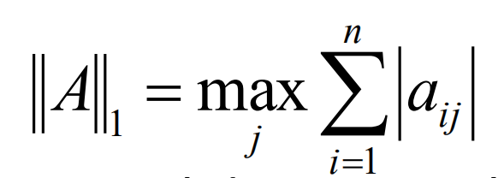
Matrix 1- Norm
Theorem A: The matrix norm corresponding to 1-norm is maximum absolute column sum:
Proof: From previous slide, we can have
A = max Ax
1
x =1
1
n
Ax = x A + x A +! + x A = ∑ x A
Also,
1 1 2 2 n n j j
where A_{j} is the j-th column of A.
j =1

Slide 42
MATRIX OPERATIONS
Transposition
Addition and Subtraction
Multiplication
Norm (of vector)
Matrix Inversion
Matrix Rank
Matrix calculus

Slide 43
(5) Inverse of a Matrix
The inverse of a matrix A is commonly denoted by A⁻¹ or inv A.
The inverse of an n x n matrix A is the matrix A⁻¹ such that AA⁻¹ = I = A⁻¹A
The matrix inverse is analogous to a scalar reciprocal
A matrix which has an inverse is called nonsingular

Slide 44
(5) Inverse of a Matrix
For some n x n matrix A , an inverse matrix A⁻¹ may not exist.
A matrix which does not have an inverse is singular.
An inverse of n x n matrix A exists if |A| not 0

Slide 45
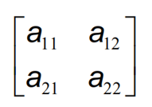
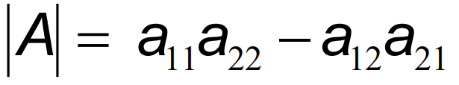
THE DETERMINANT OF A MATRIX
The determinant of a matrix A is denoted by |A| (or det(A) or det A).
Determinants exist only for square matrices.
E.g. If A =

Slide 46



THE DETERMINANT OF A MATRIX
2 x 2
3 x 3
n x n

Slide 47

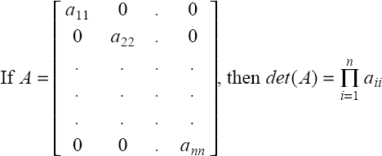
THE DETERMINANT OF A MATRIX
diagonal matrix:

Slide 48
HOW TO FIND INVERSE MATRIXES?
⎡a
^{b ⎤}
If
A =
⎢_{c d} ⎥
and |A| not 0
⎣ ⎦
_{A}-1
1
⎡ d − b⎤
=
_{a} ⎥
det( A)
⎢− c
⎣
⎦

Slide 49
Matrix Inverse
The inverse A⁻¹ of a matrix A has the property:
AA⁻¹=A⁻¹A=I
A⁻¹ exists if only if
Terminology
Singular matrix: A⁻¹ does not exist
Ill-conditioned matrix: A is close to being singular

Slide 50
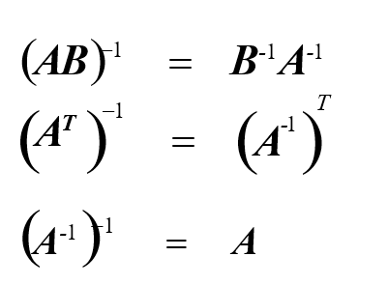
PROPERTIES OF INVERSE MATRICES

Slide 51


Inverse of special matrix
For diagonal matrices
For orthogonal matrices
a square matrix with real entries whose columns and rows are orthogonal unit vectors (i.e., orthonormal vectors)

Slide 52
Pseudo-inverse
The pseudo-inverse A⁺ of a matrix A (could be non-square, e.g., m×n) is given by:
It can be shown that:

Slide 53
MATRIX OPERATIONS
Transposition
Addition and Subtraction
Multiplication
Norm (of vector)
Matrix Inversion
Matrix Rank
Matrix calculus

Slide 54
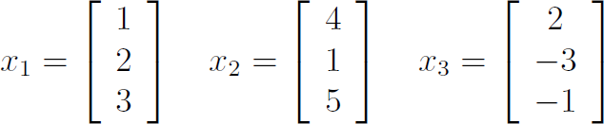
(6) Rank: Linear independence
A set of vectors is linearly independent if none of them can be written as a linear combination of the others.
x₃ = −2 x₁ + x₂
➔ NOT linearly independent

Slide 55
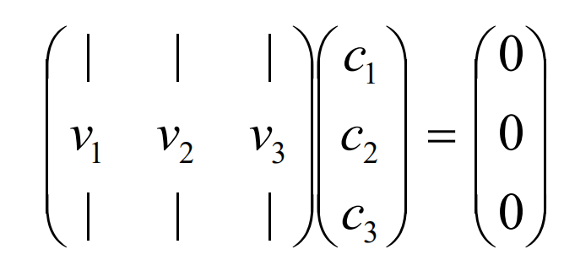
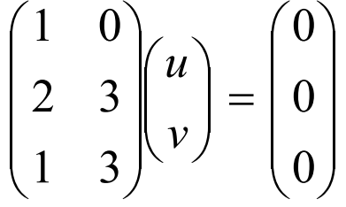
(6) Rank: Linear independence
Alternative definition: Vectors v₁,…,v_{k} are linearly
independent if c₁v₁+…+c_{k}v_{k} = 0 implies c₁=…=c_{k}=0
e.g.
(u,v)=(0,0), i.e. the columns are linearly independent.

Slide 56
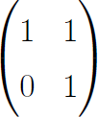
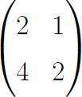
(6) Rank of a Matrix
rank(A) (the rank of a m-by-n matrix A) is
= The maximal number of linearly independent columns
=The maximal number of linearly independent rows
If A is n by m, then
rank(A)<= min(m,n)
Rank=?
Rank=?
If n=rank(A), then A has full row rank
If m=rank(A), then A has full column rank

Slide 57
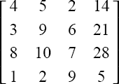

(6) Rank of a Matrix
Equal to the dimension of the largest square sub-matrix of A that has a non-zero determinant.
Example:
has rank 3

Slide 58
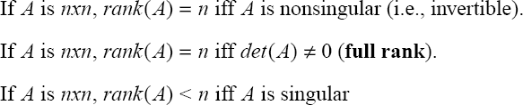
(6) Rank and singular matrices
rank(AB) <= min( rank(A), rank(B) )
We can use row reduction to calculating Rank of a matrix

Slide 59
MATRIX OPERATIONS
Transposition
Addition and Subtraction
Multiplication
Norm (of vector)
Matrix Inversion
Matrix Rank
Matrix calculus

Slide 60
Review: Derivative of a Function
_{lim} f (a + h) − f (a)
is called the derivative of f at a.
h→0
h
_{f ′( x) = lim} f ( x + h) − f ( x)
We write:
h→0
h
“The derivative of f with respect to x is …”
y = f ( x)
There are many ways to write the derivative of
➔ e.g. define the slope of the curve y=f(x) at the point x

Slide 61
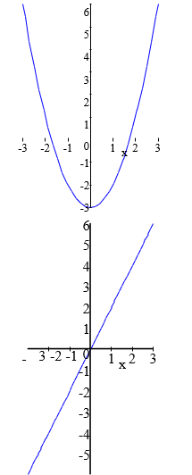
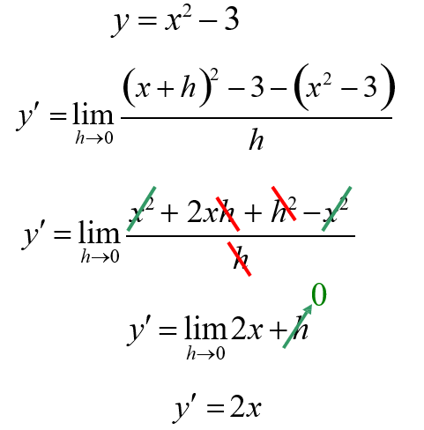
Review: Derivative of a Quadratic Function

Slide 62
Single Var-Func to Multivariate
Single Var- Function | Multivariate Calculus
Derivative | Partial Derivative
Second-order | Gradient
derivative | Directional Partial Derivative
 | Vector Field
 | Contour map of a function
 | Surface map of a function
 | Hessian matrix
 | Jacobian matrix (vector in / vector out)

Slide 63
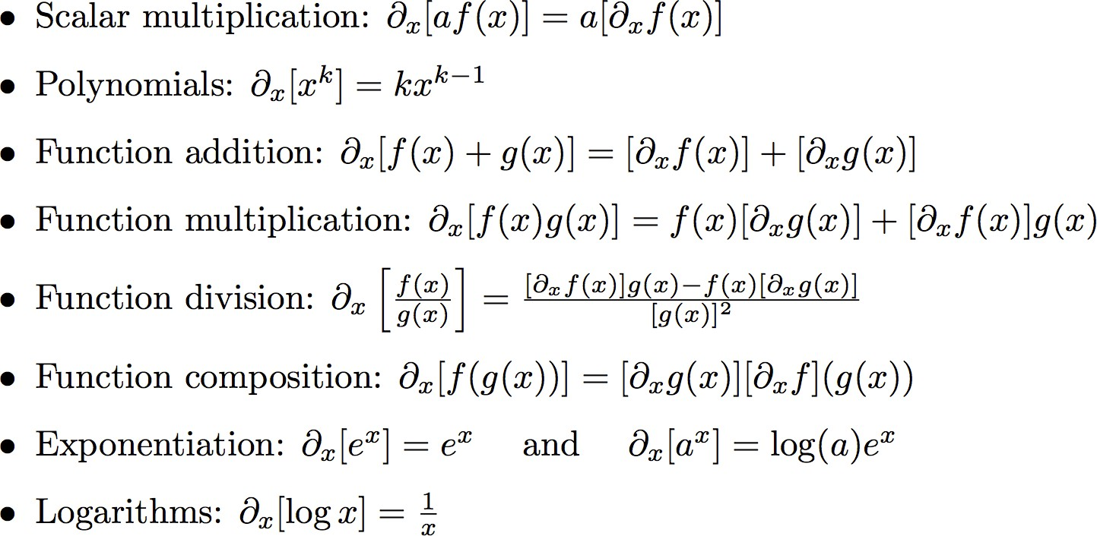
Some important rules for taking (partial) derivatives

Slide 64
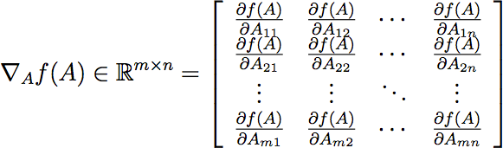
Review: Definitions of gradient
(Matrix_calculus Scalar-by-matrix)
➔ Denominator layout
In principle, gradients are a natural extension of partial derivatives to functions of
multiple variables.

Slide 65
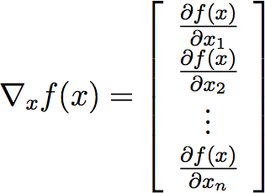


Review: Definitions of gradient
(Matrix_calculus Scalar-by-matrix)
Size of gradient is always the same as the size of variable
➔ Denominator layout
if

Slide 66




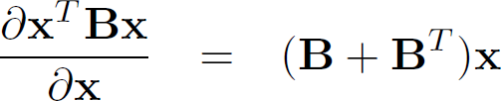
Examples

Slide 67
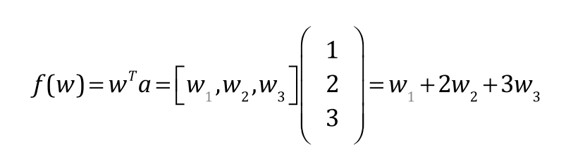

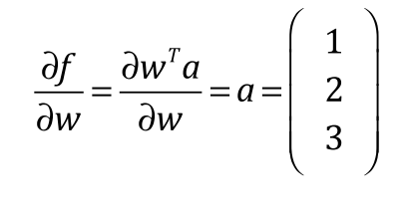


Exercise: a simple example
➔ Denominator layout

Slide 68
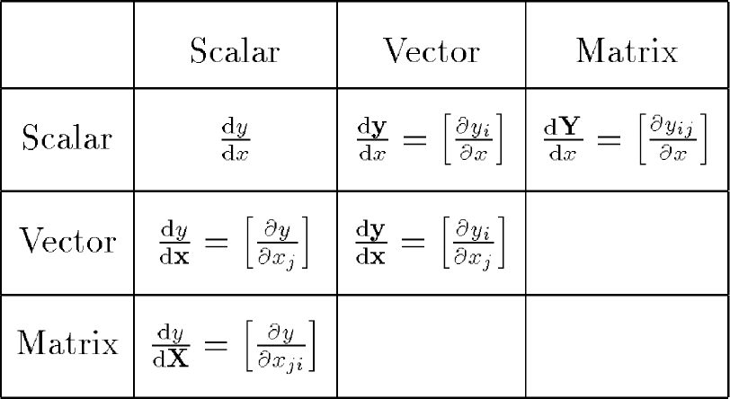
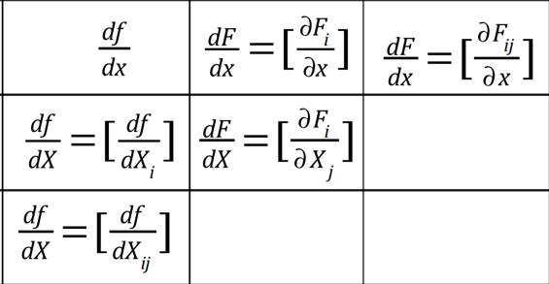

Even more general Matrix Calculus: Types of Matrix Derivatives
df
^{dF} =[ ^{∂Fi} ]
dx ∂x
^{dF} =[ ^{∂Fij} ]
dx ∂ x
dx
dF _{=[} ^{∂F}i ]
dX ∂ X _{j}
df _{=[} df ]
dX dX_{i}
df _{=[} df ]
dX dX_{ij}
Adapted from Thomas Minka. Old and New Matrix Algebra Useful for Statistics

Slide 69
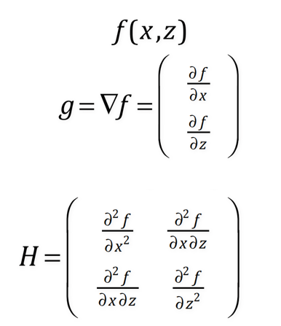
Review: Hessian Matrix / n=2 case
Singlevariate → multivariate
1st derivative to gradient
2nd derivative to Hessian

Slide 70

Review: Hessian Matrix

Slide 71
Today Recap
Linear Algebra and Matrix Calculus Review
Transposition
Addition and Subtraction
Multiplication
Norm (of vector)
Matrix Inversion
Matrix Rank
Matrix calculus

Slide 72
Extra
The following topics are covered by handout, but not by this slide (some will be covered …)
Trace()
Eigenvalue / Eigenvectors
Positive definite matrix , Gram matrix
Quadratic form
Projection (vector on a plane, or on a vector)

Slide 73
References
http://www.cs.cmu.edu/~zkolter/course/linalg/index.html
Prof. James J. Cochran’s tutorial slides “Matrix Algebra Primer II”
http://www.cs.cmu.edu/~aarti/Class/10701/recitation/LinearAlgebra_M atlab_Rev iew.ppt
Prof. Alexander Gray’s slides
Prof. George Bebis’ slides
Prof. Hal Daum ́e III’ notes
Khan Academy
https://qiyanjun.github.io/2019f-UVA-CS6316-MachineLearning/

Slide 74
Thanks for listening

