Slide 1

Machine Learning
Lecture 3:
Linear Regression Basics
Dr. Beilun Wang
Southeast University
School of Computer Science
and Engineering

Slide 2


Roadmap

Slide 3

An example: housing forecast in Boston

Slide 4
An example: housing forecast in Boston
Dataset: 14 features about houses in suburban Boston
feature | description | type
CRIM | Crime rate | continuous
ZN | Proportion of residential land covering more than 25,000 square feet | continuous
INDUS | Proportion of non-retail commercial land | continuous
CHAS | Whether near the Charles River or not | discrete
NOX | Nitric oxide concentration | continuous
… | … | …
MEDV | Median of comparable home prices | continuous

Slide 5
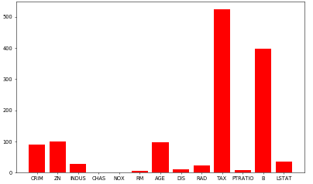
An example: housing forecast in Boston
Dataset: 14 features about houses in suburban Boston
feature scale

Slide 6
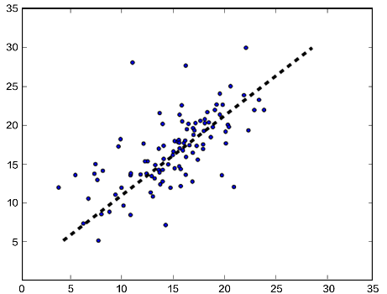

An example: housing forecast in Boston
Thus, our model can be:
$$\hat{Y}=ω_{1}X_{1}+ω_{2}X_{2}+…+ω_{13}X_{13}+b$$
housing forecast in Boston
forecast price
($1000)
actual price ($1000)

Slide 7
Why linear first?
Simple form
Rich theory support
Interpretable
…

Slide 8
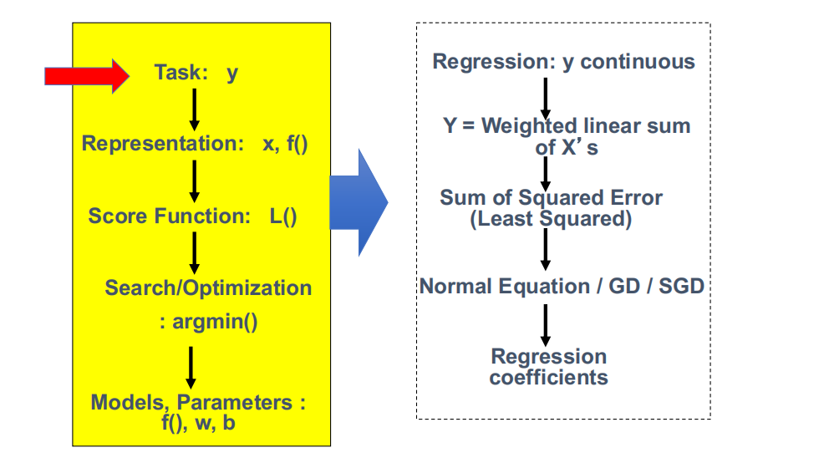
Today: Multivariate Linear Regression in a Nutshell

Slide 9
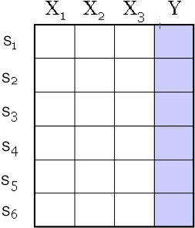

A Dataset
for regression
continuous valued variable
Data/points/instances/examples/samples/records: [ rows ]
Features/attributes/dimensions/independent variables/covariates/predictors/regressors: [ columns, except the last]
Target/outcome/response/label/dependent variable: special column to be predicted [ last column ]

Slide 10
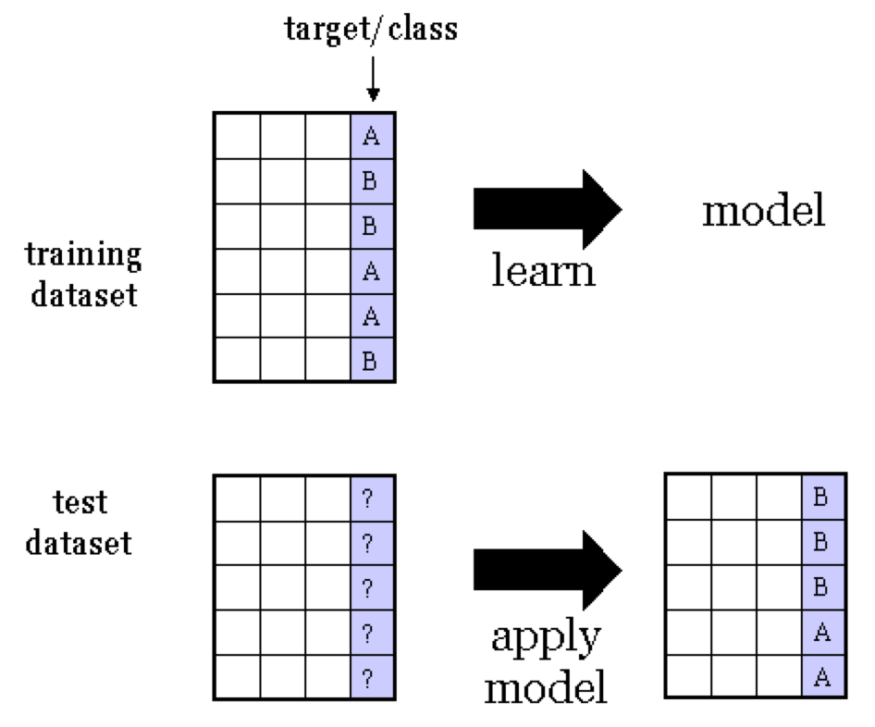



SUPERVISED Regression
Training dataset
consists of input-output pairs
f(x?)
e.g. target Y can be a continuous target variable

Slide 11
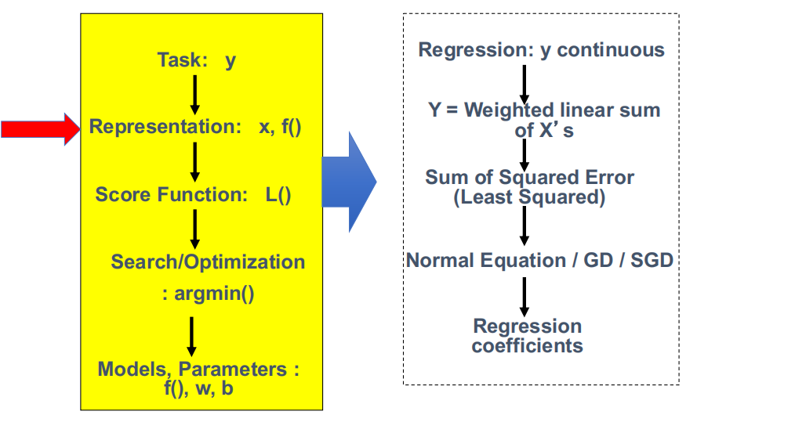
Today: Multivariate Linear Regression in a Nutshell

Slide 12
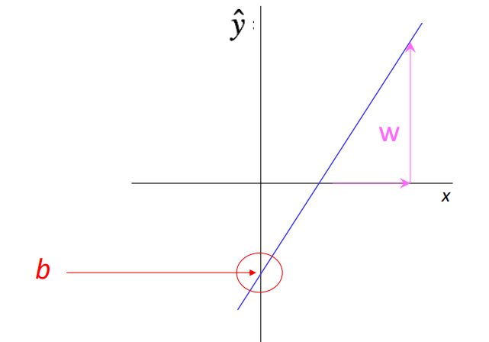
Review: f(x) is Linear when X is 1D
A slope of 2 (i.e. w=2) means that every 1-unit change in X yields a 2-unit change in Y.
f(x) = wx+b?

Slide 13
Review: f(x) is Linear when X is 1D
A slope of 2 (i.e. w=2) means that every 1-unit change in X yields a 2-unit change in Y.
f(x) = wx+b?
2
1
x=1
(x=0, y=b)

Slide 14
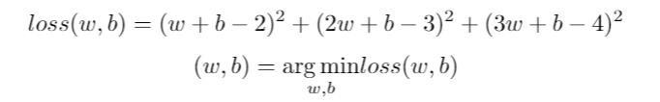
y
4
x
x
x
x
3
x | y | f(x)=wx+b
1 | 2 | f(1)=w+b
2 | 3 | f(2)=2w+b
3 | 4 | f(3)=3w+b
x
x
x
2
x
x
1
1
2
3
x

Slide 15
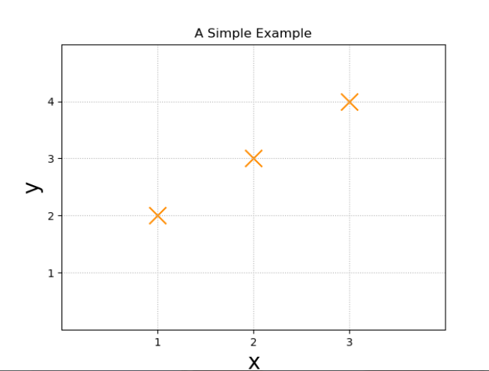
One concrete example
x | y | f(x)=wx+b
1 | 2 | f(1)=w+b
2 | 3 | f(2)=2w+b
3 | 4 | f(3)=3w+b
p=1, n=3

Slide 16
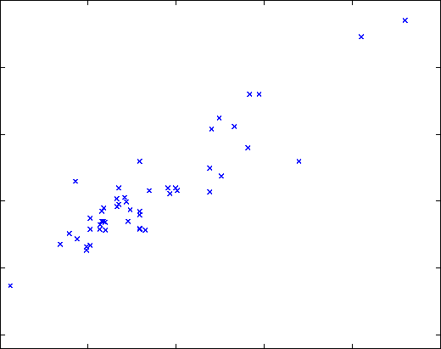

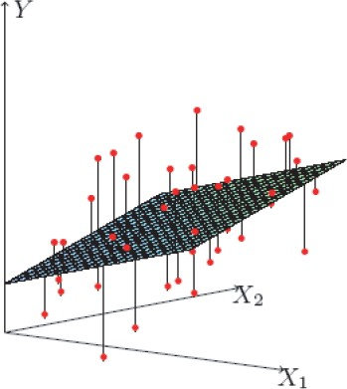
y
f(x)=wx+b
rent
Living area as X
yˆ = f (x) = θ₀
+ θ₁x₁
+ θ₂ x₂
rent
Location
Living area
(Living area, Location) as X
9/18/19

Slide 17
Linear SUPERVISED Regression
e.g. Linear Regression Models
yˆ = f (x) = θ₀+ θ₁x₁+ θ₂ x₂
=> Features x:
e.g., Living area, distance to campus, # bedroom …
=> Target y:
e.g., Rent-> Continuous

Slide 18
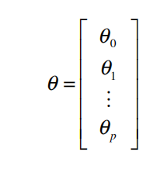

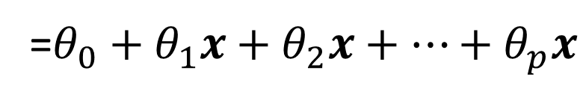
Apply f(x) : A Concise Notation
Represent each sample x as a column vector, plus a pseudo feature
We add a pseudo "feature" x₀=1 (this is the intercept term ), and RE-define the feature vector to be:
x^{T}=[(x =1), x , x , … ,x ]
0 1 2
p
The parameter vector θ is also a column vector
yˆ = f (x)
= x^{T}θ =θ ^{T} x
=$θ_{0}+$ $θ_{1}x+θ_{2}x+…+θ_{p}x$

Slide 19
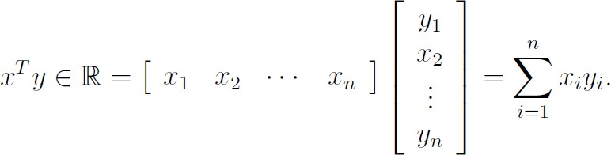

Review:
Dot (or Inner) Product of two Vectors <x, y> is the sum of products of elements in similar positions for the two vectors
<x, y> = <y, x>
px1 px1
1x1
$$=x^{T}y=y^{T}x$$
We also always write
<x, y> =

Slide 20
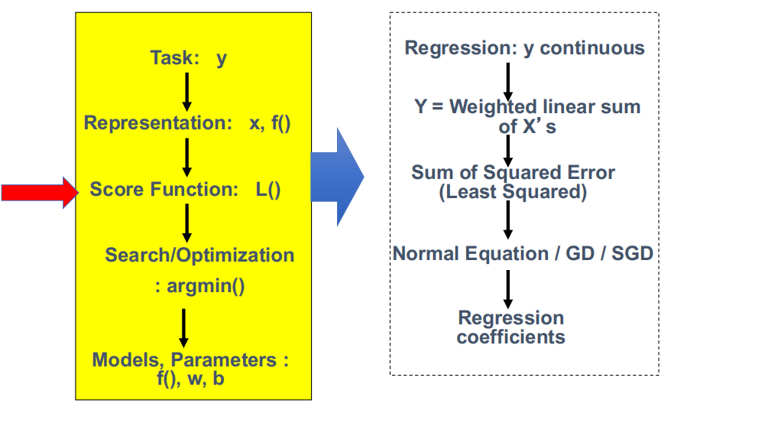
Today: Multivariate Linear Regression in a Nutshell

Slide 21
One concrete example
x | y | f(x)=wx+b | (f(x)-y)^2
1 | 2 | f(1)=w+b | (w+b-2)^2
2 | 3 | f(2)=2w+b | (2w+b-3)^2
3 | 4 | f(3)=3w+b | (3w+b-4)^2
p=1, n=3

Slide 22



y
$$\hat{y}$$
rent
$$y$$
Living area as X
$${(y−\hat{y})}^{2}$$
rent
Location
Living area
(Living area, Location) as X
9/18/19

Slide 23
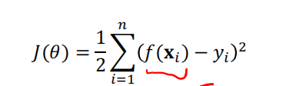


Now the loss function:
SSE: Sum of squared error
Our goal is to pick the optimal θ that minimize the following lost /cost function:
$$x_{i}^{T}θ$$

Slide 24
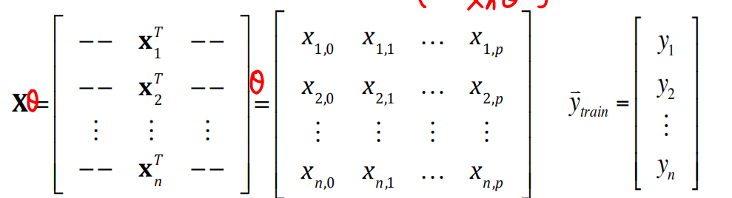

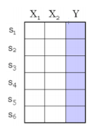
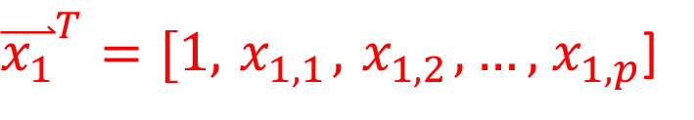
Review: Training Set in Matrix Form
The whole Training set (with n samples) as matrix form :
${\overset{⃑}{x_{1}}}^{T}=[1, { x}_{1,1},{ x}_{1,2}, …,{ x}_{1,p}$]

Slide 25
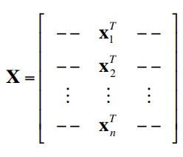
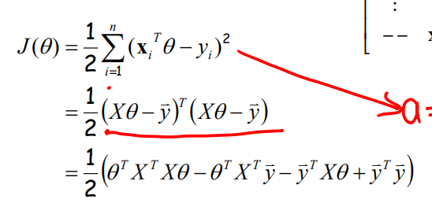

Now the loss function: via A Concise Notation
Using matrix form, we get the following general representation of the linear regression function:
Derivation

Slide 26
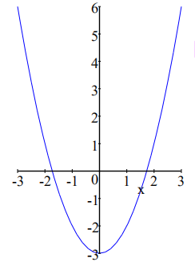
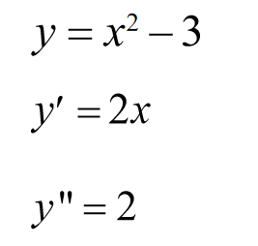
Review (IV): Derivative of a Quadratic Function
This quadrative (convex) function is minimized at the unique point whose derivative (slope) is zero.
-> When finding zeros of the derivative of this function, we also find the minima (or maxima) of that function.

Slide 27

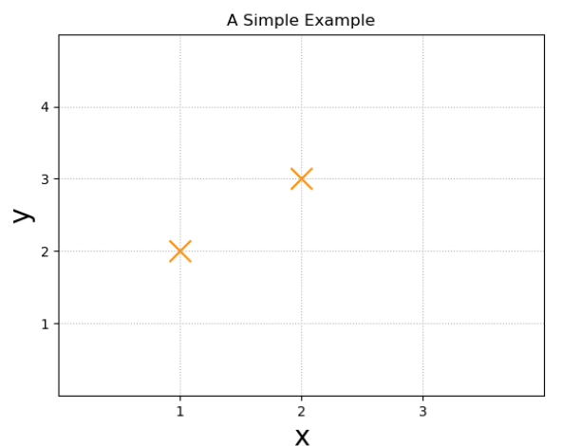

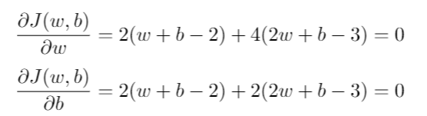
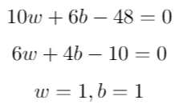
One concrete example
Step ’A’:
Step ’B’:
Step ’C’:
Step ’D’:
In Step [D], we solve the matrix equation via Gaussian Elimination

Slide 28
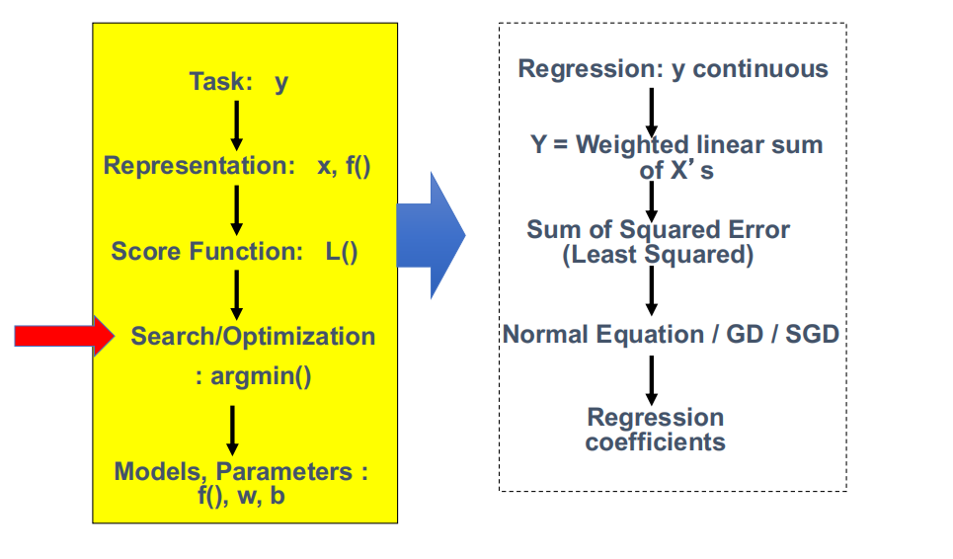
Today: Multivariate Linear Regression in a Nutshell

Slide 29
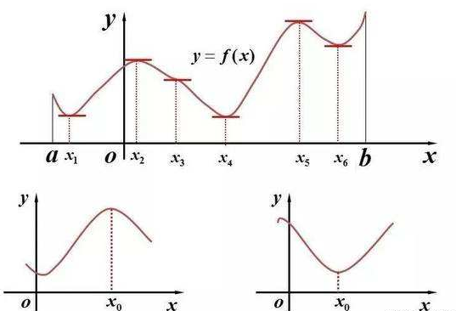
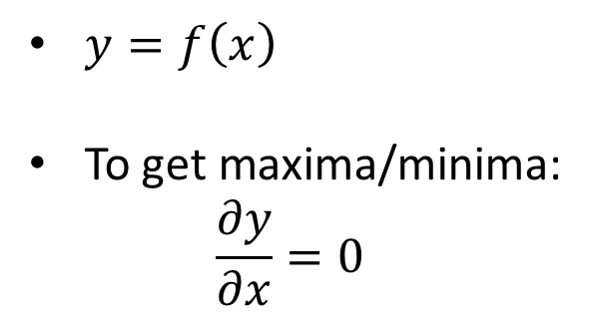
Review: Maxima & Minima
$y=f\left(x\right)$
To get maxima/minima:
$$\frac{∂y}{∂x}=0$$

Slide 30

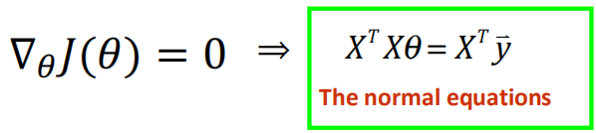


Method I: normal equations to minimize the loss
Write the cost function in matrix form:
To minimize J(θ), take derivative and set to zero:
Why?
Closed form
solution

Slide 31



Derivation:
We have known that:
Hessian matrix of J(θ):
For
We know that loss function J(θ) is convex
make J(θ) equals 0
Θ* can minimize J(θ)

Slide 32
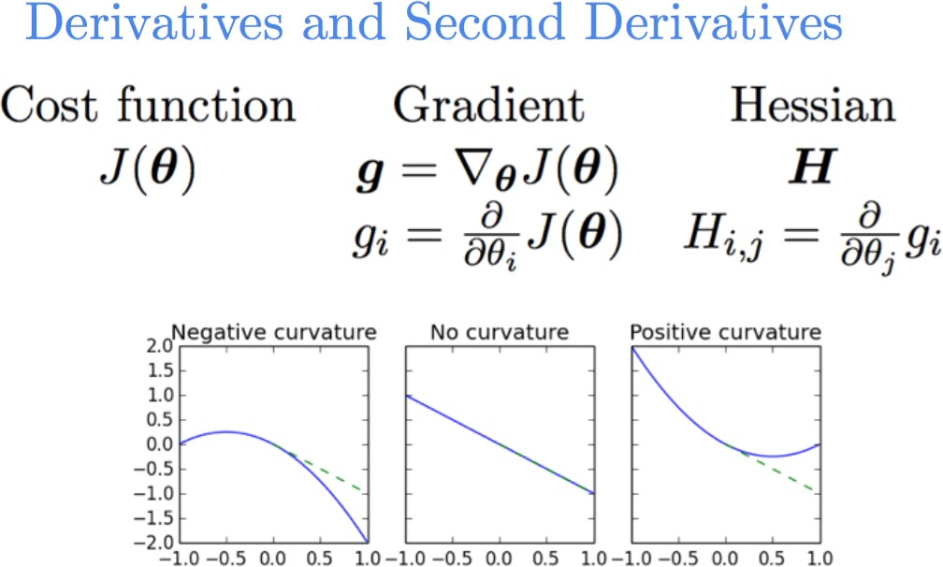
Review: Hessian Matrix
Positive Definite Hessian

Slide 33
Extra: Convex function
Intuitively, a convex function (1D case) has a single point at which the derivative goes to zero, and this point is a minimum.
Intuitively, a function f (1D case) is convex on the range [a,b] if a function’s second derivative is positive every-where in that range.
Intuitively, if a multivariate function's Hessians is pd (positive definite!), this (multivariate) function is Convex
Intuitively, we can think “Positive definite” matrices as analogy to positive numbers in matrix case
Our loss function J() ’s Hessian is
Positive Semi-definite - PSD

Slide 34

Intuitively, a convex function with PD hessian is minimized at point whose
derivative (slope) is zero
gradient is zero vector (multivariate case)
Gram Matrix
when X is full rank, H is positive definite!

Slide 35

Extra: Gram Matrix
is always positive semi-definite!
Because for any vector a
a^{T} X^{T} Xa =| Xa|² ≥ 0
2
Besides, when X is full rank,
H is Positive Definite (PD) and invertible

Slide 36
Later: Comments on the normal equation
When X full rank
In most situations of practical interest, the number of data points n is larger than the dimensionality p of the input space and the matrix X is of full column rank. If this condition holds, then it is easy to verify that X^{T}X is necessarily invertible.
The assumption that X^{T}X is invertible implies that it is positive definite, thus the critical point (by solving gradient to zero) we have found is a minimum.
What if X has less than full column rank? → regularization (later).
When X not full rank , e.g.
When p>n ➔ rank(X)_{nxp}<p
➔ rank(X^{T}X)_{pxp} <=min{rank(X)}<p ➔ X^{T}X is not invertible

Slide 37
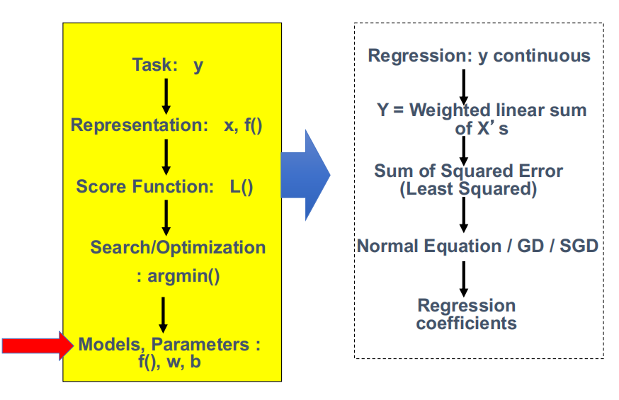
Today: Multivariate Linear Regression in a Nutshell

Slide 38

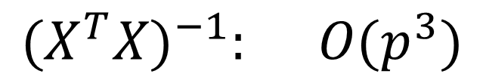

Computational Cost (Naïve Way)
pxn nxp
$$X^{T}X: O\left(p^{2}n\right)$$
$$O\left(p^{2}n+p^{3}\right)$$
$${(X^{T}X)}^{−1}: O(p^{3})$$
When n>>p, matrix’s multiplication is slower than inversion

Slide 39
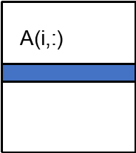
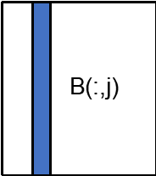
Extra: Naïve Matrix Multiply
{implements C = C + A*B}
for i = 1 to n
for j = 1 to n for k = 1 to n
C(i,j) = C(i,j) + A(i,k) * B(k,j)
Algorithm has 2*n³ = O(n³) Flops and operates on 3*n² words of memory
C(i,j)
C(i,j)
=
+
*

Slide 40
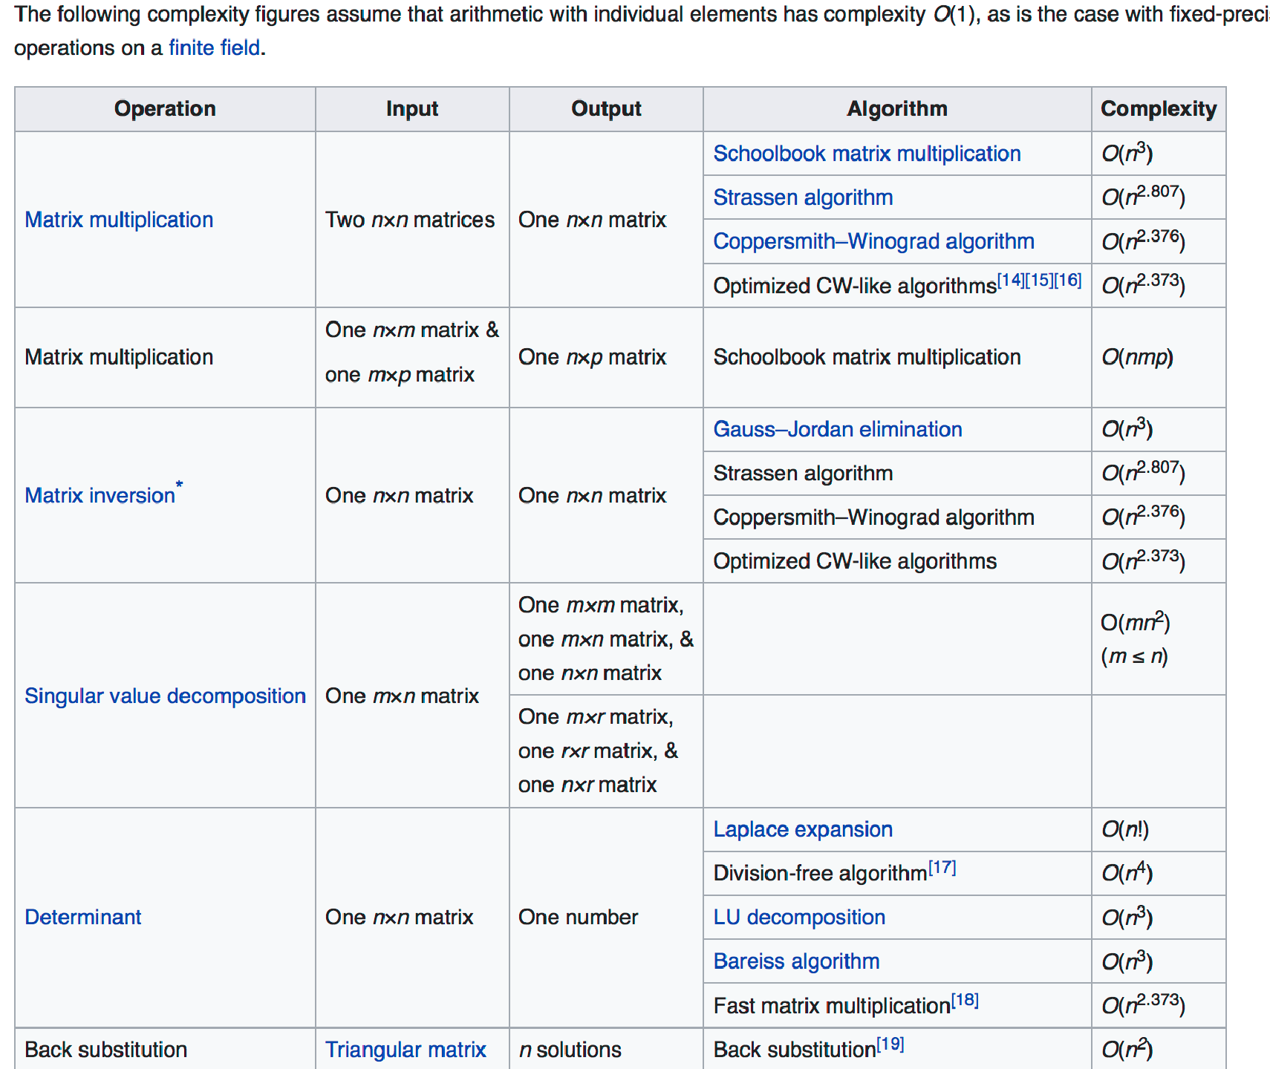
Extra: Scalability to big data?
19 Dr. Yanjun Qi / 38

Slide 41
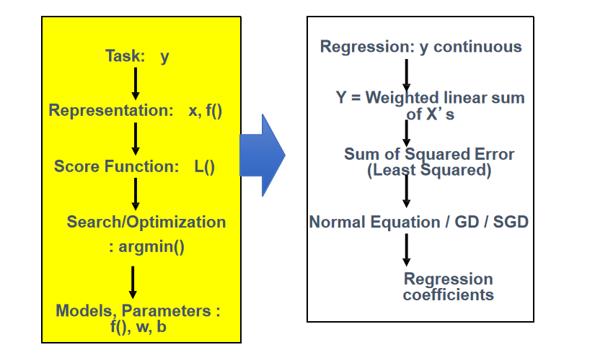
Today: Multivariate Linear Regression in a Nutshell

Slide 42
Next: More Regression (supervised)
Four ways to train / perform optimization for linear regression models
Normal Equation
Gradient Descent (GD)
Stochastic GD
Newton’s method
Supervised regression models
Linear regression (LR)
LR with non-linear basis functions
Locally weighted LR
LR with Regularizations

Slide 43


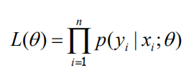

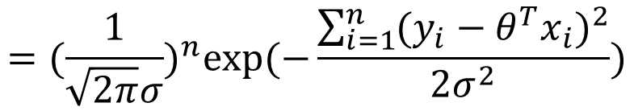
Probabilistic Interpretation of Linear Regression (LATER)
Let us assume that the target variable and the inputs are related by the equation:
where ε is an error term of unmodeled effects or random noise
Now assume that ε follows a Gaussian N(0,σ), then we have:
$$y_{i}=θ^{T}x_{i}+ε_{i}$$
Many more variations
of LinearR from this perspective, e.g. binomial / poisson (LATER)
By iid (among samples) assumption:
$$={(\frac{1}{\sqrt{2π}σ})}^{n}exp⁡(−\frac{\sum_{i=1}^{n}{{(y_{i}−θ^{T}x_{i})}^{2}}}{2σ^{2}})$$

Slide 45
References
https://qiyanjun.github.io/2019f-UVA-CS6316-MachineLearning/
https://www.numpy.org.cn/deep/basics/fit_a_line.html

Slide 46
EXTRA

Slide 47
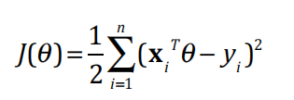
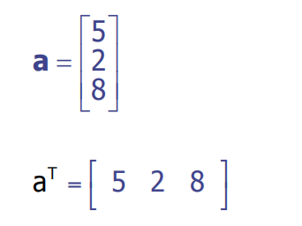
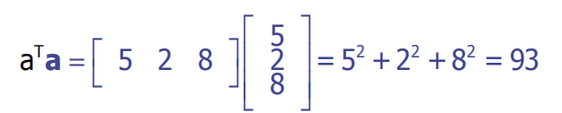
Review (I):
Sum the Squared Elements of a Vector equals Vector dot product to itself

Slide 48
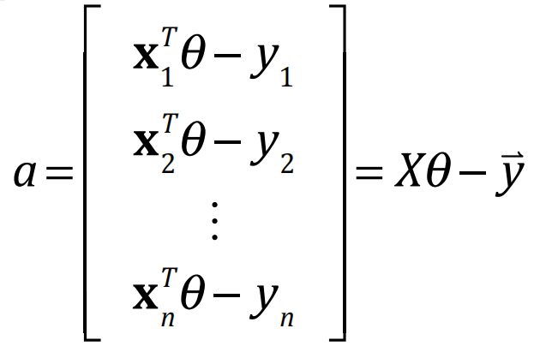

Review (I):

Slide 49

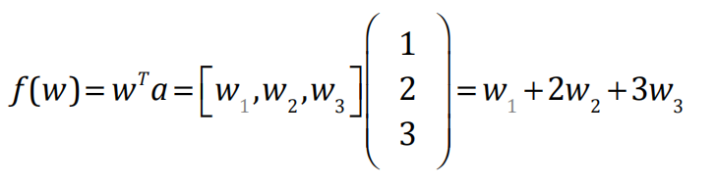

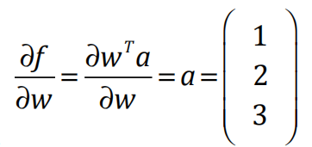

Review (II): gradient of linear form
∂(θ ^{T} X^{T} y) ₌
T
X y
∂θ
One Concrete Example

Slide 50
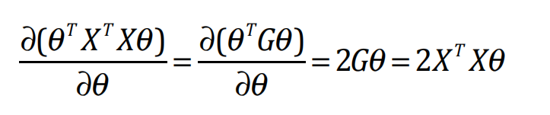
Review(III): Gradient of Quadratic Form
See L2-note.pdf

Slide 51
Review (III): Single Var-Func to Multivariate
Single Var- Multivariate Calculus Function
Derivative Second-order derivative
Partial Derivative Gradient
Directional Partial Derivative Vector Field
Contour map of a function Surface map of a function
Hessian matrix
Jacobian matrix (vector in / vector out)

Slide 52
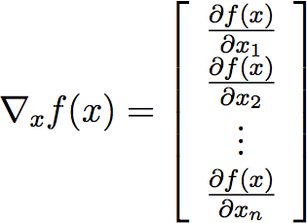


Review (IV) : Definitions of gradient (Matrix_calculus / Scalar-by-vector)
Size of gradient is always the same as the size of variable
if
In principle, gradients are a natural extension of partial derivatives to functions of multiple variables.
52

Slide 53
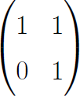
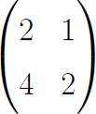
Review (V): Rank of a Matrix
rank(A) (the rank of a m-by-n matrix A) is
= The maximal number of linearly independent columns
=The maximal number of linearly independent rows
If A is n by m, then
rank(A)<= min(m,n)
If n=rank(A), then A has full row rank
If m=rank(A), then A has full column rank
Rank=?
Rank=?
If A is n*n, rank(A)=n iff A is invertible
rank(AB) <= min( rank(A), rank(B) )
Dr. Yanjun Qi /

Slide 54

Extra: positive semi-definite!
Derivation: How to prove that A is PSD?
$$A∈R^{n×n}$$

Slide 55
Thanks for listening

