Slide 1
Machine Learning
Lecture 5: Non-Linear Regression Models and
Model Selection
Dr. Beilun Wang
Southeast University
School of Computer Science
and Engineering

Slide 2
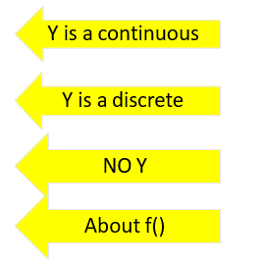
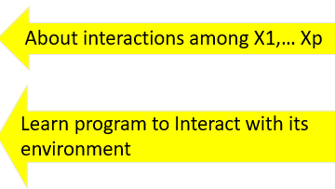
Course Content Plan
Six major sections of this course
❑ Regression (supervised)
❑ Classification (supervised)
❑ Unsupervised models
❑ Learning theory
❑ Graphical models
Reinforcement Learning

Slide 3

Last: Multivariate Linear Regression in a Nutshell
Task: y Representation: x, f()
Score Function: L() Search/Optimization
: argmin()
Models, Parameters :
Regression: y continuous
Y = Weighted linear sum of X’s
Sum of Squared Error (Least Squared)
Normal Equation / GD / SGD
Regression coefficients
yˆ = f (x) = θ ^{T} x

Slide 4
Today : Multivariate Linear Regression with basis Expansion
Regression: y continuous
Y = Weighted linear sum of (X basis expansion)
Sum of Squared Error (Least Squared)
Normal Equation / GD / SGD
Regression coefficients
Task: y
Representation:
x, f()
Score Function: L()
Search/Optimization
: argmin()
Models, Parameters :
ˆ
∑
m
y = θ +
θ ϕ (x ) = ϕ(x )^{T} θ
0
j=1
j j

Slide 5
Today
LR with non-linear basis functions
Main issues: Model Selection

Slide 6

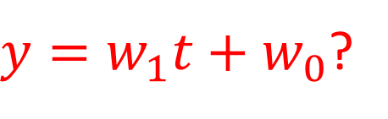

Modeling the free fall
$y=w_{1}t+w_{0}$?
$$y$$

Slide 7
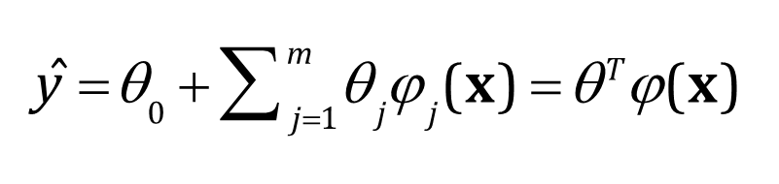

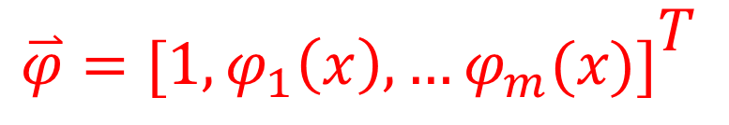
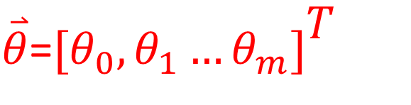
LR with non-linear basis functions
LR does not mean we can only deal with linear relationships
yˆ = θ ^{T} x
$\overset{⃑}{θ}$=$[θ_{0},θ_{1}…θ_{m}]{\begin{aligned}T \\ \end{aligned}}^{ }$
$$\overset{⃑}{φ}=[1,φ_{1}\left(x\right),…φ_{m}(x)]{\begin{aligned}T \\ \end{aligned}}^{ }$$

Slide 8


LR with non-linear basis functions
We are free to design basis functions (e.g., non-linear features:
Here ϕ _{j} (x ) are predefined basis functions (also ϕ₀(x ) = 1 )
E.g.: polynomial regression with degree up-to two (d=2):
$$φ\left(x\right)={[1,x,x^{2}]}^{T}$$
$$linear:\overset{⃑}{x}={[1,x]}^{T}$$

Slide 9
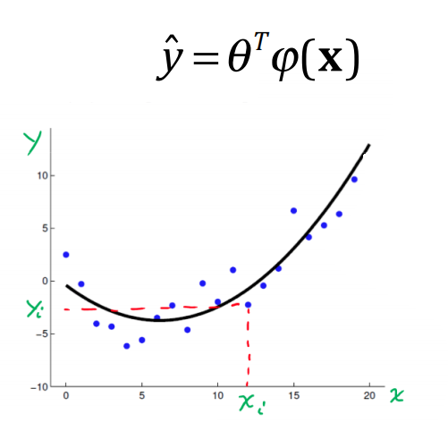
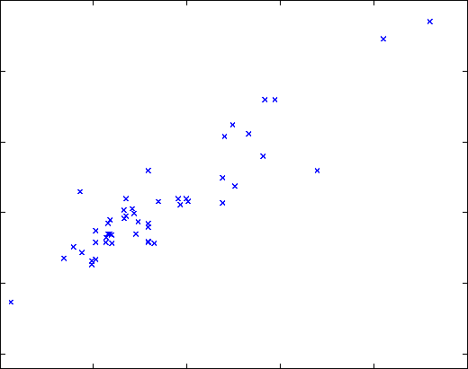

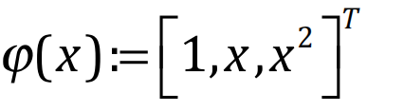




e.g. (1) polynomial regression
yˆ = θ ^{T} x
Y
$$θ_{0}+xθ_{1}$$
$${f\left(x\right)=θ}_{0}+xθ_{1}+ x^{2}θ_{2}$$
θ * = (X ^{T} X ) ⁻¹ X ^{T}
X
( )
$$\overset{⃑}{y}$$
θ = ϕ ϕ
−1
ϕ
*
T
T
$$\overset{⃑}{y}$$

Slide 10

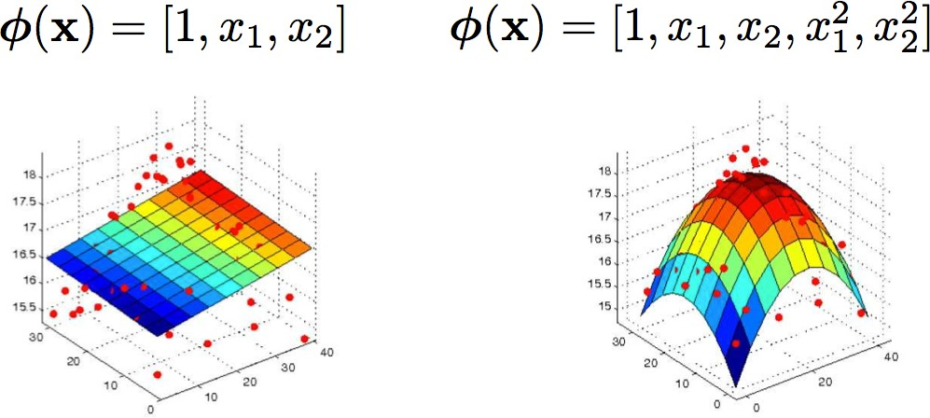
e.g. (1) polynomial regression
yˆ = θ ^{T} x
yˆ = θ ^{T}ϕ(x)
Y
Y
X1
X2
X1
X2
KEY: when the bases are given, the problem of learning the parameters from data is still linear.
9 Dr. Yanjun Qi / UVA CS 8
9 Dr. Yanjun Qi / UVA CS 8

Slide 11
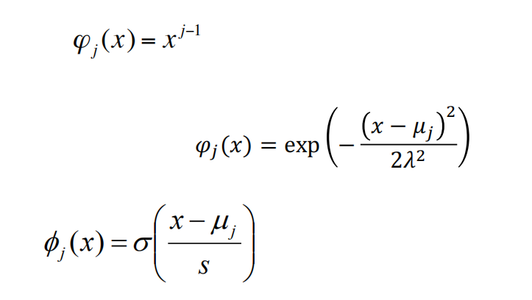
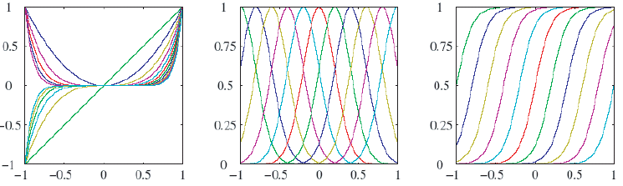

Many Possible Basis functions
There are many basis functions, e.g.:
Polynomial
Radial basis functions
Sigmoidal
Splines,
Fourier,
Wavelets, etc
$$[1,x,x^{2},x^{3}…x^{d}]$$
Poly RBF Sigmoid

Slide 12
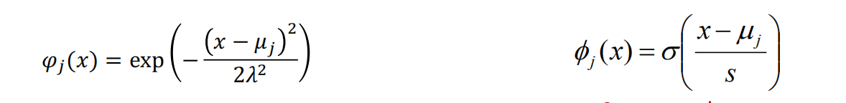
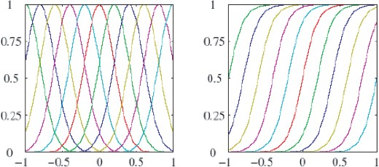
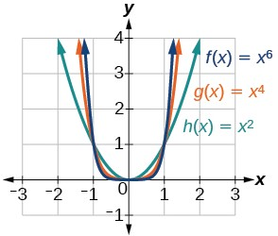
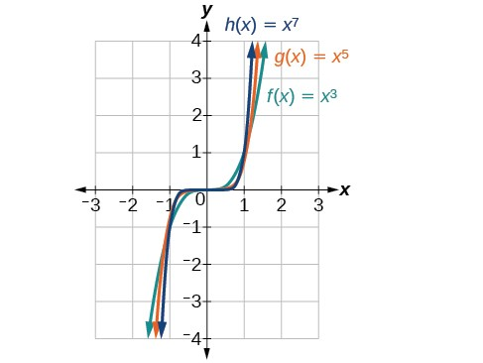
RBF Sigmoid
even odd
j−1
ϕ _{j} (x) = x

Slide 13
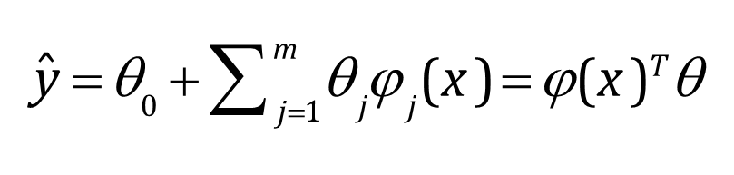
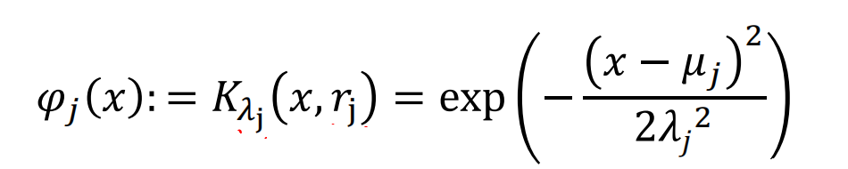
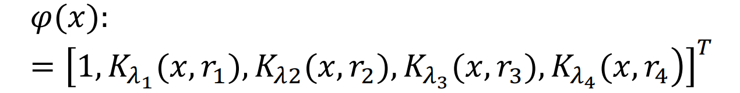
e.g. (2) LR with radial-basis functions
E.g.: LR with RBF regression:
E.g. with four predefined RBF kernels

Slide 14

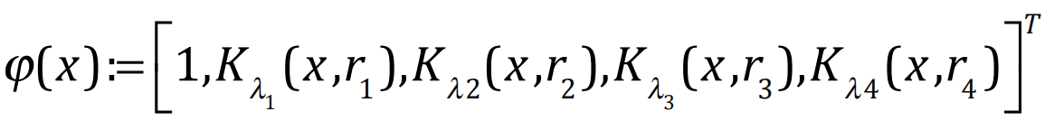
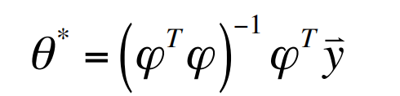

e.g. (2) LR with radial-basis functions
E.g.: LR with RBF regression:
$$\overset{⃑}{θ}={[θ_{0},θ_{1},θ_{2},θ_{3},θ_{4}]}^{T}$$

Slide 15
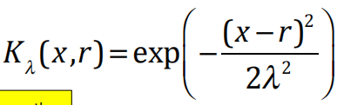
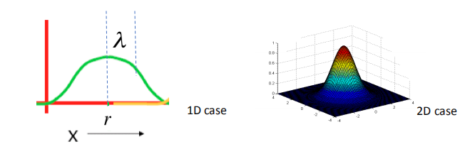
e.g. (2) LR with radial-basis functions
RBF / radial-basis function: a function which depends only on the radial distance from a center point
Gaussian RBF:

Slide 16
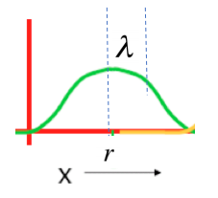
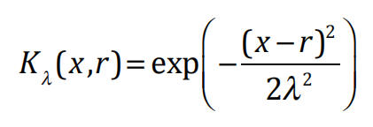
e.g. (2) LR with radial-basis functions
X= | K _{λ} (x ,r ) =
r | 1
r + λ | 0.6065307
r + 2λ | 0.1353353
r + 3λ | 0.0001234098

Slide 17
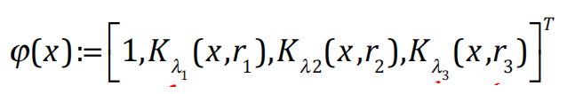

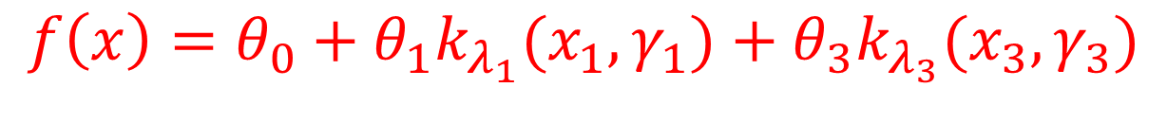
e.g. another regression with 3 1D RBF basis functions (given 3 predefined centres and width)
$$f\left(x\right)=θ_{0}+θ_{1}k_{λ_{1}}(x_{1},γ_{1})+θ_{3}k_{λ_{3}}(x_{3},γ_{3})$$

Slide 18


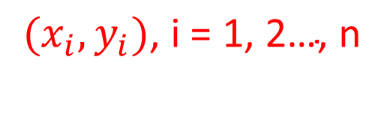
e.g. another regression with 3 1D RBF basis functions (given 3 predefined centres and width)
Y
$$(x_{i},y_{i})\text{, }\text{i} \text{=} \text{1, 2…, }\text{n}$$
5
2
-0.5
X
$$f\left(x\right)=−0.5k_{λ_{1}}\left(x_{1},γ_{1}\right)+5k_{λ_{2}}(x_{2},γ_{2})+2k_{λ_{3}}(x_{3},γ_{3})$$

Slide 19
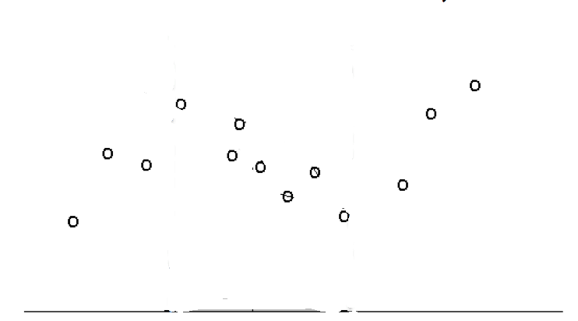
e.g. Another dataset: even more possible basis function: RBF, or Piecewise Linear based?

Slide 20
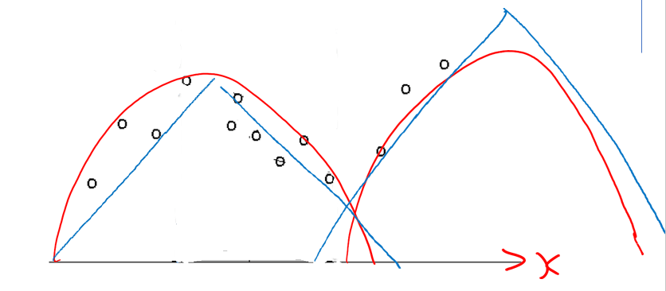

e.g. Another dataset: even more possible basis function: RBF, or Piecewise Linear based?
Y
X

Slide 21


e.g. 2D Good & Bad RBF Basis
Blue dots denote coordinates of input vectors
$$x_{2}$$
$$x_{1}$$

Slide 22
e.g. 2D Good & Bad RBF Basis
A bad set of 2D predefined RBF basis
$$x_{2}$$
center
Use every dot as centers
$$x_{1}$$

Slide 23
e.g. 2D Good & Bad RBF Basis
A good set of 2D predefined RBF basis
$$x_{2}$$
center
$$x_{1}$$

Slide 24
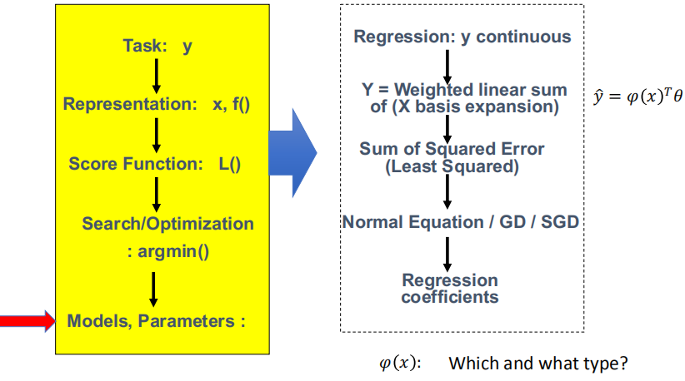
Today : Multivariate Linear Regression with basis Expansion

Slide 25
Today
LR with non-linear basis functions
Main issues: Model Selection

Slide 26
Main issues: Model Selection
How to select the right model?
E.g. what polynomial degree d for polynomial regression?
E.g., where to put the centers for the RBF kernels? How wide?
E.g. which basis type? Polynomial or RBF?

Slide 27
To avoid: Overfitting or Underfitting
Can we learn a regression f from the data?
Let’s consider three methods…
y
x

Slide 28
Linear Regression
y
x

Slide 29
Quadratic Regression
y
x

Slide 30
Join-the-dots
Also known as piecewise linear nonparametric regression
y
x

Slide 31
Which is best?
y
x
x
Why not choose the method with the best fit to the training data?

Slide 32
What do we really want?
y
y
x
x
Why not choose the method with the best fit to the data?
“How well are you going to predict future data drawn from the same distribution?”

Slide 33



What Model Type to Select?
Underfit
Good?
Overfit
y
y
x
x
K-fold Cross Validation / Train-Test /
Why not choose the method with the best fit to the data?
“How well are you going to predict future data drawn from the same distribution?”

Slide 34


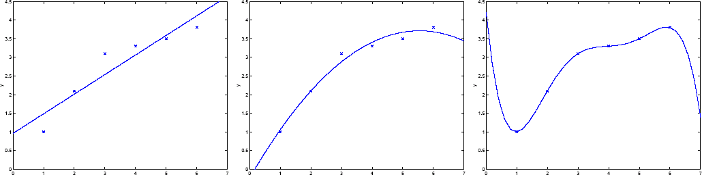
What Model Order to Select?
Under fit
Looks good
Over fit
y = θ₀ +θ₁ x y = θ₀ + θ₁ x + θ₂ x²
y =
∑
5
θ x ^{j}
j =0
j
K-fold Cross Validation / Train-Test /
Generalisation: learn function / hypothesis from past data in order to “explain”, “predict”, “model” or “control” new data examples

Slide 35
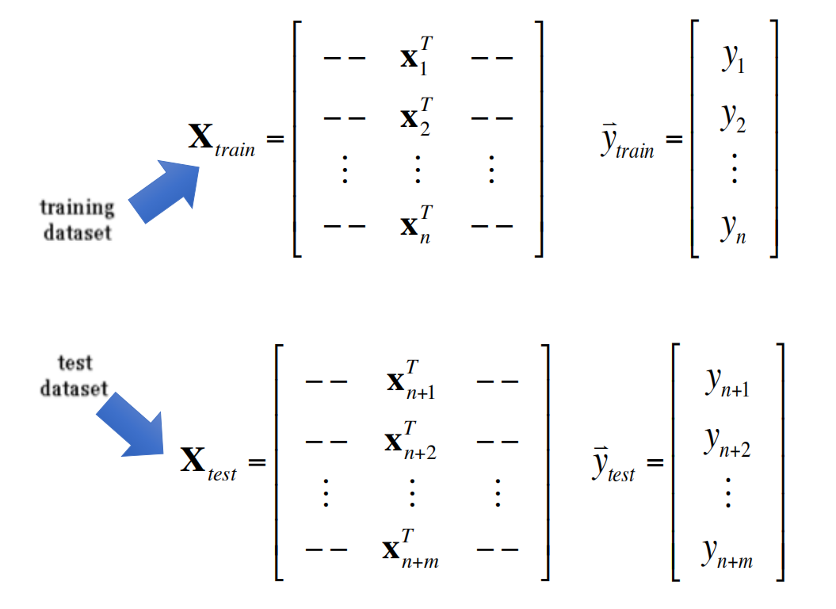
Choice-I: Train-Test (Leave m out)

Slide 36
The test set method
1. Randomly choose some percentage like 30% of the labeled data to be in a test set
2. The remainder is a training set
y
x
Credit: Prof. Andrew Moore

Slide 37
The test set method
1. Randomly choose some
percentage like 30% of the labeled data to be in a test set
2. The remainder is a training set
3. Perform your regression on the training set
y
x
(Linear regression example)
Credit: Prof. Andrew Moore

Slide 38
The test set method
1. Randomly choose 30% of the data to be in a test set
2. The remainder is a training set
3. Perform your regression on the training set
4. Estimate your future performance with the test set
y
x
(Linear regression example) Mean Squared Error = 2.4
Credit: Prof. Andrew Moore

Slide 39
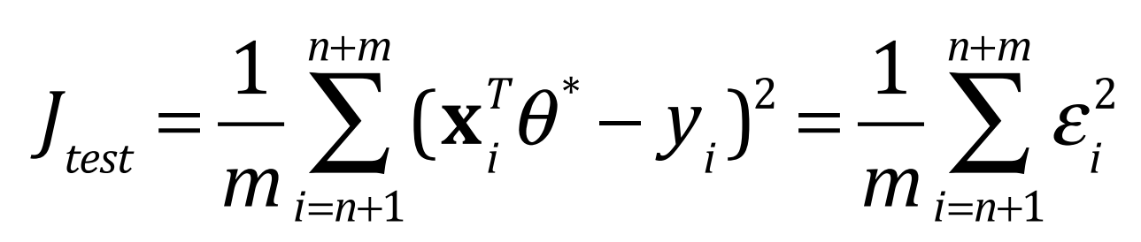
e.g. for Regression Models
Testing Mean Squared Error - MSE:

Slide 40
The test set method
1. Randomly choose 30% of the data to be in a test set
2. The remainder is a training set
3. Perform your regression on the training set
4. Estimate your future performance with the test set
y
x
(Quadratic regression example) Mean Squared Error = 0.9
Credit: Prof. Andrew Moore

Slide 41
The test set method
1. Randomly choose 30% of the data to be in a test set
2. The remainder is a training set
3. Perform your regression on the
training set
4. Estimate your future performance with the test set
y
x
(Join the dots example) Mean Squared Error = 2.2
Credit: Prof. Andrew Moore

Slide 42
The test set method
Good news:
Very very simple
Can then simply choose the method with the best test-set score
Bad news:
Wastes data: we get an estimate of the best method to apply to 30% less data
If we don’t have much data, our test-set might just be lucky or unlucky
We say the “test-set estimator of performance has high variance”
Credit: Prof. Andrew Moore

Slide 43
Choice-II: k-Fold Cross Validation
Problem of train-test: in many cases we don’t have enough data to set aside a test set
Solution: Each data point is used both as train and test
Common types:
K-fold cross-validation (e.g. K=5, K=10)
Leave-one-out cross-validation (LOOCV, i.e., k=n)

Slide 44
e.g. By k=10 fold Cross Validation
Divide data into 10 equal pieces
9 pieces as training set, the rest 1 as test set
Collect the scores from each test
We normally use the mean of the scores
model | P1 | P2 | P3 | P4 | P5 | P6 | P7 | P8 | P9 | P10
1 | train | train | train | train | train | train | train | train | train | test
2 | train | train | train | train | train | train | train | train | test | train
3 | train | train | train | train | train | train | train | test | train | train
4 | train | train | train | train | train | train | test | train | train | train
5 | train | train | train | train | train | test | train | train | train | train
6 | train | train | train | train | test | train | train | train | train | train
7 | train | train | train | test | train | train | train | train | train | train
8 | train | train | test | train | train | train | train | train | train | train
9 | train | test | train | train | train | train | train | train | train | train
10 | test | train | train | train | train | train | train | train | train | train

Slide 45
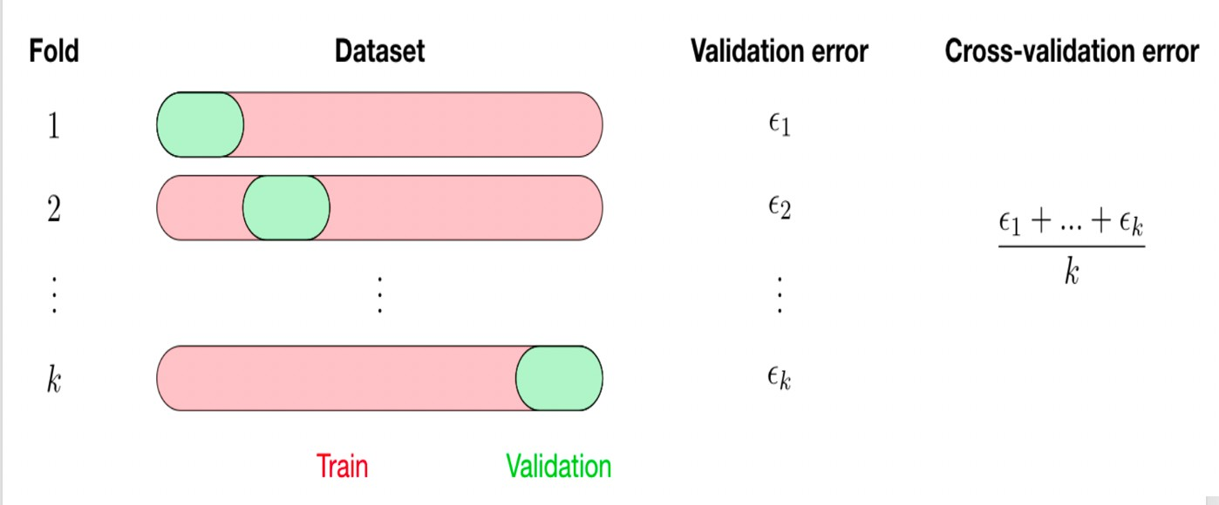
e.g. By k=10 fold Cross Validation

Slide 46
e.g. Leave-one-out / LOOCV(n-fold cross validation)

Slide 47
LOOCV (Leave-one-out Cross Validation)
For k=1 to n
1. Let (x_{k},y_{k}) be the k^{th} record
y
x

Slide 48
LOOCV (Leave-one-out Cross Validation)
For k=1 to n
1. Let (x_{k},y_{k}) be the k^{th} record
2. Temporarily remove (x_{k},y_{k})
from the dataset
Train on the remaining n-1 datapoints
y
x

Slide 49
LOOCV (Leave-one-out Cross Validation)
For k=1 to n
1. Let (x_{k},y_{k}) be the k^{th} record
2. Temporarily remove (x_{k},y_{k})
from the dataset
Train on the remaining n-1 datapoints
y
4. Note your error (x_{k},y_{k})
x

Slide 50
LOOCV (Leave-one-out Cross Validation)
For k=1 to R
1. Let (x_{k},y_{k}) be the k^{th} record
2. Temporarily remove (x_{k},y_{k})
from the dataset
Train on the remaining n-1 datapoints
y
4. Note your error (x_{k},y_{k})
When you’ve done all points, report the mean error.
x

Slide 51
LOOCV for Linear Regression
For k=1 to n
1. Let (x_{k},y_{k}) be the k^{th} record
2. Temporarily remove (x_{k},y_{k}) from the dataset
3. Train on the remaining n-1 data points
4. Note your error (x_{k},y_{k})
When you’ve done all points, report the mean error.
y
y
y
x
x
x
y
y
y
x
x
x
MSE_{LOOCV} = 2.12
y
y
y
x
x
x
Credit: Prof. Andrew Moore

Slide 52
LOOCV for Quadratic Regression
For k=1 to n
1. Let (x_{k},y_{k}) be the k^{th} record
2. Temporarily remove (x_{k},y_{k}) from the dataset
3. Train on the remaining n-1 data points
4. Note your error (x_{k},y_{k})
When you’ve done all points, report the mean error.
y
y
y
x
x
x
y
y
y
x
x
x
MSE_{LOOCV}=0.962
y
y
y
x
x
x
Credit: Prof. Andrew Moore

Slide 53
LOOCV for Join The Dots
For k=1 to n
1. Let (x_{k},y_{k}) be the k^{th} record
2. Temporarily remove (x_{k},y_{k}) from the dataset
3. Train on the remaining n-1 data points
4. Note your error (x_{k},y_{k})
When you’ve done all points, report the mean error.
y
y
y
x
x
x
y
y
y
x
x
x
MSE_{LOOCV}=3.33
y
y
y
x
x
x
Credit: Prof. Andrew Moore

Slide 54
Which kind of Cross Validation?
Downside
Upside
Test-set
Variance: unreliable estimate of future performance
Cheap
Leave- one-out
Expensive.
Has some weird behavior
Doesn’t waste data
..can we get the best of both worlds?
Credit: Prof. Andrew Moore

Slide 55
k-fold Cross Validation
Randomly break the dataset into k partitions (in our example we’ll have k=3 partitions colored Purple Green and Blue)
y
x
Credit: Prof. Andrew Moore

Slide 56
k-fold Cross Validation
Randomly break the dataset into k partitions (in our example we’ll have k=3 partitions colored Purple Green and Blue)
For the blue partition: Train on all the points not in the blue partition. Find the test-set sum of errors on the blue points.
y
x
Credit: Prof. Andrew Moore

Slide 57
k-fold Cross Validation
Randomly break the dataset into k partitions (in our example we’ll have k=3 partitions colored Purple Green and Blue)
For the blue partition: Train on all the points not in the blue partition. Find the test-set sum of errors on the blue points.
For the green partition: Train on all the points not in the green partition. Find the test-set sum of errors on the green points.
y
x
Credit: Prof. Andrew Moore

Slide 58
k-fold Cross Validation
Randomly break the dataset into k partitions (in our example we’ll have k=3 partitions colored Purple Green and Blue)
For the blue partition: Train on all the points not in the blue partition. Find the test-set sum of errors on the blue points.
For the green partition: Train on all the points not in the green partition. Find the test-set sum of errors on the green points.
y
x
For the purple partition: Train on all the points not in the purple partition. Find the test-set sum of errors on the purple points.
Credit: Prof. Andrew Moore

Slide 59
k-fold Cross Validation
Randomly break the dataset into k partitions (in our example we’ll have k=3 partitions colored Purple Green and Blue)
For the blue partition: Train on all the points not in the blue partition. Find the test-set sum of errors on the blue points.
For the green partition: Train on all the points not in the green partition. Find the test-set sum of errors on the green points.
y
For the purple partition: Train on all the points not in the purple partition. Find the test-set sum of errors on the purple points.
x
Linear Regression MSE_{3FOLD} = 2.05
Then report the mean error
Credit: Prof. Andrew Moore

Slide 60
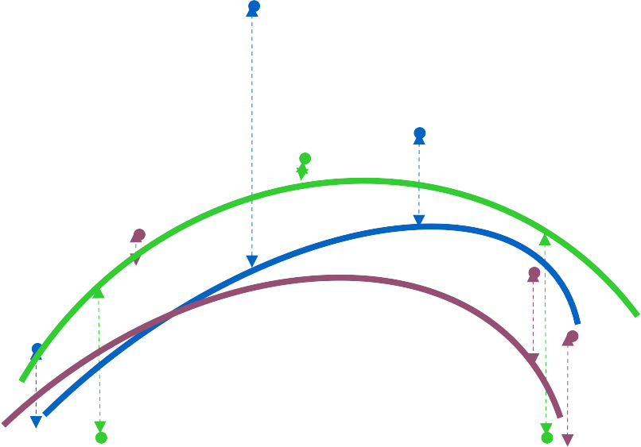
k-fold Cross Validation
Randomly break the dataset into k partitions (in our example we’ll have k=3 partitions colored Purple Green and Blue)
For the blue partition: Train on all the points not in the blue partition. Find the test-set sum of errors on the blue points.
For the green partition: Train on all the points not in the green partition. Find the test-set sum of errors on the green points.
y
For the purple partition: Train on all the points not in the purple partition. Find the test-set sum of errors on the purple points.
Quadratic Regression MSE_{3FOLD} = 1.11
Then report the mean error
Credit: Prof. Andrew Moore

Slide 61
k-fold Cross Validation
Randomly break the dataset into k partitions (in our example we’ll have k=3 partitions colored Purple Green and Blue)
For the blue partition: Train on all the points not in the blue partition. Find the test-set sum of errors on the blue points.
For the green partition: Train on all the points not in the green partition. Find the test-set sum of errors on the green points.
y
For the purple partition: Train on all the points not in the purple partition. Find the test-set sum of errors on the purple points.
x
Joint-the-dots MSE_{3FOLD} = 2.93
Then report the mean error
Credit: Prof. Andrew Moore

Slide 62
Which kind of Cross Validation?
Downside Upside
Test-set
Variance: unreliable estimate of future performance
Cheap
Leave- one-out
Expensive.
Has some weird behavior
Doesn’t waste data
10-fold
Wastes 10% of the data. 10 times more expensive than test set
Only wastes 10%. Only 10 times more expensive instead of n times.
3-fold
Wastier than 10-fold. More Expensive than test set style
better than test-set
n-fold
Identical to Leave-one-out

Slide 63
CV-based Model Selection
We’re trying to decide which algorithm/model to use.
We train/learn/fit each model and make a table…
i | f_{i} | TRAINERR | k-FOLD-CV-ERR | Choice
1 | f₁
2 | f₂
3 | f₃
4 | f₄
5 | f₅
6 | f₆
Credit: Prof. Andrew Moore

Slide 64
Extra: K-Nearest Neighbor
 |  | Regression/ classification Local Smoothness NA NA Training Samples
Task Representation Score Function Search/Optimization Models, Parameters

Slide 65
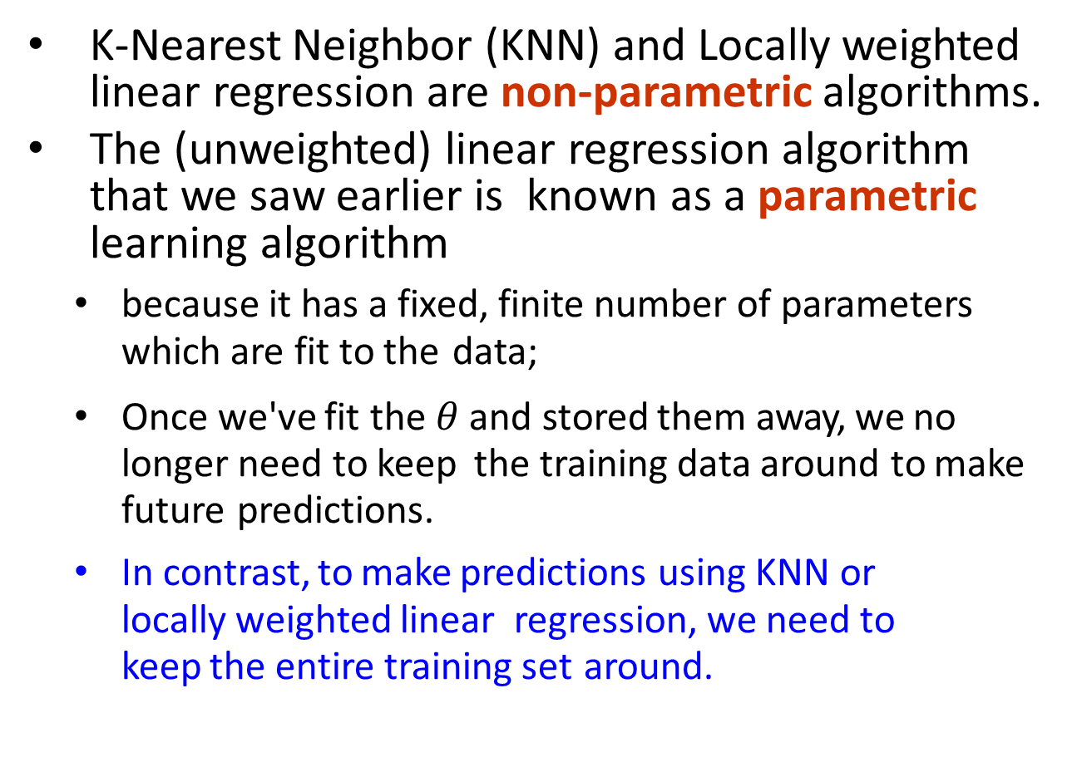
Extra: Nonparametric Regression Models
K-Nearest Neighbor (KNN) and Locally weighted linear regression are non-parametric algorithms.
The (unweighted) linear regression algorithm that we saw earlier is known as a parametric learning algorithm
because it has a fixed, finite number of parameters which are fit to the data;
Once we've fit the $θ$ and stored them away, we no longer need to keep the training data around to make future predictions.
In contrast, to make predictions using KNN or locally weighted linear regression, we need to keep the entire training set around.

Slide 66
Extra: Nonparametric Regression Models
The term "non-parametric" (roughly) refers to the fact that the amount of knowledge we need to keep, in order to represent the hypothesis grows with linearly the size of the training set.

Slide 67
References
https://qiyanjun.github.io/2019f-UVA-CS6316-MachineLearning/

Slide 68
Thanks for listening

