Slide 1
Machine Learning
Lecture 7: Feature Selection
Dr. Beilun Wang
Southeast University
School of Computer Science
and Engineering

Slide 2
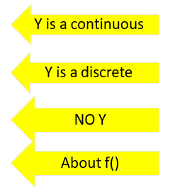
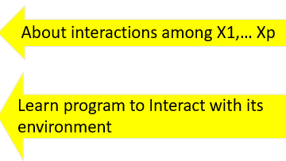
Course Content Plan
Six major sections of this course
❑ Regression (supervised)
❑ Classification (supervised)
❑ Unsupervised models
❑ Learning theory
❑ Graphical models
Reinforcement Learning

Slide 3
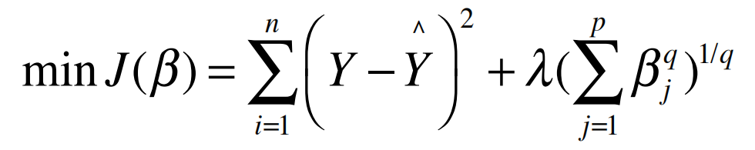
Last: Regularized multivariate linear regression
Task
Regression
Representation
Y = Weighted linear sum of X’s
Score Function
Least-squares + Regularization
Search/Optimization
Linear algebra for Ridge / sub-GD for Lasso & Elastic
Models, Parameters
Regression coefficients (regularized weights)

Slide 4
Today: Feature Selection
Selecting p’ original features from p Features
Task
Representation
Filter / Wrapper / Embedded
Score Function
Improve Classification / Regression
Search/Optimization
Univariate / Combinatorial Search?
Models, Parameters
Selected p’ features’ index

Slide 5
Feature Selection
Thousands to millions of low level features.
select the most relevant ones to build better, faster, and easier to understand learning models.
p
X
n
From Dr. Isabelle Guyon

Slide 6
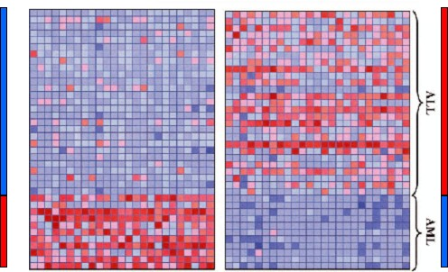


e.g., Leukemia Diagnosis
pʼ
$$>30000$$
-1
n
$$<100$$
+1
{-y_{i}}
Golub et al, Science Vol 286:15 Oct. 1999
{y_{i}},

Slide 7
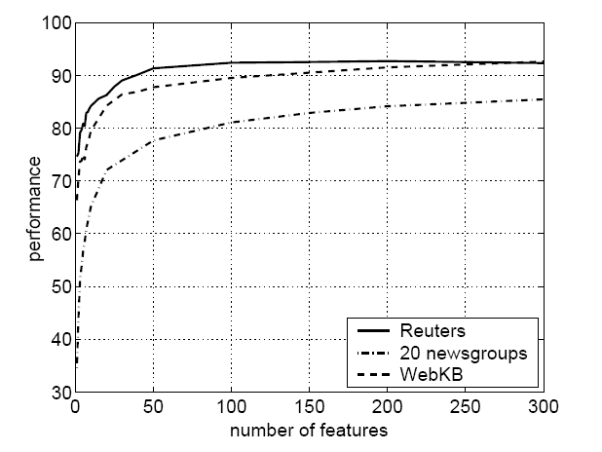
e.g., Text Categorization with feature Filtering
Reuters: 21578 news wire, 114 semantic categories.
20 newsgroups: 19997 articles, 20 categories.
WebKB: 8282 web pages, 7 categories.
Bag-of-words: >100,000 features.
Top 3 words of some output Y categories:
Alt.atheism: atheism, atheists, morality
Comp.graphics: image, jpeg, graphics
Sci.space: space, nasa, orbit
Soc.religion.christian: god, church, sin
Talk.politics.mideast: israel, armenian, turkish
Talk.religion.misc: jesus, god, jehovah
Bekkerman et al, JMLR, 2003

Slide 8
We aim to make the learned model: Feature Selection ➔ Simpler models
Generalize Well
Less sensitive to noise
Lower variance - Occamʼs razor (see later)
Computationally Scalable and Efficient
Easier to train ( to need less labeled examples)
Simpler to use (computationally)
Robust / Trustworthy / Interpretable
Especially for some domains, this is about trust!
Easier to explain (more interpretable!)

Slide 9

Occamʼs razor: law of parsimony
problem-solving principle
"Entities should not be multiplied without necessity.“
"the simplest solution is most likely the right one."

Slide 10
Summary of Feature Selection Methods:
Filtering approach:
ranks features or feature subsets independently of the predictor.
…using univariate methods: consider one variable at a time
…using multivariate methods: consider more than one variables at a time
Wrapper approach:
uses a predictor to assess features or feature subsets.
Embedding approach:
uses a predictor to build a (single) model with a subset of features that are internally selected.

Slide 11
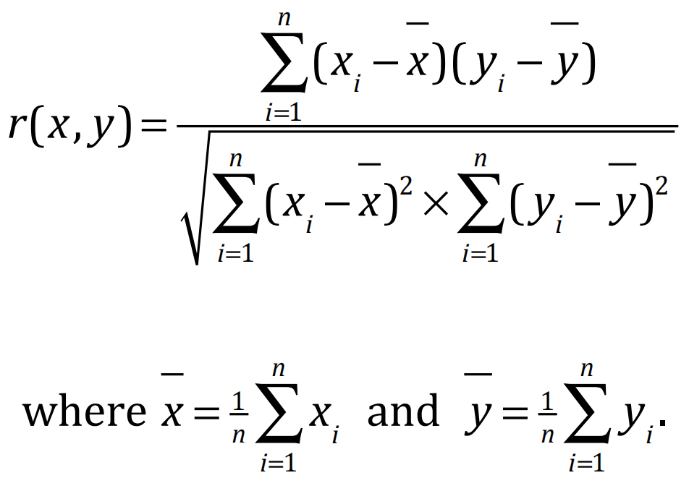
(1) Filtering: univariate: e.g., Pearson Correlation
Pearson correlation coefficient
Measuring the linear correlation between two sequences, x and y,
giving a value between +1 and −1 inclusive, where 1 is total positive correlation, 0 is no correlation, and −1 is total negative correlation.
r(x , y) ≤ 1
Correlation is unit independent

Slide 12

(1) Filtering: univariate: e.g., Pearson Correlation
Pearson correlation coefficient
Special case: cosine distance:
Correlation is unit independent

Slide 13
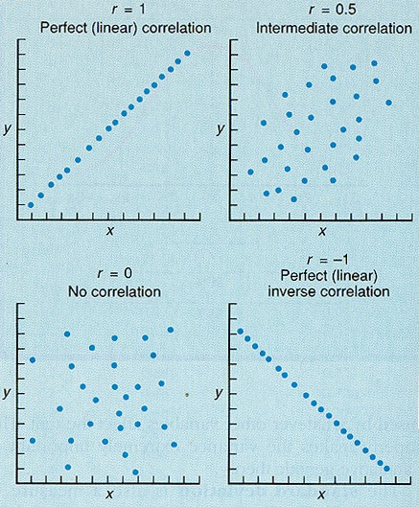
(1) Filtering: univariate: e.g., Pearson Correlation
can only detect linear dependencies between two variables
(e.g. between one feature vs. target)
9/25/19 Dr. Yanjun Qi / UVA CS

Slide 14
(1) Filtering: univariate filtering: e.g. T-test
Goal: determine the relevance of a given single feature for two classes of samples.
μ-, μ+
μ- μ+
Legend: Y=1
Y=-1
Density P(X_{i}|Y=-1) P(X_{i}|Y=1)
-1
σ-
σ-
σ+
Bad feature x_{i}
σ+
Good feature x_{i}
9/25/19
18

Slide 15

(1) Filtering: univariate filtering: e.g. T-test
T-test
Assumption: Two normally distributed classes with equal variance $σ^{2}$ unknown;
estimated from data as ${σ^{2}}_{within}$
Null hypothesis H₀: $μ^{+}=μ^{_}$
μ- μ+
-1
σ-
σ+
x_{i}

Slide 16

















(1) Filtering: univariate filtering may fail
Univariate selection may fail

Slide 17

(1) Filtering: multi-variate: Feature Subset Selection
Filter Methods
Select subsets of variables as a pre-processing step, independently of the used classifier!
E.g. Group correlation
E.g. Information theoretic filtering methods such as Markov blanket

Slide 18
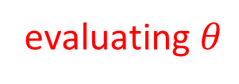

(1) Filtering: multi-variate: Feature Subset Selection
You need:
a measure for assessing the goodness of a feature subset (scoring function)
a strategy to search the space of possible feature subsets
Finding a minimal optimal feature set for an arbitrary target is NP-hard
→ Good heuristics are needed!
evaluating $θ$
search $θ$

Slide 19
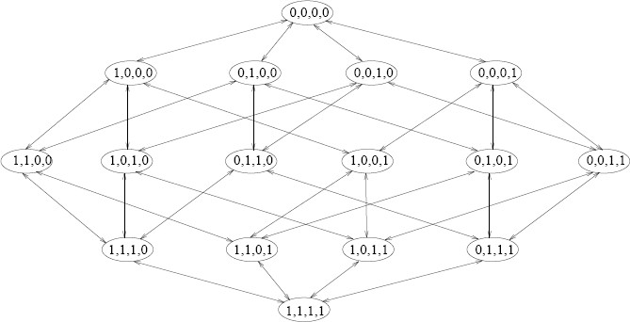

(1) Filtering: multi-variate: e.g.
Each feature subset can be described by: $θ=$[0/1, 0/1, … 0/1$]^{T}$
$θ= no feature selected$
$θ= all selected$
p features, 2^{p} possible feature subsets!

Slide 20
(1) Filtering: Summary
usually fast
provide generic selection of features, not tuned by given learner (universal, learner-agnostic )
this is also often criticised (feature set not optimized for used learner)
Often used as a pre-processing step for other methods

Slide 21
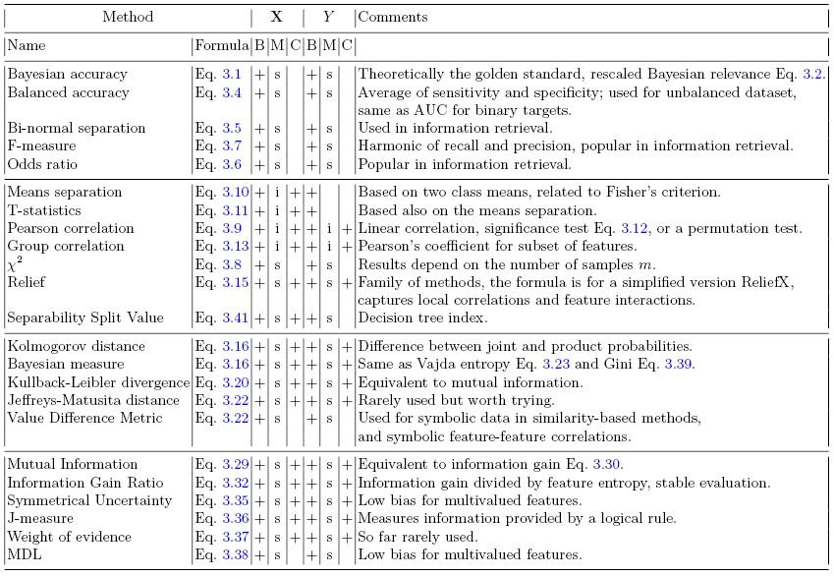
(1) Filtering: (many other choices)
Guyon-Elisseeff，JMLR2004; Springer 2006

Slide 22
Summary of Feature Selection Methods:
Filtering approach:
ranks features or feature subsets independently of the predictor.
…using univariate methods: consider one variable at a time
…using multivariate methods: consider more than one variables at a time
Wrapper approach:
uses a predictor to assess features or feature subsets.
Embedding approach:
uses a predictor to build a (single) model with a subset of features that are internally selected.

Slide 23
(2) Wrapper: Feature Subset Selection
Learner is considered a black-box
Interface of the black-box is used to score subsets of variables according to the predictive power of the learner when using the subsets.
Results vary for different learners

Slide 24
(2) Wrapper: Feature Subset Selection
Two major questions to answer:
Search: How to search in the space of all feature subsets ?
Assessment: How to measure performance of a learner that uses a particular feature subset ?

Slide 25
(a) Search: How to search the space of all feature subsets?
The problem of finding the optimal subset is NP-hard!
A wide range of heuristic search strategies can be used. Two different classes:
Forward selection (start with empty feature set and add features at each step)
Backward elimination (start with full feature set and discard features at each step)
predictive power is usually measured on a validation set or by cross-validation
By using the learner as a black box, wrappers are universal and simple!
Criticism: a large amount of computation is required.

Slide 26

(a) Search: How to search the space of all feature subsets?
E.g.
$$2^{P}⇒p\left(p−1\right)\left(p−2\right)…(p−T)$$

Slide 27
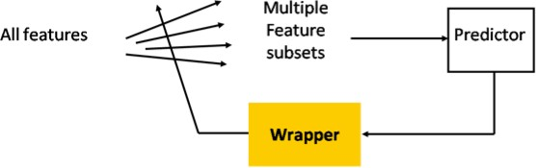
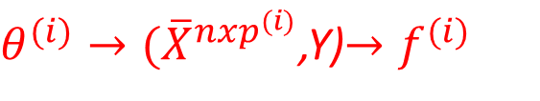
(b) Assessment: How to access multiple candidates of feature subsets
Wrapper Methods
$θ^{(i)}→({\overline{X}}^{nxp^{(i)}}$,Y)$→f^{(i)}$

Slide 28


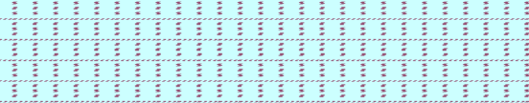

(b) Assessment: How to access multiple candidates of feature subsets
p variables/features
Split data into 3 sets:
training, validation, and test set.
For each feature subset, train predictor on training data.
Select the feature subset, which performs best on validation data.
Repeat and average if you want to reduce variance (cross-validation).
Test on test data.
m₁
m₂
m₃
N samples
From Dr. Isabelle Guyon

Slide 29




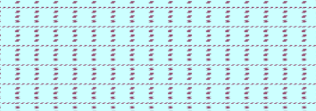
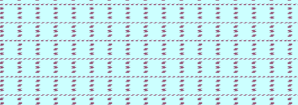
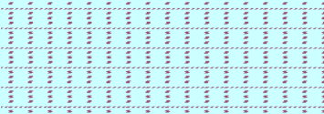
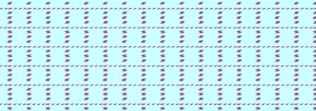





(b) Assessment: How to access multiple candidates of feature subsets
$$θ_{1}$$
$$θ_{2}$$
$$θ_{3}$$
…
$$θ_{m}$$
m₁
m₁
m₁
m₁
m₂
m₂
m₂
m₂
Train for m times on train fold
validate for m times on validation fold
$$⇒argmin val:Error⇒θ^{∗}$$

Slide 30
(b) Search: search strategies for selecting feature subset
eg. BEAM search
Keep top k=2 path
$$2^{P}⇒p\left(p−1\right)\left(p−2\right)…(p−T)$$

Slide 31
Summary of Feature Selection Methods:
Filtering approach:
ranks features or feature subsets independently of the predictor.
…using univariate methods: consider one variable at a time
…using multivariate methods: consider more than one variables at a time
Wrapper approach:
uses a predictor to assess features or feature subsets.
Embedding approach:
uses a predictor to build a (single) model with a subset of features that are internally selected.

Slide 32
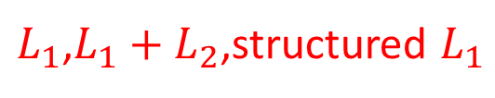
(3) Embedded: Feature Subset Selection
Specific to a given learning machine
Performs variable selection (implicitly) in the process of training
Just train a (single) model
$L_{1}$,$L_{1}+L_{2}$,structured $L_{1}$

Slide 33
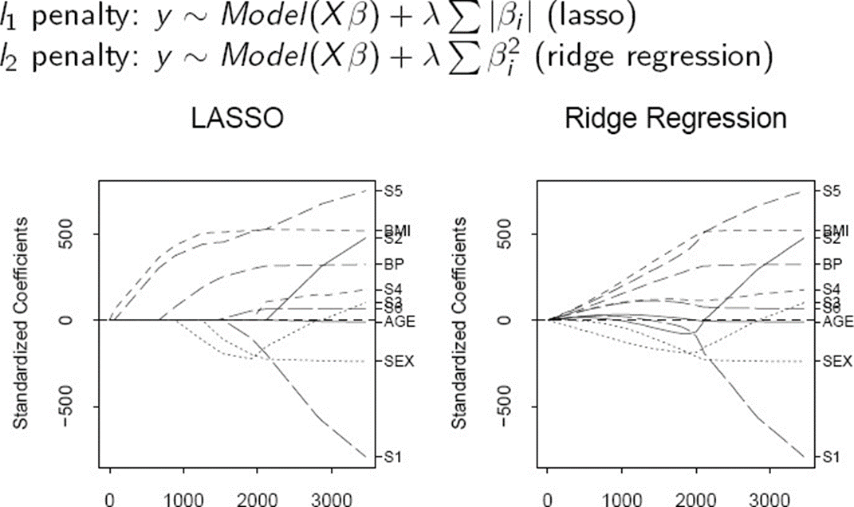
(3) Embedded: e.g. Feature Selection via Embedded Methods: e.g.,L1-regularization

Slide 34
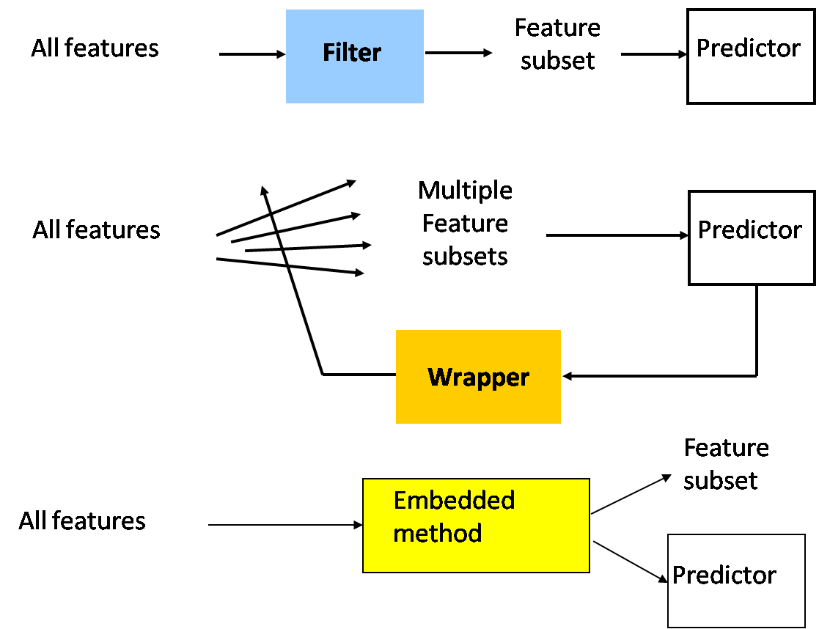
Summary: filters vs. wrappers vs. embedding
Main goal: rank subsets of useful features
41
From Dr. Isabelle Guyon

Slide 35
In practice…
No method is universally better:
wide variety of types of variables, data distributions, learning machines, and objectives.
Feature selection is not always necessary to achieve good performance.

Slide 36


Later: Dimensionality Reduction
In the presence of many of features, select the most relevant subset of (weighted) combinations of features.
Feature Selection:
Dimensionality Reduction:

Slide 37
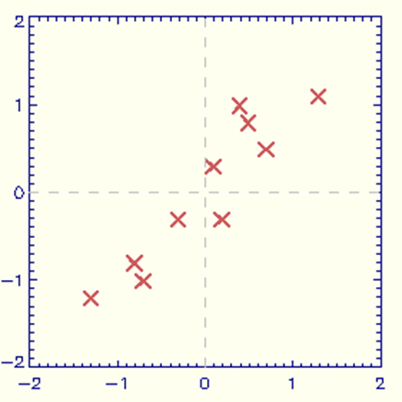
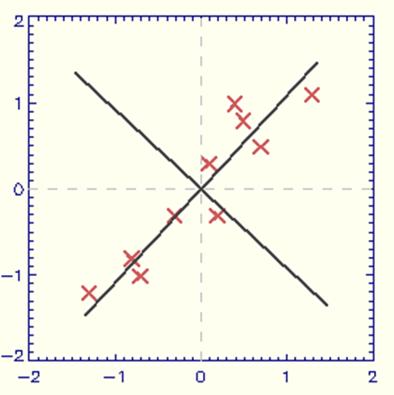
Later: Dimensionality Reduction e.g.,(Linear) Principal Components Analysis
PCA finds a linear mapping of dataset X to a dataset X’ of lower dimensionality. The variance of X that is remained in X’ is maximal.
Dataset X is mapped to dataset X’, here of the same dimensionality. The first dimension in X’ (= the first principal component) is the direction of maximal variance. The second principal component is orthogonal to the first.

Slide 38



Later: Dimensionality Reduction e.g.,(Linear) Principal Components Analysis
PCA finds a linear mapping of dataset X to a dataset X’ of lower dimensionality. The variance of X that is remained in X’ is maximal.
$$g_{1}$$
$$X_{2}$$
$$X_{1}$$
Dataset X is mapped to dataset X’, here of the same dimensionality. The first dimension in X’ (= the first principal component) is the direction of maximal variance. The second principal component is orthogonal to the first.

Slide 39
Today: Feature Selection
Selecting p’ original features from p Features
Task
Representation
Filter / Wrapper / Embedded
Score Function
Improve Classification / Regression
Search/Optimization
Univariate / Combinatorial Search?
Models, Parameters
Selected p’ features’ index

Slide 40
Model Selection and Assessment
Model Selection
Estimating performances of different models to choose the best one
Model Assessment
Having chosen a model, estimating the prediction error on new data

Slide 41
Model Selection and Assessment
When Data Rich Scenario: Split the dataset
When Insufficient data to split into 3 parts
Approximate validation step analytically
AIC, BIC, MDL, SRM
Efficient reuse of samples
Cross validation, bootstrap
Train Validation
Test
Model Selection
Model assessment

Slide 42
Model Selection (Hyperparameter Tuning)
train / validation / test
k-CV on train to choose hyperparameter / then test

Slide 43
need to make assumptions that are able to generalize
Underfitting: model is too “simple” to represent all the relevant characteristics
High bias and low variance
High training error and high test error
Overfitting: model is too “complex” and fits irrelevant characteristics (noise) in the data
Low bias and high variance
Low training error and high test error
A Gentle Touch of Bias - Variance Tradeoff
(More details … Later)

Slide 44
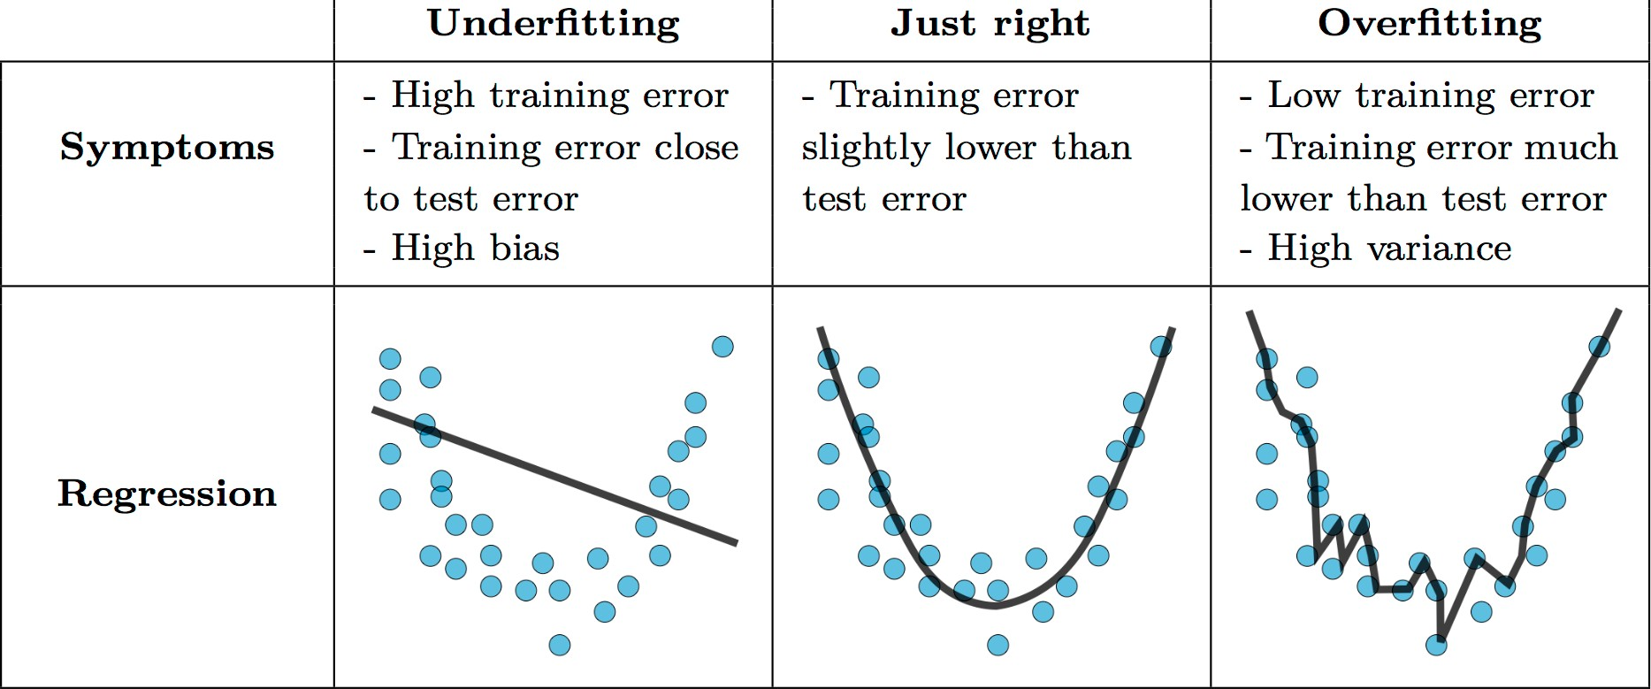
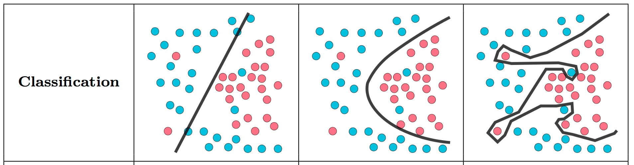
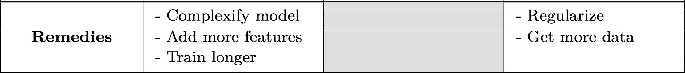
9/25/19 Dr. Yanjun Qi / UVA CS 51

Slide 45
need to make assumptions that are able to generalize
Components
Bias: how much the average model over all training sets differ from the true model?
Error due to inaccurate assumptions/simplifications made by the model
Variance: how much models estimated from different training sets differ from each other

Slide 46
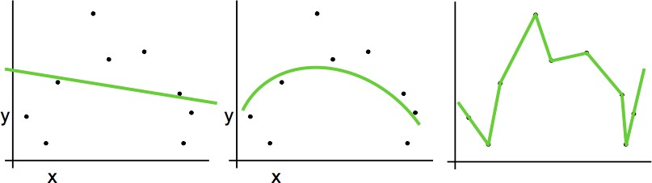







Randomness of Train Set → Variance of Models, e.g.,
$$\hat{θ_{1}}$$
$$\hat{θ_{2}}$$
$$\hat{θ_{2}}$$
$$\hat{θ_{2}}$$
$$\hat{θ_{1}}$$
$$\hat{θ_{1}}$$
Eg. removing one training sample
Model complexity$↑⇒\text{Model} \text{variance}↑$

Slide 47
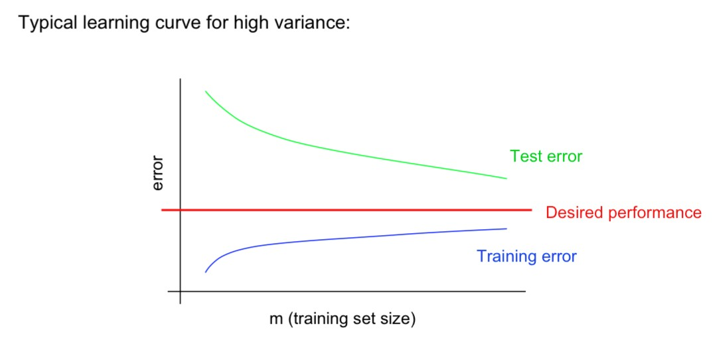
(1) Overfitting / High variance / Model too complex
overfit
Large gap
•
•
Low training error and high test error
Test error still decreasing as m increases. Suggests larger training set will help. Large gap between training and test error.
Dr. Yanjun Qi / UVA CS 54

Slide 48
How to reduce Model High Variance?
Choose a simpler classifier
More Bias
Regularize the parameters
More Bias
Get more training data
Try smaller set of features
More Bias

Slide 49
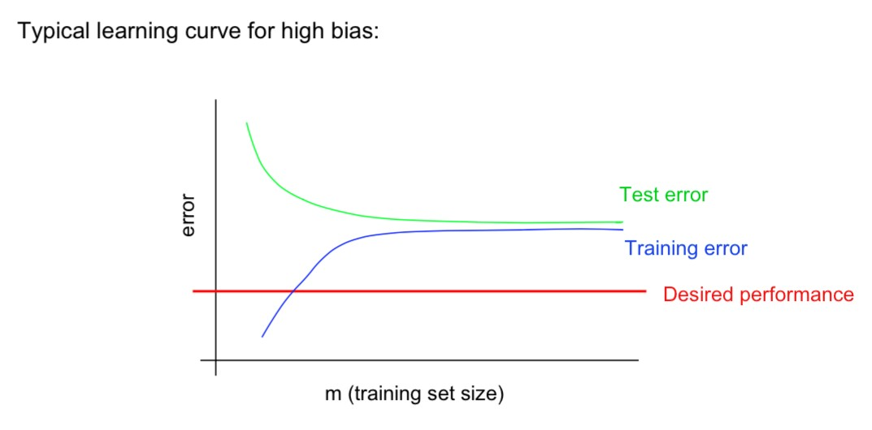
(2) Underfitting / High bias / Model too simple
underfit
Very close
Even training error is unacceptably high.
Small gap between training and test error.
High training error and high test error
Dr. Yanjun Qi / UVA CS

Slide 50
How to reduce Model High Bias ?
E.g.
Get additional features
Try more complex learner

Slide 51
References
https://qiyanjun.github.io/2019f-UVA-CS6316-MachineLearning/
https://www.wikipedia.org/

Slide 52
Thanks for listening

Slide 53
(b) Search: search strategies for selecting feature subset
Forward selection or backward elimination.
Beam search: keep k best path at each step.
GSFS: generalized sequential forward selection – when (n-k) features are left try all subsets of g features. More trainings at each step, but fewer steps.
PTA(l,r): plus l, take away r – at each step, run SFS l times then SBS r times.
Floating search: One step of SFS (resp. SBS), then SBS (resp. SFS) as long as we find better subsets than those of the same size obtained so far.
From Dr. Isabelle Guyon

