Slide 1
Machine Learning
Lecture 11a: Support Vector Machine (Basics)
Dr. Beilun Wang
Southeast University
School of Computer Science
and Engineering

Slide 2


Roadmap

Slide 3
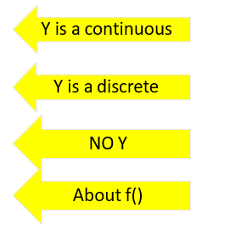
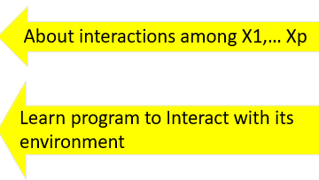
Course Content Plan
Six major sections of this course
❑ Regression (supervised)
❑ Classification (supervised)
❑ Unsupervised models
❑ Learning theory
❑ Graphical models
Reinforcement Learning

Slide 4
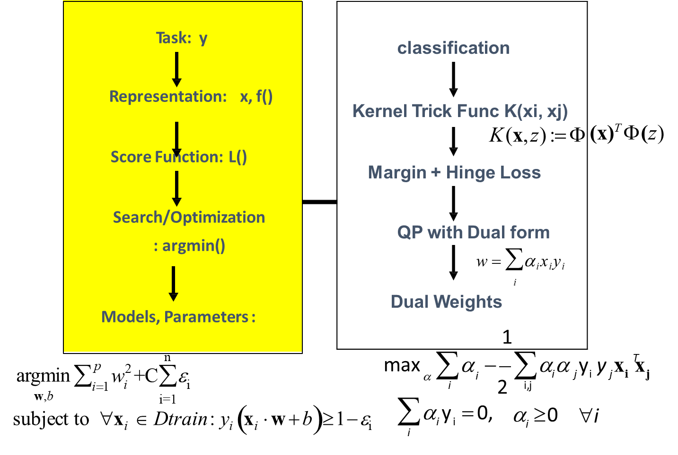
Today: Support Vector Machine

Slide 5
Today
History of SVM
Large Margin Linear Classifier
Define Margin (M) in terms of model parameter
Optimization to learn model parameters (w, b)
Linearly Non-separable case
Optimization with dual form
Nonlinear decision boundary
Practical Guide

Slide 6

Example
Foreigner
Chinese
What is the biggest difference? Masks

Slide 7
History of SVM
SVM is inspired from statistical learning theory
SVM was first introduced in 1992
SVM becomes popular because of its success in handwritten digit recognition (next) in 1994
1.1% test error rate for SVM.
The same as the error rates of a carefully constructed neural network, LeNet 4.
Regarded as an important example of “kernel methods”, arguably the hottest area in machine learning 20 years ago

Slide 8
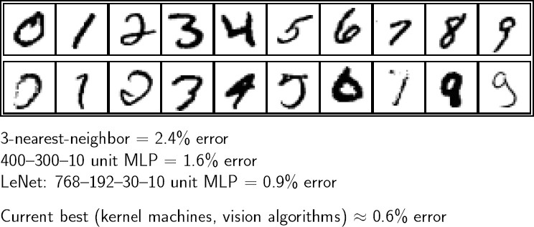
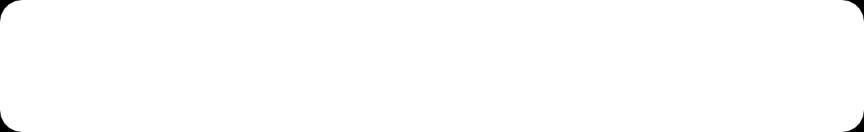
Handwritten digit recognition
MINST(SVM) 1994

Slide 9
Applications of SVMs
Computer Vision
Text Categorization
Ranking (e.g., Google searches)
Handwritten Character Recognition
Time series analysis
Bioinformatics
……….
→Lots of very successful applications!!!

Slide 10
Today
History of SVM
Large Margin Linear Classifier
Define Margin (M) in terms of model parameter
Optimization to learn model parameters (w, b)
Linearly Non-separable case
Optimization with dual form
Nonlinear decision boundary
Multiclass SVM

Slide 11
Linear Classifiers
x
f
_{y}est
denotes +1
denotes -1
How would you classify this data?

Slide 12
Linear Classifiers
X₂
x
f
_{y}est
denotes +1
denotes -1
How would you classify this data?
X₁

Slide 13
Linear Classifiers
X₂
x
f
_{y}est
denotes +1
denotes -1
How would you classify this data?
X₁

Slide 14
Linear Classifiers
X₂
x
f
_{y}est
denotes +1
denotes -1
Any of these would be fine..
..but which is best?
X₁

Slide 15
Classifier Margin
X₂
x
f
_{y}est
denotes +1
denotes -1
Define the margin of a linear classifier as the width that the boundary could be increased by before hitting a datapoint.
X₁

Slide 16
Maximum Margin
X₂
x
f
_{y}est
denotes +1
denotes -1
The maximum margin linear classifier is the linear classifier with the, maximum margin.
This is the simplest kind of SVM (Called an LSVM)
X₁
Linear SVM

Slide 17
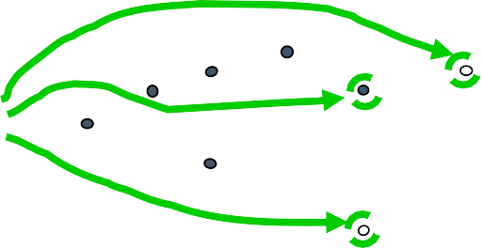
Maximum Margin
X₂
x
f
_{y}est
denotes +1
denotes -1
f(x,w,b) = sign(w^{T}x + b)
The maximum margin linear classifier is the linear classifier with the, maximum margin.
This is the simplest kind of SVM (Called an LSVM)
Support Vectors are those data points that the margin pushes up against
X₁
Linear SVM

Slide 18


Max margin classifiers
Instead of fitting all points, focus on boundary points
Learn a boundary that leads to the largest margin from both sets of points
x₂
From all the possible boundary lines, this leads to the largest margin on both sides
f(x,w,b) = sign(w^{T}x + b)
x₁

Slide 19
Max margin classifiers
Instead of fitting all points, focus on boundary points
Learn a boundary that leads to the largest margin from both sets of points
x₂
Why MAX margin?
Intuitive, ‘makes sense’
Some theoretical support (using VC dimension)
Works well in practice
D
}
D
}
f(x,w,b) = sign(w^{T}x + b)
x₁

Slide 20

Max margin classifiers
Instead of fitting all points, focus on boundary points
Learn a boundary that leads to the largest margin from both sets of points
$${\vec{W}}^{T}\vec{x}+b=0$$
x₂
That is why also known as linear support vector machines (SVMs)
D
}
D
}
f(x,w,b) = sign(w^{T}x + b)
These are the vectors supporting the boundary
x₁

Slide 21
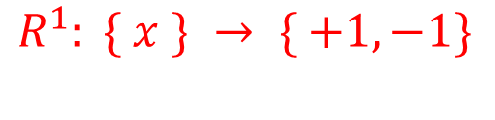

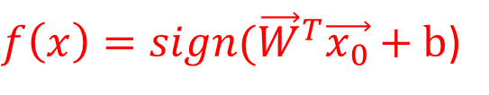
How to represent a Linear Decision Boundary?
$$R^{1}: \{ x \} → \{ +1, −1\}$$
1D case
X⁻
X⁺
-1
0
+1
X
$f\left(x\right)=sign({\vec{W}}^{T}\vec{x_{0}}+b$)
$$f\left(x\right)=\left\{\begin{aligned}W^{T}x_{0}+b=\text{0} \\ &W^{T}x^{−}+b=\text{−1} \\ W^{T}x^{+}+b=\text{1}\end{aligned}\right.$$

Slide 22



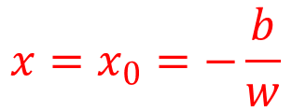


How to represent a Linear Decision Boundary?
$$x=x_{0}=−\frac{b}{w}$$
$$R^{1}: \{ x \}$$
X
x₂
$$w_{1}x_{1}+w_{2}x_{2}+b=0$$
$$R^{2}: \{x_{1},x_{2}\}$$
x₁
$$R^{Φ}: \{x_{1},x_{2},…,x_{Φ}\}$$
$${\vec{W}}^{T}\vec{x}+b=0$$

Slide 23

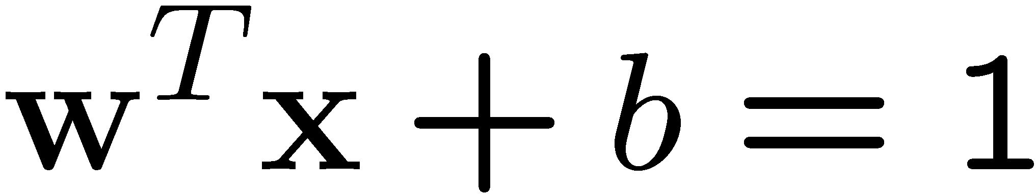
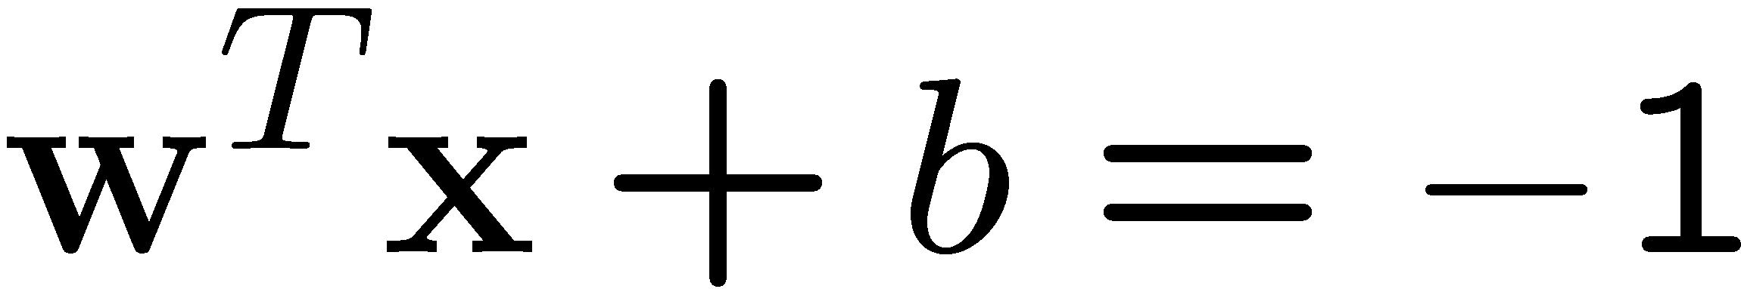
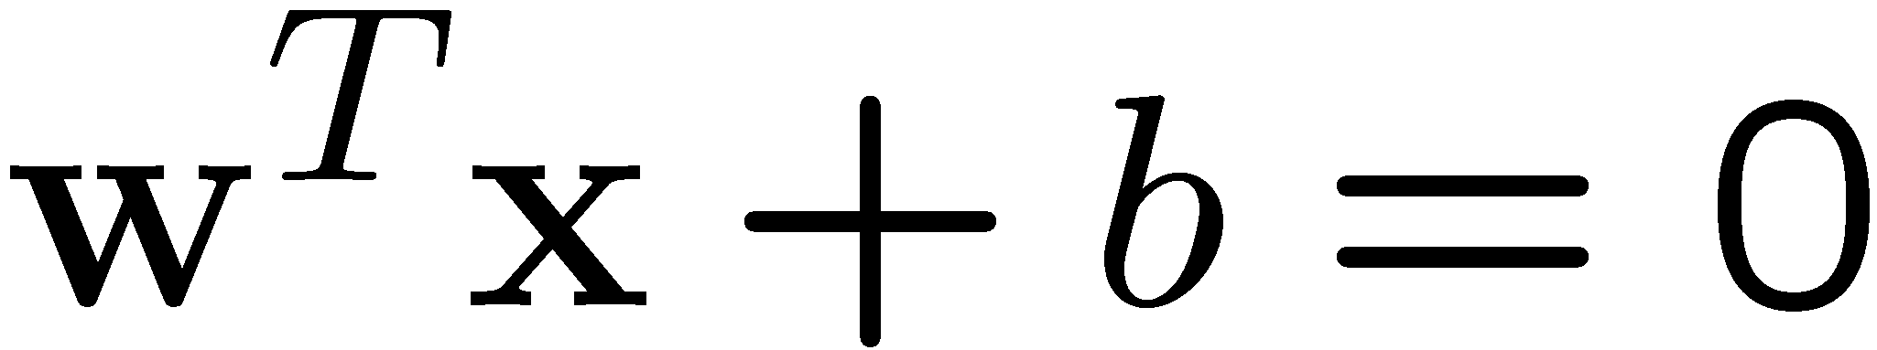


Max-margin & Decision Boundary
The decision boundary should be as far away from the data of both classes as possible
x₂
$${\vec{W}}^{T}\vec{x}+b>1$$
W is a p-dim vector; b is a scalar
Class 1
$${\vec{W}}^{T}\vec{x}+b<−1$$
Class -1
x₁

Slide 24
Specifying a max margin classifier
f(x,w,b) = sign(w^{T}x + b)
Predict class +1
Class +1 plane
Boundary
Class -1 plane
T
x+b=+1
w
T
x+b=0
w
Predict class -1
T
x+b=-1
w
Classify as +1 | if | w^{T}x+b >= 1
Classify as -1 | if | w^{T}x+b <= - 1
Undefined | if | -1 <w^{T}x+b < 1

Slide 25
Specifying a max margin classifier
Is the linear separation assumption realistic?
We will deal with this shortly, but lets assume it for now
Predict class +1
T
x+b=+1
w
T
x+b=0
w
Predict class -1
T
x+b=-1
w
Classify as +1 | if | w^{T}x+b >= 1
Classify as -1 | if | w^{T}x+b <= - 1
Undefined | if | -1 <w^{T}x+b < 1
Now assuming such lines exist in our train

Slide 26
Today
History of SVM
Large Margin Linear Classifier
Define Margin (M) in terms of model parameter
Optimization to learn model parameters (w, b)
Linearly Non-separable case
Optimization with dual form
Nonlinear decision boundary
Practical Guide

Slide 27
Maximizing the margin
Let us define the width of the margin by M
How can we encode our goal of maximizing M in terms of our parameters (w and b)?
Lets start with a few observations
Predict class +1
M
Classify as +1 | if | w^{T}x+b >= 1
Classify as -1 | if | w^{T}x+b <= - 1
Undefined | if | -1 <w^{T}x+b < 1
T
x+b=+1
w
T
x+b=0
w
Predict class -1
T
x+b=-1
w
See Concrete derivations of M in Extra slides

Slide 28
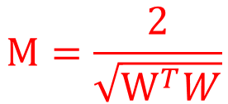
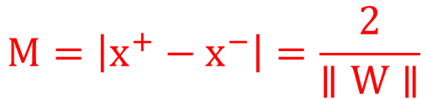

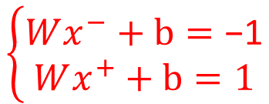
M
X
X⁻
X₀
X⁺
$$\left\{\begin{aligned}Wx^{−}+b=\text{−1} \\ &Wx^{+}+b=1\end{aligned}\right.$$
$$M=\left|x^{+}−x^{−}\right|=\frac{2}{∥W∥}$$
$$M=\frac{2}{\sqrt{W^{T}W}}$$
$$W{(x}^{+}−x^{−})=2$$
Max(M)
Min(W^{T}W)

Slide 29


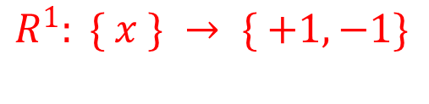
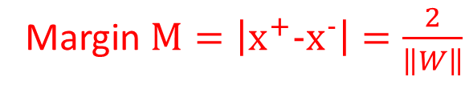


M
$$R^{1}: \{ x \} → \{ +1, −1\}$$
X
$$y=−1$$
$${\vec{W}}^{T}\vec{x}+b=0$$
$$y=+1$$
X⁻
X⁺
$$W{(x}^{+}−x^{−})=2$$
Margin $M=\left|x^{+}−x^{−}\right|=\frac{2}{\left\|W\right\|}$
Interval when 1-D x

Slide 30
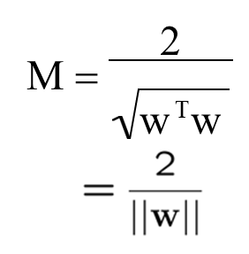
Finding the optimal parameters
We can now search for the optimal parameters by finding a solution that:
Correctly classifies all points
Maximizes the margin (or equivalently minimizes w^{T}w)
Predict class +1
M
T
x+b=+1
w
T
x+b=0
w
Predict class -1
T
x+b=-1
w

Slide 31
Today
History of SVM
Large Margin Linear Classifier
Define Margin (M) in terms of model parameter
Optimization to learn model parameters (w, b)
Linearly Non-separable case
Optimization with dual form
Nonlinear decision boundary
Multiclass SVM

Slide 32
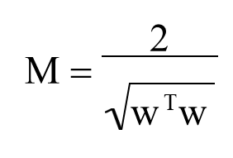

Optimization Step i.e. learning optimal parameter for SVM
X⁺
Predict class +1
M
T
x+b=+1
X⁻
w
f(x,w,b) = sign(w^{T}x + b)
T
x+b=0
w
Predict class -1
T
x+b=-1
w
Min (w^{T}w)/2
subject to the following constraints:
For all x in class + 1
w^{T}x+b >= 1
For all x in class - 1
}
A total of n constraints if we have n training samples
w^{T}x+b <= -1

Slide 33




Optimization Reformulation
f(x,w,b) = sign(w^{T}x + b)
Min (w^{T}w)/2
subject to the following constraints:
$$Pos y_{i}=1,W^{T}x_{i}+b≥1$$
}
For all x in class + 1
w^{T}x+b >= 1
For all x in class - 1
w^{T}x+b <= -1
A total of n constraints if we have n input samples
$$y_{i}(W^{T}x_{i}+b)≥1$$
y_{i}=1
$$Neg y_{i}=−1,W^{T}x_{i}+b≤−1$$
y_{i}=-1
$$y_{i}(W^{T}x_{i}+b)≥1$$

Slide 34
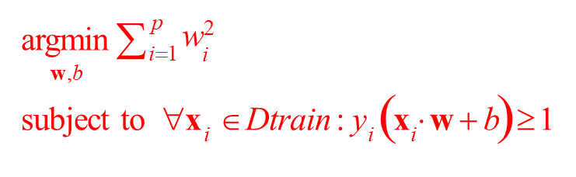
Optimization Reformulation
f(x,w,b) = sign(w^{T}x + b)
Min (w^{T}w)/2
subject to the following constraints:
Quadratic Objective
}
For all x in class + 1
w^{T}x+b >= 1
For all x in class - 1
w^{T}x+b <= -1
A total of n constraints if we have n input samples
y_{i}=1
Quadratic programming i.e.,
Quadratic objective
Linear constraints
y_{i}=-1
48

Slide 35
Next
History of SVM
Large Margin Linear Classifier
Define Margin (M) in terms of model parameter
Optimization to learn model parameters (w, b)
Linearly Non-separable case
Optimization with dual form
Nonlinear decision boundary
Practical Guide

Slide 36
References
https://qiyanjun.github.io/2019f-UVA-CS6316-MachineLearning/
B.E. Boser et al. A Training Algorithm for Optimal Margin Classifiers. Proceedings of the Fifth Annual Workshop on Computational Learning Theory 5 144-152, Pittsburgh, 1992.
L. Bottou et al. Comparison of classifier methods: a case study in handwritten digit recognition. Proceedings of the 12th IAPR International Conference on Pattern Recognition, vol. 2, pp. 77-82, 1994.
V. Vapnik. The Nature of Statistical Learning Theory. 2nd edition, Springer, 1999.

Slide 37
References
Big thanks to Prof. Ziv Bar-Joseph and Prof. Eric Xing @ CMU for allowing me to reuse some of his slides
Elements of Statistical Learning, by Hastie, Tibshirani and Friedman
Prof. Andrew Moore @ CMU’s slides
Tutorial slides from Dr. Tie-Yan Liu, MSR Asia
A Practical Guide to Support Vector Classification Chih-Wei Hsu, Chih-Chung Chang, and Chih-Jen Lin, 2003-2010
Tutorial slides from Stanford “Convex Optimization I — Boyd & Vandenberghe

Slide 38
EXTRA

Slide 39
How to define the width of the margin by M
X⁺
Classify as +1 | if | w^{T}x+b >= 1
Classify as -1 | if | w^{T}x+b <= - 1
Undefined | if | -1 <w^{T}x+b < 1
Predict class +1
M
T
x+b=+1
X⁻
w
T
x+b=0
w
Predict class -1
T
x+b=-1
w
How to represent ||x⁺-x⁻||?

Slide 40
Maximizing the margin: observation1
Observation 1: the vector w is orthogonal to the +1 plane
Why?
X⁺
Predict class +1
M
Classify as +1 | if | w^{T}x+b >= 1
Classify as -1 | if | w^{T}x+b <= - 1
Undefined | if | -1 <w^{T}x+b < 1
T
x+b=+1
X⁻
w
T
x+b=0
w
Predict class -1
T
x+b=-1
w

Slide 41
Review : Vector Product, Orthogonal, and Norm
For two vectors x and y,
x^{T}y
is called the (inner) vector product.
x and y are called orthogonal if
x^{T}y = 0
The square root of the product of a vector with itself,
is called the 2-norm ( ||x||₂ ), can also write as ||x||

Slide 42
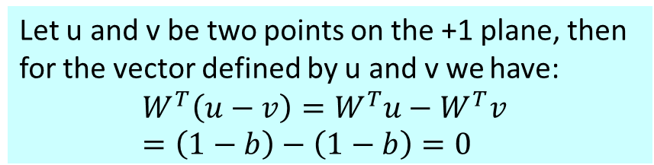
Maximizing the margin: observation1
Observation 1: the vector w is orthogonal to the +1 plane
Why?
v
X⁺
Predict class +1
M
Classify as +1 | if | w^{T}x+b >= 1
Classify as -1 | if | w^{T}x+b <= - 1
Undefined | if | -1 <w^{T}x+b < 1
u
T
x+b=+1
X⁻
w
T
x+b=0
w
Predict class -1
T
x+b=-1
w
Let u and v be two points on the +1 plane, then for the vector defined by u and v we have:
$$W^{T}\left(u−v\right)=W^{T}u−W^{T}v=\left(1−b\right)−\left(1−b\right)=0$$
Corollary: the vector w is orthogonal to the -1 plane (u-v)
Notes:
这页对应L11basic的59页，把那一串手写的式子加一下

Slide 43
Maximizing the margin: observation2
Observation 1: the vector w is orthogonal to the +1 plane
Observation 2: if x⁺ is a point on the +1 plane and x⁻ is the
closest point to x⁺ on the -1 plane then
x⁺ = λ w + x⁻
X⁺
Predict class +1
M
Classify as +1 | if | w^{T}x+b >= 1
Classify as -1 | if | w^{T}x+b <= - 1
Undefined | if | -1 <w^{T}x+b < 1
T
x+b=+1
X⁻
w
T
x+b=0
w
Predict class -1
T
x+b=-1
w
Since w is orthogonal to both planes we need to ‘travel’ some distance along w to get from x⁺ to x⁻

Slide 44
Putting it together
X⁺
w^{T} x⁺ + b = +1
w^{T} (λw + x⁻) + b = +1
w^{T}x⁻ + b + λw^{T}w = +1
-1 + λw^{T}w = +1
λ = 2/w^{T}w
Predict class +1
M
T
x+b=+1
X⁻
w
T
x+b=0
w
Predict class -1
T
x+b=-1
w
w^{T} x⁺ + b = +1
w^{T} x⁻ + b = -1
x⁺ = λw + x⁻
| x⁺ - x⁻ | = M
We can now define M in terms of w and b

Slide 45
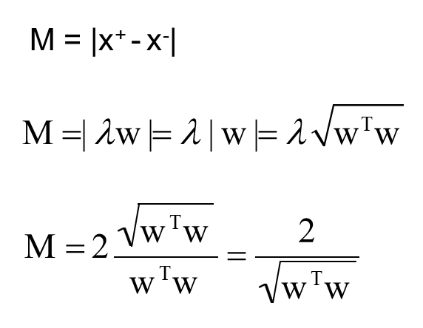
Putting it together
X⁺
Predict class +1
M
T
x+b=+1
X⁻
w
T
x+b=0
w
Predict class -1
T
x+b=-1
w
w^{T} x⁺ + b = +1
w^{T} x⁻ + b = -1
x⁺ = λw + x⁻
| x⁺ - x⁻ | = M
λ = 2/w^{T}w
Max(M)
Min(W^{T}W)
We can now define M in terms of w and b

Slide 46
Thanks for listening

