Slide 1
Machine Learning
Lecture 11b: Support Vector Machine (SVM Optimization and Dual basic)
Dr. Beilun Wang
Southeast University
School of Computer Science
and Engineering

Slide 2
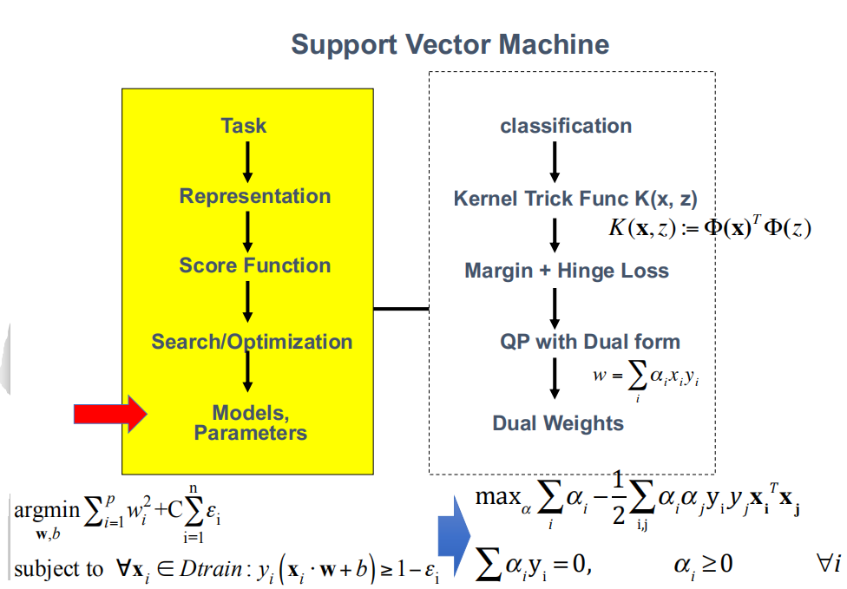

Slide 3

Today
Support Vector Machine (SVM)
History of SVM
Large Margin Linear Classifier
Define Margin (M) in terms of model parameter
Optimization to learn model parameters (w, b)
Linearly Non-separable case (soft SVM)
Optimization with dual form
Nonlinear decision boundary
Practical Guide
$$k(x,z)$$

Slide 4
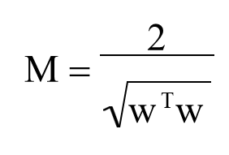

Optimization Step i.e. learning optimal parameter for SVM
X⁺
Predict class +1
M
T
x+b=+1
X⁻
w
T
x+b=0
w
Predict class -1
T
x+b=-1
w

Slide 5




Optimization Reformulation
f(x,w,b) = sign(w^{T}x + b)
Min (w^{T}w)/2
subject to the following constraints:
$$Pos y_{i}=1,W^{T}x_{i}+b≥1$$
}
For all x in class + 1
w^{T}x+b >= 1
For all x in class - 1
w^{T}x+b <= -1
A total of n constraints if we have n input samples
$$y_{i}(W^{T}x_{i}+b)≥1$$
y_{i}=1
$$Neg y_{i}=−1,W^{T}x_{i}+b≤−1$$
y_{i}=-1
$$y_{i}(W^{T}x_{i}+b)≥1$$

Slide 6
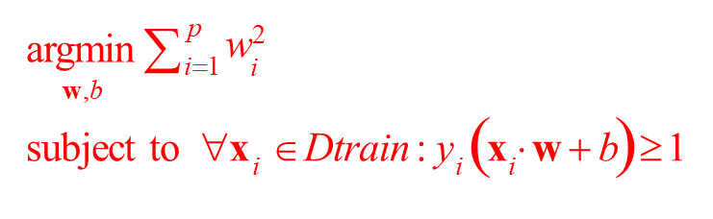
Optimization Reformulation
f(x,w,b) = sign(w^{T}x + b)
Min (w^{T}w)/2
subject to the following constraints:
}
For all x in class + 1
w^{T}x+b >= 1
For all x in class - 1
w^{T}x+b <= -1
A total of n constraints if we have n input samples
y_{i}=1
y_{i}=-1

Slide 7


Linearly Non separable case
So far we assumed that a linear hyperplane can perfectly separate the points
But this is not usually the case
How can we convert this to a QP problem?
- Minimize training errors? min w^{T}w/2
min #errors
Hard to solve (two minimization problems)

Slide 8

Linearly Non separable case
So far we assumed that a linear hyperplane can perfectly separate the points
But this is not usually the case
How can we convert this to a QP problem?
Minimize training errors?
min w^{T}w/2
min #errors
Penalize training errors: min w^{T}w/2+C*(#errors)
Hard to solve (two minimization problems)
Hard to encode in a QP problem

Slide 9


Linearly Non separable case
Instead of minimizing the number of misclassified points, we can minimize the distance between these points and their correct plane
+1 plane
The new optimization problem is:
-1 plane
ε_{j}
$$\min_{w}\frac{w^{T}w}{2}+C\sum_{i=1}^{n}{ε_{i}}$$
ε
k

Slide 10



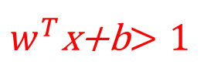


Linearly Non separable case
Instead of minimizing the number of misclassified points, we can minimize the distance between these points and their correct plane
The new optimization problem is:
$$\min_{w}\frac{w^{T}w}{2}+C\sum_{i=1}^{n}{ε_{i}}$$
$w^{T}$x+b$>1$
+1 plane
subject to the following inequality constraints:
For all x_{i} in class + 1
w^{T}x_{i}+b >= 1- ε _{i}
-1 plane
$$ε_{i}≥0$$
ε
ε
k
j
For all${ x}_{i}$in class - 1
w^{T}x_{i}+b <= -1+ε _{i}
Wait. Are we missing
something?

Slide 11
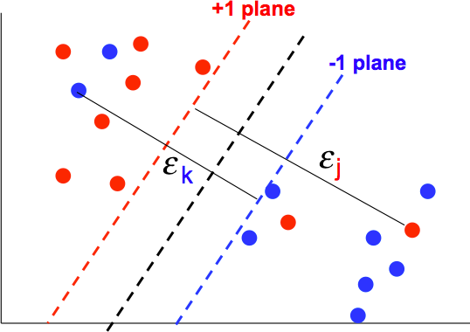
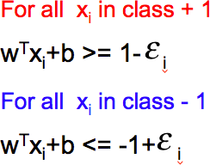
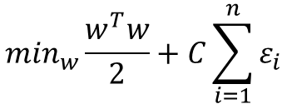
Final optimization for linearly non-separable case
The new optimization problem is:
$$\min_{w}\frac{w^{T}w}{2}+C\sum_{i=1}^{n}{ε_{i}}$$
subject to the following inequality constraints:
}
A total of n constraints
For all i
}
ε ≥ 0
Another n constraints
i

Slide 12
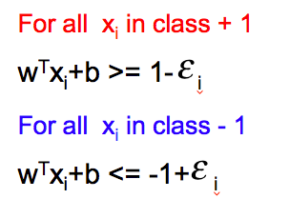

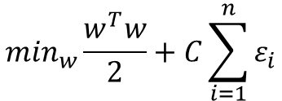
Two optimization problems: For the separable and non separable cases
separable
non separable
$$\min_{w}\frac{w^{T}w}{2}$$
$$\min_{w}\frac{w^{T}w}{2}+C\sum_{i=1}^{n}{ε_{i}}$$
For all x in class + 1
w^{T}x+b >= 1
For all x in class - 1
w^{T}x+b <=-1
For all i
ε_{i} ≥ 0

Slide 13
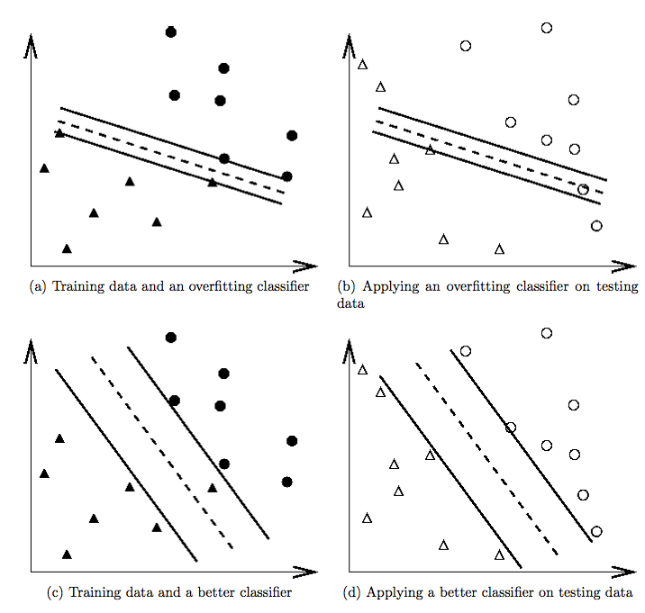
Model Selection, find right C
Training
Test
Large C
Select the right penalty parameter C
Small C

Slide 14
Model Selection, find right C
A large value of C means that misclassifications are bad - resulting in smaller margins and less training error (but may lead more expected true error).
A small C results in more training error, hopefully better true error.

Slide 15



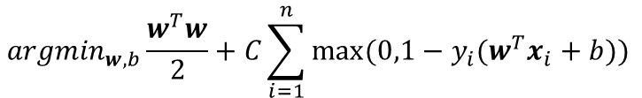
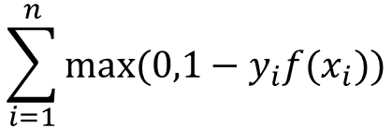

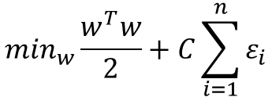


Hinge Loss for Soft SVM
$$\sum_{i=1}^{n}{max⁡(0,1−y_{i}f(x_{i}))}$$
$$\min_{w}\frac{w^{T}w}{2}+C\sum_{i=1}^{n}{ε_{i}}$$
$${argmin}_{w,b}\frac{w^{T}w}{2}+C\sum_{i=1}^{n}{max⁡(0,1−y_{i}(w^{T}x_{i}+b)) }$$
soft
subject to:
$$≥1$$
$$<1$$
$$y_{i}\left(w^{T}x_{i}+b\right)≥1−ε_{i}$$
$${ ε}_{i}≥0$$
For all i
ε ≥ 0
i
argmin
w,b
∑
p i=1
w² / 2
vs. Hard SVM
i
subject to ∀
$$x_{i}∈Dtrain:y_{i}\left(w^{T}x_{i}+b\right)≥1$$

Slide 16
Hinge Loss for Soft SVM

Slide 17
Today
Support Vector Machine (SVM)
History of SVM
Large Margin Linear Classifier
Define Margin (M) in terms of model parameter
Optimization to learn model parameters (w, b)
Linearly Non-separable case (soft SVM)
Optimization with dual form
Nonlinear decision boundary
Practical Guide

Slide 18
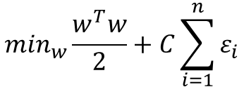

Two optimization problems: For the separable and non separable cases
separable
non separable
$$\min_{w}\frac{w^{T}w}{2}$$
$$\min_{w}\frac{w^{T}w}{2}+C\sum_{i=1}^{n}{ε_{i}}$$
For all x in class + 1
w^{T}x+b >= 1
For all x in class - 1
w^{T}x+b <=-1
For all i
ε_{i} ≥ 0
Instead of solving these QPs directly, we will solve a dual formulation of the SVM optimization problem
The main reason for switching to this type of representation is that it would allow us to use a neat trick that will make our lives easier (and the run time faster)

Slide 19
Optimization Review: Ingredients
Objective function
Variables
Constraints
Find values of the variables that minimize or maximize the objective function while satisfying the constraints

Slide 20
Optimization Review: Constrained Optimization
min_{u} u²
s.t. u >= b
Allowed min
0
Global min
Case 1:
b
Allowed min
0
Global min
b
Case 2:

Slide 21
Optimization Review: Constrained Optimization
min_{u} u²
s.t. u >= b
Allowed min
0
Global min
Case 1:
b
Allowed min
0
Global min
b
Case 2:

Slide 22
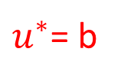

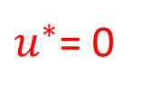

Optimization Review: Constrained Optimization
min_{u} u²
s.t. u >= b
b > 0
Allowed min
$$f\left(u^{∗}\right)=b^{2}$$
0
Global min
Case 1:
b
$u^{∗}$= b
b < 0
Allowed min
$$f\left(u^{∗}\right)=0$$
0
Global min
b
b
$u^{∗}$= 0
Case 2:

Slide 23

Optimization Review: Dual Problem
Solving dual problem if the dual form is easier than primal form
Need to change primal minimization to dual maximization (or Need to change primal maximization to dual minimization)
Primal Problem
Strong duality
Dual Problem,
Only valid when the original optimization problem is convex / concave (strong duality)

Slide 24

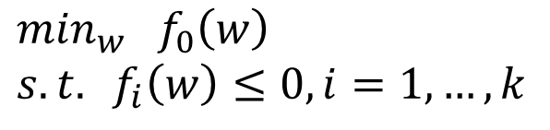



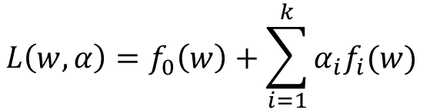
Optimization Review: Lagrangian Duality
“Method of Lagrange multipliers” convert to a higher-dimensional problem
The Primal Problem
$$\min_{w} f_{0}\left(w\right)$$
$$s.t. f_{i}\left(w\right)≤0, i=1,…,k$$
Primal:
The generalized Lagrangian:
$$L\left(w,α\right)=f_{0}\left(w\right)+\sum_{i=1}^{k}{α_{i}f_{i}(w)}$$
the $α^{′}s\left(α_{i}≥0\right)$are called the Lagarangian multipliers
Lemma:
$$f_{0}\left(w\right)$$
if w satisfies primal constraints
$$max_{α≥0}L\left(w,α\right)=$$
$∞$ otherwise
A re-written Primal:
$$mⅈn_{w}max_{α≥0}L\left(w,α\right)$$

Slide 25


Optimization Review: Lagrangian Duality, cont.
Recall the Primal Problem:
The Dual Problem:
$$mⅈn_{w}max_{α≥0}L\left(w,α\right)$$
$$max_{α≥0}mⅈn_{w}L\left(w,α\right)$$
Theorem (weak duality):
$$d^{∗}=max_{α≥0}mⅈn_{w}L\left(w,α\right)≤mⅈn_{w}max_{α≥0}L\left(w,α\right)=p^{∗}$$
Theorem (strong duality):
Iff there exist a saddle point of L(w,α )
we have
d * = p*

Slide 26
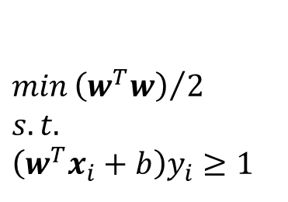
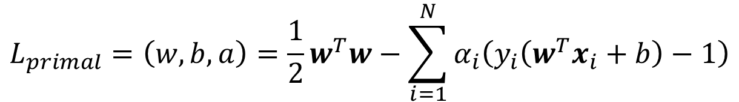
Dual representation of the hard SVM QP
We will start with the linearly separable case
Instead of encoding the correct classification rule and constraint, we will use Lagrange multiplies to encode it as part of the our minimization problem
$$min{\left(w^{T}w\right)}/2$$
$$s.t.$$
$$\left(w^{T}x_{i}+b\right)y_{i}≥1$$
Recall that Lagrange multipliers can be applied to turn the following problem:
$$L_{primal}=\left(w,b,a\right)=\frac{1}{2}w^{T}w−\sum_{i=1}^{N}{α_{i}\left(y_{i}\left(w^{T}x_{i}+b\right)−1\right)}$$

Slide 27
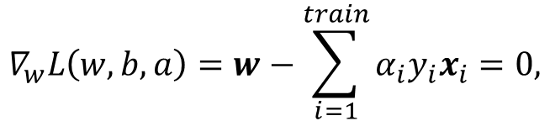

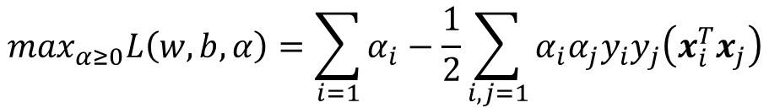
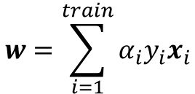
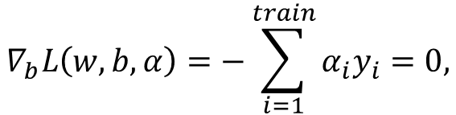
The Dual Problem
$$\max_{α≥0}\min_{w,b}L(w,b,a)$$
We minimize L with respect to w and b first:
$$∇_{w}L\left(w,b,a\right)=w−\sum_{i=1}^{train}{α_{i}y_{i}x_{i}}=0,$$
(1)
(2)
(3)
$$∇_{b}L\left(w,b,α\right)=−\sum_{i=1}^{train}{α_{i}y_{i}}=0,$$
$$w=\sum_{i=1}^{train}{α_{i}y_{i}x_{i}}$$
Note that (1) implies:
Plus (3) back to L , and using (2), we have:
$$\max_{α≥0}L\left(w,b,α\right)=\sum_{i=1}{α_{i}−\frac{1}{2}\sum_{i,j=1}{α_{i}α_{j}y_{i}y_{j}\left(x_{i}^{T}x_{j}\right)}}$$

Slide 28
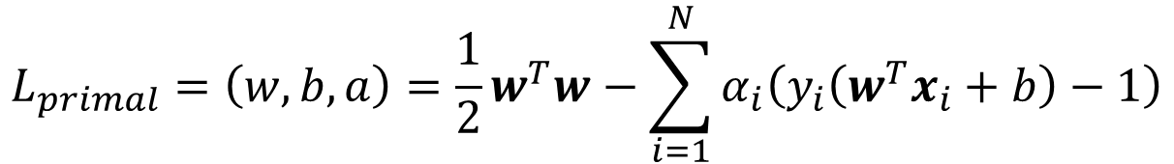
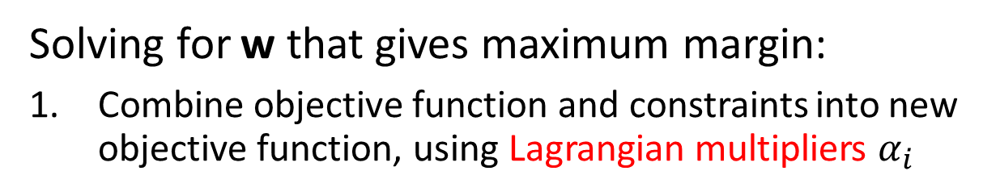
Summary: Dual for hard SVM
Solving for w that gives maximum margin:
1. Combine objective function and constraints into new objective function, using Lagrangian multipliers $α_{i}$
$$L_{primal}=\left(w,b,a\right)=\frac{1}{2}w^{T}w−\sum_{i=1}^{N}{α_{i}\left(y_{i}\left(w^{T}x_{i}+b\right)−1\right)}$$
2. To minimize this Lagrangian, we take derivatives of w and
b and set them to 0

Slide 29
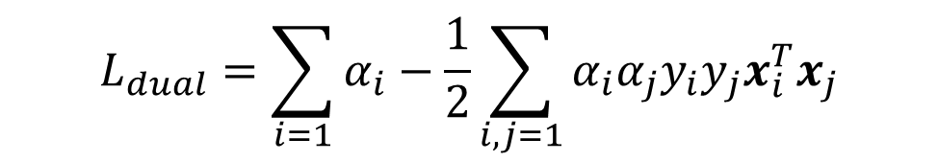
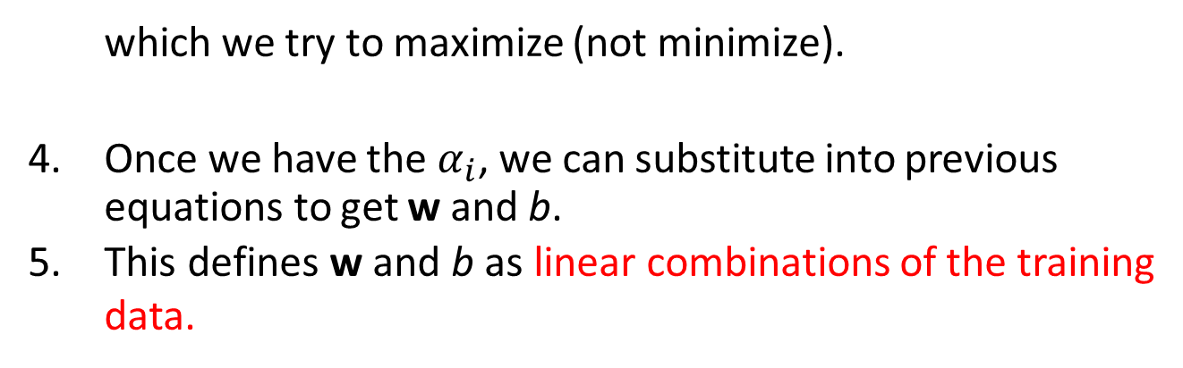

Summary: Dual for hard SVM
3. Substituting and rearranging gives the dual of the Lagrangian:
$$L_{dual}=\sum_{i=1}{α_{i}−\frac{1}{2}\sum_{i,j=1}{α_{i}α_{j}y_{i}y_{j}x_{i}^{T}x_{j}}}$$
which we try to maximize (not minimize).
Once we have the $α_{i}$, we can substitute into previous equations to get w and b.
This defines w and b as linear combinations of the training data.
$$w=\sum_{i=1}^{train}{α_{i}y_{i}x_{i}}$$

Slide 30
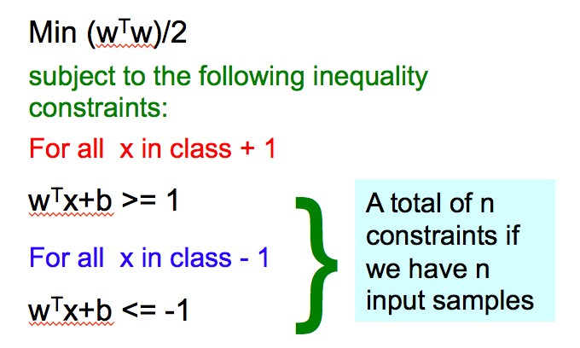

Summary: Dual SVM for linearly separable case
Dual formulation
∑
1
2
∑
α −
α α y y x x
max
T
α
i
i j i j i j
i
i,j
∑α_{i} y_{i} = 0
i
α_{i} ≥ 0
∀i
Easier than original QP, more efficient algorithms exist to find α_{i}

Slide 31
Dual formulation for linearly non-separable case
Dual target function:
1
2
∑
α −
∑
T
max
α α y y x x
α
i
i j i j i j
i
i,j
∑α_{i} y_{i} = 0
Hyperparameter C should be tuned through k-folds CV
i
C ≥ α_{i} ≥ 0,∀i
This is very similar to the optimization problem in the linear separable case, except that there is an upper bound C on α_{i} now
Once again, efficient algorithm exist to find α_{i}
The only difference is that the α are now bounded
27

Slide 32
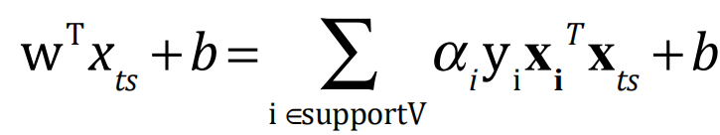
Prediction via Dual Weights for linear case
To evaluate a new sample x_{ts} we need to compute:
Dual target function:
1
2
∑
α −
∑
T
max
α α y y x x
α
i
i j i j i j
i
i,j
∑α_{i} y_{i} = 0
Hyperparameter C should be tuned through k-folds CV
This is very similar to the optimization problem in the linear separable case, except that there is an upper bound C on α_{i} now
Once again, efficient algorithm exist to find α_{i}
i
C ≥ α_{i} ≥ 0,∀i
The only difference is that the α are now bounded

Slide 33
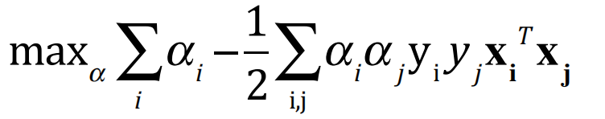
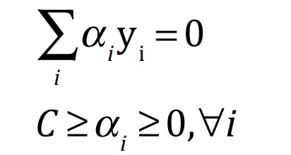


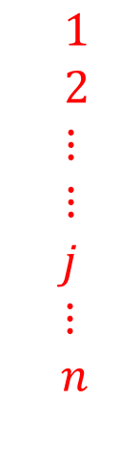
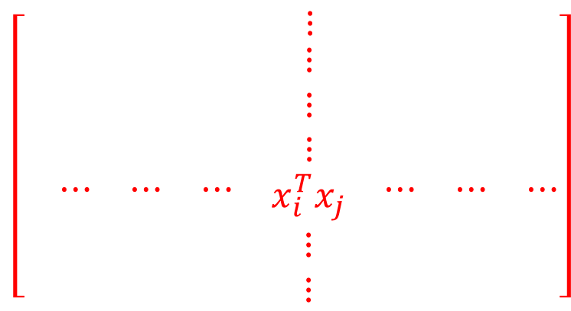
Dual SVM – Training using Kernel matrix (next)
Our dual target function:
Dot product among all training samples
$$1 2 ⋯ i ⋯ ⋯ n$$
$$\left[\begin{matrix}\begin{matrix}\begin{matrix} & & \end{matrix} & ⋮ & \end{matrix} & & \\ \begin{matrix}\begin{matrix}\begin{matrix} \\ \\ \end{matrix} & \begin{matrix} \\ \\ \end{matrix} & \end{matrix} & \begin{matrix}⋮ \\ ⋮ \\ ⋮\end{matrix} & \begin{matrix} \\ \\ \end{matrix}\end{matrix} & \begin{matrix} \\ \\ \end{matrix} & \begin{matrix} \\ \\ \end{matrix} \\ \begin{matrix}\begin{matrix}\begin{matrix} ⋯ \\ \\ \end{matrix} & \begin{matrix}⋯ \\ \\ \end{matrix} & \begin{matrix}⋯ \\ \\ \end{matrix}\end{matrix} & \begin{matrix}x_{i}^{T}x_{j} \\ ⋮ \\ ⋮\end{matrix} & \begin{matrix}⋯ \\ \\ \end{matrix}\end{matrix} & \begin{matrix}⋯ \\ \\ \end{matrix} & \begin{matrix}⋯ \\ \\ \end{matrix}\end{matrix}\right]$$
matrix
$1$
$2$
$⋮$
$⋮$
$$j$$
$$⋮$$
$$n$$
$$n×n$$

Slide 34

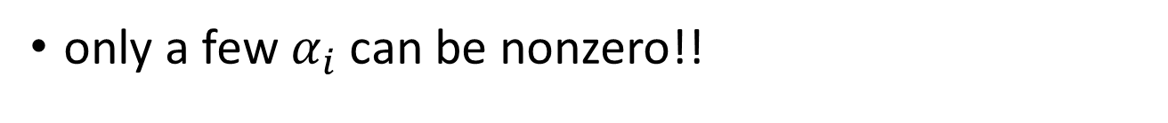

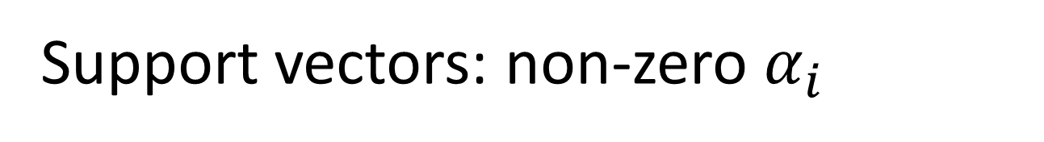



Support vectors: non-zero $α_{i}$
only a few${ α}_{i}$ can be nonzero!!
$$α_{i}\left(y_{i}\left(ω^{T}x_{i}+b\right)−1\right)=0 , i=1,2,…,n$$
$$y_{i}\left(ω^{T}x_{i}+b\right)>1⇒α_{i}=0$$
$$α_{i}=0$$
+1
$$ω^{T}x+b=1$$
$$α_{i}>0$$
-1
$$ω^{T}x+b=−1$$

Slide 35






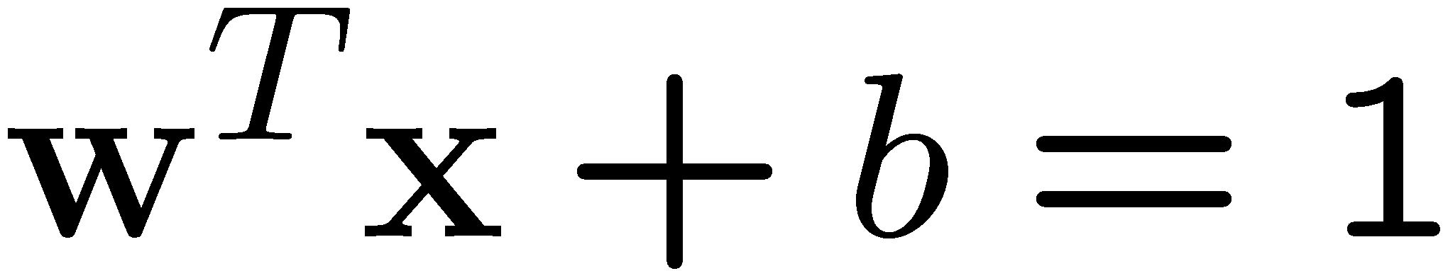
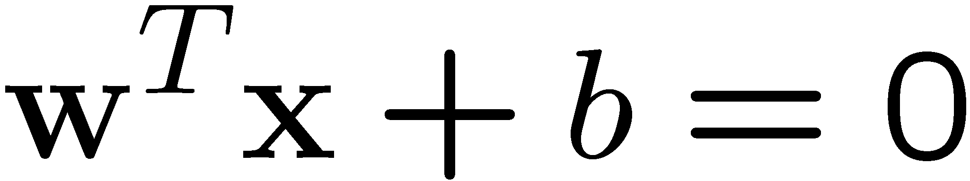
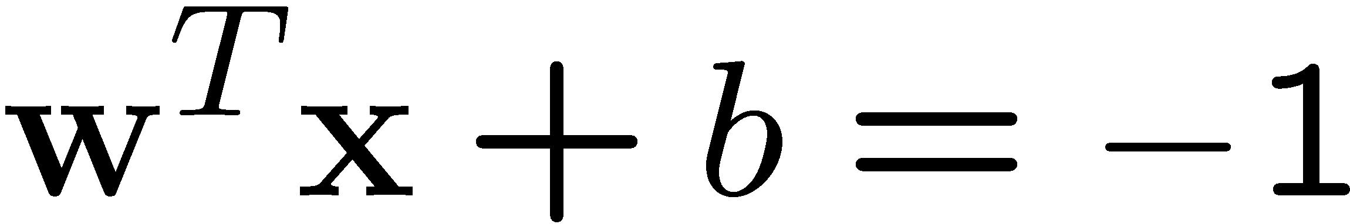

α_{i} ( y_{i} (w ⋅ x_{i} + b)− 1)= 0,
i = 1,…,n
Class 2
$$most α_{i}=0$$
α₈=0.6
α₁₀=0
Hard SVM
α₇=0
α₂=0
α₅=0
α₁=0.8
α₄=0
α₆=1.4
α₉=0
Class 1
α₃=0

Slide 36


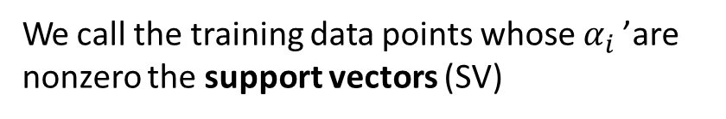

Support vectors: non-zero $α_{i}$
only a few $α_{i}$ can be nonzero!
$$for most{ α}_{i}: α_{i}=0$$
We call the training data points whose $α_{i}$’ are nonzero the support vectors (SV)

Slide 37

Dual SVM – Interpretation
training points
w = ∑α_{i} x_{i} y_{i}
i
$$α_{i}≥0$$
For α _{i} that are 0, no influence

Slide 38
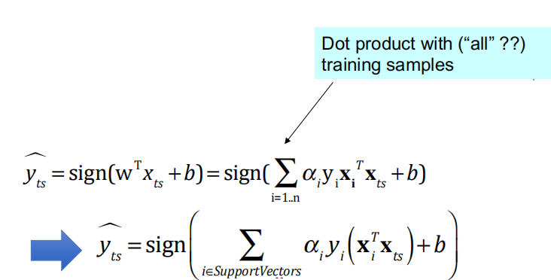


Dual SVM – Testing
To evaluate a new sample x_{ts}, we need to compute:
$$⇒$$
$$α_{i}≥0$$
For α_{i} that are 0, no influence

Slide 39



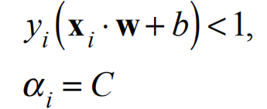



Support Vectors for the Soft-SVM
Support vectors are:
samples on the margin:
Samples violating the margin (mostly inside the margin area):
+1
$$α=0$$
-1
$$α=c$$
$$α=0$$

Slide 40
Next
Support Vector Machine (SVM)
History of SVM
Large Margin Linear Classifier
Define Margin (M) in terms of model parameter
Optimization to learn model parameters (w, b)
Non linearly separable case
Optimization with dual form
Nonlinear decision boundary
Practical Guide

Slide 41
Thanks for listening

Slide 42
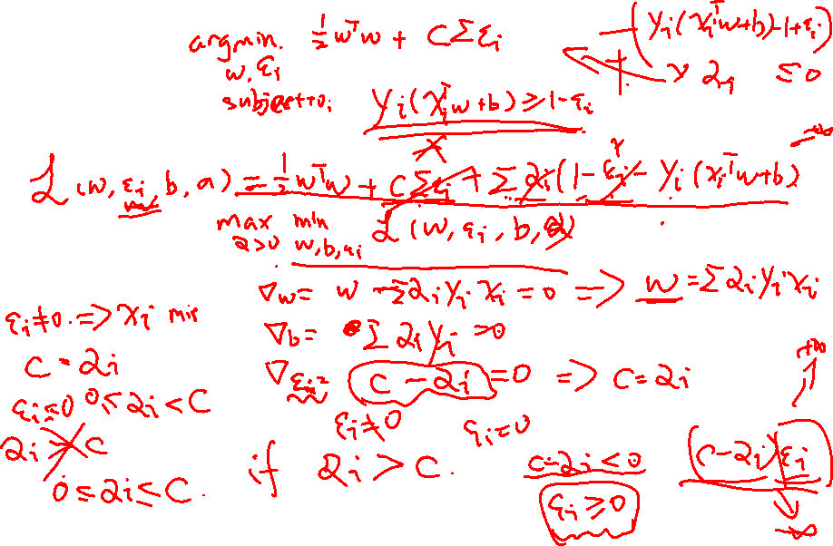
Extra: Derivation for soft SVM

Slide 43
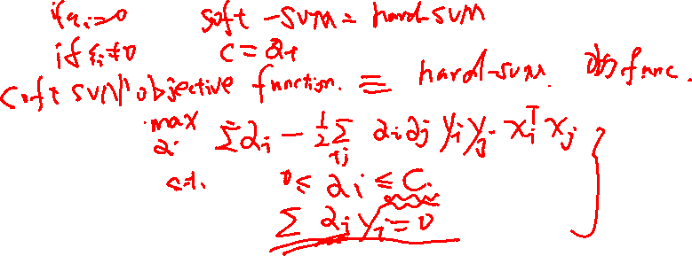
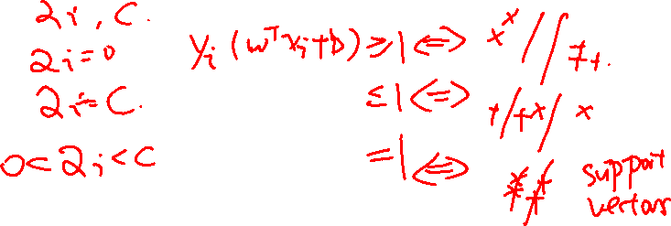
Extra: Derivation for soft SVM

