Slide 1
Machine Learning
Lecture 11c: Support Vector
Machine (nonlinear) Kernel Trick
and in Practice
Dr. Beilun Wang
Southeast University
School of Computer Science
and Engineering

Slide 2
Today
History of SVM
Large Margin Linear Classifier
Define Margin (M) in terms of model parameter
Optimization to learn model parameters (w, b)
Linearly Non-separable case
Optimization with dual form
Nonlinear decision boundary
Practical Guide

Slide 3
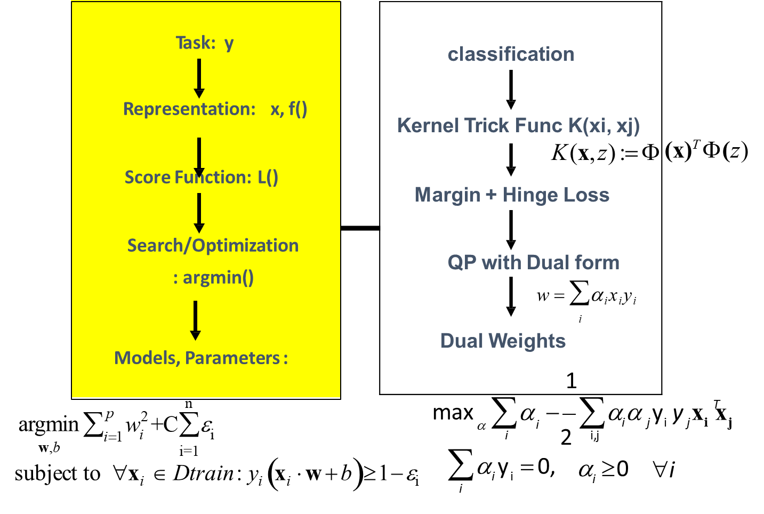
Today: Support Vector Machine

Slide 4

Example
Foreigner
Chinese
What is the biggest difference? Masks

Slide 5


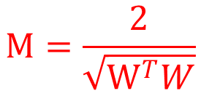
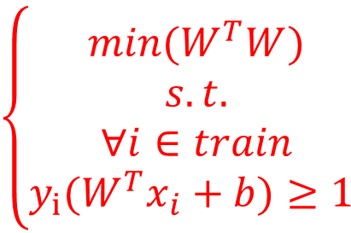
Classifying in 1-d
Can an SVM correctly classify this data?
What about this?
X⁻
X₀
X⁺
-1
+1
X
X
$$M=\frac{2}{\sqrt{W^{T}W}}$$
$$\left\{\begin{aligned}min(W^{T}W) \\ &s.t. \\ ∀i∈train \\ y_{i}(W^{T}x_{i}+b)≥1 \end{aligned}\right.$$
max(M)

Slide 6
Classifying in 1-d
Can an SVM correctly classify this data?
And now? (extend with polynomial basis)
_{X}2
X
X

Slide 7
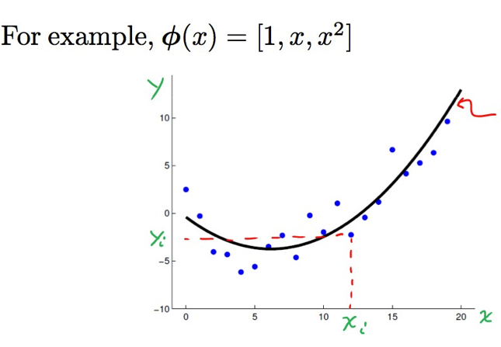


Recap: Polynomial regression
$$\hat{y}=Φ(x)θ$$
$=θ_{0}+$ ${xθ}_{1}+x^{2}θ_{2}$

Slide 8
Non-linear SVMs: 2-d
The original input space (x) can be mapped to some higher-dimensional feature space (φ(x)) where the training set is separable:
Separable/nonlinear
φ(x) =(x₁² , x₂² , 2 x₁x₂)
x=(x₁,x₂)
2 x₁x₂
X₂
Φ: x → φ(x)
X₁
x₂²
x₁²

Slide 9
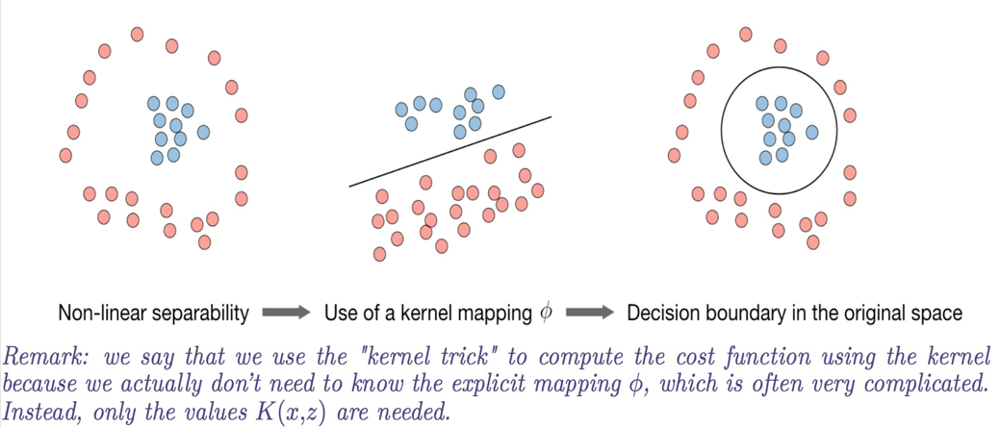


Kernel
Given a feature mapping Φ, we define the kernel K:
In practice, the kernel K defined by$K\left(x,z\right)=exp(−\frac{{\left\|x−z\right\|}^{2}}{2σ^{2}})$ is called Gaussian kernel and is commonly used.
$$K\left(x,z\right)=Φ{\left(x\right)}^{T}Φ(z)$$

Slide 10
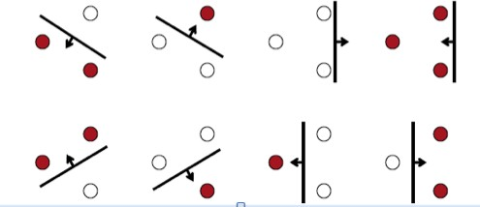
Extra: Vapnik-Chervonenkis (VC) dimension
If data is mapped into sufficiently high dimension, then samples will in general be linearly separable
N data points are in general separable in a space of N-1 dimensions or more
VC dimension of the set of oriented lines in R² is 3
It can be shown that the VC dimension of the family of oriented separating hyperplanes in R^{N} is at least N+1

Slide 11
Today: Support Vector Machine

Slide 12

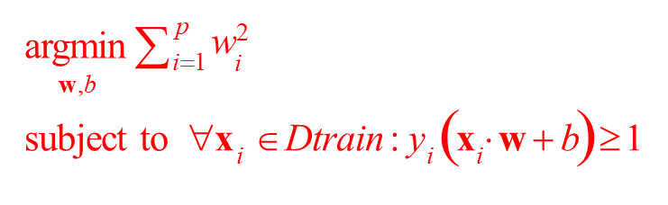
Optimization Reformulation (for linearly separable case)
f(x,w,b) = sign(w^{T}x + b)
Min (w^{T}w)/2
subject to the following constraints:
Quadratic Objective
}
For all x in class + 1
w^{T}x+b >= 1
For all x in class - 1
w^{T}x+b <= -1
A total of n constraints if we have n input samples
y_{i}=1
Quadratic programming i.e.,
Quadratic objective
Linear constraints
y_{i}=-1
48

Slide 13
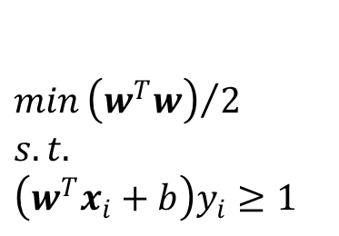
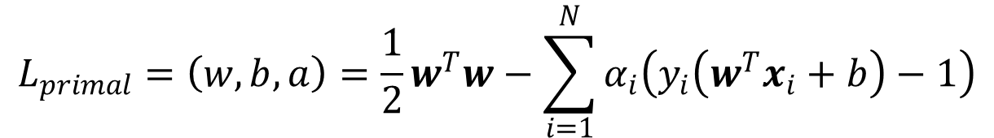
An alternative representation of the SVM QP
Instead of encoding the correct classification rule and constraint, we use Lagrange multiplies to encode it as part of the our minimization problem
$$min{\left(w^{T}w\right)}/2$$
$$s.t.$$
$$\left(w^{T}x_{i}+b\right)y_{i}≥1$$
Recall that Lagrange multipliers can be applied to turn the following problem:
$$L_{primal}=\left(w,b,a\right)=\frac{1}{2}w^{T}w−\sum_{i=1}^{N}{α_{i}\left(y_{i}\left(w^{T}x_{i}+b\right)−1\right)}$$

Slide 14
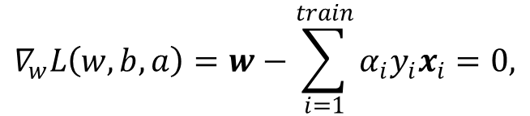

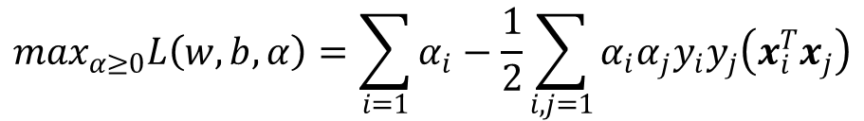
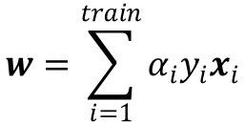
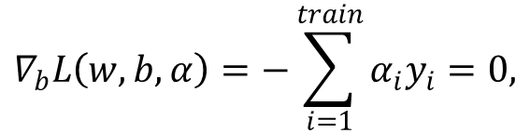
The Dual Problem
$$\max_{α≥0}\min_{w,b}L(w,b,a)$$
We minimize L with respect to w and b first:
$$∇_{w}L\left(w,b,a\right)=w−\sum_{i=1}^{train}{α_{i}y_{i}x_{i}}=0,$$
(1)
(2)
(3)
$$∇_{b}L\left(w,b,α\right)=−\sum_{i=1}^{train}{α_{i}y_{i}}=0,$$
$$w=\sum_{i=1}^{train}{α_{i}y_{i}x_{i}}$$
Note that (1) implies:
Plus (3) back to L , and using (2), we have:
$$\max_{α≥0}L\left(w,b,α\right)=\sum_{i=1}{α_{i}−\frac{1}{2}\sum_{i,j=1}{α_{i}α_{j}y_{i}y_{j}\left(x_{i}^{T}x_{j}\right)}}$$

Slide 15
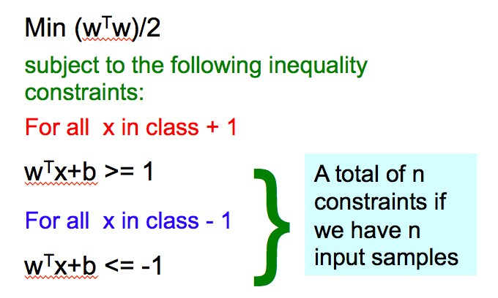
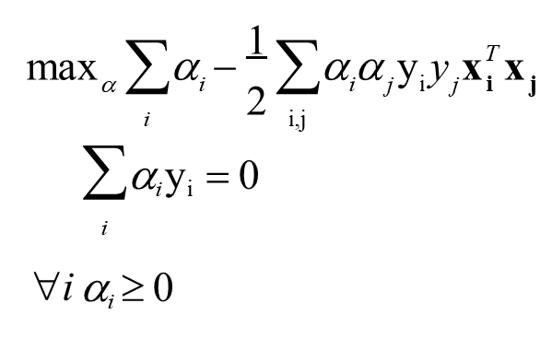

Summary: Dual SVM for linearly separable case
Dual formulation
Easier than original QP, more efficient algorithms exist to find $α_{i}$

Slide 16
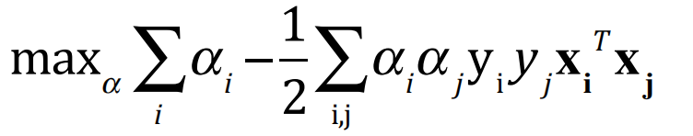
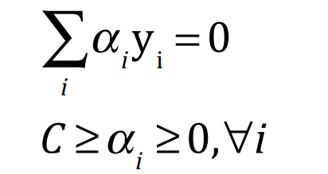


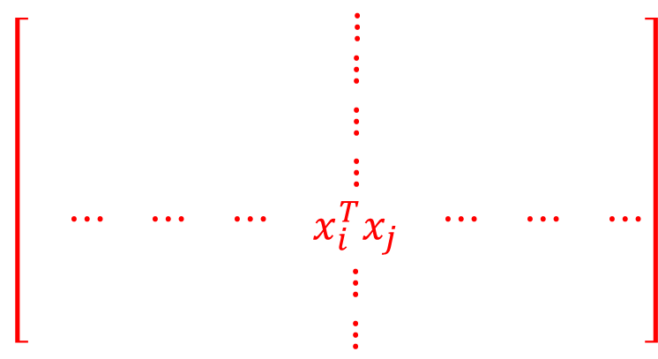
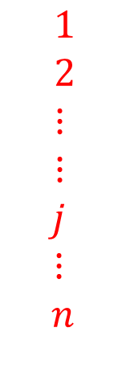
Dual SVM for linearly separable case – Training / Testing
Our dual target function:
Dot product among all training samples
$$1 2 ⋯ i ⋯ ⋯ n$$
$$\left[\begin{matrix}\begin{matrix}\begin{matrix} & & \end{matrix} & ⋮ & \end{matrix} & & \\ \begin{matrix}\begin{matrix}\begin{matrix} \\ \\ \end{matrix} & \begin{matrix} \\ \\ \end{matrix} & \end{matrix} & \begin{matrix}⋮ \\ ⋮ \\ ⋮\end{matrix} & \begin{matrix} \\ \\ \end{matrix}\end{matrix} & \begin{matrix} \\ \\ \end{matrix} & \begin{matrix} \\ \\ \end{matrix} \\ \begin{matrix}\begin{matrix}\begin{matrix} ⋯ \\ \\ \end{matrix} & \begin{matrix}⋯ \\ \\ \end{matrix} & \begin{matrix}⋯ \\ \\ \end{matrix}\end{matrix} & \begin{matrix}x_{i}^{T}x_{j} \\ ⋮ \\ ⋮\end{matrix} & \begin{matrix}⋯ \\ \\ \end{matrix}\end{matrix} & \begin{matrix}⋯ \\ \\ \end{matrix} & \begin{matrix}⋯ \\ \\ \end{matrix}\end{matrix}\right]$$
matrix
$1$
$2$
$⋮$
$⋮$
$$j$$
$$⋮$$
$$n$$
$$n×n$$

Slide 17
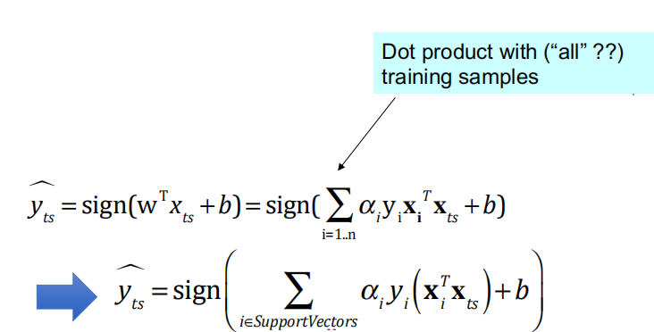


Dual SVM for linearly separable case – Training / Testing
To evaluate a new sample x_{ts}, we need to compute:
$$⇒$$
$$α_{i}≥0$$
For α_{i} that are 0, no influence

Slide 18
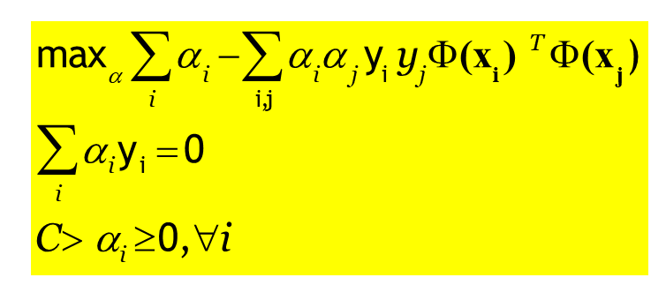
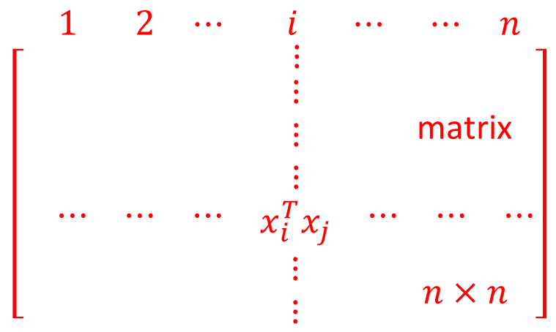
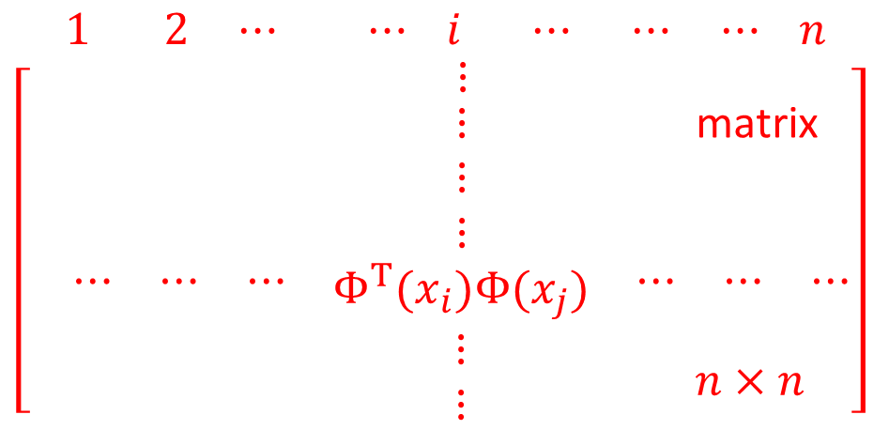
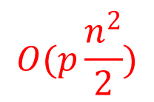

Dual SVM for linearly separable case – Training / Testing
K(x_{i},x_{j})
$$O(p\frac{n^{2}}{2})$$
$$O(p\frac{n^{2}}{2})$$
Training
Notes:
这页和下一页的手写部分还是转换一下

Slide 19
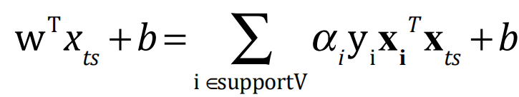

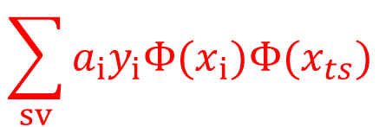




Dual SVM for linearly separable case – Training / Testing
$$\sum_{sv}{a_{i}y_{i}Φ(x_{i})Φ(x_{ts})}$$
$$x_{ts}$$
$$1$$
$$2$$
$$⋮$$
$$⋮$$
$$i$$
$$⋮$$
$$n$$
$$x_{i}^{T}x_{ts}$$
Testing
$$n×1$$

Slide 20
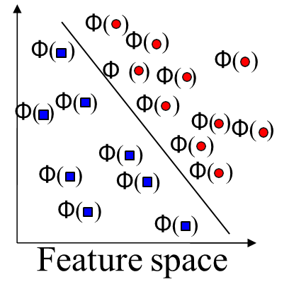
Φ(.)
Input space
Kernel solves these two issues simultaneously
“Kernel tricks” for efficient computation
Dual formulation only assigns parameters to samples, not to features

Slide 21
“Kernel tricks” for efficient computation
Never represent features explicitly
Compute dot products in closed form
Very interesting theory – Reproducing Kernel Hilbert Spaces
Not covered in detail here

Slide 22


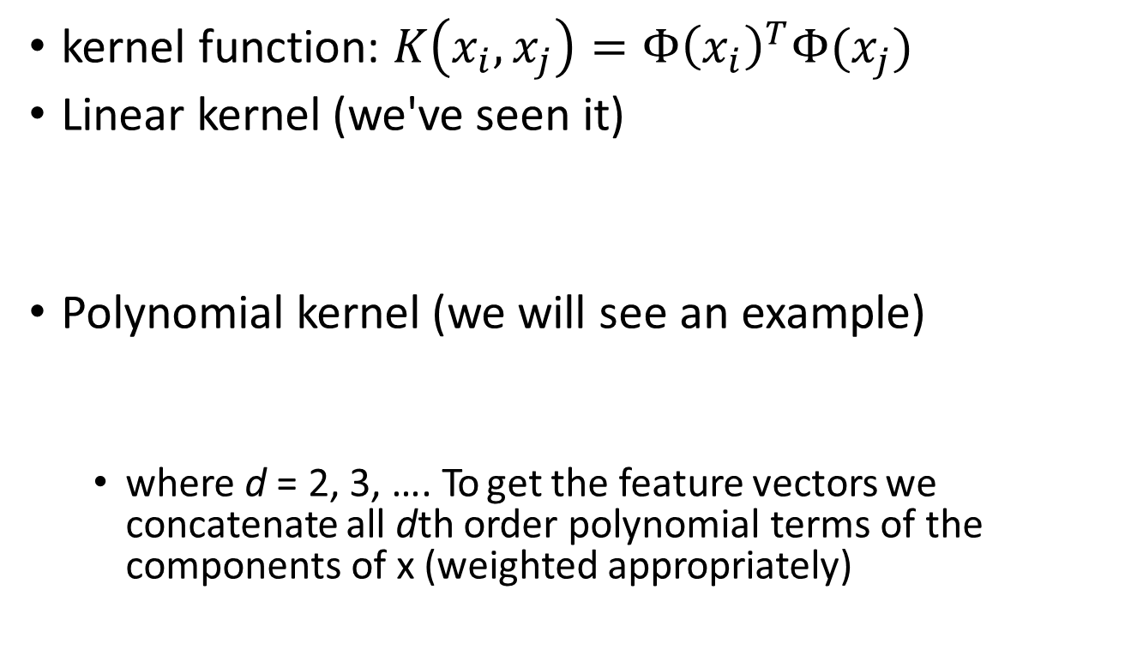
“Kernel tricks” for efficient computation
kernel function: $K\left(x_{i},x_{j}\right)=Φ{\left(x_{i}\right)}^{T}Φ(x_{j})$
Linear kernel (we've seen it)
Polynomial kernel (we will see an example)
where d = 2, 3, …. To get the feature vectors we concatenate all dth order polynomial terms of the components of x (weighted appropriately)

Slide 23
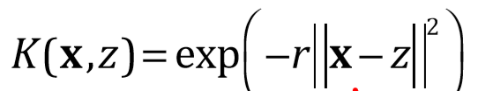
“Kernel tricks” for efficient computation
Radial basis kernel
In this case., r is hyperparameter. The feature space of the RBF kernel has an infinite number of dimensions

Slide 24
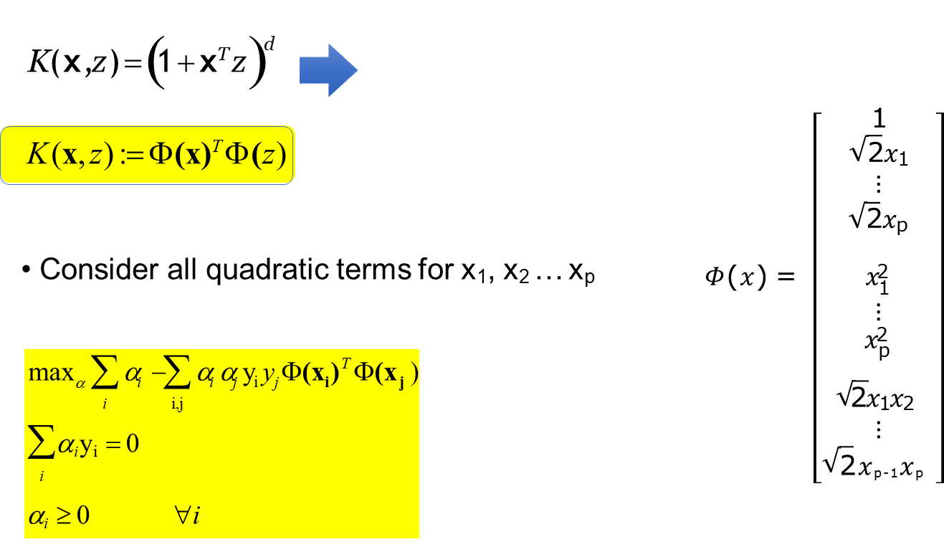


Example: Quadratic kernels
$${(1+x^{T}z)}^{2}$$

Slide 25
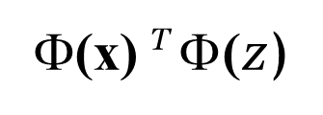
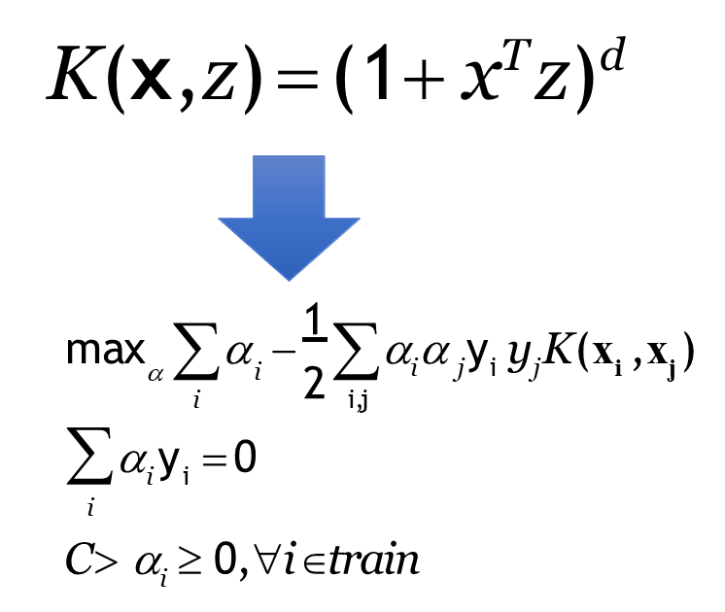

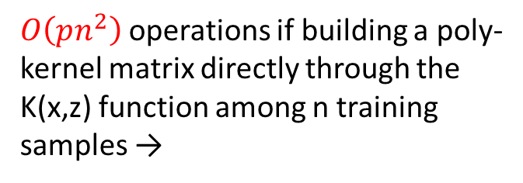
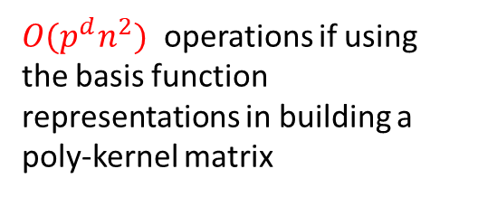
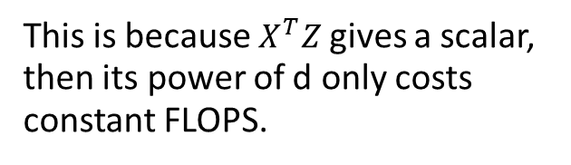
The kernel trick
If we define the kernel function as follows, there is no need to carry out basis function explicitly
$O(p^{d}n^{2})$ operations if using the basis function representations in building a poly-kernel matrix
$O\left(pn^{2}\right)$ operations if building a poly-kernel matrix directly through the K(x,z) function among n training samples →
T
This is because $X^{T}Z$ gives a scalar, then its power of d only costs constant FLOPS.

Slide 26
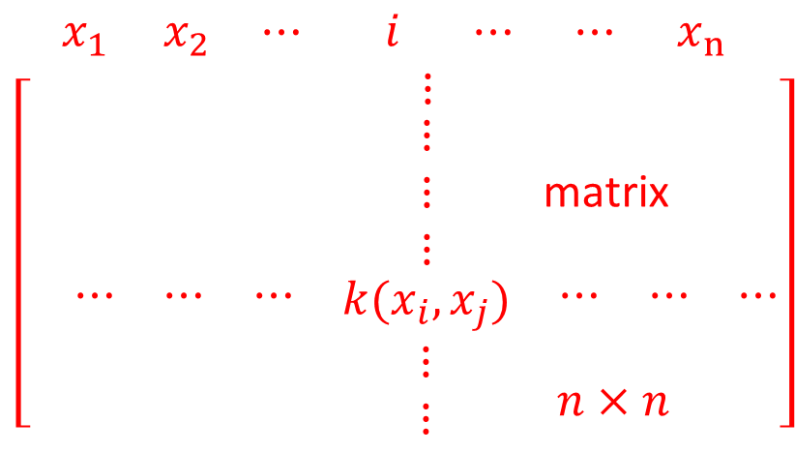

Kernel Matrix
Kernel function creates the kernel matrix, which summarize all the (train) data
$$k_{n×n}$$
Kernel matrix
positive-semi-definite
Notes:
这页的手写也转换一下

Slide 27
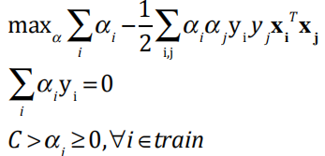
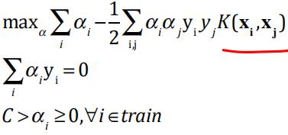
Summary: Modification due to Kernel Trick
Change all inner products to kernel functions
For training,
original linear
with kernel function - nonlinear

Slide 28
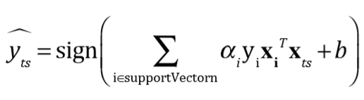
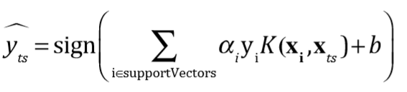

Summary: Modification due to Kernel Trick
For testing, the new data $x_{ts}$
original linear
with kernel function - nonlinear

Slide 29
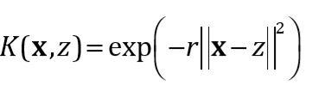
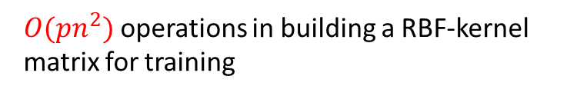
Kernel Trick: Implicit Basis Representation
For some kernels (e.g. RBF ) the implicit transform basis form Φ(x) is infinite-dimensional
But calculations with kernel are done in original space, so computational burden and curse of dimensionality aren’t a problem.
→ Gaussian RBF Kernel corresponds to an infinite-dimensional vector space.
YouTube video of Caltech: Abu-Mostafa explaining this in more detail: https://www.youtube.com/watch?v=XU j5JbQihlU&t=25m53s
$O(pn^{2})$ operations in building a RBF-kernel matrix for training

Slide 30
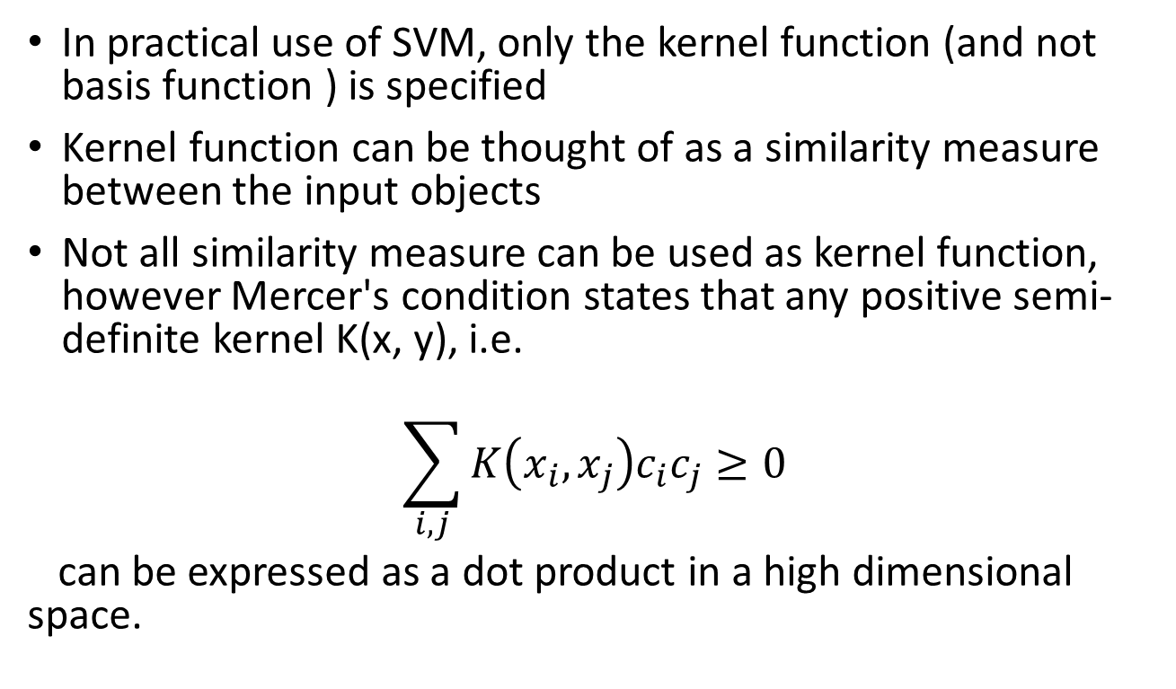
Kernel Functions (Extra)
In practical use of SVM, only the kernel function (and not basis function ) is specified
Kernel function can be thought of as a similarity measure between the input objects
Not all similarity measure can be used as kernel function, however Mercer's condition states that any positive semi-definite kernel K(x, y), i.e.
$$\sum_{i,j}{K\left(x_{i},x_{j}\right)c_{i}c_{j}≥0}$$
can be expressed as a dot product in a high dimensional space.

Slide 31
Choosing the Kernel Function
Probably the most tricky part of using SVM.
The kernel function is important because it creates the kernel matrix, which summarize all the data
Many principles have been proposed (diffusion kernel, Fisher kernel, string kernel, tree kernel, …)
Kernel trick has helped non-traditional data like strings and trees able to be used as input to SVM, instead of feature vectors (next page)
In practice, a low degree polynomial kernel or RBF kernel with a reasonable width is a good initial try for most applications.

Slide 32
Kernel trick has helped non-traditional data like strings and trees able to be used as input to SVM, instead of feature vectors
Vector vs. Relational data
e.g. Graphs, Sequences, 3D structures,
Original Space
Feature Space

Slide 33
Mercer Kernel vs. Smoothing Kernel (Extra)
The Kernels used in SVM are different from the Kernels used in Local Weighted /Kernel Regression.
We can think
Support Vector Machines’ kernels as Mercer Kernels
Local Weighted / Kernel Regression’s kernels as Smoothing Kernels

Slide 34
Why do SVMs work?
If we are using huge features spaces (e.g., with kernels), how come we are not overfitting the data?
Number of parameters remains the same (and most are set to 0)
While we have a lot of inputs, at the end we only care about the support vectors and these are usually a small group of samples
The maximizing of the margin acts as a sort of regularization term leading to reduced overfitting

Slide 35
Time Cost Comparisons
 | x_{i}^{T}x_{j} | Φ(x_{i})^{T}Φ(x_{j}) | K(x_{i}, x_{j}) | explicit
Training Stage | O(p*n²) | O(m*n²) | O(p*n²) | W
Test Stage | O(p*#SV) | O(m*#SV) | O(p*#SV) | W^{T}Φ(x_{ts})+b

Slide 36
Today
History of SVM
Large Margin Linear Classifier
Define Margin (M) in terms of model parameter
Optimization to learn model parameters (w, b)
Linearly Non-separable case
Optimization with dual form
Nonlinear decision boundary
Practical Guide

Slide 37
Software
A list of SVM implementation can be found at
http://www.kernel-machines.org/software.html
Some implementation (such as LIBSVM) can handle multi-class classification
SVMLight is among one of the earliest implementation of SVM
Several Matlab toolboxes for SVM are also available

Slide 38
References
https://qiyanjun.github.io/2019f-UVA-CS6316-MachineLearning/
Big thanks to Prof. Ziv Bar-Joseph and Prof. Eric Xing @ CMU for allowing me to reuse some of his slides
Elements of Statistical Learning, by Hastie, Tibshirani and Friedman
Prof. Andrew Moore @ CMU’s slides
Tutorial slides from Dr. Tie-Yan Liu, MSR Asi
A Practical Guide to Support Vector Classification Chih-Wei Hsu, Chih-Chung Chang, and Chih-Jen Lin, 2003-2010
Tutorial slides from Stanford “Convex Optimization I — Boyd & Vandenberghe

Slide 39
Thanks for listening

