Slide 1
run
The biography of a word with 645 meanings (so far)
Munkácsy Renáta
2026
Notes:
(0:30) Introduce yourself. Say: today I will show you that the smallest verbs hide the biggest stories. By the end you will see why one three-letter word needs 645 dictionary senses.

Slide 2
Same word, four very different jobs
She ran a marathon.
He runs a bakery.
We ran out of milk.
Tears ran down her face.
The OED lists 645 senses for the verb alone, the most of any English word (NPR, 2011).
Notes:
(1:30) Ask the class: do these four sentences use the same verb? Take two answers. Then reveal: yes, one verb, and the Oxford English Dictionary needs 645 senses for it (NPR, 2011). Goal of the talk: understand HOW one word got this big.

Slide 3
Origin: two Old English verbs merged
rinnan / irnan
ærnan / earnan
"to run, flow, run together"; cognate with Gothic rinnan and German rinnen "to flow"
transitive: "ride, run to, reach"; from Proto-Germanic *rannjanan, the causative "to make run"
Result: modern run carries both the flowing-water image and the legged-runner image. Deeper Indo-European root: uncertain (Harper, n.d.).
Notes:
(1:30) Two verbs: rinnan/irnan (intransitive, to run, flow) and aernan/earnan (transitive, to ride, reach). Point out German still keeps both: rinnen = flow, rennen = run. Be honest that the deeper Indo-European root is uncertain (Harper, n.d.). Message: water and legs were in the word from the start.

Slide 4
Which meaning is the “real” one? Corpus data answer
25%
1st
1st
most
of all tokens: the most frequent sense
sense children acquire (CHILDES data)
sense of the noun “a run” historically
formally varied: widest range of grammar and meaning contexts
Prototype: fast pedestrian motion, as in “Simons had run down to the villa to get help.” (Gries, 2006)
Notes:
(1:30) Gries (2006) coded 815 uses of run (ICE-GB + Brown). Cognitive theory says general motion is the centre, because most senses derive from it. The data say fast pedestrian motion. Go through the four reasons quickly.

Slide 5
The network: everything grows from the centre
escape
run away
abstract motion
run for office, run into trouble
run
motion
boats run, tracks run, tears run
cause motion
run a finger; run a business
fixed expressions
run the risk, run the gamut
Notes:
(2:00) This is the idea behind the website. Centre = prototype. Five branches. Walk one example per branch: escape = run away; motion = boats run; abstract = run for office; cause = run a finger, manage; fixed = run the risk. Say: on the website you can click each one.

Slide 6
How meanings stretch: four metaphors
TIME IS SPACE
STATES ARE LOCATIONS
The play ran until one o’clock.
We may run into trouble.
MORE IS UP
GOALS ARE DESTINATIONS
run up a bill
run for the White House
Notes:
(1:30) Each box is a mental shortcut English uses over and over. Ask: where else do we use TIME IS SPACE? (long way to go, ahead of schedule). Examples from Gries (2006).

Slide 7
What people actually say: the most frequent senses
Tokens of to run in ICE-GB + Brown, n = 815 (Gries, 2006)
Notes:
(1:30) Frequencies from Gries (2006). Point out: the prototype leads, but the second most common sense is the abstract one, to manage (101). Moving away from literal movement is normal, not exceptional.

Slide 8
Multi-word units: where the meaning really lives
Phrasal verbs
Idioms
run across: meet or find by chance
run out: become used up
run over: overflow
run through: use up fast, or rehearse
run the risk
run the gamut
run the gauntlet
run roughshod over
Interesting fact: many of these idioms alliterate (rampant, riot, roughshod, risk), noted by Gries (2006).
Notes:
(1:30) Often the verb alone is vague and the particle or noun decides the meaning. Run across = meet by chance (Merriam-Webster). Run out = become used up; run over = overflow (Britannica Dictionary). Gries notes many idioms alliterate: run rampant, run riot, run roughshod, run the risk.

Slide 9
Dictionaries disagree about how many meanings there are
OED
645 verb senses; about 75 columns of print
Oxford Learner’s
compact senses, plus a long list of phrasal verbs
Merriam-Webster
phrasal verbs such as run across get their own entries
Britannica Dict.
many meanings grouped under phrasal verb headings
Gries (2006): some corpus senses, such as “to stop talking”, were missing from corpus-based dictionaries.
Notes:
(1:30) Same word, different decisions about lumping and splitting. OED: 645 verb senses (NPR, 2011). Learner dictionaries (Oxford Advanced Learner, Britannica Dictionary) are compact and use phrasal verb headings. Merriam-Webster gives run across its own entry. Gries: some corpus senses are missing from dictionaries. Add your own numbers from your dictionary check.

Slide 10
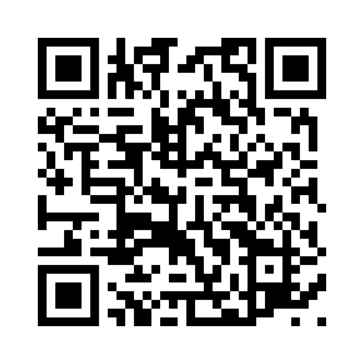
Explore it yourself
An interactive map of every sense. Filter by word class, by type of use (literal, metaphorical, metonymic), or by detailed form, and click any item to explore its meaning and example.
Notes:
(1:00) Live demo if possible: switch the filter to Type of use and show how the colours regroup the same circles.

Slide 11
Take-aways
Run began as “flow” and “run” in Old English.
Its centre is fast movement on foot, shown by corpus data.
Metaphors stretch it into time, states, goals and control.
Phrasal verbs and idioms carry much of its meaning.
Dictionaries split the same word in different ways.
Notes:
(1:00) Summarise in one sentence each. Finish with: next time you say run, notice which of the 645 jobs it is doing. Questions. Then references on the last slide if required.

Slide 12
References
Encyclopaedia Britannica. (n.d.). Run. Britannica Dictionary. britannica.com/dictionary/run
Gries, S. T. (2006). Corpus-based methods and cognitive semantics: The many senses of to run. In S. T. Gries & A. Stefanowitsch (Eds.), Corpora in cognitive linguistics (pp. 57–99). Mouton de Gruyter. researchgate.net
Harper, D. (n.d.). Online etymology dictionary. etymonline.com
Merriam-Webster. (n.d.). Run across. merriam-webster.com
NPR. (2011, May 30). Has “run” run amok? It has 645 meanings … so far. npr.org
Oxford Learner’s Dictionaries. (n.d.). Run (verb). oxfordlearnersdictionaries.com
Notes:
Optional slide: leave on screen during questions.

