Slide 1

You’re my sunshine

Slide 2
smurfs
Our name :
Mina William Adly
Huda Abdelrahman Mohamed
Huda Mohamed Fathy
Mohamed Abdelrahman Mohamed

Slide 3
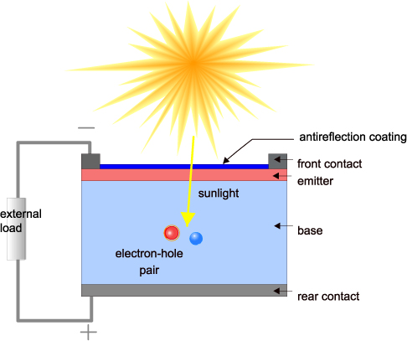
Solar power
Solar cells directly convert light into electricity.
Enough power can be generated to run a 100W light bulb from just one square meter of solar panel.
Today solar cells are used in
everyday applications, such as
calculators and outdoor
lighting.

Slide 4
Our target
we aim to :
improve the solar panels.
make solar panels to be more cheap.
make solar power compatible to all conditions .
Make all people can design their own solar panel and calculate its cost.

Slide 5
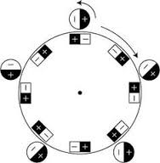
In stations that use csp solar cell
We aim to improve the output capacity of solar power
by modifying the turbine by using an infinity spinning
fan by using the power of antagonism between magnets .

Slide 6
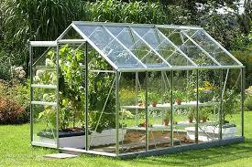
We can use green house over the solar cells
Green house reduce the effect of rains that helps the regions that are have heavy rains to improve the output of the solar cell by reducing the lost of power generated as result of dust and rain .

Slide 7
Most solar panels are cleaned by water
So that causes high cost added to the generation cost ..
Companies fees for cleaning the solar panel are about 38.35 $ that operation is repeated every 3 months .

Slide 8
If we set up fans below the solar panels so they can face wind of dust to prevent dust to collect over the solar panel.

Slide 9
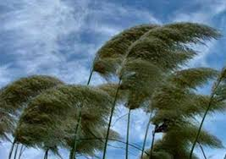
The average velocity of wind , it’s found as 14 m/s

Slide 10
By using the power of air made by air fan , that construct a block of air to face the wind and get it out of the panel

Slide 11
By calculating the power needed to the fan and its cost we found that would
$cost 15.35
That cost for each three months
Compared to the usage of water that saves 60% of cost

Slide 12
We managed to make people able to design their own solar panel
The user can choose its need of power
And there will be a sensor to detect the current temperature

Slide 13
Then he would choose his country and the type of solar cell that he will use
The program has information about his country and the data sheet of his solar cell
Then the program would calculate how many numbers of cells he needs

Slide 14
And calculate the number of series and parallel cells and the aria needed to installation.
Also the program would tell him how much power would he get and how much money would he earn by selling the other amount of power he won’t use it .

Slide 15
We dream to apply that adds in our life
The magnetic fan can be applied at csp solar cell stations rapidly
We can construct a solar cell on each house

Slide 16
Every one can get his need of power for free and without any help knowing everything about his own small station
that program can be a mobile app and available for all people

Slide 17
To add a new tool for our world
Thanks

