Slide 1


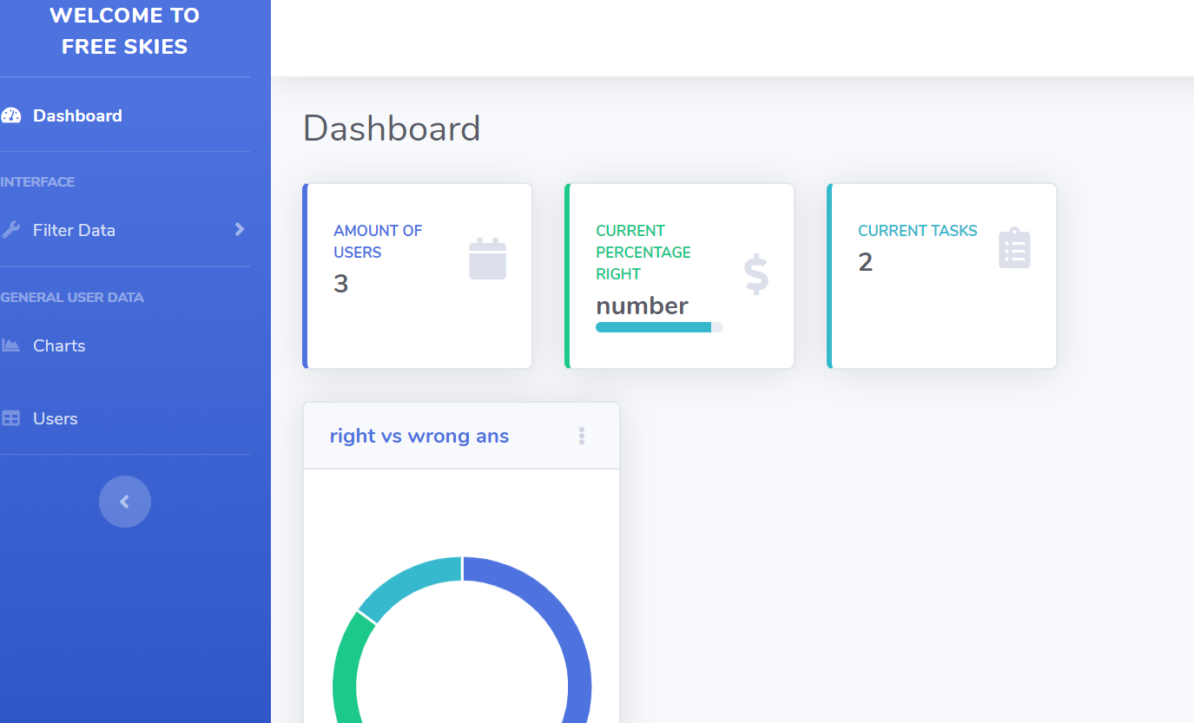
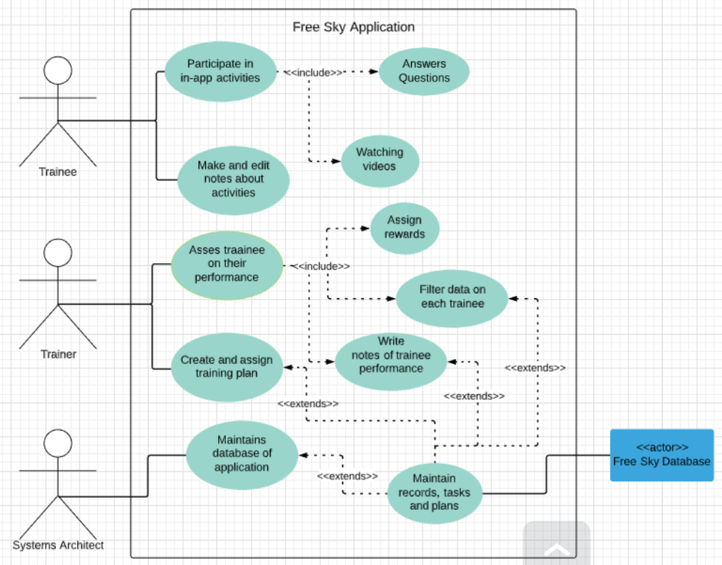
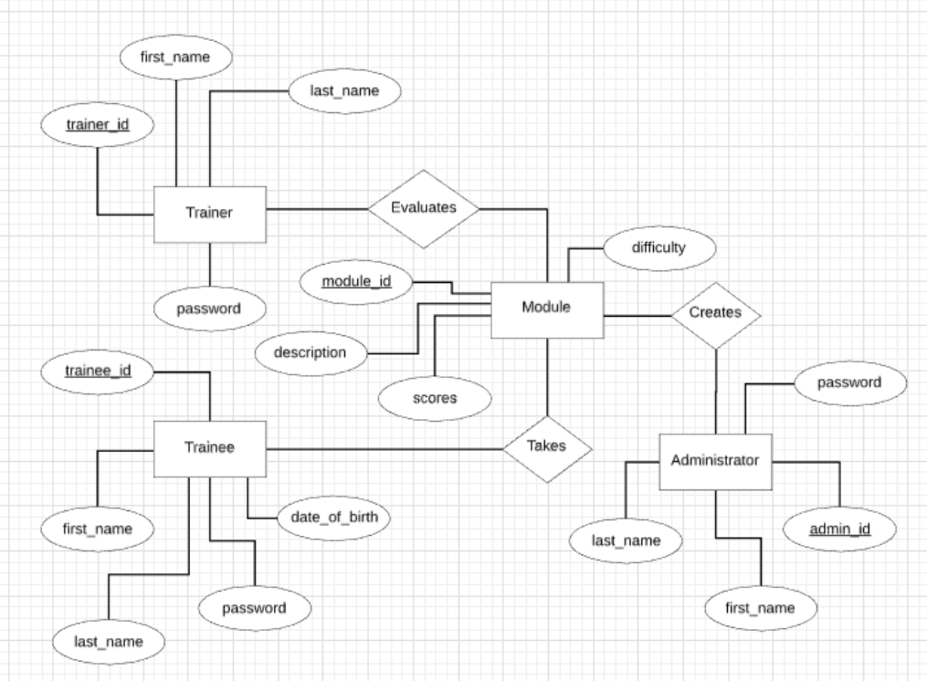
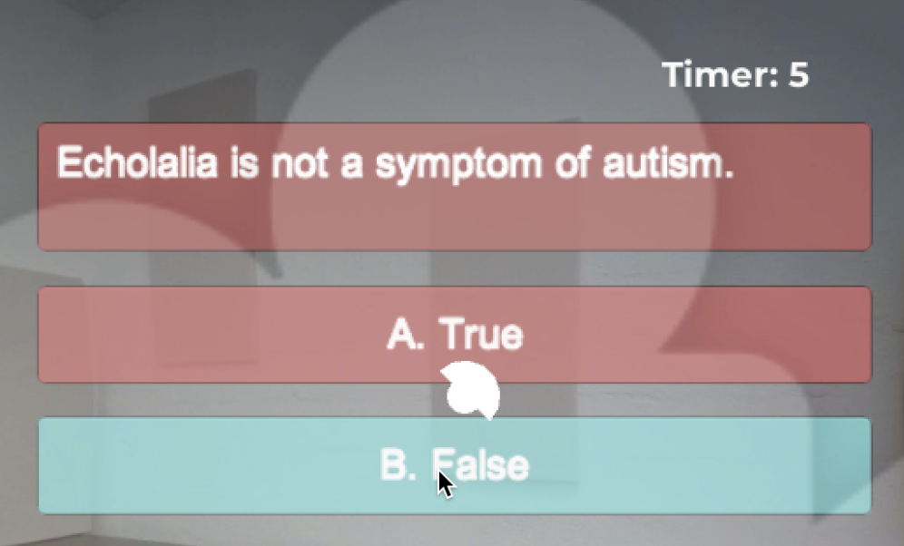
Free Skiess
Alanah Cottingham, Gavin Smith, Jiaqi Yang
Faculty Advisor: Dr. Keith Gallagher, Dept. of Computer Engineer and Sciences,
Florida Institute of Technology
INTRODUCTION
Free Skiess is a system that assists in the training of The Scott Center therapists. Our goal is to provide a more efficient and comprehensive way in aiding people on the autism spectrum. This system consists of a Web Application and a Virtual Reality Application. The lessons are mainly held in the Virtual Reality Application. The Web Application is developed for both the trainee and the trainer. They will be able to create individual accounts and keep track of their working progress.
MOTIVATION
Our motivation is to assist with the progression of autism treatment by using an immersive virtual reality experience. As we realize with the increase in technology we can now provide training for monitoring and aiding people with disabilities better.
PROJECT GOAL
The goal of the project is to create a system to assist in the training of The Scott Center therapists. With the use of our system as a training platform, the ultimate goal is for them to provide a more efficient and comprehensive way in aiding autistic kids. While some attempts to monitor individuals with autism were carried out, there are few that aim to train individuals with the right scenarios.
FUTURE IMPROVEMENT
For future work, more lessons can be created and added to the program. For future improvement, the functionalities of the Web App and the Database are just simple right now. There are more features that can be added on to the Web App and the Database.
DESIGN
System Architecture
Database Design
Question in Oculus Go
Web App Dashboard
FEATURES
Virtual Reality
The trainee will be able to learn in an immersive 360 experience. This experience will include a 360 video, interactive button(s), and learning progress. Based on the treatment needed by autistic patients the game levels which will change and provide unique challenges to keep interest
Web App
Trainer
Individual Profile
Performance Comparison between trainees
Data analysis of each trainee and the overall analysis for group of trainees
Provide feedback and communicate with the trainees
Trainee
Positive Reinforcement - A grading system will be included for trainee to see improvements and area of improvements
Trainee Plan Access - The Trainee will be able to access the trainee plan their Trainer assigned to them to complete in the 360 environment.

