Slide 1

EosDX 1st Data Conference
Analysis of Mouse Brain Structure through Fourier
Transformation of XRD Patterns
Sasha Murokh, Stuyvesant High School, NYC

Slide 2
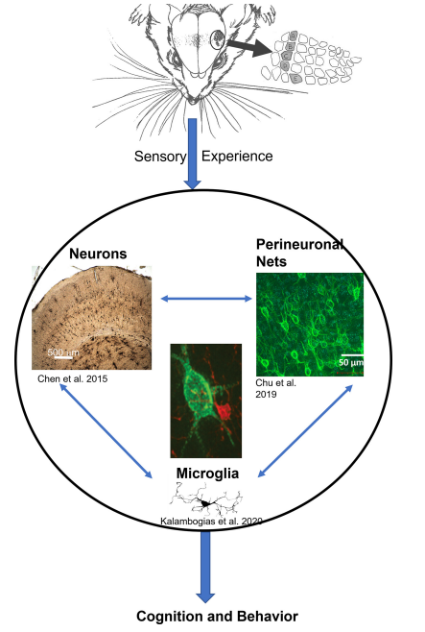
Mouse whiskers
When mouse whiskers are removed, they are deprived of key sensory information
When this is done early on in their lives, it causes a change in brain structure on a molecular level.
Experiments done by Brumberg demonstrate a change in behaviour as well as brain structure of mice.

Slide 3
Brain samples nomenclature (28 samples)
Samples of the wild type are numbered, and samples with trimmed whiskers have the letters assigned
Wild Type: | Animal #: | Sex: | Hemisphere: |  | Trimmed: | Animal #: | Sex: | Hemisphere:
1 | 4 | F | Left |  | A | 9 | F | Left
2 | 4 | F | Right |  | B | 9 | F | Right
3 | 1 | F | Left |  | C | 7 | F | Left
4 | 1 | F | Right |  | D | 7 | F | Right
5 | 3 | F | Left |  | E | 8 | F | Left
6 | 3 | F | Right |  | F | 8 | F | Right
7 | 30 | F | Left |  | G | 16 | M | Left
8 | 30 | F | Right |  | H | 16 | M | Right
9 | 31 | F | Right |  | I | 24 | M | Left
10 | 31 | F | Left |  | J | 24 | M | Right
11 | 6 | M | Left |  | K | 27 | M | Left
12 | 6 | M | Right |  | L | 27 | M | Right
13 | 5 | M | Left |  | M | 23 | M | Left
14 | 5 | M | Right |  | N | 23 | M | Right

Slide 4
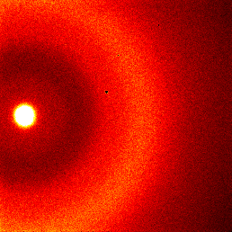
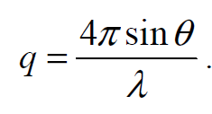
XRD Pattern Overview
Characteristic XRD pattern
28 samples
~20 mm from sample to detector
q – field of view range of approx 6 - 30
All patterns are normalized by the integral of primary beam
Concentric rings appear as peaks with associated magnitude of scattering vector:
q = 14
q = 10
q = 4.3

Slide 5
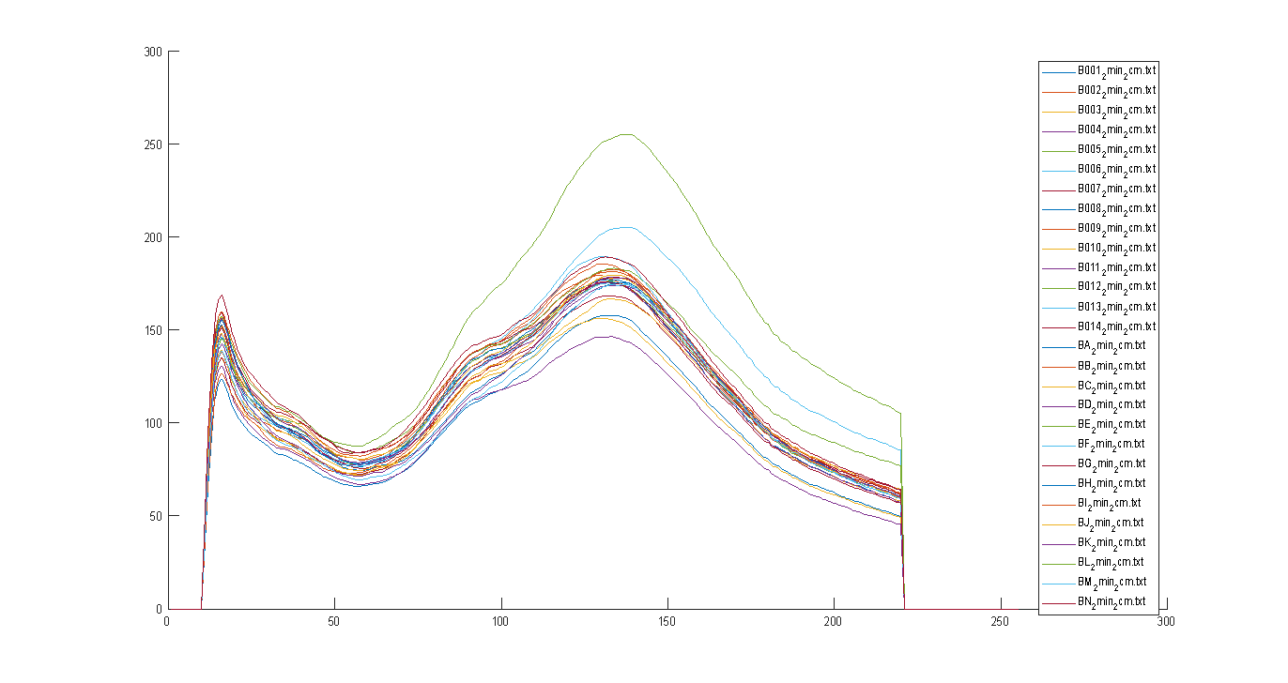
Brain samples intensity profiles (28 samples)
Peak 1
Peak 2
Primary
Beam edge
Peak 3
q ~ 4.3
q ~ 10
q ~ 14

Slide 6
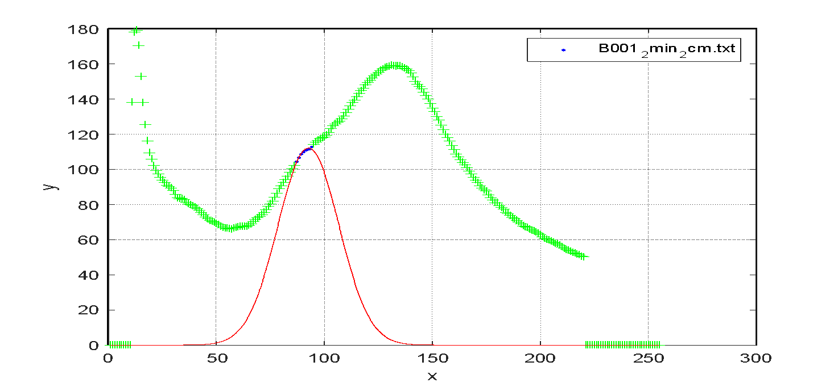
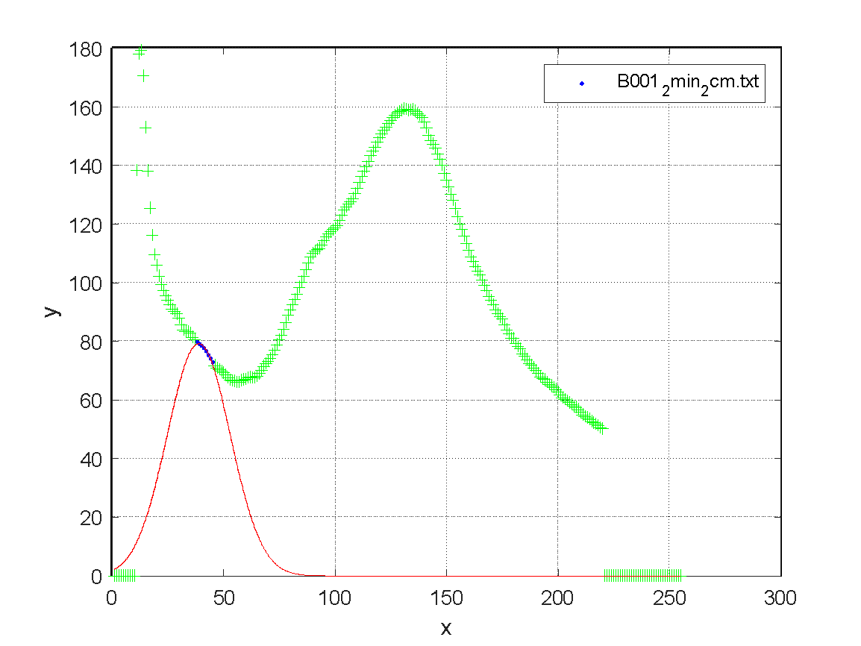
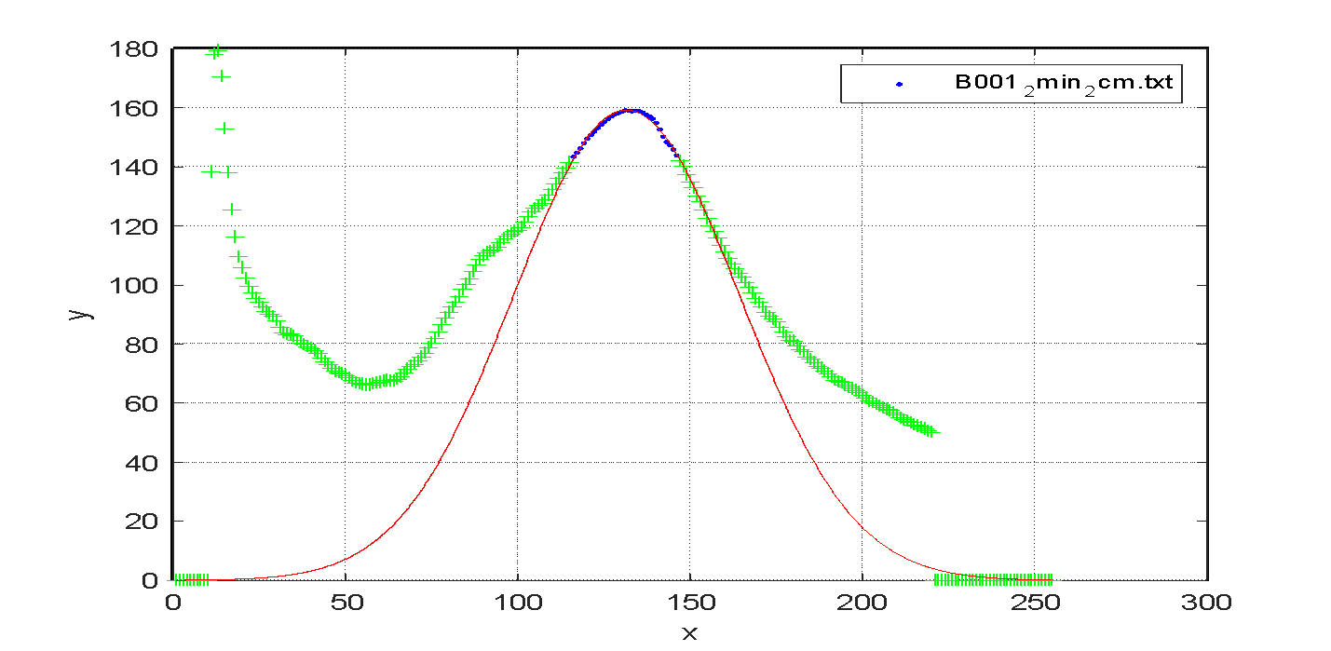
Gaussian peak analysis by Alexander Lazarev
Peak 2
Peak 3
Peak 1

Slide 7
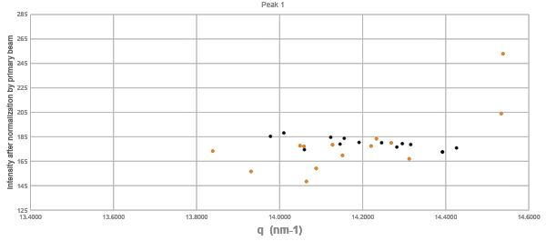
Peak 1
No clear separation between wild type and trimmed

Slide 8
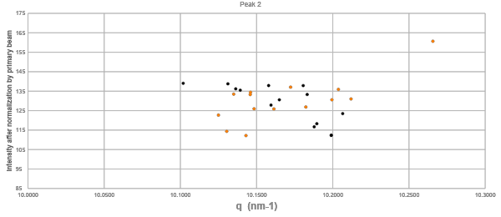
Peak 2
No clear separation between wild type and trimmed

Slide 9
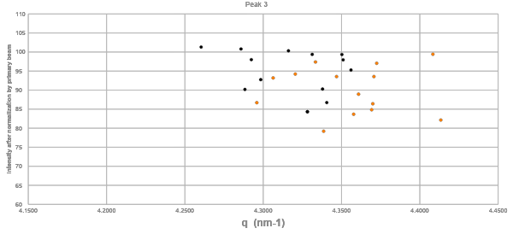
Peak 3
Seems to be some separation between wild type and trimmed

Slide 10
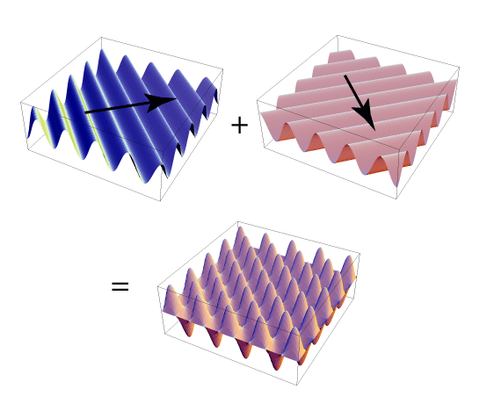
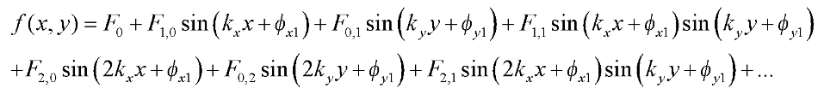
2D Fourier analysis
Product of two Fourier analysis on x and y direction, allowing for a 2D representation of the XRD image

Slide 11
=
+
A B C
F(A) = F(B) + F(C)
F(C) = F(A) - F(B)

Slide 12
Procedure
Separate 256x256 XRD image array into A and B
Fourier transformation of both
Subtract and absolute value for C because coefficients are complex numbers, creating a 256x256 Fourier transformation of the concentric rings
Normalization of each Fourier-transformed array: all values divided by (0, 0)
Average all 14 arrays for wild type and trimmed whiskers
Subtract wild type and trimmed whiskers
Manually find large/significant components which separate the two types of samples
Find and graph respective values from the normalised arrays

Slide 13
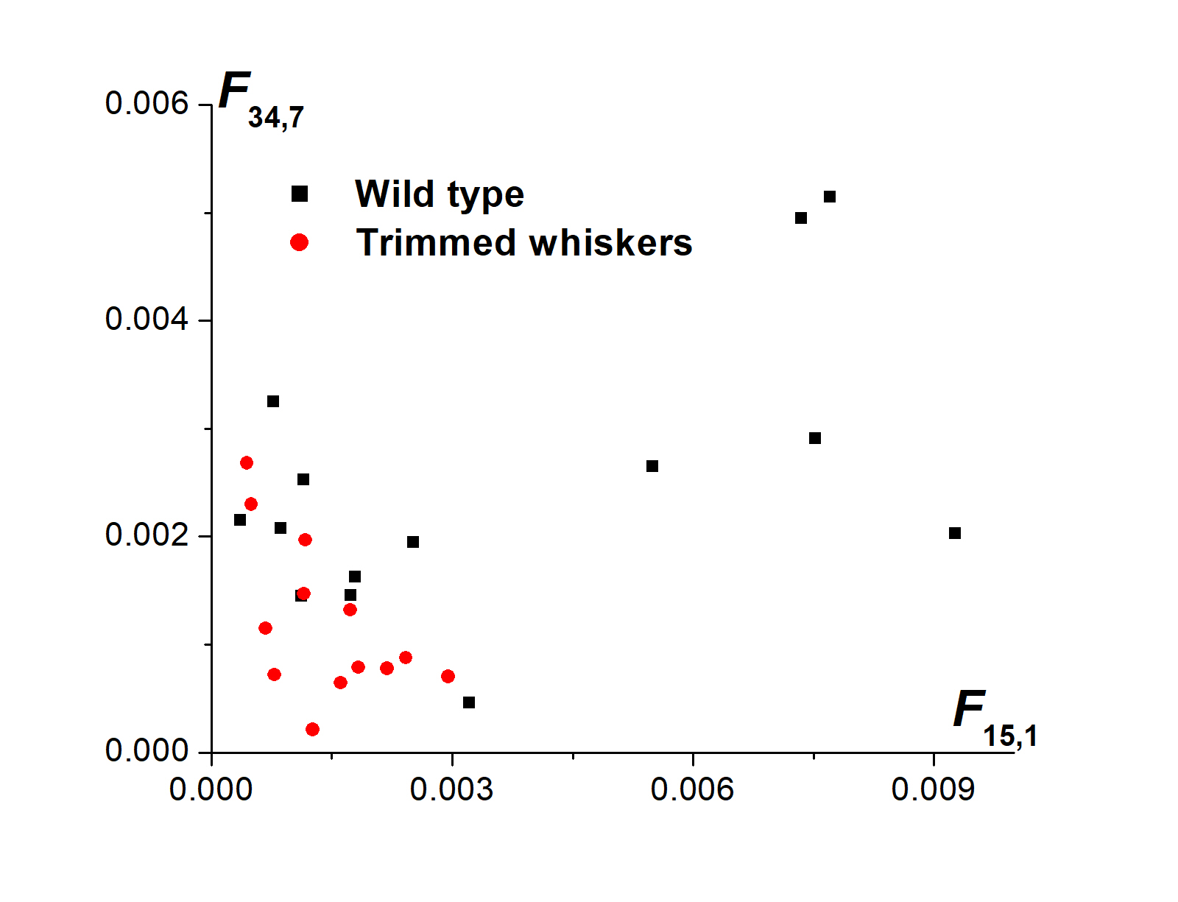
Results
There is a better separation of mouse brain on a molecular level that indicate developmental changes in mice if their whiskers are removed
Deprivation of key sensory information led to a lack of brain structural development
The larger values indicate structure, which the trimmed samples seem to lack

Slide 14
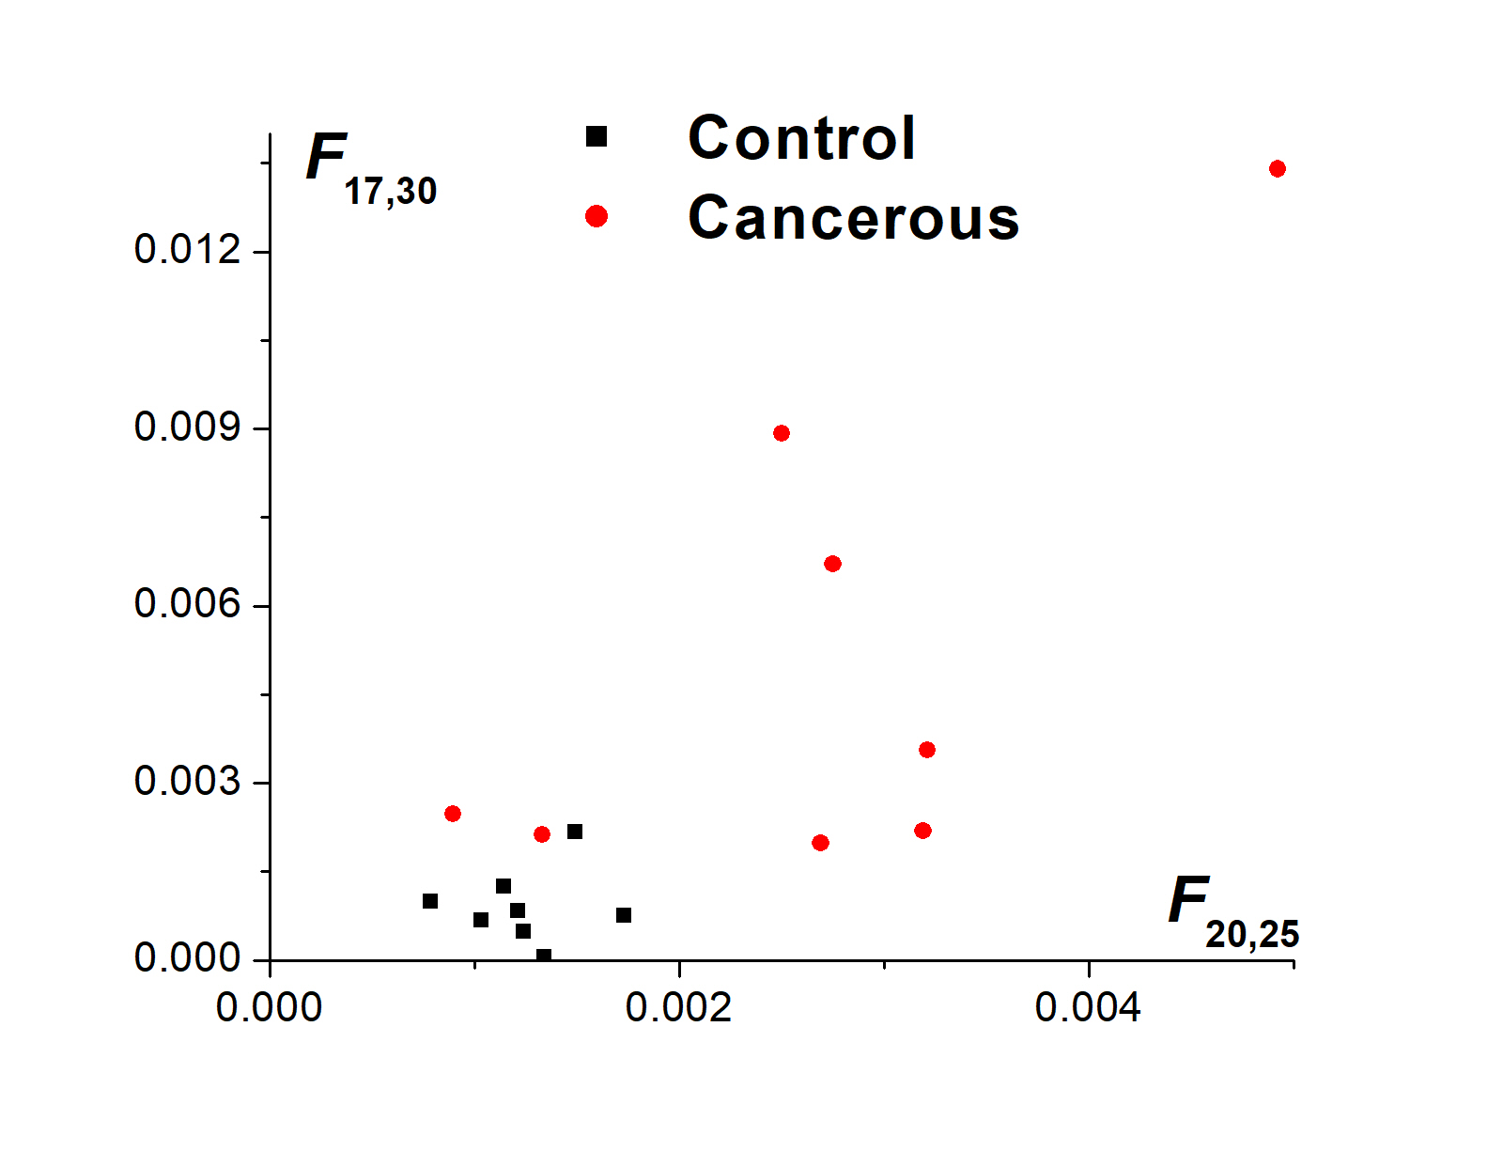
Results
Limited samples of Horizon data, provided by Jonathan
This indicates some separation of control and cancerous elements

Slide 15
Improvements
The separation between the unscattered part of the XRD and the concentric rings is harsh and there are better alternative ways of doing it gradually
Also, significant fourier components were selected and tried manually
This can be resolved with principal component analysis in the future, which will use not just two peaked components, but also their superposition, allowing for fourier components to be selected in a way that ensure clear clusterization.

Slide 16
Conclusion
I performed Fourier component analysis on mouse brain XRD, and showed the separation, indicating change in brain structure on a molecular level.
Fourier transformation have an advantage in precision over gaussian peak analysis, however it lacks the direct connection between key components and physical brain structure.
Looking at a small set of Horizon samples, there is also a clear separation that can be further improved through the use of artificial intelligence methods.

