Slide 1
Meteorology for Soaring

Slide 2
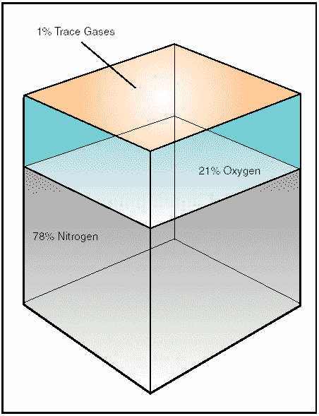
Nature of the atmosphere
Notes:
The atmosphere is a mixture of gases that surround the Earth.
Nitrogen accounts for 78 percent of the gases that comprise the atmosphere, while oxygen makes up 21 percent. Argon, carbon dioxide, and traces of other gases make up the remaining 1 percent.

Slide 3
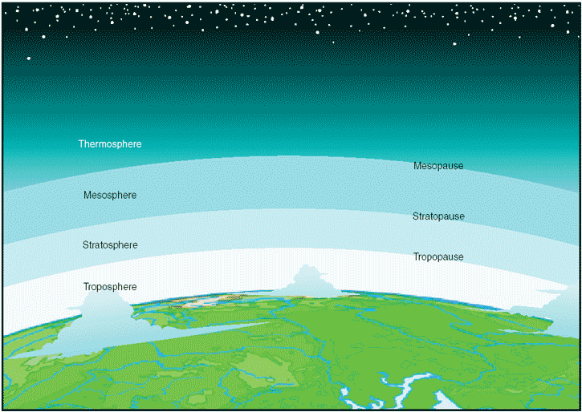
Layers of the atmosphere
Notes:
Within this envelope of gases, there are several recognizable layers of the atmosphere that are defined not only by altitude, but also by the specific characteristics of that level.
The first layer, known as the troposphere is the region that glider pilots operate.
The troposphere extends from sea level up to 20,000 feet over the northern and southern poles and up to 48,000 feet over the equatorial regions.
The vast majority of weather, clouds, storms, and temperature variances occur within this first layer of the atmosphere. Inside the troposphere, the temperature decreases at a rate of about 2°Celsius every 1,000 feet of altitude gain, and the pressure decreases at a rate of about 1 inch per 1,000 feet of altitude gain.

Slide 4
Oxygen and the human body
Nitrogen and other trace gases make up 79 percent of the atmosphere, while the remaining 21 percent is life sustaining, atmospheric oxygen. At sea level, atmospheric pressure is great enough to support normal growth, activity, and life. At 18,000 feet, however, the partial pressure of oxygen is significantly reduced to the point that it adversely affects the normal activities and functioning of the human body. In fact, the reactions of the average person begin to be impaired at an altitude of about 10,000 feet and for some people as low as 5,000 feet.
The physiological reactions to oxygen deprivation are insidious and affect people in different ways. These symptoms range from mild disorientation to total incapacitation, depending on body tolerance and altitude.
By using supplemental oxygen or cabin pressurization systems, pilots can fly at higher altitudes and overcome the ill effects of oxygen deprivation.
Notes:
Nitrogen and other trace gases make up 79 percent of the atmosphere, while the remaining 21 percent is life sustaining, atmospheric oxygen.
At sea level, atmospheric pressure is great enough to support life. At 18,000 feet, however, the partial pressure of oxygen is significantly reduced to the point that it adversely affects the normal activities and functioning of the human body.
In fact, the reactions of the average person begin to be impaired at an altitude of about 10,000 feet and for some people as low as 5,000 feet.
Oxygen starvation symptoms range from mild disorientation to total incapacitation, depending on body tolerance and altitude.
By using supplemental oxygen glider pilots can fly at higher altitudes and overcome the ill effects of oxygen deprivation.

Slide 5
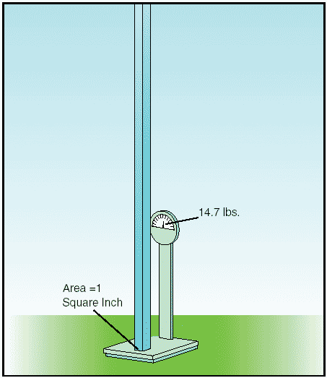
Significance of atmospheric pressure
At sea level, the atmosphere exerts pressure on the Earth at a force of 14.7 pounds per square inch. This means a column of air 1-inch square, extending from the surface up to the upper atmospheric limit, weighs about 14.7 pounds.
Notes:
Significance of atmospheric pressure
At sea level, the atmosphere exerts pressure on the Earth at a force of 14.7 pounds per square inch. This means a column of air 1-inch square, extending from the surface up to the upper atmospheric limit, weighs about 14.7 pounds.
A person standing at sea level also experiences the pressure of the atmosphere; however, the pressure is not a downward force, but rather a force of pressure over the entire surface of the skin.
The actual pressure at a given place and time will differ with altitude, temperature, and density of the air. These conditions also affect aircraft performance, especially with regard to takeoff, rate of climb, and landings.

Slide 6
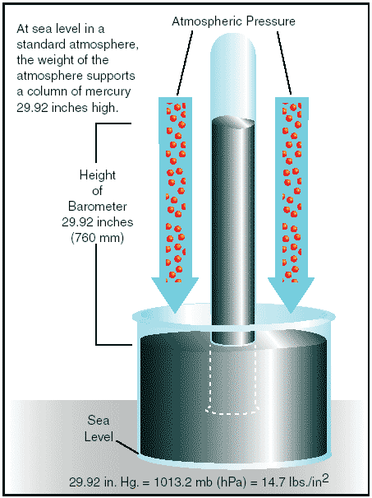
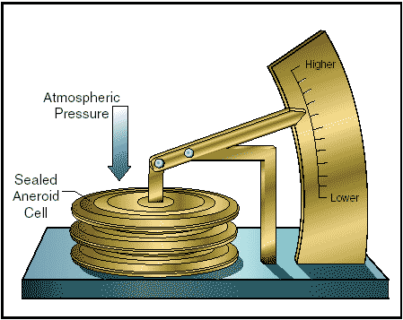
Measurement of atmospheric pressure
Atmospheric pressure is typically measured in inches of mercury (in. Hg.)
Notes:
Measurement of atmospheric pressure
Atmospheric pressure is typically measured in inches of mercury (in. Hg.) by a mercurial or aneroid barometer.

Slide 7
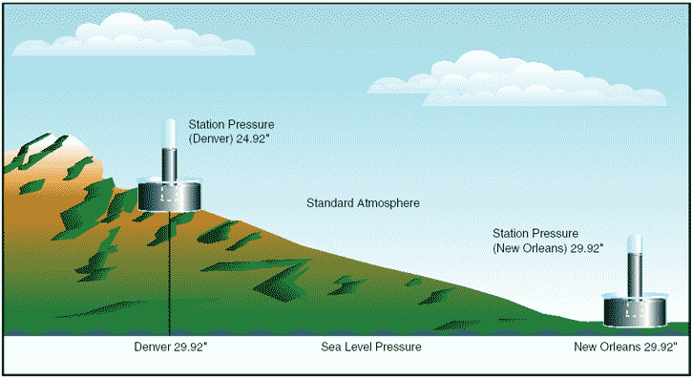
Station Pressure
Station pressure is converted to, and reported in, sea level pressure.
Notes:
Standard sea level pressure is defined as 29.92 in. Hg. at 59°F (15°C). Atmospheric pressure is also reported in millibars, with 1 inch of mercury equaling approximately 34 millibars and standard sea level equaling 1013.2 millibars. Constant pressure charts are written using millibars.
By tracking barometric pressure trends across a large area, weather forecasters can more accurately predict movement of pressure systems and the associated aviation weather.
For example, tracking a pattern of rising pressure at a single weather station generally indicates the approach of fair weather. Conversely, decreasing or rapidly falling pressure usually indicates approaching bad weather and possibly, severe storms.
When from an area of high pressure to a low pressure … look out below.

Slide 8
Atmospheric Pressure
Effect of altitude on atmospheric pressure
As altitude increases, pressure diminishes, as the weight of the air column decreases. On average, with every 1,000 feet of altitude increase, the atmospheric pressure decreases 1 inch of mercury. This decrease in pressure (increase in density altitude) has a pronounced effect on aircraft performance.
Effect of altitude on flight
Altitude affects every aspect of flight from aircraft performance to human performance. At higher altitudes, with a decreased atmospheric pressure, takeoff and landing distances are increased, as are climb rates.
When an aircraft takes off, lift must be developed by the flow of air around the wings. If the air is thin, more speed is required to obtain enough lift for takeoff; therefore, the ground run is longer. An aircraft that requires a 1,000-foot ground run at sea level will require almost double that at an airport 5,000 feet above sea level.
Notes:
Effect of altitude on atmospheric pressure
As altitude increases, pressure diminishes, as the weight of the air column decreases. On average, with every 1,000 feet of altitude increase, the atmospheric pressure decreases 1 inch of mercury. This decrease in pressure (increase in density altitude) has a pronounced effect on aircraft performance.
Effect of altitude on flight
Altitude affects every aspect of flight from aircraft performance to human performance. At higher altitudes, with a decreased atmospheric pressure, takeoff and landing distances are increased, as are climb rates.
When an aircraft takes off, lift must be developed by the flow of air around the wings. If the air is thin, more speed is required to obtain enough lift for takeoff; therefore, the ground run is longer. An aircraft that requires a 1,000-foot ground run at sea level will require almost double that at an airport 5,000 feet above sea level.

Slide 9
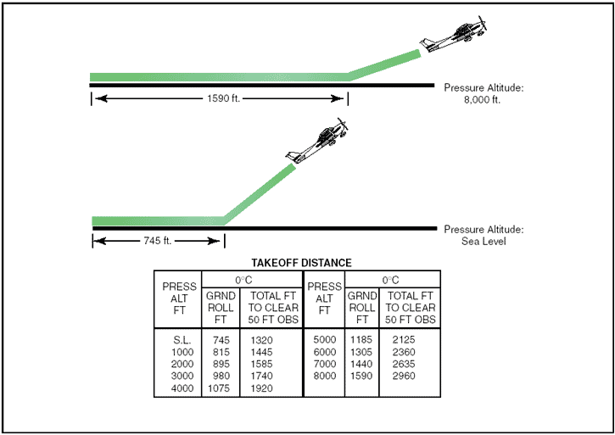
Effects of Pressure Altitude
Notes:
Effect of altitude on flight
Altitude affects every aspect of flight from aircraft performance to human performance. At higher altitudes, with a decreased atmospheric pressure, takeoff and landing distances are increased, as are climb rates.
It is also true that at higher altitudes, due to the decreased density of the air, aircraft engines and propellers are less efficient. This leads to reduced rates of climb and a greater ground run for obstacle clearance.

Slide 10
Air Density and Wind
Effect of differences in air density
Differences in air density caused by changes in temperature result in changes in pressure. This, in turn, creates motion in the atmosphere, both vertically and horizontally, in the form of currents and wind. Motion in the atmosphere, combined with moisture, produces clouds and precipitation otherwise known as weather.
Wind
Pressure and temperature changes produce two kinds of motion in the atmosphere; vertical movement of ascending and descending currents, and horizontal movement in the form of wind. Both types of motion in the atmosphere are important as they affect the takeoff, landing, and cruise flight operations. More important, however, is that these motions in the atmosphere, otherwise called atmospheric circulation, cause weather changes.
Notes:
Effect of differences in air density
Differences in air density caused by changes in temperature result in changes in pressure. This, in turn, creates motion in the atmosphere, both vertically and horizontally, in the form of currents and wind. Motion in the atmosphere, combined with moisture, produces clouds and precipitation otherwise known as weather.
Wind
Pressure and temperature changes produce two kinds of motion in the atmosphere; vertical movement of ascending and descending currents, and horizontal movement in the form of wind. Both types of motion in the atmosphere are important as they affect the takeoff, landing, and cruise flight operations. More important, however, is that these motions in the atmosphere, otherwise called atmospheric circulation, cause weather changes.

Slide 11
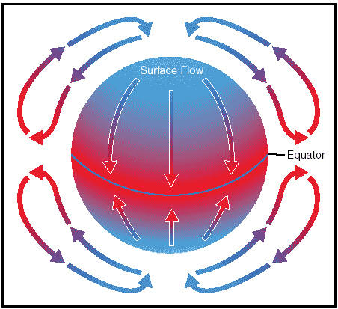
The cause of atmospheric circulation
Notes:
The cause of atmospheric circulation
Atmospheric circulation is the movement of air around the surface of the Earth. It is caused by uneven heating of the Earth´s surface and upsets the equilibrium of the atmosphere, creating changes in air movement and atmospheric pressure.
Because the Earth has a curved surface that rotates on a tilted axis while orbiting the sun, the equatorial regions of the Earth receive a greater amount of heat from the sun than the polar regions. The amount of sun that heats the Earth depends upon the time of day, time of year, and the latitude of the specific region. All of these factors affect the length of time and the angle at which sunlight strikes the surface.
In general circulation theory, areas of low pressure exist over the equatorial regions, and areas of high pressure exist over the polar regions due to a difference in temperature. Solar heating causes air to become less dense and rise in equatorial areas. The resulting low pressure allows the high-pressure air at the poles to flow along the planet´s surface toward the equator. As the warm air flows toward the poles, it cools, becoming more dense, and sinks back toward the surface.
This pattern of air circulation is correct in theory; however, the circulation of air is modified by several forces, most importantly the rotation of the Earth.

Slide 12
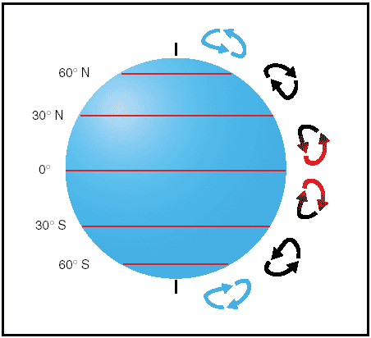
Three-cell circulation pattern due to the rotation of the Earth
Notes:
The force created by the rotation of the earth, known as the Coriolis Force, significantly affects large bodies that move over great distances, such as an air mass or body of water.
The rotation force deflects air to the right in the Northern Hemisphere, causing it to follow a curved path instead of a straight line. The amount of deflection differs depending on the latitude.
It is greatest at the poles, and diminishes to zero at the equator. The magnitude of the force also differs with the speed of the moving bod. The faster the speed, the greater the deviation. In the Northern Hemisphere, the rotation of the Earth deflects moving air to the right and changes the general circulation pattern of the air.
The speed of the Earth´s rotation causes the general flow to break up into three distinct cells in each hemisphere.

Slide 13
Circulation Patterns
In the Northern Hemisphere, the warm air at the equator rises upward from the surface, travels northward, and is deflected eastward by the rotation of the Earth. By the time it has traveled one-third of the distance from the equator to the North Pole, it is no longer moving northward, but eastward.
This air cools and sinks in a belt-like area at about 30° latitude, creating an area of high pressure as it sinks toward the surface. Then it flows southward along the surface back toward the equator. Coriolis force bends the flow to the right, thus creating the northeasterly trade winds that prevail from 30° latitude to the equator. Similar forces create circulation cells that encircle the Earth between 30° and 60° latitude, and between 60° and the poles. This circulation pattern results in the prevailing westerly winds in the conterminous United States.
Circulation patterns are further complicated by seasonal changes, differences between the surfaces of continents and oceans, and other factors.
Frictional forces caused by the topography of the Earth´s surface modify the movement of the air in the atmosphere. Within 2,000 feet of the ground, the friction between the surface and the atmosphere slows the moving air. The wind is diverted from its path because the frictional force reduces the Coriolis force.
This is why the wind direction at the surface varies somewhat from the wind direction just a few thousand feet above the Earth.
Notes:
In the Northern Hemisphere, the warm air at the equator rises upward from the surface, travels northward, and is deflected eastward by the rotation of the Earth. By the time it has traveled one-third of the distance from the equator to the North Pole, it is no longer moving northward, but eastward.
This air cools and sinks in a belt-like area at about 30° latitude, creating an area of high pressure as it sinks toward the surface. Then it flows southward along the surface back toward the equator.
Coriolis force bends the flow to the right, thus creating the northeasterly trade winds that prevail from 30° latitude to the equator. Similar forces create circulation cells that encircle the Earth between 30° and 60° latitude, and between 60° and the poles. This circulation pattern results in the prevailing westerly winds in the United States.
Circulation patterns are further complicated by seasonal changes, differences between the surfaces of continents and oceans, and other factors.
Frictional forces caused by the topography of the Earth´s surface modify the movement of the air in the atmosphere. Within 2,000 feet of the ground, the friction between the surface and the atmosphere slows the moving air. The wind is diverted from its path because the frictional force reduces the Coriolis force.
This is why the wind direction at the surface varies somewhat from the wind direction just a few thousand feet above the Earth.

Slide 14
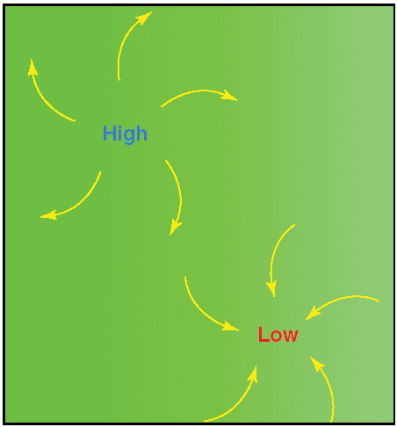
Wind Patterns
Air flows from areas of high pressure into those of low pressure because air always seeks out lower pressure.
In the Northern Hemisphere, this flow of air from areas of high to low pressure is deflected to the right; producing a clockwise circulation around an area of high pressure. This is also known as anti-cyclonic circulation. The opposite is true of low-pressure areas; the air flows toward a low and is deflected to create a counter-clockwise or cyclonic circulation.
Notes:
Air flows from areas of high pressure into those of low pressure because air always seeks out lower pressure.
In the Northern Hemisphere, this flow of air from areas of high to low pressure is deflected to the right; producing a clockwise circulation around an area of high pressure. The opposite is true of low-pressure areas; the air flows toward a low and is deflected to create a counter-clockwise or cyclonic circulation.

Slide 15
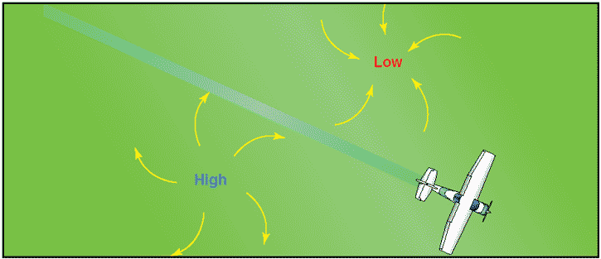
Pressure Systems
High-pressure systems are generally areas of dry, stable, descending air. Good aviation weather is typically associated with high-pressure systems for this reason.
Conversely, air flows into a low-pressure area to replace rising air. This air tends to be unstable, and usually brings increasing cloudiness and precipitation.
Thus, bad aviation weather is commonly associated with areas of low pressure.
A good understanding of high- and low-pressure wind patterns can be of great help when planning a flight, because a pilot can take advantage of beneficial tailwinds.
Notes:
High-pressure systems are generally areas of dry, stable, descending air.
Conversely, air flows into a low-pressure area to replace rising air. This air tends to be unstable, and usually brings increasing cloudiness and precipitation.
A good understanding of high and low pressure wind patterns can be of great help when planning a flight, because a pilot can take advantage of beneficial tailwinds.
When planning a flight from west to east, favorable winds would be encountered along the northern side of a high-pressure system or the southern side of a low-pressure system. On the return flight, the most favorable winds would be along the southern side of the same high-pressure system or the northern side of a low-pressure system. An added advantage is a better understanding of what type of aviation weather to expect in a given area along a route of flight based on the prevailing areas of highs and lows.
The theory of circulation and wind patterns is accurate for large-scale atmospheric circulation; however, it does not take into account changes to the circulation on a local scale. Local conditions, geological features, and other anomalies can change the wind direction and speed close to the Earth's surface.

Slide 16
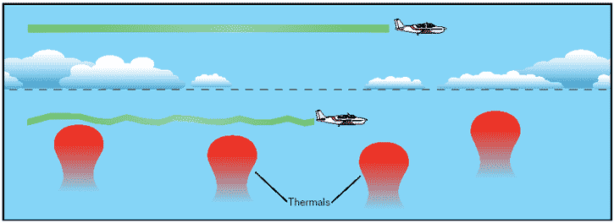
Convective Currents
Different surfaces radiate heat in varying amounts. Plowed ground, rocks, sand, and barren land give off a large amount of heat; water, trees, and other areas of vegetation tend to absorb and retain heat. The resulting uneven heating of the air creates small areas of local circulation called convective currents.
Notes:
Different surfaces radiate heat in varying amounts. Plowed ground, rocks, sand, and barren land give off a large amount of heat; water, trees, and other areas of vegetation tend to absorb and retain heat. The resulting uneven heating of the air creates small areas of local circulation called convective currents.
Unlike powered aircraft, gliders can take advantage of the thermals created by the lifting air currents.

Slide 17
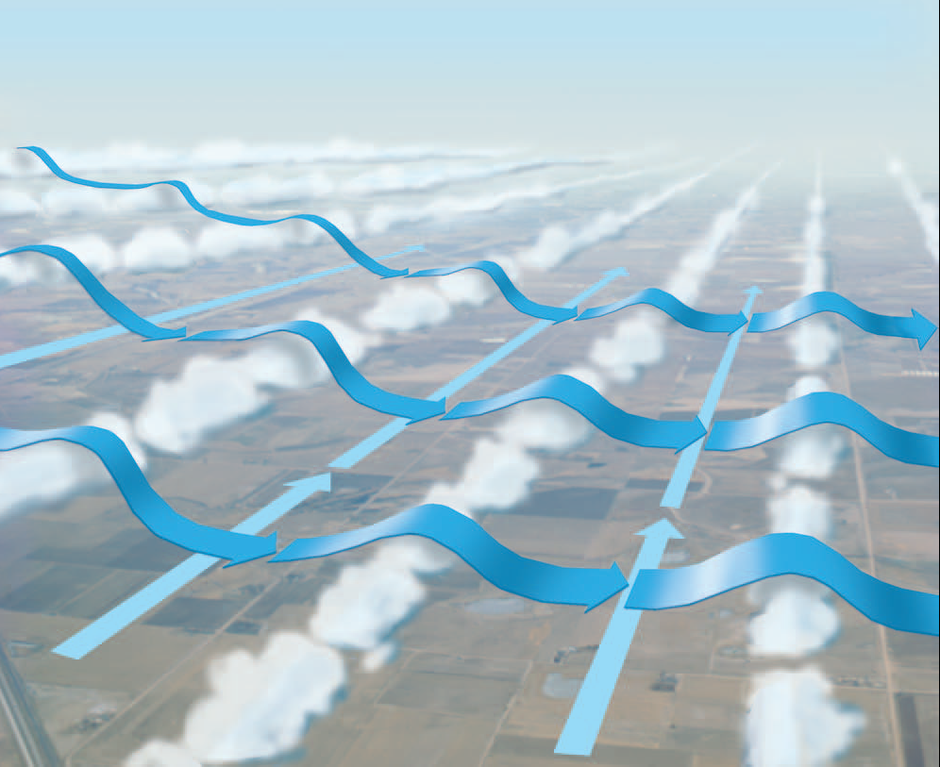
Cloud Street Wave
Upper Wind
Lower Wind
Cloud Street
Notes:
This diagram shows a wave-like formation along a cloud street.
An inversion has capped the cumulus clouds and if winds above the inversion are perpendicular to the cloud street and increasing at a rate of 10 kts per 5000 feet cloud-street waves can form in the stable air above the clouds.
This would allow smooth flights along the streets above the clouds with and a lift of 100 to 500 fpm.

Slide 18
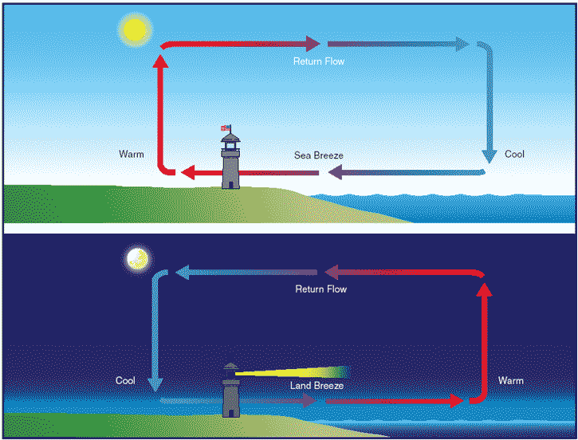
Sea and Land Breeze wind circulation patterns
Notes:
Convective currents are particularly noticeable in areas with a landmass directly adjacent to a large body of water, such as an ocean.
During the day, land heats faster than water, so the air over the land becomes warmer and less dense. It rises and is replaced by cooler, denser air flowing in from over the water. This causes an onshore wind, called a sea breeze. Conversely, at night land cools faster than water, as does the corresponding air.
In this case, the warmer air over the water rises and is replaced by the cooler, denser air from the land, creating an offshore wind called a land breeze. This reverses the local wind circulation pattern. Convective currents can occur anywhere there is an uneven heating of the Earth's surface.

Slide 19
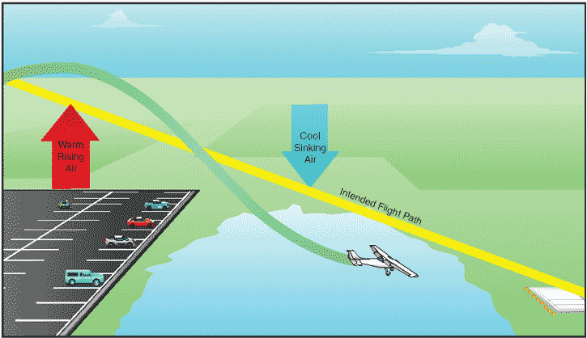
Currents generated by varying surface conditions
Convection currents close to the ground can affect a pilot´s ability to control the aircraft. On final approach, for example, the rising air from terrain devoid of vegetation sometimes produces a ballooning effect that can cause a pilot to overshoot the intended landing spot. On the other hand, an approach over a large body of water or an area of thick vegetation tends to create a sinking effect that can cause an unwary pilot to land short of the intended landing spot.
Notes:
Convection currents close to the ground can affect a pilot's ability to control the aircraft. On final approach the rising air from terrain devoid of vegetation sometimes produces a ballooning effect that can cause a pilot to overshoot the intended landing spot.
On the other hand, an approach over a large body of water or an area of thick vegetation tends to create a sinking effect that can cause an unwary pilot to land short of the intended landing spot.

Slide 20

Effect of obstructions on wind
Another atmospheric hazard exists that can create problems for pilots. Obstructions on the ground affect the flow of wind and can be an unseen danger. Ground topography and large buildings can break up the flow of the wind and create wind gusts that change rapidly in direction and speed. These obstructions range from manmade structures like hangars to large natural obstructions, such as mountains, bluffs, or canyons.
Notes:
Another atmospheric hazard exists that can create problems for pilots. Obstructions on the ground affect the flow of wind and can be an unseen danger. Ground topography and large buildings can break up the flow of the wind and create wind gusts that change rapidly in direction and speed. These obstructions range from manmade structures like hangars to large natural obstructions, such as mountains, bluffs, or canyons. It is especially important to be vigilant when flying in or out of airports that have large buildings or natural obstructions located near the runway.
The intensity of the turbulence associated with ground obstructions depends on the size of the obstacle and the primary velocity of the wind. This can affect the takeoff and landing performance of any aircraft and can present a very serious hazard. During the landing phase of flight, an aircraft may drop rapidly due to the turbulent air and be too low to clear obstacles during the approach.
It is critical to plan expect this condition and plan your approach accordingly to minimize the risks.

Slide 21
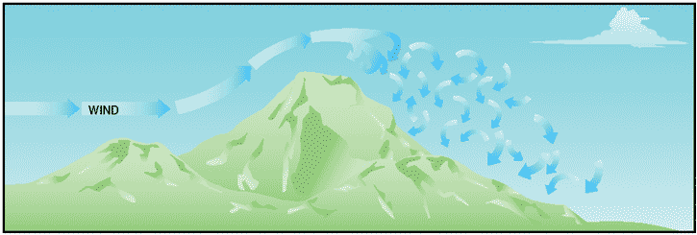
Turbulence near mountainous regions
While the wind flows smoothly up the windward side of the mountain and the upward currents help to carry an aircraft over the peak of the mountain, the wind on the leeward side does not act in a similar manner. As the air flows down the leeward side of the mountain, the air follows the contour of the terrain and is increasingly turbulent. This tends to push an aircraft into the side of a mountain. The stronger the wind, the greater the downward pressure and turbulence become.
Notes:
While the wind flows smoothly up the windward side of the mountain and the upward currents help to carry an aircraft over the peak of the mountain, the wind on the leeward side does not act in a similar manner.
As the air flows down the leeward side of the mountain, the air follows the contour of the terrain and is increasingly turbulent. This tends to push an aircraft into the side of a mountain. The stronger the wind, the greater the downward pressure and turbulence become.

Slide 22
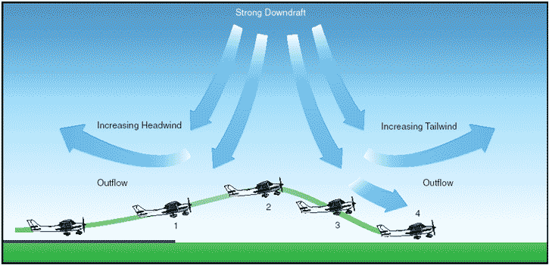
Low-level wind shear
Wind shear is a sudden, drastic change in wind speed and/or direction over a very small area. Wind shear can subject an aircraft to violent updrafts and downdrafts as well as abrupt changes to the horizontal movement of the aircraft. While wind shear can occur at any altitude, low-level wind shear is especially hazardous due to the proximity of an aircraft to the ground.
Notes:
Wind shear is a sudden, drastic change in wind speed and/or direction over a very small area.
Wind shear can subject an aircraft to violent updrafts and downdrafts as well as abrupt changes to the horizontal movement of the aircraft.
While wind shear can occur at any altitude, low-level wind shear is especially hazardous due to the proximity of an aircraft to the ground.

Slide 23
Shear Encounters
When can this happen?
Landing in gusty conditions
Landing area shielded by obstructions
During good thermal conditions
Notes:
23
You do not need strong winds for this to occur. Suppose a thermal breaks loose ¼ mile in front of you? Wind will flow into the thermal, causing a shear as the headwind turns into a tailwind on short final.

Slide 24
Recommendations
Plan for this loss of energy
Pick an approach speed that will allow for some loss
Move base leg closer to runway edge
Be higher turning Final
Be prepared to close the spoilers
Be prepared to pitch forward to maintain/recover airspeed
Notes:
Plan for this loss of energy
Pick an approach speed that will allow for some loss
Move base leg closer to runway edge
Be higher turning Final
Be prepared to close the spoilers
Be prepared to pitch forward to maintain/recover airspeed

Slide 25
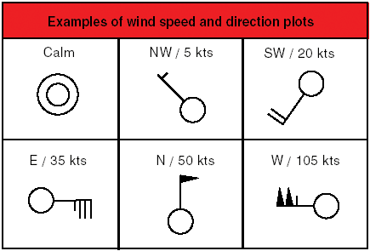
Wind and Pressure
Wind and pressure representation on surface weather maps

Slide 26
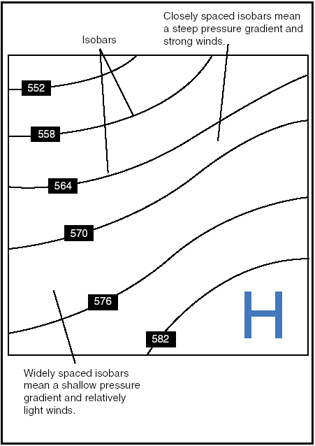
Pressure Gradient – Impact on Winds
Isobars reveal the pressure gradient of an area of high or low pressure areas

Slide 27
Atmospheric Stability
Atmospheric stability
The stability of the atmosphere depends on its ability to resist vertical motion. A stable atmosphere makes vertical movement difficult, and small vertical disturbances dampen out and disappear. In an unstable atmosphere, small vertical air movements tend to become larger, resulting in turbulent airflow and convective activity. Instability can lead to significant turbulence, extensive vertical clouds, and severe weather.
Rising air expands and cools due to the decrease in air pressure as altitude increases. The opposite is true of descending air; as atmospheric pressure increases, the temperature of descending air increases as it is compressed. Adiabatic heating, or adiabatic cooling, are the terms used to describe this temperature change.
The adiabatic process takes place in all upward and downward moving air. When air rises into an area of lower pressure, it expands to a larger volume. As the molecules of air expand, the temperature of the air lowers. As a result, when a parcel of air rises, pressure decreases, volume increases, and temperature decreases. When air descends, the opposite is true. The rate at which temperature decreases with an increase in altitude is referred to as its lapse rate. As air ascends through the atmosphere, the average rate of temperature change is 2°C (3.5°F) per 1,000 feet.
Since water vapor is lighter than air, moisture decreases air density, causing it to rise. Conversely, as moisture decreases, air becomes denser and tends to sink. Since moist air cools at a slower rate, it is generally less stable than dry air since the moist air must rise higher before its temperature cools to that of the surrounding air. The dry adiabatic lapse rate (unsaturated air) is 3°C (5.4°F) per 1,000 feet. The moist adiabatic lapse rate varies from 1.1°C to 2.8°C (2°F to 5°F) per 1,000 feet.
The combination of moisture and temperature determine the stability of the air and the resulting weather. Cool, dry air is very stable and resists vertical movement, which leads to good and generally clear weather. The greatest instability occurs when the air is moist and warm, as it is in the tropical regions in the summer. Typically, thunderstorms appear on a daily basis in these regions due to the instability of the surrounding air.
Notes:
Atmospheric stability
The stability of the atmosphere depends on its ability to resist vertical motion. A stable atmosphere makes vertical movement difficult. In an unstable atmosphere, small vertical air movements tend to become larger, resulting in turbulent airflow and convective activity. Instability can lead to significant turbulence, extensive vertical clouds, and severe weather. Great weather for soaring.
Rising air expands and cools due to the decrease in air pressure as altitude increases. The opposite is true of descending air; as atmospheric pressure increases, the temperature of descending air increases as it is compressed.
When air rises into an area of lower pressure, it expands to a larger volume. As the molecules of air expand, the temperature of the air lowers. As a result, when a parcel of air rises, pressure decreases, volume increases, and temperature decreases. When air descends, the opposite is true. The rate at which temperature decreases with an increase in altitude is referred to as its lapse rate. As air ascends through the atmosphere, the average rate of temperature change is 2°C (3.5°F) per 1,000 feet.
Since water vapor is lighter than air, moisture decreases air density, causing it to rise. Conversely, as moisture decreases, air becomes denser and tends to sink. Since moist air cools at a slower rate, it is generally less stable than dry air since the moist air must rise higher before its temperature cools to that of the surrounding air.
The combination of moisture and temperature determine the stability of the air and the resulting weather. Cool, dry air is very stable and resists vertical movement, which leads to good and generally clear weather, but poor soaring conditions. The greatest instability occurs when the air is moist and warm, as it is in the tropical regions in the summer. Typically, thunderstorms appear on a daily basis in these regions due to the instability of the surrounding air.

Slide 28
Inversion
Inversion
As air rises and expands in the atmosphere, the temperature decreases. There is an atmospheric anomaly that can occur, however, that changes this typical pattern of atmospheric behavior. When the temperature of the air rises with altitude, a temperature inversion exists. Inversion layers are commonly shallow layers of smooth, stable air close to the ground.
The temperature of the air increases with altitude to a certain point, which is the top of the inversion. The air at the top of the layer acts as a lid, keeping weather and pollutants trapped below. If the relative humidity of the air is high, it can contribute to the formation of clouds, fog, haze, or smoke, resulting in diminished visibility in the inversion layer.
Surface based temperature inversions occur on clear, cool nights when the air close to the ground is cooled by the lowering temperature of the ground. The air within a few hundred feet of the surface becomes cooler than the air above it. Frontal inversions occur when warm air spreads over a layer of cooler air, or cooler air is forced under a layer of warmer air.
Notes:
Inversion
As air rises and expands in the atmosphere, the temperature decreases. There is an atmospheric anomaly that can occur.
When the temperature of the air rises with altitude, a temperature inversion exists. Inversion layers are commonly shallow layers of smooth, stable air close to the ground.
The temperature of the air increases with altitude to a certain point, which is the top of the inversion. The air at the top of the layer acts as a lid, keeping weather and pollutants trapped below. If the relative humidity of the air is high, it can contribute to the formation of clouds, fog, haze, or smoke, resulting in diminished visibility in the inversion layer.
Surface based temperature inversions occur on clear, cool nights when the air close to the ground is cooled by the lowering temperature of the ground. The air within a few hundred feet of the surface becomes cooler than the air above it. Frontal inversions occur when warm air spreads over a layer of cooler air, or cooler air is forced under a layer of warmer air.

Slide 29
Moisture and Temperature
Moisture and Temperature
The atmosphere, by nature, contains moisture in the form of water vapor. The amount of moisture present in the atmosphere is dependent upon the temperature of the air. Every 20°F increase in temperature doubles the amount of moisture the air can hold. Conversely, a decrease of 20°F cuts the capacity in half.
Water is present in the atmosphere in three states: liquid, solid, and gaseous. All three forms can readily change to another, and all are present within the temperature ranges of the atmosphere. As water changes from one state to another, an exchange of heat takes place. These changes occur through the processes of evaporation, sublimation, condensation, deposition, melting, or freezing. However, water vapor is added into the atmosphere only by the processes of evaporation and sublimation.
Evaporation is the changing of liquid water to water vapor. As water vapor forms, it absorbs heat from the nearest available source. This heat exchange is known as the latent heat of evaporation. A good example of this is when the body´s perspiration evaporates. The net effect is a cooling sensation as heat is extracted from the body. Similarly, sublimation is the changing of ice directly to water vapor, completely bypassing the liquid stage. Though dry ice is not made of water, but rather carbon dioxide, it demonstrates the principle of sublimation, when a solid turns directly into vapor.
Notes:
Moisture and Temperature
The atmosphere, by nature, contains moisture in the form of water vapor. The amount of moisture present in the atmosphere is dependent upon the temperature of the air. Every 20°F increase in temperature doubles the amount of moisture the air can hold. Conversely, a decrease of 20°F cuts the capacity in half.
Water is present in the atmosphere in three states: liquid, solid, and gaseous. All three forms can readily change to another, and all are present within the temperature ranges of the atmosphere. As water changes from one state to another, an exchange of heat takes place. These changes occur through the processes of evaporation, sublimation, condensation, deposition, melting, or freezing. However, water vapor is added into the atmosphere only by the processes of evaporation and sublimation.
Evaporation is the changing of liquid water to water vapor. As water vapor forms, it absorbs heat from the nearest available source. This heat exchange is known as the latent heat of evaporation. A good example of this is when the body's perspiration evaporates. The net effect is a cooling sensation as heat is extracted from the body. Similarly, sublimation is the changing of ice directly to water vapor, completely bypassing the liquid stage. Though dry ice is not made of water, but rather carbon dioxide, it demonstrates the principle of sublimation, when a solid turns directly into vapor.

Slide 30
Temperature and Dewpoint Relationship
Temperature and Dewpoint Relationship
The relationship between dewpoint and temperature defines the concept of relative humidity. The dewpoint, given in degrees, is the temperature at which the air can hold no more moisture. When the temperature of the air is reduced to the dewpoint, the air is completely saturated and moisture begins to condense out of the air in the form of fog, dew, frost, clouds, rain, hail, or snow.
As moist, unstable air rises, clouds often form at the altitude where temperature and dewpoint reach the same value. When lifted, unsaturated air cools at a rate of 5.4°F per 1,000 feet and the dewpoint temperature decreases at a rate of 1°F per 1,000 feet. This results in a convergence of temperature and dewpoint at a rate of 4.4°F. Apply the convergence rate to the reported temperature and dewpoint to determine the height of the cloud base.
Notes:
Temperature and Dewpoint Relationship
The relationship between dewpoint and temperature defines the concept of relative humidity. The dewpoint, given in degrees, is the temperature at which the air can hold no more moisture. When the temperature of the air is reduced to the dewpoint, the air is completely saturated and moisture begins to condense out of the air in the form of fog, dew, frost, clouds, rain, hail, or snow.
As moist, unstable air rises, clouds often form at the altitude where temperature and dewpoint reach the same value. When lifted, unsaturated air cools at a rate of 5.4°F per 1,000 feet and the dewpoint temperature decreases at a rate of 1°F per 1,000 feet. This results in a convergence of temperature and dewpoint at a rate of 4.4°F. You can apply the convergence rate to the reported temperature and dewpoint to determine the height of the clouds.

Slide 31
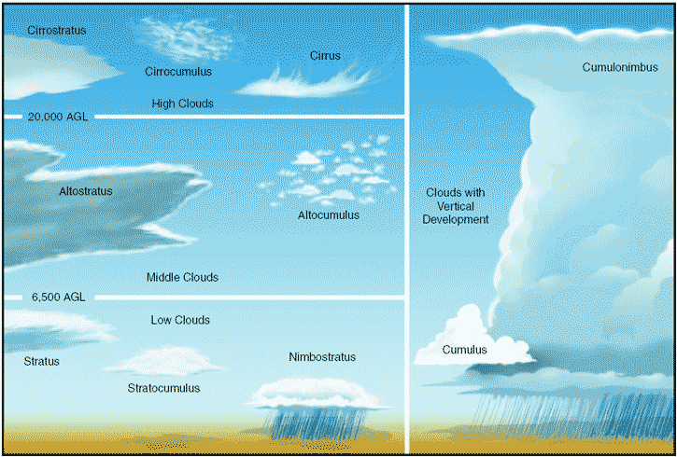
Clouds
Notes:
The following is a list of cloud classifications:
Cumulus—Heaped or piled clouds.
Stratus—Formed in layers.
Cirrus—Ringlets; fibrous clouds; also high-level clouds above 20,000 feet.
Lenticularus—Lens shaped; formed over mountains in strong winds.
Nimbus—Rain bearing clouds.
Alto—Meaning high; also middle-level clouds existing at 5,000 to 20,000 feet.

Slide 32
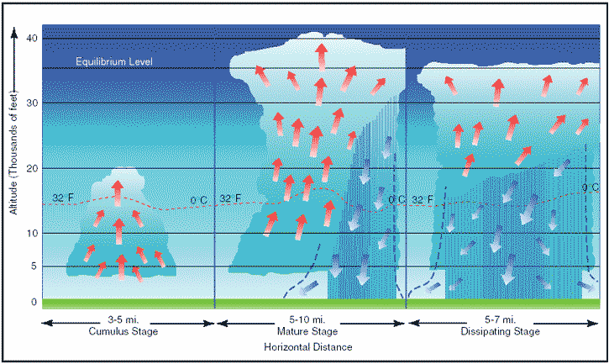
Life cycle of a Thunderstorm
Notes:
To pilots, the cumulonimbus cloud is perhaps the most dangerous cloud type. Heating of the air near the Earth's surface creates an air mass thunderstorm. The upslope motion of air in the mountainous regions causes orographic thunderstorms. Cumulonimbus clouds that form in a continuous line are non-frontal bands of thunderstorms or squall lines.
Since rising air currents cause cumulonimbus clouds, they are extremely turbulent and pose a significant hazard to flight safety. For example, if an aircraft enters a thunderstorm, the aircraft could experience updrafts and downdrafts that exceed 3,000 feet per minute. In addition, thunderstorms can produce large hailstones, damaging lightning, tornadoes, and large quantities of water, all of which are potentially hazardous to aircraft.
A thunderstorm makes its way through three distinct stages before dissipating. It begins with the cumulus stage, in which lifting action of the air begins. If sufficient moisture and instability are present, the clouds continue to increase in vertical height.
Continuous, strong updrafts prohibit moisture from falling. The updraft region grows larger than the individual thermals feeding the storm. Within approximately 15 minutes, the thunderstorm reaches the mature stage, which is the most violent time period of the thunderstorm's life cycle. At this point, drops of moisture, whether rain or ice, are too heavy for the cloud to support and begin falling in the form of rain or hail. This creates a downward motion of the air. Warm, rising air; cool, precipitation-induced descending air; and violent turbulence all exist within and near the cloud. Below the cloud, the down-rushing air increases surface winds and decreases the temperature. Once the vertical motion near the top of the cloud slows down, the top of the cloud spreads out and takes on an anvil-like shape. At this point, the storm enters the dissipating stage. This is when the downdrafts spread out and replace the updrafts needed to sustain the storm.

Slide 33
Types of Fronts
Cold
Good soaring conditions
Squall lines 50 - 300 miles ahead
Warm
Temperature inversion
Broad cloud system precedes front
Occluded
Both warm & cold cloud patterns
Notes:
Types of Fronts
Cold
Good soaring conditions
squall lines 50 - 300 miles ahead
Warm
temperature inversion
broad cloud system precedes front
Occluded
both warm & cold cloud patterns

Slide 34
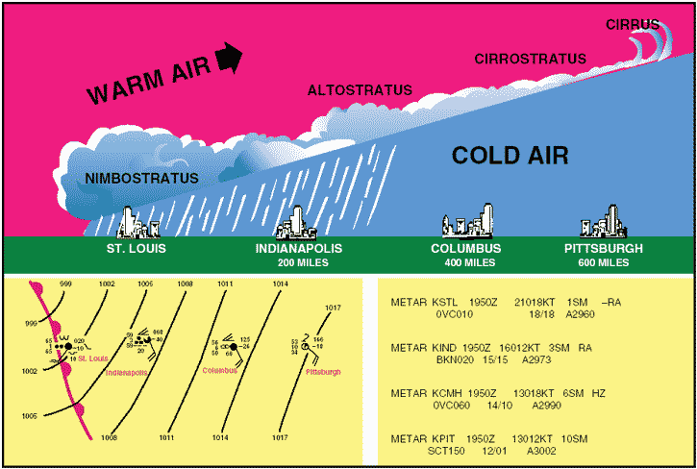
Warm Front
Notes:
Warm front
A warm front occurs when a warm mass of air advances and replaces a body of colder air. Warm fronts move slowly, typically 10 to 25 miles per hour (m.p.h.).
The slope of the advancing front slides over the top of the cooler air and gradually pushes it out of the area.
Warm fronts contain warm air that often has very high humidity. As the warm air is lifted, the temperature drops and condensation occurs.
Generally, prior to the passage of a warm front, cirriform or stratiform clouds, along with fog, can be expected to form along the frontal boundary. In the summer months, cumulonimbus clouds (thunderstorms) are likely to develop. Light to moderate precipitation is probable, usually in the form of rain, sleet, snow, or drizzle, punctuated by poor visibility. The wind blows from the south-southeast, and the outside temperature is cool or cold, with increasing dew point. Finally, as the warm front approaches, the barometric pressure continues to fall until the front passes completely.
During the passage of a warm front, stratiform clouds are visible and drizzle may be falling. The visibility is generally poor, but improves with variable winds. The temperature rises steadily from the inflow of relatively warmer air. For the most part, the dew point remains steady and the pressure levels off.
After the passage of a warm front, stratocumulus clouds predominate and rain showers are possible. The visibility eventually improves, but hazy conditions may exist for a short period after passage. The wind blows from the south-southwest. With warming temperatures, the dew point rises and then levels off. There is generally a slight rise in barometric pressure, followed by a decrease of barometric pressure.

Slide 35
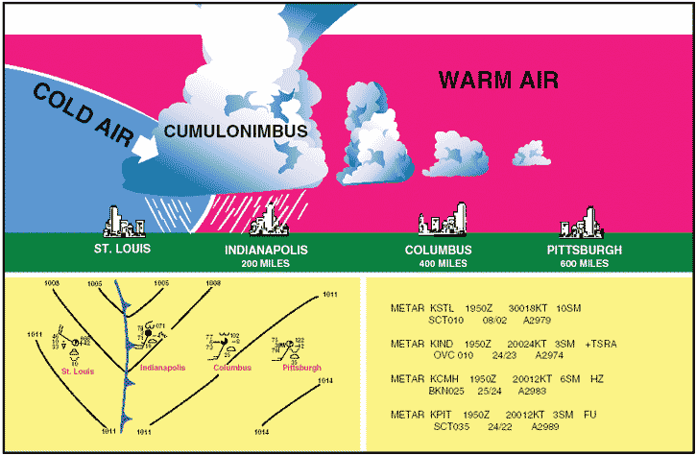
Cold Front
Notes:
Cold front
A cold front occurs when a mass of cold, dense, and stable air advances and replaces a body of warmer air.
Cold fronts move more rapidly than warm fronts, progressing at a rate of 25 to 30 m.p.h. However, extreme cold fronts have been recorded moving at speeds of up to 60 m.p.h. A typical cold front moves in a manner opposite that of a warm front; because it is so dense, it stays close to the ground and acts like a snowplow, sliding under the warmer air and forcing the less dense air aloft. The rapidly ascending air causes the temperature to decrease suddenly, forcing the creation of clouds. The type of clouds that form depends on the stability of the warmer air mass. A cold front in the Northern Hemisphere is normally oriented in a northeast to southwest manner and can be several hundred miles long, encompassing a large area of land.
Prior to the passage of a typical cold front, cirriform or towering cumulus clouds are present, and cumulonimbus clouds are possible. Rain showers and haze are possible due to the rapid development of clouds. The wind from the south-southwest helps to replace the warm temperatures with the relative colder air. A high dew point and falling barometric pressure are indicative of imminent cold front passage.
As the cold front passes, towering cumulus or cumulonimbus clouds continue to dominate the sky.
Depending on the intensity of the cold front, heavy rain showers form and might be accompanied by lightning, thunder, and/or hail. More severe cold fronts can also produce tornadoes. During cold front passage, the visibility will be poor, with winds variable and gusty, and the temperature and dew point drop rapidly. A quickly falling barometric pressure bottoms out during frontal passage, then begins a gradual increase.
After frontal passage, the towering cumulus and cumulonimbus clouds begin to dissipate to cumulus clouds with a corresponding decrease in the precipitation.
Good visibility eventually prevails with the winds from the west-northwest. Temperatures remain cooler and the barometric pressure continues to rise.

Slide 36
Comparison of Cold and Warm Fronts
Warm fronts and cold fronts are very different in nature as are the hazards associated with each front. They vary in speed, composition, weather phenomenon, and prediction. Cold fronts, which move at 20 to 35 m.p.h., move very quickly in comparison to warm fronts, which move at only 10 to 25 m.p.h. Cold fronts also possess a steeper frontal slope. Violent weather activity is associated with cold fronts and the weather usually occurs along the frontal boundary, not in advance.
Squall lines can form during the summer months as far as 200 miles in advance of a severe cold front. Whereas warm fronts bring low ceilings, poor visibility, and rain, cold fronts bring sudden storms, gusty winds, turbulence, and sometimes hail or tornadoes.
Cold fronts are fast approaching with little or no warning, and they make a complete aviation weather change in just a few hours. The weather clears rapidly after passage and drier air with unlimited visibilities prevail.
Warm fronts, on the other hand, provide advance warning of their approach and can take days to pass through a region.
Notes:
Warm fronts and cold fronts are very different in nature as are the hazards associated with each front. They vary in speed, composition, weather phenomenon, and prediction.
Cold fronts, which move at 20 to 35 m.p.h., move very quickly in comparison to warm fronts, which move at only 10 to 25 m.p.h. Cold fronts also possess a steeper frontal slope. Violent weather activity is associated with cold fronts and the weather usually occurs along the frontal boundary, not in advance.
Squall lines can form during the summer months as far as 200 miles in advance of a severe cold front. Whereas warm fronts bring low ceilings, poor visibility, and rain, cold fronts bring sudden storms, gusty winds, turbulence, and sometimes hail or tornadoes.
Cold fronts are fast approaching with little or no warning, and they make a complete aviation weather change in just a few hours. The weather clears rapidly after passage and drier air with unlimited visibilities prevail.
Warm fronts, on the other hand, provide advance warning of their approach and can take days to pass through a region.

Slide 37
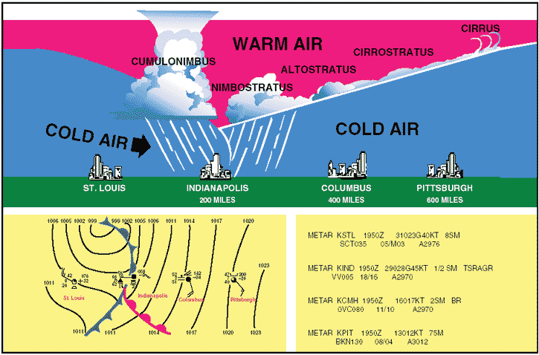
Occluded Front
Notes:
An occluded front occurs when a fast-moving cold front catches up with a slow-moving warm front. As the occluded front approaches, warm front weather prevails, but is immediately followed by cold front weather. There are two types of occluded fronts that can occur, and the temperatures of the colliding frontal systems play a large part in defining the type of front and the resulting aviation weather.
A cold front occlusion occurs when a fast-moving cold front is colder than the air ahead of the slow-moving warm front. When this occurs, the cold air replaces the cool air and forces the warm front aloft into the atmosphere. Typically, the cold front occlusion creates a mixture of weather found in both warm and cold fronts, providing the air is relatively stable.
A warm front occlusion occurs when the air ahead of the warm front is colder than the air of the cold front. When this is the case, the cold front rides up and over the warm front. If the air forced aloft by the warm front occlusion is unstable, the weather will be more severe than the weather found in a cold front occlusion. Embedded thunderstorms, rain, and fog are likely to occur.

Slide 38
Obtaining Weather Data
Look Outside
Local sounding
Flight Service Station (1-800-WXBrief)
National Weather Service
3rd party service provider
Internet (email and Web)

Slide 39
Atmospheric Assumptions
Pressure lapse rate 1” Hg/1000 ft
Dry adiabatic lapse rate 5.4º (3ºC)/1000 ft
Convergence Rate 4.4ºF
Standard Temperature: 59ºF (15ºC)
Temperature Lapse Rate: 3.5ºF (2ºC)/1000 ft
Standard Pressure: 29.92 inches Hg

Slide 40
Soaring Calculations
Thermal Index (TI)
measured - adiabatic (minus is better)
Cloud base
(max surface - dewpoint)/4.4 (in 1000’s of ft)

Slide 41
Calculate Cloud Base
Given:
Temperature (T) = 85°F
Dewpoint (DP) = 71°F
Convergence Rate (CR) = 4.4°
T — DP = Temperature Dewpoint Spread (TDS)
TDS÷CR = X
Xx1,000 feet = height of cloud base AGL
Example:
85°F - 71°F = 14°F
14°F ÷ 4.4°F = 3.18
3.18 x 1,000 = 3,180 feet AGL
The height of the cloud base is 3,180 feet AGL.
Explanation:
With an outside air temperature (OAT) of 85°F at the surface, and dewpoint at the surface of 71°F, the spread is 14°. Divide the temperature dewpoint spread by the convergence rate of 4.4°F, and multiply by 1,000 to determine the approximate height of the cloud base.

Slide 42
Obtaining a Weather Briefing
FSS call 1-800-992-7433 (WXBrief)
Identify yourself as a glider pilot
Give Aircraft ‘N’ number
Say type of flight and location
Ask for standard briefing
Ask for surface reports
Ask for winds aloft forecast
Ask for Soaring forecast
Ask for other pertinent data (Notams, TFR’s)

Slide 43
Thermal Predictors/Indicators
Negative Thermal Index values at alt.
Forecast plots
Clouds
Birds/Gliders circling
Dirt, crops, houses, animals rising before your eyes (Reference: Wizard of OZ)

Slide 44
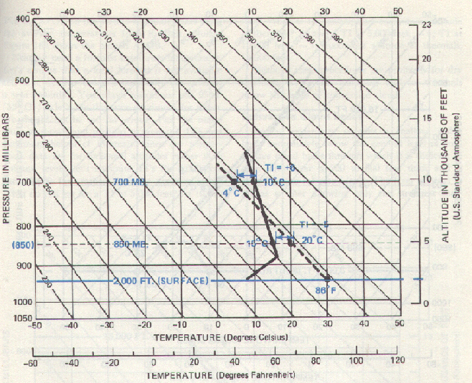
Pseudo-Adiabatic plot
Notes:
Three temperature values are needed:
Forecasted Maximum Temperature for the day (Example: 86F or 30C)
Temperature at 5,000 feet (Example: 15C)
Temperature at 10,000 feet (Example: 10C)
Conclusion:
TI at 5,000 feet: 15-20 = -5 (Good for soaring)
TI at 10,000 feet: 10-4= +6 (Bad for soaring)

Slide 45
Typical FSS Soaring Forecast
T.I. at 5000 ft -5
T.I. at 10,000 ft +2
Height of -3 7200
Top of Lift 8500
Max Expected Temp 89
Morning Low 50

Slide 46
Internet Sources
Kevin Ford - http://www.soarforecast.com
NOAA-FSL, Forecast Systems Laboratory - http://www-frd.fsl.noaa.gov/mab/soundings/java/
Aviation Digital Data Service - http://adds.aviationweather.noaa.gov
Dr Jack BLIPMAP - http://www.drjack.info/BLIP/index.html

Slide 47
Kevin Ford Plots
=== Interpolations (temps in deg. F, altitudes in feet MSL) ===
MSL *TI* Wdir@kts trig VirT 1.2 degrees/division ("`": Dry Adiabatic)
----- ---- -------- ---- . ---- -----------------------------------------
10000 12.4 40 | -9.8 ` :
9500 11.6 39 | -8.6 ` :
9000 10.7 280 27 37 | -7.5 ` :
8500 9.8 35 | -6.5 ` :
8000 8.8 290 25 34 | -5.5 ` :
7500 7.9 32 | -4.5 ` :
7000 6.9 295 24 30 | -3.5 ` :
6500 6.0 29 | -2.6 ` :
6000 3.7 300 27 25 | -4.0 ` :
5500 3.6 24 | -1.5 ` :
5000 3.5 24 | 0.9 ` :
4500 3.3 24 | 3.3 ` :
4000 2.1 22 | 3.7 ` :
3500 0.8 19 | 4.1 `:
3000 -0.5 18 | 4.4 :`
2500 -1.8 16 | 4.8 : `
2000 -2.1 15 | 7.0 : `
1500 -2.1 15 | 9.7 : `
1000 -2.1 15 | 12.3 : `

Slide 48
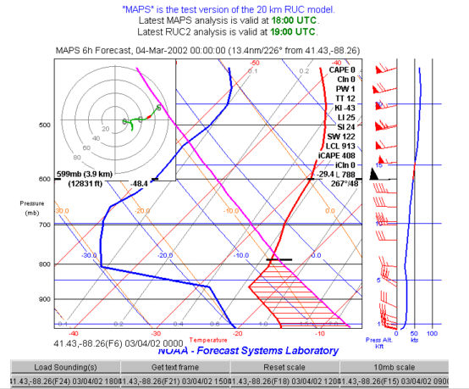
NOAA Forecast Plot

Slide 49
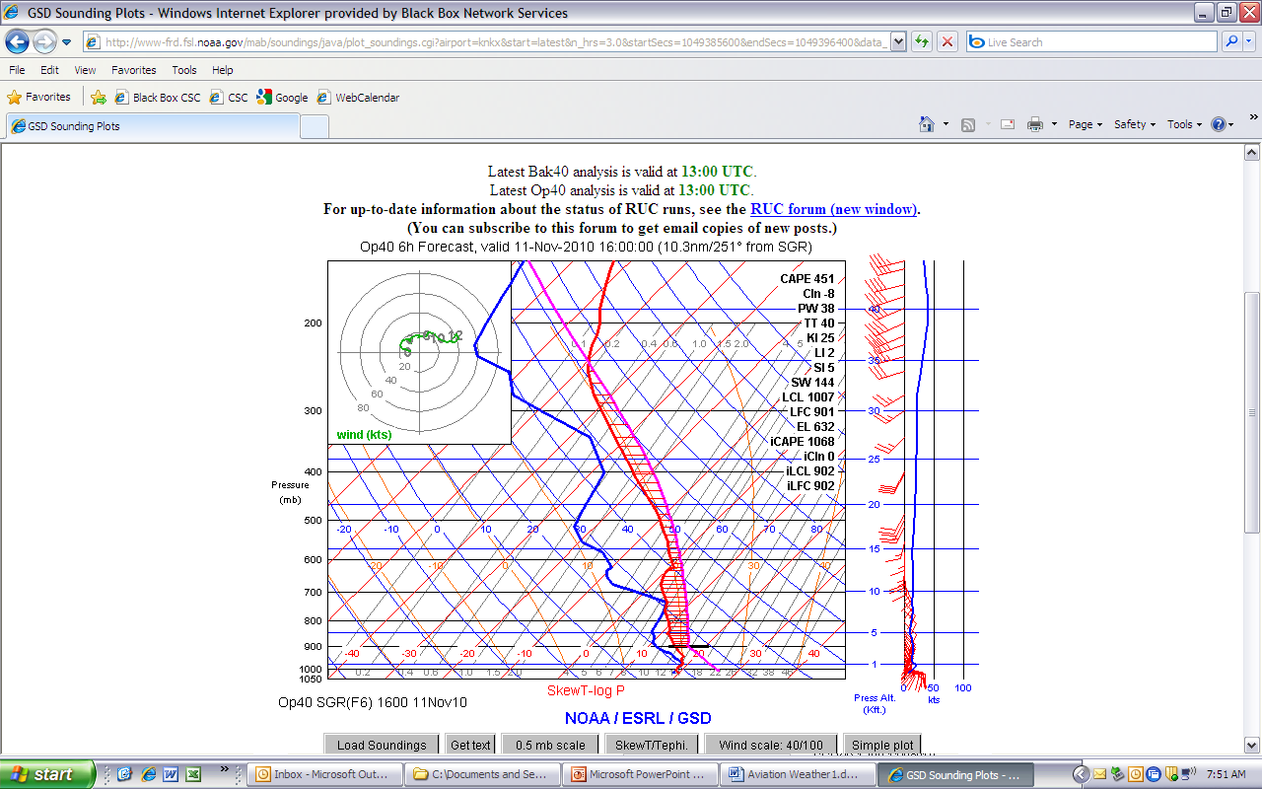
NOAA Forecast Plot

Slide 50
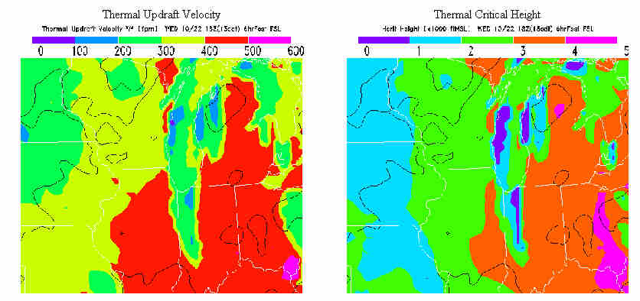
Dr Jack BLIPMAP

Slide 51
Local factors
Terrain features
Ridges
Mountains
Rivers
Lakes
Towns

Slide 52
Local factors
Ridge conditions
Calculations
Predictions
90^{O} +/- 30^{O} to ridge line
10 - 15 kts
Ridges
Lift extends 2 – 3 times the ridge height
Ridge length should be several miles

Slide 53
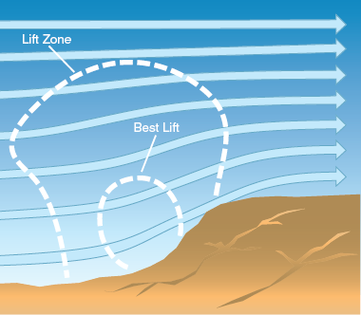
Ridge Lift Zones

Slide 54
Local factors
Wave conditions
Calculations
Predictions
Wind at peak
15 to 20 kts
Wind 2000 m above peak
Same direction
20 to 25 kts higher

Slide 55
Mountain Wave System

Slide 56
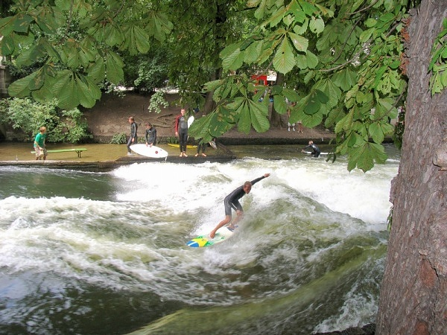

Slide 57
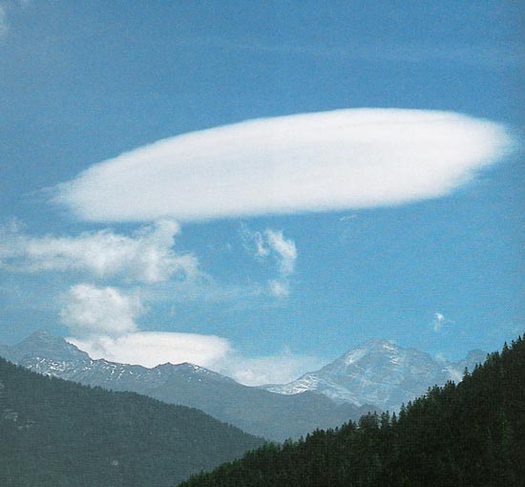
Altocumulus Lenticularis

Slide 58
Seasonal Weather Operations
Density Altitude
Thunderstorms
Frost, Snow Ice
Temperature extremes
Wind shear
Microbursts

Slide 59
Meteorology for Soaring
Questions?

