Slide 1
Zlotcar Pilot

Slide 2
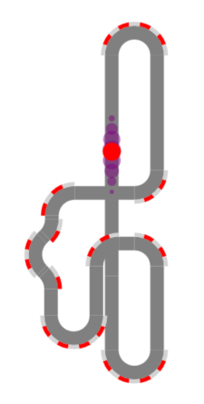

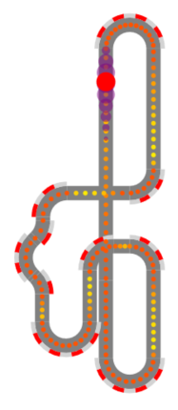
Overview
1. Reconstruct Track
2. Localize Zlotcar
3. Optimize Power Control

Slide 3
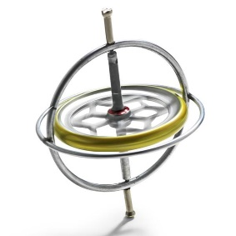
Reconstruct Track
Input: - Drive a couple of rounds
- Use rotation of Zlotcar,
i.e., z-axis of gyrosensor
Detect laps:
- Autocorrelation
of gyro sensor
1. lap

Slide 4
Reconstruct Track
Extract segments:
- Align laps
- Detect curves & straights
curves
straights
1. lap
2. lap
curves
Reconstruct track:
- Curves sum to 360°
- Round to standard segments

Slide 5
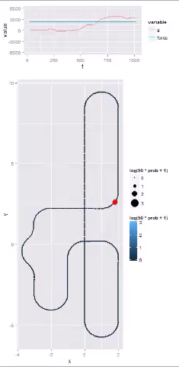
Localize Zlotcar
gyro values
of last second
Compute probability at each track position:
- Update last estimate: Move previous
probabilities according to current force
value and apply Gaussian blur
- Use sensor measurements: Calculate
cross-correlation between gyro values
of last second and the track
- Multiply both and scale to 1 to get
probability at each track position
Probability at
Each track position
Red dot: most
likely position

Slide 6
Optimize Power Control
Power control via neural network:
- Extract local track features
at most likely position
- Use neural network to
compute power value
- Control Zlotcar accordingly
Optimize neural network:
- Evaluate parameter settings on track
- Use genetic algorithm to find optimal
neural network parameters

