Slide 1
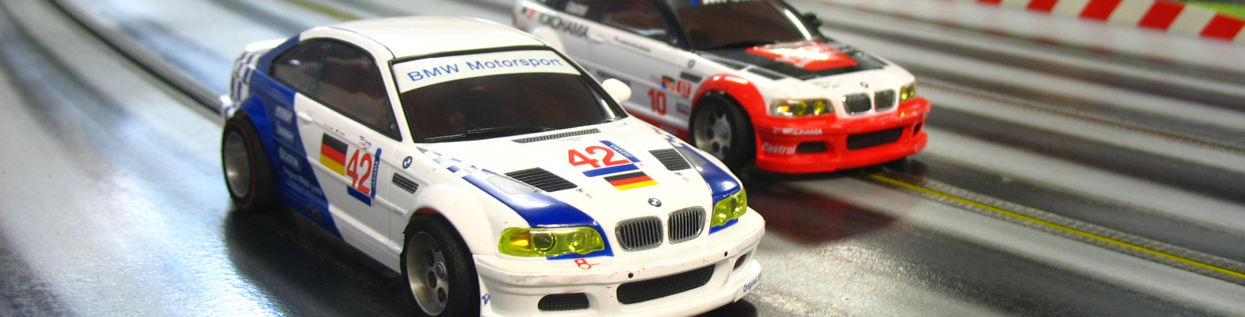
Slot Car Pilot

Slide 2
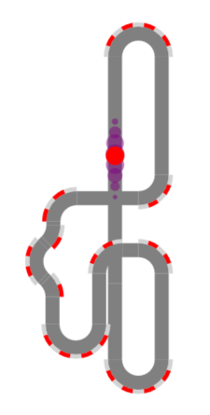

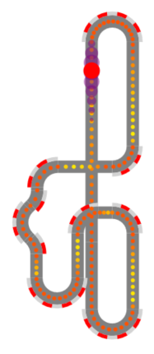
Overview
1. Reconstruct Track
2. Localize Slot Car
3. Optimize Power Control
Visualize

Slide 3
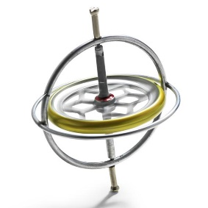
Reconstruct Track
Lap Detection
Input:
Drive a couple of rounds
Use rotation of Slot Car, i.e., z-axis of gyrosensor
Detect laps:
Autocorrelation of gyro sensor
1. lap

Slide 4
Reconstruct Track
Shape Estimation
Extract segments:
Align laps
Detect curves & straights
curves
straights
1. lap
2. lap
curves
Reconstruct track:
Curves sum to 360°
Round to standard segments

Slide 5
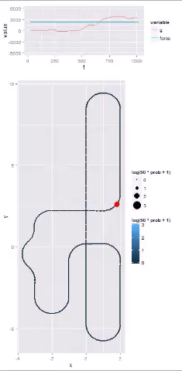
Localize Slot Car
gyro values
of last second
Compute probability at each track position:
Update last estimate: Move previous probabilities according to current force value and apply Gaussian blur
Use sensor measurements: Calculate cross-correlation between gyro values of last second and the track
Multiply both and scale to 1 to get probability at each track position
Probability at
Each track position
Red dot: most
likely position

Slide 6
Optimize Power Control
Power control via neural network:
Extract local track features at most likely position
Use neural network to compute power value
Control Slot Car accordingly
Optimize neural network:
Evaluate parameter settings on track
Use genetic algorithm to find optimal neural network parameters

Slide 7
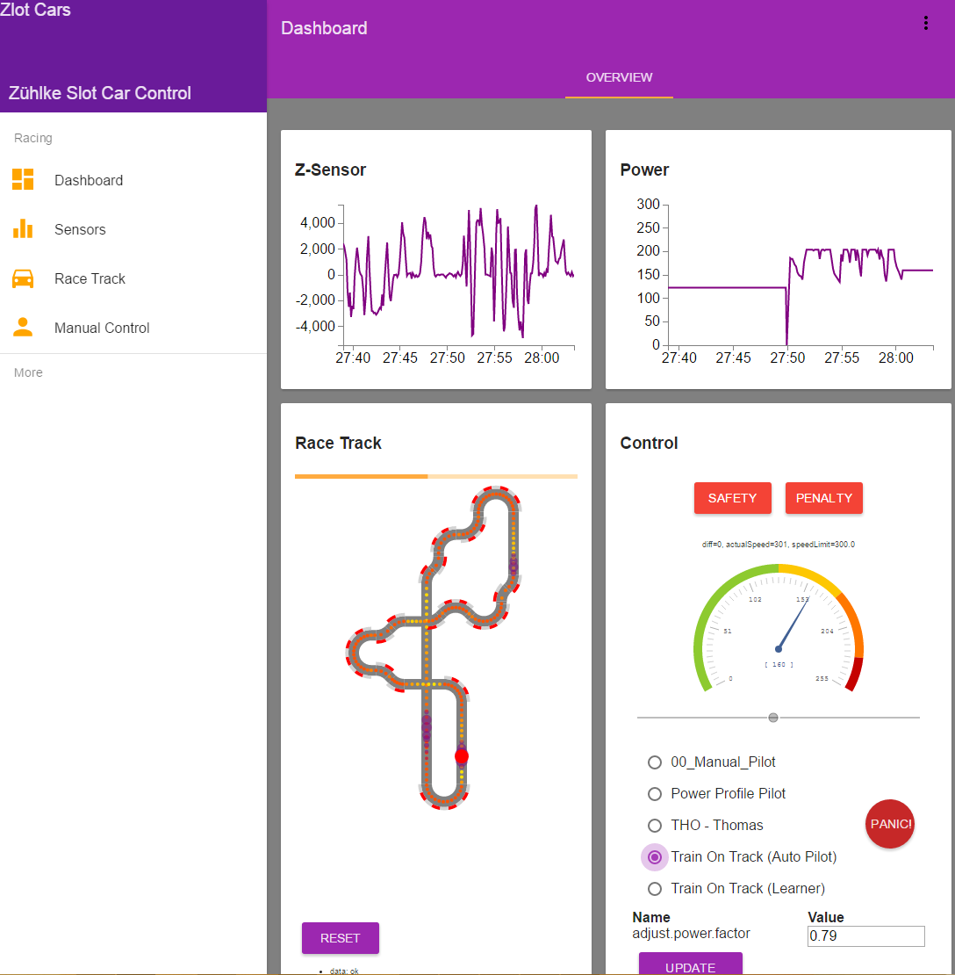
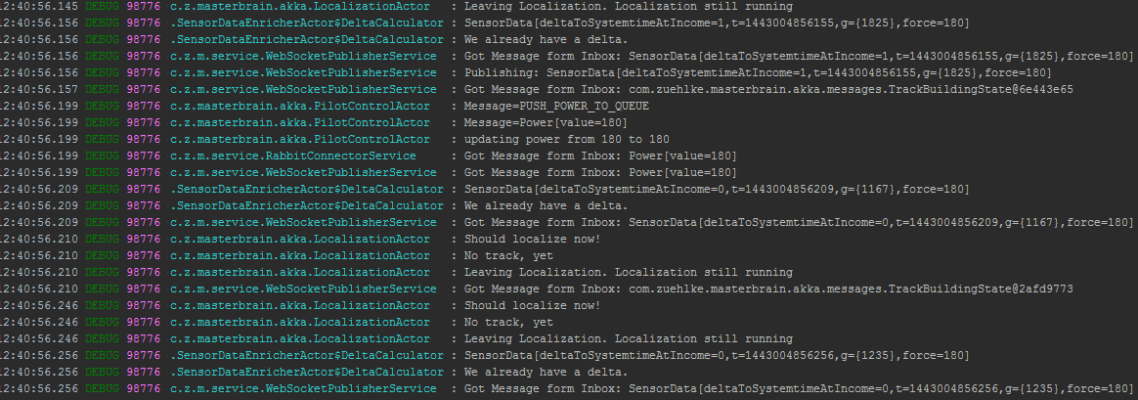
Visualize
A picture is worth a thousand words
Easier to interpret than log files
Log files are still important!
Your boss likes pictures!

