Slide 1
Akira – A personal desktop assistant
By : Shaikh Musab Parvez
Guided by : Mr. Javed Pathan

Slide 2
Abstract
The Project is called “Akira-A Personal Desktop Assistant” is a desktop assistant helping you with your day-to-day activities on your desktop.
Laptops and Desktops have become a part and parcel of everyone’s life, as every level of task requires some computation.
Everyone in the whole wide world is in need of computers and laptops because of 4th Industrial Revolution and work on these systems have increased a lot.
The main reason for a personal desktop assistant was to take some load of simple work performed in your system and give it an assistant who can complete and assist you while you keep working on the system

Slide 3
Features
Akira contains the following features:
Dr. Akhtar Hasan Rizvi - tells you about Dr. Akhtar Hasan Rizvi
Adv. Mrs. Rubina Rizvi - tells you about Mrs. Rubina Akhtar Hasan Rizvi
Rizvi College - tells you about Rizvi college 4. tell me about rumi care - tells you about Rumi care
help yourself foundation - tell you about Help yourself foundation
launch Website (pause) Name of Website - opens website
google search + your query - opens google search and speak 3 sentences from you query

Slide 4
7. from YouTube + your query - open YouTube and search videos on your query
8. tell me about Dr Anjum Ara Ahmed - Information about Dr Anjum Ara Ahmed
9. from wikipedia + your query - tell 3 sentences from your wikipedia query
10. take note - takes note and saves it
11. take a screenshot + name of the screenshot - takes a screenshot and saves it
12. tell me A joke - Tells a joke
13. music - Plays music from your directory
14. open app - Opens Specific apps
15. bitcoin - Tell the current value of Bitcoin
16. time - Tells current time
17. date - Tells current date
18. today - Tells current day
19. set an alarm - Sets an alarm
20. goodbye or exit - Exits the program

Slide 5
How does it work?
When Application is Opened, you see gui and a text document named as Features.
Gui has a button called “Talk to Akira” which starts the assistant and Features text document contains keywords and what they do.
Input device is use to take listen you voice.
Recognize.google recognizes your voice with Microphone as source.
Function TaskExec() contains tasks that triggers specific keywords are said.
Tasks are performed
Pyttsx3 library converts text to speech. You can make assistant speak stuff with speak() function

Slide 6
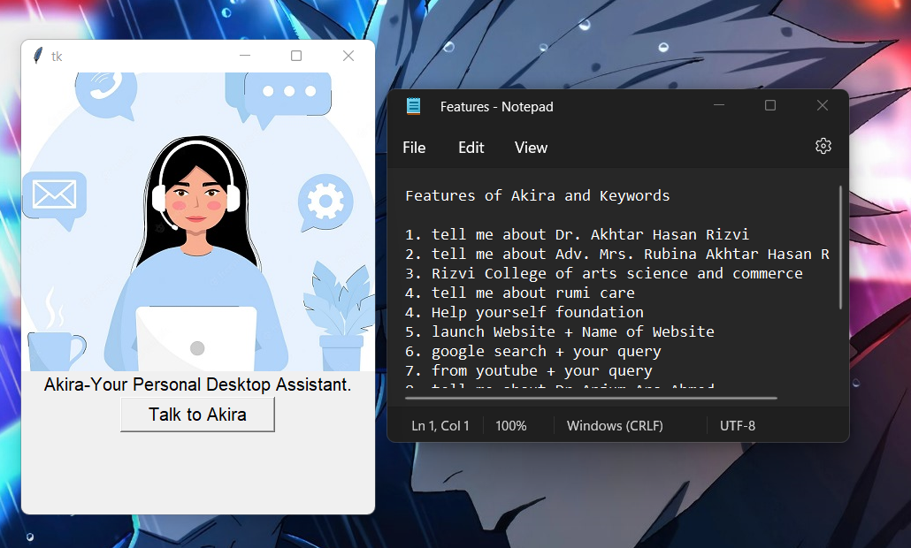
Photos
Opening Software

Slide 7
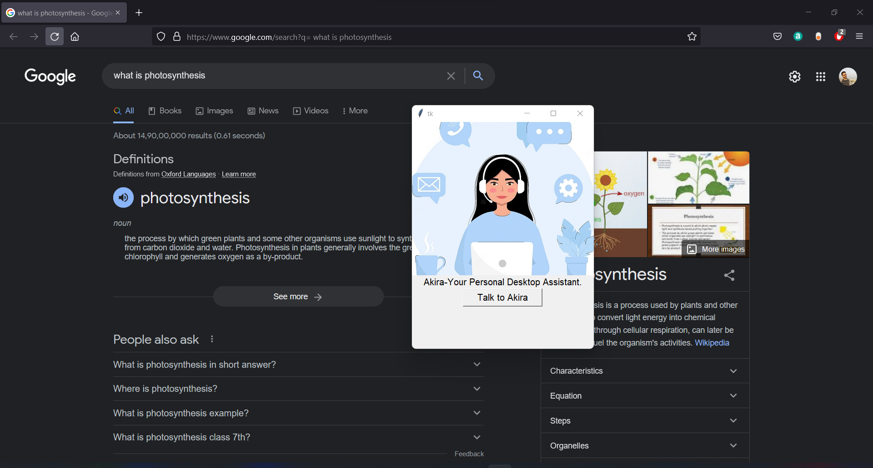
Google Search : “What is Photosynthesis”

Slide 8
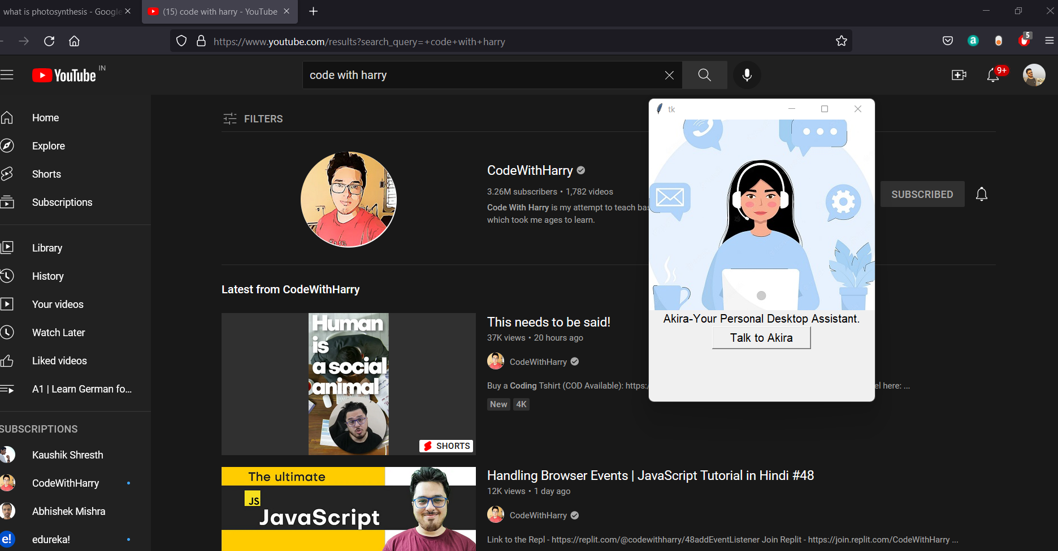
YouTube Search: “Code with Harry”

Slide 9
Limitations of Akira
Besides the above achievements and the successful completion of the project, we still feel the project has some limitations, listed as below:
Akira can only execute tasks when specific words are said.
Very limited number of tasks can be performed right now
Recognizer is very slow and not very reliable
Music function is not ideal as it needs you put your song files in specific folder

Slide 10
Conclusion and future work
Conclusion:
The project entitled “Akira – A Personal Desktop Assistant” is developed using Python Programming language to help desktop users in their day-to-day simple tasks on their system using only voice commands.
Future Work:
There are plenty of opportunities to explore in Akira such as adding new features, connecting it a home automation system, also it can be converted into an IOT project by importing python script into Raspberry or Arduino. The Future work on this project contains a lot of potential and will be very exciting.

Slide 11
Thank you!

