Slide 1
STATISTICAL ANALYSIS OF CLIMATE CHANGE IN INDIA (INSIGHTS FROM TEMPERATURE CHANGE DATA)
Group 4:
Soham Mhatre (24MBD016), Shalini Chaurasia (24MBD004), Musab Shaikh (24MBD026)

Slide 2
INTRODUCTION
Surface basal temperature typically refers to the average temperature of the Earth's surface, particularly in the context of climate studies. It serves as a baseline for comparing temperature variations over time or across different regions. Establishing a baseline often using historical data (like the 1961-1990 average)is essential for understanding how current temperatures deviate from historical norms and assessing the impacts of climate change.
Objectives of the study:
Understand temperature variations across different regions of India.
Study temperature changes over time from 1901-2020.
Analyze patterns in different seasonal periods (Winter, Summer, etc.).

Slide 3
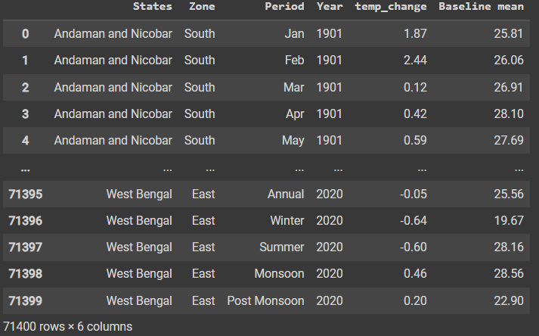
DATA OVERVIEW
THE DATASET CONTAINS THE FOLLOWING COLUMNS:
STATES: THE NAME OF THE STATE (E.G., ANDAMAN AND NICOBAR, WEST BENGAL).
ZONE: THE GEOGRAPHICAL ZONE THE STATE BELONGS TO (E.G., SOUTH, EAST).
PERIOD: THE TIME PERIOD (E.G., JANUARY, WINTER, ANNUAL).
YEAR: THE YEAR OF THE TEMPERATURE MEASUREMENT (E.G., 1901, 2020).
TEMP_CHANGE: THE TEMPERATURE CHANGE IN THAT YEAR RELATIVE TO THE BASELINE MEAN.
BASELINE MEAN: THE BASELINE MEAN TEMPERATURE (AVERAGED FOR THE PERIOD 1961-1990).

Slide 4
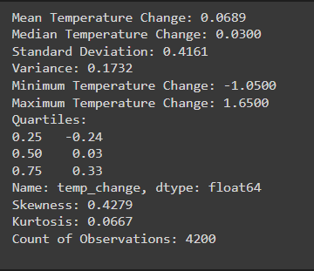
DESCRIPTIVE ANALYSIS OF TEMPERATURE CHANGE
Mean: On average, the temperature has increased by 0.0689°C relative to the baseline.
Median: Half of the data points have a temperature change below 0.03°C, and half have a change above this value.
Variance: A standard deviation of 0.4161°C indicates that the temperature changes vary, on average, by about 0.4161°C from the mean value.
Skewness: A skewness of 0.4279 indicates that the data is slightly positively skewed,
Kurtosis: A kurtosis value of 0.0667 is close to zero, which indicates the distribution is fairly normal

Slide 5
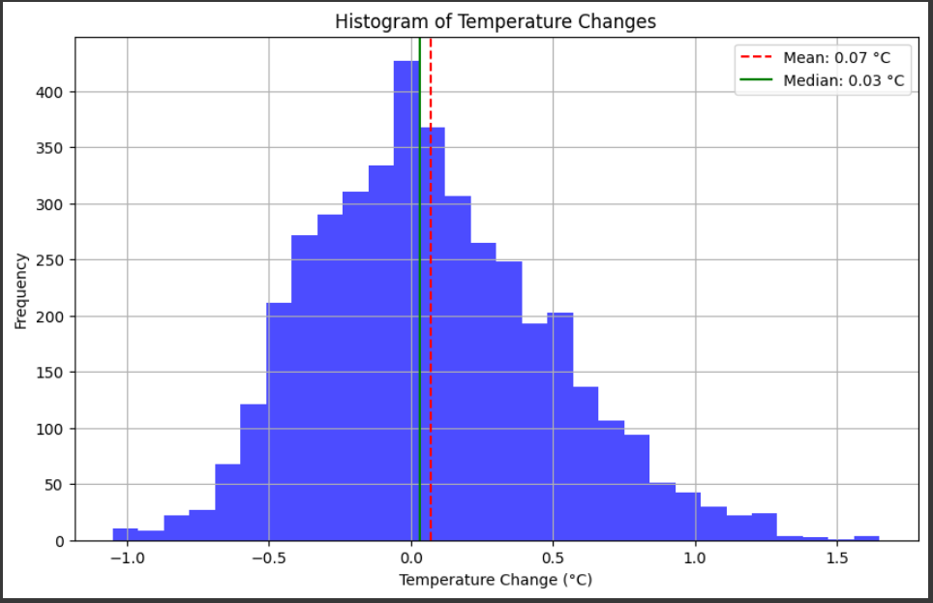
VISUALIZING TEMPERATURE TRENDS: HISTOGRAM
Conclusion:
Normal distribution:
Stable temperature changes
Higher mean:
A few larger positive changes
Histogram shape:
Reveals variability and central tendency

Slide 6
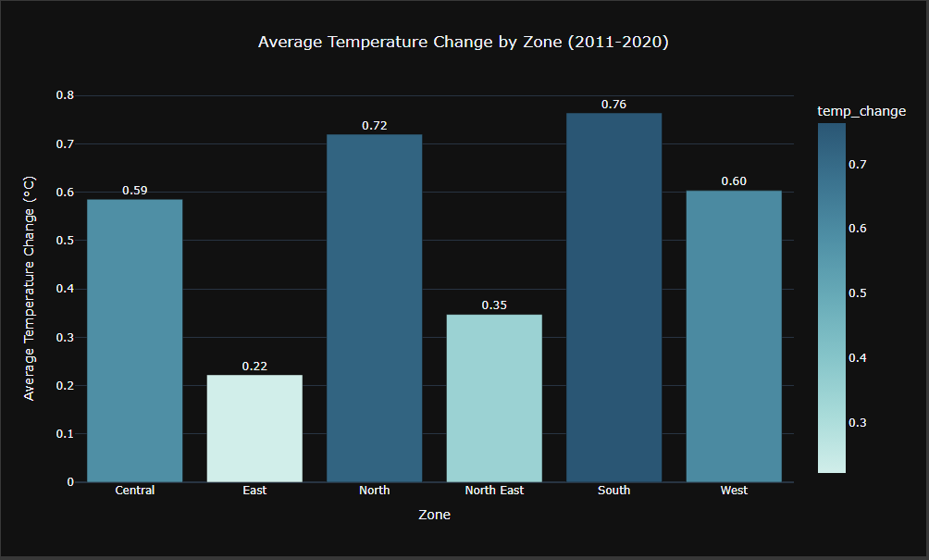
TEMPERATURE CHANGE BY ZONES

Slide 7
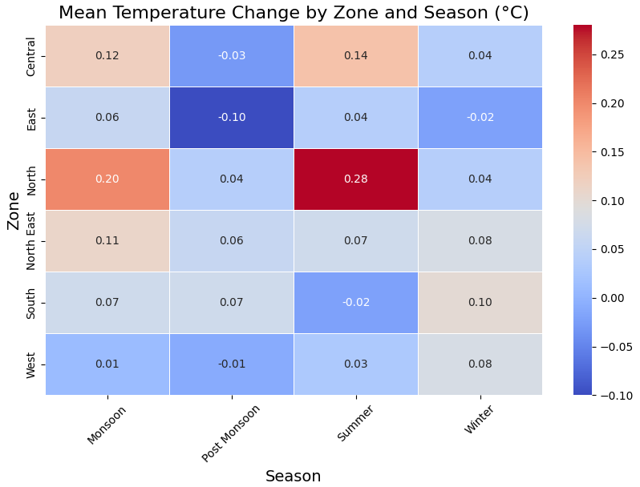

Slide 8
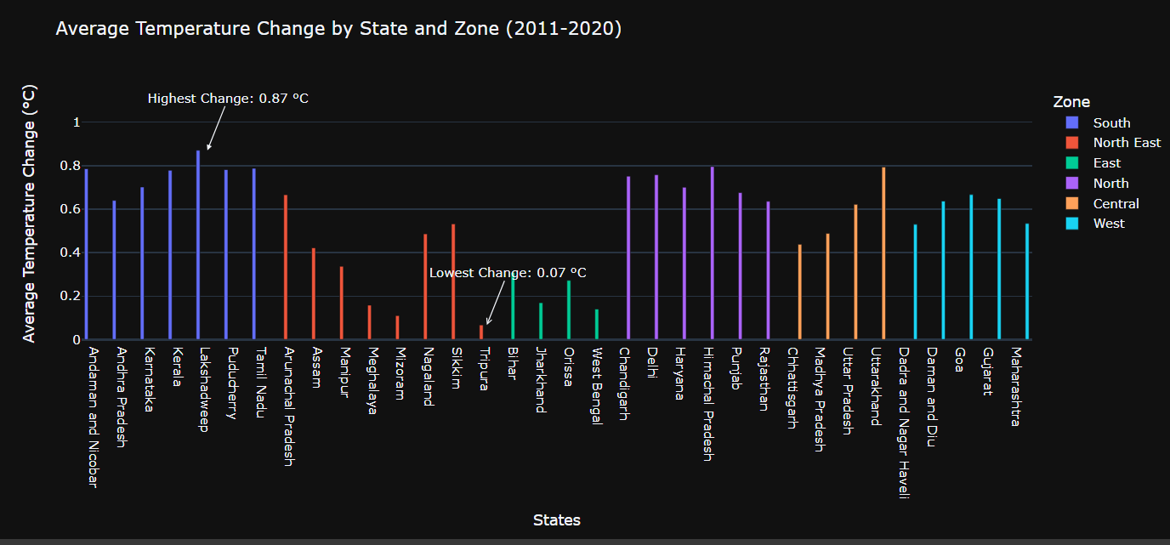
VISUALIZING TEMPERATURE TRENDS

Slide 9
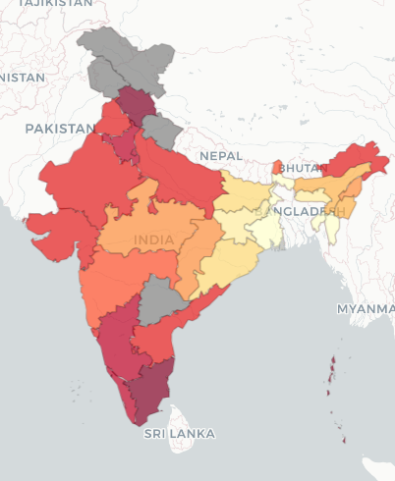

VISUALIZING TEMPERATURE TRENDS: HEATMAP
Temperature Range: The map appears to depict average temperature changes ranging from approximately 0.1°C to 0.9°C.
Hottest Regions: Areas in dark red likely experienced the most significant temperature increases, possibly between 0.8°C and 0.9°C.
Cooler Regions: Regions in light yellow or white may have experienced minimal or no temperature changes, possibly around 0.1°C or below.
Regional Variations: The map clearly shows distinct temperature gradients across the subcontinent. Some regions, particularly in the northern and central parts of India, appear to have experienced more substantial warming compared to others.

Slide 10
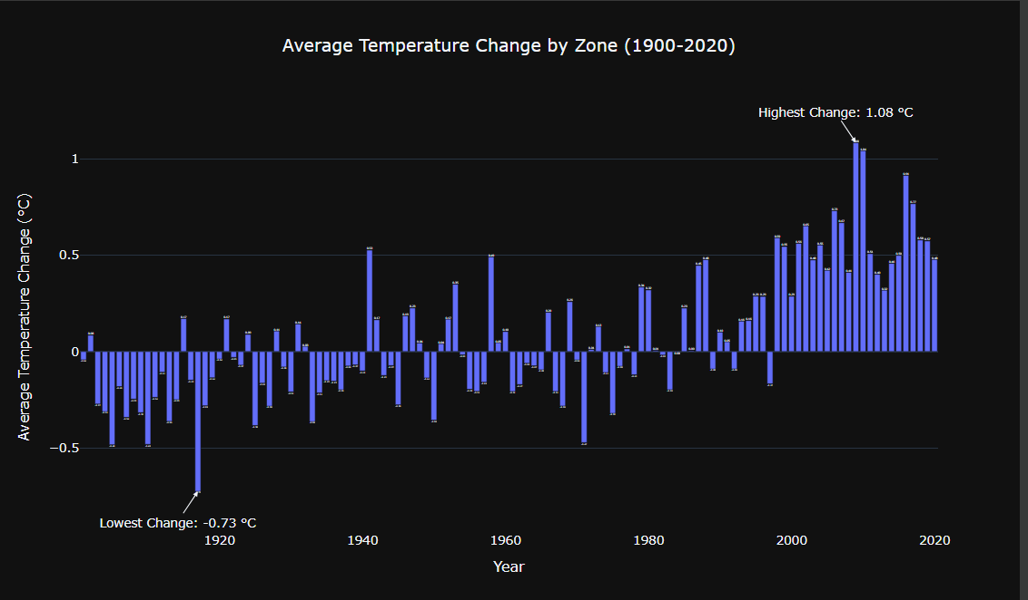

Slide 11
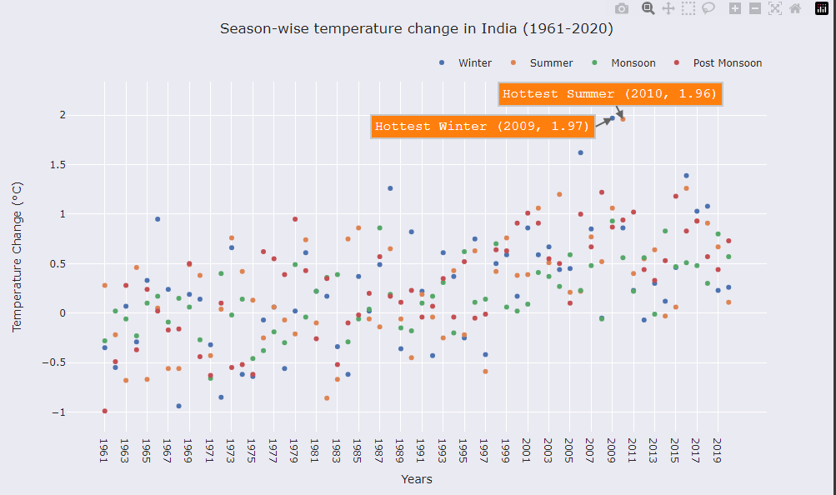
SCATTERPLOT: SEASON-WISE TEMPERATURE CHANGE IN INDIA

Slide 12
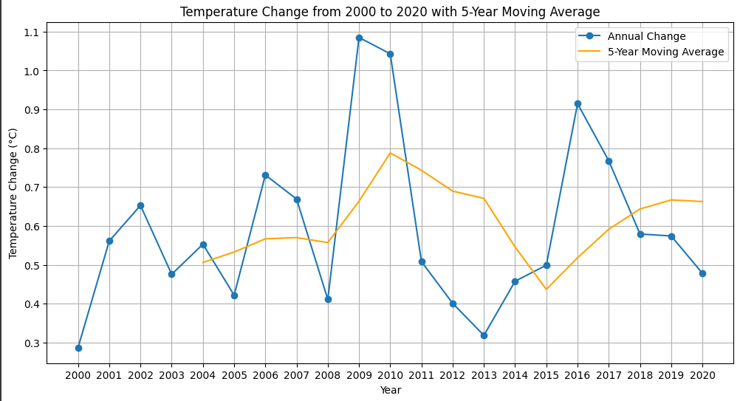
LINE PLOT: TEMPERATURE CHANGE FROM 2000 TO 2020 WITH 5-YEAR MOVING AVERAGE

Slide 13
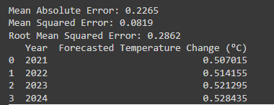
LINEAR REGRESSION
Error metrics indicate that there are still some discrepancies between the forecasted and actual values, suggesting that other factors besides the linear trend may influence temperature changes.

Slide 14
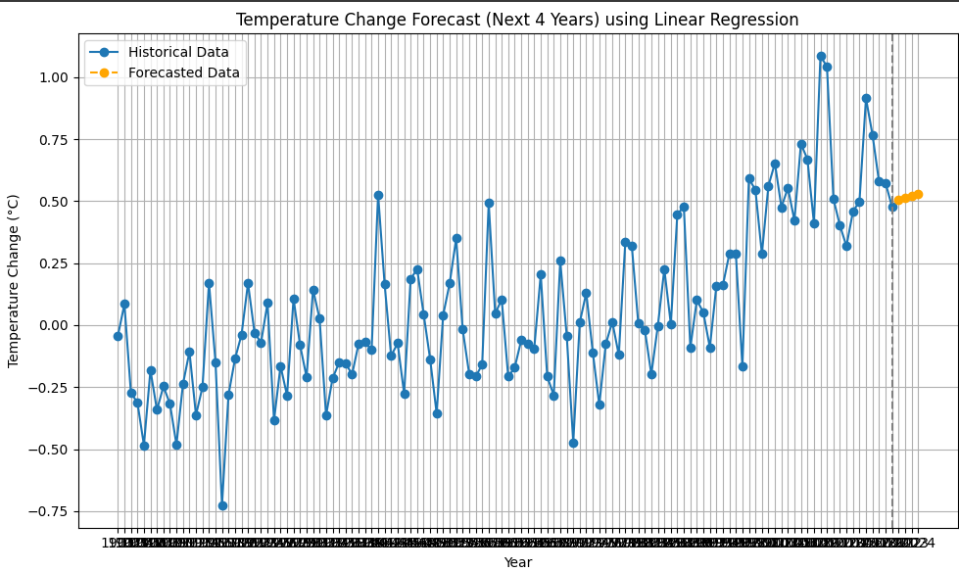
PLOTTING FORECASTED VALUE BY LINEAR REGRESSION

Slide 15
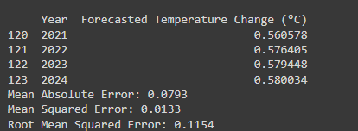
ARIMA MODEL
The error metrics (MAE, MSE, and RMSE) suggest that the model performed reasonably well, with a relatively low average error.

Slide 16
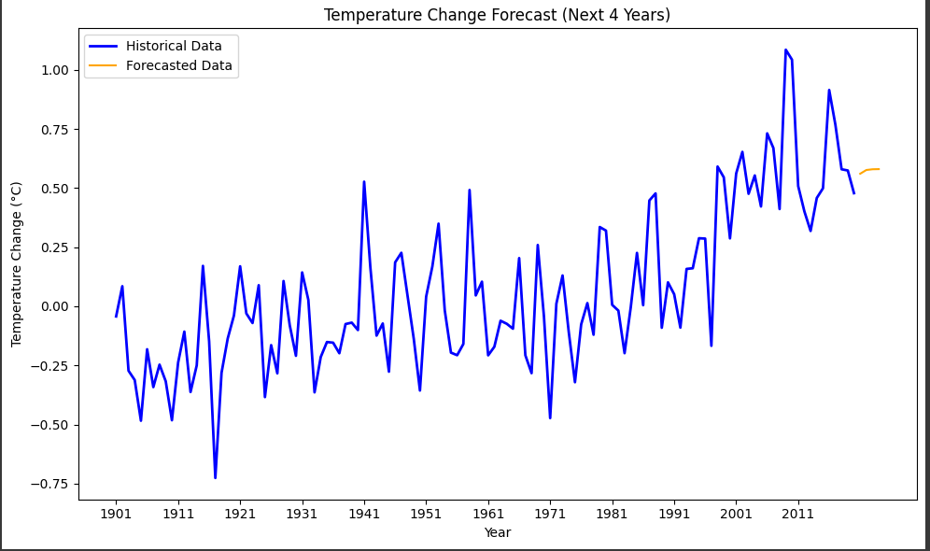
PLOTTING FORECASTED BY ARIMA MODEL

Slide 17

HYPOTHESIS TESTING – Z TEST
Null = The mean temperature change for the last 20 years is equal to the overall historical mean temperature change.
Alternative = The mean temperature change for the last 20 years is not equal to the overall historical mean temperature change.
Since P-Value is 0, and Z-Value is greater than 0, we reject the null hypothesis.
Conclusion:
Alternative Hypothesis is accepted, The mean temperature change for the last 20 years is not equal to the overall historical mean temperature change.

Slide 18

HYPOTHESIS TESTING – T TEST
Null = There is a significant difference in mean temperature changes between the West and East zones. .
Alternative = There is a no significant difference in mean temperature changes between the West and East zones.
Since P-Value is 0, and Z-Value is greater than 0, we reject the null hypothesis.
Conclusion:
Reject the null hypothesis: There is a significant difference in mean temperature changes between the West and East zones. The West zone has a higher mean temperature change than the East zone.

Slide 19

HYPOTHESIS TESTING – T TEST
Null = There is a significant difference in mean temperature changes between the North and North - East zones. .
Alternative = There is a no significant difference in mean temperature changes between the North and North -East zones.
Since P-Value is 0, and Z-Value is greater than 0, we reject the null hypothesis.
Conclusion:
Reject the null hypothesis: There is a significant difference in mean temperature changes between the West and East zones. The North zone has a higher mean temperature change than the North-East zone.

Slide 20

HYPOTHESIS TESTING – ANOVA
Null = There is no significant difference in mean temperature changes among the seasons.
Alternative = There is a significant difference in mean temperature changes among the seasons.
Since P-Value is 0, and Z-Value is greater than 0, we reject the null hypothesis.
Conclusion:
Sum of Squares (Period): 15.34 This indicates the variability in temperature changes explained by the different periods (seasons).
Degrees of Freedom (df): 3.0 This represents the number of groups minus one (number of seasons - 1)
F-statistic: 13.64. A higher F-statistic indicates a significant difference between the means of the groups.
P-value (PR(>F)): 6.97e-09 . This p-value is extremely low, suggesting strong evidence against the null hypothesis

Slide 21
CONCLUSIONS AND INSIGHTS
Our analysis of Indian temperature data from 1901 to 2020 shows a clear rise, especially in the last two decades, reflecting global climate change trends.
Statistical tests confirm significant temperature changes over time.
Also certain regions are experiencing more rapid temperature changes than others, indicating uneven impacts across the country
Additionally, the ARIMA model predicts that temperatures will continue to rise in the coming years.
These findings highlight the need for India to adopt sustainable measures to tackle the challenges of increasing temperatures

Slide 22
THANK YOU!

