Slide 1
Capital Bikeshare data analysis
- GARS CONSULTING RESOURCES

Slide 2
AGENDA
INTRODUCTION & GOALS
FINDINGS
DATA INFORMATION

Slide 3
INTRODUCTION
TEAM MEMBERS - Alisha Gonsalves, Gina Visnansky, Roberto Rubio and Sean Mussenden
Consulting group hired by Capital Bikeshare executives.

Slide 4
OUR TASK
To analyze Capital Bikeshare data
To make recommendations to improve:
Business operations
Revenue
Customer Satisfaction

Slide 5
FINDINGS

Slide 6
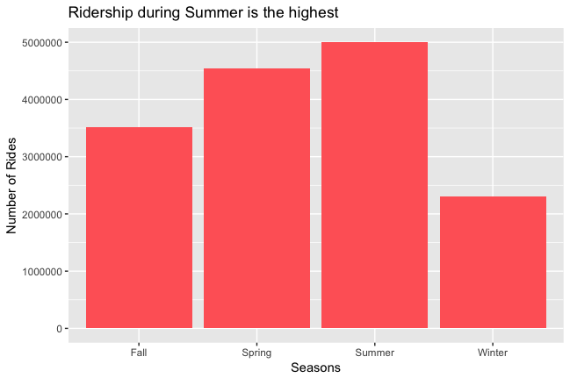
Finding 1
There is room to improve ridership in Fall and Spring.

Slide 7
Recommendation
Ad campaigns displaying benefits of riding during Fall and Spring
Affiliate discount, partner up with local restaurants to provide discounts.
Reduce membership fees during Fall and Spring seasons
Stronger pitch to commuters to become registered members

Slide 8
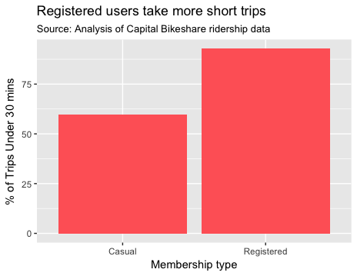
Finding 2
Casual users take longer trips than Registered users. This takes bikes out of circulation for loyal customers.

Slide 9
Recommendation
Create special colored bikes for longer trips with lower penalty prices.
Special membership for Tourists (7-day pass) with higher upfront costs but lower penalty costs.

Slide 10
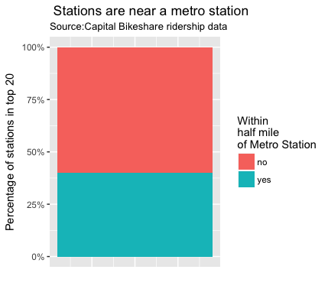
Finding 3
40 % of the most popular Capital Bikeshare stations are within a 0.5 mile radius from metro stations.

Slide 11
Recommendation
Increase number of Bikeshare stations within 0.5 mile radius of a metro station.
Increase number of bikes and docks at current stations.
Introduce new Bikeshare stations near metro stations in the DMV area that do not currently have a bike station within 0.5 miles.

Slide 12
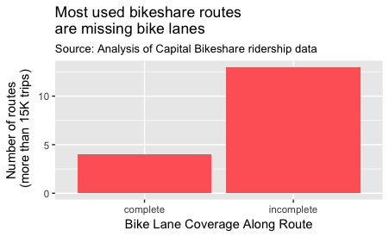
Finding 4
The most common combinations of start and end stations used by Capital Bikeshare riders have incomplete bike lane coverage.

Slide 13
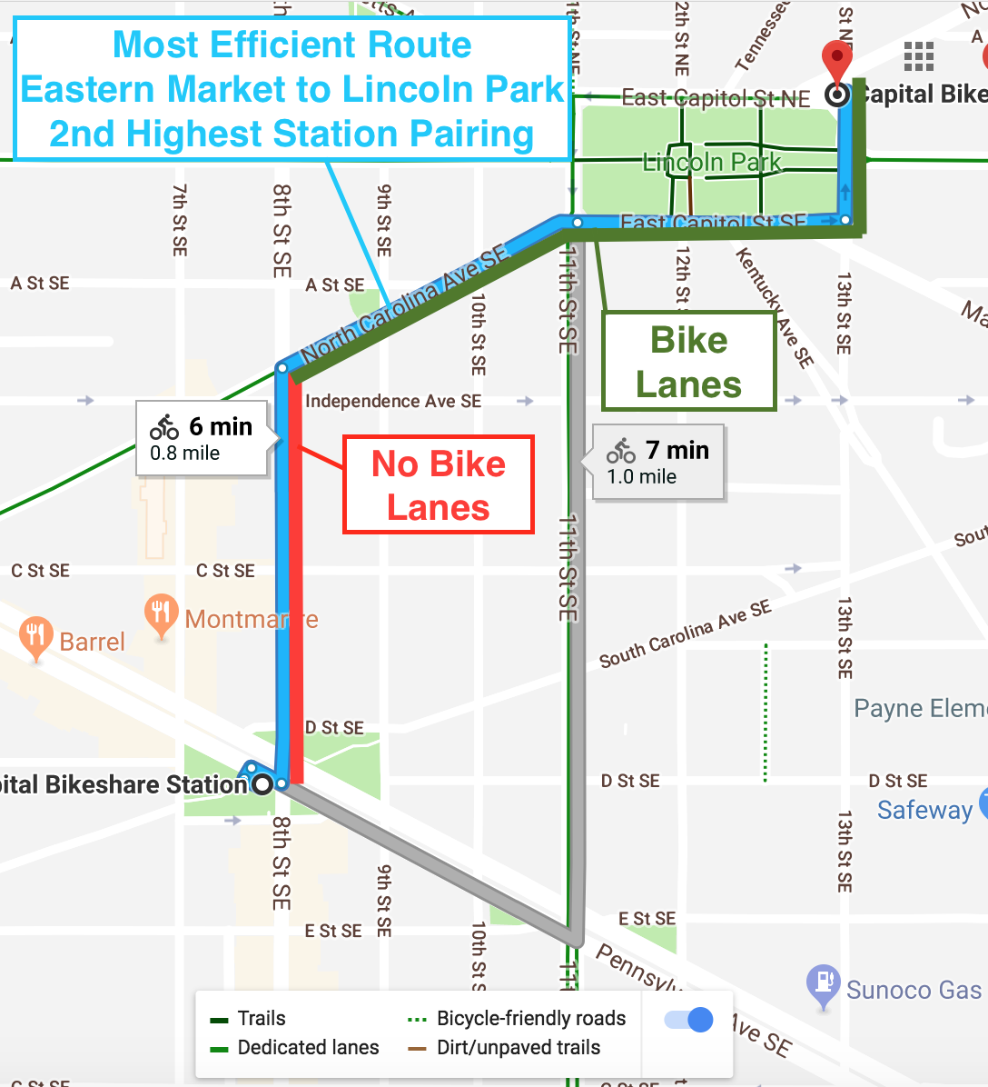
Finding 4
The most common combinations of start and end stations used by Capital Bikeshare riders have incomplete bike lane coverage.

Slide 14
Recommendation
Pitch the city to build more bike lanes in order to promote customer safety and increase customer satisfaction.

Slide 15
Finding 5
Bikeshare stations in Washington, D.C. are significantly more popular than stations in the suburbs.

Slide 16
Recommendation
Marketing strategies to increase suburban bike usage.

Slide 17
DATA INFORMATION

Slide 18
SOURCE
Data was downloaded from the Capital Bikeshare’s site.
https://www.capitalbikeshare.com/system-data
Capital Bikeshare provided data files from year 2010 to 2017.
The years were stored in based on a year quarter.
Each record in the data files represents a single bike ride.
The record holds information like , trip minutes, start date, end date, start station, end station, bike number, membership type

Slide 19
LIMITATIONS
Over the time period from 2010 to 2017 the number of attributes in data file changes several times.
Inconsistent naming conventions for fields and variables.
Maximum time spent in combining the data files together.

Slide 20
THANK YOU!

Slide 21
QUESTIONS?
-Ask us anything.

