Slide 1
Analytics in Tableau

Slide 2
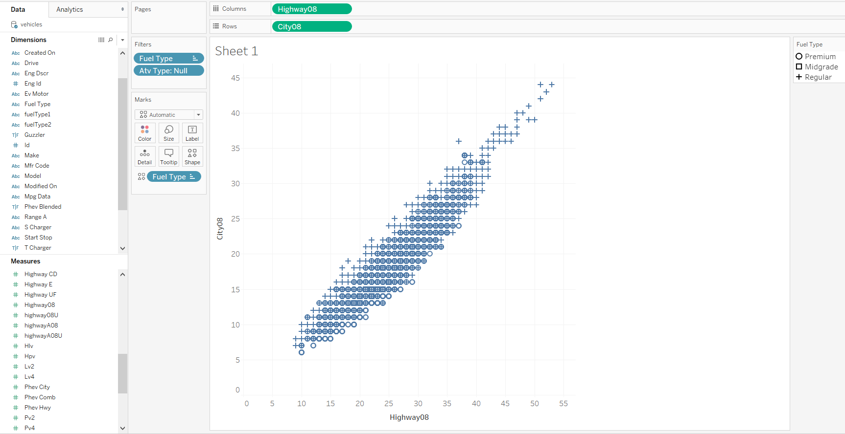
The analytics pane
Notes:
Describe dataset.
Mention disaggregation.

Slide 3
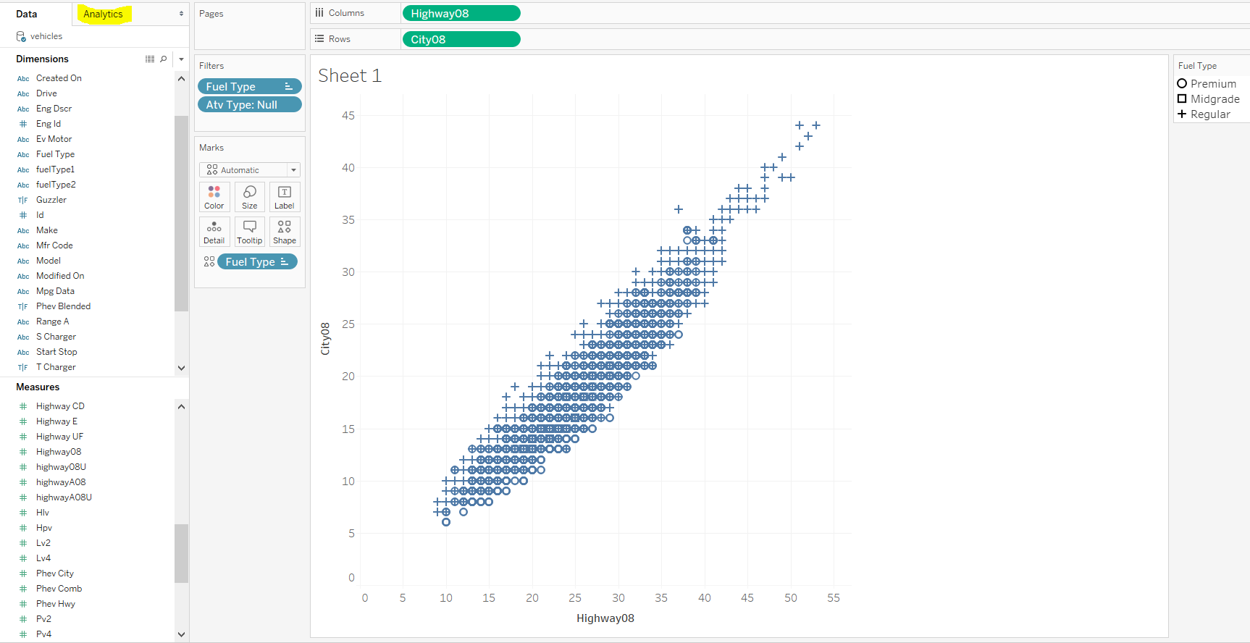
The analytics pane
Notes:
Mention Analytics Pane.

Slide 4
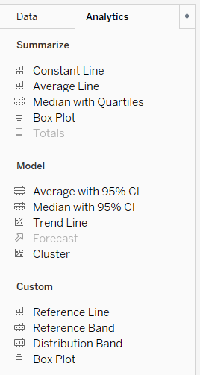
The analytics pane
Summarize options within the Analytics Pane include:
Constant Line
Average Line
Confidence Intervals optional
Median (Line)
Quartiles optional
Confidence Intervals optional
Reference Line
Generalization of previous line options
Reference Band
Distribution Band
Box Plot
Totals
We will return to Trend Line and Forecast options.

Slide 5
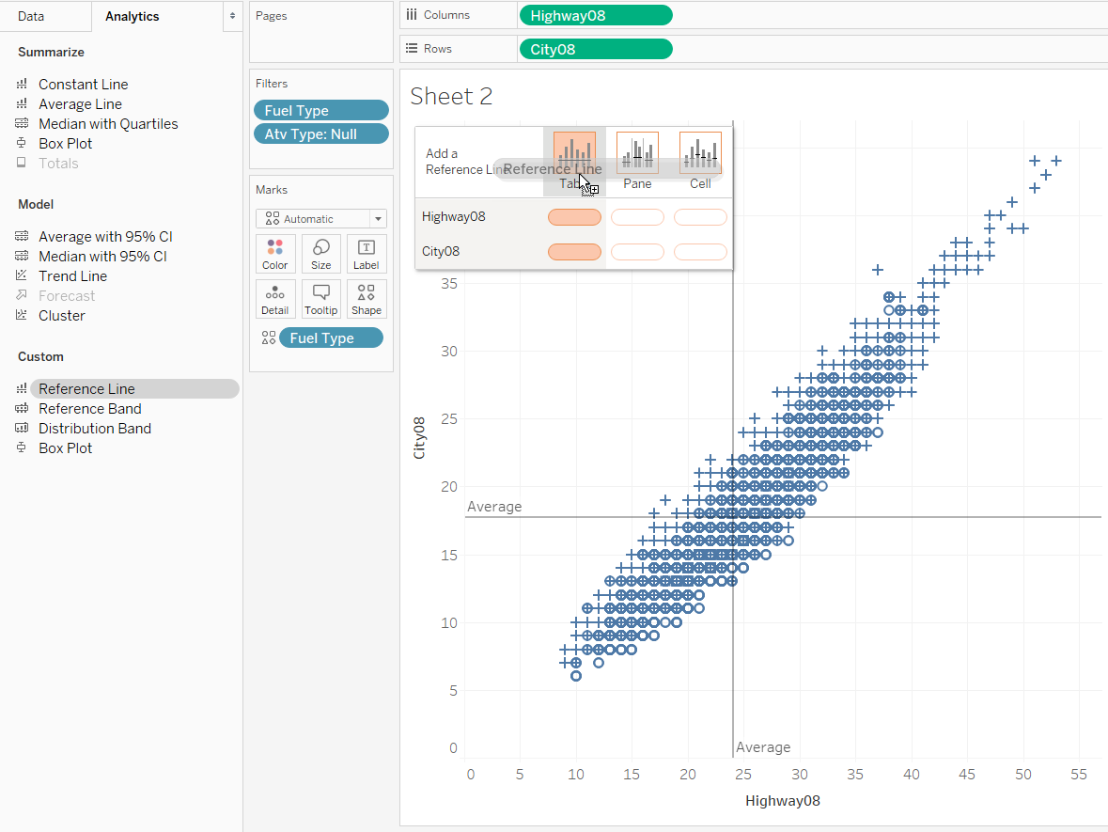
The analytics pane
Notes:
Drag and drop functionality. Right click to edit. Drag off of viz to remove.
One measure/dimension or many.
Set up for instant analytics.

Slide 6
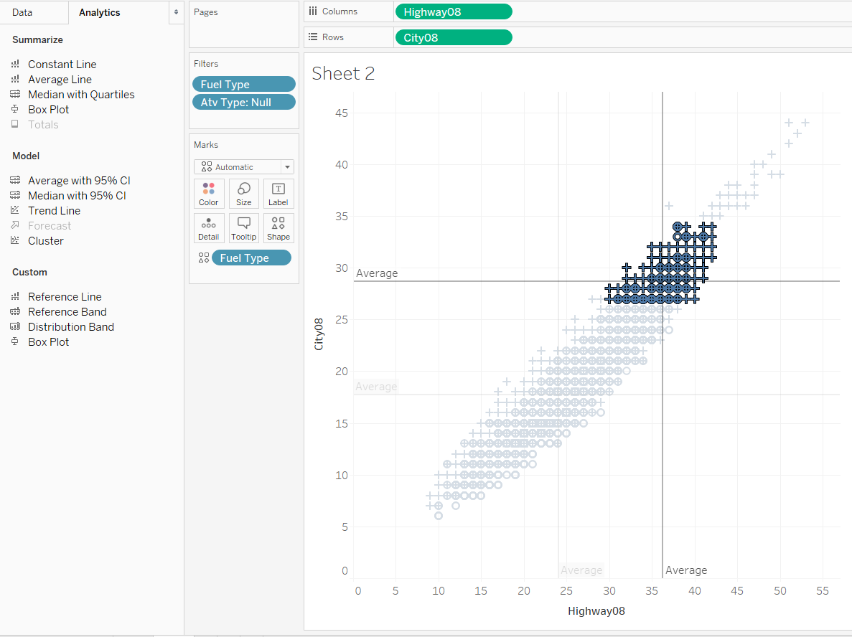
The analytics pane
Instant Analytics!!!
Ooooohhh!
Aaaaahhhhh!
Wowzerrs!
Notes:
Mention grayed out lines and update lines.

Slide 7
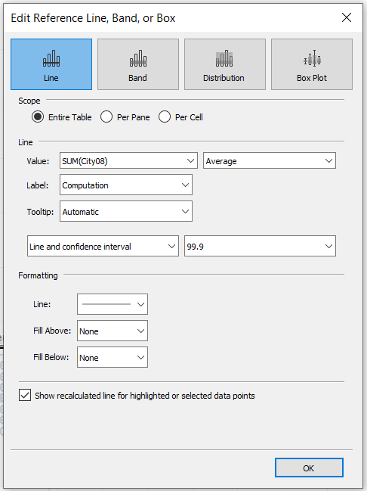
Reference lines
Options within the Reference Line menu include:
Type of object
Line
Band
Distribution
Box Plot
Scope
Value
Max, Min, Average, Median, Constant (parameter), etc.
Label
Value, Computation, or Custom
Tooltip
Automatic or Custom
CI Option (only for statistical value selections)
Formatting
Recalculation checkbox (Instant Analytics!)
Notes:
End with “So let’s go ahead and make some selections”

Slide 8
Reference lines
Options within the Reference Line menu include:
Type of object
Line
Band
Distribution
Box Plot
Scope (Table)
Value
Max, Min, Average, Median, Constant (parameter), etc.
Label
Value, Computation, or Custom
Tooltip
Automatic or Custom
CI Option (only for statistical value selections)
Formatting
Recalculation checkbox (Instant Analytics!)

Slide 9
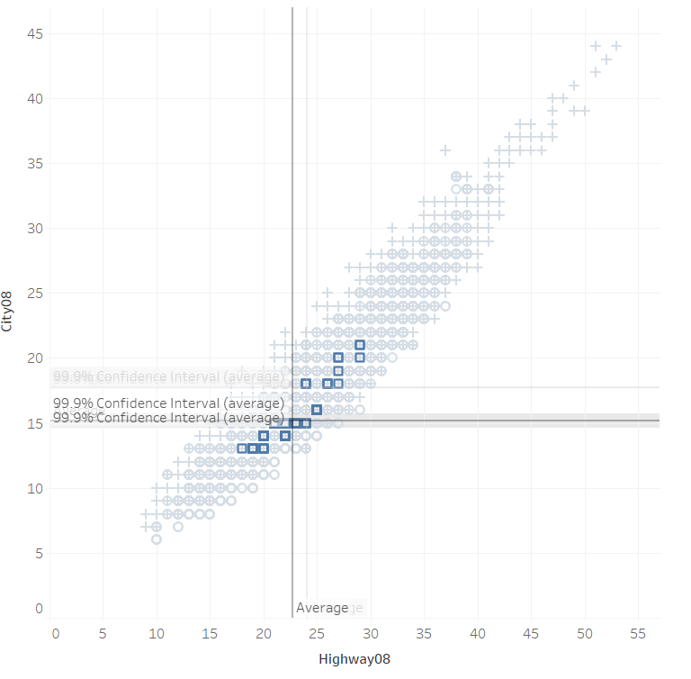
Reference lines

Slide 10
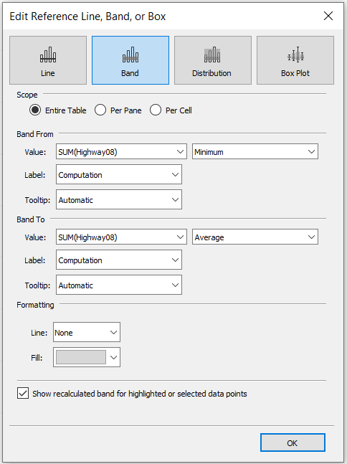
Reference lines
Contextual!!!
Options within the Reference Band menu include:
Type of object
Line
Band
Distribution
Box Plot
Scope (Table)
Value
Max, Min, Average, Median, Constant (parameter), etc.
Label
Value, Computation, or Custom
Tooltip
Automatic or Custom
CI Option (only for statistical value selections)
Formatting
Recalculation checkbox (Instant Analytics!)

Slide 11
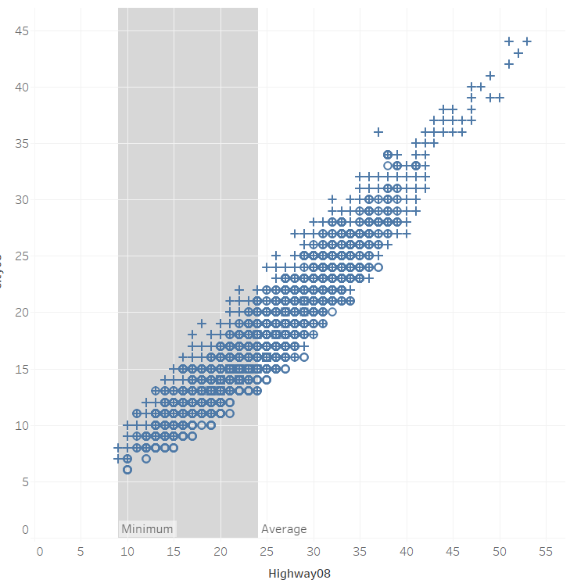
Reference lines

Slide 12
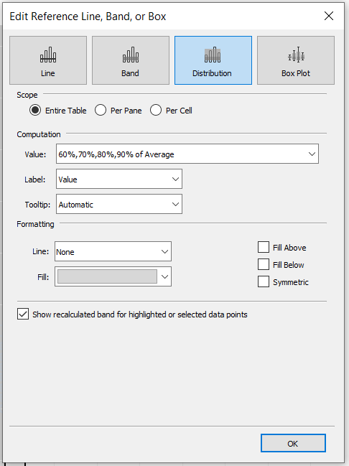
Reference lines
Contextual!!!
Options within the Reference Distribution menu include:
Type of object
Line
Band
Distribution
Box Plot
Scope (Table)
Value
Max, Min, Average, Median, Constant (parameter), etc.
(percent of Average)
Label
Value, Computation, or Custom
Tooltip
Automatic or Custom
CI Option (only for statistical value selections)
Formatting
Recalculation checkbox (Instant Analytics!)

Slide 13
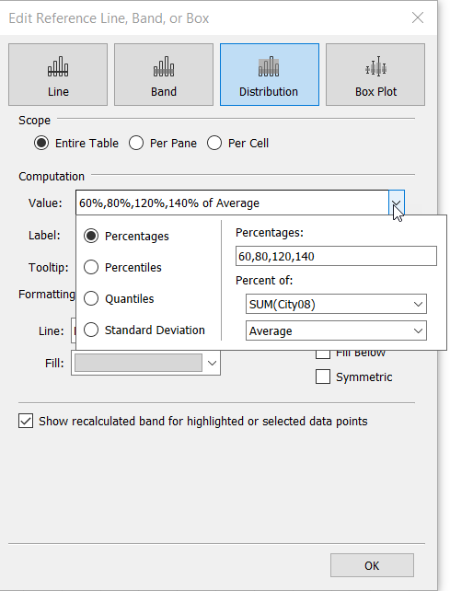
Reference lines
Contextual!!!
Options within the Reference Distribution menu include:
Type of object
Line
Band
Distribution
Box Plot
Scope (Table)
Value
Max, Min, Average, Median, Constant (parameter), etc.
(percent of Average)
Label
Value, Computation, or Custom
Tooltip
Automatic or Custom
CI Option (only for statistical value selections)
Formatting
Recalculation checkbox (Instant Analytics!)

Slide 14
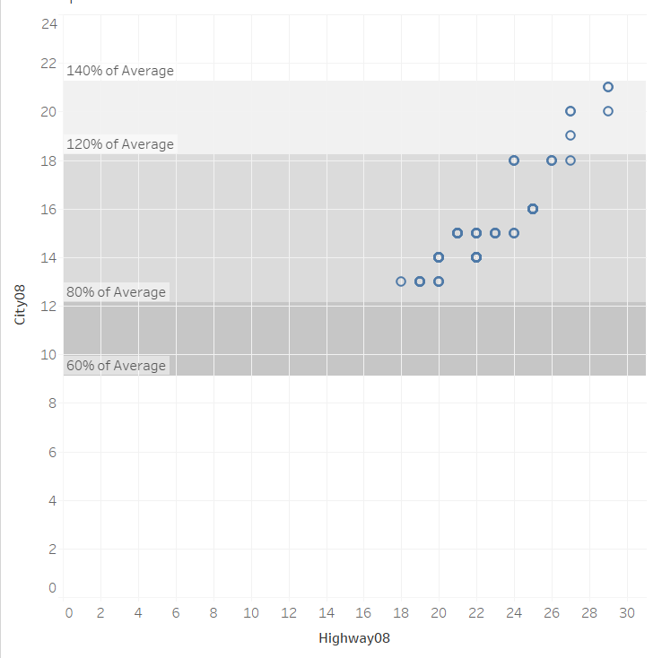
Reference lines
Notes:
Mention that this is what is going on behind the scenes in a bullet graph.

Slide 15
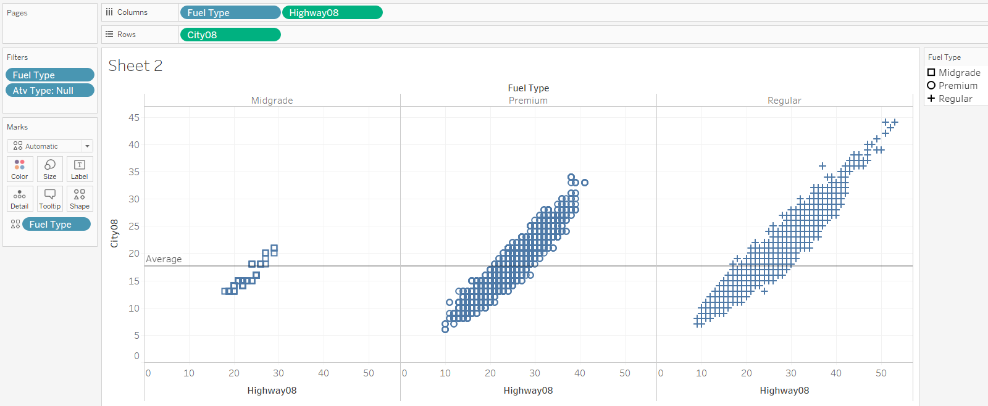
Reference lines
What if we want the Average to be calculated for each pane?

Slide 16
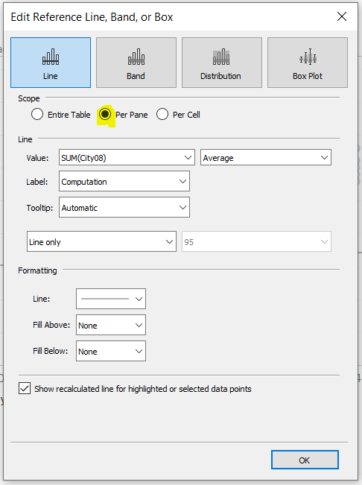
Reference lines
What if we want the Average to be calculated for each pane?

Slide 17
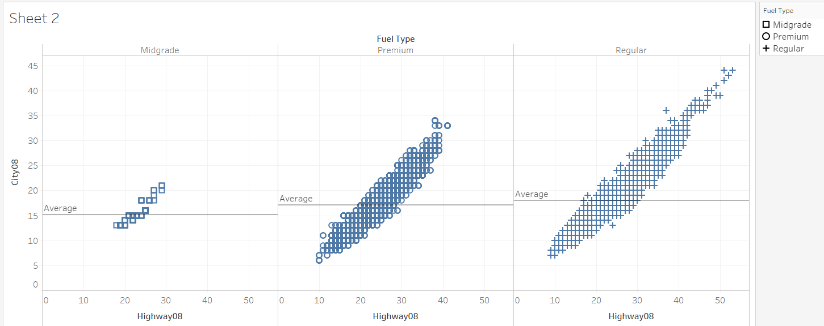
Reference lines
What if we want the Average to be calculated for each pane?

Slide 18
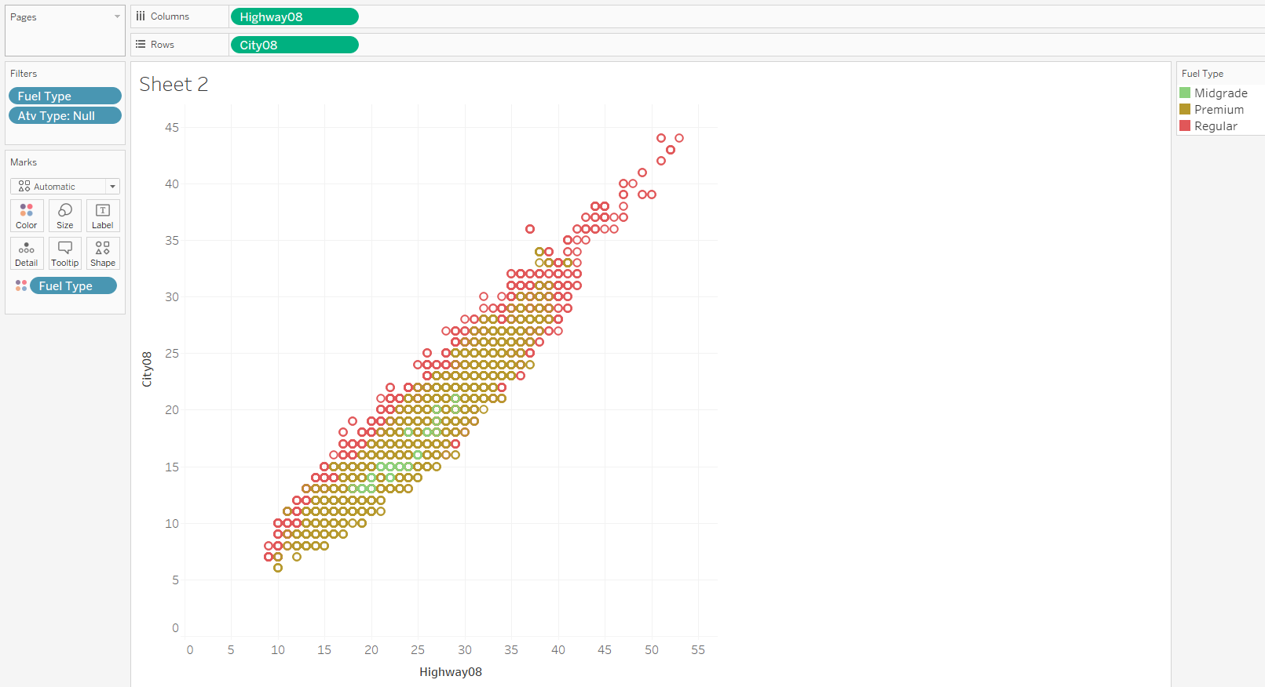
Trend lines
Is there a relationship between highway and city mileage?

Slide 19
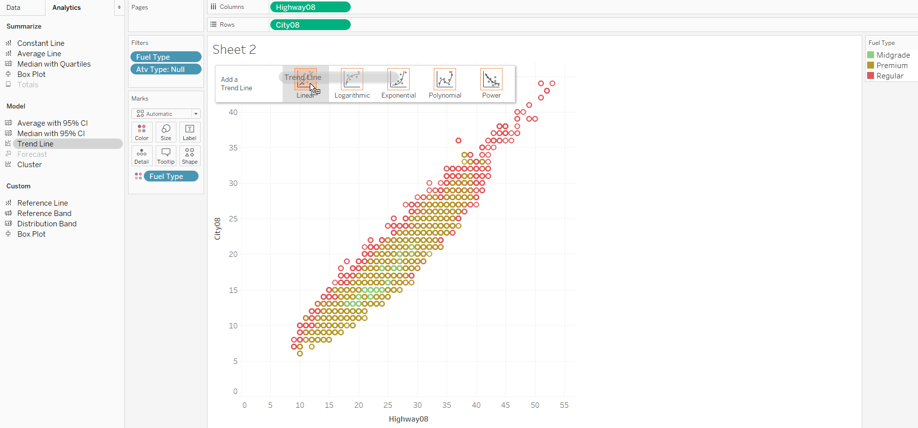
Trend lines
Is there a relationship between highway and city mileage?

Slide 20
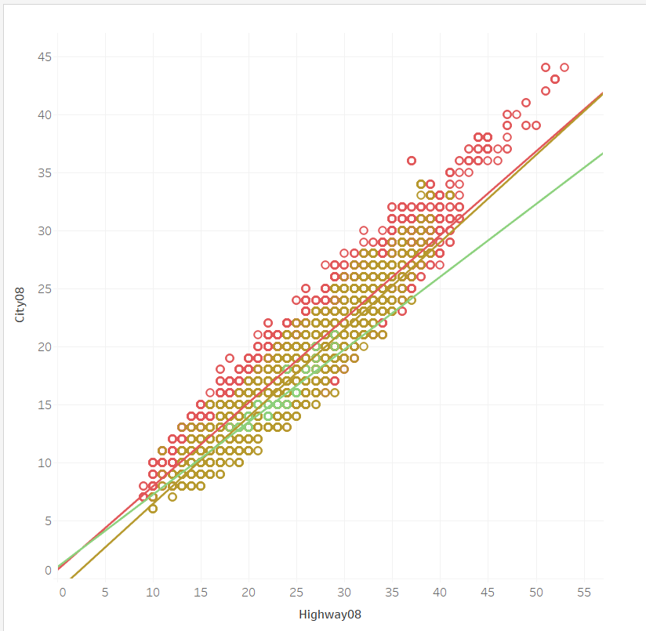
Trend lines
Is there a relationship between highway and city mileage?

Slide 21
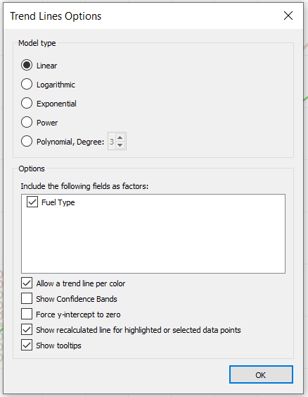
Trend lines
Is there a relationship between highway and city mileage?

Slide 22
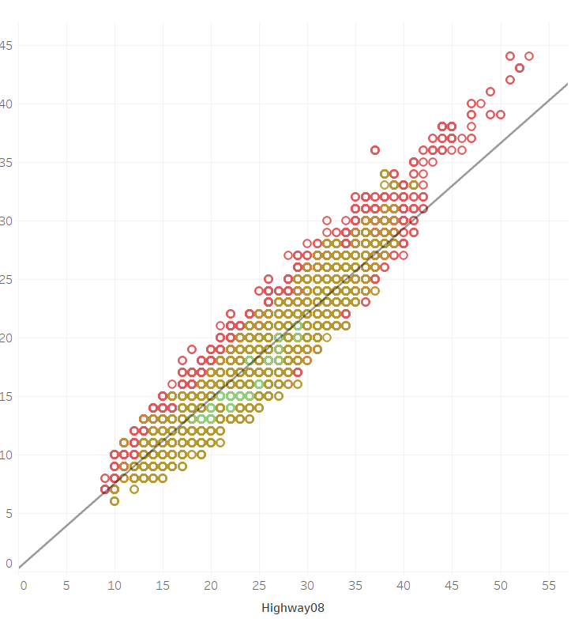
Trend lines
Is there a relationship between highway and city mileage?

Slide 23
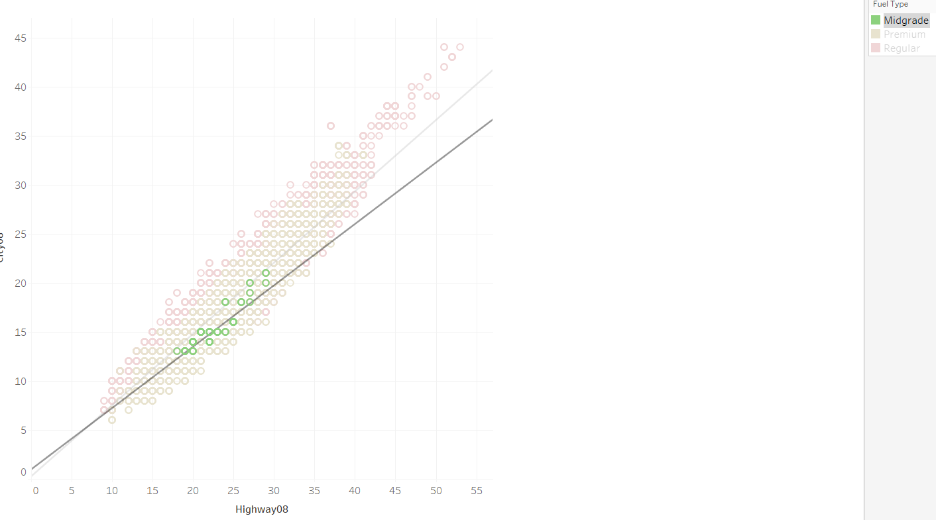
Trend lines

Slide 24
Trend lines
How good does this model fit the data?

Slide 25
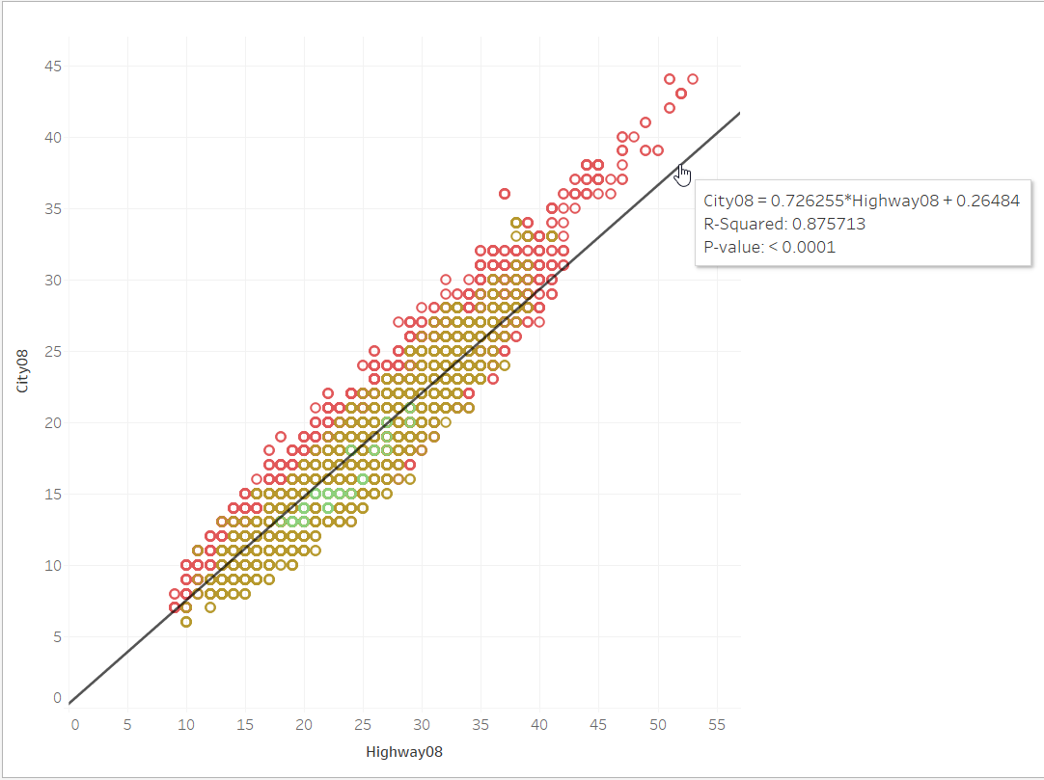
Trend lines
How good does this model fit the data?
Notes:
A small p-value indicates that we are unlikely to observe such a strong relationship between variables by chance in the absence of any such actual relationship.

Slide 26
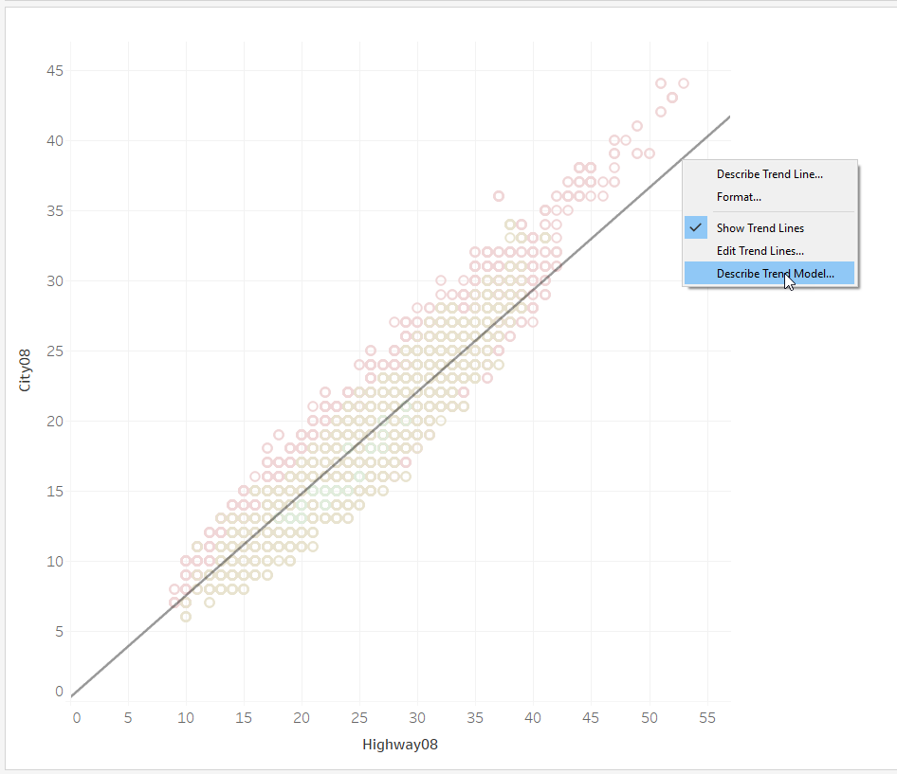
Trend lines
How good does this model fit the data?

Slide 27
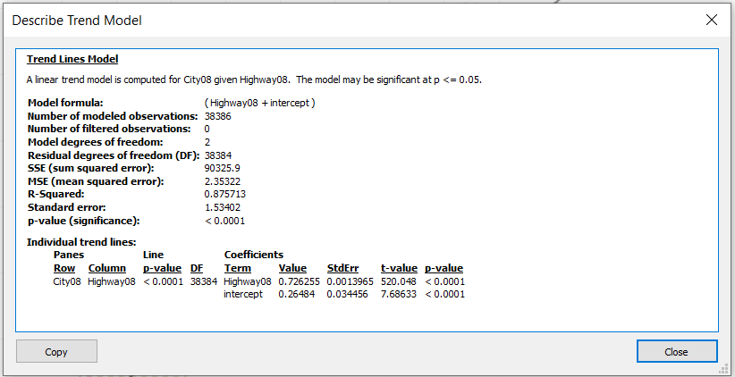
Trend lines
How good does this model fit the data?

Slide 28
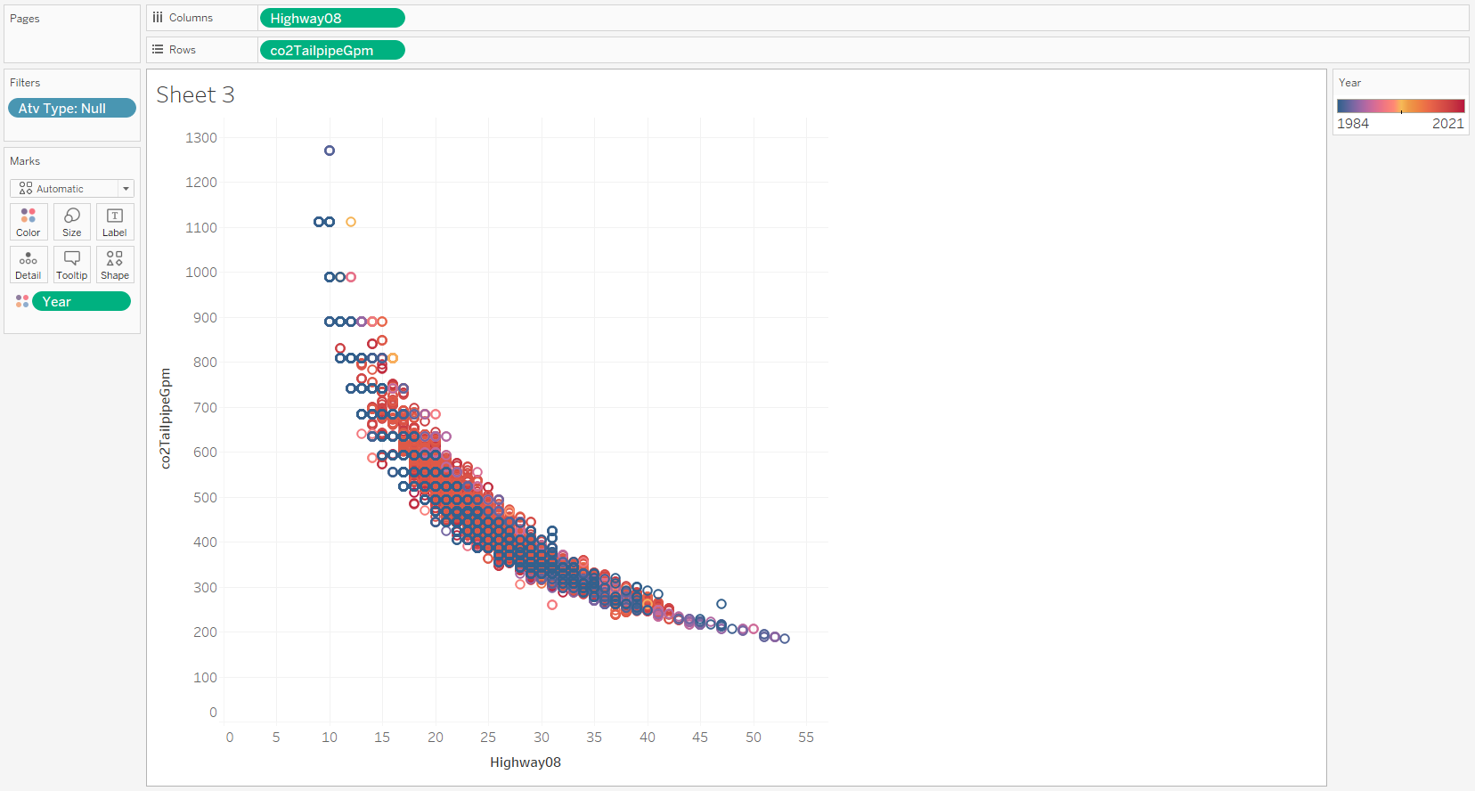
Trend lines
Is there a relationship between highway mileage and CO₂?

Slide 29
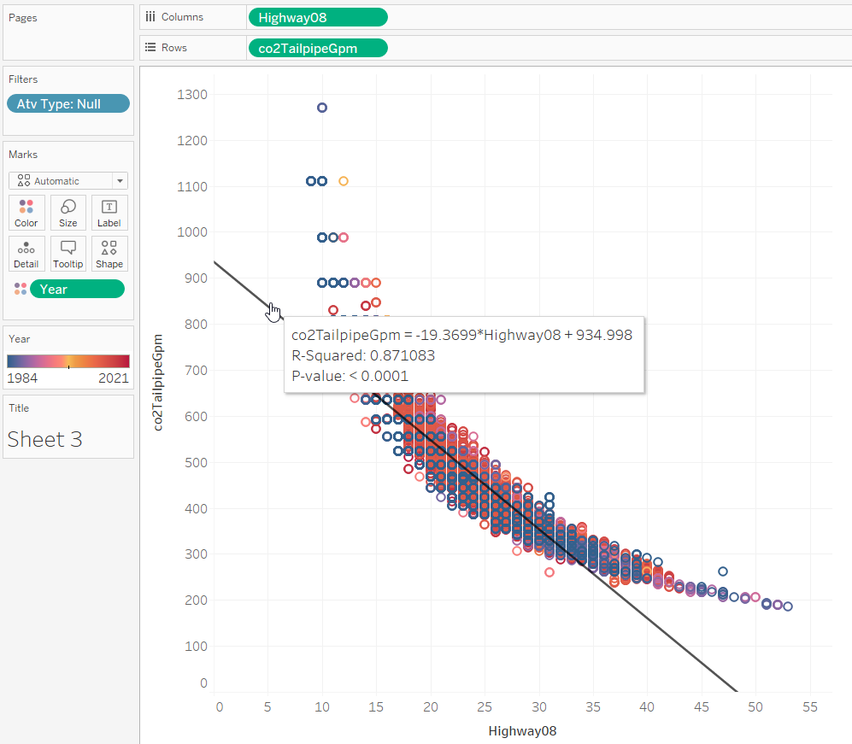
Trend lines
Is there a relationship between highway mileage and CO₂?

Slide 30
Trend lines
But is this the best model?

Slide 31
Trend lines
What do the residuals tell us about model fit?

Slide 32
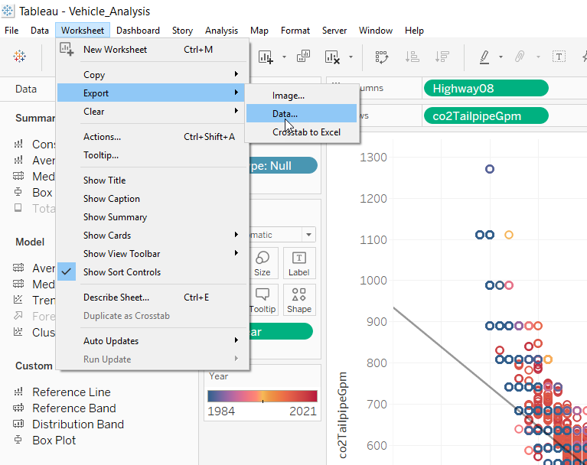
Trend lines
What do the residuals tell us about model fit?

Slide 33
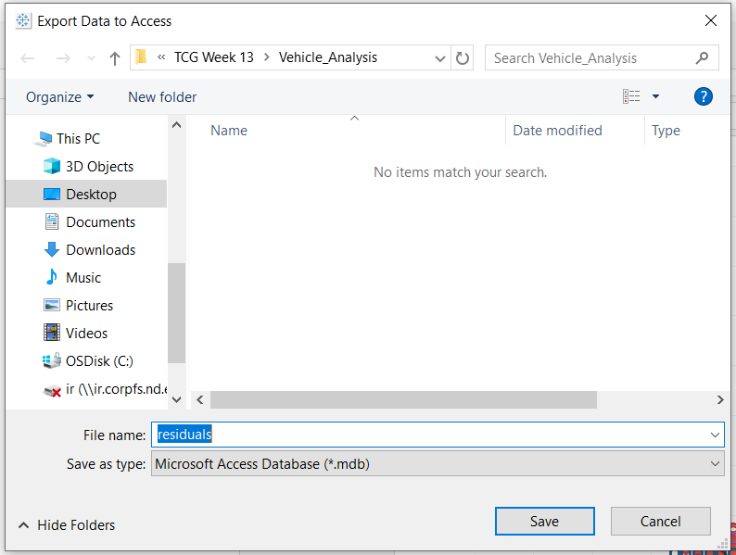
Trend lines
What do the residuals tell us about model fit?

Slide 34
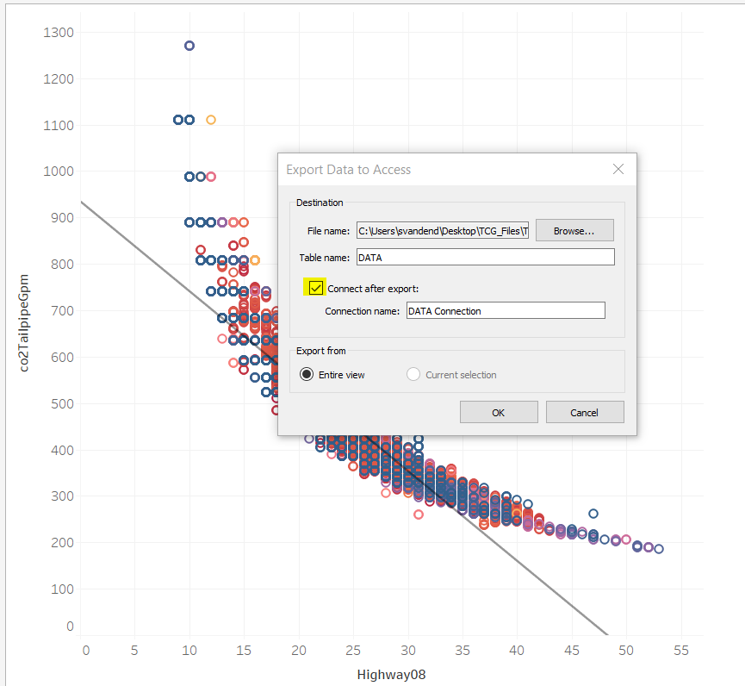
Trend lines
What do the residuals tell us about model fit?

Slide 35
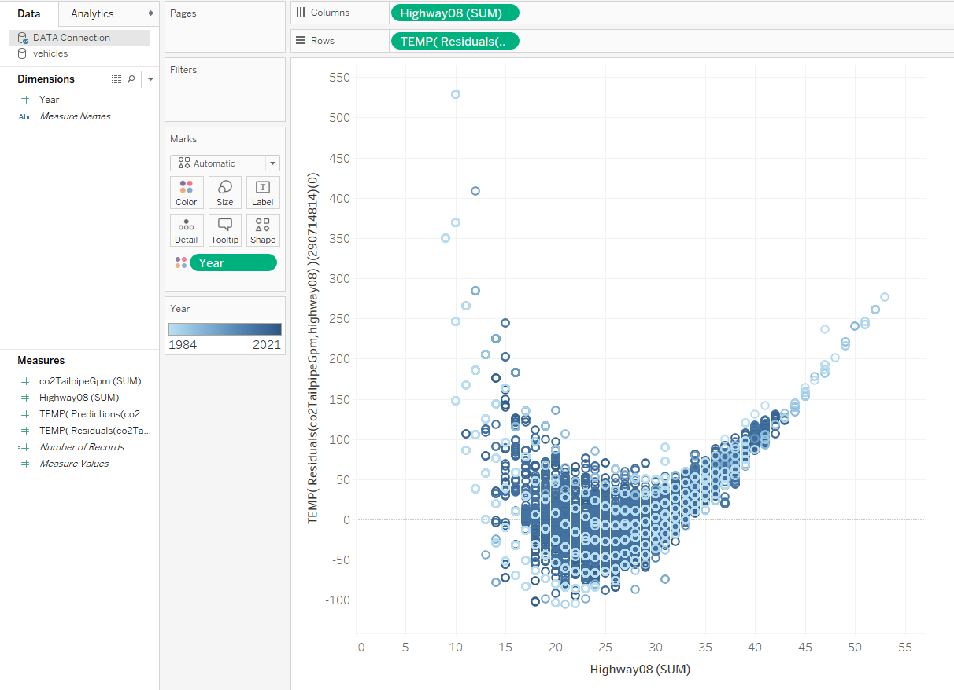
Trend lines
What do the residuals tell us about model fit?

Slide 36

Trend lines
Regularity!
Patterns!
What do the residuals tell us about model fit?

Slide 37
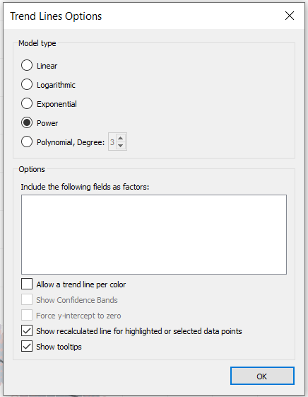
Trend lines

Slide 38
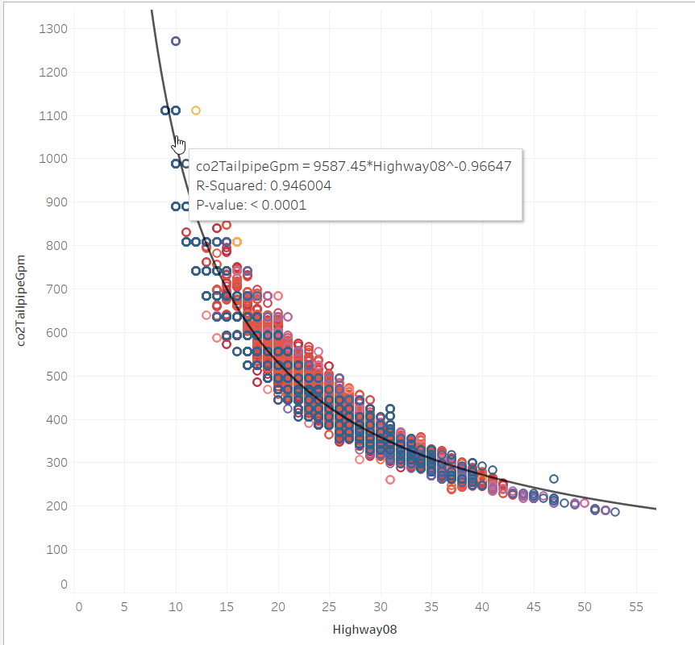
Trend lines

Slide 39
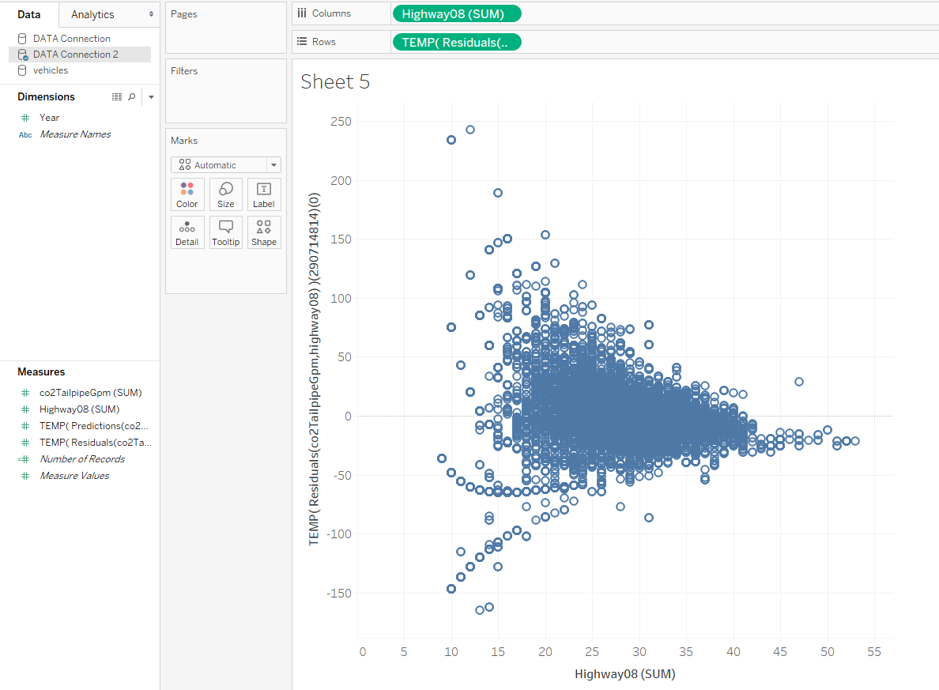
Trend lines

Slide 40
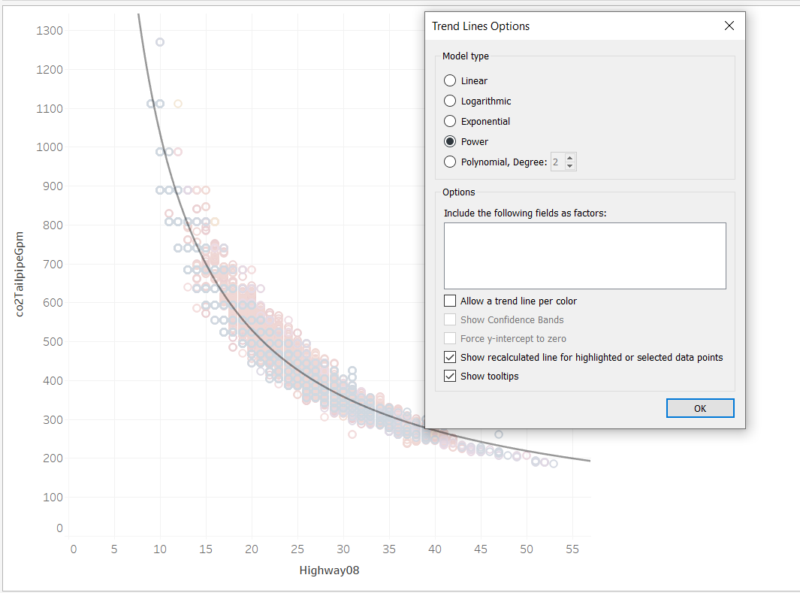
Trend lines
Note that not all configurations allow for Confidence Bands.

Slide 41
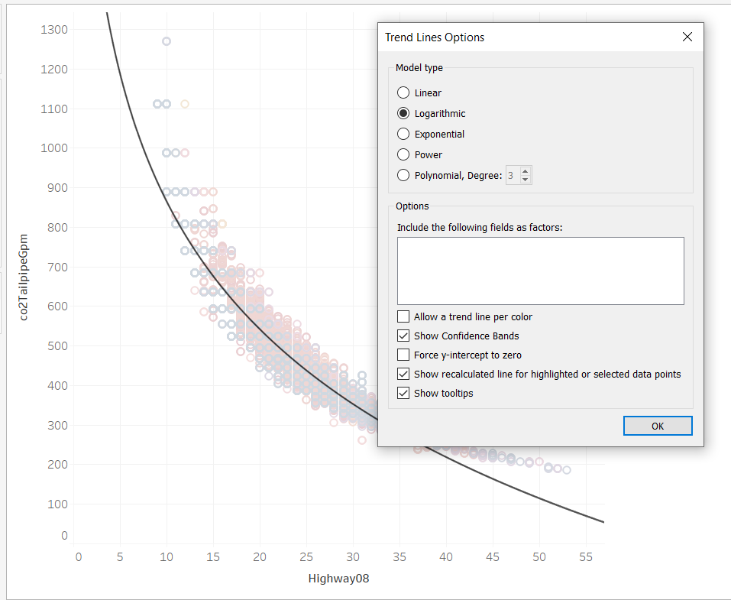
Trend lines
Note that not all configurations allow for Confidence Bands.

Slide 42
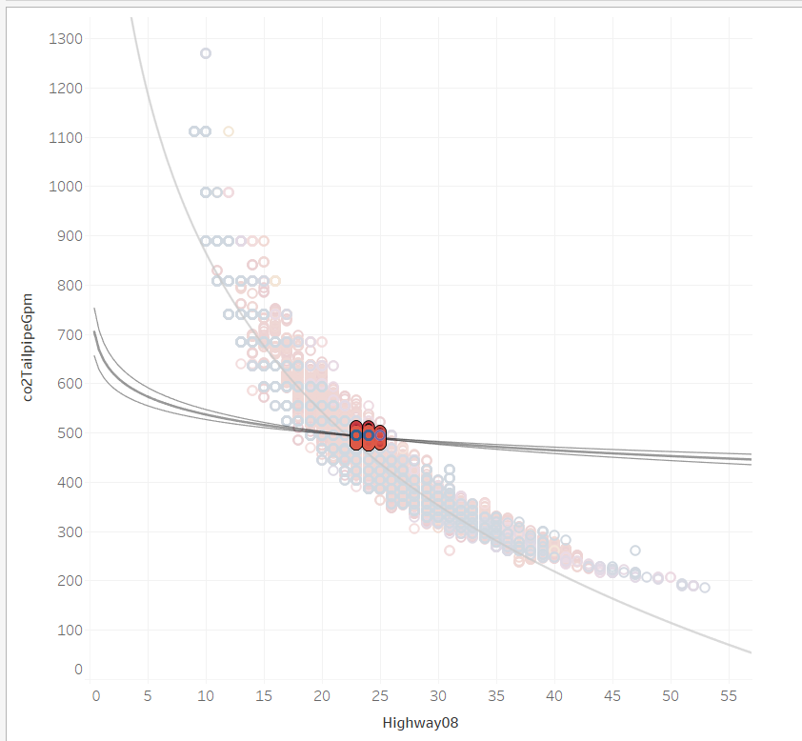
Trend lines
Note that not all configurations allow for Confidence Bands.

Slide 43
Trend lines
Confidence Bands default to 95% confidence.

Slide 44
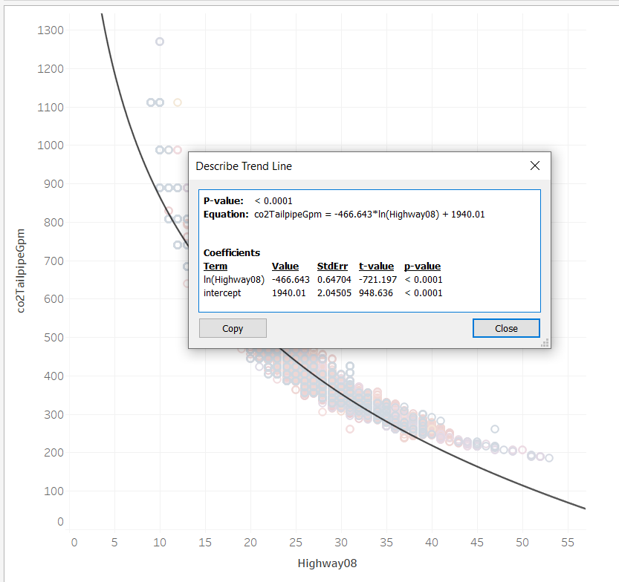
Trend lines
Right clicking and selecting Describe Trend Line gives the statistical properties.

Slide 45
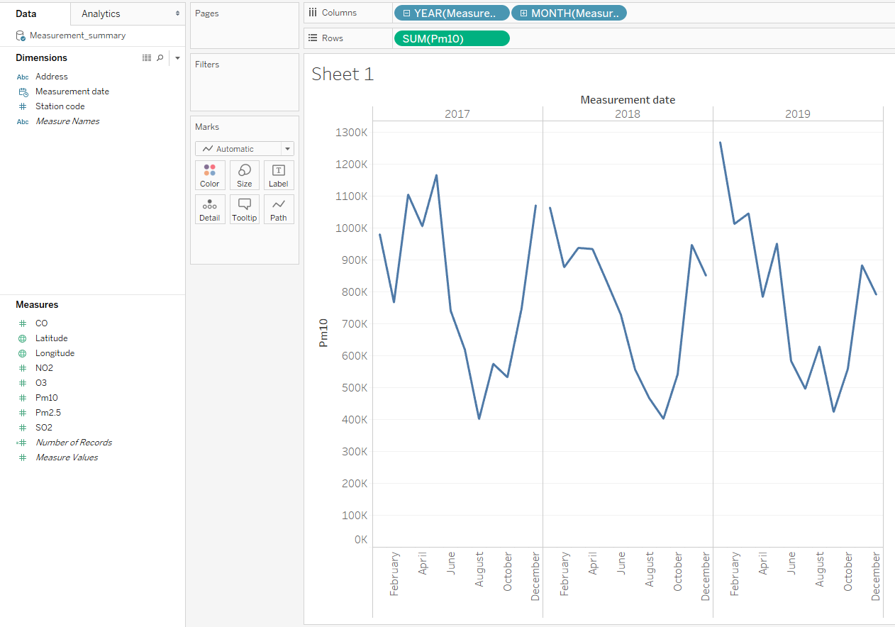
Forecasts
Is there a relationship between date and air pollution in Seoul?

Slide 46
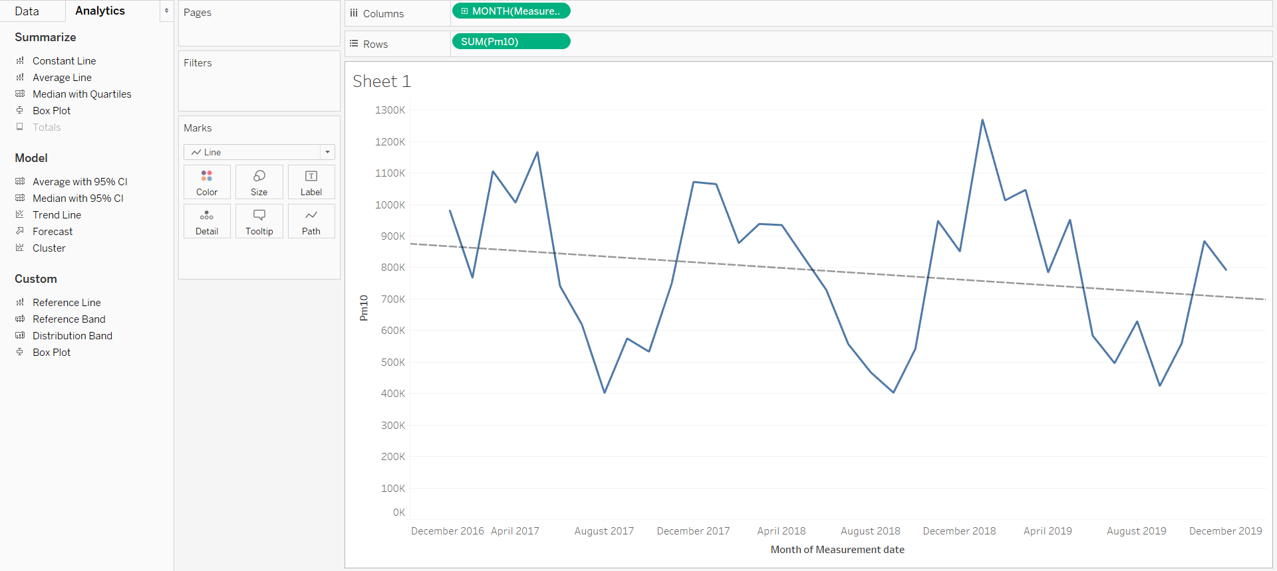
Forecasts
The Trend Line options don’t look too promising.

Slide 47
Forecasts
The seasonal nature tells us we should use a Forecast.

Slide 48
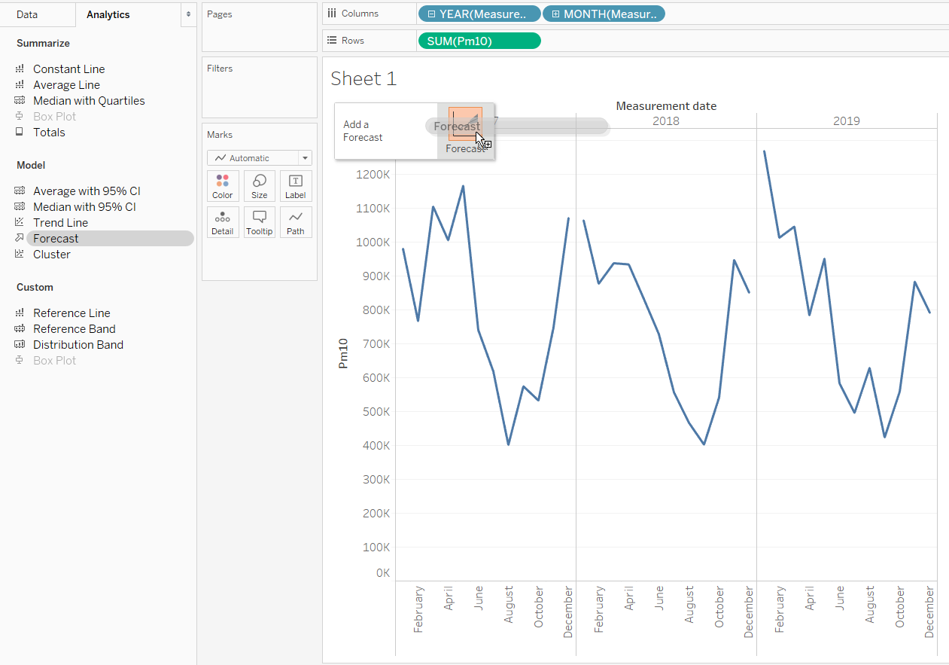
Forecasts
The seasonal nature tells us we should use a Forecast.

Slide 49
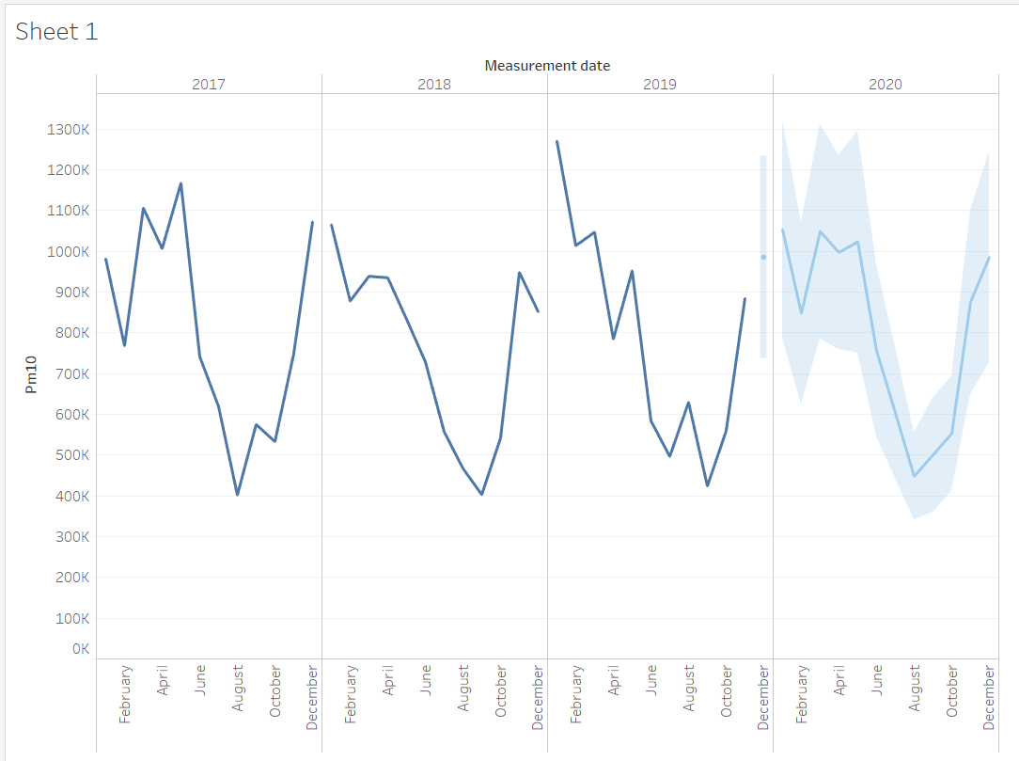
Forecasts
The seasonal nature tells us we should use a Forecast.

Slide 50
Forecasts
Right clicking the line gives us some options.

Slide 51
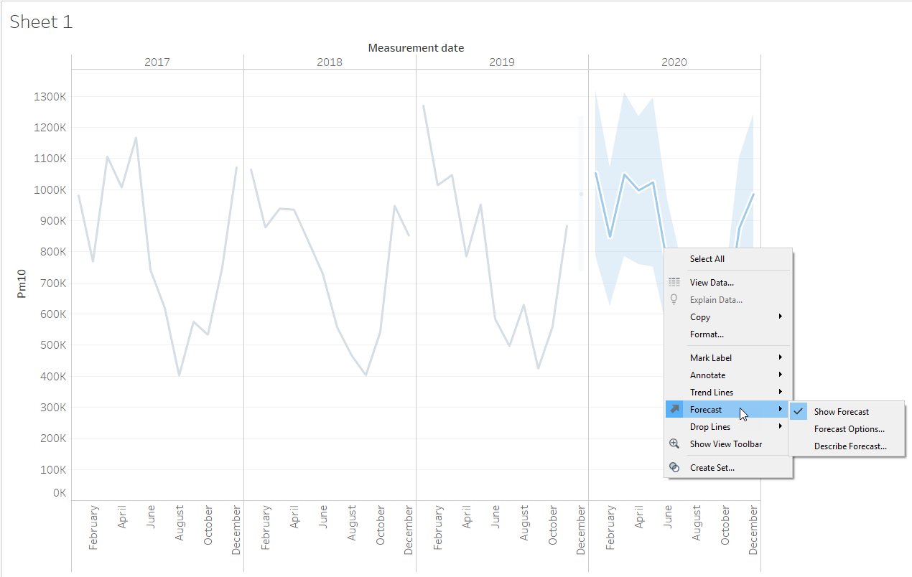
Forecasts
Right clicking the line gives us some options.

Slide 52
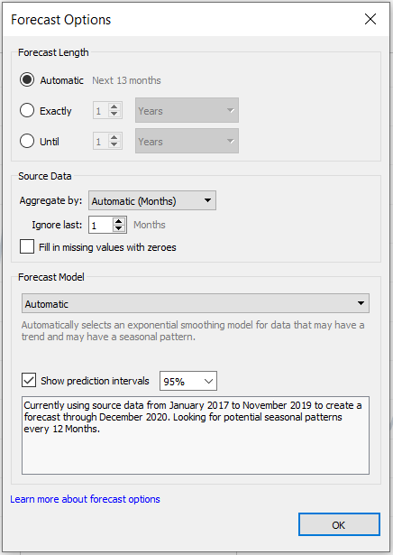
Forecasts
Right clicking the line gives us some options.

Slide 53
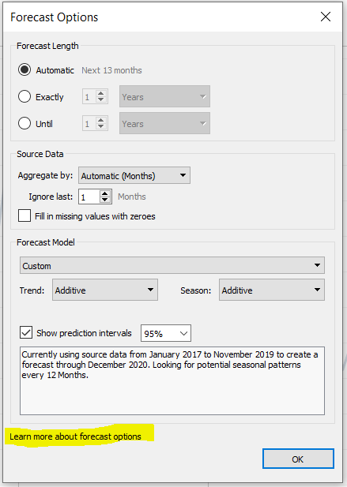
Forecasts
Adaptive!
Hyperlinks!
Bubbles!
Customizable!
Right clicking the line gives us some options.

Slide 54
Forecasts
Adaptive!
Hyperlinks!
Bubbles!
Customizable!
The hyperlink takes us to a great high-level resource for forecasting in Tableau.

Slide 55
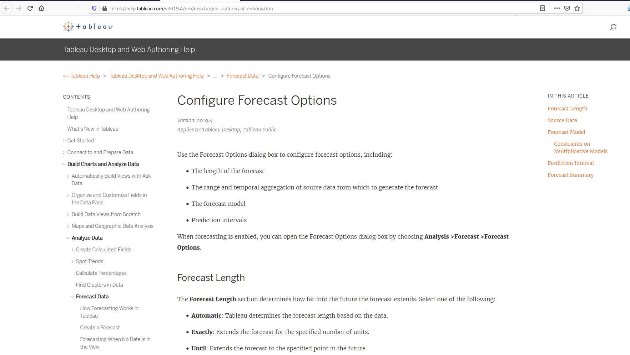
Forecasts
Adaptive!
Hyperlinks!
Bubbles!
Customizable!
The hyperlink takes us to a great high-level resource for forecasting in Tableau.

Slide 56
Forecasts
Right clicking the line gives us some options.

Slide 57
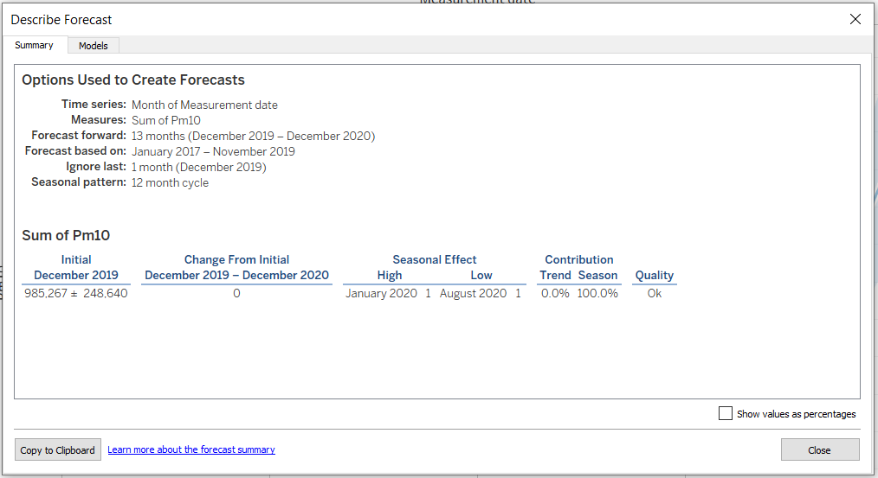
Forecasts
Right clicking the line gives us some options.

Slide 58
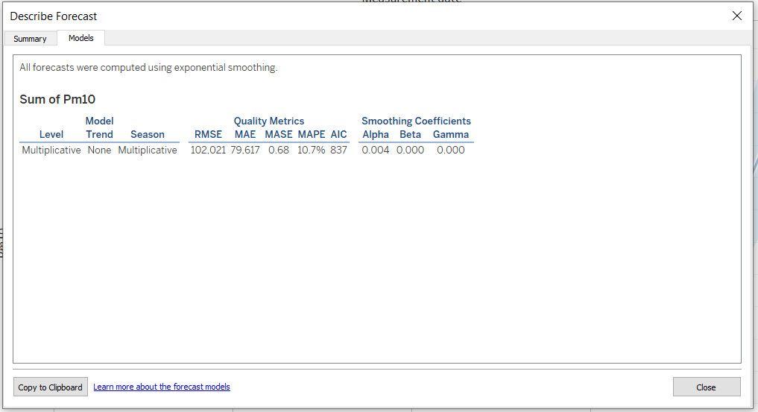
Forecasts
Right clicking the line gives us some options.

Slide 59
Forecasts
We also have another great hyperlink.

Slide 60
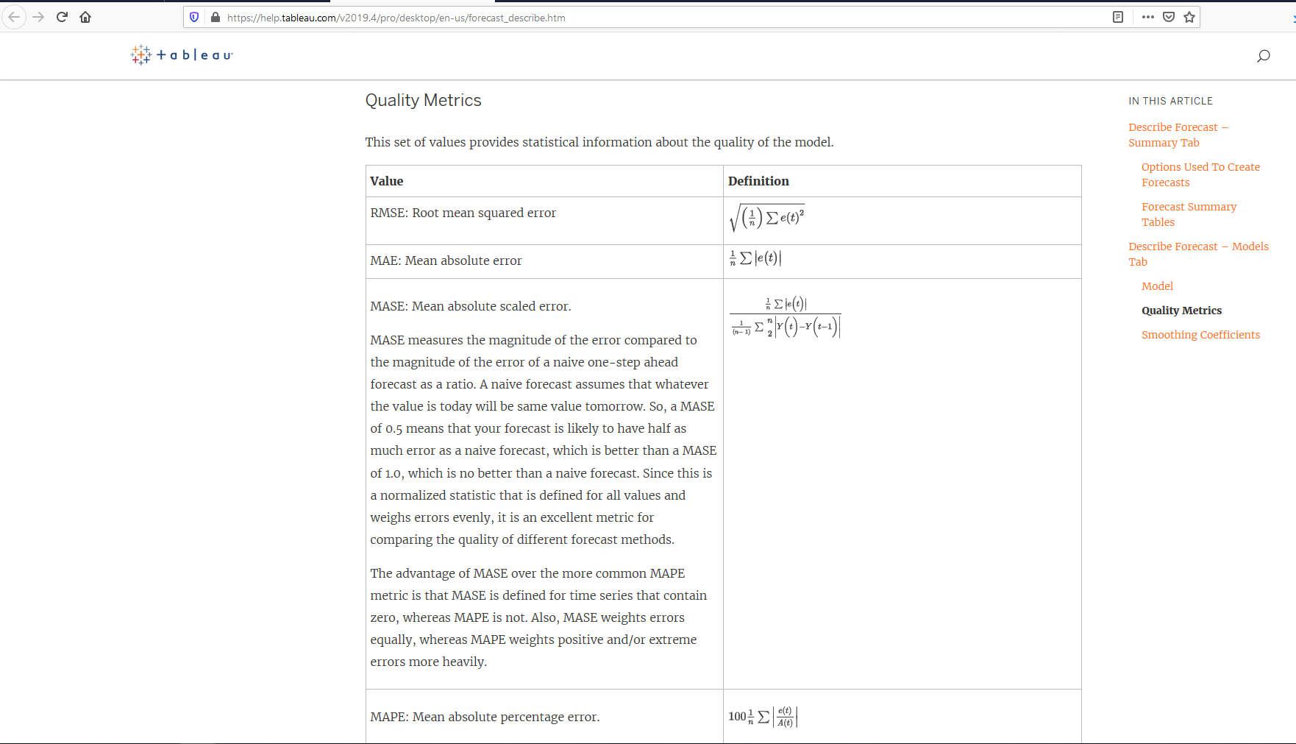
Forecasts
We also have another great hyperlink.

Slide 61
Forecasts
Let’s go back to that options dialog.

Slide 62
Forecasts
Let’s go back to that options dialog.

Slide 63
Forecasts
This is where we can change the forecast length.

Slide 64
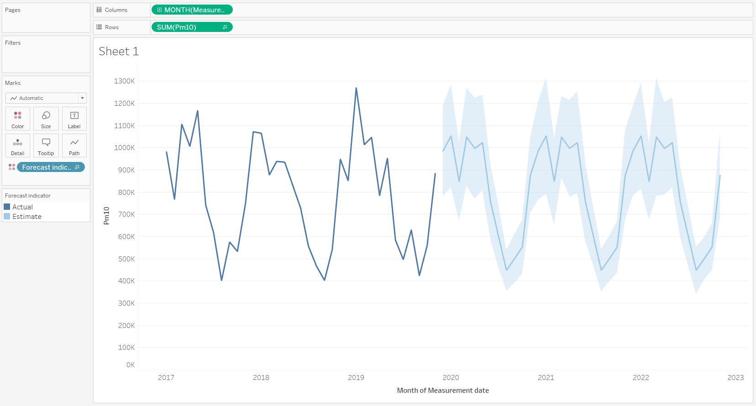
Forecasts
This is where we can change the forecast length.

Slide 65
Forecasts
Changing the mark for the viz can yield some interesting alternatives.

Slide 66
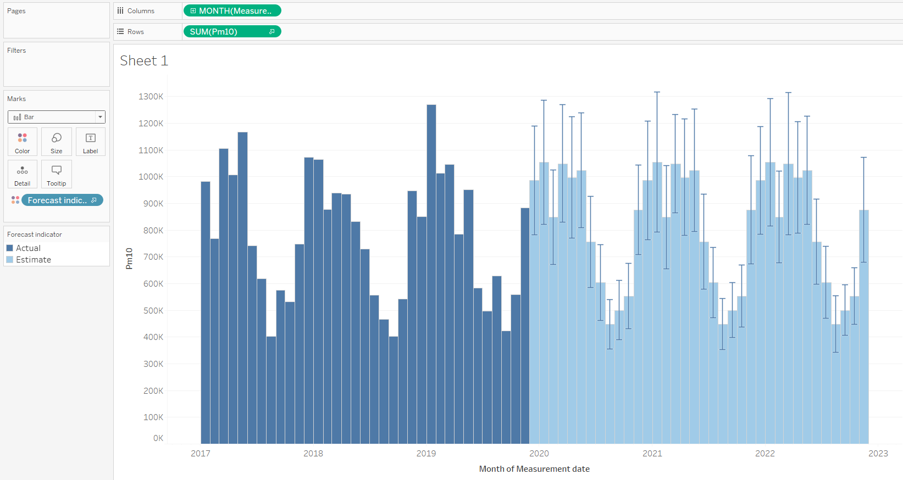
Forecasts
Changing the mark for the viz can yield some interesting alternatives.

Slide 67

Forecasts
Changing the mark for the viz can yield some interesting alternatives.

Slide 68
Summary Card
Is there a super quick way we can describe the spread of these two variables to our audience?

Slide 69

Summary Card
Is there a super quick way we can describe the spread of these two variables to our audience?

Slide 70

Summary Card
Is there a super quick way we can describe the spread of these two variables to our audience?

Slide 71
Summary Card
You’re now an expert in “Drag and Drop Analytics”!!!
Is there a super quick way we can describe the spread of these two variables to our audience?

