Slide 1

Training:
Machine Learning with R
Steve VanDenDriessche Office of Natural Resources Revenue
Notes:
Some brief background and acknowledge sources for this presentation

Slide 2
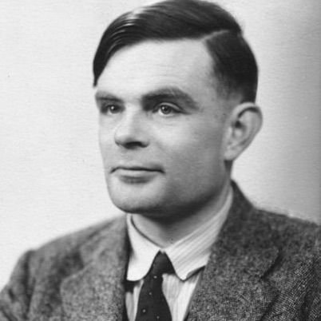
Background - History
“What we want is a machine that can learn from experience […] and letting the machine alter its own instructions provides the mechanism for that.”
- Turing, 1947 address to the London Mathematical Society

Slide 3
Background - Well-posed learning problems
Definition: A program is said to learn from experience E with respect to some class of tasks T and performance measure P, if its performance, as measured by P, at tasks in T improves with experience E.
Examples:
Automated visual wildfire detection
E = collection of video feeds with instances of wildfire occurrence, T = detecting wildfires based on real-time video feeds, P = minimizing the time to accurate detection
PDF scraping of oil and gas leasing contracts
E = corpus of translated pdfs, T = extracting text from new pdfs, P = percent words/punctuation correctly extracted
Identification of federal natural resource revenue royalty noncompliance
E = database of completed cases, T = predicted probability and $ of noncompliance , P = accuracy of predictions

Slide 4
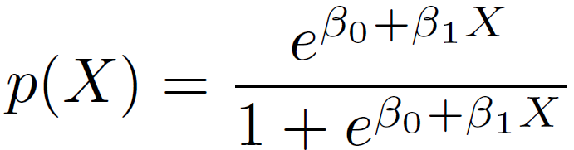
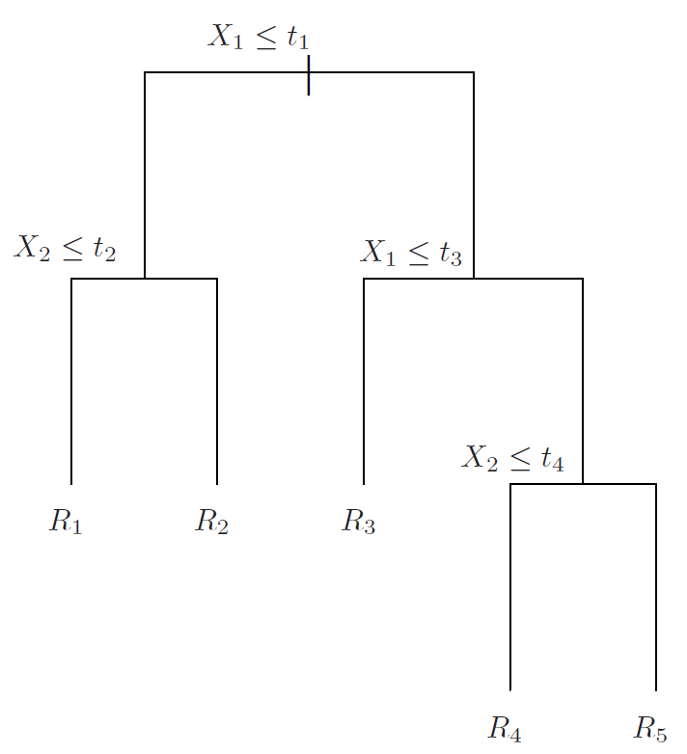
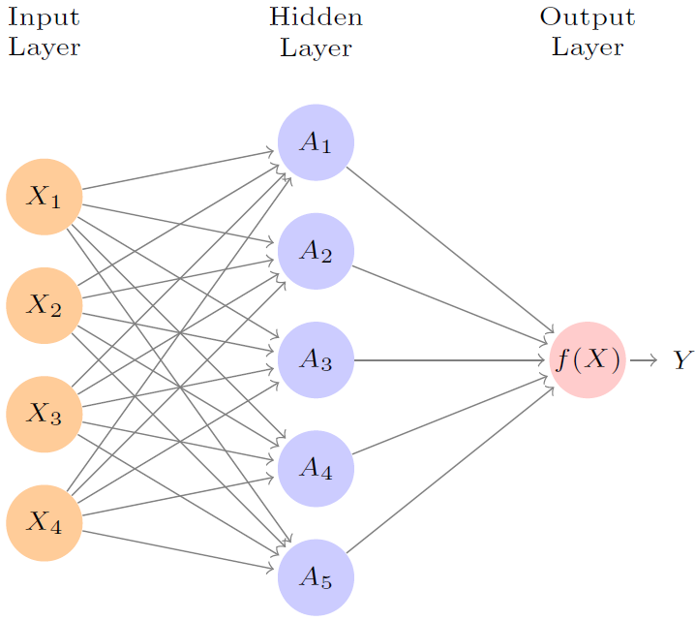
Background - Well-posed learning problems
Other considerations:
Direct or indirect training
Degree to which learner controls the sequence of training examples
Extent that training set E represents greater collection of tasks T
Target function representation
Approximation algorithm

Slide 5
Background - Well-posed learning problems
Other considerations:
Direct or indirect training
Degree to which learner controls the sequence of training examples
Extent that training set E represents greater collection of tasks T
Target function representation
Approximation algorithm
“A program can never learn a thing that it cannot at least represent.”

Slide 6
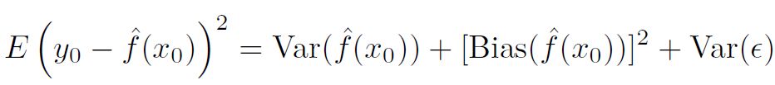
Aside – Bias-Variance Tradeoff
Theorem: The expected error of a model applied to a set of test data can be (pointwise) decomposed into the variance of the model, the bias of the model, and the variance of the inherent error term.

Slide 7
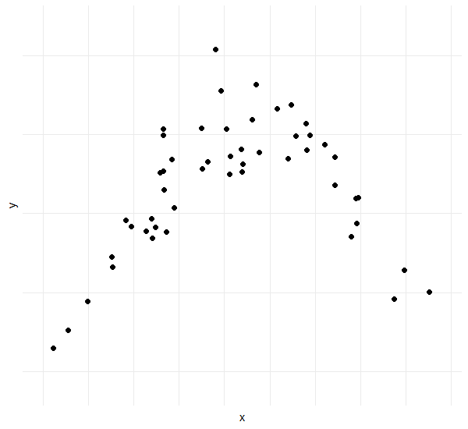
Aside – Bias-Variance Tradeoff
Theorem: The expected error of a model applied to a set of test data can be (pointwise) decomposed into the variance of the model, the bias of the model, and the variance of the inherent error term.

Slide 8
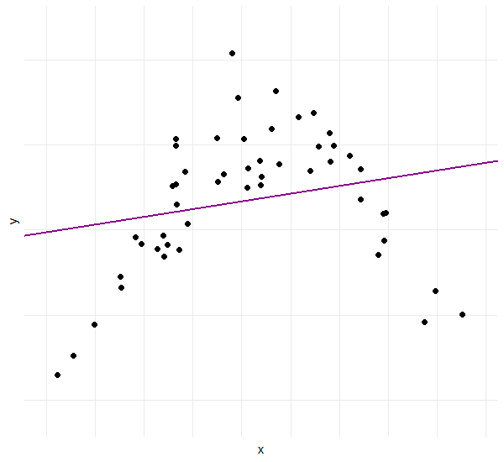
Aside – Bias-Variance Tradeoff
Theorem: The expected error of a model applied to a set of test data can be (pointwise) decomposed into the variance of the model, the bias of the model, and the variance of the inherent error term.

Slide 9
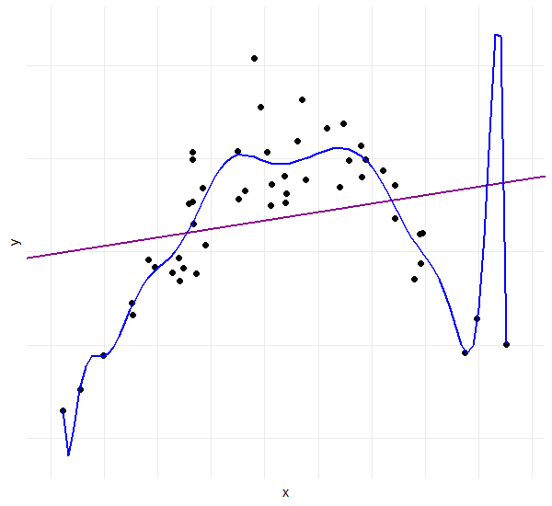
Aside – Bias-Variance Tradeoff
Theorem: The expected error of a model applied to a set of test data can be (pointwise) decomposed into the variance of the model, the bias of the model, and the variance of the inherent error term.

Slide 10
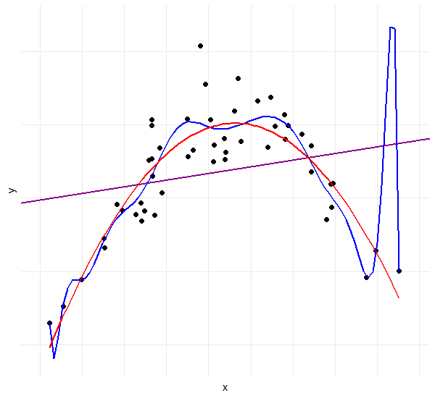
Aside – Bias-Variance Tradeoff
Theorem: The expected error of a model applied to a set of test data can be (pointwise) decomposed into the variance of the model, the bias of the model, and the variance of the inherent error term.
Bias
Error from model inflexibility
Oversimplification of the underlying pattern
Underfitting
Variance
Error from excess model flexibility
“Memorization” of training data
Overfitting

Slide 11
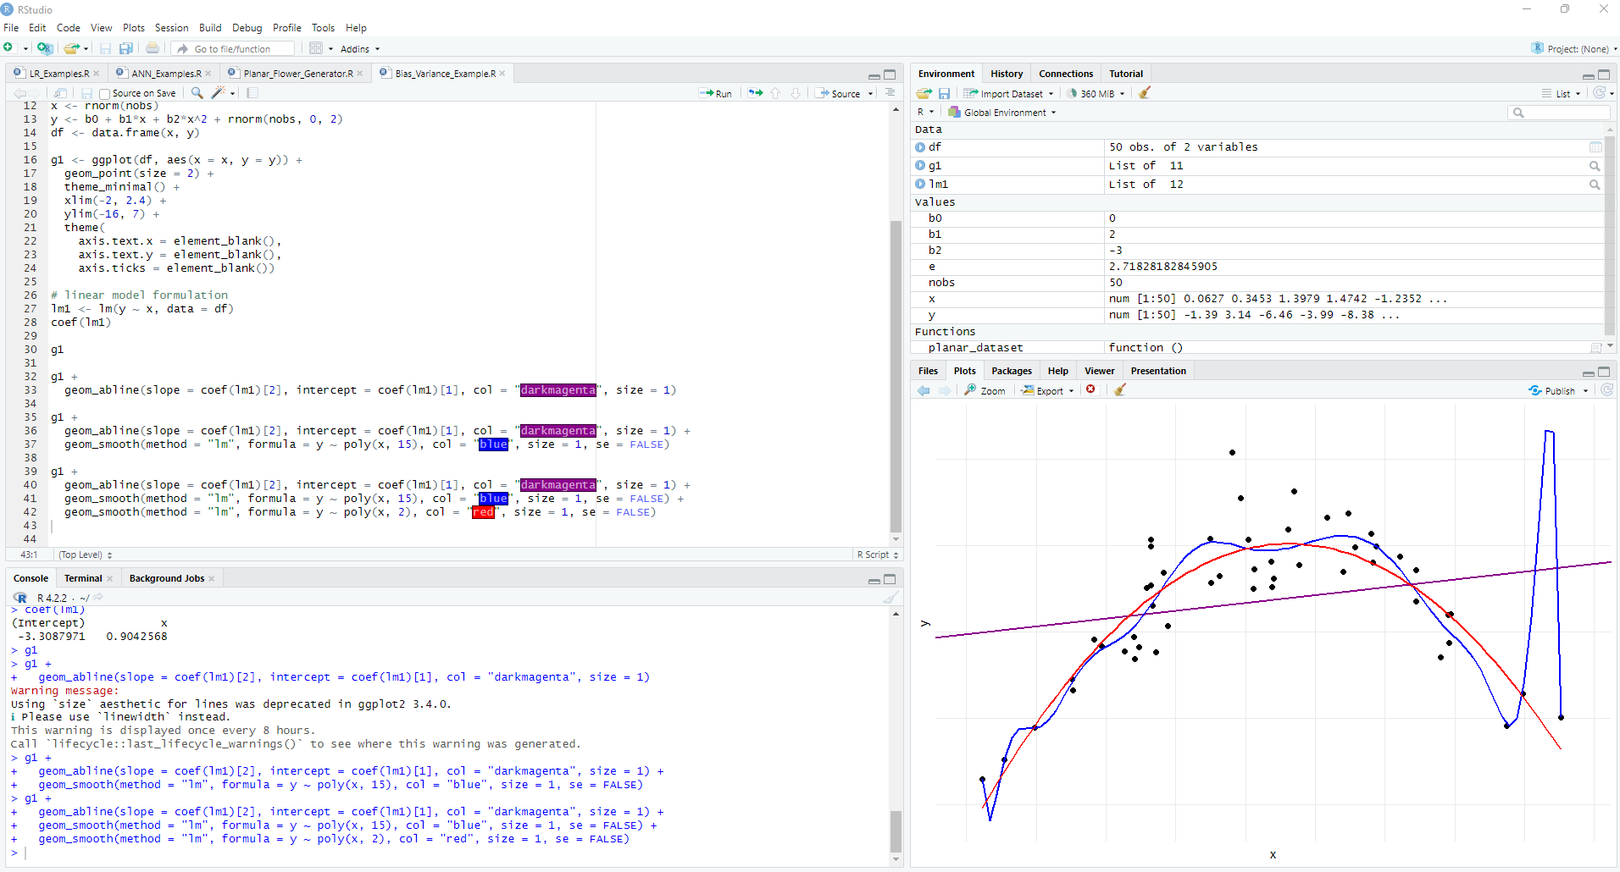
Overview of RStudio

Slide 12
Overview of RStudio

Slide 13
Overview of RStudio

Slide 14
Overview of RStudio

Slide 15
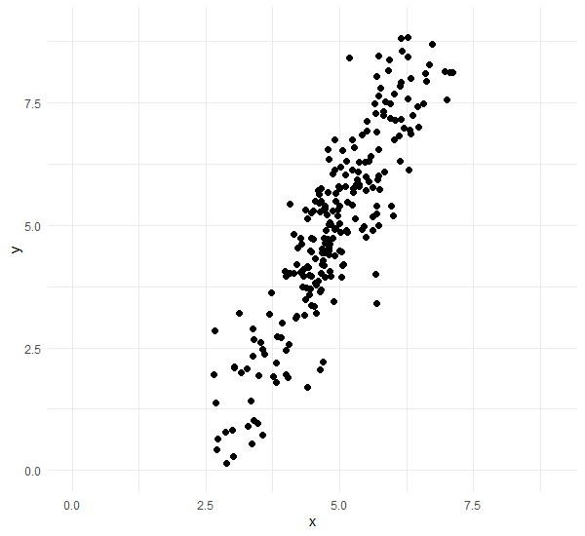


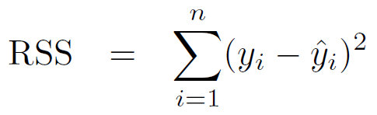
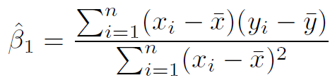

Regression - Quick Review
Notes:
Review T, E, P

Slide 16
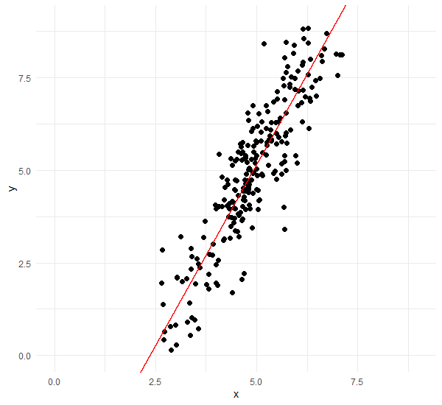
Regression - Quick Review
Notes:
Review T, E, P

Slide 17
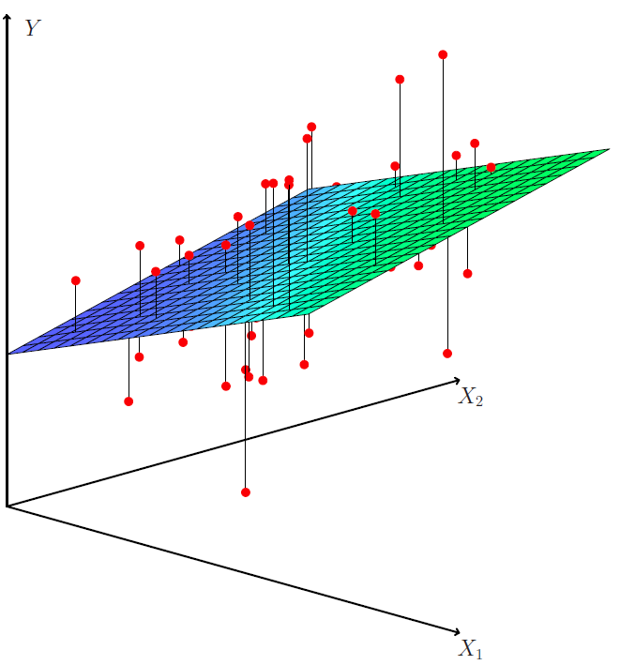

Regression - Quick Review
* Introduction to Statistical Learning with Applications in R
Notes:
Review T, E, P

Slide 18



Regression - Quick Review
* Introduction to Statistical Learning with Applications in R
Notes:
Review T, E, P

Slide 19
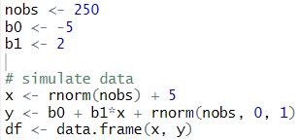


Regression - Quick Review
Notes:
Note: model.matrix creates a default “1” column to interact nicely with matrix multiplication for beta_0

Slide 20
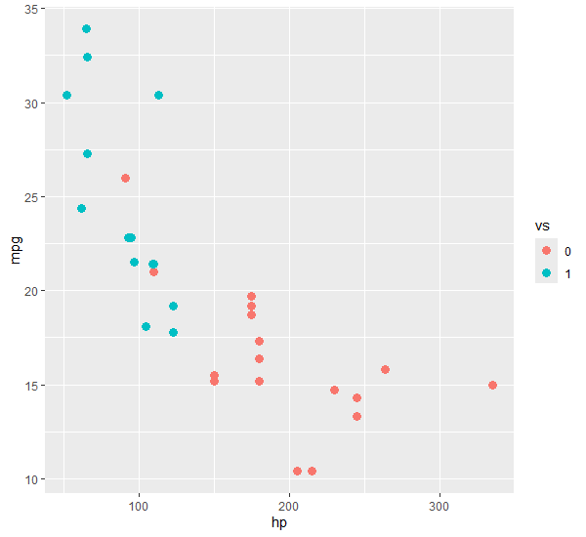

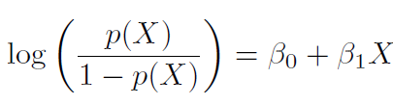
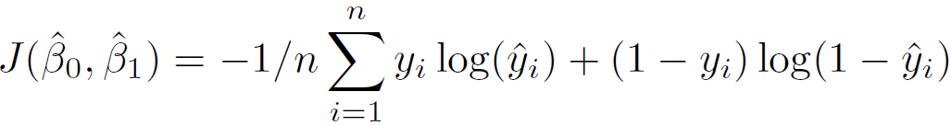
Logistic Regression
Goal: Minimize cost function
Notes:
Quick aside on human interpretability
#### Add attribution

Slide 21
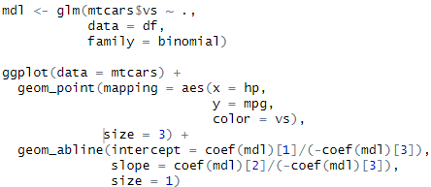
Logistic Regression

Slide 22
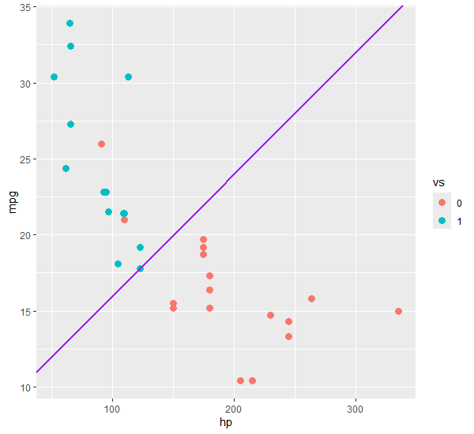
Logistic Regression

Slide 23
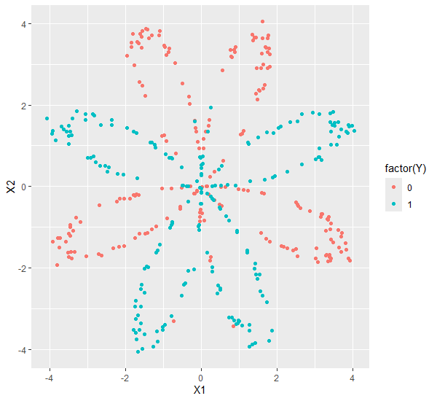

Logistic Regression - Limitations

Slide 24
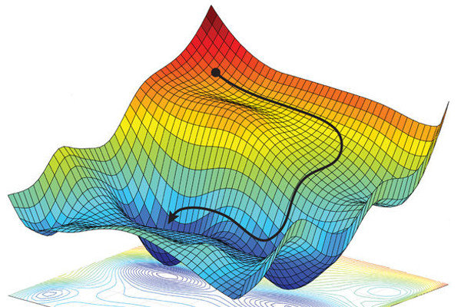
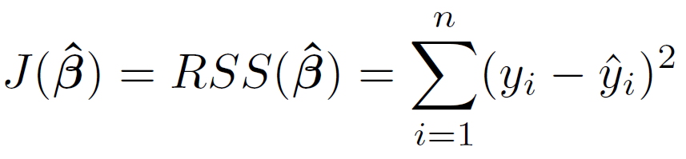
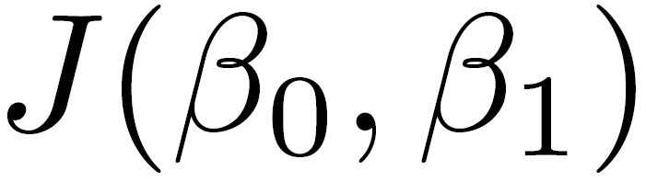
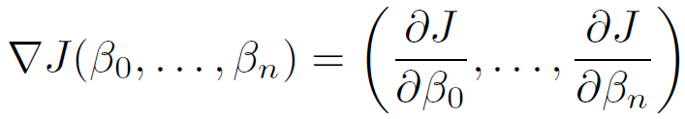


Gradient Descent
Goal: Minimize cost function
Idea: The gradient points in the direction of greatest increase
So, we just head the opposite direction, looking for a minima!
* Pic from Spatial Uncertainty Sampling for End-to-End Control

Slide 25
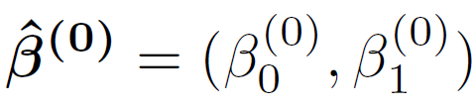
Gradient Descent
Start with a guess in some random spot
Then calculate the gradient at that spot and take a step in the opposite direction
Then iterate until a stop condition is met!
* Pic from Spatial Uncertainty Sampling for End-to-End Control
Notes:
Note that this process of decreasing the cost = improving performance = learning

Slide 26
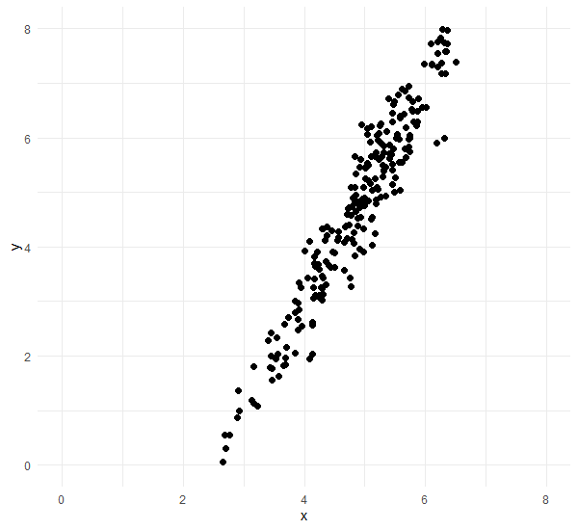
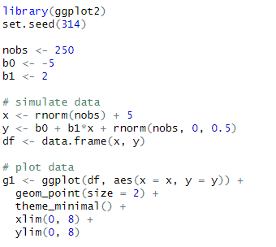
Gradient Descent
* Modified example from from Daniel Oehm | Gradient Descending

Slide 27
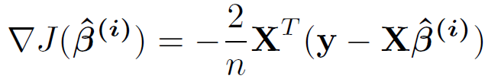

Gradient Descent
* Modified example from from Daniel Oehm | Gradient Descending

Slide 28
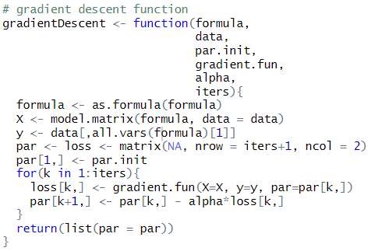

Gradient Descent
$$×$$
* Modified example from from Daniel Oehm | Gradient Descending

Slide 29
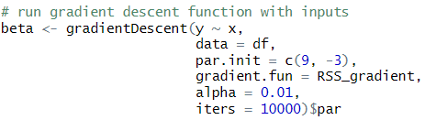
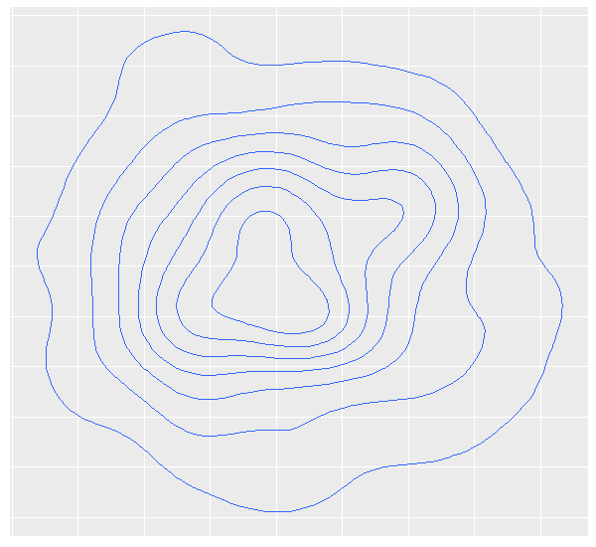



Gradient Descent
$$×$$
$$×$$
* Modified example from from Daniel Oehm | Gradient Descending

Slide 30
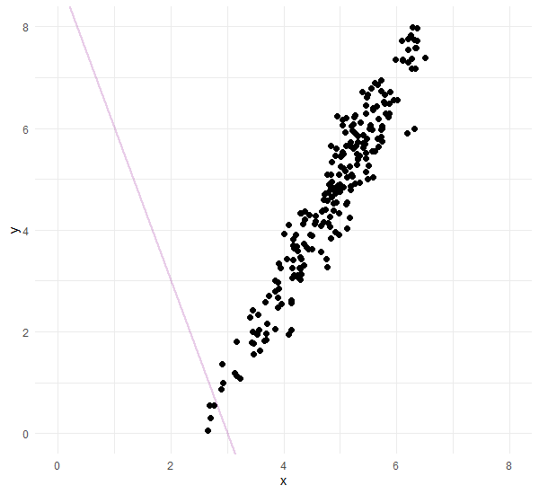
Gradient Descent
$$×$$
$$×$$
* Modified example from from Daniel Oehm | Gradient Descending

Slide 31
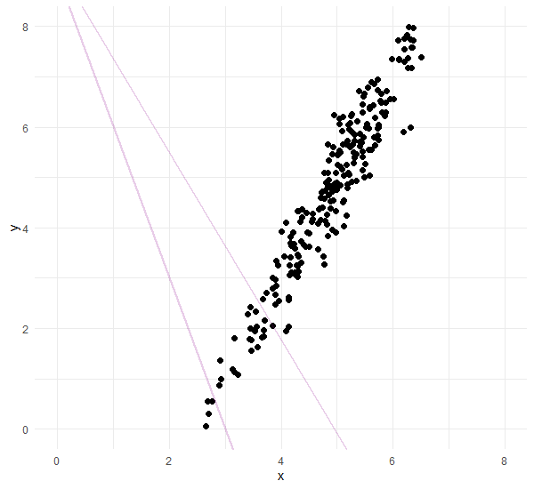
Gradient Descent
$$×$$
$$×$$
$$×$$
* Modified example from from Daniel Oehm | Gradient Descending

Slide 32
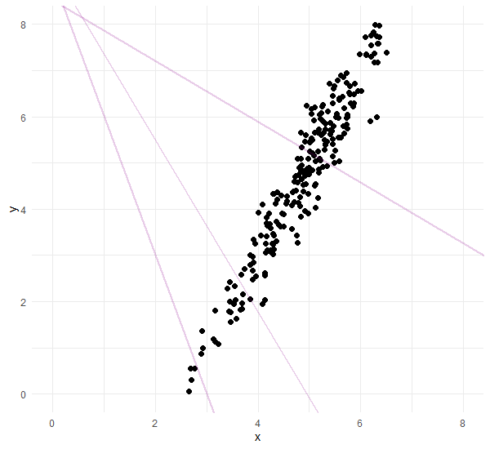



Gradient Descent
$$×$$
$$×$$
$$×$$
$$×$$
$$×$$
$$×$$
$$×$$
$$×$$
$$×$$
$$×$$
$$×$$
* Modified example from from Daniel Oehm | Gradient Descending

Slide 33
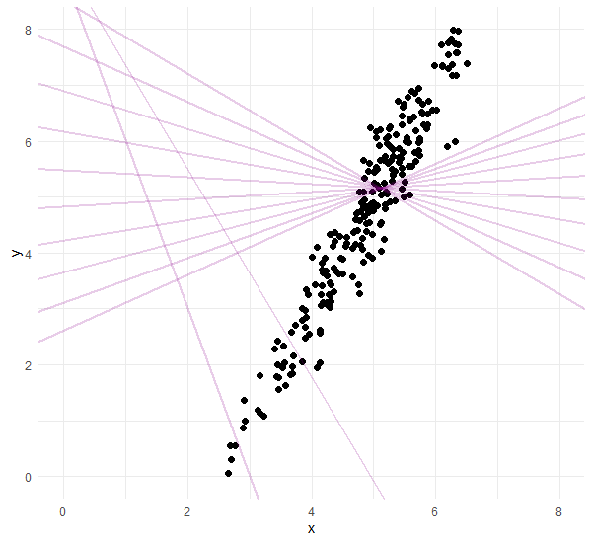
Gradient Descent
$$×$$
$$×$$
$$×$$
$$×$$
$$×$$
$$×$$
$$×$$
$$×$$
$$×$$
$$×$$
$$×$$
$$×$$
$$×$$
$$×$$
$$×$$
$$×$$
$$×$$
$$×$$
$$×$$
$$×$$
$$×$$
* Modified example from from Daniel Oehm | Gradient Descending

Slide 34
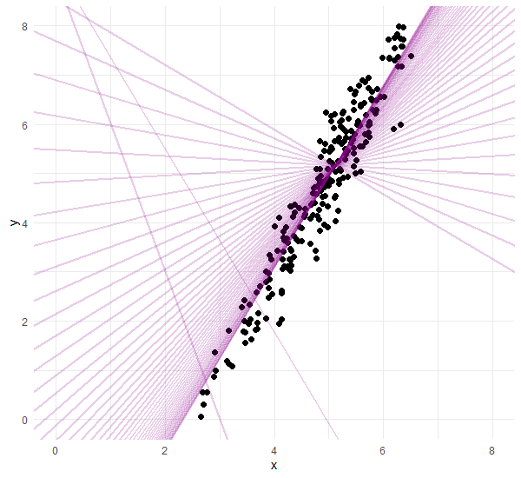
Gradient Descent
$$×$$
$$×$$
$$×$$
$$×$$
$$×$$
$$×$$
$$×$$
$$×$$
$$×$$
$$×$$
$$×$$
$$×$$
$$×$$
$$×$$
$$×$$
$$×$$
$$×$$
$$×$$
$$×$$
$$×$$
$$×$$
* Modified example from from Daniel Oehm | Gradient Descending

Slide 35
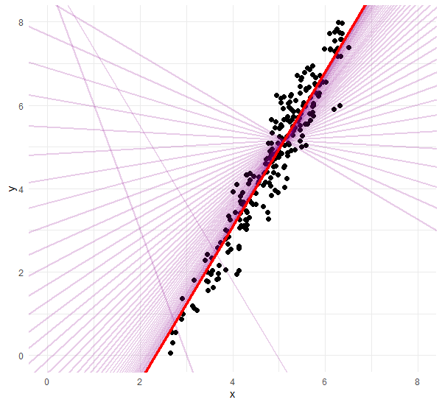

Gradient Descent
$$×$$
$$×$$
$$×$$
$$×$$
$$×$$
$$×$$
$$×$$
$$×$$
$$×$$
$$×$$
$$×$$
$$×$$
$$×$$
$$×$$
$$×$$
$$×$$
$$×$$
$$×$$
$$×$$
$$×$$
$$×$$
$$×$$
* Modified example from from Daniel Oehm | Gradient Descending

Slide 36
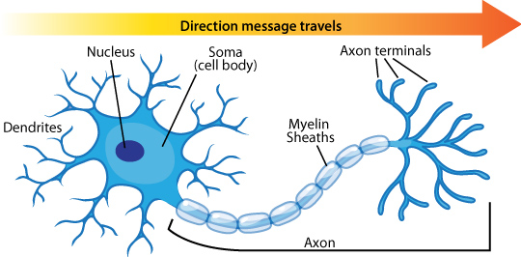
Artificial Neural Networks - Background
* Picture from ASU | Ask a Biologist
Notes:
- Biological inspiration for the perceptron (‘59)
- Note the “firing” nature and the options for the activation function

Slide 37
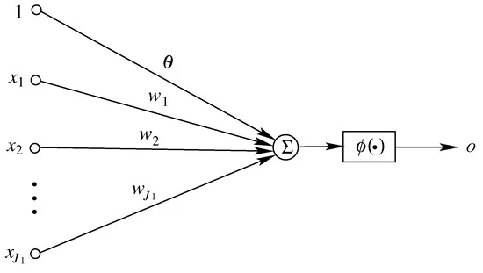
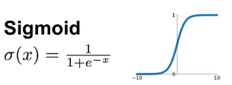

Artificial Neural Networks - Background
Activation function
* Picture from Du, et al. | Perceptron: Learning, Generalization,…
Notes:
- Biological inspiration for the perceptron (‘59)
- Note the “firing” nature and the options for the activation function

Slide 38
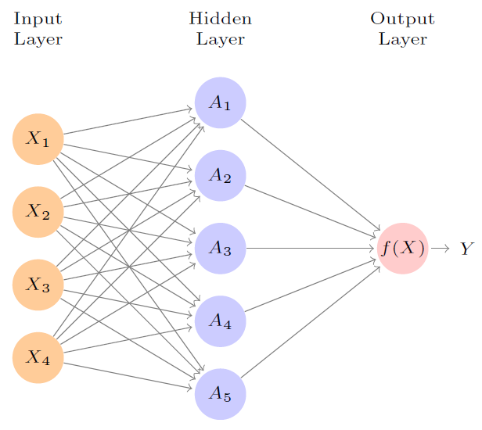
Artificial Neural Networks - Background
* Picture from Introduction to Statistical Learning with Applications in R
Notes:
The human brain contains about 10^11 neurons, each connected on average to 10,000 others.
Our networks today are going to be a little simpler.

Slide 39
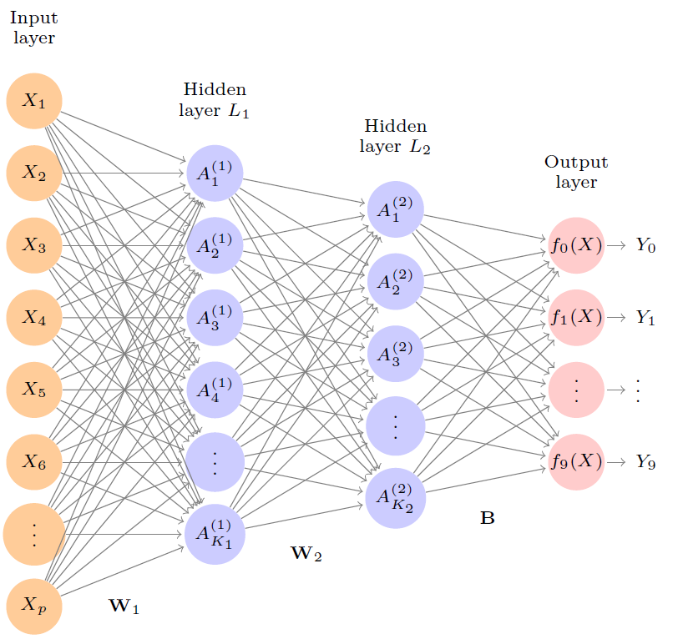
Artificial Neural Networks - Background
* Picture from Introduction to Statistical Learning with Applications in R
Notes:
You can add an extra hidden layer
They could be “recurrent” where some outputs feed back as inputs to previous nodes

Slide 40
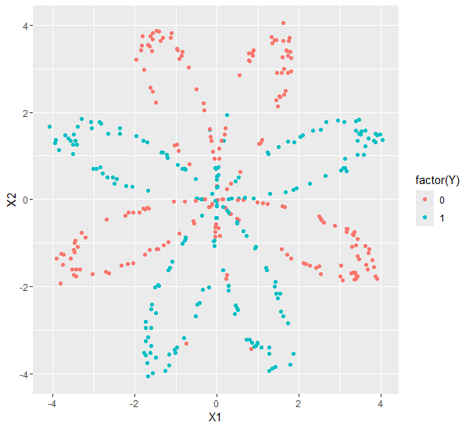
Artificial Neural Networks - Example
* Example based on Verma | Building a Neural Network from Scratch Using R

Slide 41
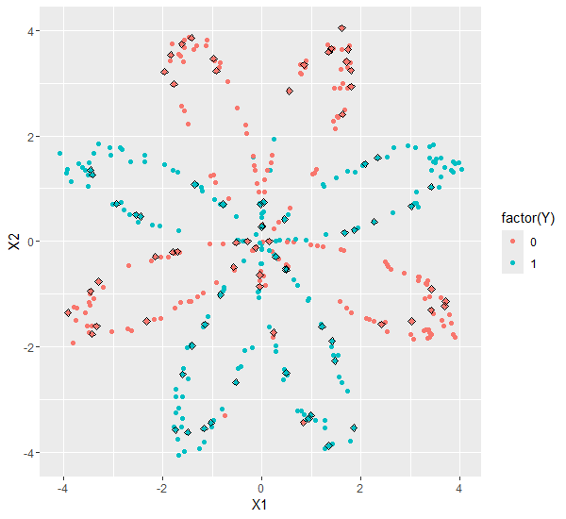
Artificial Neural Networks - Example
* Example based on Verma | Building a Neural Network from Scratch Using R

Slide 42
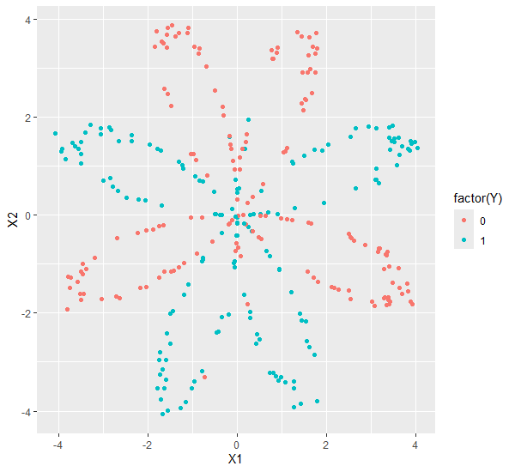
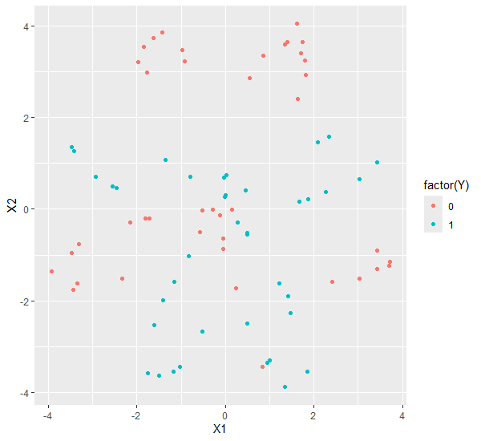
Artificial Neural Networks – Train/Test Split
Training Set
Test Set
* Example based on Verma | Building a Neural Network from Scratch Using R
Notes:
Acknowledge here that the code for this is very simple.

Slide 43
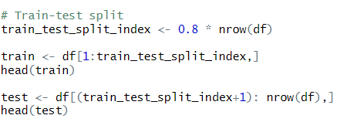
Artificial Neural Networks – Train/Test Split
* Example based on Verma | Building a Neural Network from Scratch Using R
Notes:
Acknowledge here that the code for this is very simple.
Note that some of the other preprocessing includes scaling variables, organizing object dimensions, etc.

Slide 44
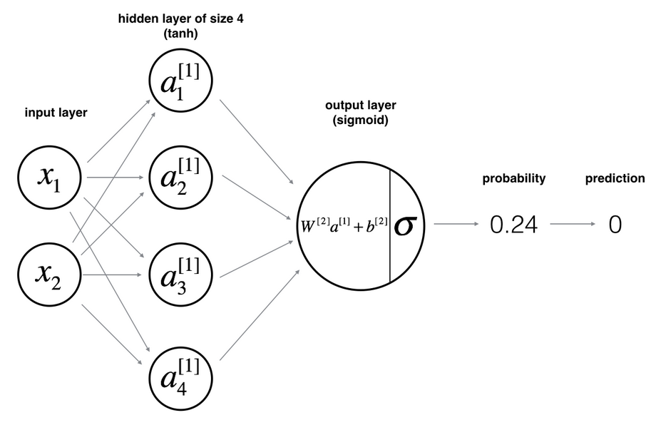
Artificial Neural Networks - Architecture
* Example based on Verma | Building a Neural Network from Scratch Using R

Slide 45

Artificial Neural Networks - Architecture
Steps to execute a feed forward:
* Example based on Verma | Building a Neural Network from Scratch Using R

Slide 46

Artificial Neural Networks - Architecture
Steps to execute a feed forward:
* Example based on Verma | Building a Neural Network from Scratch Using R

Slide 47

Artificial Neural Networks - Architecture
Steps to execute a feed forward:
* Example based on Verma | Building a Neural Network from Scratch Using R

Slide 48
Artificial Neural Networks - Architecture
Steps to execute a feed forward:
* Example based on Verma | Building a Neural Network from Scratch Using R

Slide 49

Artificial Neural Networks - Architecture
Steps to execute a feed forward:
* Example based on Verma | Building a Neural Network from Scratch Using R

Slide 50

Artificial Neural Networks - Architecture
Steps to execute a feed forward:
* Example based on Verma | Building a Neural Network from Scratch Using R

Slide 51


Artificial Neural Networks - Architecture
Steps to execute a feed forward:
* Example based on Verma | Building a Neural Network from Scratch Using R
Notes:
We are going to write code that will generalize to enabling more than 4 neurons in the hidden layer.

Slide 52


Artificial Neural Networks - Architecture
Steps to execute a feed forward:
* Example based on Verma | Building a Neural Network from Scratch Using R
Notes:
We are going to write code that will generalize to enabling more than 4 neurons in the hidden layer.

Slide 53


Artificial Neural Networks - Optimization
How does tweaking weights optimize the program:
* Example based on Verma | Building a Neural Network from Scratch Using R
Notes:
Binary cross entropy (equivalent to mle)

Slide 54
Artificial Neural Networks - Backpropagation
* Example based on Verma | Building a Neural Network from Scratch Using R

Slide 55


Artificial Neural Networks - Backpropagation
Gradient Components:
* Example based on Verma | Building a Neural Network from Scratch Using R

Slide 56
Artificial Neural Networks – Model Fitting
Overall plan:
Run entire training set through forward propagation
Calculate total cost function
Calculate gradients (backpropagation)
Update weights by taking one step of gradient descent
Repeat for given n
* Example based on Verma | Building a Neural Network from Scratch Using R

Slide 57
Artificial Neural Networks – Model Fitting
Overall plan:
Run entire training set through forward propagation
Calculate total cost function
Calculate gradients (backpropagation)
Update weights by taking one step of gradient descent
Repeat for given n
* Example based on Verma | Building a Neural Network from Scratch Using R

Slide 58
Artificial Neural Networks – Model Fitting
Overall plan:
Run entire training set through forward propagation
Calculate total cost function
Calculate gradients (backpropagation)
Update weights by taking one step of gradient descent
Repeat for given n
* Example based on Verma | Building a Neural Network from Scratch Using R

Slide 59
Artificial Neural Networks – Model Fitting
Overall plan:
Run entire training set through forward propagation
Calculate total cost function
Calculate gradients (backpropagation)
Update weights by taking one step of gradient descent
Repeat for given n
* Example based on Verma | Building a Neural Network from Scratch Using R

Slide 60

Artificial Neural Networks – Model Fitting
Overall plan:
Run entire training set through forward propagation
Calculate total cost function
Calculate gradients (backpropagation)
Update weights by taking one step of gradient descent
Repeat for given n
* Example based on Verma | Building a Neural Network from Scratch Using R

Slide 61

Artificial Neural Networks – Model Fitting
Overall plan:
Run entire training set through forward propagation
Calculate total cost function
Calculate gradients (backpropagation)
Update weights by taking one step of gradient descent
Repeat for given n
* Example based on Verma | Building a Neural Network from Scratch Using R

Slide 62

Artificial Neural Networks – Model Fitting
Overall plan:
Run entire training set through forward propagation
Calculate total cost function
Calculate gradients (backpropagation)
Update weights by taking one step of gradient descent
Repeat for given n
* Example based on Verma | Building a Neural Network from Scratch Using R

Slide 63

Artificial Neural Networks – Model Fitting
Overall plan:
Run entire training set through forward propagation
Calculate total cost function
Calculate gradients (backpropagation)
Update weights by taking one step of gradient descent
Repeat for given n
* Example based on Verma | Building a Neural Network from Scratch Using R

Slide 64

Artificial Neural Networks - Efficacy
* Example based on Verma | Building a Neural Network from Scratch Using R

Slide 65


Artificial Neural Networks - Efficacy
* Example based on Verma | Building a Neural Network from Scratch Using R

Slide 66


Artificial Neural Networks - Packages
TensorFlow for R
* Example based on Verma | Building a Neural Network from Scratch Using R

Slide 67



Resources

Slide 68

Resources

Slide 69

Resources

Slide 70

Resources

Slide 71

Resources

Slide 72

Resources

Slide 73
Resources
Please feel free to reach out if you would like copies of the scripts used in this presentation:
Steve VanDenDriessche Steven.VanDenDriessche@onrr.gov

Slide 74
References
G. James, D. Witten, T. Hastie, R. Tibshirani. An Introduction to Statistical Learning with Applications in R. Springer Publishing Co., New York, 2013. ISBN 978-1-4614-7137-0.
T. Mitchell. Machine Learning. MIT Press and The McGraw-Hill Companies, Inc., New York, 1997. ISBN 978-0-0704-2870-2.
H. Wickham, G. Grolemund. R for Data Science Import, Tidy, Transform, Visualize, and Model Data. O’Reilly Media Inc., Sebastopol, CA, 2017. ISBN 978-1-491-91039-9.
A. Awan. Building Neural Network (NN) Models in R. Datacamp. 2023. Accessed 4/23/2024. <https://www.datacamp.com/tutorial/neural-network-models-r>
C. Bare. Linear Regression by Gradient Descent. R-bloggers. 2012. Accessed 4/23/2024. <https://www.r-bloggers.com/2012/07/linear-regression-by-gradient-descent/>
F. de Abreu. Gradient Descent in R. R-bloggers. 2023. Accessed 4/23/2024. <https://www.r-bloggers.com/2023/04/gradient-descent-in-r-2/>
C. Ford. Load_planar_dataset.R. GitHub Gist. 2020. Accessed 4/23/2024. <https://gist.github.com/clayford/92b661115536efedb0a87ddde850a185/revisions>
D. Oehm. Applying Gradient Descent – Primer/Refresher. R-bloggers. 2019. Accessed 4/23/2024. <https://www.r-bloggers.com/2019/04/applying-gradient-descent-primer-refresher/>
A. Verma. Building a Neural Net from Scratch Using R – Part 1. R Views. 2020. Accessed 4/23/2024. <https://rviews.rstudio.com/2020/07/20/shallow-neural-net-from-scratch-using-r-part-1/>
A. Verma. Building a Neural Net from Scratch Using R – Part 2. R Views. 2020. Accessed 4/23/2024. <https://rviews.rstudio.com/2020/07/24/building-a-neural-net-from-scratch-using-r-part-2/>

