Slide 1
Regression Diagnostics for Salary Equity Modeling
M. Gunty, A. Lanski, S. VanDenDriessche*
INAIR - March 24, 2022
Notes:
- Thanks to organizers and moderators
- Should have put Gifs in like Bridgett and Doug
- Acknowledge references at the beginning
- Really focusing on outlier diagnostics
- In the spirit of Krista’s message from the keynote, this presentation is meant to be framed in a context for everyone, regardless of background

Slide 2
The Motivation
Background
Question: Are faculty members paid equitably across various demographic categories?
Why a linear model?
Linear models for salary prediction are well studied and easily understood.
They are particularly well-suited to equity studies, due to their “other things equal” calculation.
Explicit coefficients and their corresponding significance allow for an easy approach to inference regarding equity assessment.
Notes:
- Actually a collection of questions – for example, are females paid equitably? Are URM faculty paid equitably?
- Also no fear of overtraining.
- Oprah joke

Slide 3
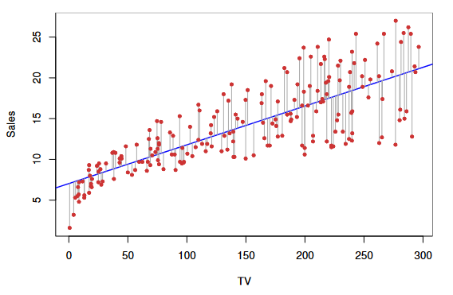


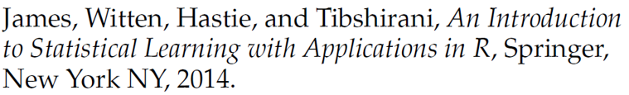
A Quick Review
Background
Notes:
- Assume that the left is reality, determine estimates of the parameters that best model reality.
- Model training is typically by OLS
OR
- Thinking of X, Y, and Beta as vectors and matrices:

Slide 4
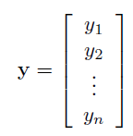
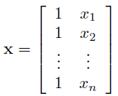


A Quick Review
Background
Notes:
Here m-hat is the vector of fitted values although y-hat is also often used, not sure of the history why this notation is used, but it’s how I learned this stuff so we’ll stick with it for this presentation.
Also, X is often called the design matrix.

Slide 5
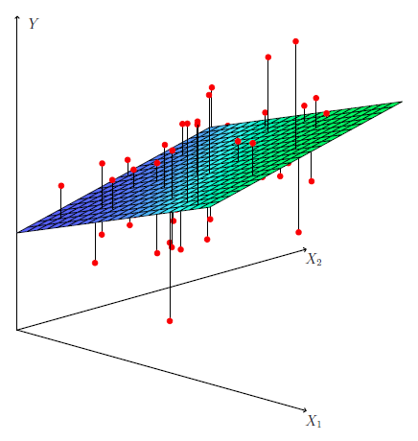

A Quick Review
Background
Notes:
Walk through idea, just add new vars. Two gives a plane in R^3, three gives a hyperplane in a higher dimension.

Slide 6

A Quick Review
Background
Notes:
Since our conversion to matrix notation was independent of n, the formula holds.
We can mostly ignore this if needed, but it will be useful for some formulas we look at here in a little bit.

Slide 7
The Model(s)
Background
List of analyzed variables:
Terminal degree
Dichotomous variables for rank
Dichotomous variables for department
Years in current rank (and this term squared)
Years in prior rank (and this term squared)
Years from grad to hire (and this term squared)
Minority status
Gender (flag for “female”)
Notes:
- Dichotomous variable for rank -> flag
- Note that gender flag could be implemented either way
- Actually use one big model for the University and then one for each college and each rank

Slide 8
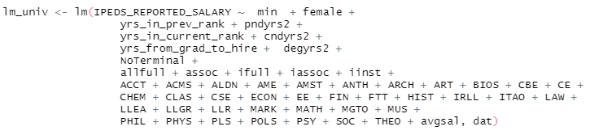
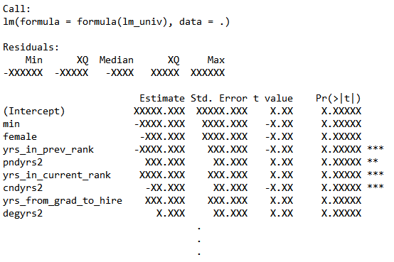
The Model(s)
Background
Notes:
- Actual numbers are scrubbed because I did not really feel like going through the approval process needed to share this info.
- Note lack of significance for min and female variables.
- Note vertical ellipses and that there is more info. Adj R^2 = .757

Slide 9
The Motivation
Background
Follow-up Question: Are there outliers that are influencing this study and hiding any biases?
Observation: There are many well known approaches to handling outliers in the response variable, but outlier detection for the independent variables is less well known.
Notes:
- A dean who is a very good sociologist was looking at her College’s model and removed some number of particularly high earning females, which switched the coefficient to be significant. I wasn’t directly involved in this discussion, but my understanding is that the outliers were sort of hand-picked rather than chosen by following a rule.
- From discussion, it became clear that the potential outliers in question were all outliers in the independent variables, especially with regards to time in current rank, and the other time-related vars.

Slide 10
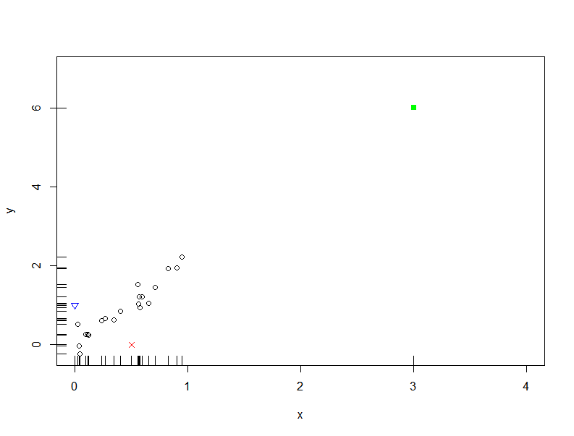

More Review
Background
Question: What counts as an outlier?
Notes:
- In some usage in the context of regression, an outlier is specifically a point with a high residual.
- In another sense, in regression we don’t really care is some point is far from the rest of the data, but rather, whether it breaks a pattern exhibited by the rest of the data.
- In this example, the green point is extreme in the sense that it falls far outside the typical range for x and y, but does not break the pattern (created to fall right on the line)
- The blue and red points however fall in the typical range for x and y, but do not follow the exhibited linear pattern.
- All three are outliers in their own way.
- We need measures to help us effectively determine what counts as an outlier and in what sense.

Slide 11
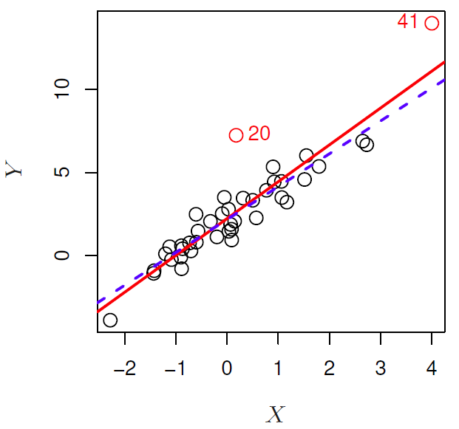
Visual Intuition
Leverage
Notes:
- Observations 20 and 41 have approximately the same residual, but their inclusion/exclusion from model training has different influence on the regression line.
- The red line is fit on all of the data while the dashed blue line excludes observation 41. If we only exclude observation 20, there is far less of an impact on the regression line.
- Because of this, we call observation 41 a “high leverage point.”

Slide 12



Mathy Intuition
Leverage
Observation: Data points close to the average on the X-axis have small impact on their corresponding fitted value!
Notes:
- Suppose we have a data point (x_i, y_i) having x_i equal to x-bar, then the regression line *has* to go through x-bar, y-bar, almost regardless of the actual value of y_i. In this sense, the data point has very little influence over the regression line.

Slide 13
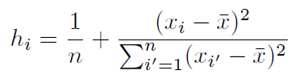



Implementation
Leverage
or
,
which shows up naturally in regression via
Notes:
- We won’t go into the derivation, but note that the distance from the average plays a major role in the definition and that y is nowhere to be found.
- If we switch back to matrix world, this is just the ith term on the diagonal of the hat matrix. It’s defined here, but the important thing to point out is that it already naturally shows up in the study of regression.
- The intuition is that the hat matrix describes the influence each response observation has on the set of all fitted values
- Also, this captures the notion we described where H_ii is the influence of y_i on its own fitted value.
- A cool insight about these equations is that they don’t care at all about y.

Slide 14
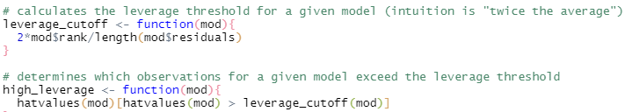
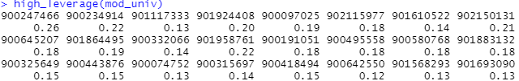
Implementation
Leverage
Luckily we don’t have to do the math ourselves!
Notes:
- The intuition for the threshold is “twice the average” and some algebra shows that the average is (p+1)/n, which is what we are calculating in the high_leverage function.
- This direction of inquiry can be further explored by looking at “Studentized Residuals”

Slide 15
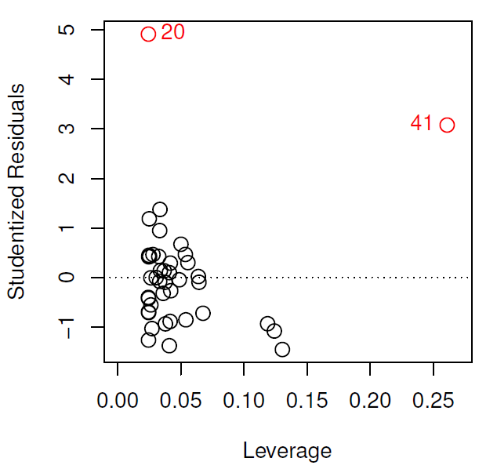
Studentized Residuals
Leverage
Notes:
- A Studentized Residual is obtained by taking the residual, e_i and dividing by its estimated standard error.
- A point with a Studentized Residual outside +/- 3 is a potential outlier.
- This combination can be used to see which observations are particularly influential to the model since the combination of high leverage and high studentized residual can throw a model way off.

Slide 16


Visual Intuition
Cook’s Distance
Notes:
- As we discussed earlier, leaving out a data point has some impact on the regression line. Is there an easy way to quantify this impact?
- Recall that m_hat is the vector of n fitted points, so these are the predictions for the y values, given the set of input x values.
- In this image, we’ve got the m_hats pointing to the lines that are used to generate them. That’s not quite accurate, since these are both vectors in R^n.
- Because they are vectors, we can take the distance between the two vectors as a measure of how much excluding observation 40 has impacted the set of predictions.

Slide 17


Implementation
Cook’s Distance
To make the metric more comparable across models with varying numbers of predictors:
or
Notes:
- e_i is the ith residual

Slide 18
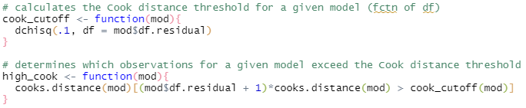
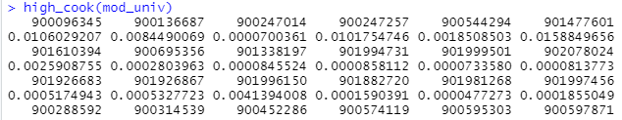
Implementation
Cook’s Distance
Luckily we don’t have to do the math ourselves!
Notes:
- Again, R takes care of the math for us.
- Cook’s traditional threshold uses a chi_squared distribution with p+1 degrees of freedom and input 0.1, so that is what we stuck with here although there is no clear intuition behind the input of 0.1.
- Again, passing this function a model spits out the NDIDs and corresponding Cook’s Distance for those exceeding the threshold.

Slide 19


Visual Intuition
DFBETA
Notes:
- The influence excluding a point has on a single parameter, here the beta_0 and beta_1

Slide 20

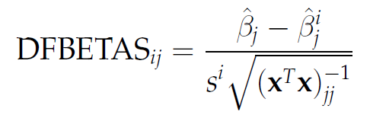
Implementation
DFBETA
It is also common to “standardize” by dividing by the standard error of the jth coefficient:
Notes:
- The names feel kind of backwards to me since the top is a vector of the p+1 changes to the coefficients while the bottom is the standardized change to solely the jth coefficient
- The denominator in the standardized DFBETAS is essentially a standard error of \beta_j after ignoring the ith observation

Slide 21
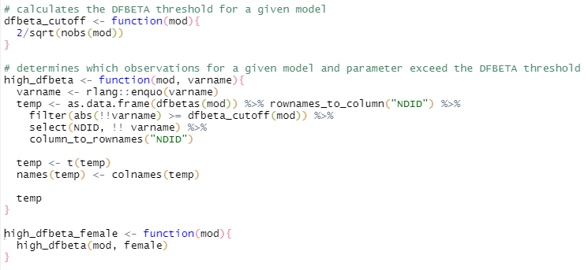
Implementation
DFBETA
Luckily we don’t have to do the math ourselves!
Notes:
- Threshold is 2/sqrt(n)
- This function is a little more difficult to write since we also pass it the name for X_j
- Our implementation would sometimes create a helper function having X_j fixed, in this example that is the female flag

Slide 22
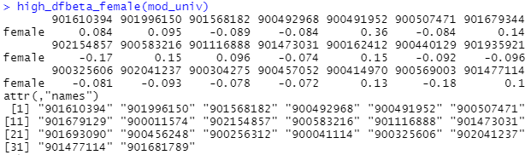
Implementation
DFBETA
Luckily we don’t have to do the math ourselves!
Notes:
- And we get our usual output, just a few more bells and whistles,

Slide 23
Conclusions
What sort of techniques have we covered
Leverage
How far away is a given point from the cluster of typical data? (Because this changes its influence.)
Cook’s Distance
How influential is the inclusion of a single point on the overall model (specifically its predictions).
DFBETA(S)
How influential is a single observation to a single parameter estimate?

Slide 24
Conclusions
Okay, so these potential influential points are identified. Now what do we do?
Deletion
Never too be taken lightly. Best in cases where data is actually incorrect in some way.
Alter the Model
It’s possible we are making incorrect assumptions about the underlying pattern. Maybe a spline would be more accurate?
Robust Linear Regression
Modification to the OLS approach using a modified loss function to smooth loss contribution.

Slide 25
What did ND learn?
Conclusions
There are many ways to assess “influence” and define outliers.
Utilizing the three notions defined here, we were able to rebuild models excluding theses points to determine their impact on our equity analyses.
Fortunately our conclusions regarding equity hold true, even when removing highly influential points.
All this work and more is done by the Influence.measures function!

Slide 26
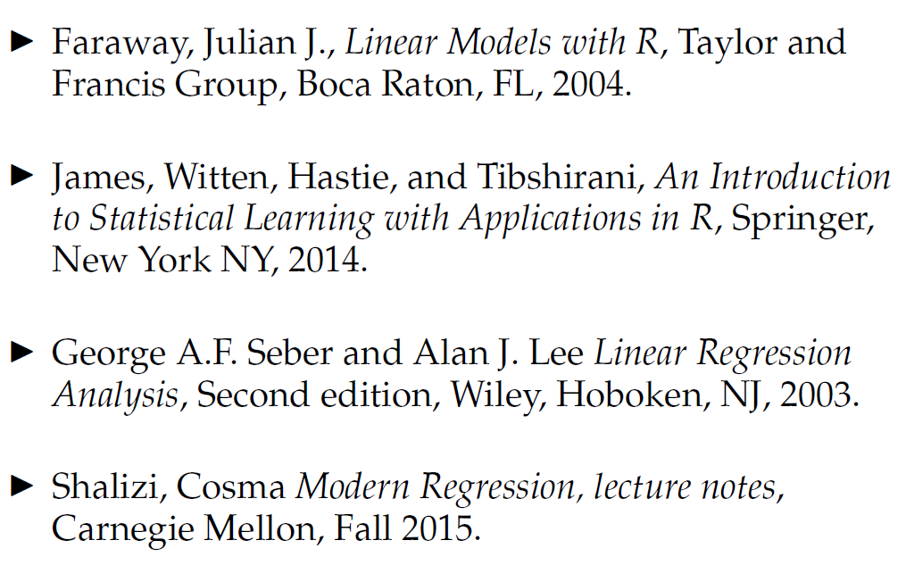
References

