Slide 1
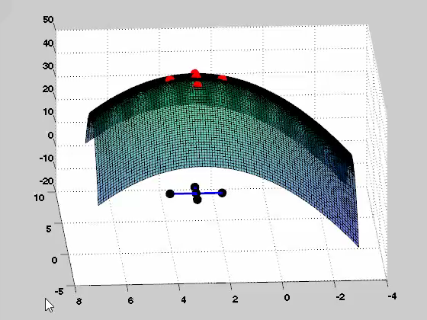
Notes:
To model uncertainty and nonlinearity, we are going to represent the structure by FE.
these are the points I'm going to use in FE algorithm
Its going to give me response at Red Dots
in other words,
we are doing some sampling points using FORM and the distribution of the random variables, and get the nonlinear response from the FE algorithm
then fit a polynomial through that dots.
Choosing the sample points is very important

