Slide 1
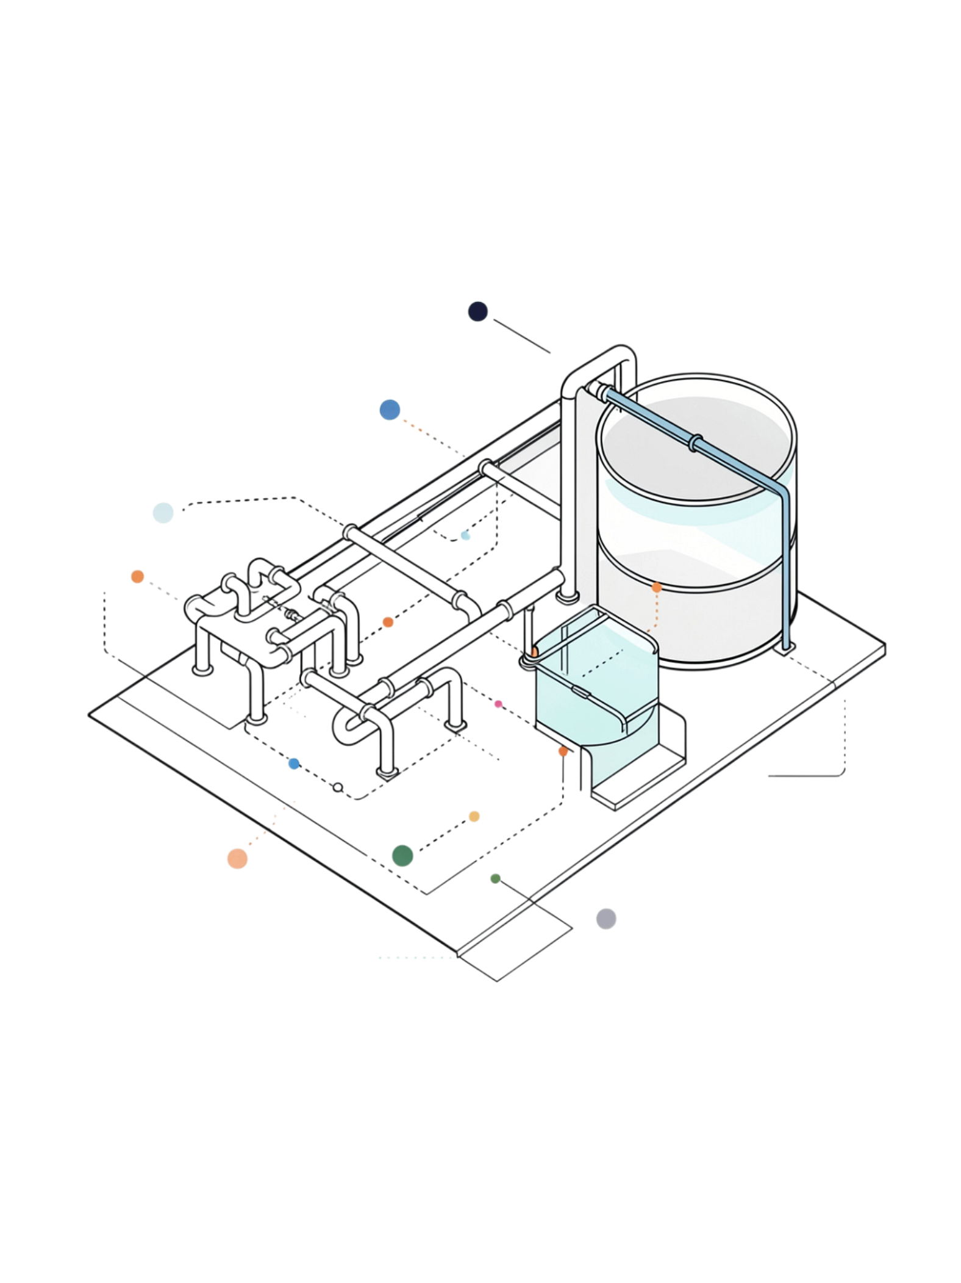
Mpumalanga Water Crisis: Decentralised AMD Solution

Slide 2
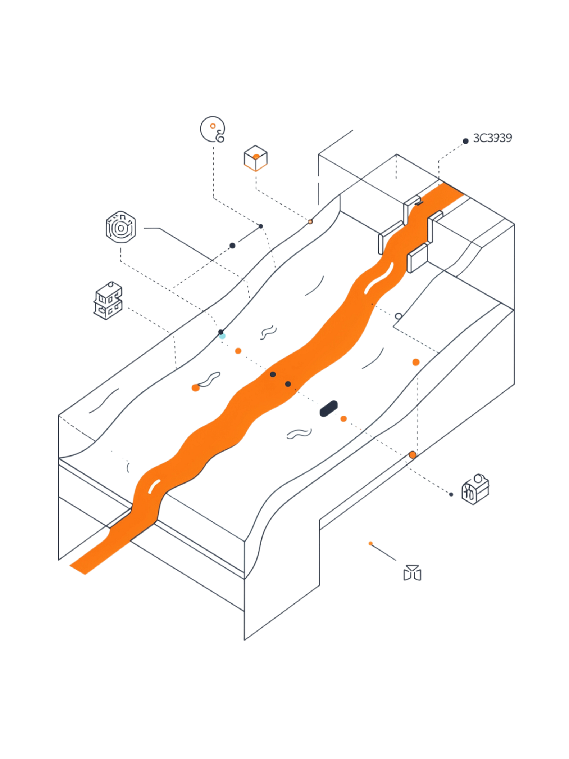

The Challenge: Acid Mine Drainage Threatens Water Security
Toxic Runoff at Scale
Coal mining runoff contaminates Mpumalanga's water infrastructure with heavy metals and sulfuric acid, threatening communities and ecosystems.
Centralised Systems Are Failing
Existing treatment infrastructure is slow, expensive, and unable to prevent localised contamination events before they spread.
The Gap
Real-time toxicity detection combined with automated response at the source — this capability does not yet exist at meaningful scale in the region.

Slide 3
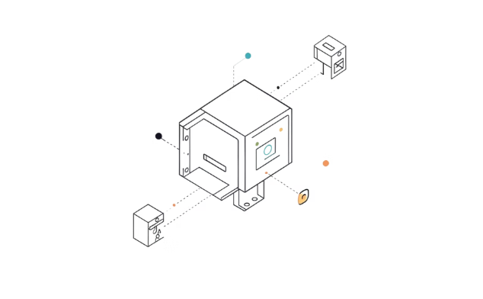
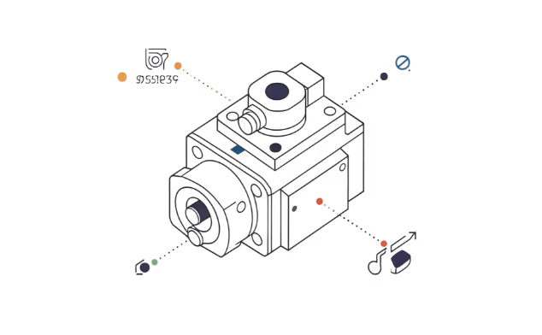
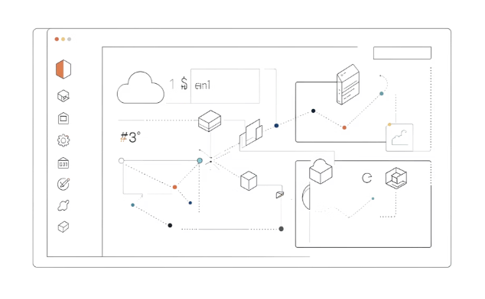
AquaSentinel: Autonomous Water Monitoring & Control
Real-Time Sensing
Autonomous Valve Control
Cloud Compliance Dashboard
Field nodes continuously measure soil moisture, water presence, and contamination levels — every second, without interruption.
On-device logic acts instantly — closing valves the moment contamination exceeds safe thresholds, opening only when water is safe and soil is dry.
Every reading is logged, timestamped, and available for live monitoring and fully auditable compliance reporting.

Slide 4
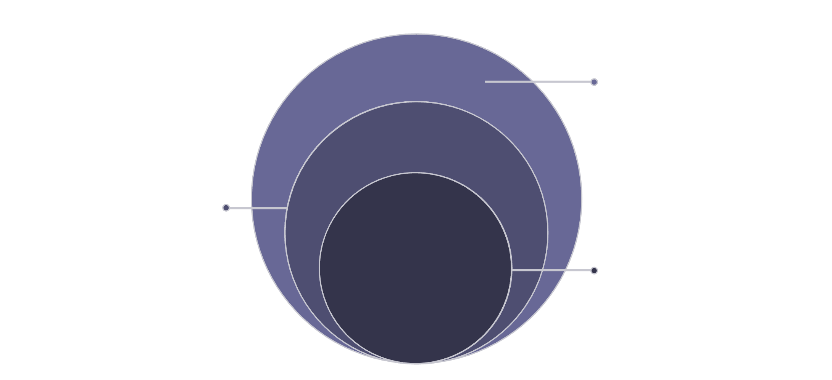
System Architecture: Field Node to Cloud
Hardware
Microcontroller paired with a servo-driven valve, housed in a weatherproof 3D-printed enclosure with a dedicated waterproof probe pod — robust, low-cost, and field-ready.
Hardware Layer
Microcontroller, servo valve, weatherproof enclosure, probe
Safety-First Logic
Safety-First Logic
Contamination threshold triggers immediate valve closure. Secondary checks evaluate water presence and soil moisture before any open command is issued.
Contamination threshold closes valve; moisture checks
Cloud Backend
Firestore, Cloud Functions, auth, compliance dashboard
Cloud Backend
Firestore and Cloud Functions handle ingestion, storage, and authentication — integrating cleanly with the existing compliance dashboard.

Slide 5



Why This Works: Efficiency, Auditability, Scalability
Efficiency
Auditability
Scalability
Autonomous decisions every second reduce wasted water. Unsafe conditions are caught and contained immediately — no manual site visits required.
Every reading is timestamped and logged. Operators receive a complete, verifiable record — ready for regulatory compliance at any time.
Inexpensive sensors and a 3D-printable enclosure keep per-node costs low. The same design scales from a single prototype to many distributed field sites.

Slide 6
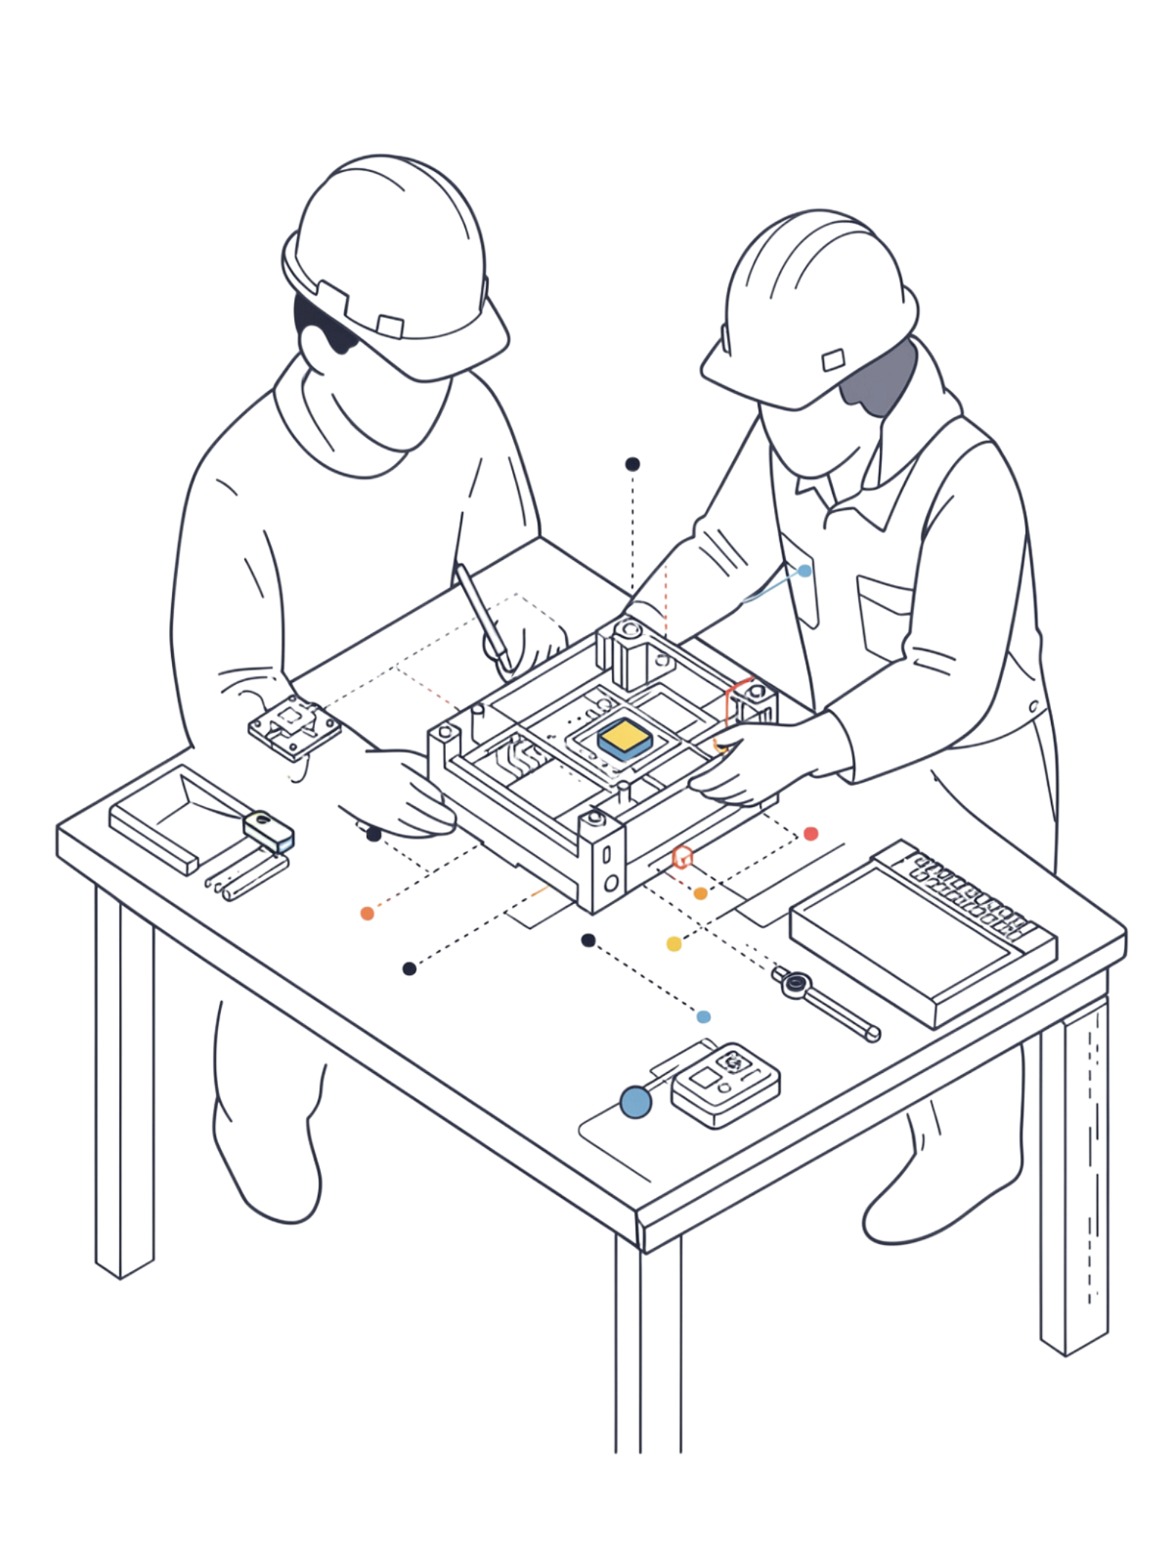
Current Status & Next Steps
What's Delivered
In Progress
Working prototype with autonomous valve control logic
Cloud ingestion pipeline live (Firestore + Cloud Functions)
Compliance dashboard integration complete
End-to-end live field operation testing
Hardware board selection finalised
Dashboard UI refinement
Path Forward
Full field verification followed by production-ready deployment across Mpumalanga's most affected water corridors. Your support makes this possible.

