Slide 1
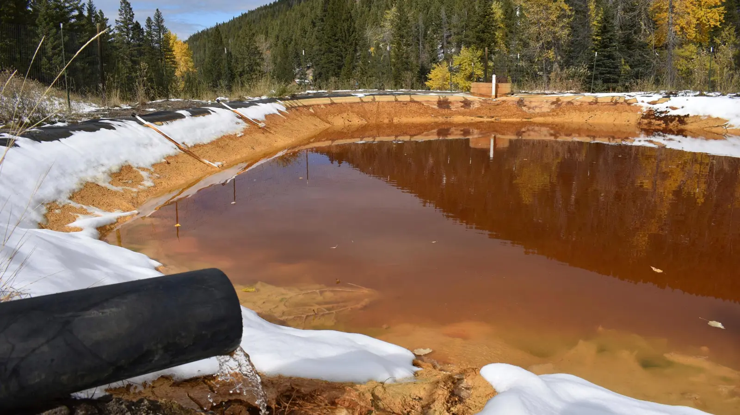
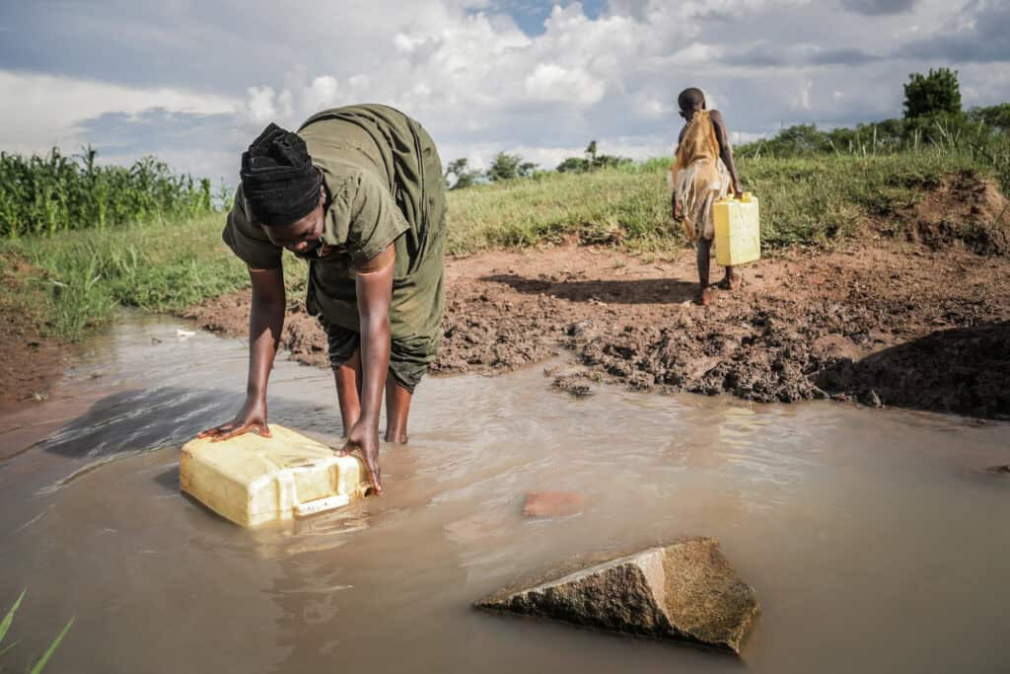
AQUASENTINEL
Monitor. Detect. Comply. Protect.
Stopping mine toxic water before it reaches our rivers.
MICT HACKATHON 2026 · TEAM AQUASENTINEL

Slide 2
THE PROBLEM
Mine Toxic Runoff Is A Massive Problem
Acid and dirty water leak out of mine sites and into our rivers and drinking water — and in South Africa, it happens all the time.
⛏️
Toxic Runoff
🚱
Poisons The Water
Acid and heavy metals leak straight out of mine sites into nearby rivers and streams.
Communities and farms downstream lose access to clean, safe drinking water.
⏱️
Found Too Late
👁️
No One Is Watching
Most leaks are only discovered days later — after the damage is already done.
A mine site can't be checked by a person, every hour, every single day.
AQUASENTINEL
2

Slide 3
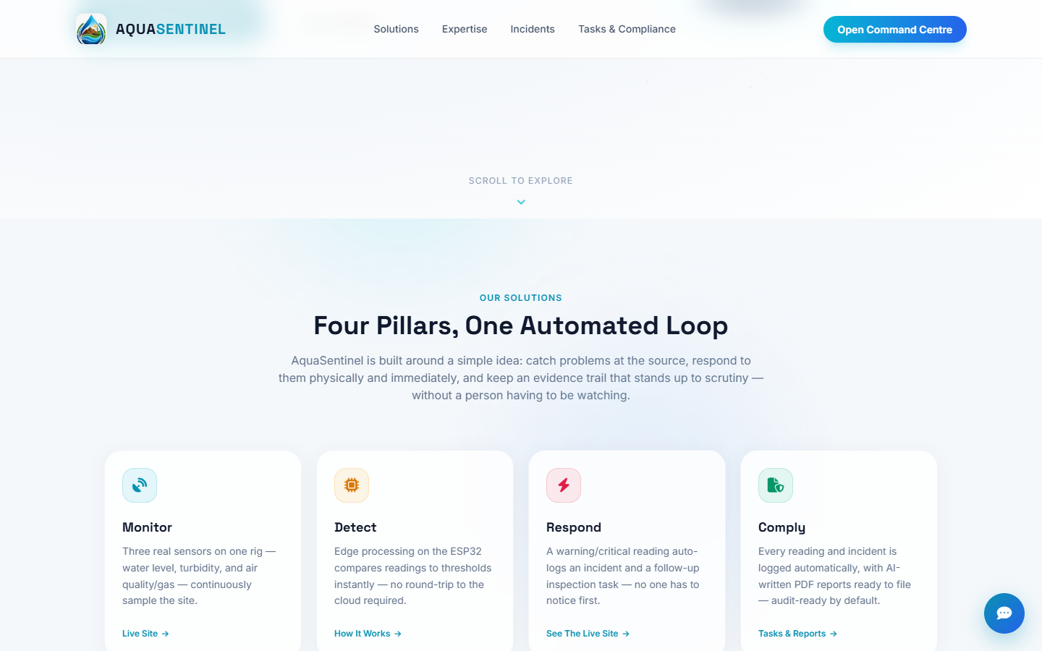
OUR SOLUTION
Meet AquaSentinel
One small rig. Three real sensors. Watching the water non-stop.
💧
Water Level
Is the water rising, or running dry?
🌫️
Turbidity
How dirty or cloudy is the water, right now?
💨
Air Quality & Gas
Is it safe to breathe near the site?
No person has to be there. AquaSentinel watches, decides, and acts on its own.
AQUASENTINEL
3

Slide 4
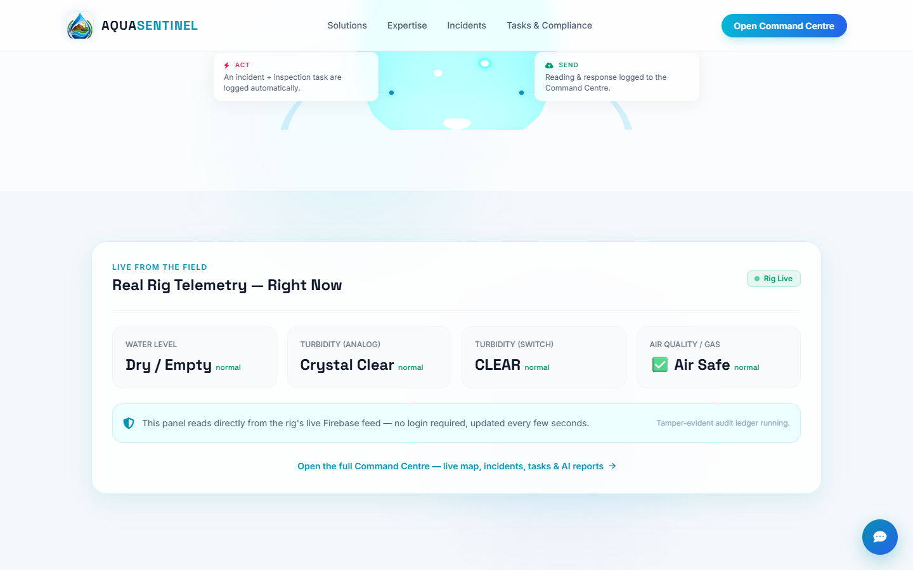
LIVE DEMO
Real Data, Right Now
This is not a mockup — these readings are coming straight from our real sensor rig, live, as we speak.
AQUASENTINEL
4

Slide 5
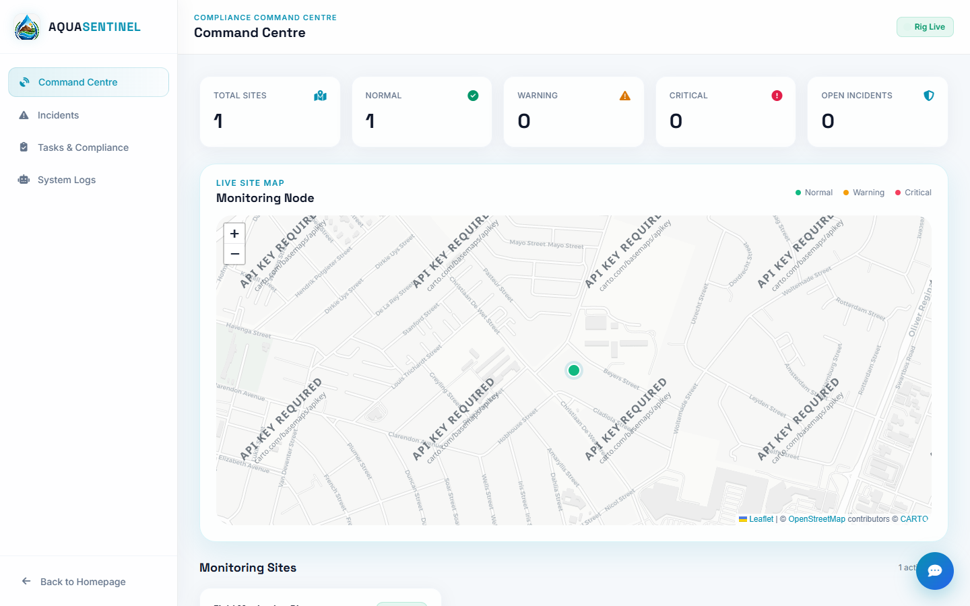
THE SOFTWARE
PRESENTED BY UNATHI
The Command Centre
One live dashboard
Every site, every sensor, one clear screen.
A map that shows where
Green, orange, or red — see the exact site in trouble.
Updates instantly
Normal → Warning → Critical, the moment it changes.
AQUASENTINEL
5

Slide 6
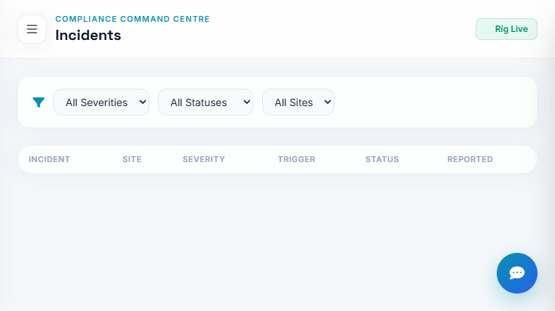
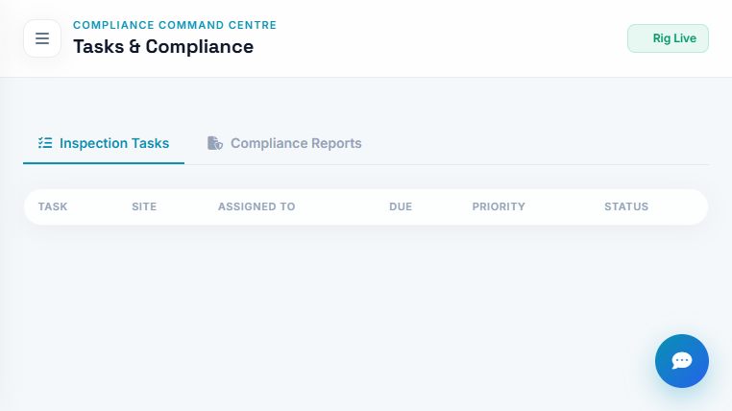
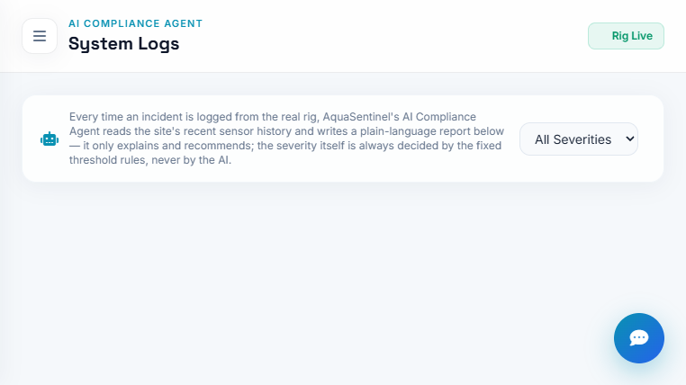
COMPLIANCE, AUTOMATED
It Handles The Paperwork Too
Every incident is caught, logged, and turned into a task — automatically. No one has to notice first.
Incidents Log
Inspection Tasks
AI Compliance Reports
Every anomaly, with proof and a timestamp.
Someone is assigned to check it, automatically.
An audit-ready report, written for you.
AQUASENTINEL
6

Slide 7
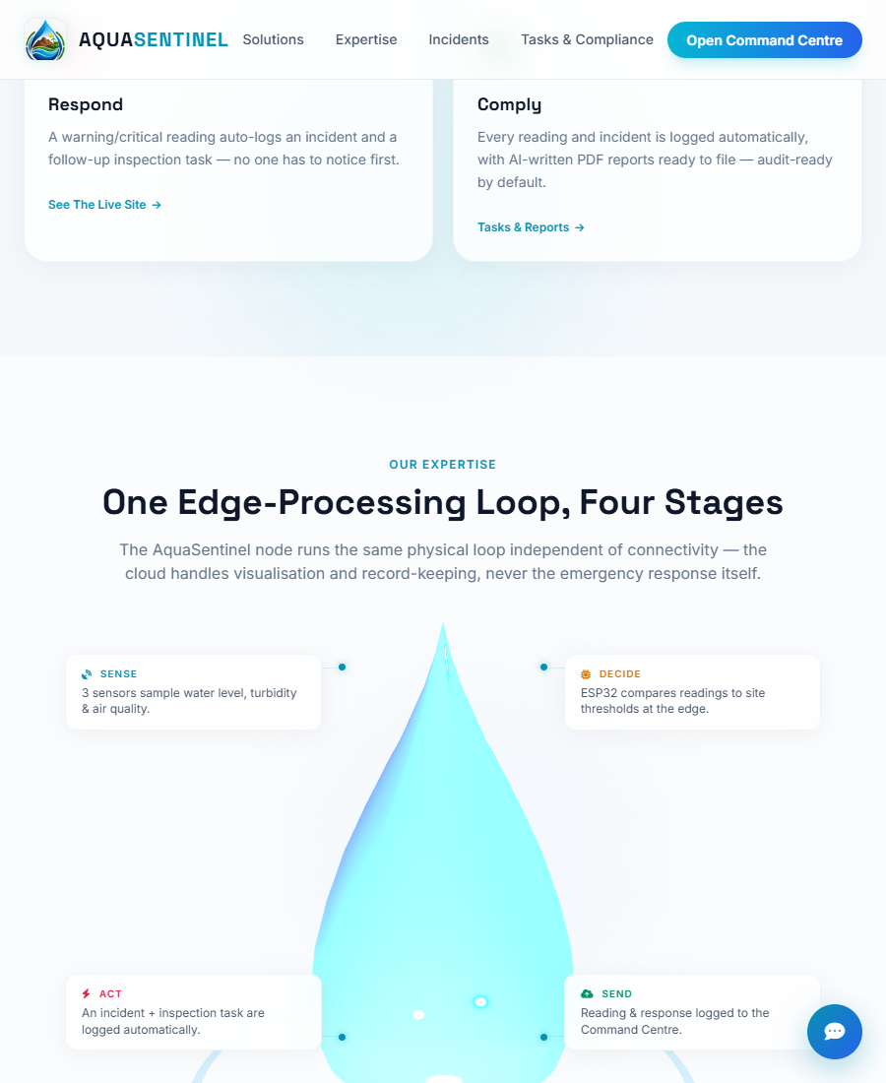
HOW IT WORKS
PRESENTED BY KELANI
One Loop, Four Steps
1. SENSE
Three sensors read the water and air, all the time.
2. DECIDE
The device on-site checks readings against safe limits, instantly.
3. ACT
If something's wrong, it logs it and creates a task right away — no internet needed for this step.
4. SEND
The reading and the response are sent to the cloud, so everyone can see it.
The physical safety response never waits on an internet connection.
AQUASENTINEL
7

Slide 8
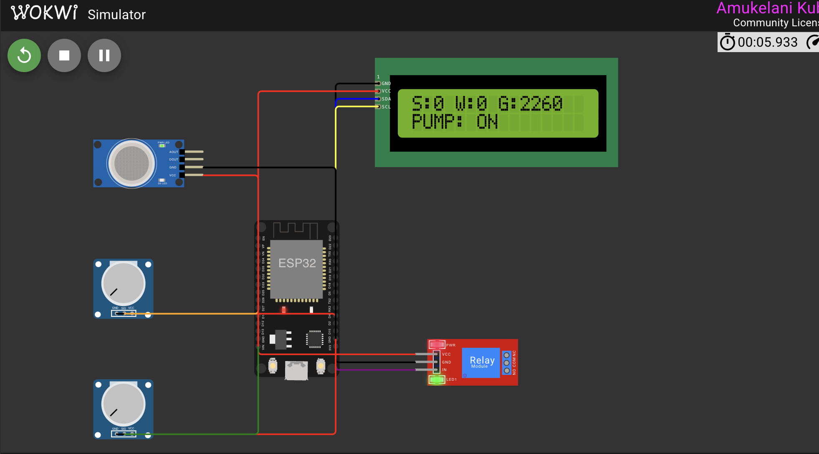
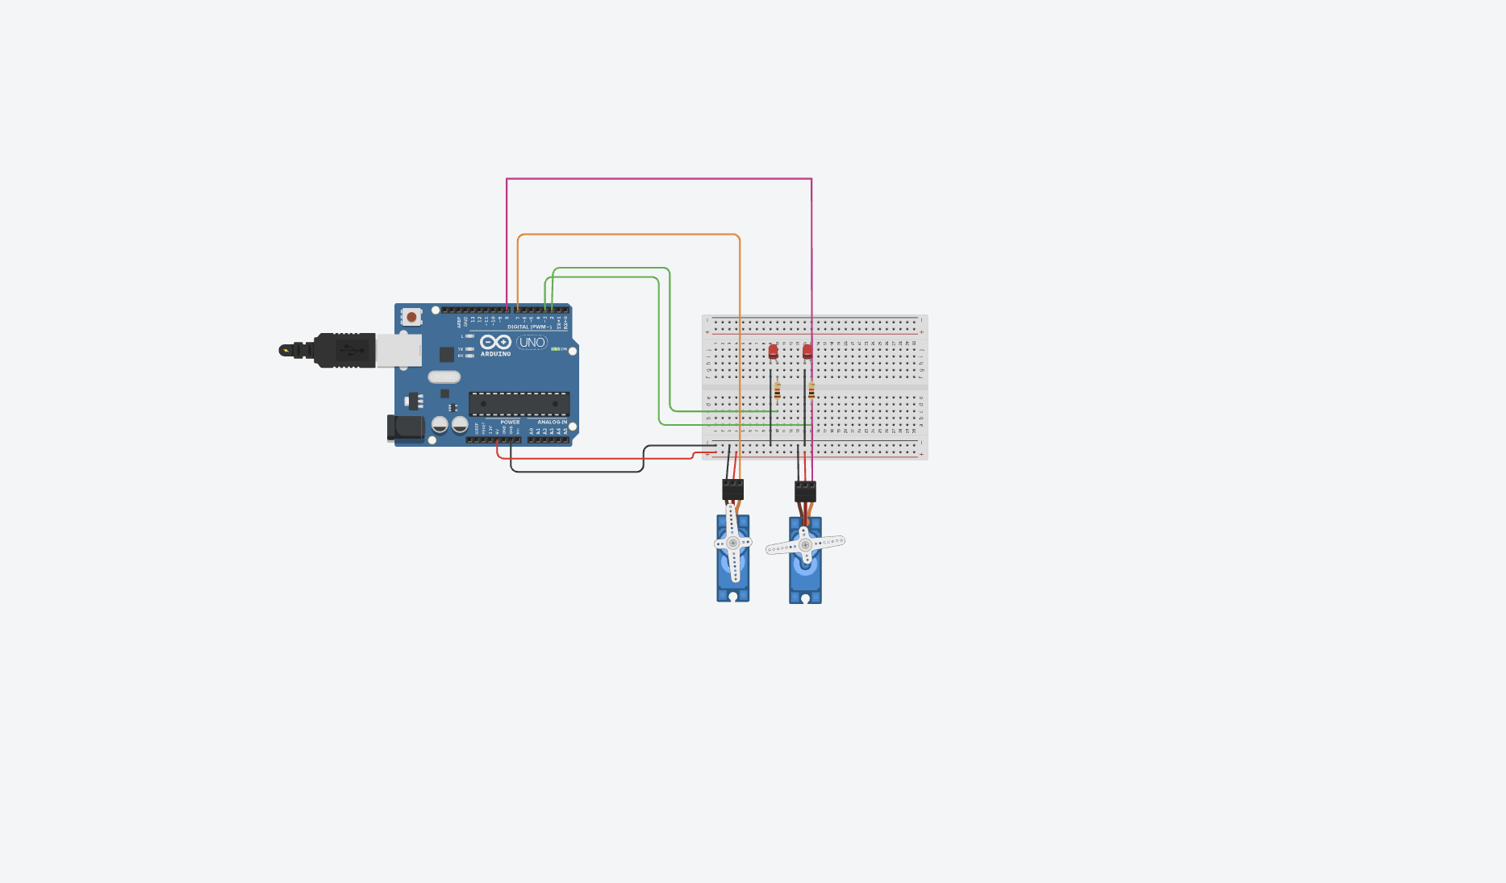

Slide 9
SOUTH AFRICA'S FIRST
We Are The First Of Our Kind
By using these three sensors together, on one rig, this way — AquaSentinel is the first system of its kind in South Africa.
And mine toxic runoff is one of the biggest environmental problems facing our country today.
AQUASENTINEL
8

Slide 10
WHAT'S NEXT
PRESENTED BY KARABO
Closing The Loop
Right now, AquaSentinel detects and alerts. Here's where we take it next.
TODAY
NEXT — WITH FUNDING
Detect & Alert
Automatic Water Treatment
→
AquaSentinel finds the problem the moment it happens and tells you immediately — with proof, logged automatically.
A pump system that treats the water on-site — using acids and other treatment to neutralise it — the moment a problem is found.
Turning an alarm into an actual fix — no person needed.
AQUASENTINEL
9

Slide 11
Thank You
AQUASENTINEL
Monitor. Detect. Comply. Protect.
TEAM AQUASENTINEL · MICT HACKATHON 2026

