Slide 1
0
Facing Lynch Station
Harris Hall
37
Correct Error
127˚
At Batty Hall
Correct Answer
-90
90
Participant Angle
180

Slide 2
0
Facing Lynch Station
Harris Hall
37
At Batty Hall
Correct Answer
-90
90
Participant Angle
Buggy Participant Angle
Bug effect #1
180

Slide 3
0
Facing Building 2
Point to Building 3
37
Actual Error
127˚
Reference Direction
Response Direction
Correct Direction
At Building 1
Buggy Error = 53˚
-90
90
Response
direction
Buggy response direction
Effect of bug
180

Slide 4

Reference direction
0˚
Reference direction
Gem of Building 2
37˚
Correct direction
Gem of Building 1
(Pointing Location)
Buggy error
53˚
Actual error
127˚
Response
direction
-90˚
90˚
Buggy response direction
180˚
Effect of bug
±180˚

Slide 5
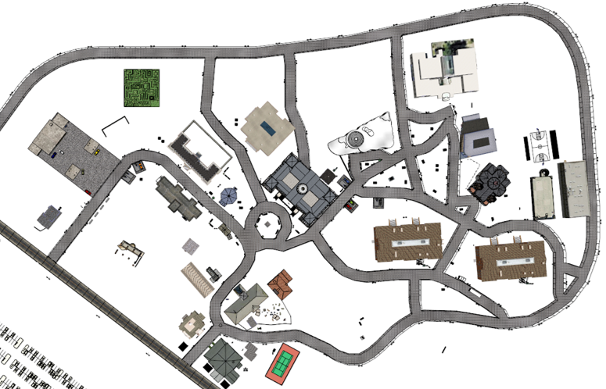
Target building (Main Route 1)
Target building (Main Route 2)
Reference direction

