Slide 1
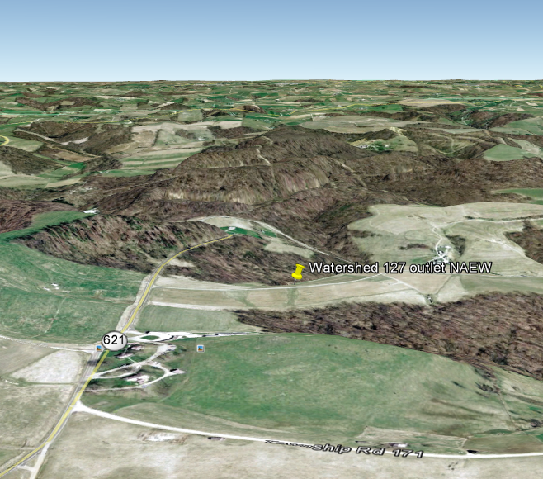

Slide 2
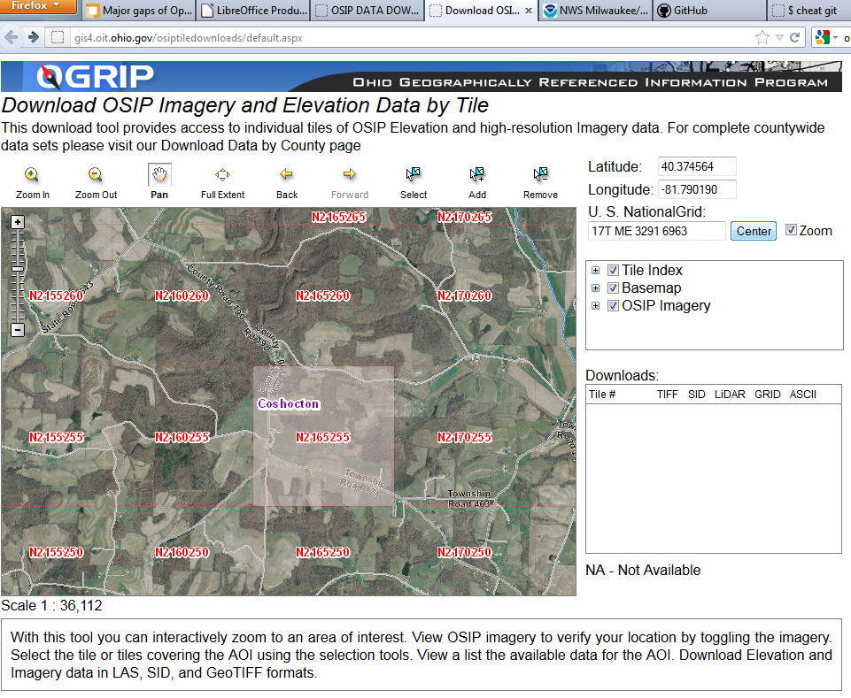
Obtain elevation from Ohio

Slide 3
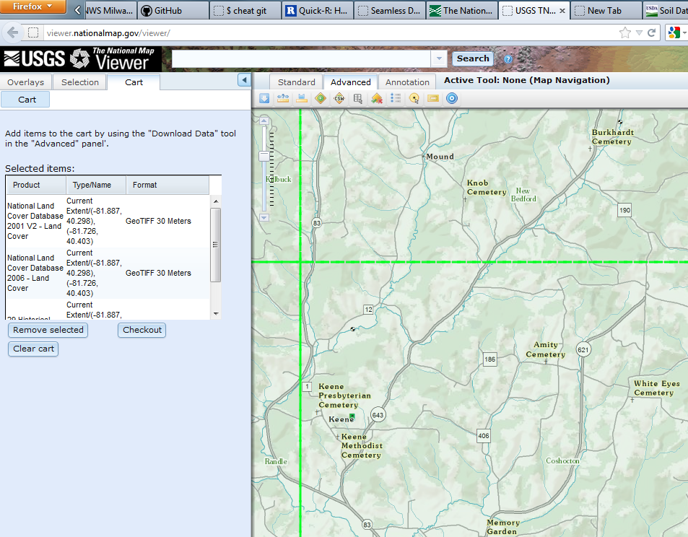
Obtain landuse from the National Map

Slide 4
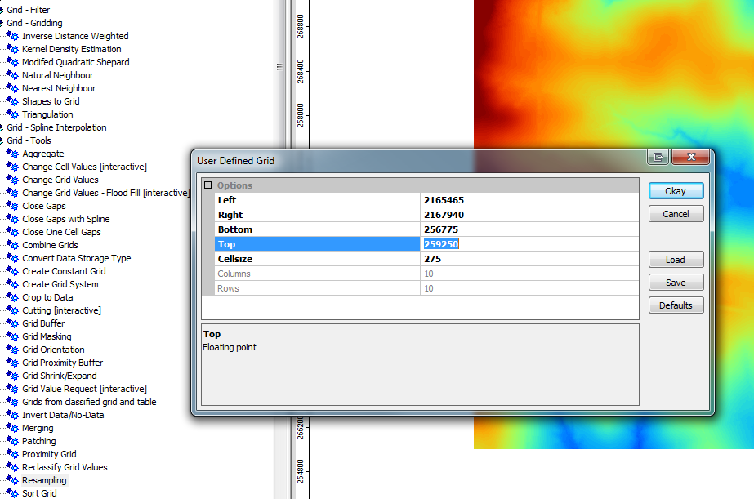
Resample with SAGA GIS

Slide 5
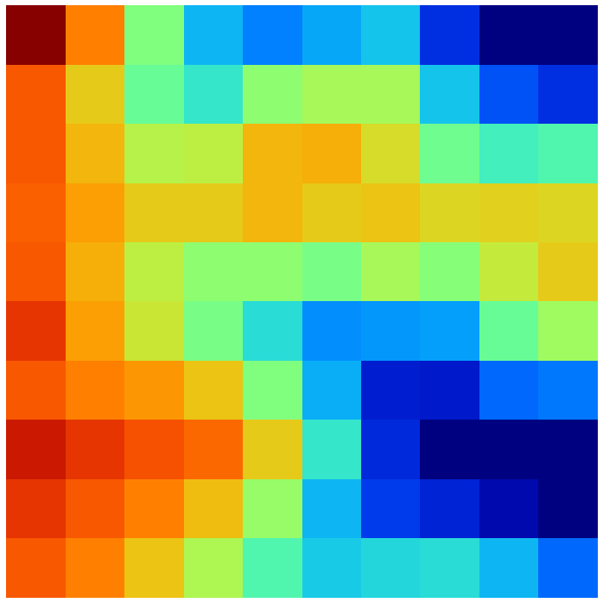
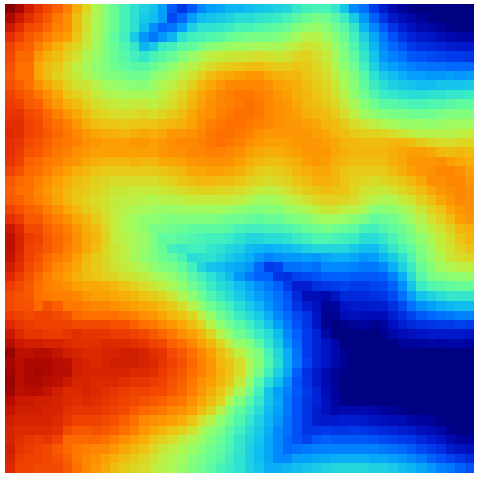
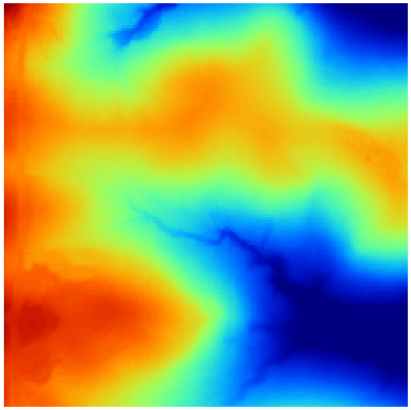
275 ft (10 by 10)
50 ft (49 by 49)
15 ft (164 by 164)

Slide 6
Data Type | Projection | Datum | Provider
Elevation | State Plane, Ohio North (feet) | NAD 1983 | Ohio Statewide Imagery Program
Soils | UTM Zone 17N (meters) | NAD 1983 | USDA Soil Data Mart

Slide 7
SWB Grid Type | Derived from | Tools used
Available Water Content (AWC)
Soil Hydrologic Group

Slide 8
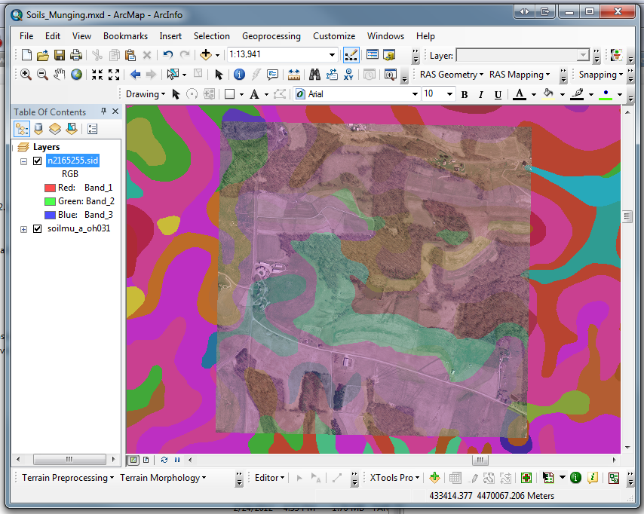
Departure from Open Source... ArcMap

Slide 9
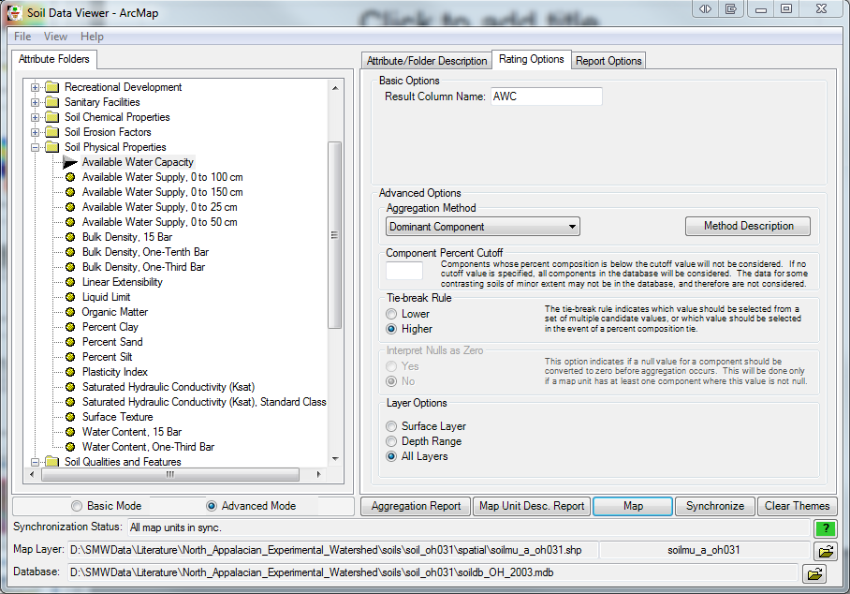

Slide 10
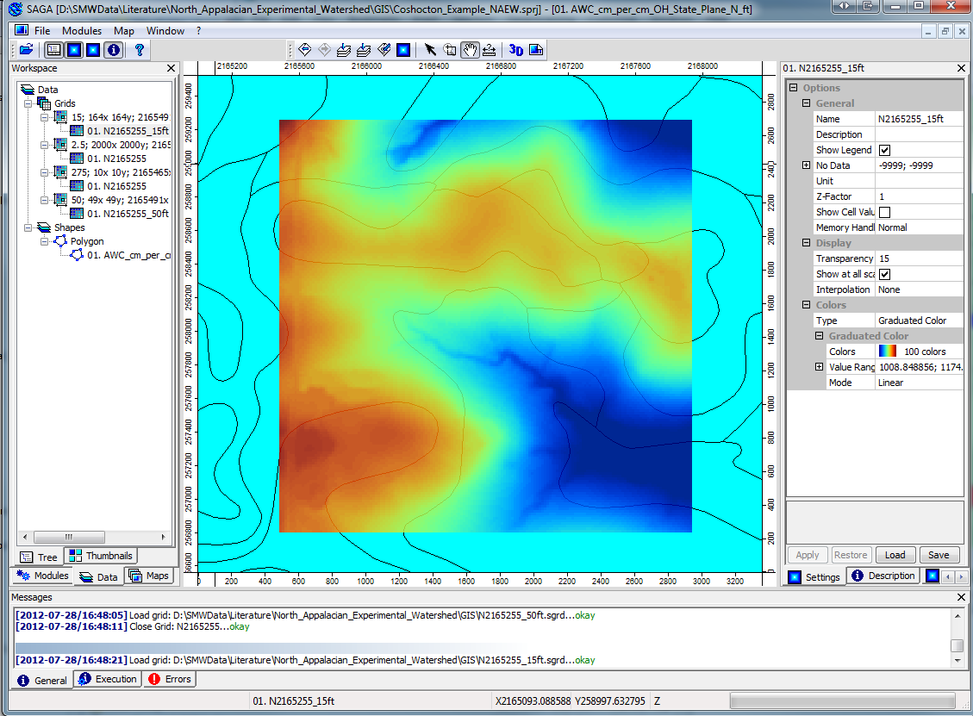

Slide 11
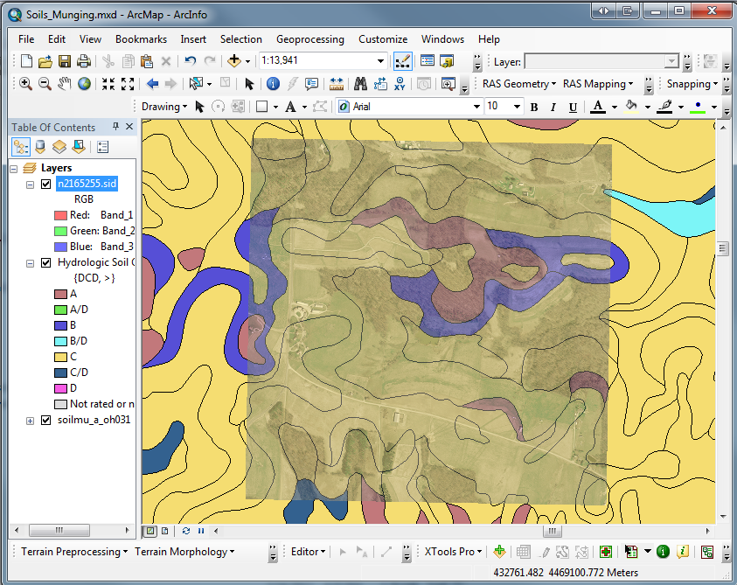

Slide 12
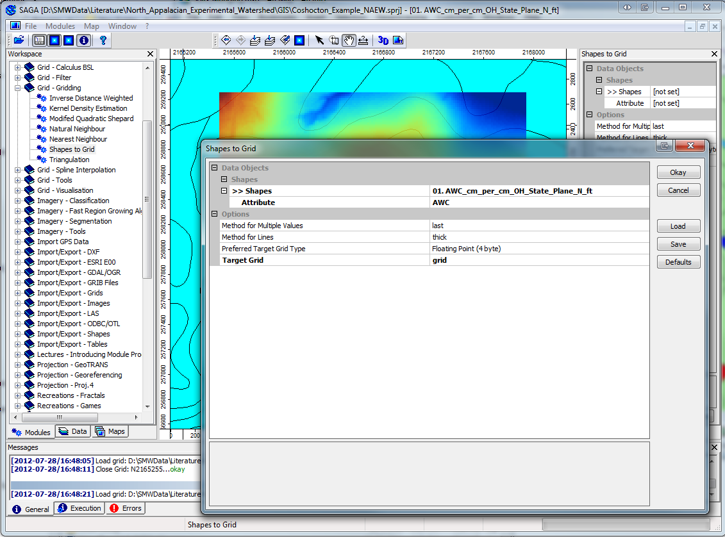

Slide 13
