Slide 1
HMS 520 Final Project
Global Mortality and Risk Factor Contributions for Tuberculosis Estimates (2015 – 2020)
Sophie Whikehart & Ye Htet Naing
December 2024

Slide 2
Overview
Analyze global TB mortality trends [2015 – 2020]
Examine risk factor contributions [smoking, alcohol, diabetes]
Explore disparities across regions and age groups
Inform efforts toward WHO’s End TB Strategy
Notes:
Ye

Slide 3
Research Questions
1. How have mortality rates changed from 2015 to 2020 across different age groups and regions?
2. What is the relative contribution of different risk factors (e.g., smoking, alcohol use, and diabetes) to TB mortality in 2015 and 2020?
3. Do regions or age groups with higher reductions in TB mortality also show lower contributions of risk factors?
Notes:
Ye

Slide 4
Dataset
Source: Global Burden of Disease (GBD) 2021
https://ghdx.healthdata.org/record/ihme-data/gbd-2021-tuberculosis-incidence-mortality-1990-2021
Includes global TB mortality and risk factor estimates for 2015, 2020 and 2021
Variables
Mortality counts, risk factors, regions and age groups
Notes:
Sophie

Slide 5
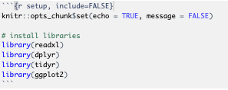
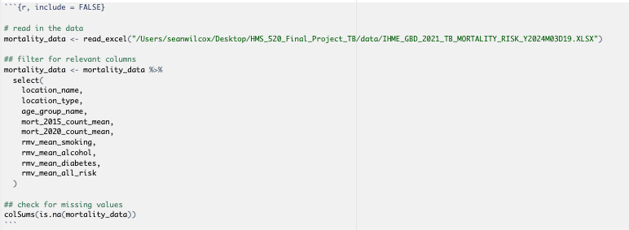
Notes:
Sophie

Slide 6
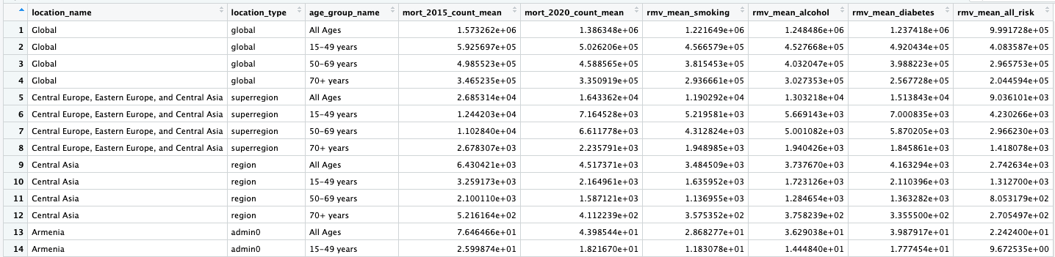
Example of our data set after filtering for relevant columns to use for data analysis
Notes:
Sophie

Slide 7
Methods
Trend analysis
Percent change in mortality [2015 – 2020]
Stratified by region and age group
Risk factor analysis
Smoking, alcohol and diabetes contribution
Regression analysis
Association between mortality reduction and risk factor contributions
Notes:
Sophie

Slide 8
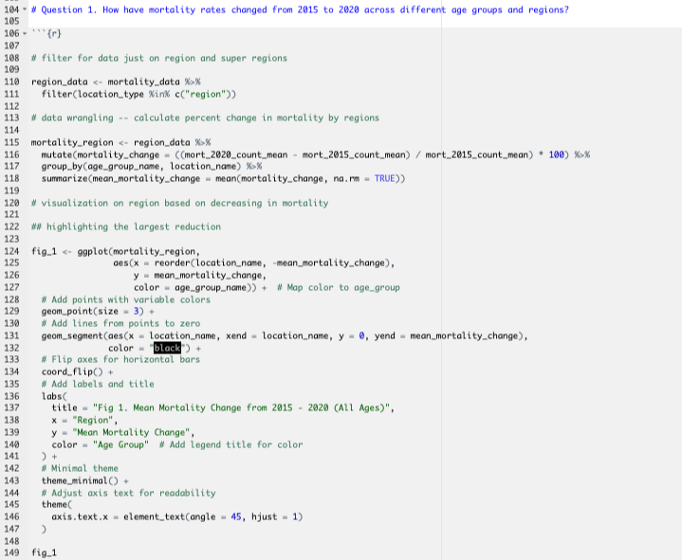

Slide 9
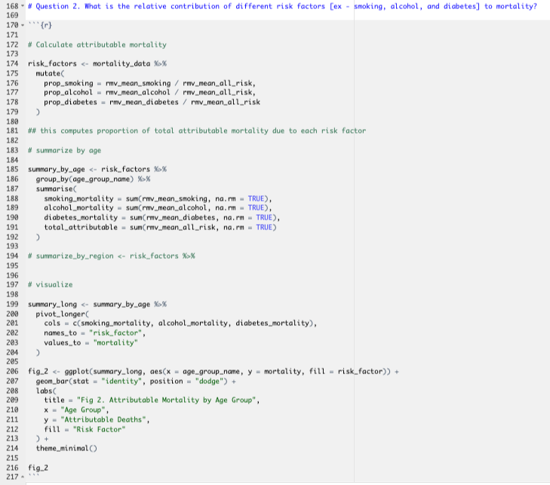

Slide 10
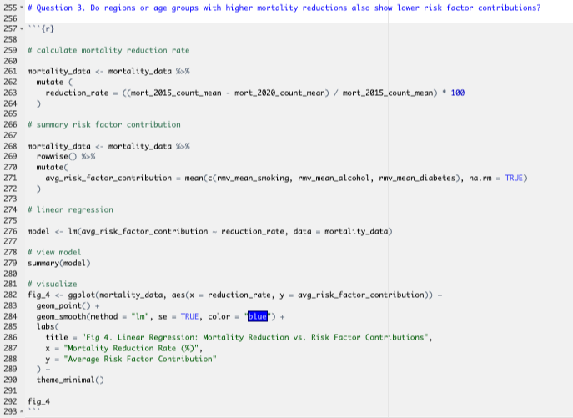

Slide 11
Key Findings
Significant disparities in TB mortality reductions across regions and age groups
Smoking, alcohol and diabetes contribute variable to TB deaths
Regions with higher reductions in mortality have no significant correlation to risk factor contributions
Notes:
Ye

Slide 12
Results

Slide 13

Figure 1
Notes:
YE

Slide 14
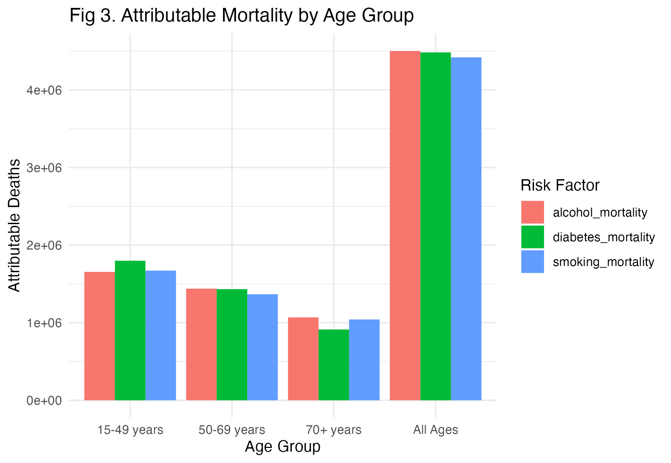
Figure 2
Notes:
Ye

Slide 15
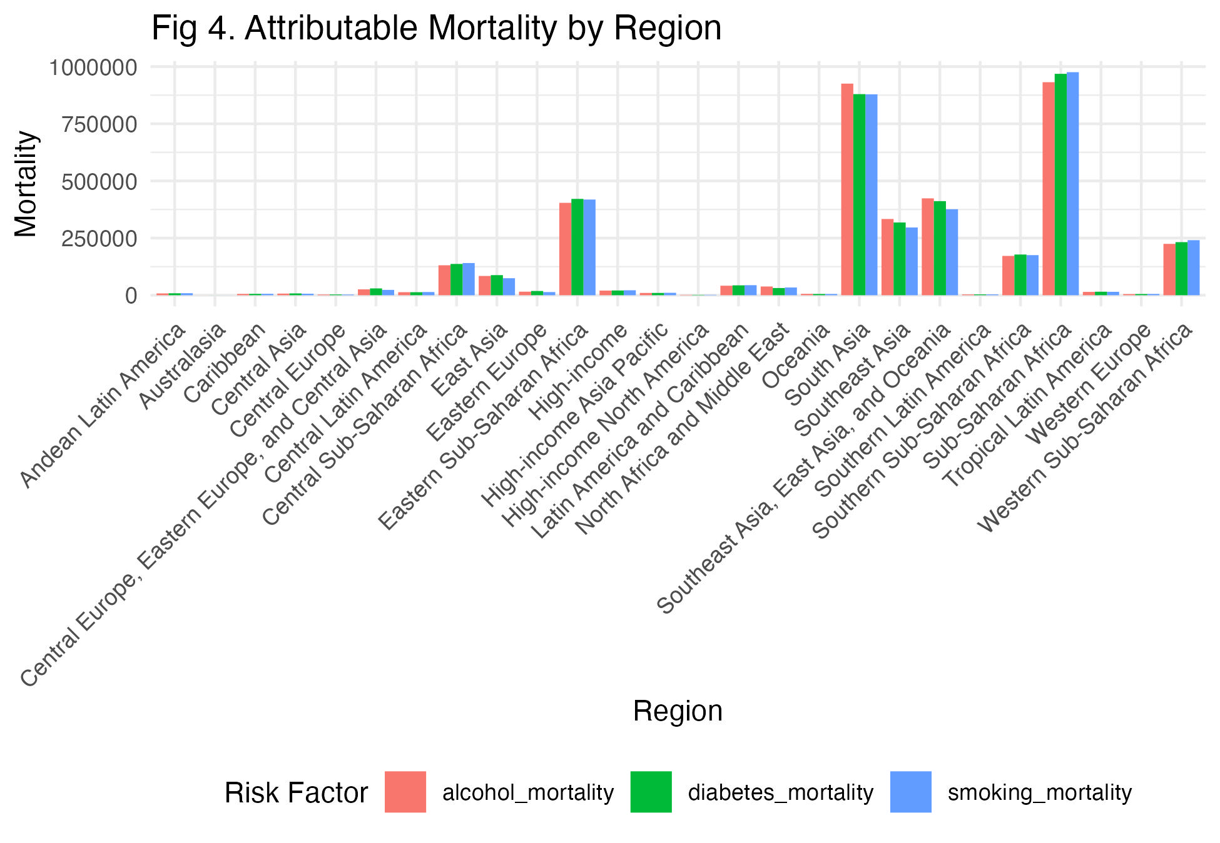
Figure 3

Slide 16
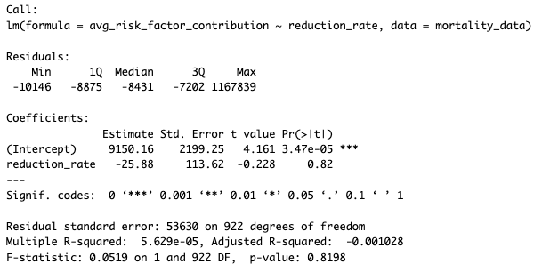
Regression Model

Slide 17
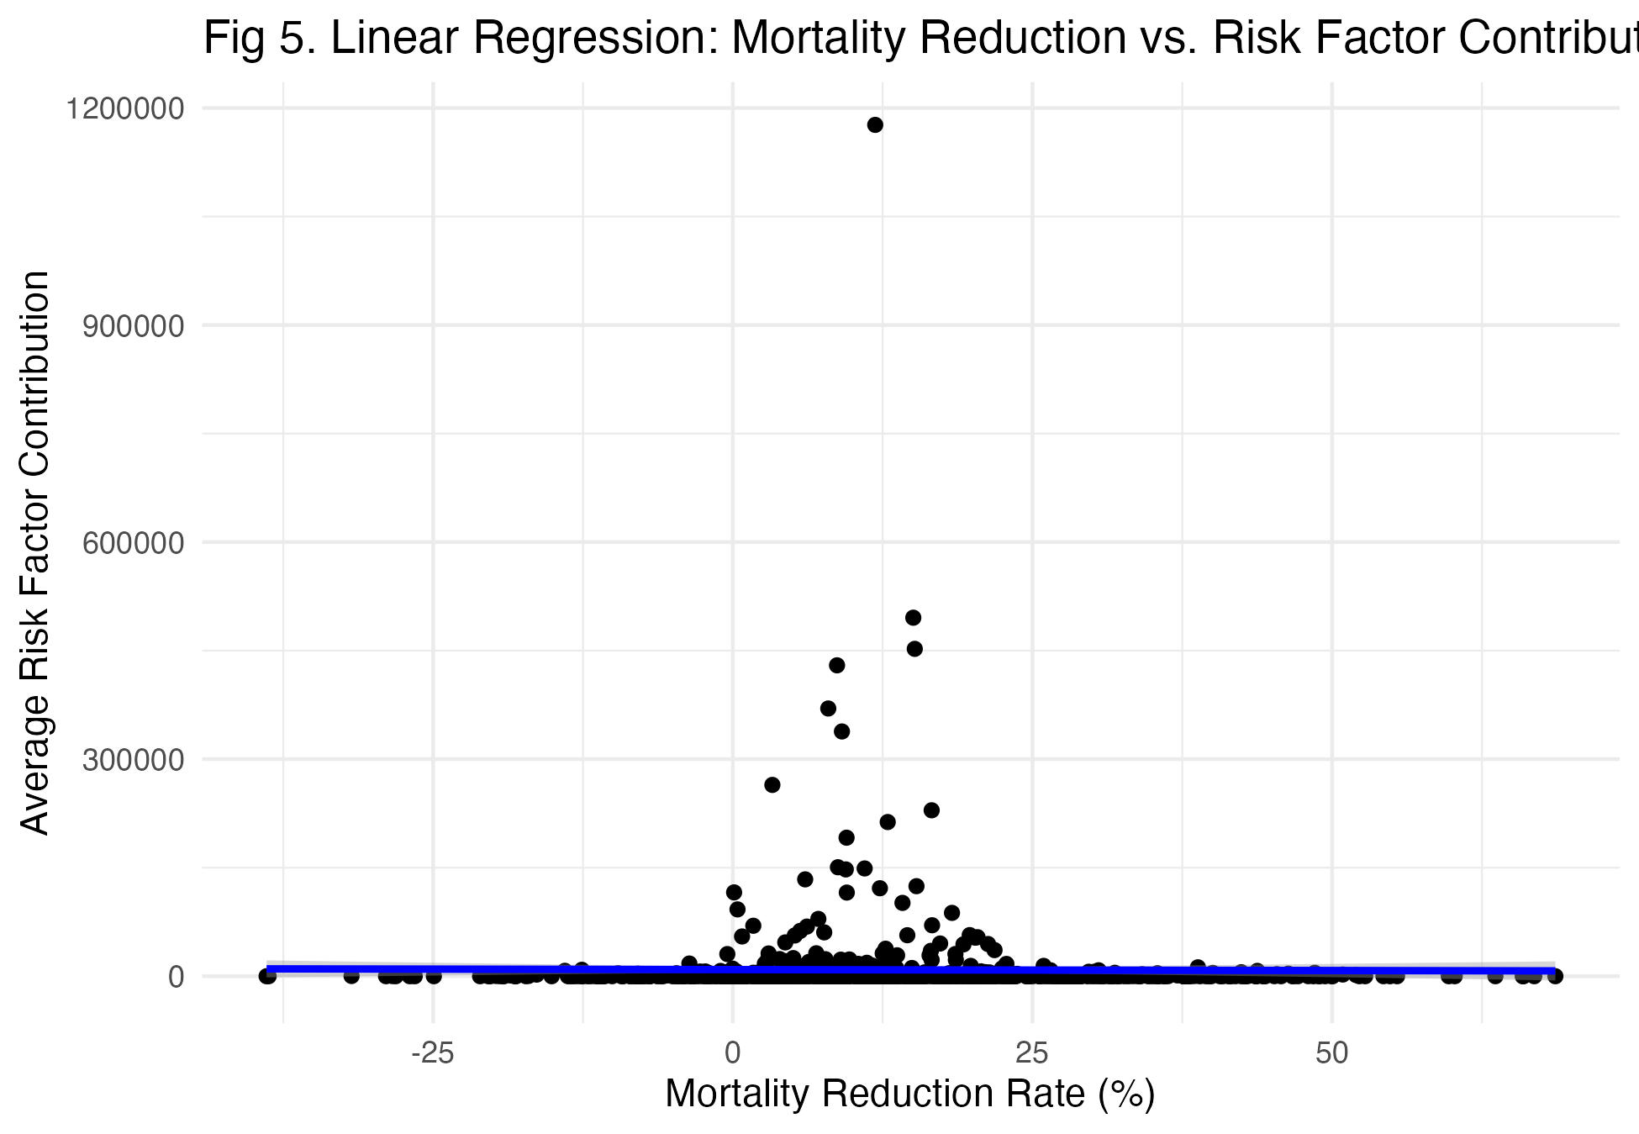
Figure 4

Slide 18
Conclusion
Progress is uneven, targeted interventions are needed
Risk factor mitigation is important to reducing TB mortality
Results support evidence-based policies aligned with WHO goals
Notes:
Sophie

