Slide 1
HMS 520 Final Project
Global Mortality and Risk Factor Contributions for Tuberculosis Estimates (2015 – 2020)
Sophie Whikehart & Ye Htet Naing
December 2024
Notes:
Sophie

Slide 2
Overview
Analyze global tuberculosis (TB) mortality trends [2015 – 2020] from the IHME GBD dataset
Examine risk factor contributions [smoking, alcohol, diabetes]
Explore disparities across regions and age groups
Inform efforts toward WHO’s End TB Strategy
Notes:
Sohpie

Slide 3
Introduction
Tuberculosis is an ancient infectious disease with evidence of bone in TB in Egyptian mummies (2400 BC)
TB is an airborne infection that is spread from someone with active TB
1/10 people on average who are infected will go on to develop active TB
TB continues to be one of the leading causes of infectious disease mortality globally, posing significant challenges to public health systems
In this study, we leverage the GBD TB Estimates to examine TTB mortality trends
Notes:
Ye

Slide 4
Research Questions
1. How have mortality rates changed from 2015 to 2020 across different age groups and regions?
2. What is the relative contribution of different risk factors (e.g., smoking, alcohol use, and diabetes) to TB mortality in 2015 and 2020?
3. Do regions or age groups with higher reductions in TB mortality also show lower contributions of risk factors?
Notes:
Ye

Slide 5
Dataset
Source: Global Burden of Disease (GBD) 2021
https://ghdx.healthdata.org/record/ihme-data/gbd-2021-tuberculosis-incidence-mortality-1990-2021
Includes global TB mortality and risk factor estimates for 2015, 2020 and 2021
Variables
Mortality counts, risk factors, regions and age groups
Notes:
Sophie
TB mortality was informed by vital registration, verbal autopsy, sample based vital registration and mortality surveillance data
TB mortality data also included annual case notifications, data from prevalence surveys and estimated cause specific mortality [CSMR] of TB among HIV positive and HIV negative individuals

Slide 6
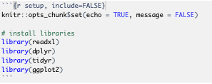
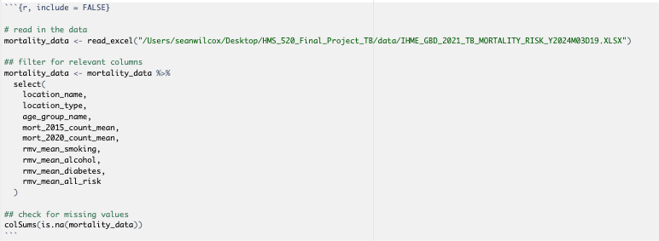
Data Cleaning and Pre-processing
Notes:
Sophie

Slide 7
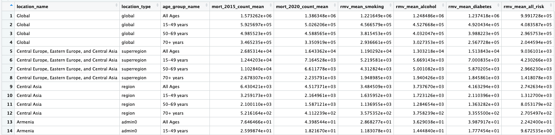
Example of our data set after filtering for relevant columns to use for data analysis
Notes:
Sophie

Slide 8
Methods
Trend analysis
Percent change in mortality [2015 – 2020]
Stratified by region and age group
Risk factor analysis
Smoking, alcohol and diabetes contribution
Regression analysis
Association between mortality reduction and risk factor contributions
Notes:
Sophie

Slide 9

Notes:
S

Slide 10
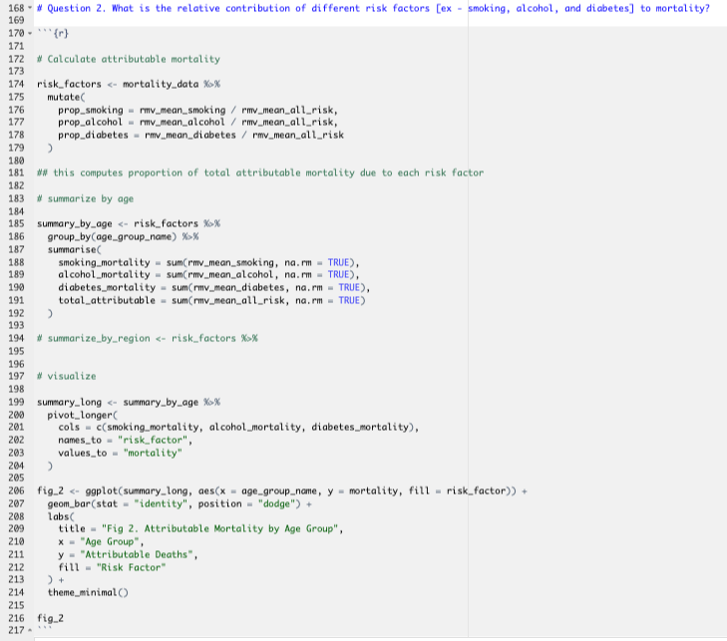
Notes:
S

Slide 11
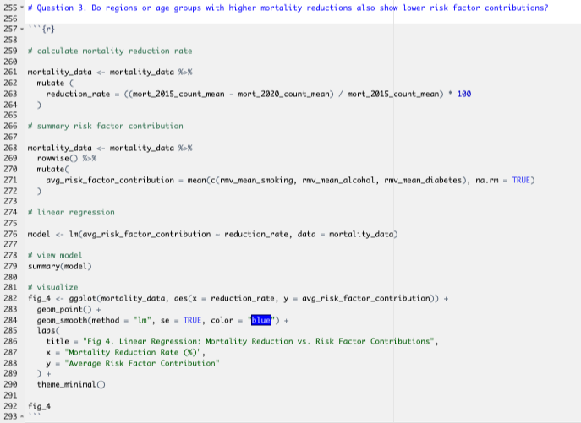
Notes:
S

Slide 12
Key Findings
Significant disparities in TB mortality reductions across regions and age groups
Smoking, alcohol and diabetes contribute variable to TB deaths
Regions with higher reductions in mortality have no significant correlation to risk factor contributions
Notes:
Ye

Slide 13
Results

Slide 14
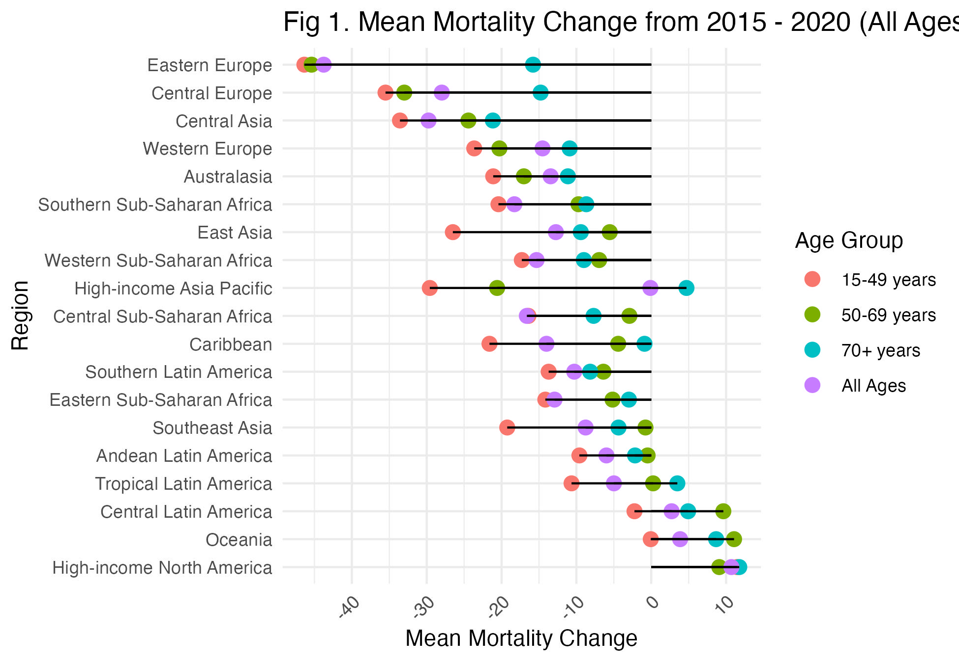
Figure 1
Notes:
YE
Our results show there are differences in reductions and increases in TB mortality by region and age group
This figure shows visualization of region based on decreases in mortality by age group
Eastern Europe, central Europe and central asia have seen the biggest reduction in mortality from 2015 – 2020
These are likely areas where health interventions, improvements in healthcase and other factors have led to a reduction in deaths due to TB
On the other hand, regions such as high income north America, oceania and central latin America have shown highest increases in mortality which is a bit surprising
This could be due to weaknesses in the data such as some countries having a weak survelliance system with under diagnosis / under-reporting as well as lack of bacteriological confirmation either over-diagnosis or over-reporting
However, the data is consistent where it shows that older age groups also report higher mean mortality change from 2015 – 2020 and therefore regional and age group interventions are important to consider

Slide 15
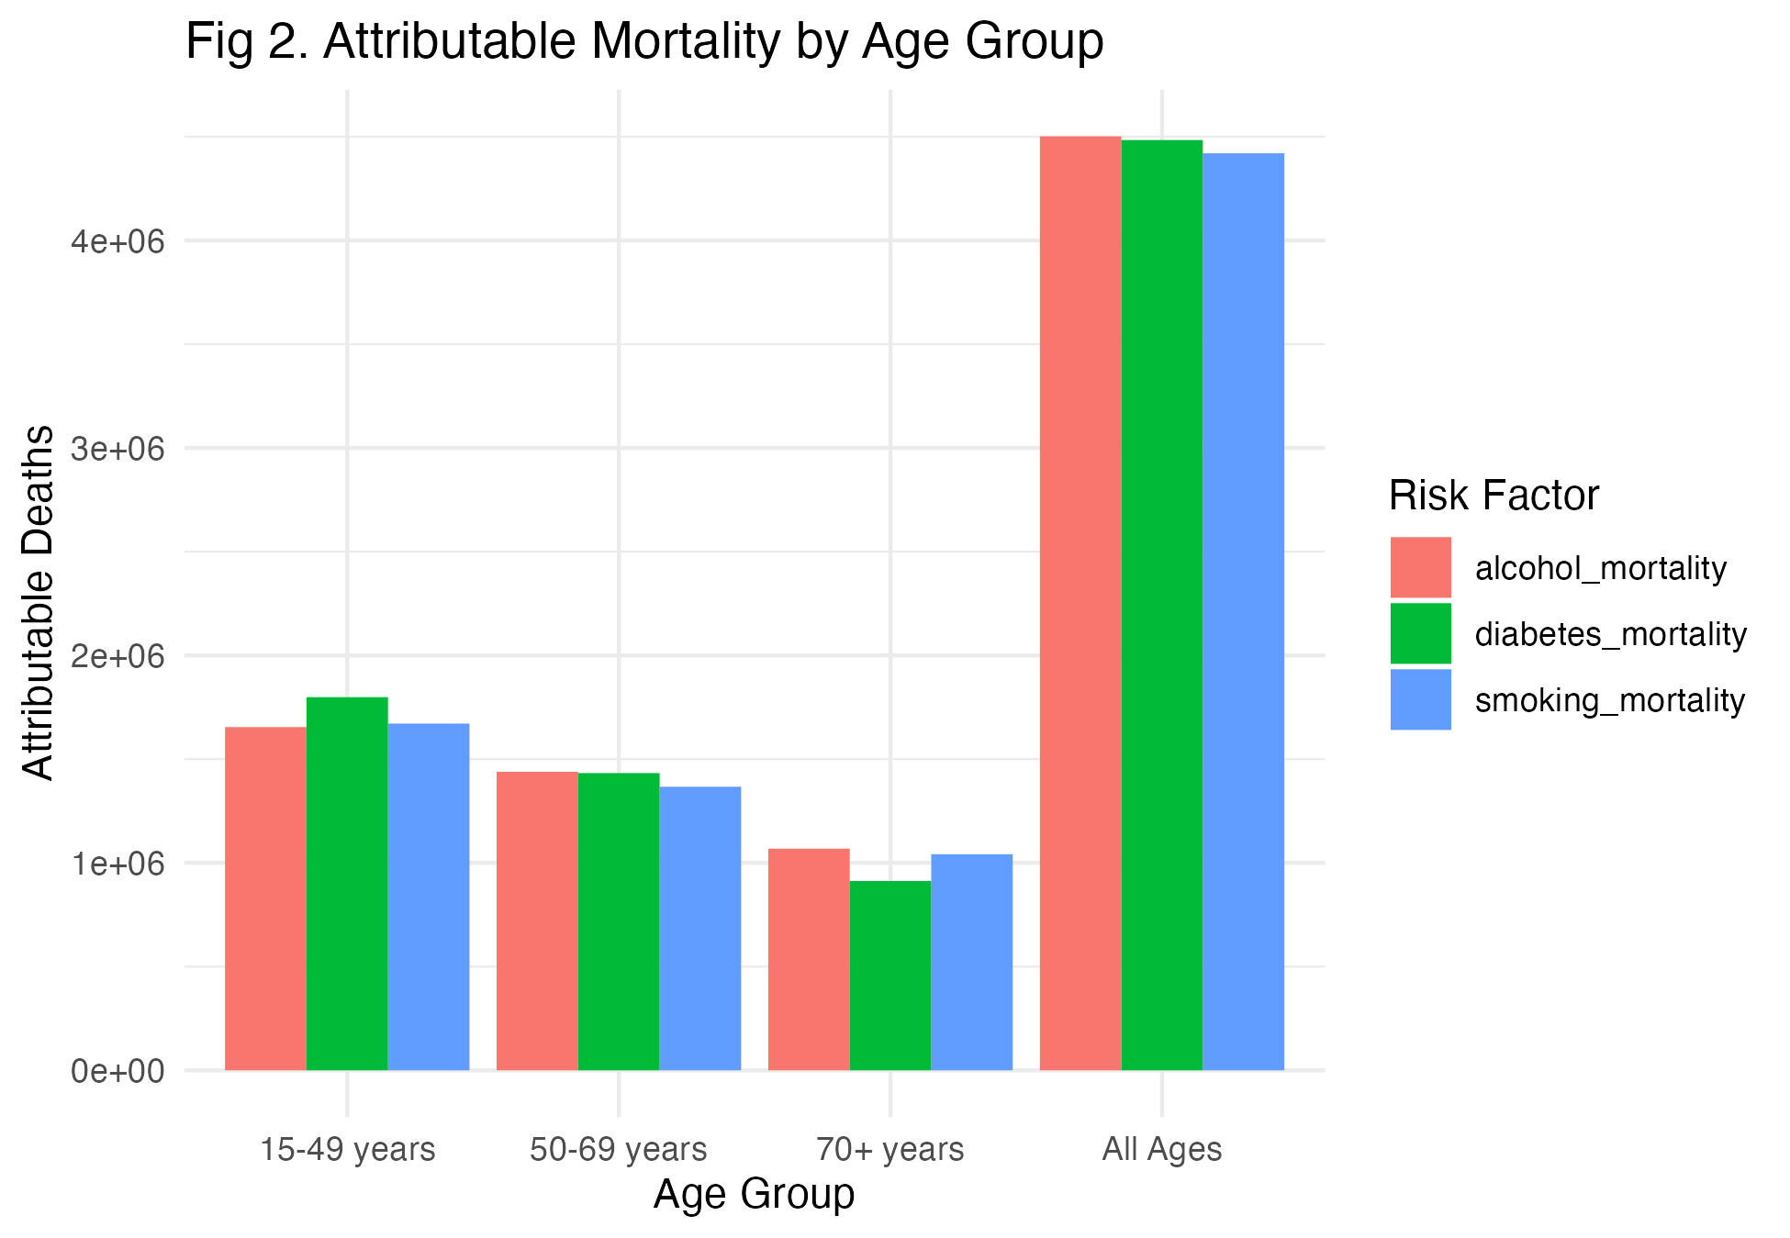
Figure 2
Notes:
Ye
This figure provides insight into relative contribution of different risk factors such as alcohol, smoking and diabetes to mortality by different age group
In figure 2, we can see differences by age group based on what risk factor has the highest mortality.
This allows us to be able to plan different intervention strategies based on age group and risk factor
For example, in ages 15-49 with diabetes being the highest contribute there could be a need for early screening and prevention programs for diabetes and promoting lifestyle modifications among younger populations.
For ages 50-69 with alcohol being the leading risk factor in this age group interventions could include strengthening alcohol education and harm reduction initiatives as well as enhancing access to treatment for alcohol dependency
For ages 70+ alcohol remains the highest contributor which suggests long-term impact
of alcohol use or age related vulnerabilities but smoking is the second highest so interventions could include the need for lifelong smoking cessation programs and addressing comorbidities related to alcohol and smoking in older adults.

Slide 16
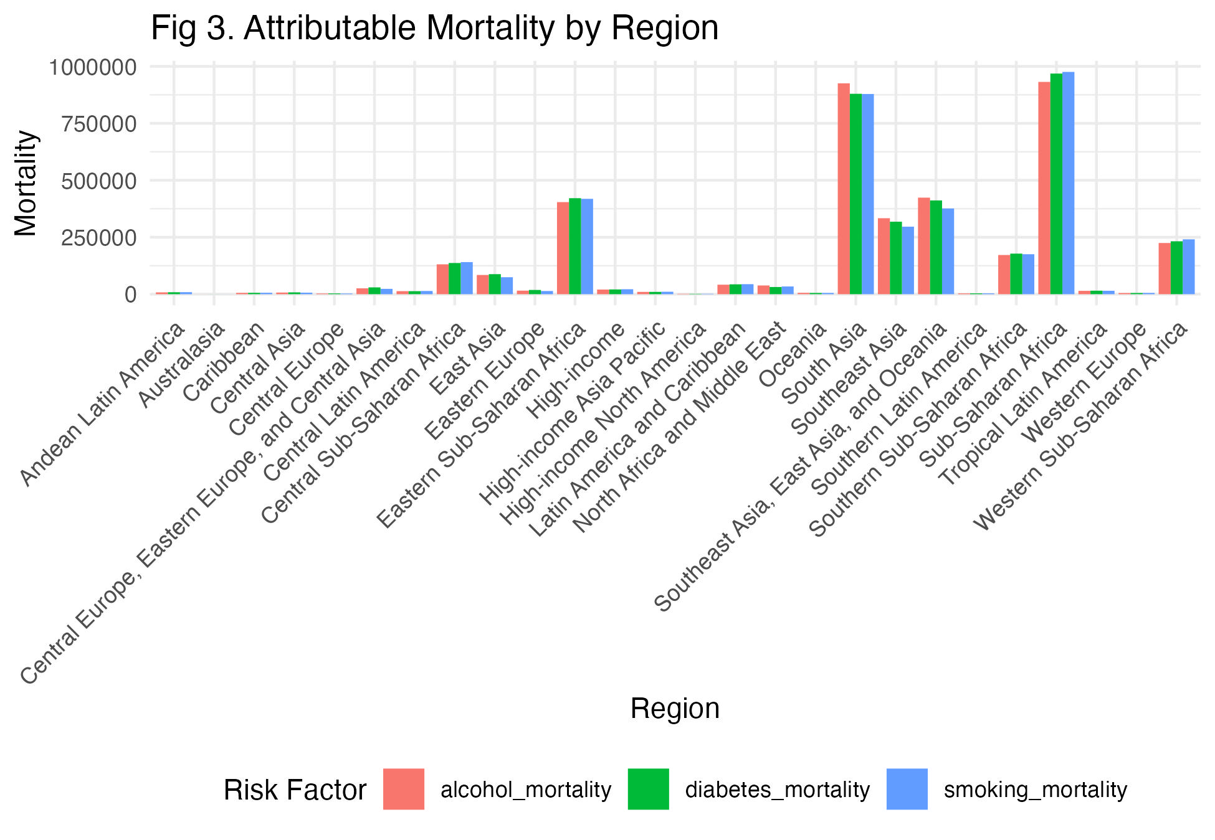
Figure 3
Notes:
Sophie
Figure 3 shows the attributable mortality risk by region to see which regions have the highest morbidity due to different risk factors. From this figure we can see that regions with highest risk factor attributable deaths are Sub-Saharan Africa, South Asia and Eastern Sub-Saharan Africa.
These likely reflect broader challenges such as limited access to healthcare and preventative services, socioeconomic inequalities that exacerbate exposure to risk factors and insufficient infrastructure for managing chronic diseases and addiction. In order to reduce these risk factors, public health policy and intervention priorities should be placed on these regions.

Slide 17
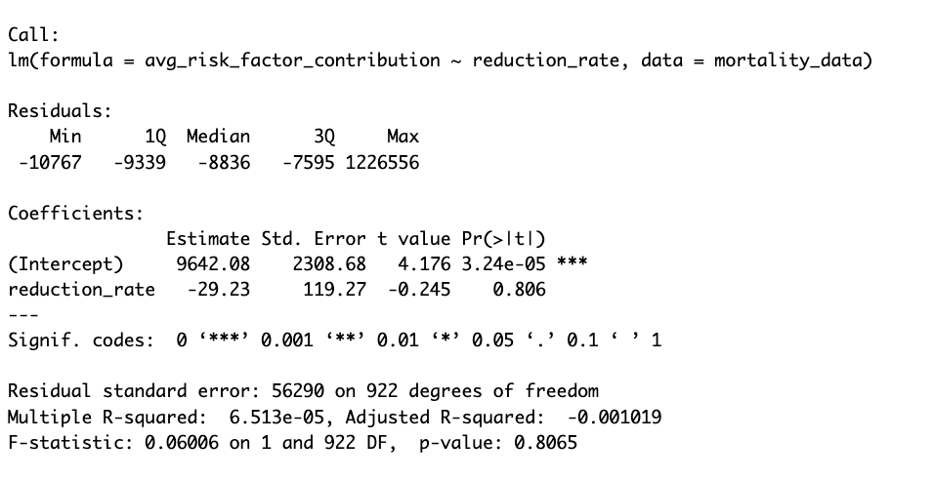
Regression Model
Notes:
Sophie
Finally our last question wanted to see if regions or ages groups with higher mortality reductions also showed lower risk factor contributions?
We calculated the mortality reduction rate and then ran a linear regression model to provide insights about the relationship between mortality reduction and average risk factor contribution.
The slope B1 was at -29.23 which indicates a very slight and non-significant decrease in average risk factor contribution for each 1% increase in mortality reduction rate.
The p-value for the slop was 0.80 which indicates that there is no statistically significant relationship between mortality reduction and risk factor contribution.
In addition the R^2 value was at 6.513 X 10^-5 which indicates that the reduction rate explains virtually none of the variation in the average risk factor contribution.
The residuals also range quite widely to show that the data points are spread out and the model does not capture much variation.

Slide 18
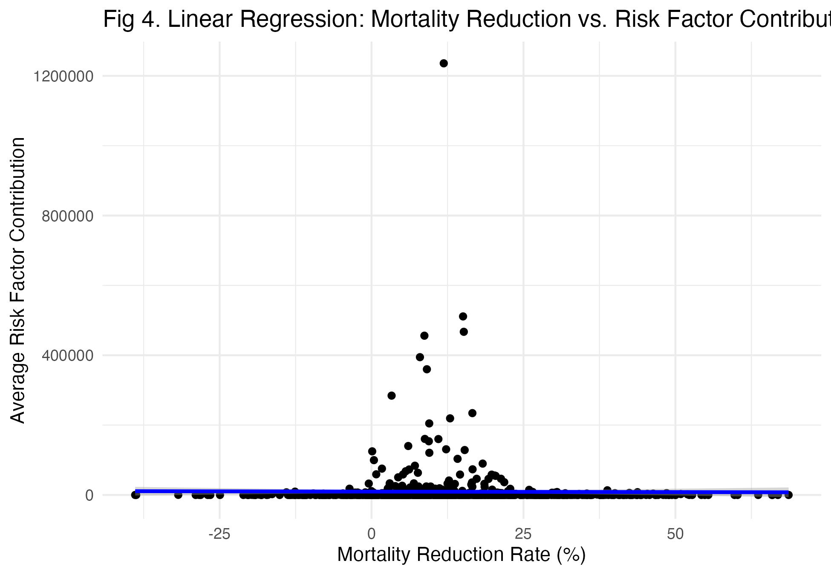
Figure 4
Notes:
Sophie
In **Figure 4.** we visualized the results of our linear regression model and you can clearly see that there is no correlation.
Because there is no significant relationship it is most likely that mortality reductions may be driven by other factors such as improvements in healthcare systems or better access to treatments rather than direct reductions in risk factor contributions.
This highlights the need for broader exploration of mortality determinants beyond the examined risk factors.

Slide 19
Conclusion
Progress is uneven, targeted interventions are needed
Risk factor mitigation is important to reducing TB mortality
Results support evidence-based policies aligned with WHO goals
It is also important to consider the quality of the data and that no data is perfect
Notes:
Ye

