Slide 1
Weekly update 12/08

Slide 2
Progress since last week
Sourcing, cleaning and analysing datasets for irradiance
Converting leaf_delta13C values to ci:ca ratios

Slide 3

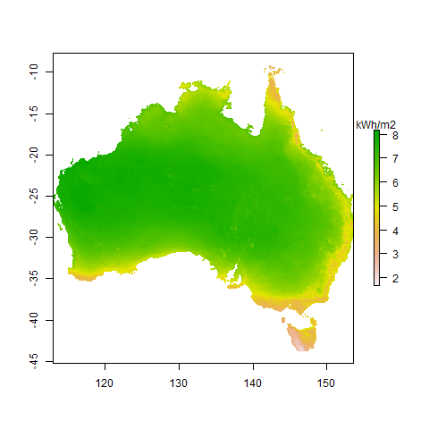
Irradiance datasets - DNI
Annual average of daily direct normal irradiation (DNI)

Slide 4
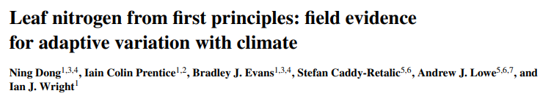
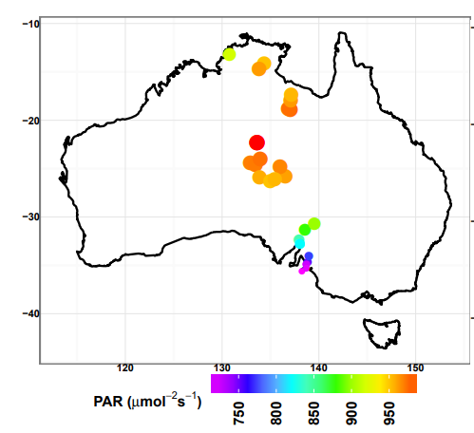

Irradiance datasets - PAR

Slide 5

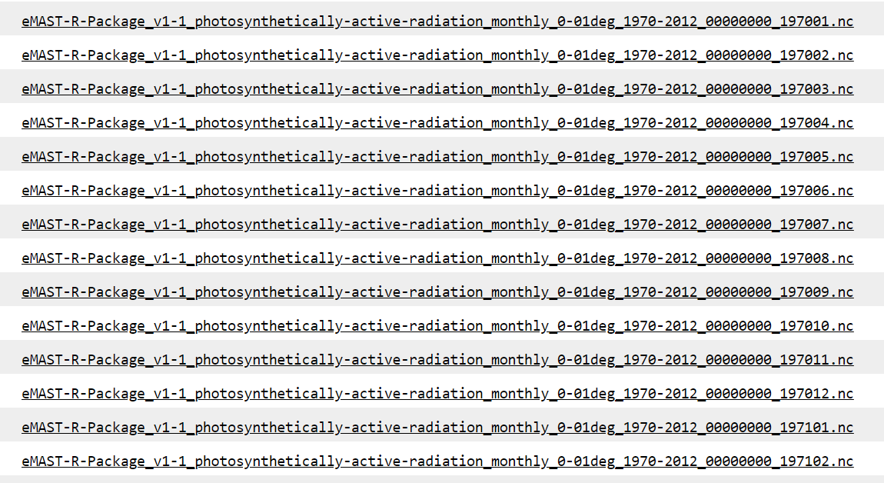
Irradiance datasets - PAR
…2012

Slide 6
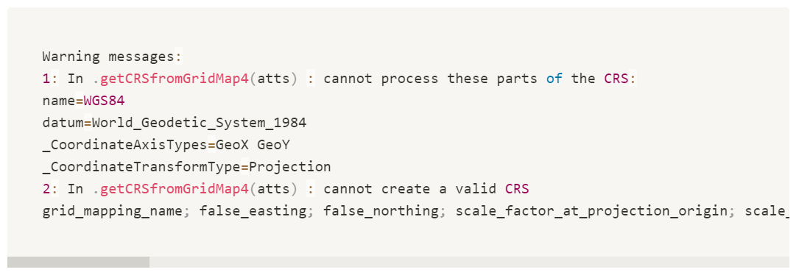
Irradiance datasets - PAR

Slide 7
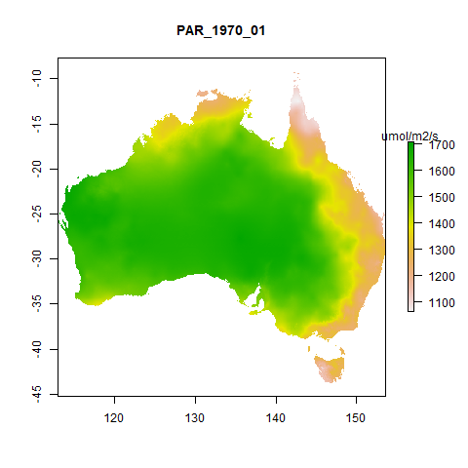
Irradiance datasets - PAR

Slide 8
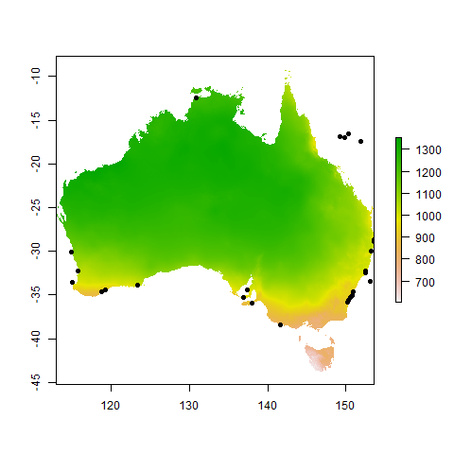
Irradiance datasets - PAR
Missing sites n = 79

Slide 9
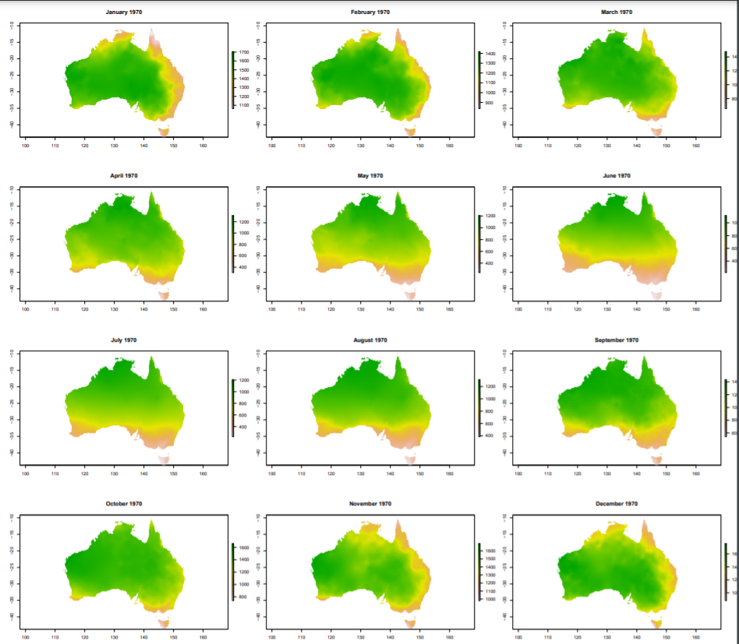
Irradiance datasets - PAR

Slide 10
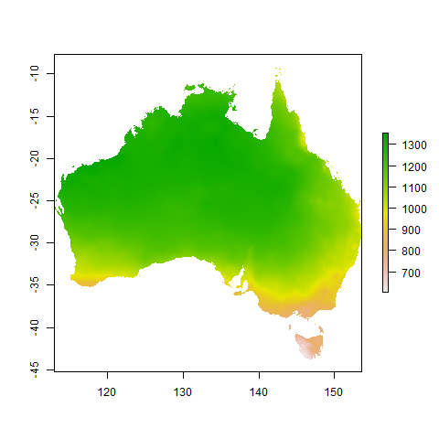

Irradiance datasets - PAR
1970 Annual mean of monthly average PAR
1970 Annual mean of monthly average PAR – site values overlaid

Slide 11
Irradiance datasets – PAR vs. DNI
Annual average of daily direct normal irradiation (DNI)
1970 Annual mean of monthly average PAR

Slide 12
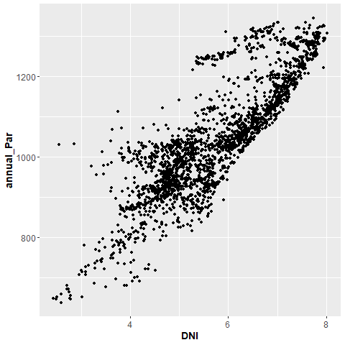
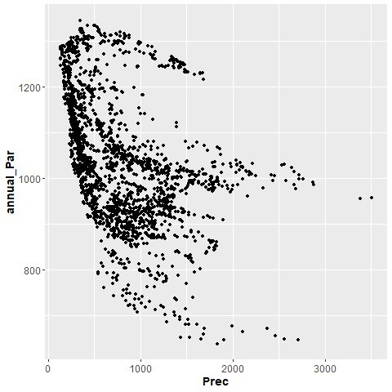
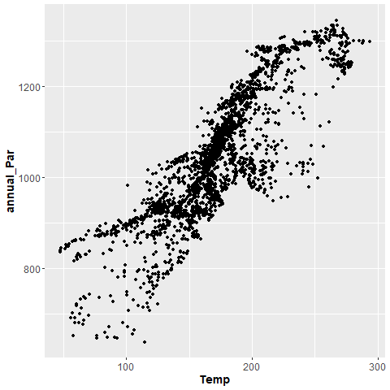
Irradiance datasets – PAR vs. climate

Slide 13
Questions..
Does our source for PAR seem reasonable?
Single spatial dataset for PAR? Find annual averages for 1970 – 2012, then average across?
Overhead canopy value for irradiance, or average PAR through the canopy according to Beer’s law (e.g. Dong et al. (2017)? Would require spatial dataset for LAI.

Slide 14
Converting leaf_delta13C values to ci:ca ratios
Leaf_delta 13C n = 5071 observations
Ci/ca n = 2885 observations
835 observations have both leaf_delta 13C and Ci/ca

Slide 15
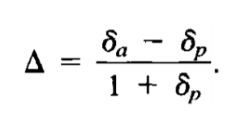

Converting leaf_delta13C values to ci:ca ratios
a, b, and delta_a are all constants

Slide 16
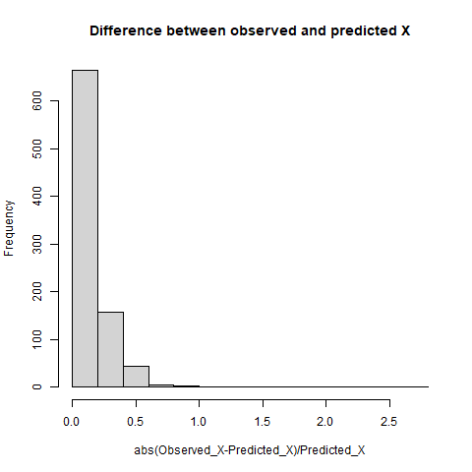
Converting leaf_delta13C values to ci:ca ratios
X= ci :ca

Slide 17
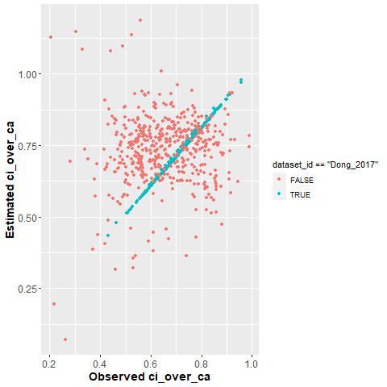
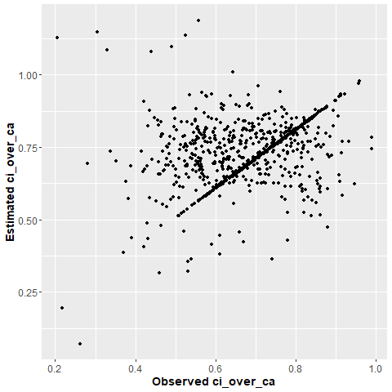
Converting leaf_delta13C values to ci:ca ratios

Slide 18
Questions..
Confidence about conversion from c13 to ci:ca?

