Slide 1
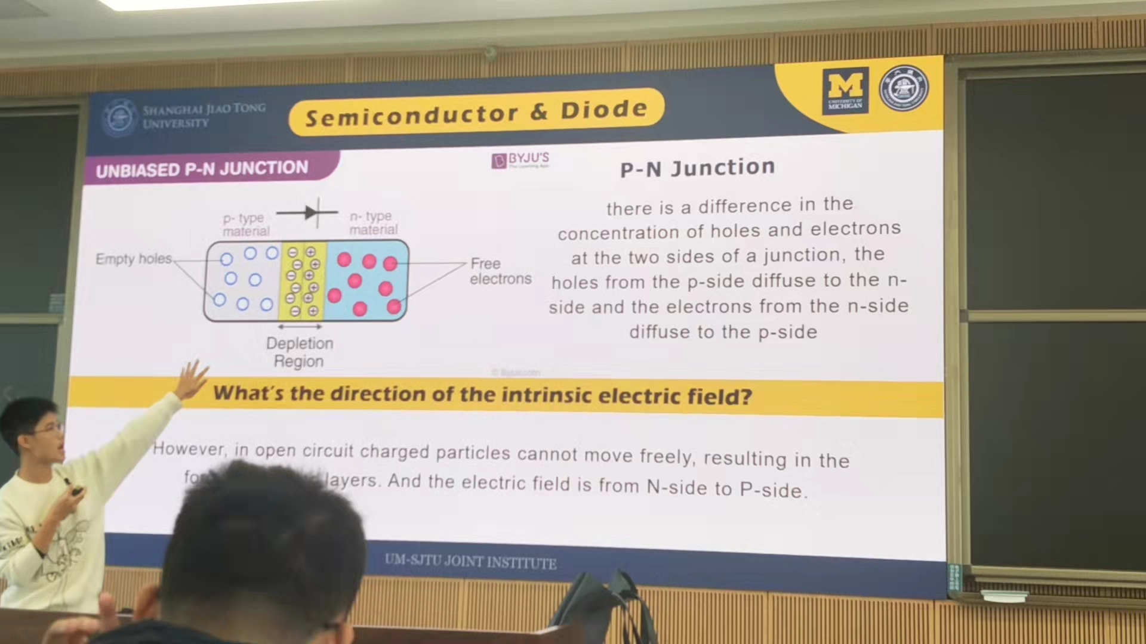

Slide 2



Semiconductor & Diode
UNIBIASED P-N JUNCTION
P-N Junction
p- type
material
n- type
material
there is a difference in the concentration of holes and electrons at the two sides of a junction, the holes from the p-side diffuse to the n-side and the electrons from the n-side diffuse to the p-side
Empty holes
Free
electrons
Depletion
Region
What’s the direction of the intrinsic electric field?
However, in open circuit charged particles cannot move freely, resulting in the fo layers. And the electric field is from N-side to P-side.
UM-SJTU JOINT INSTITUTE

