Slide 1


Group 6
孟庆丰 武世豪
苏辉锋 周宇宸
张杰
Analyzing the Audience

Slide 2
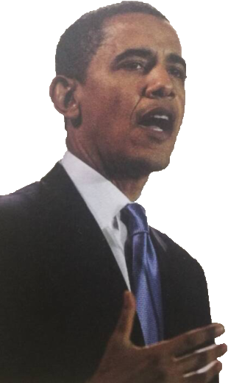
Catalogues
Audience-Centeredness
Factors in Audience Analysis
Getting Information About the Audience
Adapting to the Audience
Summary
The Psychology of Audience
Speaker: Meng
Analyzing the Audience
Audience-Centeredness 59
The Psychology of Audience 60
Factors in Audience Analysis 60
Size 60
Physical Setting 61
Demographic Traits 62
Disposition Toward the Topic 62
Disposition Toward the Speaker 64
Disposition Toward the Occasion 64
Getting Information About the Audience 64
Adapting to the Audience 67
Audience Adaptation Before the Speech 67
Audience Adaptation During the Speech 69
Audience Adaptation After the Speech 69

Slide 3
Catalogues
Audience-Centeredness
Factors in Audience Analysis
Getting Information About the Audience
Adapting to the Audience
Summary
The Psychology of Audience
Speaker: Wu
Ⅰ. Audience-Centeredness
1.Good public speakers are audience-centered
2.The primary purpose of speechmaking:
3. Keep following questions in mind to be audience-centered：
①Browbeat the audience or to blow off steam
②Compromise your beliefs to get a favorable response.
③Using devious, unethical tactics to achieve your goal.
④gain a desired response from listeners.
⑤Remain true to yourself and speak ethically while adapting your message to the needs of your listeners.
① To whom am I speaking?
② What do I want them to know, believe, or do as a result of my speech?
③ What is the most effective way of composing and presenting my speech to accomplish that aim?
Audience-centeredness: Keeping the audience foremost in mind at every step of speech preparation and presentation.

Slide 4
Catalogues
Audience-Centeredness
Factors in Audience Analysis
Getting Information About the Audience
Adapting to the Audience
Summary
The Psychology of Audience
Speaker: Wu
Ⅱ. The Psychology of Audiences
(Why should speakers be audience-centered?)
Why
How to do
People may be compelled to attend a speech.
Don’t waste your audience’s time and let your great speech skills attract their attention.
Conclusion:
Auditory perception is always selective：
So, the one sent by the speaker ≠ the one received by the listeners
People are egocentric. They pay closest attention to messages that affect their own values, beliefs, and well-being.
Your listeners will hear and judge what you say on the basis of what they already know and believe，so you must relate your message to your listeners-show how it pertains to them, explain why they should care about it as much as you do.
Learn about your audience to know what you should do to make your ideas clear and meaningful.
Egocentrism: The tendency of people to be concerned above all with their own values, beliefs, and well-being.

Slide 5
Catalogues
Audience-Centeredness
Factors in Audience Analysis
Getting Information About the Audience
Adapting to the Audience
Summary
The Psychology of Audience
Speaker: Zhang
Ⅲ. Factors in audience analysis
Small & Large
For physical setting
For demographic traits
Six categories:
Size
Physical setting
Disposition toward the occasion
Demographic traits
Disposition toward the topic
Disposition toward the speaker
The importance :
somehow decide your audience will accept or refuse your ideas and even listen to you.
What can it Influence?
formal
The receptivity of listeners
What should we pay attention to？
For the position towards the
topic & speaker & occasion
What can you do?
How?
①Look over the room a few days in advance.
②See about adjusting the thermostat.
③Check the seating arrangements and the location of the lectern.
Age
Gender
Education
Economic
Standing
The like.
Affect what ?
Language
Choice of appeals
Use of visual aids
······
Cultural background
Informal

Slide 6
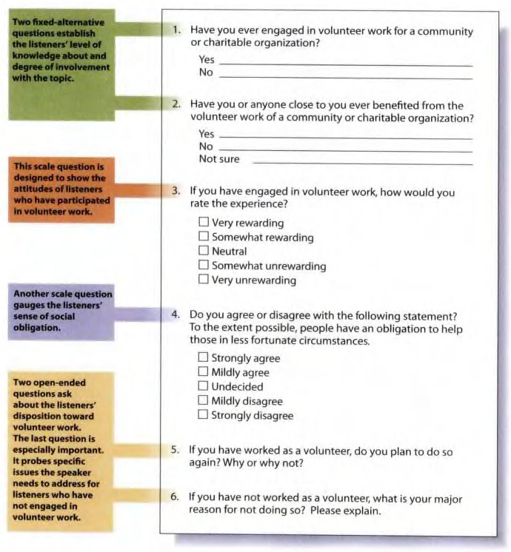

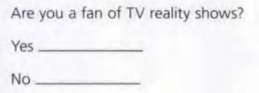
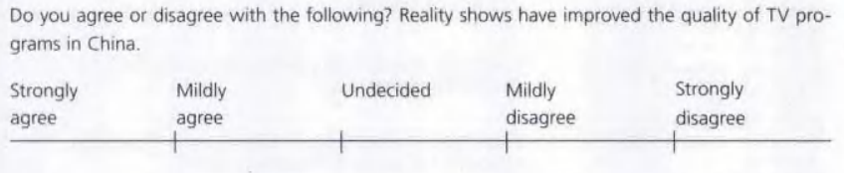
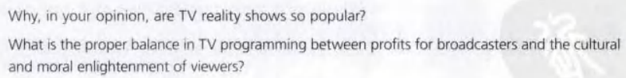

Catalogues
Audience-Centeredness
Factors in Audience Analysis
Getting Information About the Audience
Adapting to the Audience
Summary
The Psychology of Audience
Speaker: Meng
1. Plan the questionnaire carefully to elicit precisely the information you need
3. Make sure the questions are clear and unambiguous.
4. Keep the questionnaire relatively brief.
2. Use all three types of questions: fixed-alternative, scale, and open-ended.
Ⅵ. Getting Information About the Audience
Fixed-alternative questions
Open-ended questions
Scale questions

Slide 7
Catalogues
Audience-Centeredness
Factors in Audience Analysis
Getting Information About the Audience
Adapting to the Audience
Summary
The Psychology of Audience
Speaker: Su
Ⅴ. Adapting to the Audience
AUDIENCE ADAPTATION BEFORE THE SPEECH
AUDIENCE ADAPTATION DURING THE SPEECH
AUDIENCE ADAPTATION AFTER THE SPEECH
Meanings：
（1）Assessing how audience is likely to respond to what you say in your speech.
（2）Adjust what you say to make is as clear, appropriate, and convincing as possible.
Problems：
（1）Room for the speech has been changed;
（2）The audience will be larger(or smaller) than anticipated;
（3）Time for the speech has been reduced...
How：
(1)Use the survey to make changes of speech;
(2)Rethink how the audience reacted and modify the speech;
(3)Keep a journal of speech, audience, and responses.
Solutions：
（1）Adjust your delivery to the changed room and audience size;
（2）Condense speech to its most essential points and present them in the time available;
（3）Keep an eye out during the speech for audience feedback.
Solutions：
（1）Submerge your own views completely.
（2）Anticipate your audience’s respond.

Slide 8
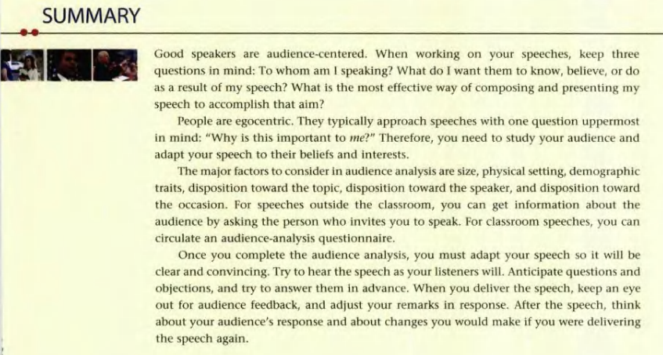
Catalogues
Audience-Centeredness
Factors in Audience Analysis
Getting Information About the Audience
Adapting to the Audience
Summary
The Psychology of Audience
Speaker: Zhou

Slide 9
Group 6
孟庆丰 武世豪
苏辉锋 周宇宸
张杰

