Slide 1
Source-Domain Confounding as the
Primary Driver of Overestimated
Ames Mutagenicity QSAR Performance
A Multi-Level Evaluation Across Three Genotoxicity Endpoints
375 configurations | 5 datasets | 7 algorithms | 3 preprocessing scenarios
Journal of Chemical Information and Modeling

Slide 2
The problem: what drives QSAR performance variation?
Random vs. scaffold splitting?
Most published Ames models report random-split metrics (MCC 0.60–0.80)
Drug vs. industrial compound mixing?
Drug-sourced: 58.3% positive vs. Industrial-sourced: 3.0% positive (19.5-fold)
Algorithm choice?
Most studies focus on algorithm comparison — is this the right question?
Preprocessing choices?
Salt stripping, metal removal — rarely documented, never compared per endpoint

Slide 3
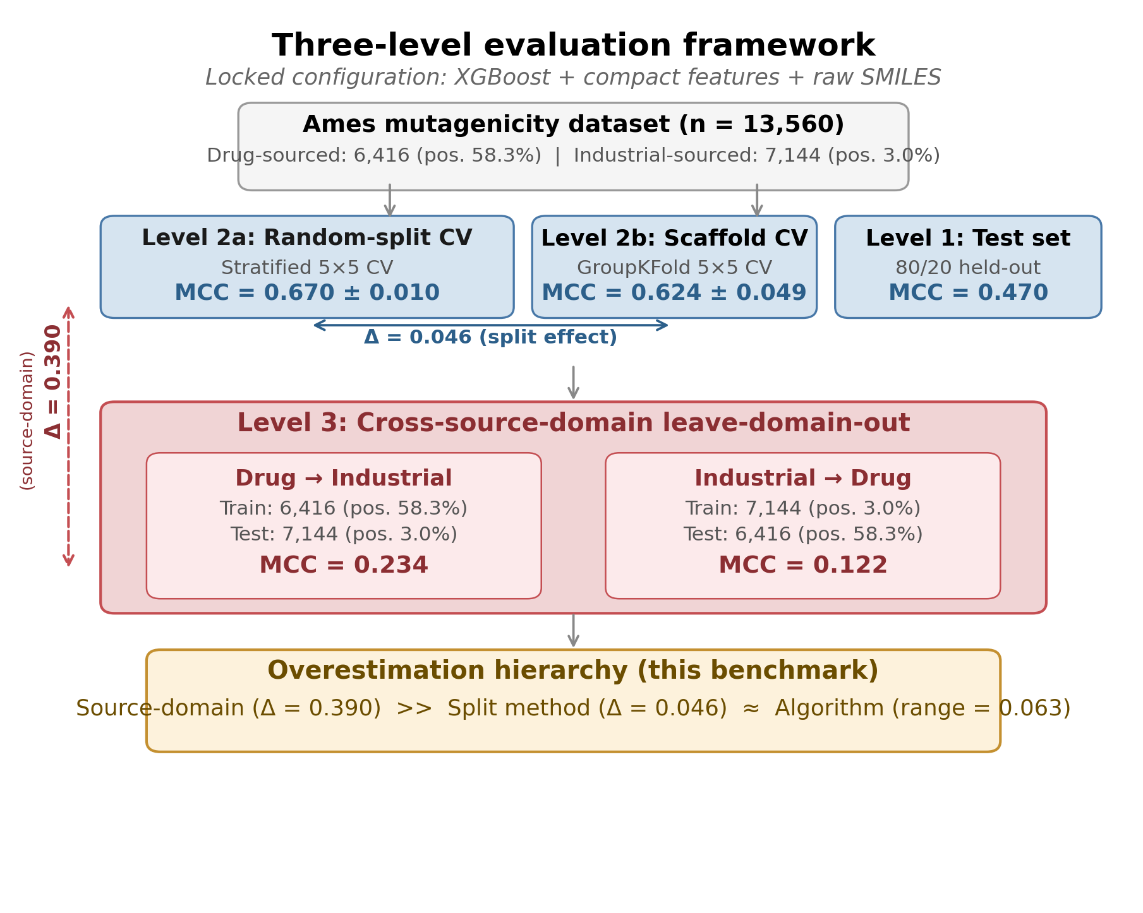
Three-level evaluation framework

Slide 4
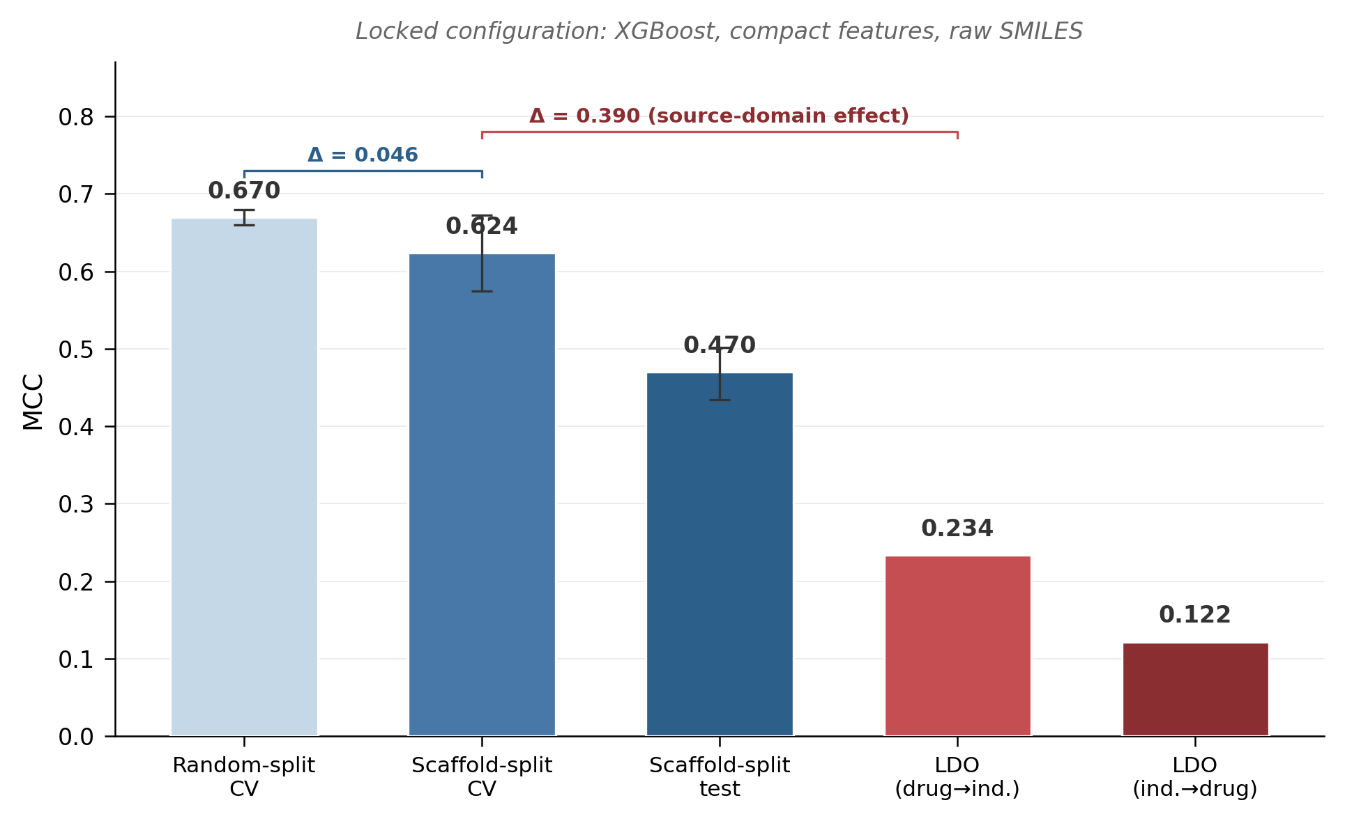
Key result: evaluation rigor cascade
KEY FIGURE

Slide 5
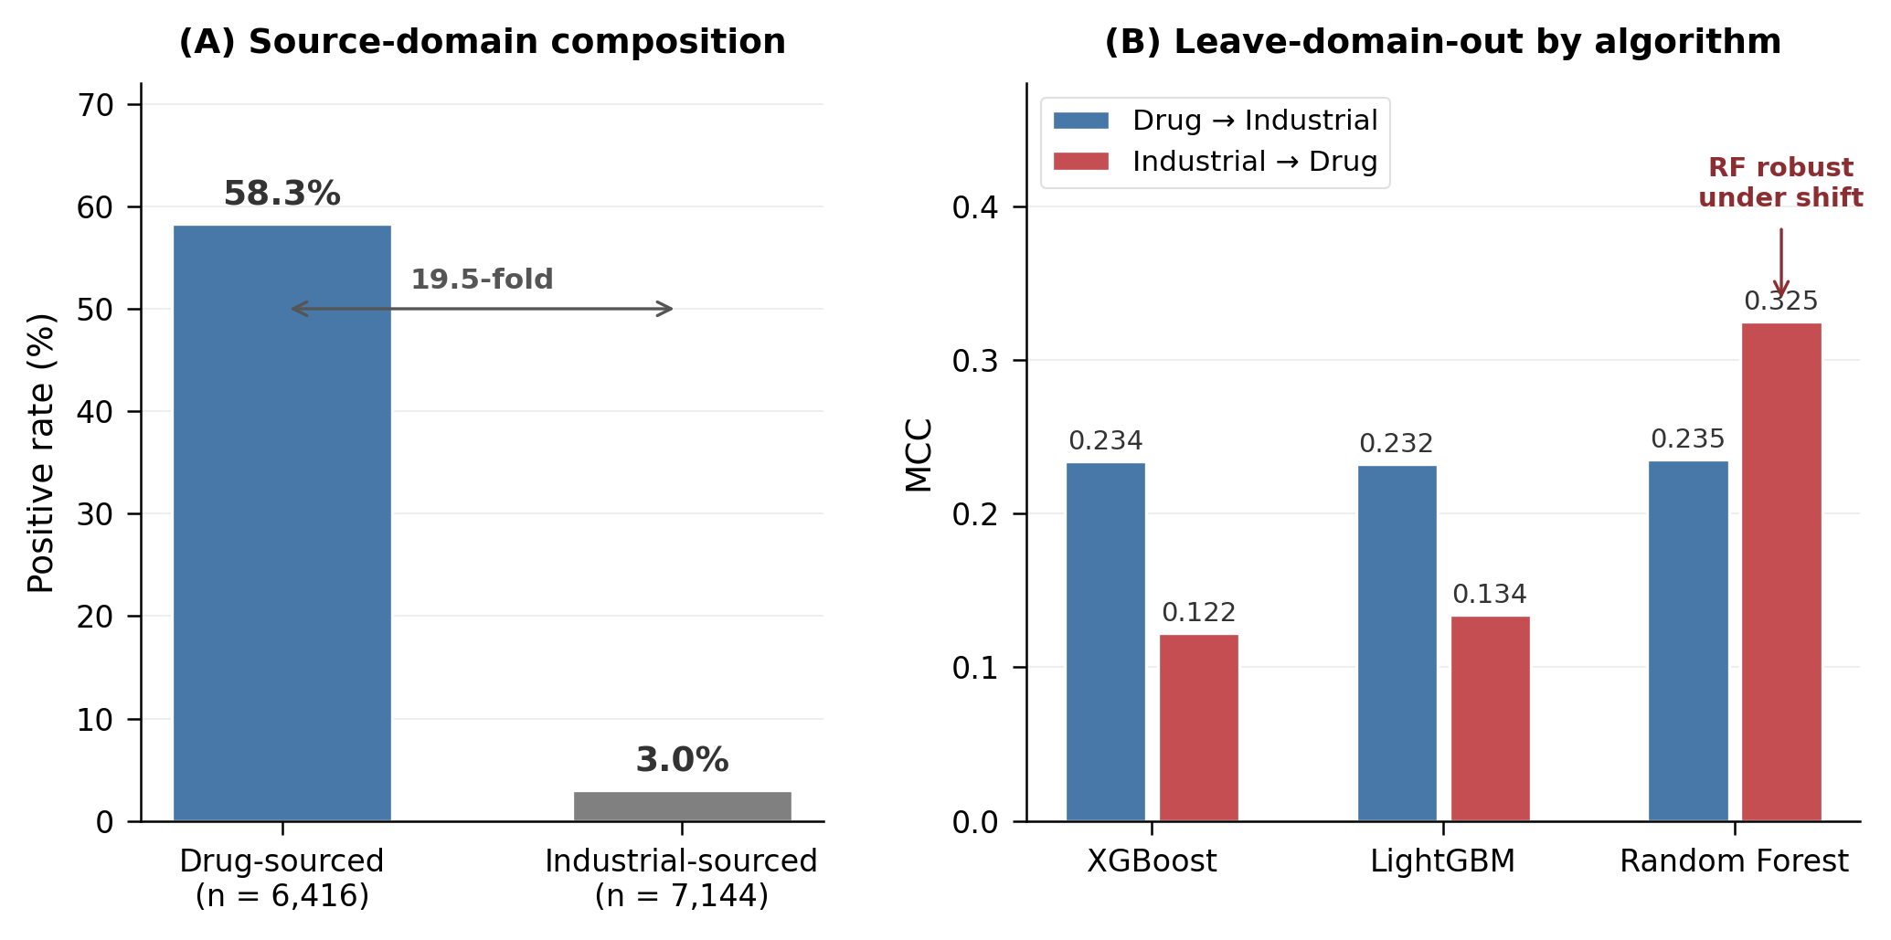
Source-domain confounding & algorithm robustness
Naive source-domain classifier: MCC = 0.608, balanced accuracy = 0.834 — without any structural information

Slide 6
Best observed performance (descriptive benchmark)
Note: Best among 375 configurations evaluated on test set — descriptive benchmark, not unbiased estimates. Confirmatory analysis uses locked configuration.
Endpoint | Algorithm | Preproc. | Features | MCC [95% CI] | ROC-AUC | PR-AUC
Ames | XGBoost | raw | FP-2048 (522) | 0.555 [.522, .588] | 0.850 | 0.765
In vitro CA | LightGBM | salt_str. | FP-1024 (394) | 0.297 [.131, .450] | 0.665 | 0.278
In vivo MN | XGBoost | salt_str. | FP-512 (266) | 0.311 [−.014, .571] | 0.860 | 0.237
Locked configuration cascade (XGBoost, compact, raw SMILES)
Level | Method | Ames MCC | In vitro MCC | In vivo MCC
2a | Random-split 5×5 CV | 0.670 ± 0.010 | 0.180 ± 0.053 | 0.181 ± 0.094
2b | Scaffold-split 5×5 CV | 0.624 ± 0.049 | 0.189 ± 0.084 | 0.104 ± 0.111
1 | Scaffold-split test | 0.470 [.434, .502] | 0.114 | 0.071
3a | LDO: drug → industrial | 0.234 | — | —
3b | LDO: industrial → drug | 0.122 | — | —

Slide 7
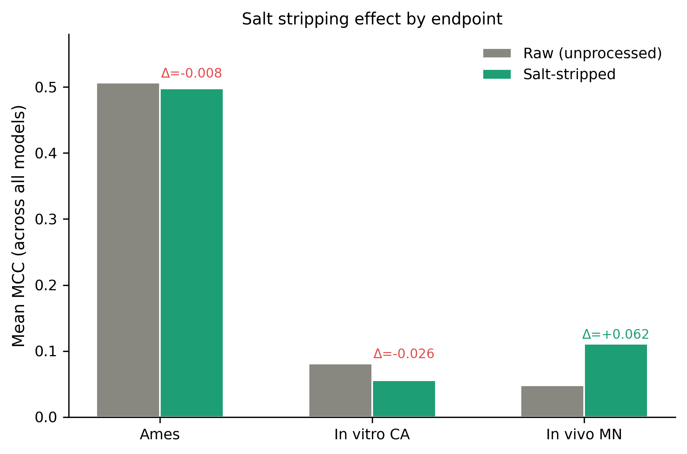
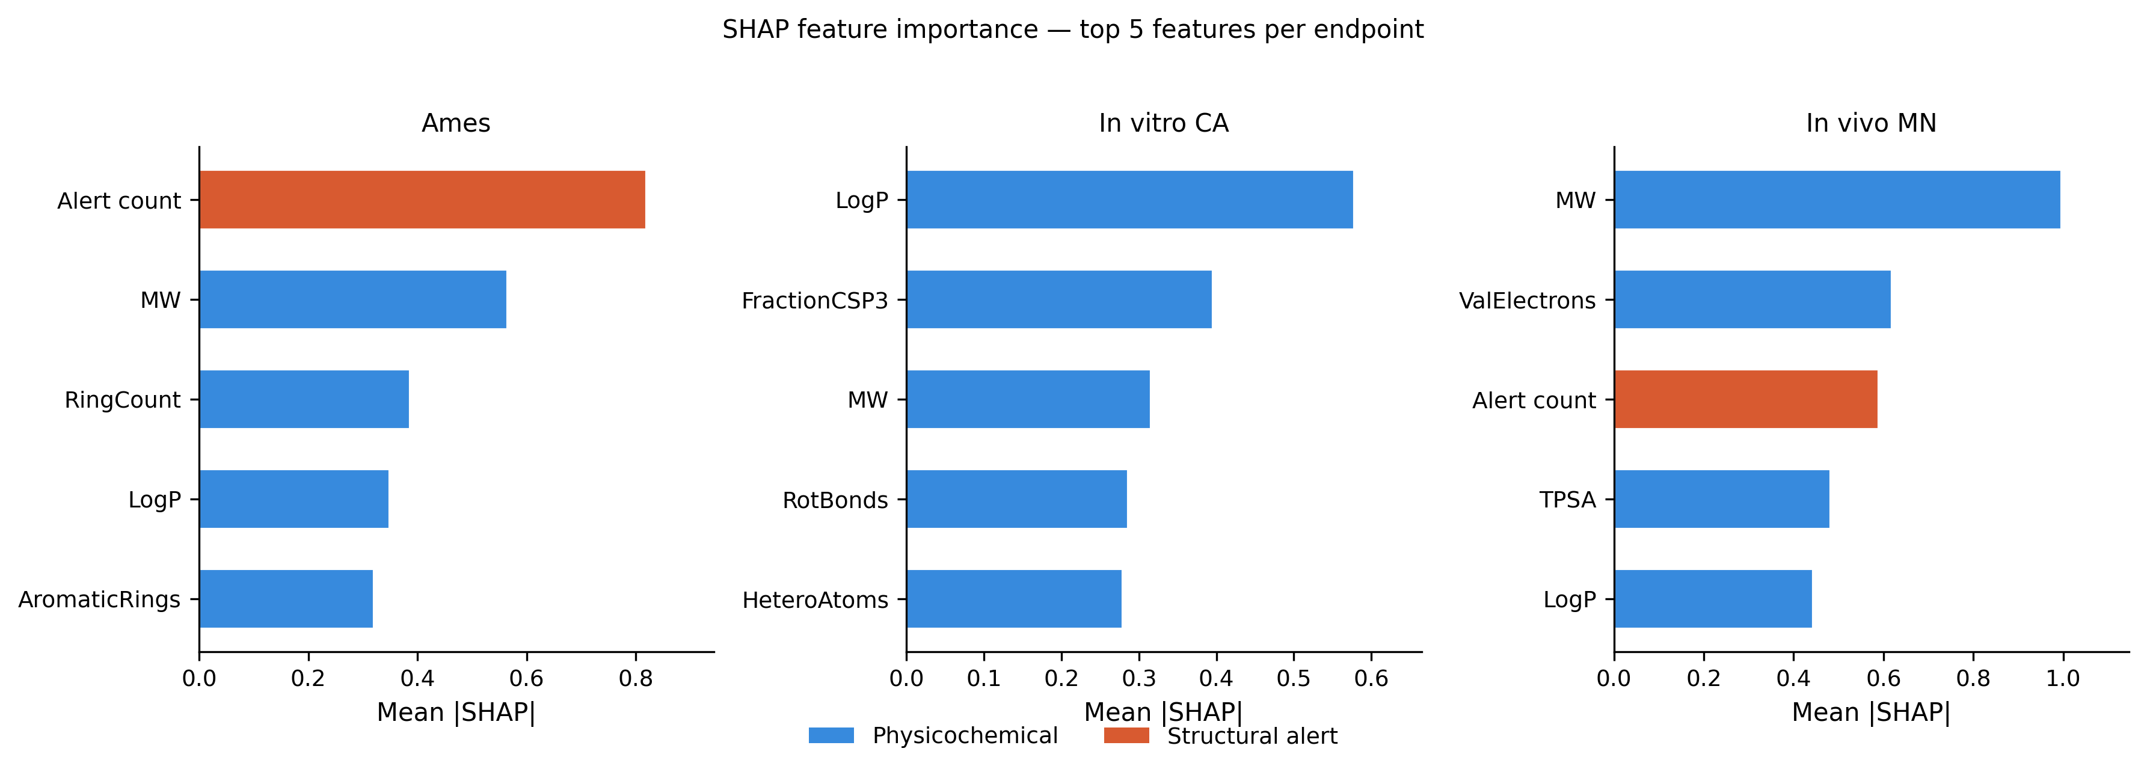
Preprocessing & feature importance
Salt stripping: in vivo +0.22, Ames ±0.03, in vitro −0.03 | SHAP: physicochemical descriptors dominate; FP bits absent from top-5
→ Preprocessing is endpoint-specific; compact features capture most signal (+0.075 MCC from adding FP to Ames)

Slide 8
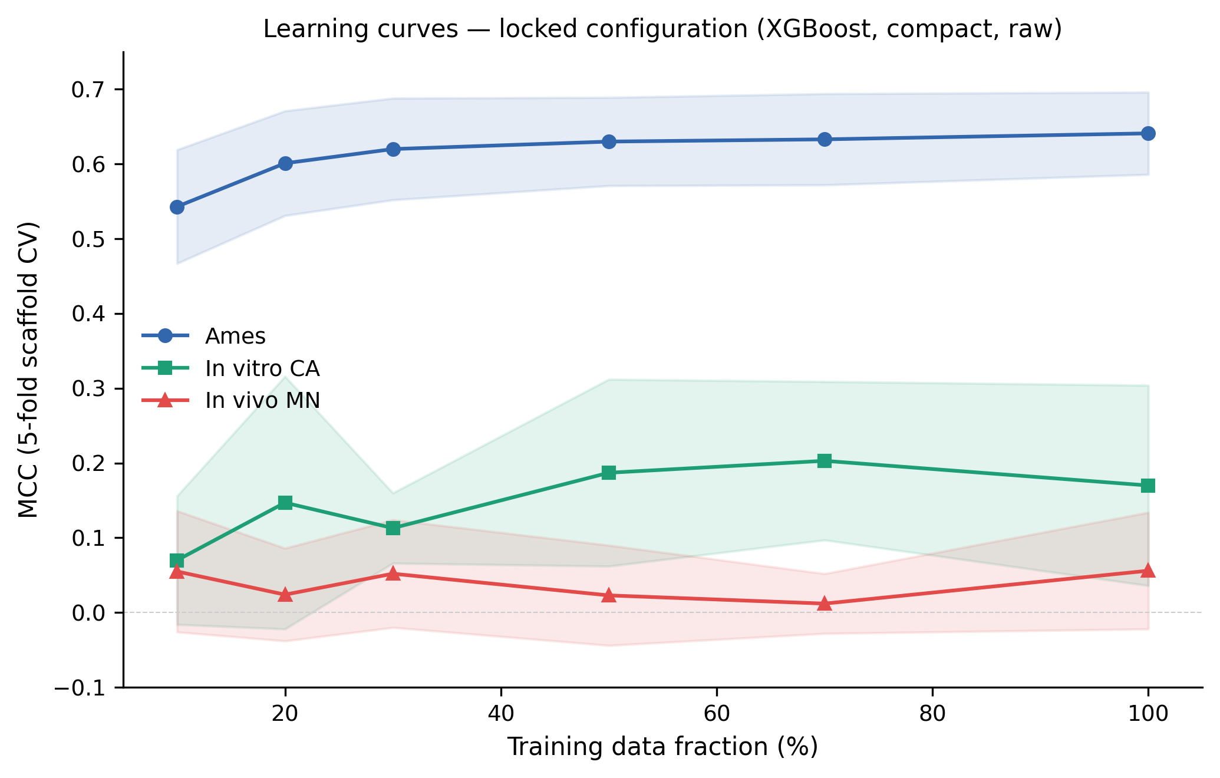
Learning curves & in vivo limitations
Ames: saturating
85% of final MCC at 10% data
→ more data unlikely to help
In vitro: noisy upward
0.07 → 0.17 — larger datasets
may modestly improve
In vivo: flat
MCC ≈ 0.055 regardless of
training size → 2D descriptors
cannot capture in vivo biology

Slide 9
Overestimation hierarchy
Source-domain (Δ = 0.390) >> Split method (Δ = 0.046) ≈ Algorithm (range = 0.063)
1.
Use scaffold-based splitting for primary performance reporting
2.
Report leave-domain-out performance when source labels are available
3.
Optimize preprocessing per endpoint, not globally
4.
Separately report threshold-free (ROC-AUC, PR-AUC) and threshold-dependent metrics (MCC)
5.
Test algorithm robustness under domain shift, not just in-domain
6.
Do not claim in vivo MN binary classification with 2D descriptors alone
Open-source pipeline: github.com/[repo] | Pipeline v12.1 | Seed = 42

