Slide 1

REACT NATIVE
Osman Korcan Andaç
Osman.korcan@gmail.com
Doğuş Teknoloji
Mobile Developer
https://github.com/smyracula
11.01.2019

Slide 2
NPM : Node Package Manager
“npm makes it easy for JavaScript developers to share and reuse code, and it makes it easy to update the code that you’re sharing” — npmjs.org
You need to set up nodejs for npm and it is automatically installed in npm when nodejs is installed.
For download: https://nodejs.org/en/download/
The minimum node.js version that supports React native is 4.5 and 4.5+.

Slide 3
NPM Detaıl: Package.json
is containing information about the project.
to create the Package.json file : npm install
NPM Package Setup : Local ve global
for detail: https://nodejs.org/en/blog/npm/npm-1-0-global-vs-local-installation/

Slide 4
NPM Detaıl: Package.json
npm install <package_name> -g --save-dev
➫ install : package download command
➫ -g : global type
➫ --save-dev : saves the downloaded package to the package.json file.

Slide 5
Package.json Sample
{
"name": "Application_Name",
"version": "0.0.1",
"private": true,
"scripts": {
"start": "node node_modules/react-native/local-cli/cli.js start",
"test": "jest"
},
"dependencies": {
"axios": "^0.15.3",
"react": "16.6.3",
"react-native": "0.57.8",
"react-native-maps": "^0.22.1",
"react-native-router-flux": "^4.0.6"
},
"devDependencies": {
"babel-jest": "23.6.0",
"jest": "23.6.0",
"metro-react-native-babel-preset": "0.51.1",
"react-test-renderer": "16.6.3"
},
"jest": {
"preset": "react-native"
}
}

Slide 6
ES6 : EcmaScrıpt
New version of the Javascript language.
Who are developing this language?
An organization called ECMA International sets the rules for Javascript and initiates its development. All development is open source.
Java Script Code
var squere = function(a) { return a * a; };
ES6
const squere = a => a * a

Slide 7
BABEL
current browsers are not running es6 codes
in this case, babel provides the ability to translate es6 codes into browser interpretable codes.
So babel is a kind of javascript translator between versions.

Slide 8
Eslint
ESLint is an open source JavaScript linting utility
ESLint allow developers to discover problems with their JavaScript code without executing it.
Developers create their own linting rules.
ESLint is written using Node.js

Slide 9
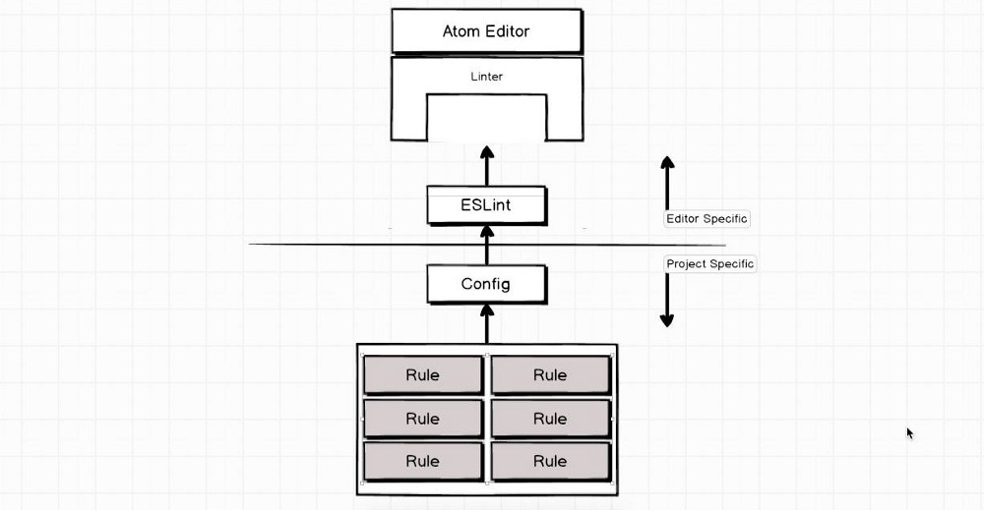
Eslint

Slide 10
watchman
React Native uses watchman to detect when you've made code changes and then automatically build and push the update your device without you needing to manually refresh it.
More info
https://www.facebook.com/notes/facebook-engineering/watchman-faster-builds-with-large-source-trees/10151457195103920/
https://facebook.github.io/watchman/

Slide 11
REACt natıve clı
A command line interface tool that seeks to automate some tasks when working on a React.js project.
React Native has a local-cli folder with a file named cliEntry.js. Here, the commands are read from commands.js and added as possible CLI commands. E.G. the react-native link command, exists in the react-native/local-cli/link folder, and is required in commands.js, which will register it as a documented command to be exposed to the CLI.
https://facebook.github.io/react-native/docs/understanding-cli

Slide 12
COMMANDs
brew update ( for install https://docs.brew.sh/Installation )
brew Install node ( for confirm node –v )
brew install watchman
npm install -g react-native-cli
npm install -g eslint
react-native init Project_name
react-native run-ios or react-native run-android

Slide 13
troubleshoots
At the begining, sometimes ios project may not work because of commandline location xcode
For this trouble, commandline location must be entered from Pref->Locations.

Slide 14
COMMANDs more
npm install —save-dev eslint-config-rallycoding (sample js rules)
react-native start --reset-cache
For reset all cache and hot reload
rm -rf $TMPDIR/react-*
rm -rf $TMPDIR/haste-*
rm -rf $TMPDIR/metro-*
watchman watch-del-all
sudo lsof -i :8081
kill -9 34781

Slide 15
THANKS

