Slide 1

DOC EASY
PIP104 University Project-II
Review-1
Under the Supervision of,
Dr.Mohana S D
Assistant Professor
School of Computer Science & Engineering
Presidency University

Slide 2
Team Members
Roll Number | Student Name | Phone Number | Email ID
20201CCS0078 | Sagili Mythili | 70320 49933 | SAGILI.20201CCS0078@presidencyuniversity.in
20201CCS0088 | Chrisilda Shamayah Babu Anthony | 97620 02103 | CHRISILDA.20201CCS0088@presidencyuniversity.in
20201CCS0150 | Ravuri Venkata Koushik | 81069 84875 | ravuri.20201ccs0150@presidencyuniversity.in

Slide 3
Content
1.Introduction
1.1 Challenges
2.Problem Statement
3.Literature Survey
4.Objectives
5.Proposed design and methodology
5.1 Design
5.2 Methods
6.Results and Discussion
6.1 Software and hardware Requirements
6.2 Database
7.Conclusion
8.Timeline
9.References

Slide 4
1.Introduction
Traditional method of maintaining manual records of every patient appointment, visit history and reports is tedious it takes up a lot of time. So we want to create a mobile app that could be designed to be simple and user-friendly, with easy navigation between different sections and intuitive ways to enter and view information. The app could also offer analytics and reporting features to help doctors track their productivity and patient outcomes over time. The key features of app are:
Appointment scheduling
Patient profiles
In-patient care
Handover of patients

Slide 5
1.1 Challenges
While developing a mobile app for doctors to manage appointments, out-patient and in-patient care and handover processes, there are several challenges that need to be considered:
Integration with Existing Systems
Security and Compliance
User Adoption and Training
Interoperability
Customization for Different Specialties
Facilitating the handover of patients in case of leave

Slide 6
2.Problem Statement
Problem Statement:
A mobile app for helping doctors plan their appointments, out-patient & in-patient care, handover of patients in case of leaves for seamless continuity of care.

Slide 7
3.Literature Survey
AUTHOR | YEAR | METHODOLOGY | REVIEW
[1] Nazia S, Ekta Sarda | 2014 | Scheduling(Case Study) | The paper provided an insight into online consultation appointment scheduling systems and its benefits for patients.
[2] Akinode, John Lekan, and S. A. Oloruntoba | 2017 | Ajax framework and MYSQL | This paper entails the process of developing a patient appointment and scheduling system using Angular JS for the frontend, Ajax framework for handling client-server request and Sqlite3 and MYSQL for the backend
[3] Dat, Luu Tien | 2019 | Analysis | This paper encapsulates the problems faced by incompetent scheduling systems as well as waiting times and patient satisfaction with outpatient clinic visits, treatments and services.

Slide 8
3.Literature Survey
AUTHOR | YEAR | METHODOLOGY | REVIEW
[4] Roma Chauhan, Amit Kumar, and Harjit Singh | 2015 | Case Study | This paper delves into the homegrown healthcare startup, 'Practo', and entails its features, success, as well as drawbacks.
[5]Ismail, N. S., Kasim, S., Jusoh, Y. Y., Hassan, R., & Alyani | 2017 | Prototype Model, MySQL Database and programming language use is PHP and JavaScript. | Prototype Model is used to develop this system. As for the hardware and software used to develop this system is MySQL Database and programming language use is PHP and JavaScript. By developing this system, it will reduce the number of calls for an appointment and avoid the morning rush for an urgent appointment.
[6]Pal, S., Biswas, B., Gupta, R., Kumar, A., & Gupta, S. | 2023 | Text-mining & Machine-learning | Recommendations from our study by offering an improved service design leading to higher user satisfaction across these m-health platforms.

Slide 9
3.Literature Survey
AUTHOR | YEAR | METHODOLOGY | REVIEW
[7]Sandesara, M., Bodkhe, U., Tanwar, S., Alshehri, M. D., Sharma, R., Neagu, B. C., ... & Raboaca, M. S. | 2022 | Literature Survey & Visualization | Provides insight about what factors should be taken into consideration while designing interfaces for mobile applications.
[8]Jadhav, M. L. S., Mhade, M. T. R., Jagushte, M. S. S., & Gosavi, M. M. K. | 2016 | Web Based Notification Management System with Android Application) | Implementation of system is mostly concentrating on receiving notifications through android applications
[9]Vidya, K. | 2020 | Analysing (Simple Mail Transfer Protocol) | SMTP is used as the common mechanism for transporting electronic mail among different hosts within the transmission control protocol/Internet protocol (TCP/IP) suite. It is an application layer protocol

Slide 10
3.Literature Survey
AUTHOR | YEAR | METHODOLOGY | REVIEW
[10]Qabajeh, M. M., Mousa, S., Saleh, H. A., & Hasan, J. A. | 2023 | Analysing and Designing | Android mobile application portal for doctor and patient booking.

Slide 11
4.Objectives
The main objectives of the mobile app were:
To design and development of time scheduling model using mobile app

Slide 12
5.Proposed Design and Methodology
5.1 Design
Android Studio
Firebase
5.2 Methodology
UML Sequence Diagram
5.3 Algorithm

Slide 13
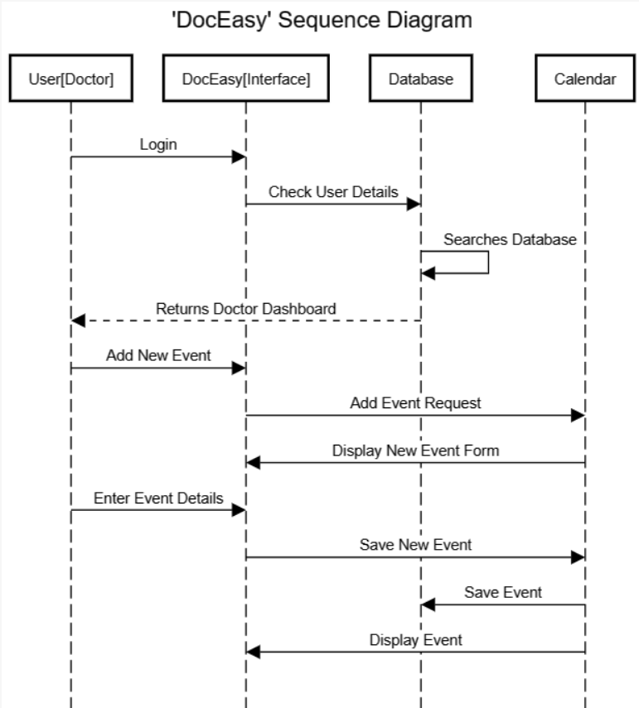
5.1 Design

Slide 14
5.2 Methodology
Android Studio: is the official Integrated Development Environment (IDE) for Android app development. It offers a range of features that enhance productivity when building Android apps.
This IDE provides a perfect environment for the development of our application.
Here are some key features:
Flexible Gradle-based build system: Android Studio uses Gradle as the foundation of the build system, allowing you to customize, configure, and extend the build process.
Fast and feature-rich emulator for app testing: It comes with a fast emulator that helps you test your application on a variety of Android devices.
Consolidated environment: Android Studio provides a unified environment where you can develop apps for all Android devices.

Slide 15
5.2 Methodology
Code templates and GitHub integration: These help you build common app features and import sample code.
Extensive testing tools and frameworks: Android Studio provides a range of testing tools and frameworks to ensure your app works as expected.
Built-in support for Google Cloud Platform: This makes it easy to integrate Google Cloud Messaging and App Engine.

Slide 16
5.2 Methodology
MySQL:
MySQL is a free, open-source relational database management system that operates using SQL (Structured Query Language).
It’s recognized for its quickness, dependability, scalability, and user-friendliness.
It has the ability to manage multi-threading, which enhances its scalability.
It’s capable of managing extensive data, with the capacity to handle up to 50 million rows or even more.
It’s versatile and can operate on a variety of operating systems, including Windows, Linux, and Unix.

Slide 17
5.2 Methodology
Firebase Cloud:
Firebase, developed by Google, is a platform that provides a range of features to assist in the development and expansion of apps.
It offers unlimited reporting, cloud messaging, authentication, and hosting services.
It includes an in-built analytics dashboard that can report on 500 distinct events without any limits.
It allows for audience segmentation, integration with other services, and facilitates app development.
It’s known for its superior performance and productivity.
It supports a wide range of embedded applications, enhancing its flexibility.
It’s compatible with numerous operating systems.
Being cloud-hosted, Firebase allows developers to scale on-demand effortlessly.

Slide 18
6.1 Software and Hardware Requirements
Software Requirements:
Operating System: The application will be compatible with Android (version 8.0 and above) to cater a wide range of users.
Database: A robust database system like MySQL will be used for storing appointment details, doctor profiles, patient information, etc.
Backend Server: A server-side framework like Node.js, Django, or Ruby on Rails for handling requests from the mobile application.
Push Notifications: A service for sending push notifications to the app, we intend on using Firebase Cloud Messaging.

Slide 19
6.1 Software and Hardware Requirements
Hardware Requirements:
Device: The application should be able to run on smartphones with at least 2GB of RAM for smooth operation.
Storage: Depending on the size of the completed application and the amount of data to be stored locally, a minimum of 100MB of free storage space might be required.
Internet: A stable internet connection for real-time updates of appointments and other data is required.
Screen Size: The application should be optimized for screen sizes of 4.7 inches and above to ensure a good user experience.
Battery: As the application might be used frequently throughout the day, the device should have a decent battery life.

Slide 20
6.2 Database
Doctor Table:
DoctorID (PK) | Name | Specialization | Contact | Availability
Patient Table:
PatientID (PK) | Name | Contact | MedicalHistory
Appointments Table:
AppointmentID (PK) | DoctorID (FK - Doctors.DoctorID) | PatientID (FK - Patients.PatientID) | Date | Time | Status
PK: Private Key
FK: Foreign Key
Handover Table:
HandoverID (PK) | CurrentDoctorID (FK - Doctors.DoctorID) | NewDoctorID (FK - Doctors.DoctorID) | AppointmentID (FK-Appointments.AppointmentID)

Slide 21
7.Conclusion
In conclusion, the development of a comprehensive mobile app aimed at assisting doctors in planning appointments, managing out-patient and in-patient care, and facilitating seamless patient handovers during leaves holds significant potential to enhance healthcare delivery.

Slide 22
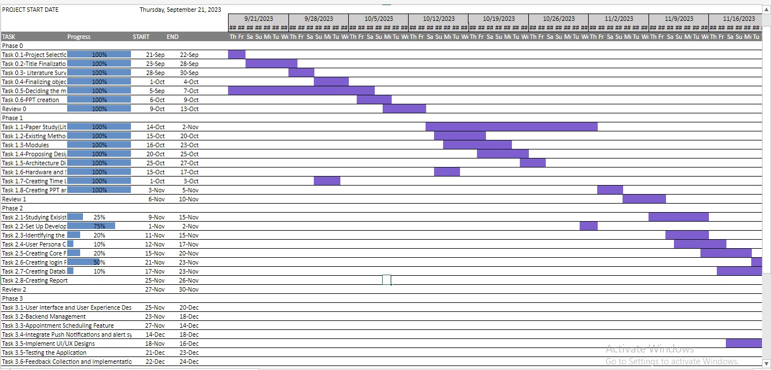
8.Timeline of Project

Slide 23
9.References
[1]Nazia S, Ekta Sarda,2014,Online Appointment Scheduling System for Hospitals–An Analytical Study, International Journal of Innovations in Engineering and Technology (IJIET). https://ijiet.com/wp-content/uploads/2014/12/4.pdf
[2] Akinode, John Lekan, and S. A. Oloruntoba. "Design and implementation of a patient appointment and scheduling system." Department of Computer Science, Federal Polytechnic Ilaro Nigeria (2017). https://www.researchgate.net/publication/332864696_Design_and_Implementation_of_a_Patient_Appointment_and_Scheduling_System
[3] Dat, Luu Tien, "Associations Between Waiting Time and Patient Satisfaction Level at Tan Phu DistrictHospital in Ho Chi Mihn City, Vietham" (2019). Master's Theses. 115. https://digscholarship.unco.edu/theses/115
[4] Roma Chauhan, Amit Kumar and Harjit Singh, 2015, "Lessons from startup for energising online patient care". https://www.inderscienceonline.com/doi/pdf/10.1504/IJTMKT.2015.068599
[5] Ismail, N. S., Kasim, S., Jusoh, Y. Y., Hassan, R., & Alyani, A. (2017). Medical appointment application. Acta Electronica Malaysia, 1(2), 5-9.
https://www.jait.us/uploadfile/2023/JAIT-V14N3-581.pdf

Slide 24
9.References
[6] Pal, S., Biswas, B., Gupta, R., Kumar, A., & Gupta, S. (2023). Exploring the factors that affect user experience in mobile-health applications: A text-mining and machine-learning approach. Journal of Business Research, 156, 113484.
https://www.sciencedirect.com/science/article/pii/S0148296322009493
[7] Sandesara, M., Bodkhe, U., Tanwar, S., Alshehri, M. D., Sharma, R., Neagu, B. C., ... & Raboaca, M. S. (2022). Design and Experience of Mobile Applications: A Pilot Survey. Mathematics, 10(14), 2380.
https://www.mdpi.com/2227-7390/10/14/2380
[8] Jadhav, M. L. S., Mhade, M. T. R., Jagushte, M. S. S., & Gosavi, M. M. K. (2016). Web based Notification Management System with Android Application. Int. J. Sci. Technol. Eng., 2(10), 1218-1220.
http://surl.li/nagsw
[9]Vidya, K. (2020). An Overview on E-mail and Protocols Included with the IP and SMTP. Anveshana’s Int. J. Res. Eng. Appl. Sci, 5.
http://surl.li/nagtm
[10}Qabajeh, M. M., Mousa, S., Saleh, H. A., & Hasan, J. A. (2023). Designing an Android Application for Electronic Booking in Health Clinics and Building Health Record System. Journal of Advances in Information Technology, 14(3).
https://www.jait.us/uploadfile/2023/JAIT-V14N3-581.pdf

Slide 25
Thank You

