Slide 1

DOC EASY
PIP104 University Project-II
Review-2
Under the Supervision of,
Dr.Mohana S D
Assistant Professor
School of Computer Science & Engineering
Presidency University

Slide 2
Team Members
Roll Number | Student Name | Phone Number | Email ID
20201CCS0078 | Sagili Mythili | 70320 49933 | SAGILI.20201CCS0078@presidencyuniversity.in
20201CCS0088 | Chrisilda Shamayah Babu Anthony | 97620 02103 | CHRISILDA.20201CCS0088@presidencyuniversity.in
20201CCS0150 | Ravuri Venkata Koushik | 81069 84875 | ravuri.20201ccs0150@presidencyuniversity.in

Slide 3
Content
Introduction
Problem Statement
Objectives
Firebase
4.1 Firebase Authentication
4.2 Firebase Collection
Results
Conclusion
Expected Outcomes

Slide 4
1.Introduction
Mismanagement within a large institution such as a hospital or clinic gives rise to various complications, such as longer wait times, delayed and erratic healthcare, and the need to work overtime for healthcare providers and related staff. Developed on Android Studio and by implementing services provided by Firebase, the ‘DocEasy’ application (which can be accessed by physicians and desk clerks) boasts several features, such as reducing wait times by scheduling, the ability to hand over appointments to a substitute physician (in the event that the primary physician is on vacation, or overcome by an emergency) ensuring uninterrupted healthcare, the receptionist can select physicians based on the patient's corresponding symptoms, and the provision for doctors to view their patients' profile ahead of the appointment.
The key features of app are:
Appointment scheduling
Patient profiles
In-patient care
Handover of patients

Slide 5
2.Problem Statement
Problem Statement:
A mobile app for helping doctors plan their appointments, out-patient & in-patient care, handover of patients in case of leaves for seamless continuity of care.

Slide 6
3.Objectives
The main objectives of the mobile app are:
Design a Login Page and Signup page for Receptionist.
Create a Firebase Authentication to integrate sign-up and sign-in functionality of receptionist into the Application.
Create a database collection for Receptionist, Patients and Appointments.
Design Receptionist Home Page.

Slide 7
4.Firebase
Firestore is a NoSQL, document-oriented database provided by Google Cloud Platform. In Firestore, a new Project doc-easy has been created.
A collection is a grouping of documents within Firestore.
Collections:
A collection is a grouping of documents within Firestore.
It can be thought of as a container for organizing related documents.
Collections do not require a schema, meaning each document in a collection can have different fields.
Documents:
Documents are individual records within a collection.
Each document is a set of key-value pairs, where the keys are field names, and the values are the data.
Firestore documents are typically stored in JSON-like format.

Slide 8
4.1 Firebase Authentication
Firebase Authentication is a separate service provided by Google Firebase that handles user authentication. Firestore, on the other hand, is a NoSQL database offered by Firebase for storing and retrieving data.
Users sign up or sign in through Firebase Authentication.
Firebase Authentication issues a token that identifies the authenticated user.
We can specify conditions like allowing a user to read their own data or restricting write access to certain user roles.
Firebase Authentication has been employed for the authentication of the receptionist.

Slide 9
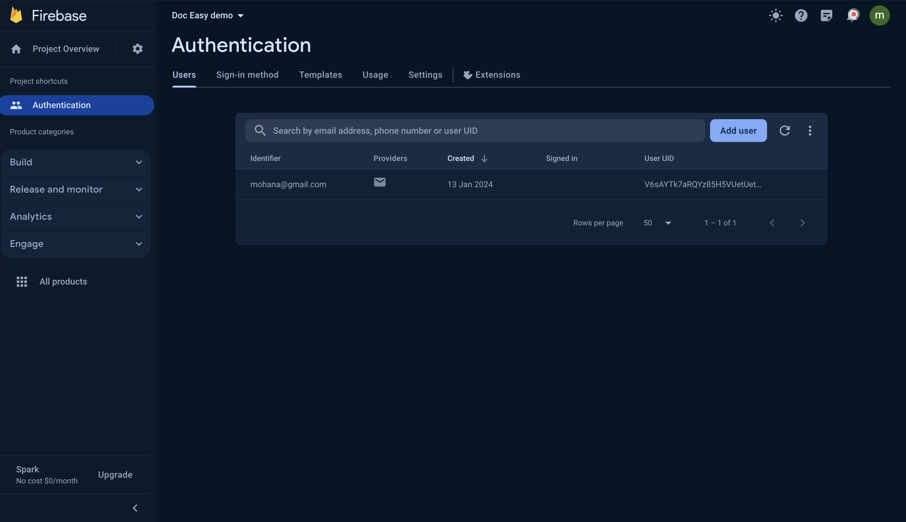
4.1 Firebase Authentication

Slide 10
4.2 Firebase Collections
In Firebase, a collection refers to a grouping of documents within Firestore, which is a document-oriented database.
Firestore organizes data into collections, and each collection contains individual documents.
The documents within a collection can have different fields, and Firestore automatically generates unique identifiers for each document within a collection.
Collections provide a way to structure and organize related data in a Firebase Firestore database.
Separate collections have been set up to store data regarding patients, appointments, and receptionists.

Slide 11
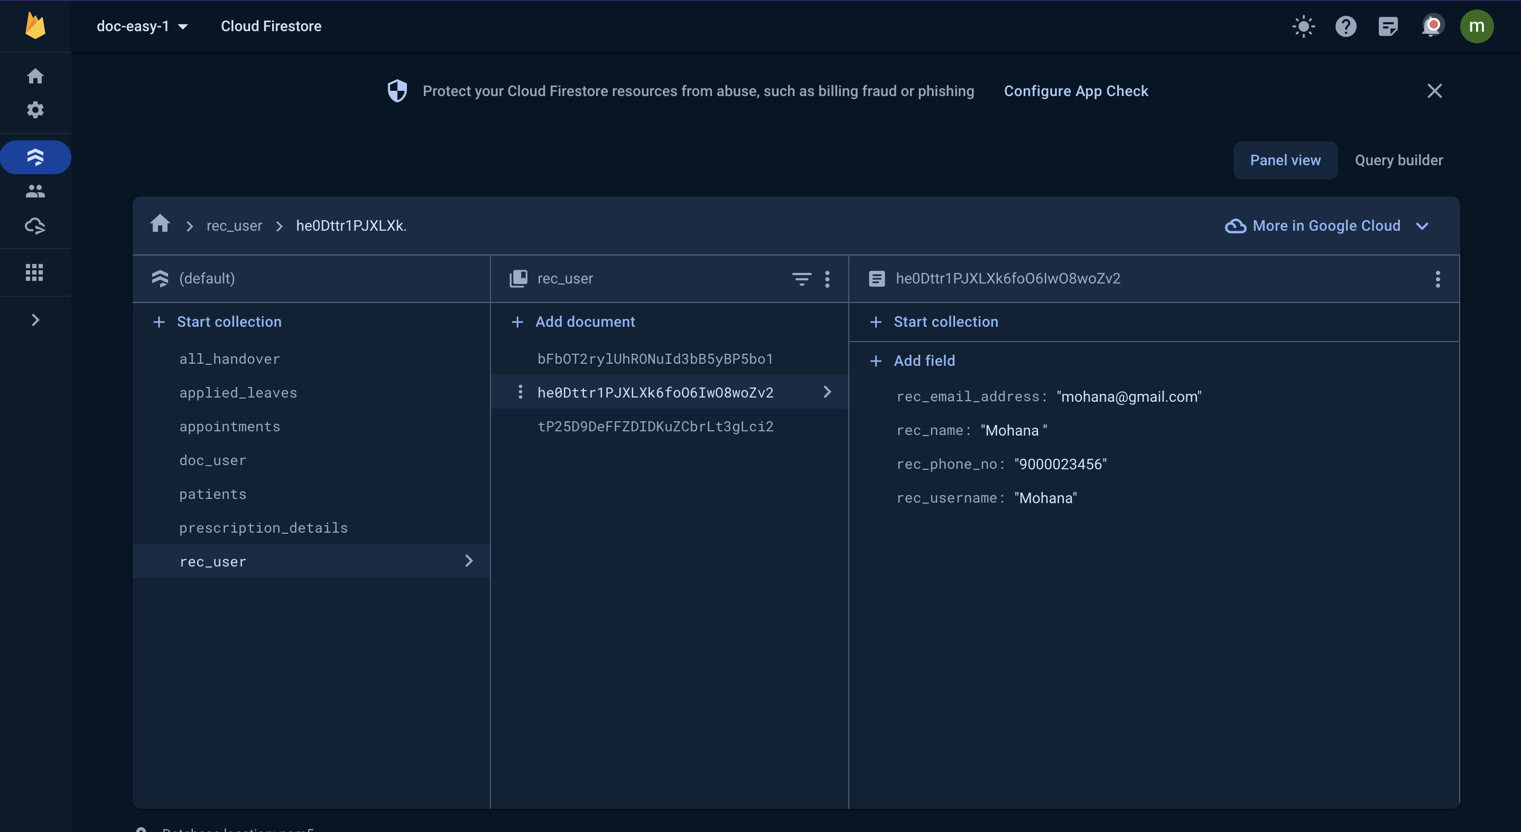
Receptionist Collection

Slide 12
Receptionist Collection
A collection named "rec_user" has been created to store details about receptionist, including their personal information and relevant data.
Fields have been added to the receptionist collection, that contains specific details about receptionist like Name, Username, Phone Number and Email address.

Slide 13
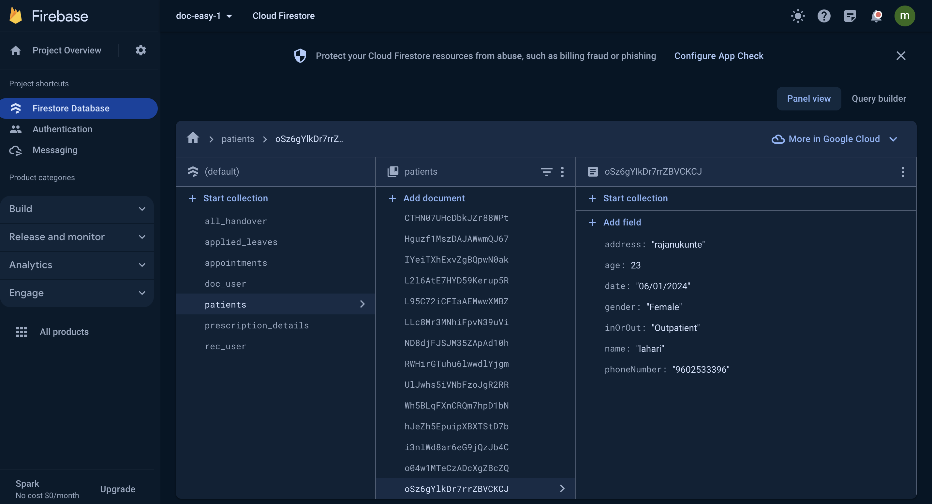
Patient Collection

Slide 14
Patients Collection
A collection named "Patients" has been created to store details about patients, including their personal information and relevant data.
Fields have been added to the patient collection, that contains specific patient details like Patient Name, Age, Gender, Phone Number, InorOut Patient and Address.

Slide 15
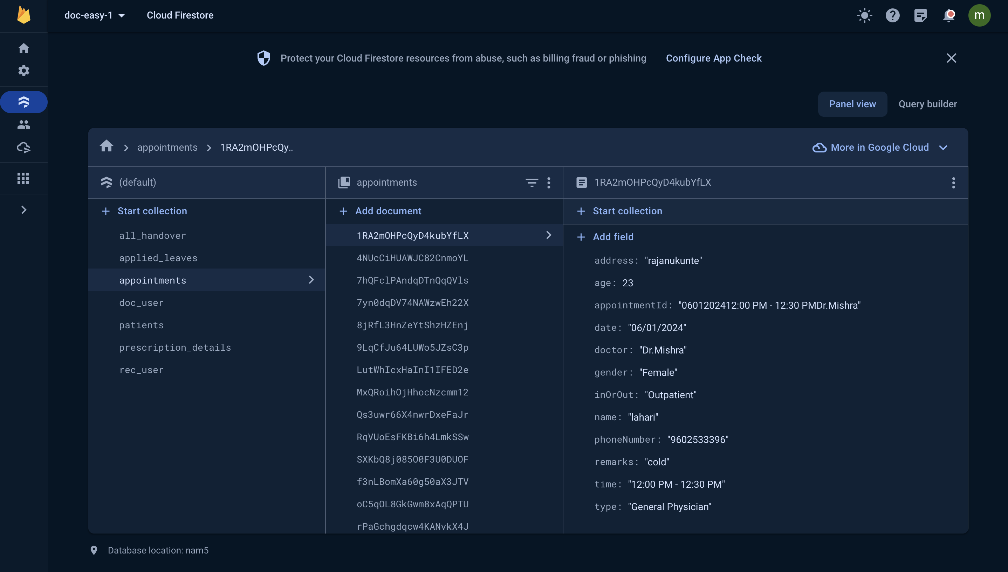
Appointments Collection

Slide 16
Appointments Collection
A collection named "appointments" has been created to store details about individual appointments, including their personal information and relevant data.
Fields have been added to the appointments collection, that contains specific patient details like Patient's Name, Age, Gender, Phone Number, InorOut Patient, Address, Doctor's Name,
Speciality, Remarks , Appointment Date and Time.

Slide 17
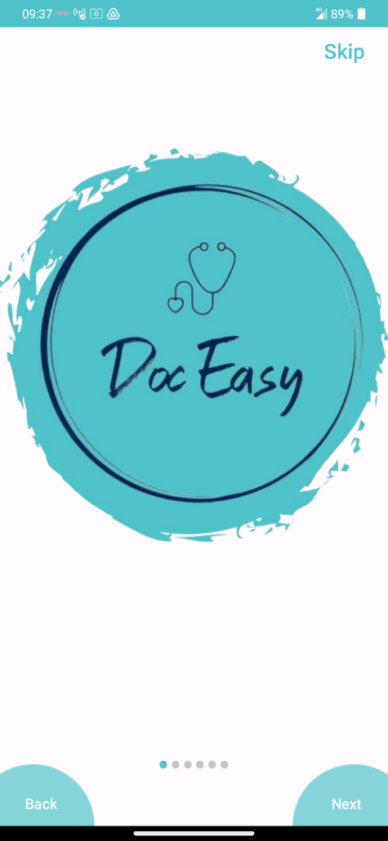
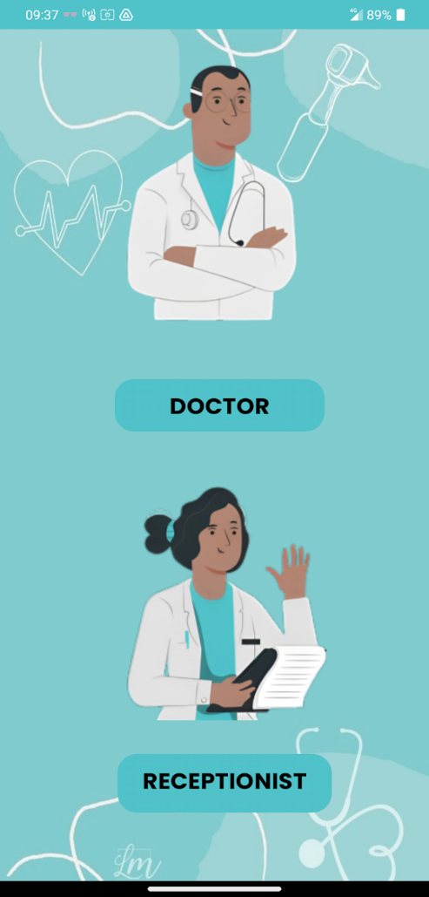
5.Results

Slide 18
5.Results
Algorithm:
The `UserType` class extends `AppCompatActivity`which represents a page where the user can choose their type: either "Doctor" or "Receptionist".
The class declares two `Button` instance variables: `doctor` and `receptionist`. These buttons are initialized in the `onCreate` method by linking them to their corresponding views in the layout file.
Click listeners are set up for both buttons. When the `doctor` button is clicked, an `Intent` is created to start the `DocLoginPage` activity, and the current activity is finished. Similarly, when the `receptionist` button is clicked, an `Intent` is created to start the `RecLoginPage` activity, and the current activity is finished.
This class essentially serves as a gateway for users to navigate to the appropriate login page based on their user type. It's a common design pattern in applications that have different user roles with different permissions and functionalities.
The `finish` method call ensures that the `UserType` activity is removed from the back stack, preventing users from navigating back to it once they've chosen their user type and moved to the corresponding login page. This can be useful in situations where you want to prevent users from changing their user type without logging out first.

Slide 19
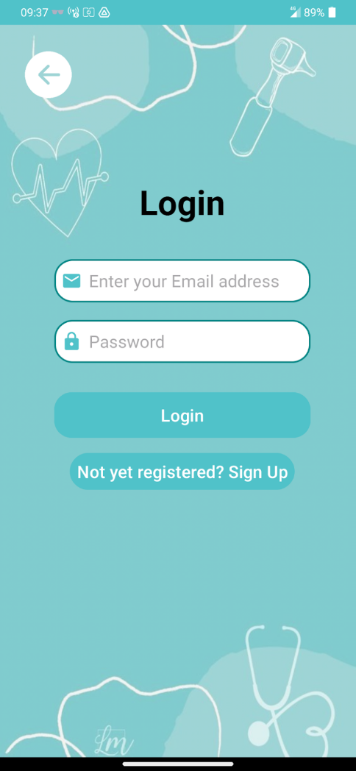
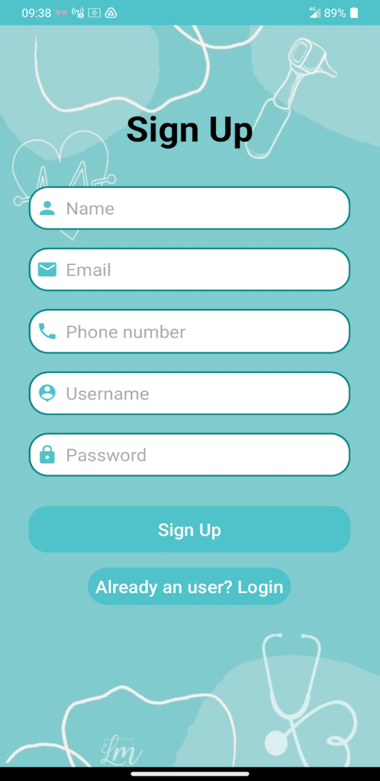
5.Results

Slide 20
Receptionist Login
Algorithm:
The `RecLoginPage` class extends `AppCompatActivity` and represents a login page for a user type referred to as "Rec".
The class declares several instance variables for UI elements such as `EditText` fields for email and password, `Button` objects for login and signup redirection, an `ImageView` for a back button, a `ProgressBar`, and a `FirebaseAuth` object for handling authentication.
The `onCreate` method is overridden to set up the initial state of the activity. It initializes the UI elements by linking them to their corresponding views in the layout file, and sets up the Firebase authentication instance.
If a user is already signed in, the `startMainActivity` method is called, which starts the `RecHomePage` activity and finishes the current one.
Click listeners are set up for the signup redirection and login buttons. The signup redirection button starts the `RecSignupPage` activity when clicked. The login button retrieves the entered email and password, validates them, and attempts to sign in the user using Firebase authentication. If the sign-in task is successful, the `RecHomePage` activity is started.

Slide 21
Receptionist Sign-Up
Algorithm:
Here, the Java code class`RecSignupPage` extends `AppCompatActivity’ and represents a signup page for a user type referred to as "Rec".
The class declares several instance variables for UI elements such as `EditText` fields for name, username, email, password, and phone number, a `TextView` for login redirection, a `Button` for signup, a `FirebaseAuth` object for handling authentication, a `ProgressBar`, and a `FirebaseFirestore` object for handling database operations.
The `onCreate` method is overridden to set up the initial state of the activity. It initializes the UI elements by linking them to their corresponding views in the layout file, and sets up the Firebase authentication and Firestore instances.
Click listeners are set up for the login redirection and signup buttons. The login redirection button starts the `RecLoginPage` activity when clicked.
The signup button retrieves the entered details, validates them, and attempts to create a new user using Firebase authentication.
If the user creation task is successful, it's likely that the user's details are stored in Firestore and the `RecHomePage` activity is started.

Slide 22
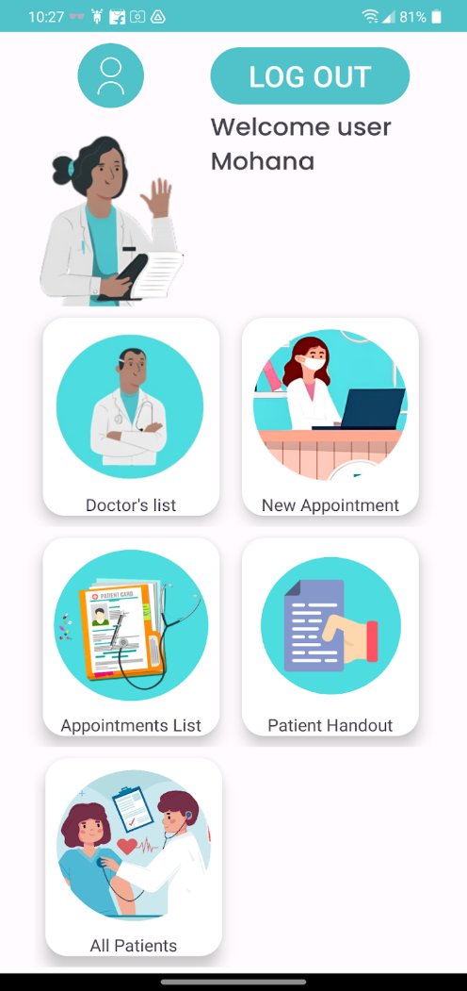
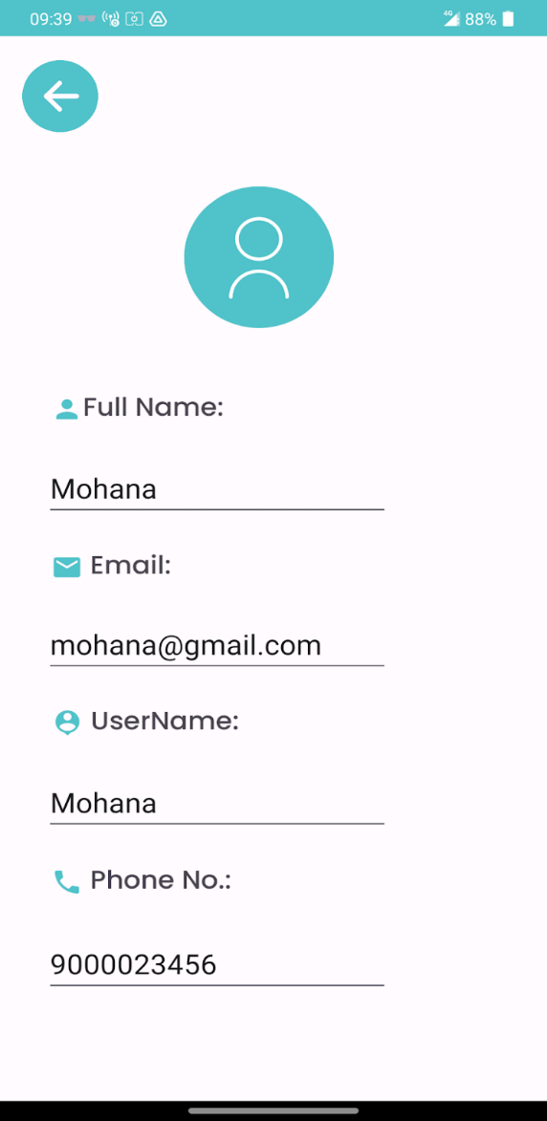
5.Results

Slide 23
Receptionist Dashboard
Algorithm:
The `RecHomePage` class extends `AppCompatActivity`and represents the home page for a user type referred to as "Rec".
This class declares several instance variables for UI elements such as `CardView` objects for different features like adding a new appointment, viewing handovers, appointments list, all doctors, and all patients. It also includes an `ImageView` for the profile, a `Button` for logout, a `FirebaseFirestore` object for handling database operations, a `TextView` for displaying the username, and a `FirebaseAuth` object for handling authentication.
The `onCreate` method is overridden to set up the initial state of the activity. It initializes the UI elements by linking them to their corresponding views in the layout file, and sets up the Firebase authentication and Firestore instances.
Click listeners are set up for the different features. When clicked, they start the corresponding activities. For example, clicking on the `addNewAppointment` CardView starts the `NewAppointmentPage` activity.
The `logout` method signs out the user using Firebase authentication, removes the "role" from shared preferences, and starts the `RecLoginPage` activity.
The `userID` is retrieved from the current Firebase user, and a `DocumentReference` is created to the user's document in the "rec_user" collection in Firestore. A snapshot listener is added to the document reference, which updates the `welcome_username` TextView with the user's username whenever the document changes.
This algorithm provides a comprehensive overview of the app's structure and its interactions with the Android system and Firebase. It's a vital part of the app's source code and plays a crucial role in how the app operates and interacts with the device's operating system.

Slide 24
Receptionist Profile
Algorithm:
The `RecProf` class extends `AppCompatActivity`and represents a profile page for a user type referred to as "Rec".
The class declares several instance variables for UI elements such as `EditText` fields for name, email, username, and phone number, an `ImageView` for a back button, a `FirebaseAuth` object for handling authentication, and a `FirebaseFirestore` object for handling database operations.
The `onCreate` method is overridden to set up the initial state of the activity. It initializes the UI elements by linking them to their corresponding views in the layout file, and sets up the Firebase authentication and Firestore instances.
The `userID` is retrieved from the current Firebase user, and a `DocumentReference` is created to the user's document in the "rec_user" collection in Firestore. A snapshot listener is added to the document reference, which updates the `EditText` fields with the user's details whenever the document changes.
A click listener is set up for the `back_button`. When clicked, it creates an intent to start the `RecHomePage` activity and finishes the current one.
This class provides a comprehensive overview of the app's structure and its interactions with the Android system and Firestore. It's a vital part of the app's source code and plays a crucial role in how the app operates and interacts with the device's operating system.
It allows the user to view their profile details and navigate back to the home page. The use of intents to navigate between activities is a common pattern in Android development.
The `finish` method call ensures that the `RecProf` activity is removed from the back stack, preventing users from navigating back to it once they've navigated away. This can be useful in situations where you want to prevent users from accessing certain pages without going through a specific flow. For example, you might want to prevent users from accessing their profile page without first logging in.

Slide 25
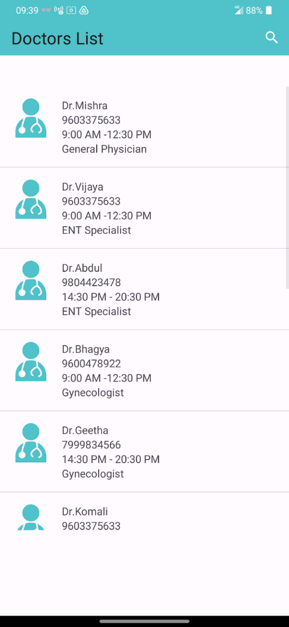
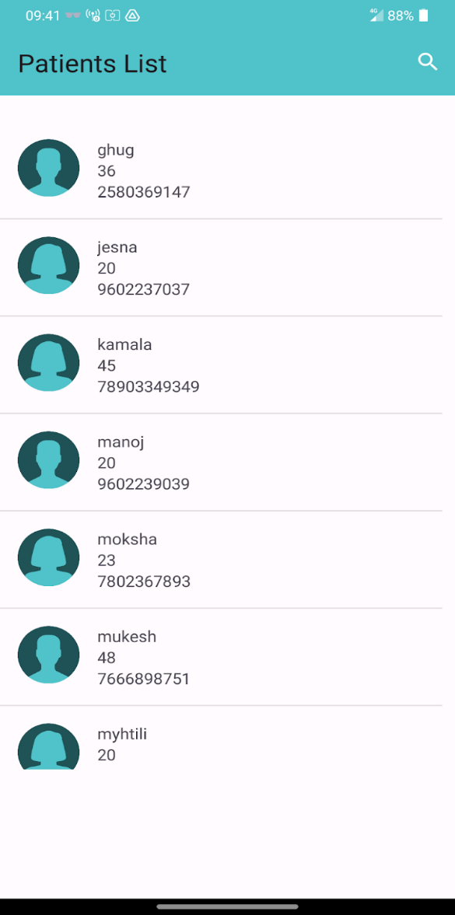
5.Results

Slide 26
List of Doctors
Algorithm:
The `AllDoctors` class extends `AppCompatActivity` and represents a page displaying a list of all doctors.
The class declares several instance variables for UI elements such as a `ListView` for displaying the doctors, an `ArrayList` for storing the doctors, a custom `DoctorAdapter` for adapting the doctors to the `ListView`, a `FirebaseFirestore` object for handling database operations, and a `Toolbar`.
The `onCreate` method is overridden to set up the initial state of the activity. It initializes the UI elements by linking them to their corresponding views in the layout file, sets up the Firestore instance, creates the `DoctorAdapter`, and sets the adapter for the `ListView`.
The `EventChangeListener` method sets up a snapshot listener on the "doc_user" collection in Firestore, ordered by username. When a new document is added to the collection, a new `Doctor` object is created from the document, added to the `doctorArrayList`, and the `doctorAdapter` is notified of the change.
The `onCreateOptionsMenu` method inflates a menu with a `SearchView`. The `SearchView` is set up with a query hint and a query text listener. When the query text changes, the `filterdoctorsBySearch` method is called with the new text.
The `filterdoctorsBySearch` method creates a new `ArrayList` of doctors that match the query, either by username, phone number, or specialty. A new `DoctorAdapter` is created with the filtered doctors and set as the adapter for the `ListView`.
The code seems to be cut off at the end, so it's unclear what happens in the `onPostCreate` method. However, it's likely that it performs some additional setup after the activity has been created.
This class provides a comprehensive overview of the app's structure and its interactions with the Android system and Firestore. It's a vital part of the app's source code and plays a crucial role in how the app operates and interacts with the device's operating system. It allows the user to view a list of all doctors, filter the list by a search query, and navigate to other pages. The use of a custom adapter and a `ListView` allows for efficient display and scrolling of large lists.

Slide 27
List of Patients
Algorithm:
The`AllPatients` class in this code extends `AppCompatActivity’ and represents a page displaying a list of all patients.
The class declares several instance variables for UI elements such as a `ListView` for displaying the patients, an `ArrayList` for storing the patients, a custom `PatientAdapter` for adapting the patients to the `ListView`, a `FirebaseFirestore` object for handling database operations, and a `Toolbar`.
The `onCreate` method is overridden to set up the initial state of the activity. It initializes the UI elements by linking them to their corresponding views in the layout file, sets up the Firestore instance, creates the `PatientAdapter`, and sets the adapter for the `ListView`.
The `EventChangeListener` method sets up a snapshot listener on the "patients" collection in Firestore, ordered by name. When a new document is added to the collection, a new `Patient` object is created from the document, added to the `patientArrayList`, and the `patientAdapter` is notified of the change.
The `onCreateOptionsMenu` method inflates a menu with a `SearchView`. The `SearchView` is set up with a query hint and a query text listener. When the query text changes, the `filterpatientsBySearch` method is called with the new text.
The `filterpatientsBySearch` method creates a new `ArrayList` of patients that match the query, either by name or phone number. A new `PatientAdapter` is created with the filtered patients and set as the adapter for the `ListView`.
The code seems to be cut off at the end, so it's unclear what happens in the `onPostCreate` method. However, it's likely that it performs some additional setup after the activity has been created.
This class provides a comprehensive overview of the app's structure and its interactions with the Android system and Firestore. It's a vital part of the app's source code and plays a crucial role in how the app operates and interacts with the device's operating system. It allows the user to view a list of all patients, filter the list by a search query, and navigate to other pages. The use of a custom adapter and a `ListView` allows for efficient display and scrolling of large lists.

Slide 28
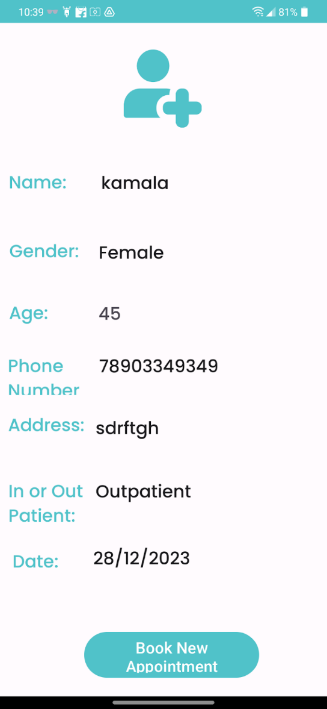
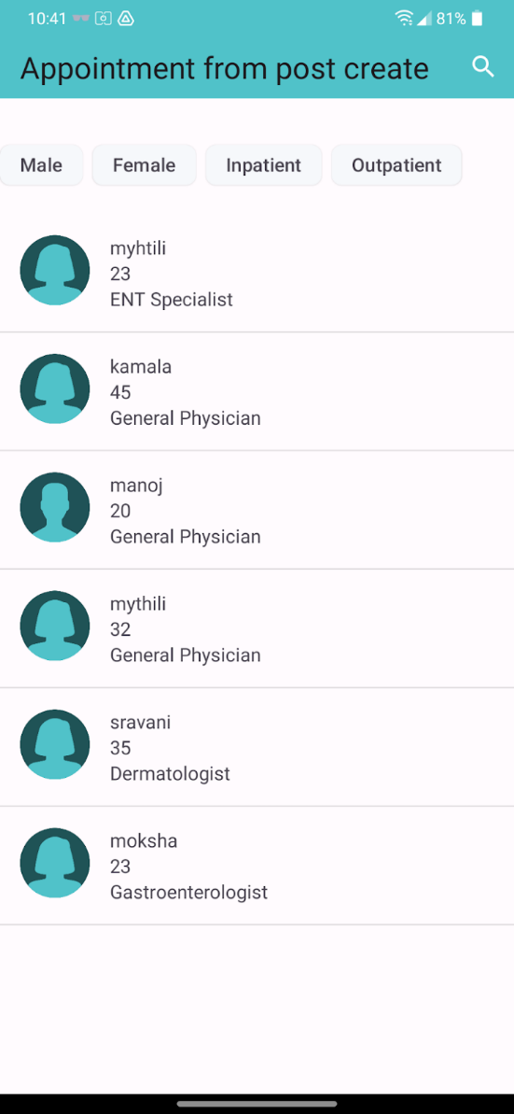
5.Results

Slide 29
Patient Details
Algorithm:
Patient Details can be created and viewed by the receptionists. The `PatientDetails` class extends `AppCompatActivity`. This class represents a page displaying the details of a patient.
The class declares several instance variables for UI elements such as `EditText` fields for name, gender, phone number, address, in-patient or out-patient status, and date. It also includes a `Button` for booking an appointment, a `TextView` for age, and a `FirebaseFirestore` object for handling database operations.
The `onCreate` method is overridden to set up the initial state of the activity. It initializes the UI elements by linking them to their corresponding views in the layout file, and sets up the Firestore instance.
The patient's details are retrieved from the intent extras and set in the corresponding `EditText` fields. The patient's age is converted to a string and set in the `textView_age` TextView.
A click listener is set up for the `bookappointment` button. When clicked, it creates a bundle with the patient's details, creates an intent to start the `NewAppointmentPageContinued` activity, puts the bundle in the intent, and starts the activity.
This class provides a comprehensive overview of the app's structure and its interactions with the Android system and Firestore. It's a vital part of the app's source code and plays a crucial role in how the app operates and interacts with the device's operating system.
It allows the user to view a patient's details and book an appointment for them. The use of intents and bundles to pass data between activities is a common pattern in Android development.
The `finish` method call ensures that the `PatientDetails` activity is removed from the back stack, preventing users from navigating back to it once they've chosen their user type and moved to the corresponding login page.
This can be useful in situations where you want to prevent users from changing their user type without logging out first.

Slide 30
List of Appointments
Algorithm:
This Java code is part of an Android application, specifically the `AllAppointments` class which extends `AppCompatActivity`. This class represents a page displaying a list of all appointments.
The class declares several instance variables for UI elements such as a `ListView` for displaying the appointments, an `ArrayList` for storing the appointments, a custom `AppointmentAdapter` for adapting the appointments to the `ListView`, a `FirebaseFirestore` object for handling database operations, a `Toolbar`, and a `ChipGroup`.
The `onCreate` method is overridden to set up the initial state of the activity. It initializes the UI elements by linking them to their corresponding views in the layout file, sets up the Firestore instance, creates the `AppointmentAdapter`, and sets the adapter for the `ListView`.
The `showAllAppointments` method (which is not shown in the provided code) presumably retrieves all appointments from Firestore and adds them to the `mAppointments` ArrayList.
The `filterChips` ArrayList is populated with several strings representing different filters. For each filter, a `Chip` is created, given an ID, and added to the `chipGroup`.
A checked state change listener is set up for the `chipGroup`. When the checked state changes, it checks which chips are checked and calls the appropriate filtering or sorting method based on the chip's text. If no chips are checked, it calls the `showAllAppointments` method.
The `sortAppointmentsByAge` method clears the `mAppointments` ArrayList, notifies the `adapter1` of the change, and then retrieves the appointments from Firestore ordered by age in ascending order. The code seems to be cut off at the end, so it's unclear what happens after the appointments are retrieved.
This class provides a comprehensive overview of the app's structure and its interactions with the Android system and Firestore. It's a vital part of the app's source code and plays a crucial role in how the app operates and interacts with the device's operating system. It allows the user to view a list of all appointments, filter and sort the list using chips, and navigate to other pages.
The use of a custom adapter and a `ListView` allows for efficient display and scrolling of large lists. The snapshot listener ensures that the list is always up-to-date with the latest data from Firestore, and the chip functionality allows the user to easily filter and sort the appointments. The `AllAppointments` class is a good example of how to use Firestore, `ListView`s, adapters, and chips to create a dynamic and interactive list page in an Android app.

Slide 31
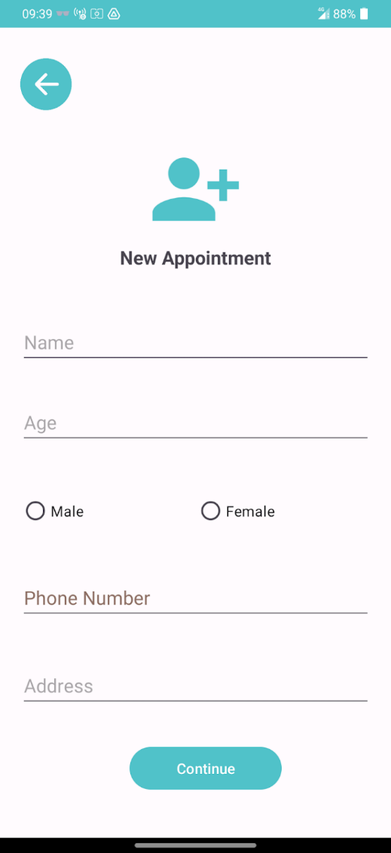
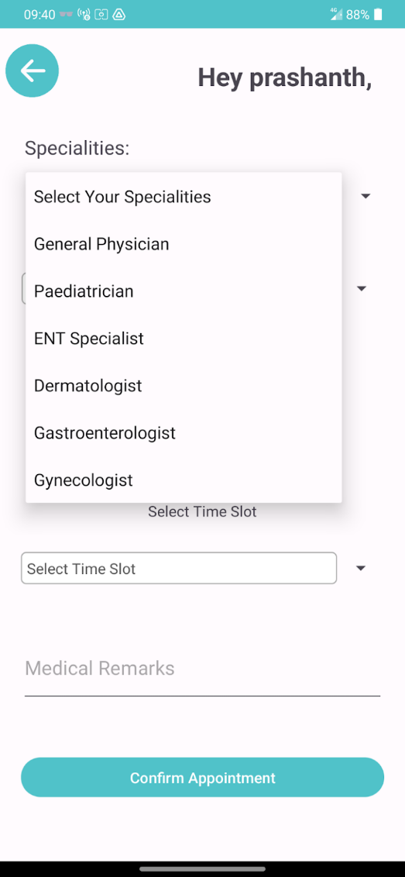
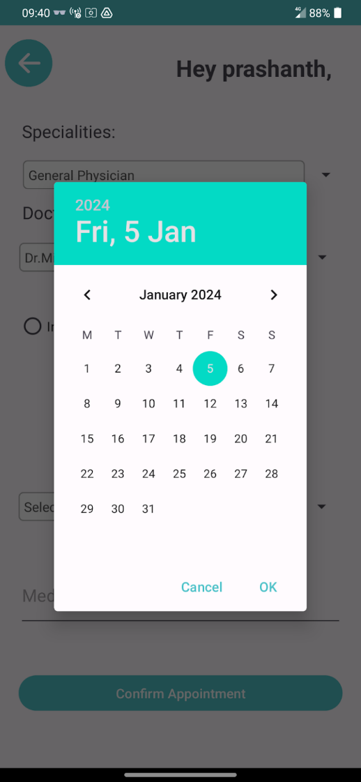
New Appointments

Slide 32
New Appointments
New Appointments Algorithm:
`Appointment` is defined in the package `com.example.doc_easy_1`. The `Appointment` class is a data model that represents an appointment in the context of the application. It contains several private fields to store information about an appointment, such as:
- `mName`: The name of the person who has the appointment.
- `mAge`: The age of the person.
- `mGender`: The gender of the person.
- `mType`: The type of appointment.
- `mid`: A unique identifier for the appointment.
- `mRemarks`: Any remarks or notes associated with the appointment.
- `time`: The time of the appointment.
- `doctor`: The doctor with whom the appointment is.
- `date`: The date of the appointment.
- `inOrOut`: Whether the appointment is for an inpatient or outpatient.
- `address`: The address of the appointment.
- `phoneNumber`: The phone number of the person who has the appointment.
The class provides a default constructor (which is required for Firestore deserialization) and a parameterized constructor to create an instance of `Appointment` with specific details.
It also provides getter and setter methods for each field, allowing the values of these fields to be read (getters) and modified (setters). These methods follow the standard Java naming conventions for getters and setters.
This class is likely used in conjunction with Firebase Firestore to store and retrieve appointment data. The data can be serialized into an `Appointment` object when it is retrieved from Firestore, and an `Appointment` object can be deserialized into data that can be stored in Firestore when it is saved. This makes it easier to work with the data in the Android application, as you can work with `Appointment` objects instead of raw data.
The `Appointment` class is a good example of a simple, well-structured data model in Java. It encapsulates the data and provides methods to access and modify it, making it easier to manage the data and ensure its integrity. The use of private fields and public getter and setter methods follows the principle of encapsulation in object-oriented programming, which helps to protect the data and make the code more maintainable. The `Appointment` class could be used in a variety of contexts in

Slide 33
New Appointments
New Appointments Algorithm:
the NewAppointmentPage class which extends AppCompatActivity. This class represents a page for creating a new appointment.
The class declares several instance variables for UI elements such as EditText fields for name, age, phone number, and address, RadioButton objects for gender selection, a Button for continuing to the next page, and a few other elements.
The onCreate method is overridden to set up the initial state of the activity. It initializes the UI elements by linking them to their corresponding views in the layout file.
A click listener is set up for the continueBtn. When clicked, it retrieves the entered details, validates them, and if valid, creates a bundle with the details, creates an intent to start the NewAppointmentPageContinued activity, puts the bundle in the intent, and starts the activity.
Another click listener is set up for the backbutton. When clicked, it creates an intent to start the RecHomePage activity and finishes the current one.

Slide 34
6.Conclusion
We were able to develop the DocEasy application up to where it is able to display the launch screen (splash screen) upon launching the application.
After that, the login screen is displayed where the user has to select between Doctor and Receptionist dashboards.
The user is then directed to the actual login pages themselves, and after logging in, is lead to their respective dashboard.
If the user has not registered yet, they may be directed to the sign up page when they tap the ‘Sign Up’ button.
This function works for both interfaces.
In conclusion, the development of a comprehensive mobile app aimed at assisting doctors in planning appointments, managing out-patient and in-patient care, and facilitating seamless patient handovers during leaves holds significant potential to enhance healthcare delivery.

Slide 35
7.Expected Outcomes
The expected outcomes of this project are:
A working Design for Login Page and Signup page for Receptionist.
Successful Creation of Firebase Authentication to integrate sign-up and sign-in functionality of doctor and receptionist into the Application.
Successful Create a database collection for Receptionist, Patients and Appointments.
A thoughtfully crafted homepage for Receptionist.

Slide 36
Thank You

