Slide 1
Applications of Artificial Intelligence in Dementia Research
Eunseo Choi 02315996

Slide 2
Table of contents
01
02
03
04
Introduction
Neuroimaging
Speech and Language
Drug Discovery
2/11

Slide 3
Introduction: Why Artificial Intelligence?
Artificial Intelligence
Dementia
Alzheimer Disease
: slows down memory, thinking, language
↓
Machine learning
Difficult to detect early
→ changes in brain/speech
Brain images, language tests, medical data
→ not always easy to find hidden patterns
↓
Deep Learning
3/11

Slide 4
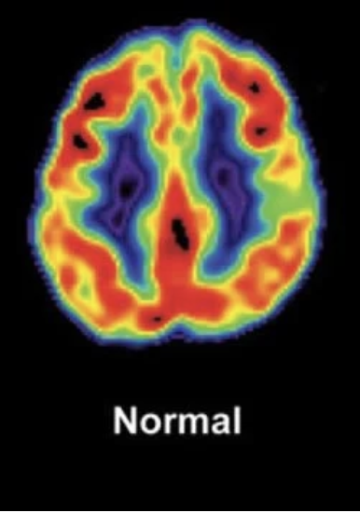
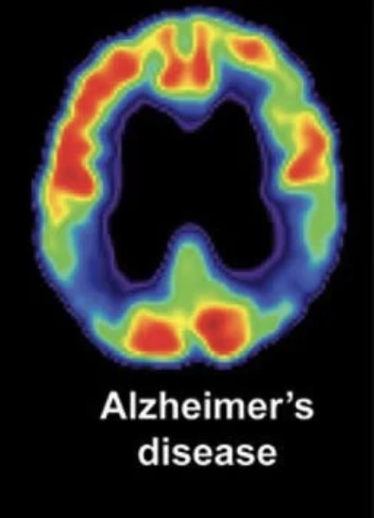
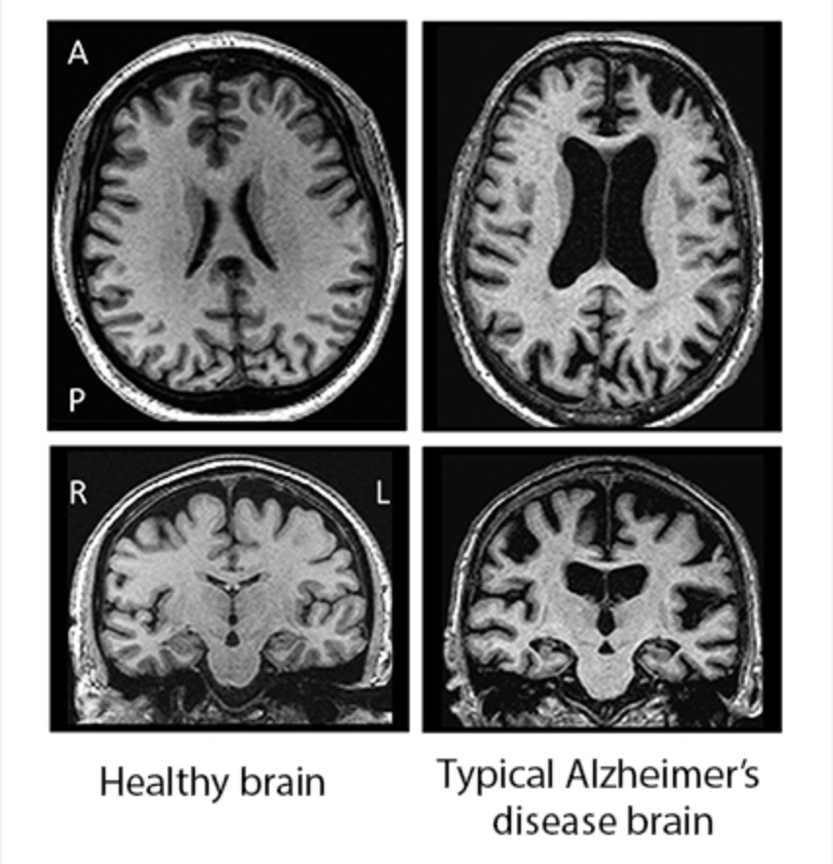
Neuroimaging: CNN
CNN
: find Alzheimer’s Disease from brain images
PET
MRI
Some parts slowly change:
brain areas can shrink
grey matter may change
hippocampus may become smaller
Theses images show the structure activity of the brain
- CNN helps by learning small patterns from many brain images in AD patients and normal patients → automatically decides group
4/11

Slide 5
Speech and Language: NLP + CNN/LSTM-RNN
Speech converted to written script
NLP
CNN
LSTM-RNN
LSTM-CNN
Participants speak
- It studies the language inside the speech,
such as words, grammar, sentence structure, and repeated phrases
- NLP help computer process the transcript by turning word patterns
→ numerical information that the neural network can understand
5/11

Slide 6
Speech and Language: NLP + CNN/LSTM-RNN
CNN
- Each word in the transcript is changed into a word vector
- Uses filters to scan small groups of words
- Checks which word groups are important
“uh the boy is taking cookies”
“uh the boy”
“the boy is”
“boy is taking”
“is taking cookies”
6/11

Slide 7
Speech and Language: NLP + CNN/LSTM-RNN
LSTM-RNN
- It starts from the first word and moves to the next one by one
- Tries to remember what appeared earlier in the sentence
“The mother is washing dishes, and the boy is taking cookies.”
“The mother is… uh… and the boy… I don’t know… water…”
Unclear, repeats something, loses connection between ideas
→ weak sequences
7/11

Slide 8
Speech and Language: NLP + CNN/LSTM-RNN
CNN-LSTM
- Combines the two methods
- CNN scans the sentence and finds small patterns
- LSTM reads those extracted pattens in order and checks how they connect in the sentence
“uh” “I don’t know” “the boy” repeated filler words
“uh… the boy… and… I don’t know… the mother…”
8/11

Slide 9
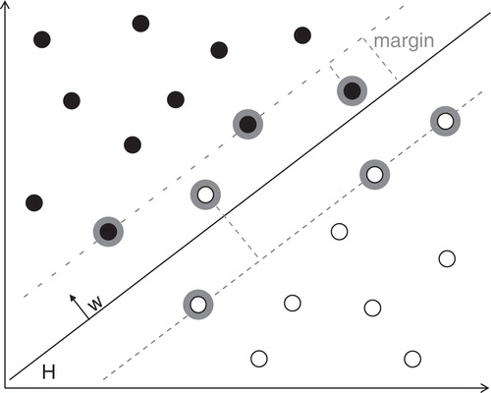
Drug Discovery: SVM
SVM : find good drug candidates from a very large number of compounds → narrow down the huge number of possible compounds
Hyperplane
Margin: widest space in active & inactive
Active Compounds
Inactive Compounds
Researchers already have some compounds that were tested before
Compound information(molecular structure, size, charge, etc.)
SVM places these compounds in data space, separate the active and inactive
9/11

Slide 10
References
Tsoi, K. K. F., Jia, P., Dowling, N. M., Titiner, J. R., Wagner, M., Capuano, A. W., & Donohue, M. C. (2022). Applications of artificial intelligence in dementia research. Cambridge Prisms Precision Medicine, 1, e9. https://doi.org/10.1017/pcm.2022.10
Ebrahimighahnavieh, M. A., Luo, S., & Chiong, R. (2020). Deep learning to detect Alzheimer’s disease from neuroimaging: A systematic literature review. Computer Methods and Programs in Biomedicine, 187, 105242. https://doi.org/10.1016/j.cmpb.2019.105242
Karlekar, S., Niu, T., & Bansal, M. (2018). Detecting linguistic characteristics of Alzheimer’s dementia by interpreting neuralmodels. arXiv. https://doi.org/10.48550/arXiv.1804.06440
Carpenter, K. A., & Huang, X. (2018). Machine learning-based virtual screening and its applications to Alzheimer’s drug discovery: A review. Current Pharmaceutical Design, 24(28), 3347–3358. https://doi.org/10.2174/1381612824666180607124038

Slide 11
Thank You

