Slide 1

B-CELL EPITOPE IDENTIFICATION USING
DEEP LEARNING MODELS
Jiyun Lee (02316434)
Dokyeong Kim (02503182)
CAI
1/11

Slide 2
CONTENTS
Step 04
Innovation
Step 02
Discussion
1. GraphBepi
2. MsgaBpred
3. RoBep
Feature Encoding: PACVF
2. ConvNN
Step 01
Introduction
Step 03
Limitation
Biological Background
2. Types of EPitope
Linear vs Static
2. Feature-engineering dependence
3. Biological Interpretability
CAI
2/11

Slide 3
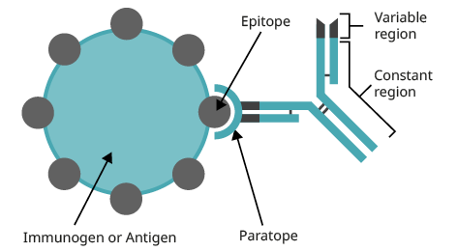
Biological Background
B-Cell Epitope
Target: Specific amino acid region on the antigen surface
Mechanism: Selectively recognized and bound
Interact with: Antibodies or B-cell receptors
CAI
3/11

Slide 4
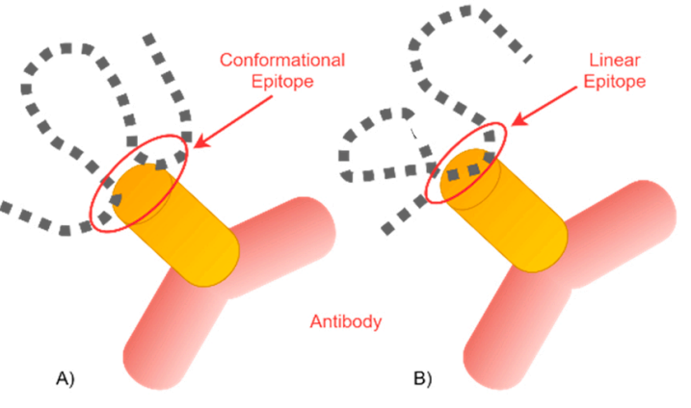
Types of Epitope
CAI
4/11

Slide 5
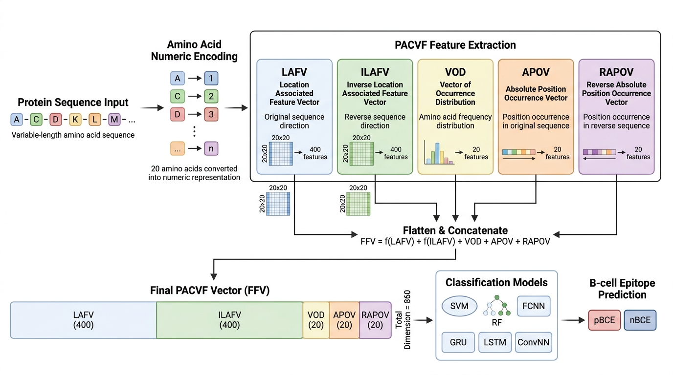
Feature Encoding : PACVF
(Position and Amino acid Composition Variant Feature)
CAI
5/11

Slide 6
Results
Model | mAP | Specificity | F-measure | MCC
ConvNN | 0.934 | 0.889 | 0.871 | 0.743
LSTM | 0.883 | 0.850 | 0.839 | 0.680
FCNN | 0.814 | 0.741 | 0.778 | 0.574
SVM | 0.601 | 0.722 | 0.350 | 0.674
BepiPred-2.0 | 0.506 | 0.599 | 0.579 | 0.164
ConvNN showed the strongest candidate-screening performance by ranking likely pBCEs higher, filtering out nBCEs, and maintaining balanced classification.
CAI
6/11

Slide 7
Why ConvNN Perfomed best
(Convolutional Neural Network)
Feature Engineering
(PACVF)
ConvNN
pBCE/nBCE
ConvNN performed better because linear epitopes contain short local patterns that convolution filters can detect,
while LSTM’s advantage in learning raw sequence dependency is limited after sequences are converted into fixed-size PACVF vectors.
CAI
7/11

Slide 8
LIMITATIONS
1. Linear & Static Sequence Views
Missing 3D spatial information
2. Feature Engineering Dependence
Limited automatic representation learning
3. Limited Biological Realism
Ignores dynamic antigen–antibody interactions
CAI
8/11

Slide 9
Innovation
GraphBepi
AlphaFold2 +EGNN
ESM-2 +BiLSTM
Linear/Static View ➔ 3D Spatial Context
MsgaBpred
AlphaFold3 + ESM-C,
Multi-Scale Distance Scanning GCN
Linear/Static Views ➔ Dynamic 3D Interaction,
Feature Blurring ➔ Multi-Scale Precision
RoBep
ESM-C + GNN
Linear/Static Views ➔ Dynamic 3D Interaction
MSA Bottleneck ➔ Computational Efficiency
CAI
9/11

Slide 10
REFERENCES
Abcam. (2024). Antibody basics. Abcam.com. https://www.abcam.com/en-us/technical-resources/guides/antibody-basics/antibody-basics
‌
Attique, M., Alkhalifah, T., Alturise, F., & Khan, Y. D. (2023). DeepBCE: Evaluation of deep learning models for identification of immunogenic B-cell epitopes. Computational Biology and Chemistry, 104, 107874. https://doi.org/10.1016/j.compbiolchem.2023.107874‌
Wang, S., Geng, A., Luo, Z., Li, Y., Xu, J., Meng, Y., Wei, L., Zou, Q., Zhang, Z., Wang, T., & Cui, F. (2026). MsgaBpred: A B-cell epitope predictor integrating AlphaFold3-predicted structures with multi-scale GCNs and pre-trained language model ESM-C. PLoS Computational Biology, 22(4), e1014195.
https://doi.org/10.1371/journal.pcbi.1014195
Xu, Y., Wei, G., Zhou, J., Huang, Y., Yu, W., Lin, Z., Liu, R., & Fan, X. (2026). RoBep: A region-oriented deep learning model for B-cell epitope prediction. Bioinformatics, 42(1), btag006. https://doi.org/10.1093/bioinformatics/btag006
CAI
10/11

Slide 11
THANK YOU
Jiyun Lee (02316134) Jiyunlee.Lee@ghent.ac.kr
Dokyeong Kim (02503182) Dokyeong.kim@ghent.ac.kr
11/11
CAI

