Slide 1
AI-guided gRNA Design for Optimized
CRISPR-Cas-based Pathogen Detection
Narim Kim , 22/06/2026

Slide 2
outline
Introduction
What is CRISPR?
Why Cas13?
Cas13-based pathogen detection
Problem – Guide RNA design bottleneck
Artificial Intelligent for crRNA design – DeepCas13
DeepCas13 overview
How DeepCas13 helps
Future perspective
Problem – Guide RNA design bottleneck
CRISPR × ML tools – DeepCas13
DeepCas13 overview
How DeepCas13 helps
Future perspective

Slide 3
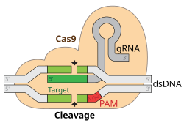
What is crispr
Clustered Regularly Interspaced Short Palindromic Repeats (CRISPR)
A bacterial immune system, repurposed into a programmable nucleic-acid targeting tool
Guide RNA (gRNA) decides what gets cut → guide design makes or breaks the whole system
Cas protein acts as molecular scissors that cut DNA or RNA

Slide 4
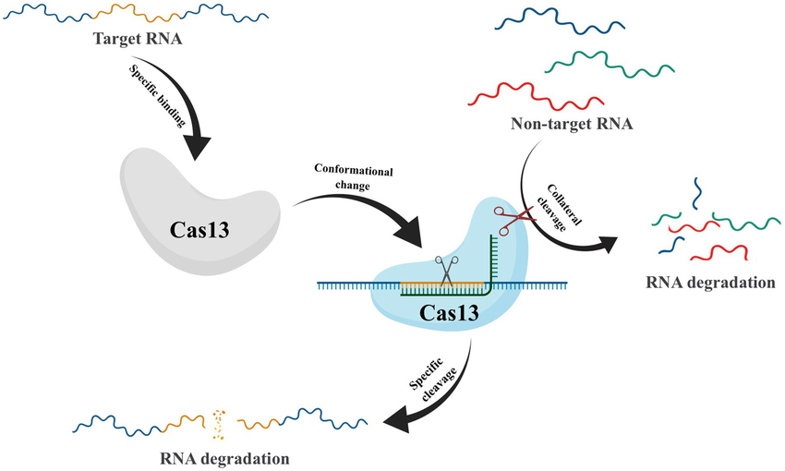
Why cas13?
Cas9 or Cas12 targets DNA , Cas13 targets RNA
Nearby RNA cut → detection signal
Target cleaved → RNA knockdown

Slide 5
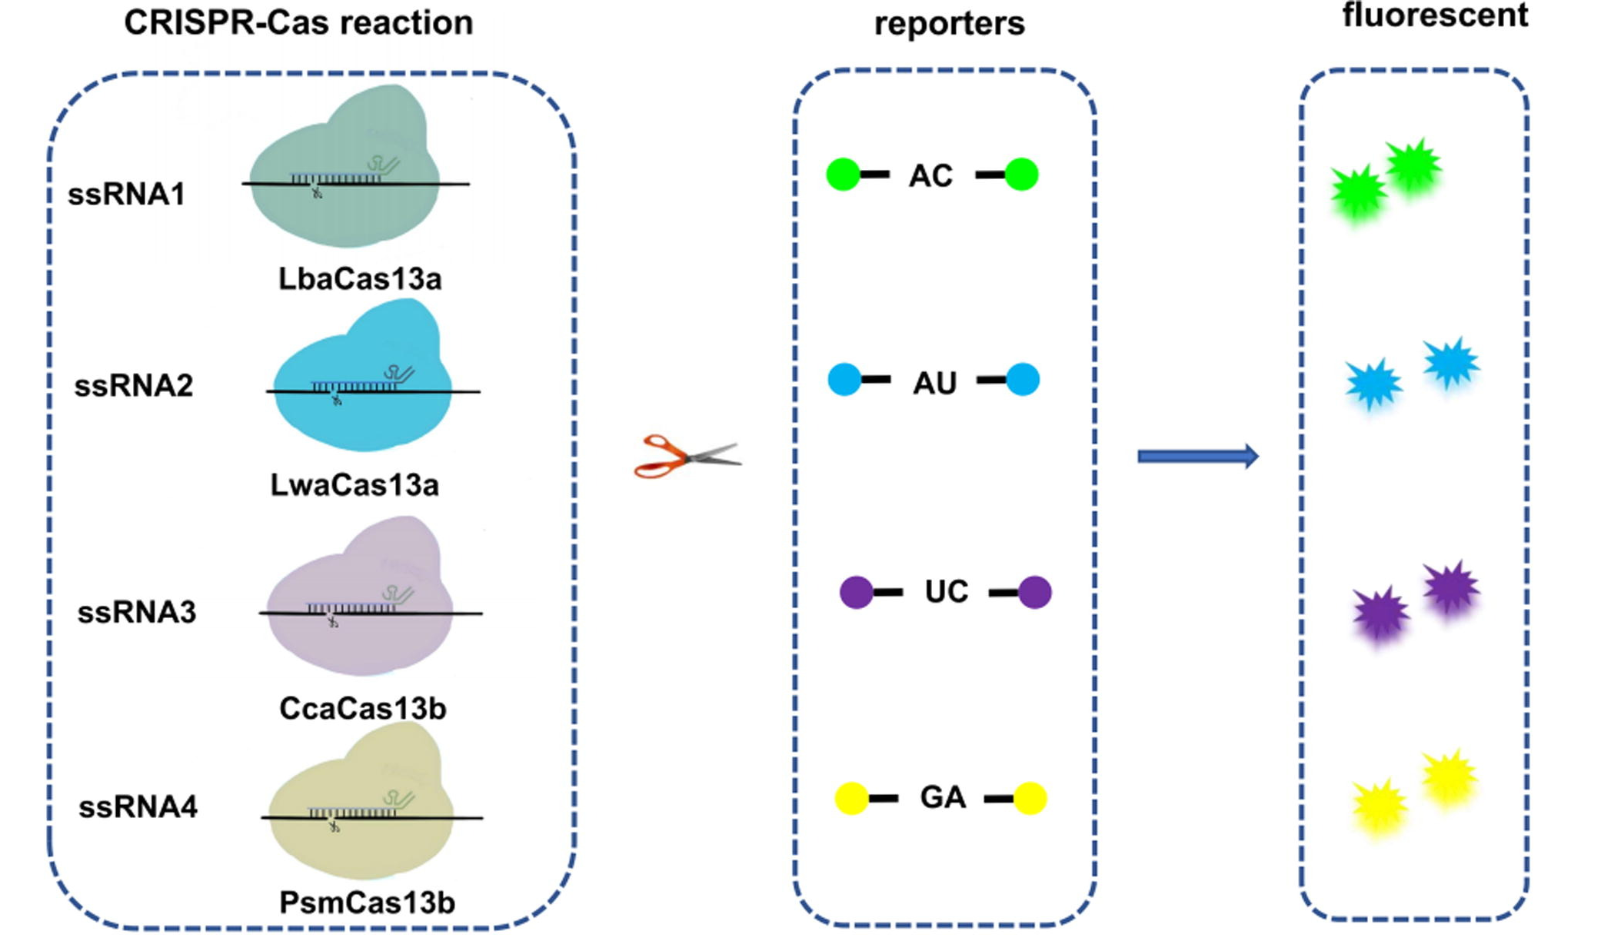
Why cas13?
Cas13 subtypes
Cas13a
Cas13b
Cas13d
etc.

Slide 6
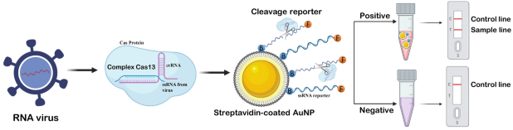
Cas13-based pathogen detection
Pathogen RNA → activation → signal
Pathogen RNA is recognized by a Cas13-crRNA complex
Target recognition activates Cas13, leading to collateral cleavage of reporter RNA
Reporter cleavage generates a detectable fluorescence or lateral-flow signal

Slide 7
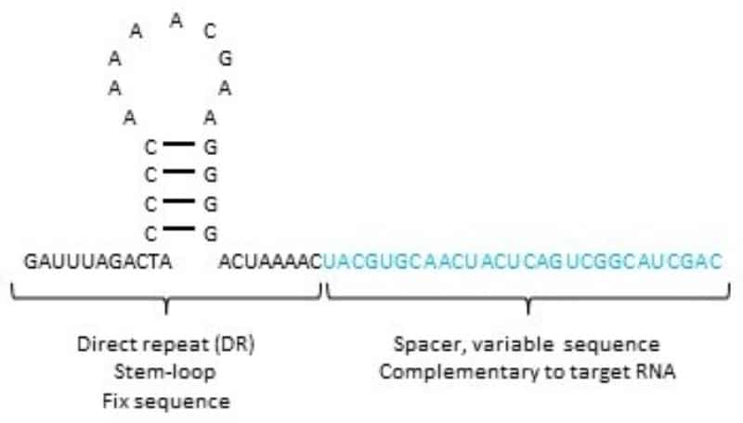
GRNA design bottleneck
Same Cas13 system, different spacer → very different activity
CrRNA is gRNA in CRISPR system
CrRNA design is predicting which spacer will actually work
Knockdown efficiency varies widely depending on spacer choice
→ Whatever Cas13, readout is only as good as the crRNA

Slide 8
GRNA design bottleneck
What makes crRNA design difficult?
Many interacting factors: crRNA sequence, target accessibility, RNA structure, and specificity all affect Cas13 activity
RNA structure uncertainty: target accessibility is difficult to predict because RNA folding can change inside cells
Off-target risk: similar transcripts or pathogen variants can cause off-target binding or weak detection signals
→ Slow, costly, hard to generalize

Slide 9
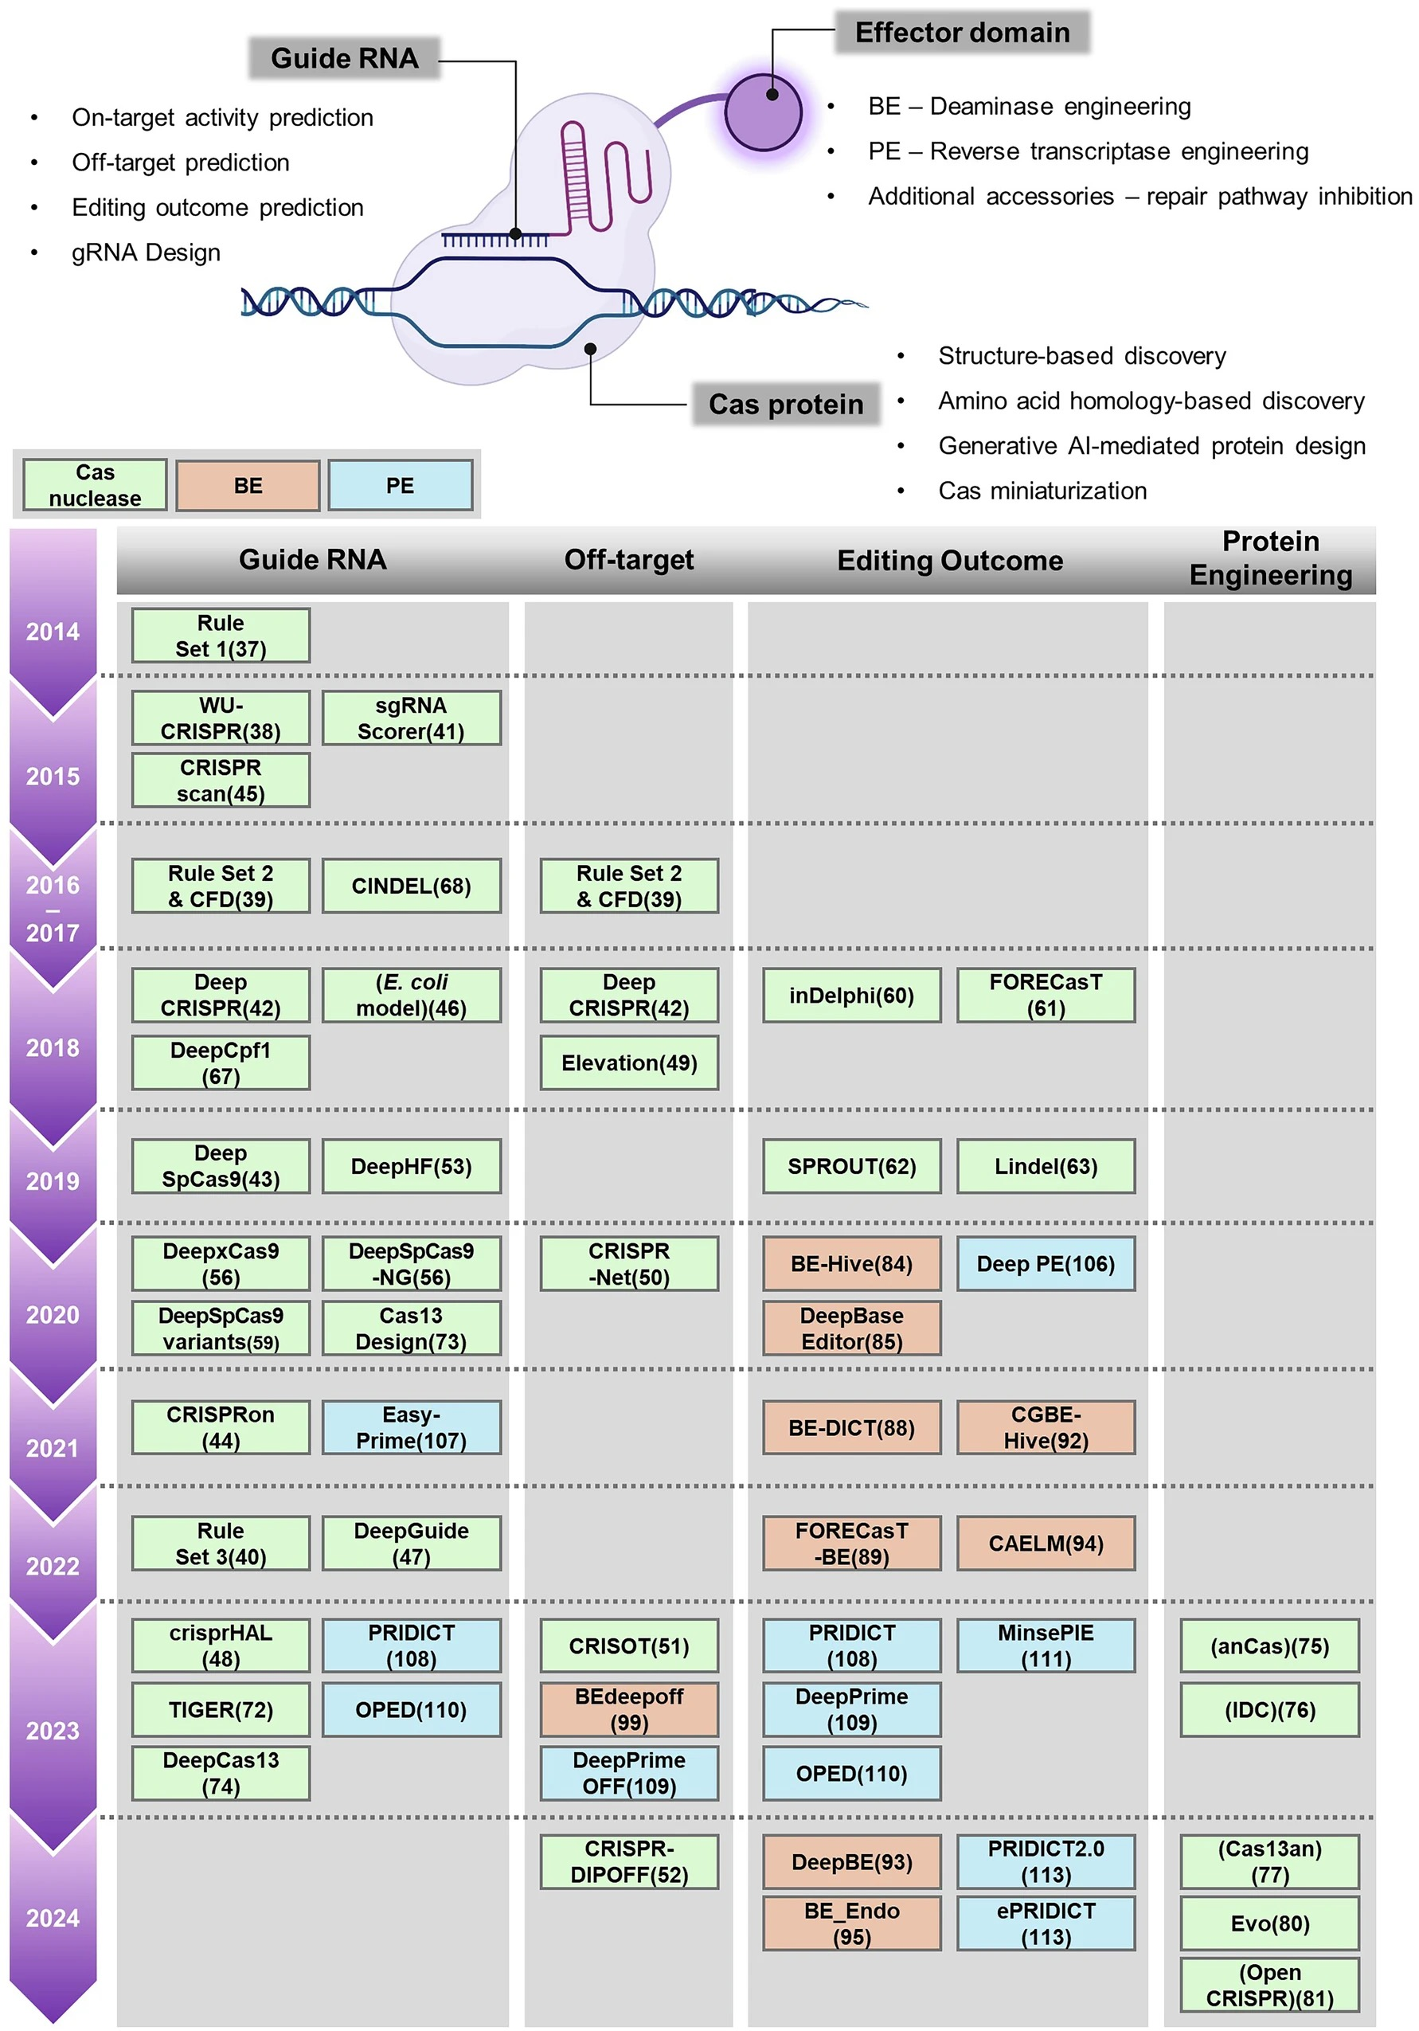
Artificial Intelligent for crrNA design
AI reduces trial-and-error
Prediction-guided screening starts from likely high-performing guides
Score candidate crRNAs first, then validate only a short list

Slide 10
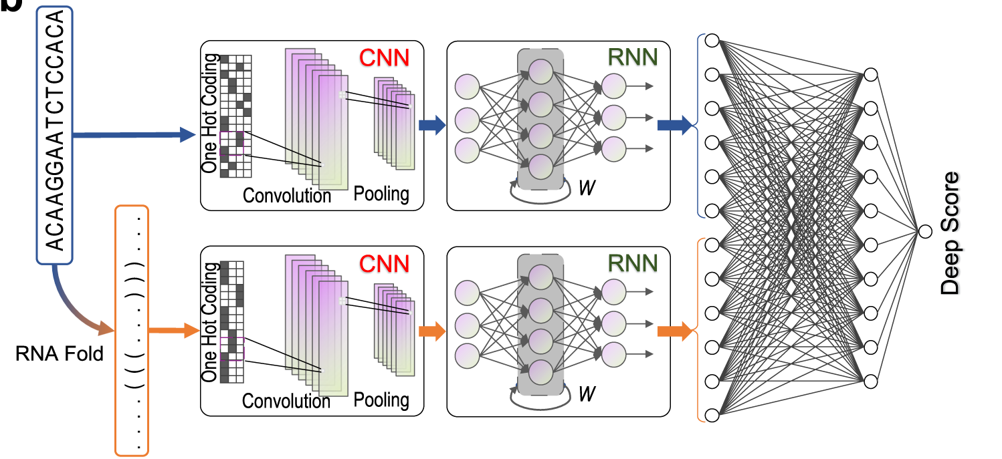
DeepCas13 overview
Cas13d guide-activity predictor
Guide-design model: predicts on-target knockdown efficiency of Cas13d (CasRx) guides
Trained on 22,599 gRNAs across coding & non-coding RNAs
Unlike Cas9 tools that use sequence only, it also feeds in RNA secondary structure

Slide 11
DeepCas13 overview
Cas13d guide-activity predictor
Guide-design model: predicts on-target knockdown efficiency of Cas13d (CasRx) guides
Trained on 22,599 gRNAs across coding & non-coding RNAs
Unlike Cas9 tools that use sequence only, it also feeds in RNA secondary structure

Slide 12
DeepCas13 overview
Cas13d guide-activity predictor
Guide-design model: predicts on-target knockdown efficiency of Cas13d (CasRx) guides
Trained on 22,599 gRNAs across coding & non-coding RNAs
Unlike Cas9 tools that use sequence only, it also feeds in RNA secondary structure

Slide 13
How DeepCas13 helps
Better-prioritized guides & much less screening
Activity prediction: predicts guide-dependent on-target efficiency
Off-target / viability modeling: helps identify guides with potential off-target or viability-related effects
Candidate prioritization: ranks crRNAs before validation, reducing trial-and-error screening

Slide 14
Future perspective
Could AI-designed guides aid pathogen detection?
THE IDEA: Adapt AI-guided guide design to Cas13a diagnostics
DeepCas13 predicts efficient Cas13d guides
Most Cas13-based RNA detection assays use Cas13a
Train or fine-tune models with Cas13a diagnostic guide-activity data
Apply this to multiplex and field-ready animal pathogen detection

Slide 15
Thank You
Huang, T., Zhang, R., & Li, J. (2022). CRISPR-Cas-based techniques for pathogen detection: Retrospect, recent advances, and future perspectives. Journal of Advanced Research, 50, 69–82. https://doi.org/10.1016/j.jare.2022.10.011
Cheng, X., Li, Z., Shan, R., Li, Z., Wang, S., Zhao, W., Zhang, H., Chao, L., Peng, J., Fei, T., & Li, W. (2023). Modeling CRISPR-Cas13d on-target and off-target effects using machine learning approaches. Nature Communications, 14(1), 752. https://doi.org/10.1038/s41467-023-36316-3
Kim, M., Go, M., Kang, S., Jeong, S., & Lim, K. (2025). Revolutionizing CRISPR technology with artificial intelligence. Experimental & Molecular Medicine, 57(7), 1419–1431. https://doi.org/10.1038/s12276-025-01462-9
Narim.kim@ghent.ac.kr

Slide 16
Appendix

Slide 17
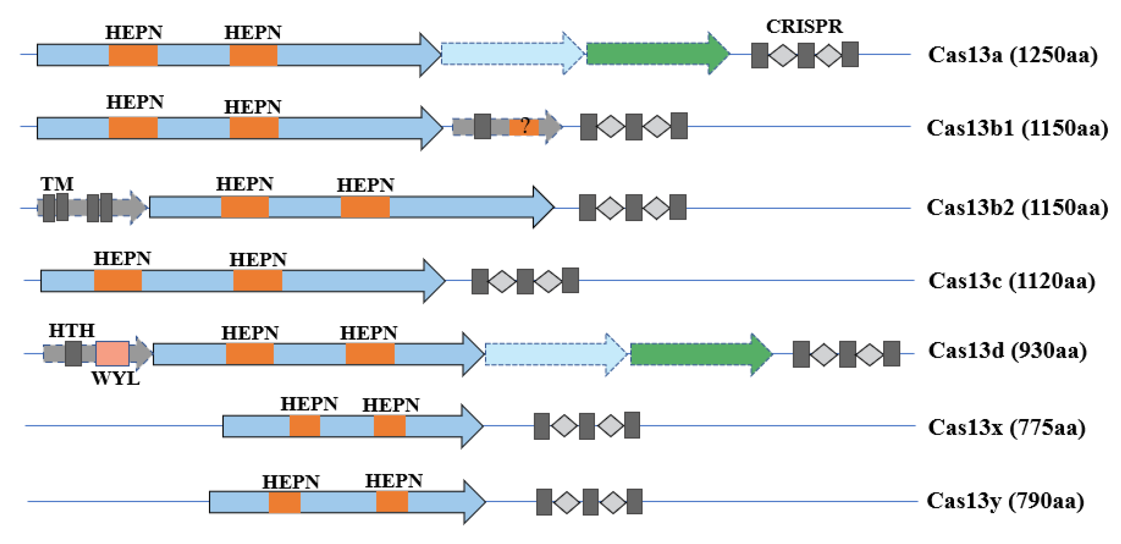
cas13c in Cas13

