Slide 1
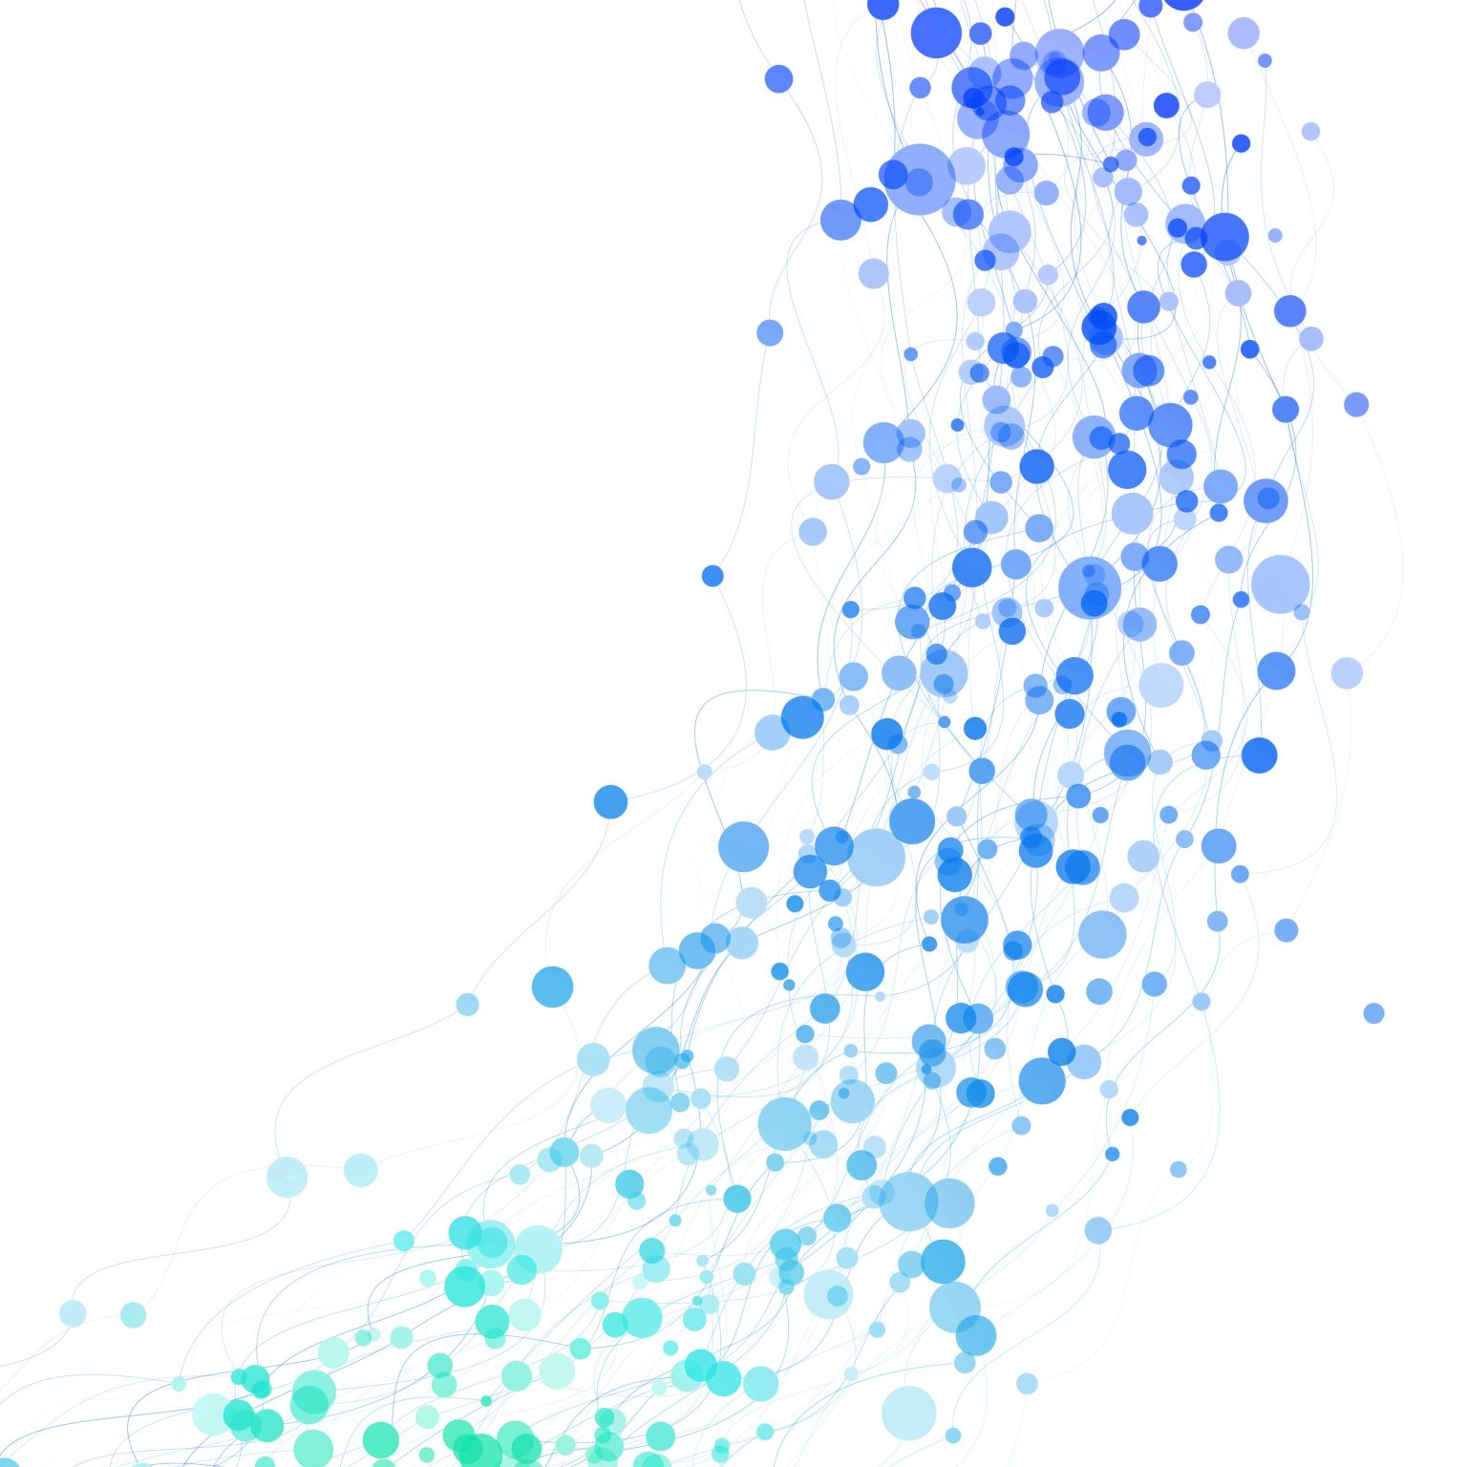
급하게 만든 머신러닝 요약집
02116987 kwon, jihun

Slide 2
General ML process
Problem clarification
Data collection
Data pre-processing
Feature engineering
Model Selection
Train/test
Model tuning / Evaluation
Train,test split
Deploy & Monitoring

Slide 3
Problem clarification
What kind of problem is this?? (classification? forecasting? Recommender system??)
What kind of result that I want to see? (Answer?? Grouping??)
What type of data could be collected? (quantitative data? Qualitative data?)

Slide 4
Data collection
Crowling : get all the data from internet <- in real world
In experiment, we usually get the wet lab data to analyze
Cautious! : Be aware where that came from
Is data enough confident??
Is data related to my problem??

Slide 5
Data pre-processing(EDA)
Before we make model, we have to make data refine.(Even that data is confident, we need to check the data is profit to learn
Ex1) Outlier detecting – overfitting, underfitting
Ex2) Nan? Missing value – SMOTE? Data drop?
Ex3) Taking the adequate number of feature (feature drop) a.k.a dimension curse

Slide 6
Feature Engineering
Make the data to adequate form for machine – quantative data, (one-hot encoding)
color
Red
blue
Green
yellow
red | Blue | Green | yellow
1 | 0 | 0 | 0
0 | 1 | 0 | 0
0 | 0 | 1 | 0
0 | 0 | 0 | 1
color
1
2
3
4

Slide 7
Feature Engineering
Usually, After one-hot encoding, number of feature increase more than a two times
Need to decrease the Number of feature – Curse of Dimension
Chi-square value
P-value
Cramer’s V
Correlation
ETC

Slide 8
Train-Test Split
Model not supposed to learn with test data (Data leakage)
If model learn with data mixed with test data, we call that data is contaminated.
GIGO (Garbage in, Garbage out) -> Model will be fucked up
With adequate ratio, we need to split the data for only training and only for testing

Slide 9
Model Selection
Depends on which problem you have, you need to choose the model.
Ex) classification? Regression? Grouping? Image classification? Time series?
Sometimes, Since of the characteristic of data, we need to choose certain model to solve that problemic character
Data imbalance – weight, L1,L2 regularization…etc

Slide 10
Model building Ex) ANN
Define Structure – Number of layer, activation function (if needed)… etc
Forward propagation – Calculate the result based on the data
Result Evaluation – Loss function (how wrong? Which one??)
Back propagation – calculate the weight and bias that induce this result
Optimization – Fixing the parameter’s argument depends on the result
Do again if there’s no big problem (if is, stop and find the way to figure it out)

Slide 11
Train/test
Train the model with train_data
Validate the model with validation data
Parameter tuning (learning rate, decay, etc)
Overfitting check
Test the model with test data
Check the result and with evaluation index
Finding improvement(AAR)

Slide 12
Deploying & Monitoring
Check the whether Model can work in the real world.
What problem can happen in the real world?
How can we improve the model in the real world?

Slide 13
시계열 데이터?
Definition : Data which recorded based on time
Character

