Slide 1
ES2105 Earth Science Lab 1
29/08/2024

Slide 2
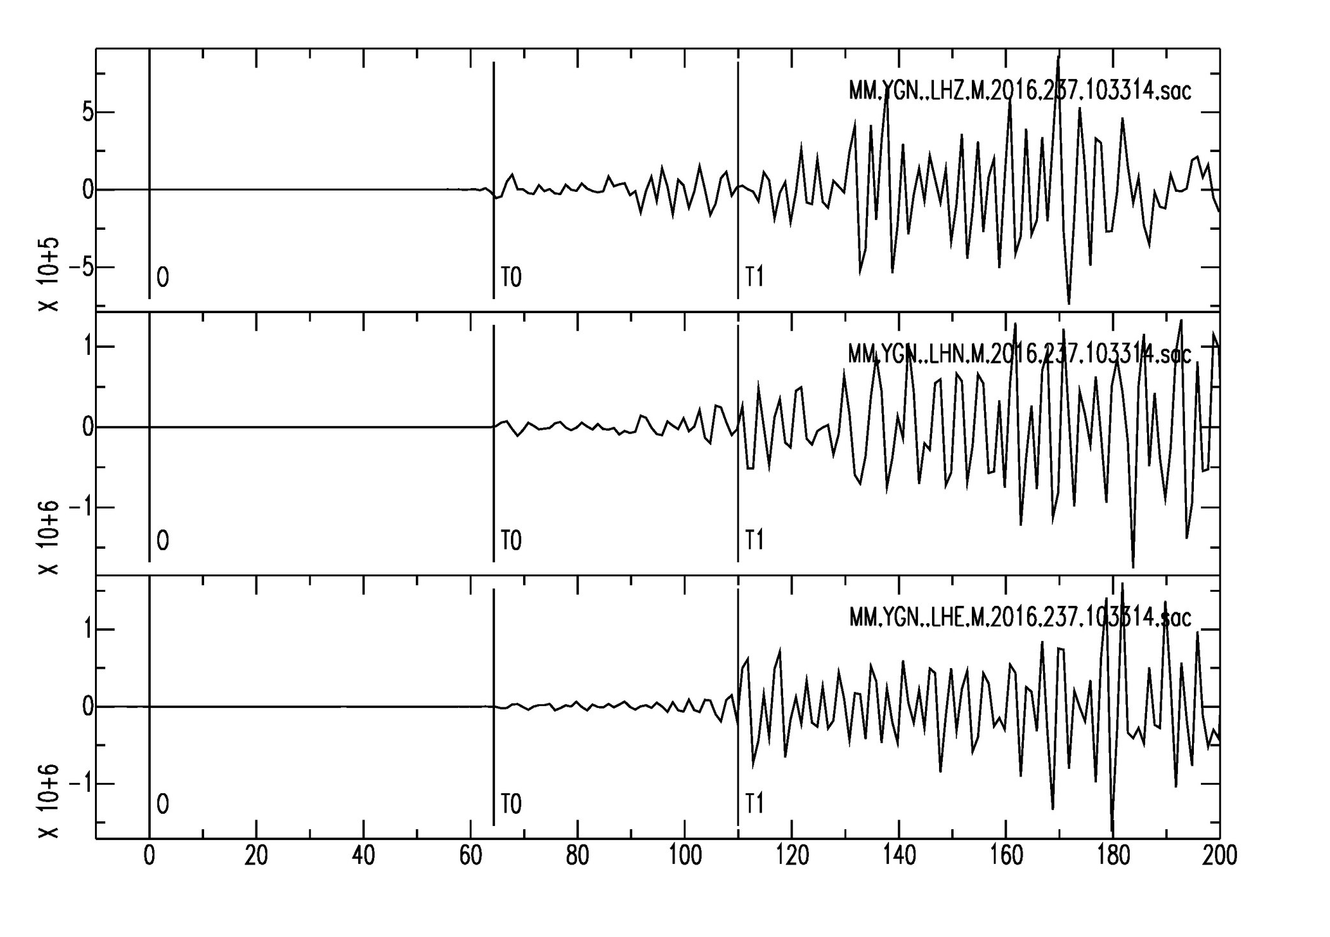
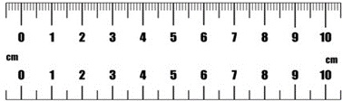
Seismogram
Vertical Component (Z)
P
Horizontal Component (N-S)
Horizontal Component (E-W)
S
1 cm = 1 s
DIST – 482.08
T0 – 64.33
T1 – 109.97

Slide 3
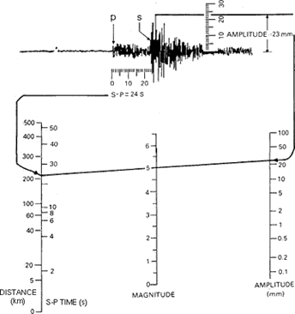
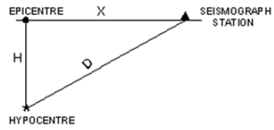
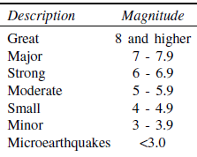
Earthquake Magnitude
Richter Scale
Size of an Earthquake

Slide 4
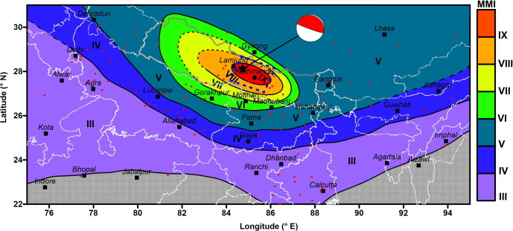
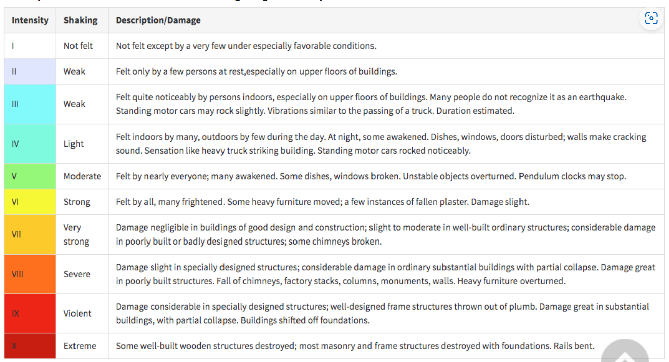
Earthquake Intensity
Isoseismal map
Effect of an Earthquake on the Earth’s Surface
Modified Mercalli Intensity Scale

Slide 5
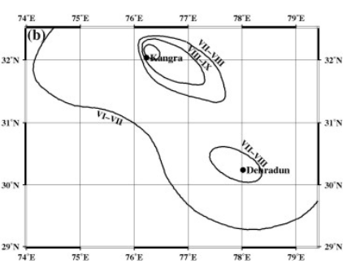
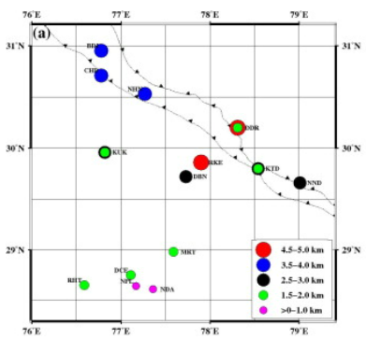
Isoseismal map of Kangra Earthquake (4th April 1905, M~7.8)

Slide 6
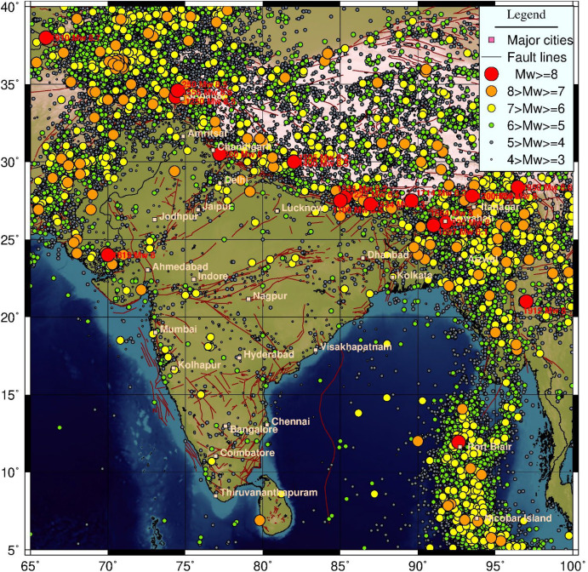
Seismicity Map

Slide 7
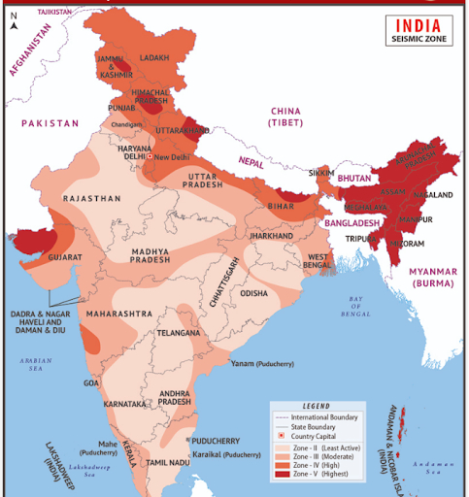
Earthquake Zone Map

Slide 8
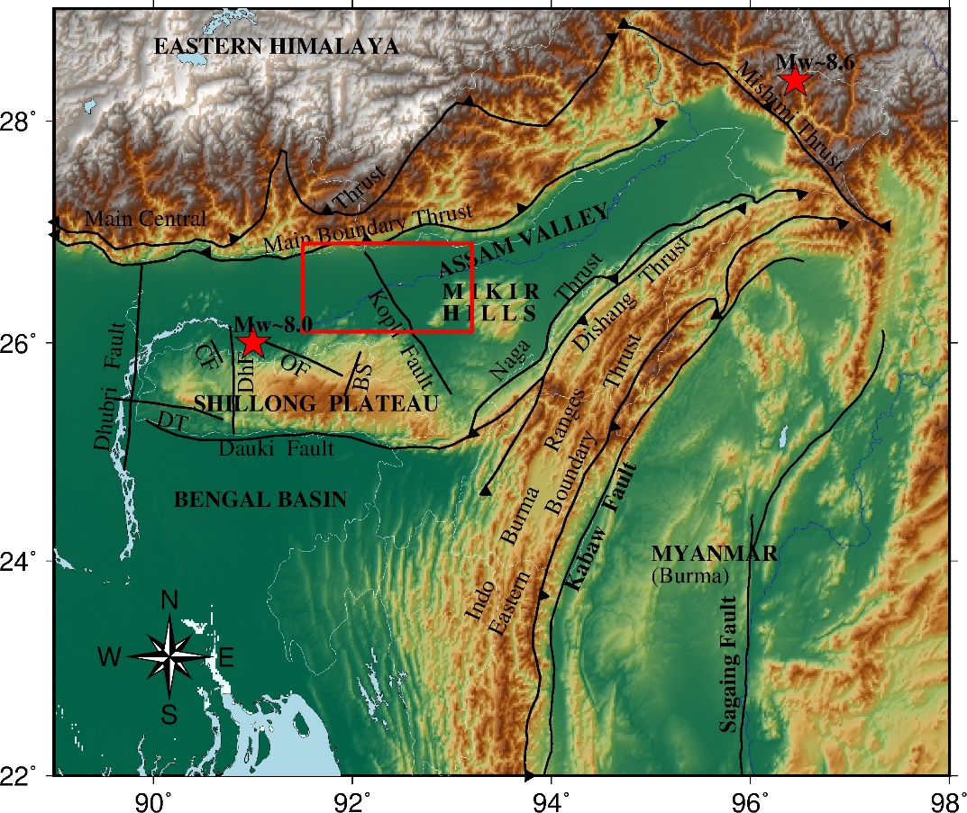
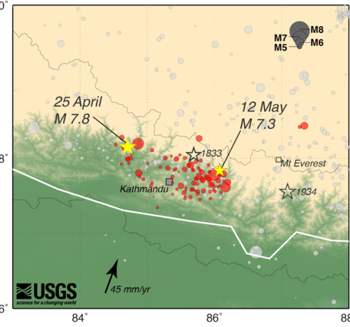
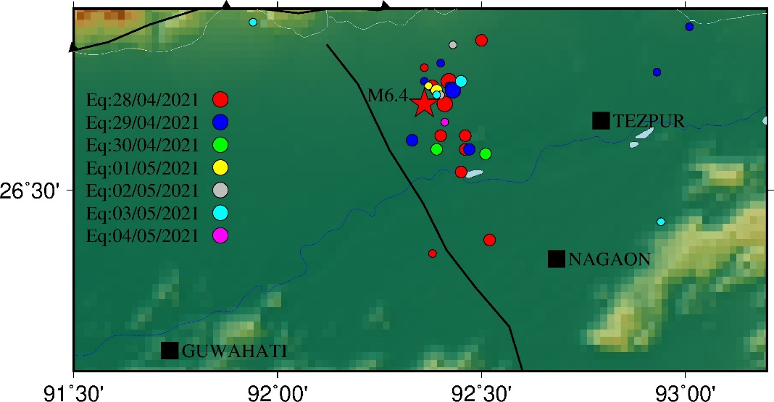
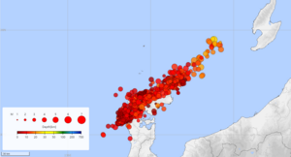
Aftershocks
Foreshocks
Earthquake Swarms

Slide 9
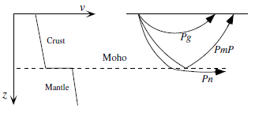
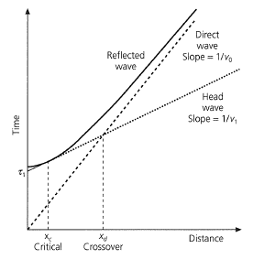
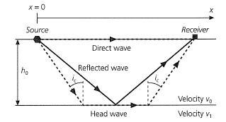
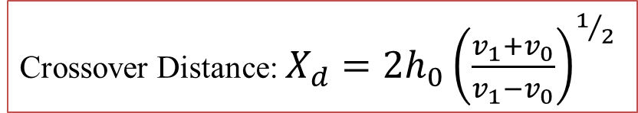
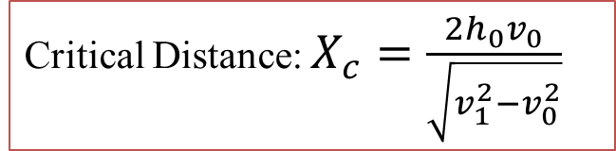
Critical & Crossover Distance
Crossover Distance: $X_{d}=2h_{0}{\left(\frac{v_{1}+v_{0}}{v_{1}−v_{0}}\right)}^{1/2}$
Critical Distance: $X_{c}=\frac{2h_{0}v_{0}}{\sqrt{v_{1}^{2}−v_{0}^{2}}}$

Slide 10
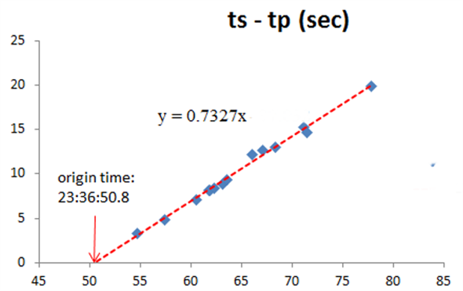
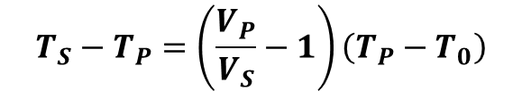
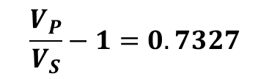
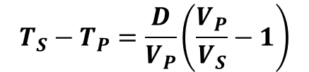
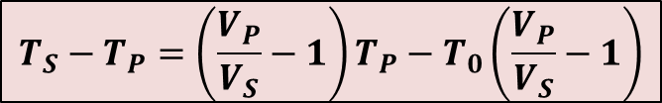
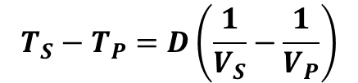




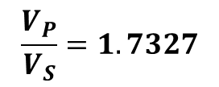
Origin Time Calculation
Arrival Time =
Origin Time + Travel Time
$$T_{P}=T_{0}+\frac{D}{V_{P}}$$
$$T_{S}=T_{0}+\frac{D}{V_{S}}$$
$$T_{S}−T_{P}=\left(\frac{V_{P}}{V_{S}}−1\right)T_{P}−T_{0}\left(\frac{V_{P}}{V_{S}}−1\right)$$
$$T_{S}−T_{P}=D\left(\frac{1}{V_{S}}−\frac{1}{V_{P}}\right)$$
$$\frac{V_{P}}{V_{S}}−1=0.7327$$
$$T_{S}−T_{P}=\frac{D}{V_{P}}\left(\frac{V_{P}}{V_{S}}−1\right)$$
$$T_{S}−T_{P}$$
$$\frac{V_{P}}{V_{S}}=1.7327$$
$$T_{S}−T_{P}=\left(\frac{V_{P}}{V_{S}}−1\right)\left(T_{P}−T_{0}\right)$$
$$T_{P}$$
Wadati Diagram

Slide 11
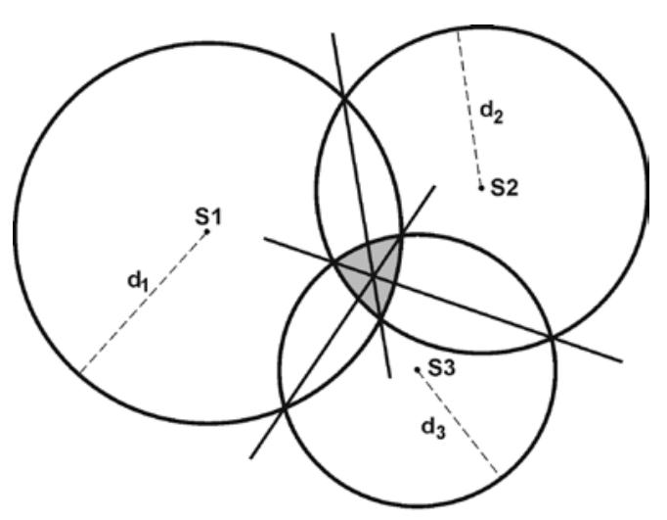

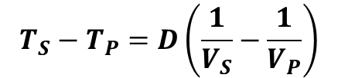

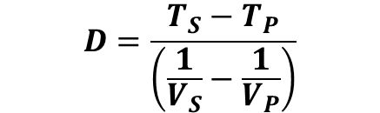
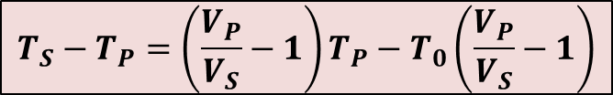
Earthquake location
$$T_{S}−T_{P}=D\left(\frac{1}{V_{S}}−\frac{1}{V_{P}}\right)$$
$$D=\frac{T_{S}−T_{P}}{\left(\frac{1}{V_{S}}−\frac{1}{V_{P}}\right)}$$
$$T_{S}−T_{P}=\left(\frac{V_{P}}{V_{S}}−1\right)T_{P}−T_{0}\left(\frac{V_{P}}{V_{S}}−1\right)$$
$$T_{S}−T_{P}$$
$$T_{P}$$

