Slide 1
Stage 1: Plan and prepare
Plan and prepare for the installation
Stage 2: Install the Zowe runtime
Start the installation
Ensure system requirements are met
What is your preferred installation method?
SMP/E build
Convenience build
Download the Zowe SMP/E build
Download the convenience build
Install the Zowe SMP/E build
Verify, transfer, and expand the PAX file on z/OS
Install the Zowe runtime
Method 1: Use shell script
(Script: zowe-install.sh)
Method 2: Use z/OSMF Workflow
Stage 3:
Configure the Zowe runtime and start Zowe
(One-time setup per z/OS environment)
Configure the z/OS system for Zowe
Method 1: Use JCL
(JCL: ZWESECUR)
Method 2: Use z/OSMF Workflow
(One-time setup per z/OS environment)
Create the Zowe certificates keystore directory
Method 1: Use shell script
(Script: zowe-setup-certificates.sh)
Method 2: Use z/OSMF Workflow
Create and configure the Zowe instance directory
Instance directory 2
Method 1: Use shell script
(Script: zowe-configure-instance.sh)
Method 2: Use z/OSMF Workflow
(Required for Zowe Desktop)
Install and configure the Zowe cross memory server (ZWESISTC)
(Script: zowe-install-xmem.sh)
Install the Zowe started task (ZWESVSTC)
(Script: zowe-install-proc.sh)
Stage 4: Verify the installation
Verify that Zowe is installed and configured correctly

Slide 2
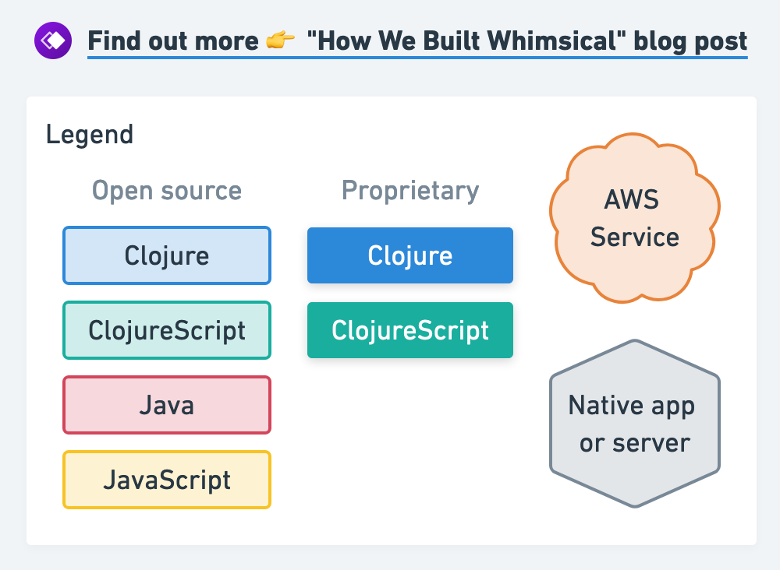
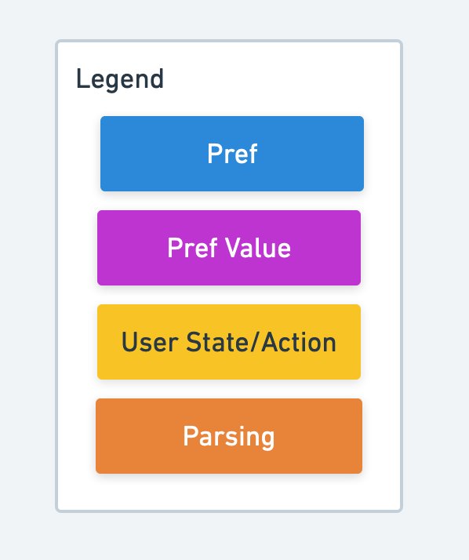
Stage 1: Plan and prepare
Plan and prepare for the installation
Stage 2: Install the Zowe runtime
Start the installation
Ensure system requirements are met
What is your preferred installation method?
SMP/E build
Convenience build
Download the Zowe SMP/E build
Download the convenience build
Install the Zowe SMP/E build
Verify, transfer, and expand the PAX file on z/OS
Install the Zowe runtime
Method 1: Use shell script
(Script: zowe-install.sh)
Method 2: Use z/OSMF Workflow
(ZWEWRF04.xml)
Stage 3:
Configure the Zowe runtime and start Zowe
(One-time setup per z/OS environment)
Configure the z/OS system for Zowe
Method 1: Use JCL
(JCL: ZWESECUR)
Method 2: Use z/OSMF Workflow
(ZWESECUR.xml)
(One-time setup per z/OS environment)
Create the Zowe certificates keystore directory
Method 1: Use shell script
(Script: zowe-setup-certificates.sh)
Method 2: Use z/OSMF Workflow
(ZWEWRF02.xml)
Create and configure the Zowe instance directory
Instance directory 2
Method 1: Use shell script
(Script: zowe-configure-instance.sh)
Method 2: Use z/OSMF Workflow
(ZWEWRF03.xml)
(Required for Zowe Desktop)
Install and configure the Zowe cross memory server (ZWESISTC)
Method 1: Use shell script
(Script: zowe-install-xmem.sh)
Method 2: Use z/OSMF Workflow
(ZWEWRF06.xml)
Install the Zowe started task ZWESVSTC
(Script: zowe-install-proc.sh)
Stage 4: Verify the installation
Verify that Zowe is installed and configured correctly

Slide 3
Stage 1: Plan and prepare
Plan and prepare for the installation
Stage 2: Install the Zowe runtime
Start the installation
Ensure system requirements are met
What is your preferred installation method?
SMP/E build
Convenience build
Download the Zowe SMP/E build
Download the convenience build
Install the Zowe SMP/E build
Verify, transfer, and expand the PAX file on z/OS
Install the Zowe runtime
Method 1: Use shell script
(Script: zowe-install.sh)
Method 2: Use z/OSMF Workflow
(ZWEWRF04.xml)
Stage 3:
Configure the Zowe runtime and start Zowe
(One-time setup per z/OS environment)
Configure the z/OS system for Zowe
Method 1: Use JCL
(JCL: ZWESECUR)
Method 2: Use z/OSMF Workflow
(ZWESECUR.xml)
(One-time setup per z/OS environment)
Create the Zowe certificates keystore directory
Method 1: Use shell script
(Script: zowe-setup-certificates.sh)
Method 2: Use z/OSMF Workflow
(ZWEWRF02.xml)
Create and configure the Zowe instance directory
Instance directory 2
Method 1: Use shell script
(Script: zowe-configure-instance.sh)
Method 2: Use z/OSMF Workflow
(ZWEWRF03.xml)
(Required for Zowe Desktop)
Install and configure the Zowe cross memory server (ZWESISTC)
Method 1: Use shell script
(Script: zowe-install-xmem.sh)
Method 2: Use z/OSMF Workflow
(ZWEWRF06.xml)
Install the Zowe started task (ZWESVSTC)
Method 1: Use shell script
(Script: zowe-install-proc.sh)
Method 2: Use z/OSMF Workflow
(ZWEWRF03.xml)
Stage 4: Verify the installation
Verify that Zowe is installed and configured correctly

Slide 4
Stage 1: Plan and prepare
Plan and prepare for the installation
Stage 2: Install the Zowe runtime
Start the installation
Ensure system requirements are met
What is your preferred installation method?
SMP/E build
Convenience build
Download the Zowe SMP/E build
Download the convenience build
Install the Zowe SMP/E build
Verify, transfer, and expand the PAX file on z/OS
Install the Zowe runtime
Method 1: Use shell script
(Script: zowe-install.sh)
Method 2: Use z/OSMF Workflow
Stage 3:
Configure the Zowe runtime and start Zowe
(One-time setup per z/OS environment)
Configure the z/OS system for Zowe
Method 1: Use JCL
(JCL: ZWESECUR)
Method 2: Use z/OSMF Workflow
(ZWESECUR.xml)
(One-time setup per z/OS environment)
Create the Zowe certificates keystore directory
Method 1: Use shell script
(Script: zowe-setup-certificates.sh)
Method 2: Use z/OSMF Workflow
(ZWEWRF02.xml)
Create and configure the Zowe instance directory
Method 1: Use shell script
(Script: zowe-configure-instance.sh)
Method 2: Use z/OSMF Workflow
(ZWEWRF03.xml)
Instance directory 2
(Required for Zowe Desktop)
Install and configure the Zowe cross memory server (ZWESISTC)
Method 1: Use shell script
(Script: zowe-install-xmem.sh)
Method 2: Use z/OSMF Workflow
(ZWEWRF06.xml)
Install the Zowe started task (ZWESVSTC)
(Script: zowe-install-proc.sh)
Stage 4: Verify the installation
Verify that Zowe is installed and configured correctly

